Slide 1
HI266
Deviance and Non-Conformity
Medical Marginality
Stephen Bates
s.m.j.bates@warwick.ac.uk

Slide 2
Aims of today
Thinking of physical and psychological abnormality
How is it defined?
How were sufferers treated?
What distinctions (if any) were made?
The significance of causality

Slide 3
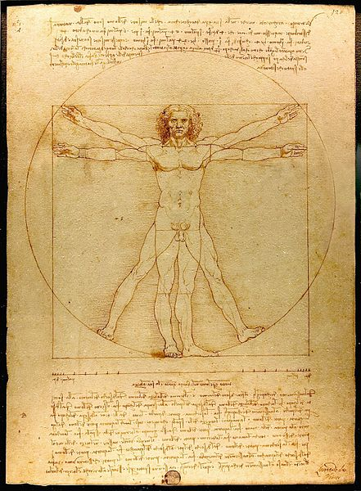
Vitruvian Man
Leonardo da Vinci
(c.1490)

Slide 4
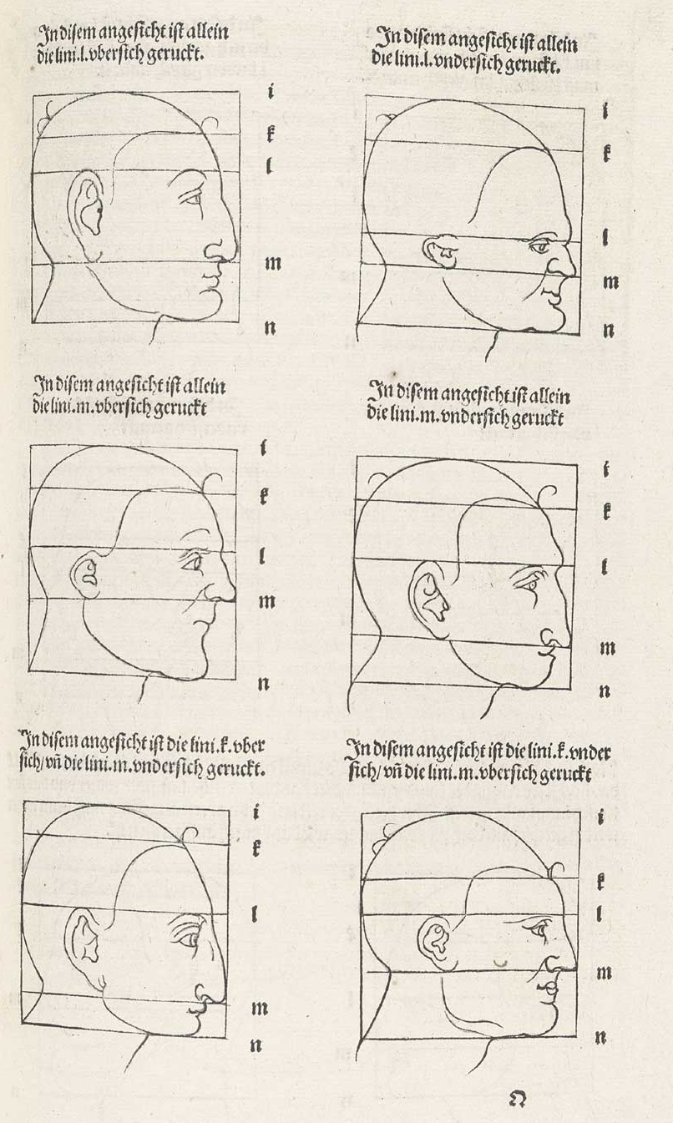
Menschlicher Proportion
Albrecht Dürer
(1528)

Slide 5
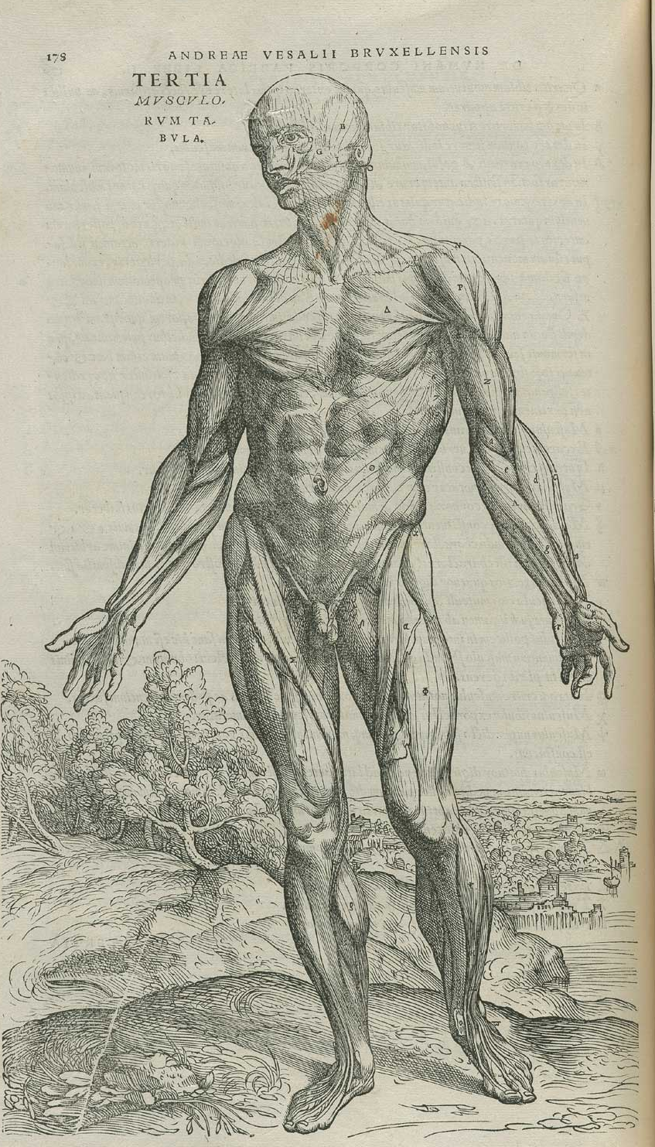
De Humani Corporis Fabrica
Andreas Vesalius
(1528)

Slide 6
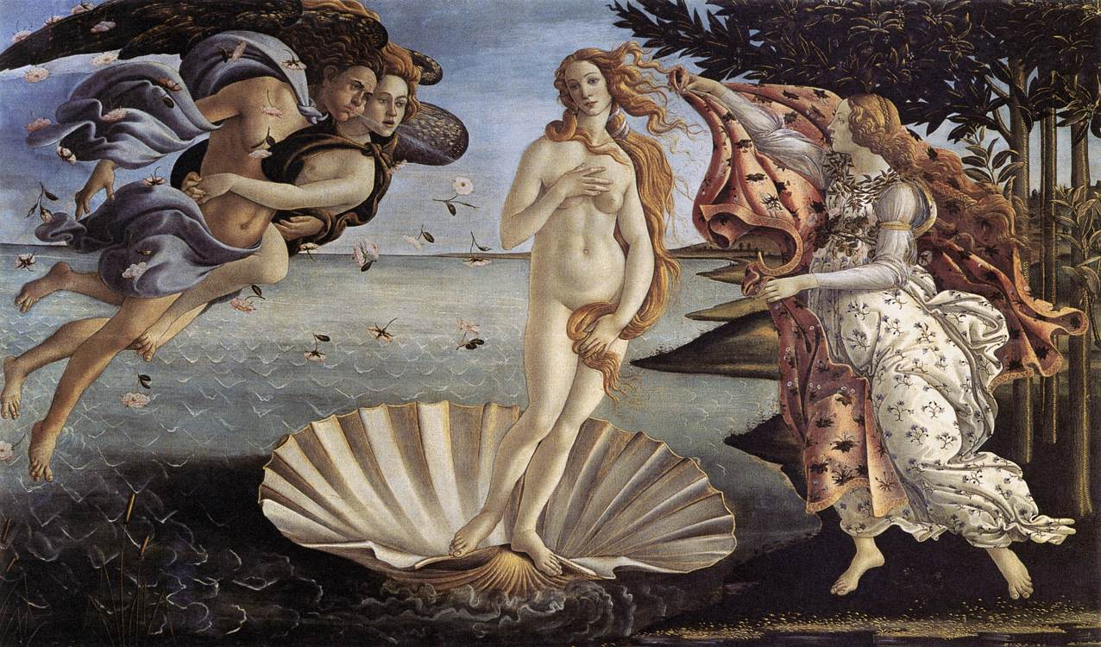
The birth of Venus
Sandro Botticelli (c.1485)

Slide 7
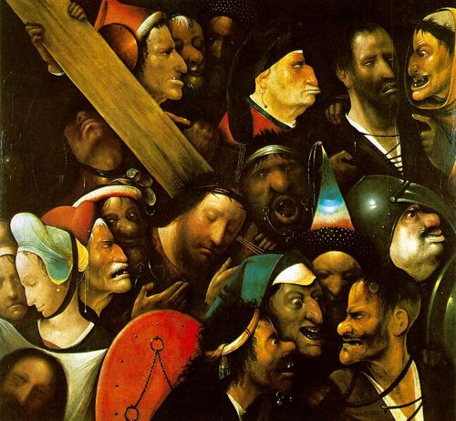
Christ Carrying the Cross
Hieronymous Bosch
(1510)

Slide 8
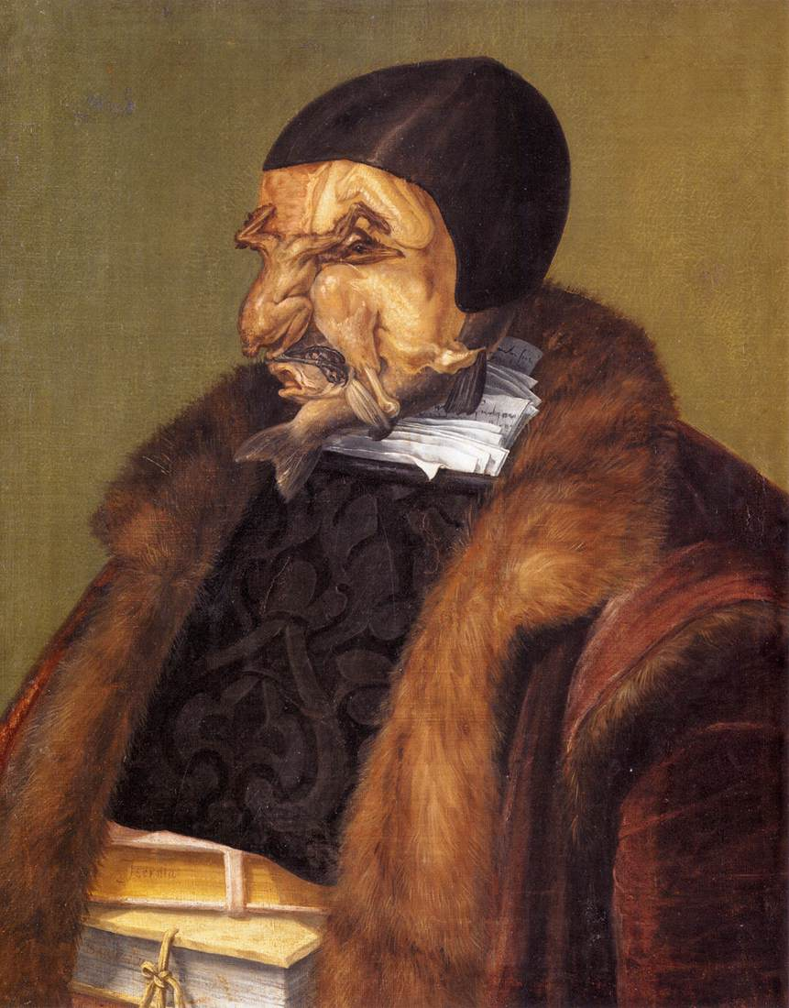
The Jurist
Giuseppe Arcimboldo
(1566)

Slide 9
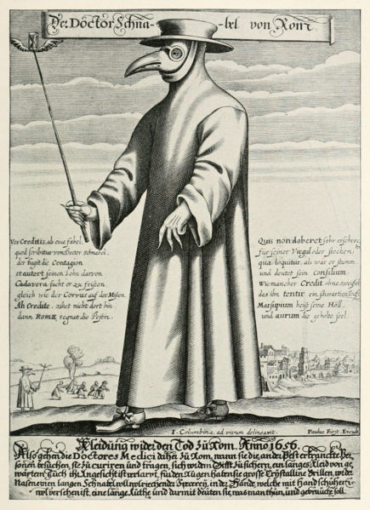
“Dr Beak”
Paul Fürst
(c.1676)

Slide 10
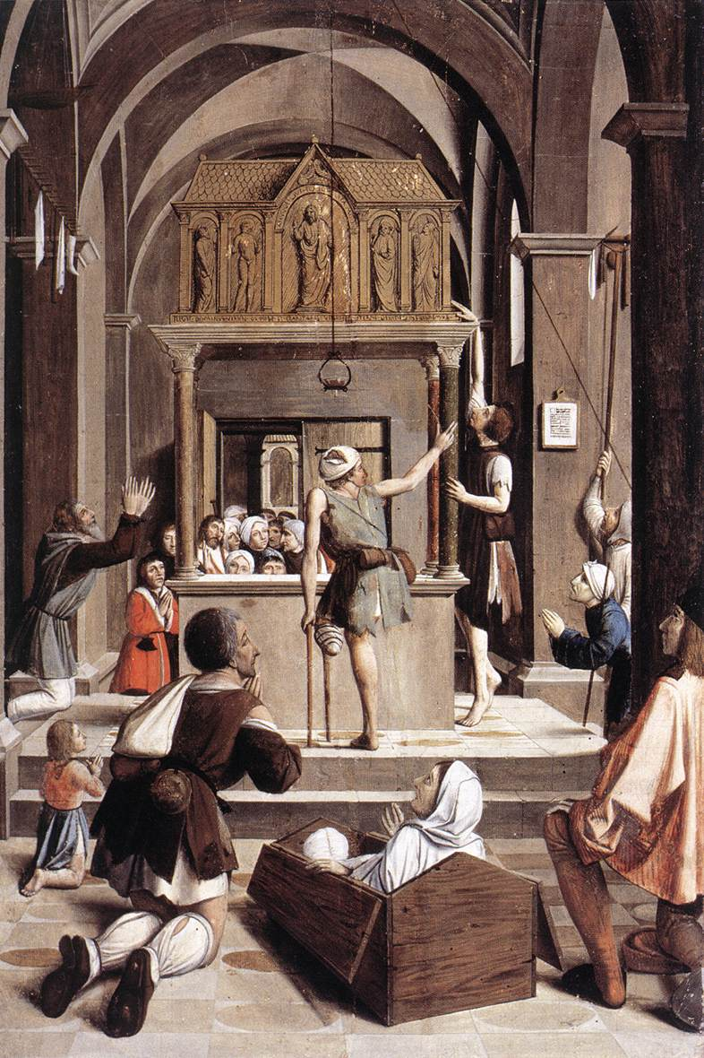
Pilgrims at the tomb of St Sebastian
Josse Lieferinxe
(1497)

Slide 11
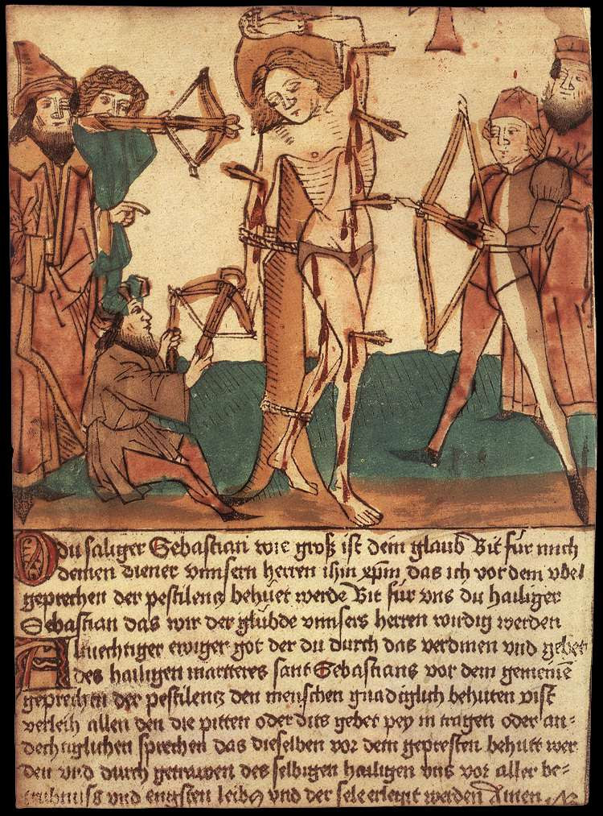
Martyrdom of St Sebastian
Hans Paur
(c.1472)

Slide 12
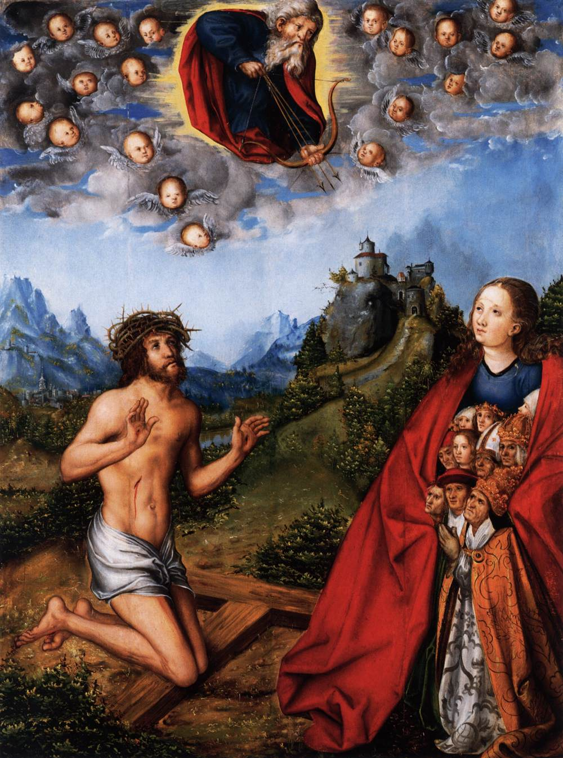
Plague Picture
Lucas Cranach
(1518)

Slide 13
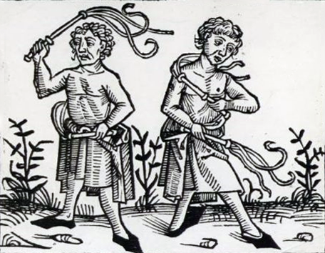
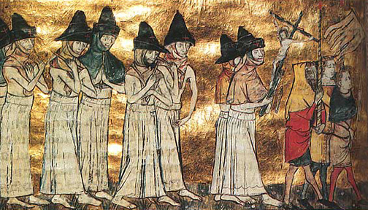
Flagellants
(Fifteenth-century woodcut)

Slide 14
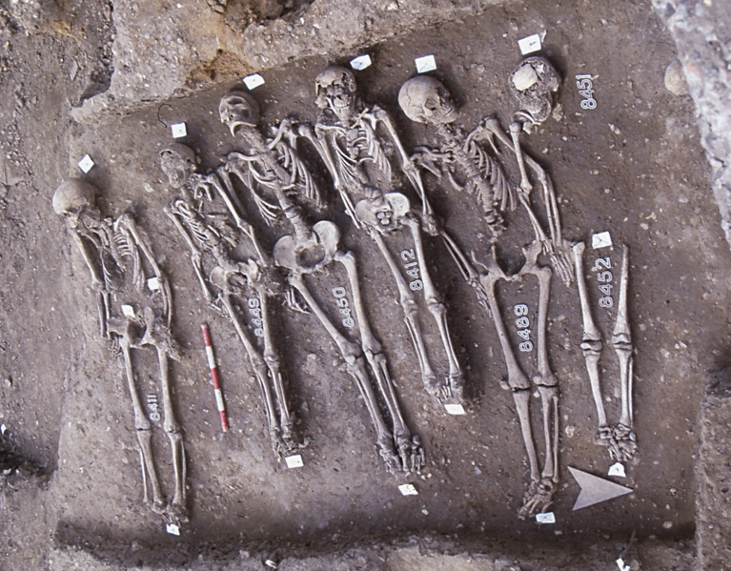
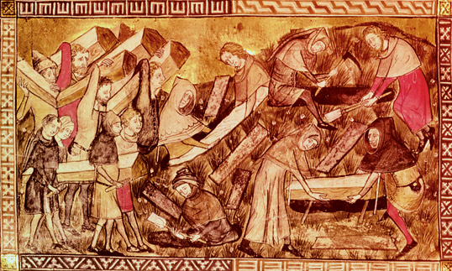
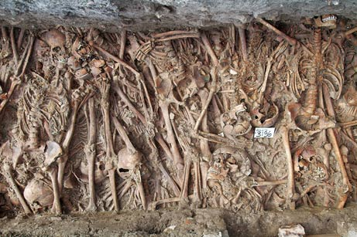
The Black Death

Slide 15
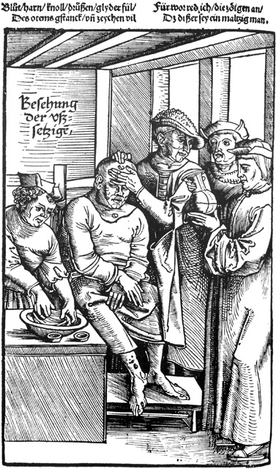
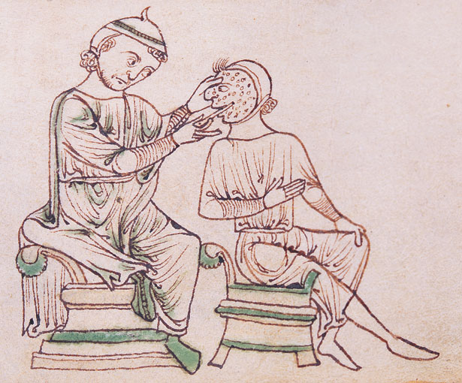
Treating Lepers

Slide 16
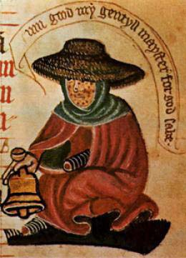
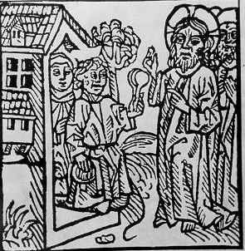
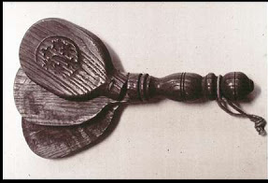
Avoiding Lepers

Slide 17
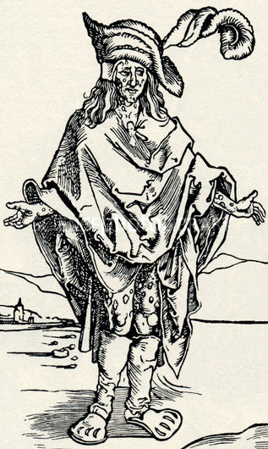
Syphilitic man
Albrecht Dürer
(1496)

Slide 18
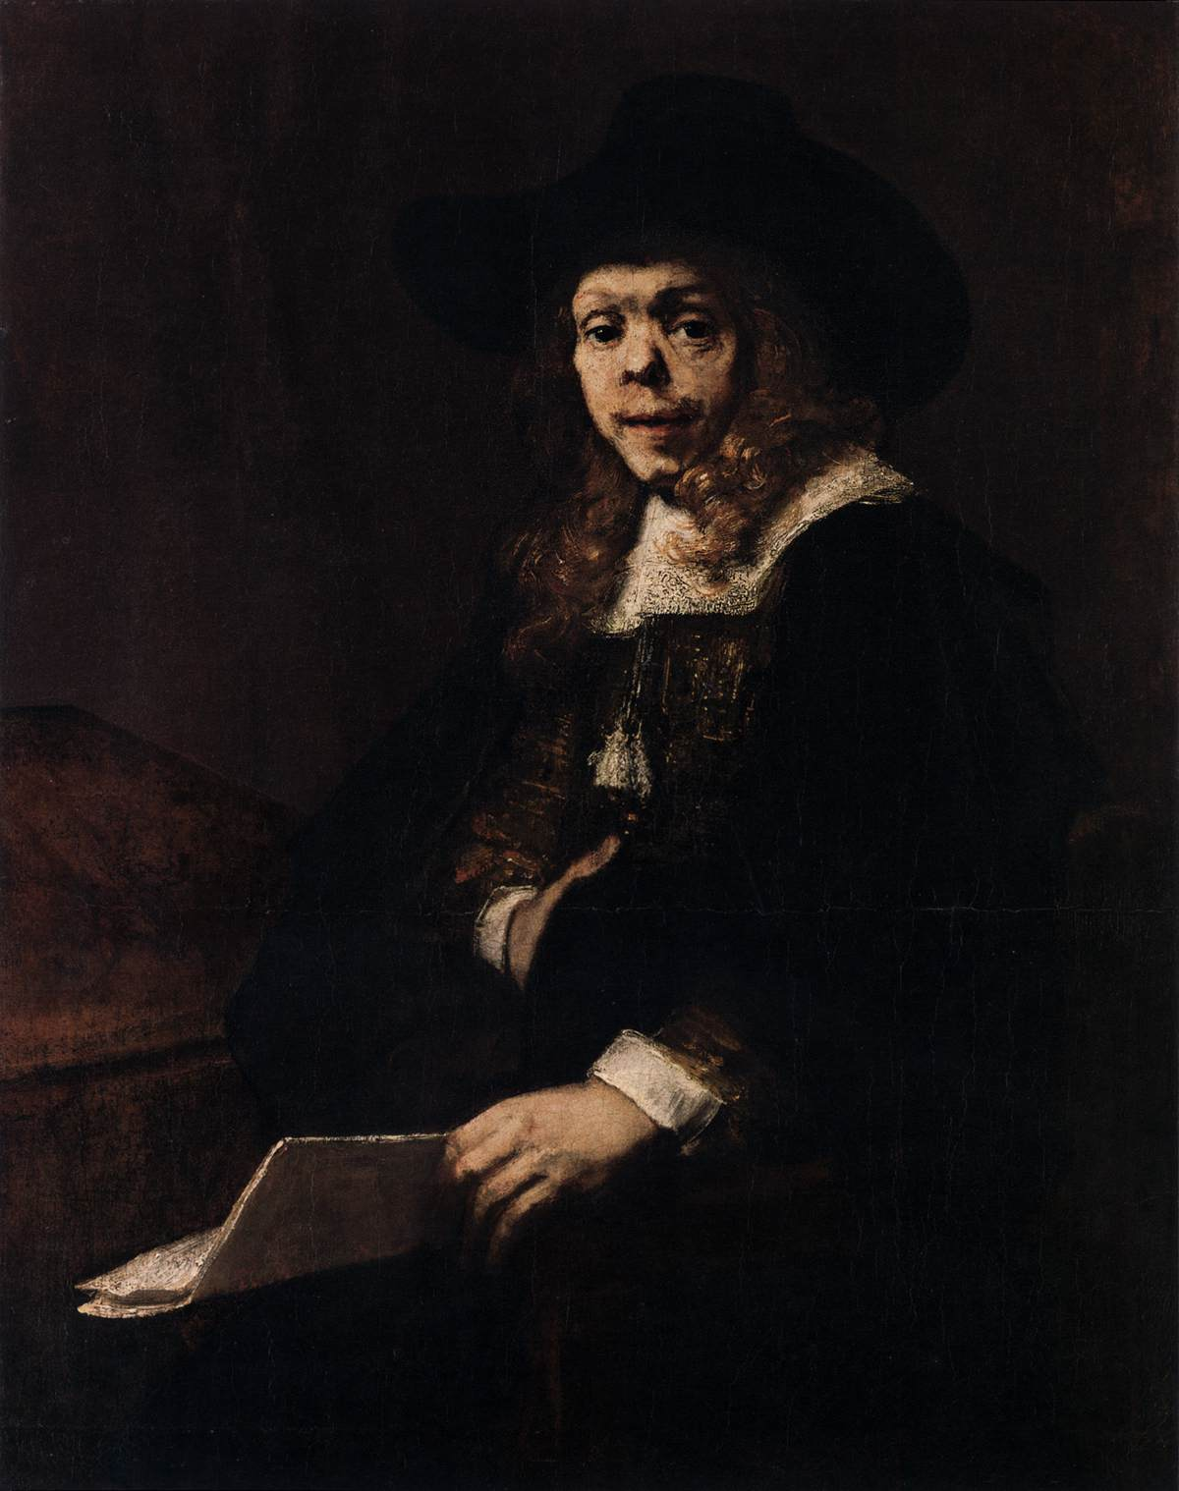
Gerard de Lairesse
Rembrandt van Rijn
(1667)

Slide 19
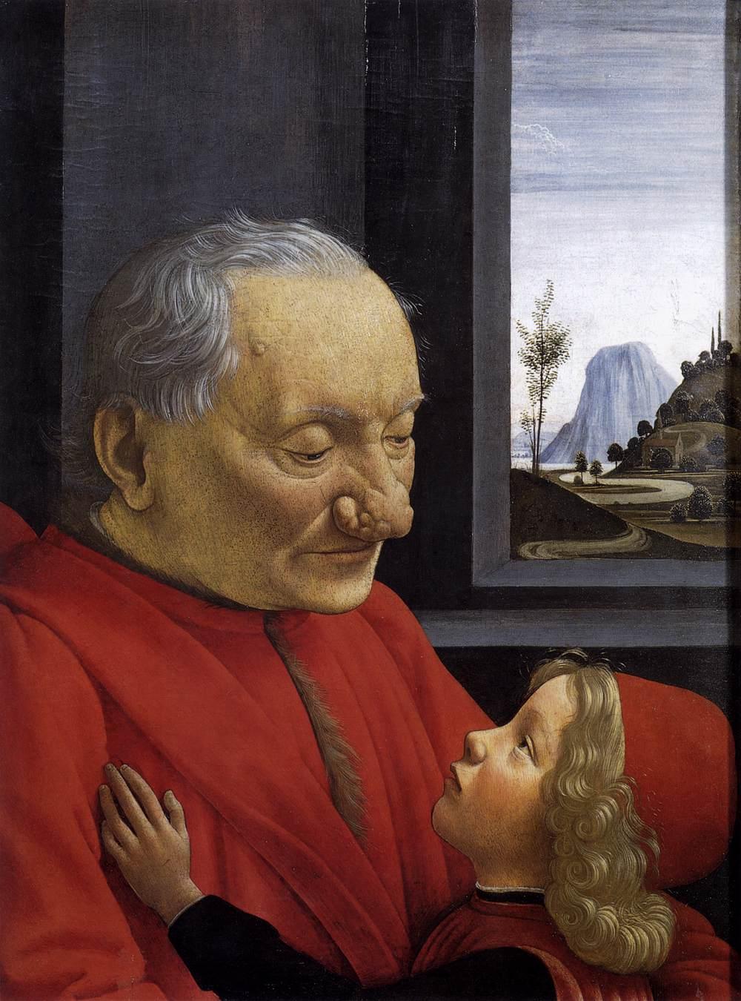
Old Man with his Grandson
Domenico Ghirlandaio
(c.1490)

Slide 20
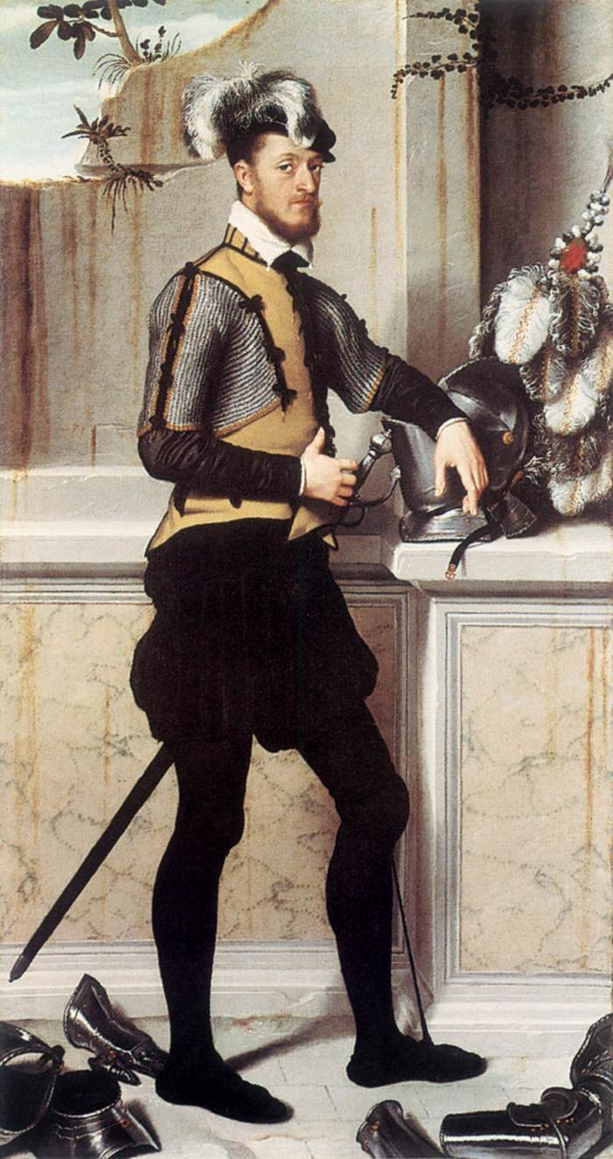
Il Cavaliere dal Piede Ferito
Giovanni Batista Moroni
(c.1550)

Slide 21
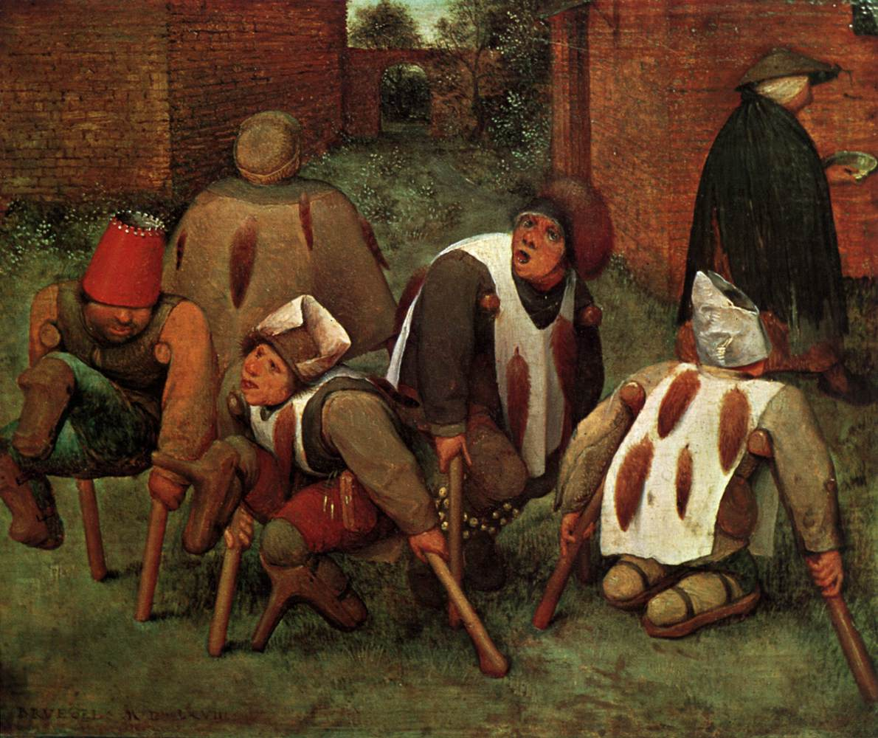
The Cripples
Pieter Bruegel the Elder (1568)

Slide 22
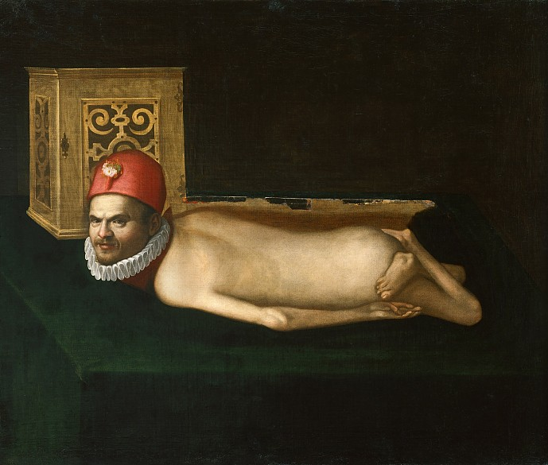
Disabled Man
(Sixteenth century)

Slide 23
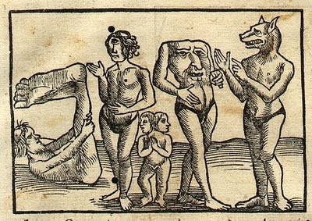
Not medieval ‘monsters’!

Slide 24
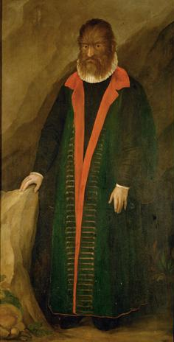
Petrus Gonsalvus
(1648)

Slide 25
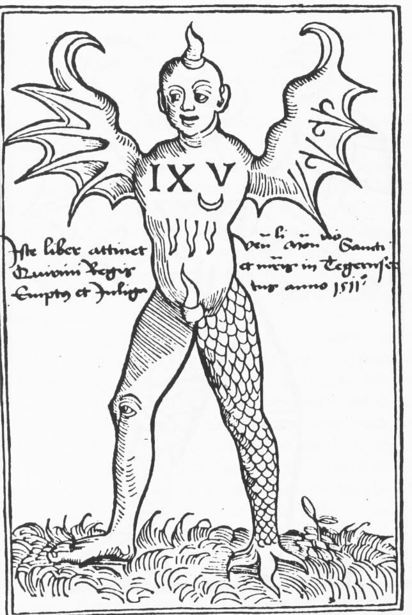
Ravenna monster
(1512)

Slide 26
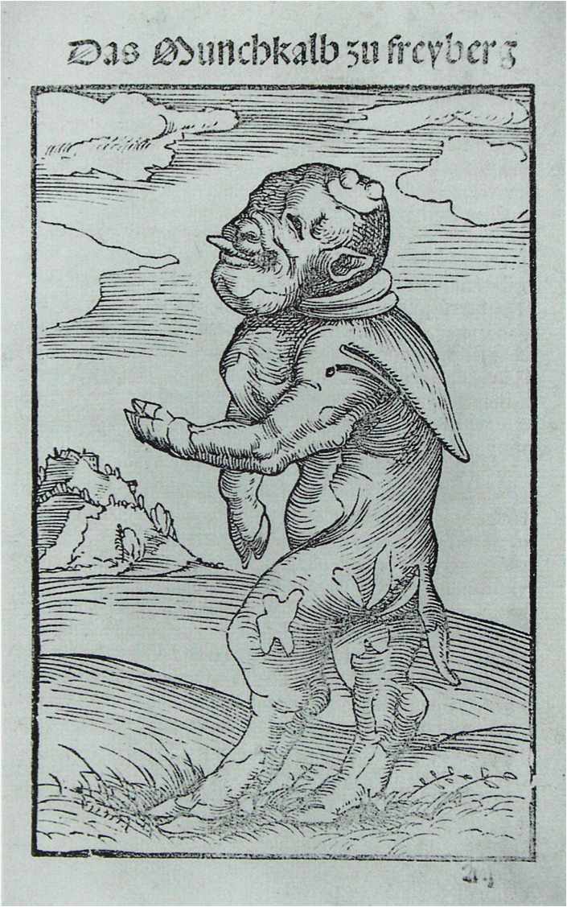
Luther’s monk-calf
(1522)

Slide 27
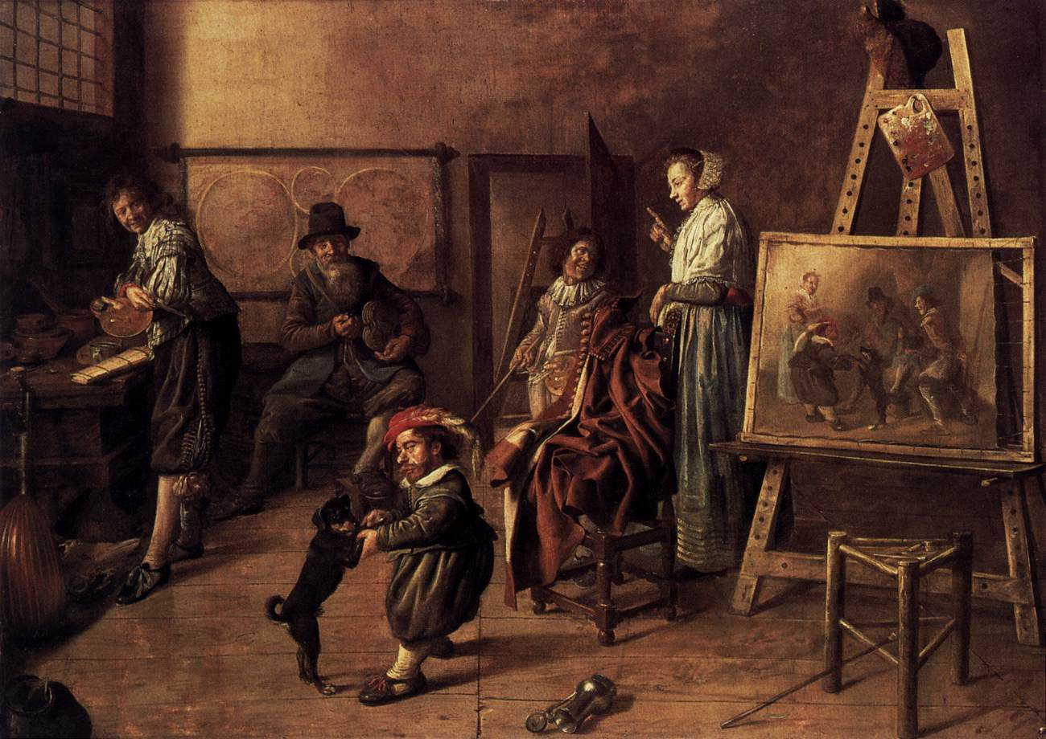
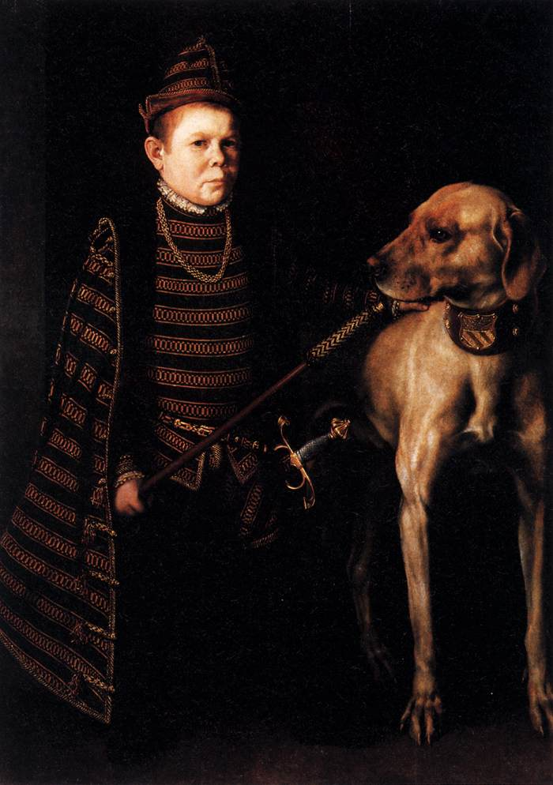
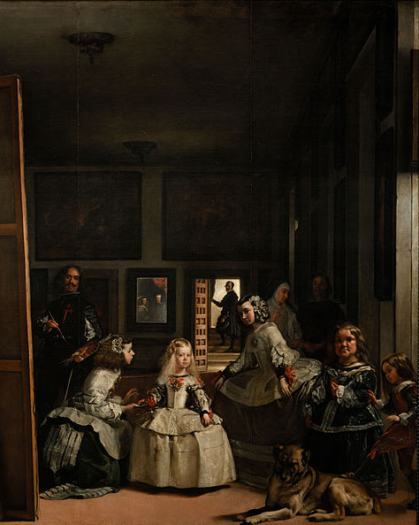
Cardinal Granvelle’s Dwarf
Anthonis van Dashorst
(c.1560)
Las Meninas
Diego Velázquez
(1656)
Painting a Musical Company
Jan Molenaer (1631)

Slide 28
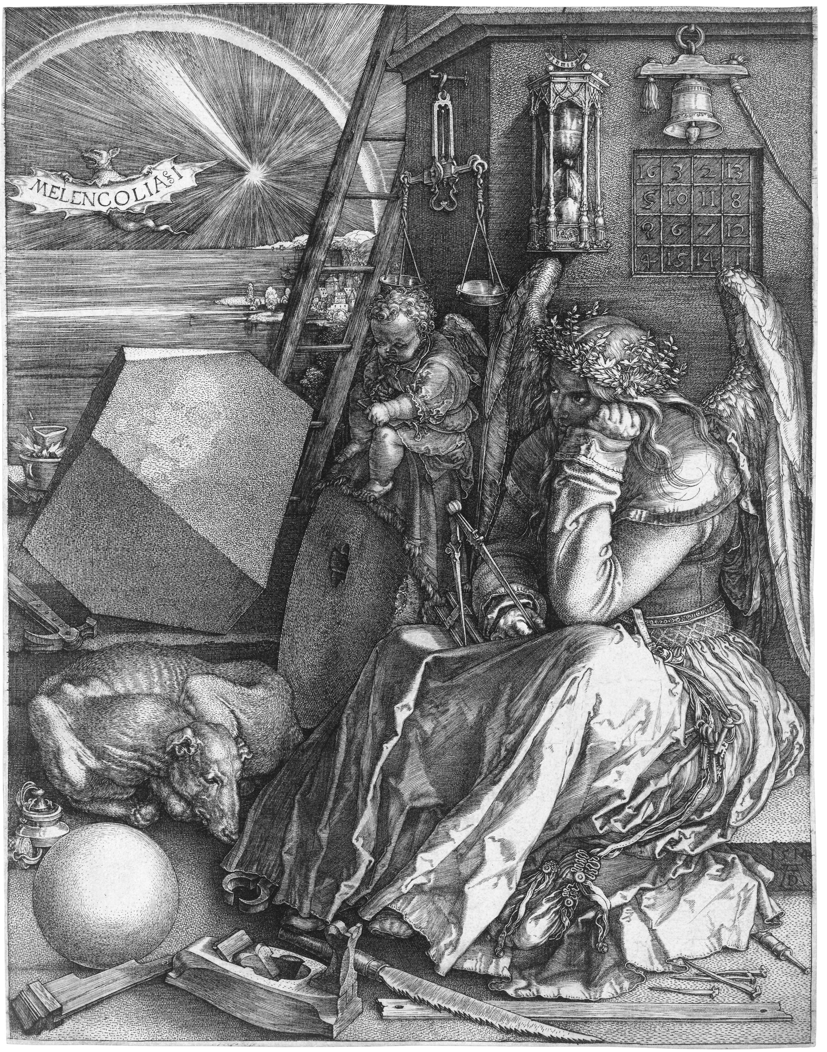
Melencolia I
Albrecht Dürer
(1514)

Slide 29
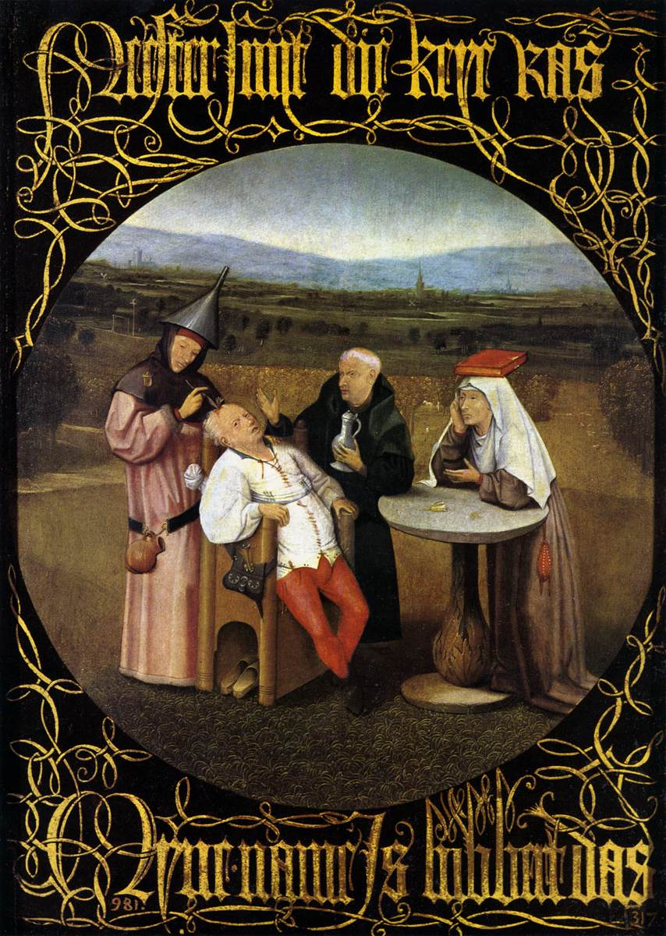
The Cure of Folly
(extracting the stone of madness)
Hieronymus Bosch
(c.1480)

Slide 30
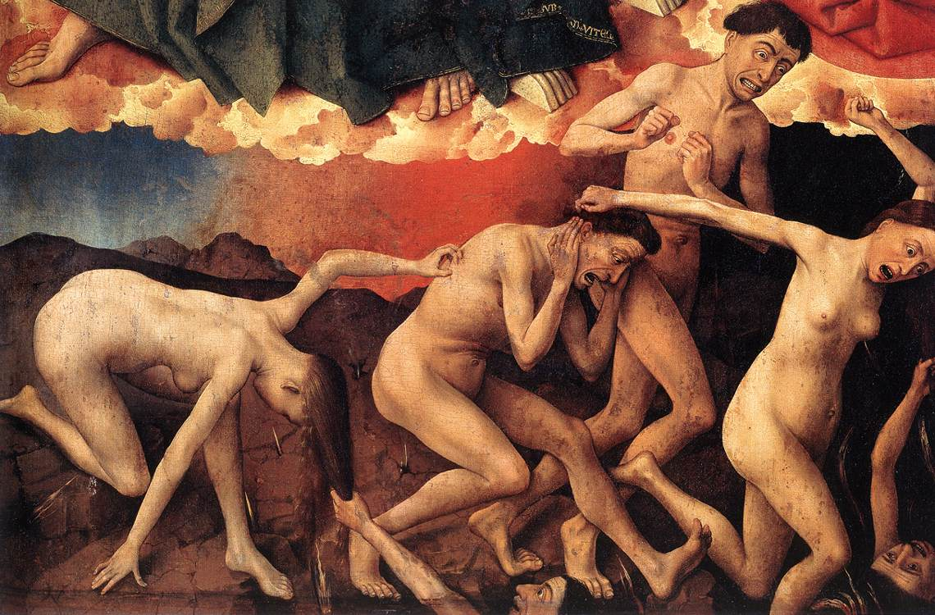
Last Judgement (detail)
Rogier van der Weyden (c.1452)

Slide 31
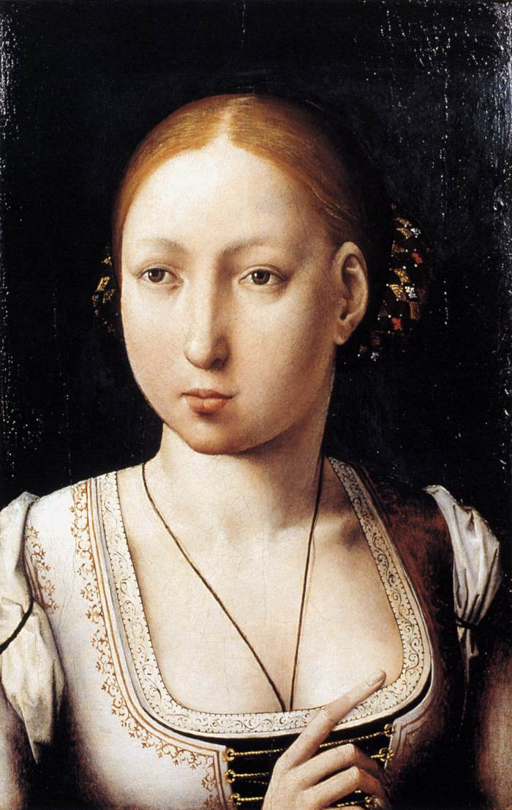
Joan of Castile
Juan de Flandes
(c.1500)

Slide 32
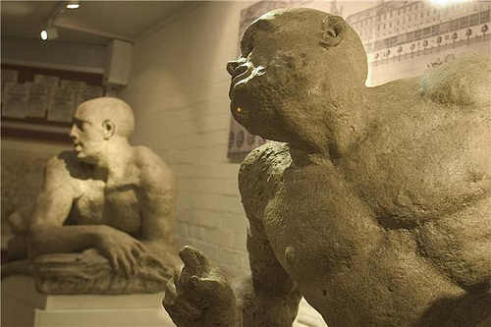
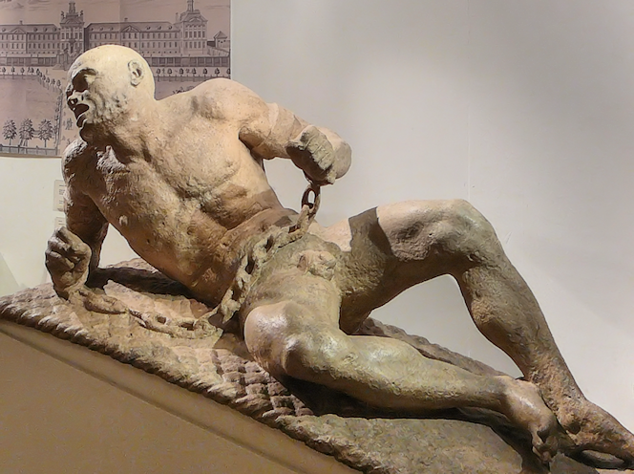
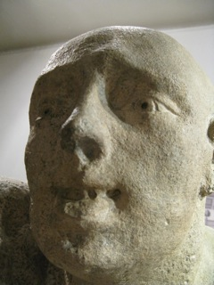
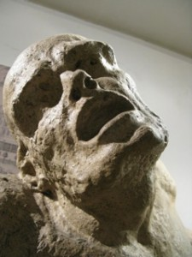
Melancholy and Raving
Caius Gabriel Cibber (c.1676)

Slide 33
Conclusions
‘Abnormality’ associated with divine providence
Anatomy and psychology begin to divide from C16
Tension between intellectual curiosity and anxiety
Increased state institutionalisation

