Slide 1
SOCIAL OUTCASTS AND DEVIANCE

Slide 2
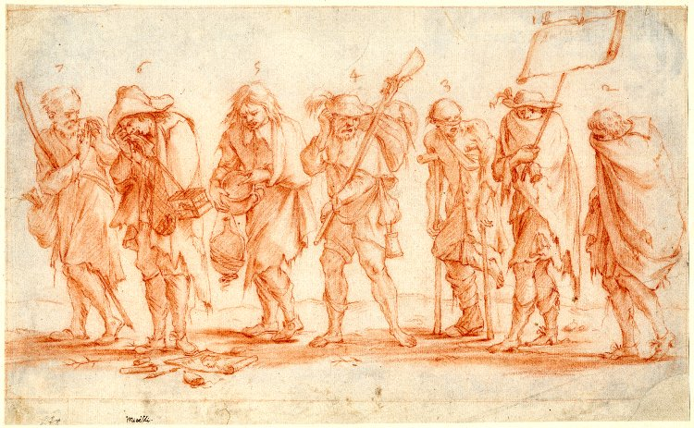
‘Company of the Ruined’ c.1687

Slide 3
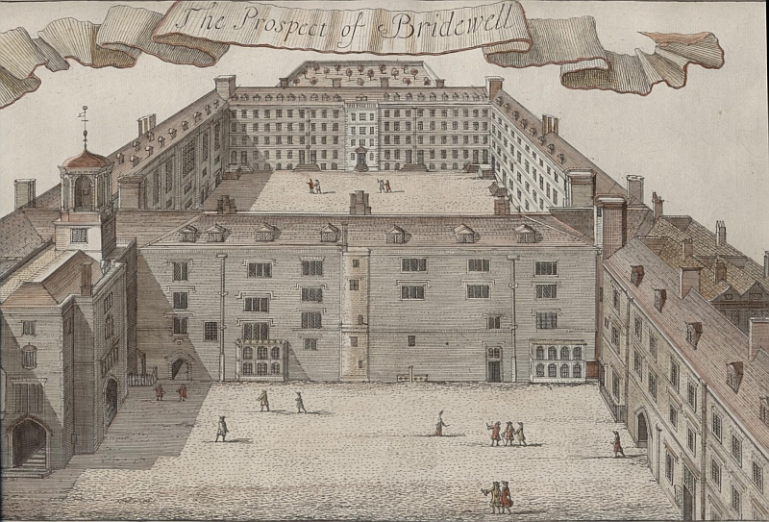
Bridewell, London, c.1720

Slide 4
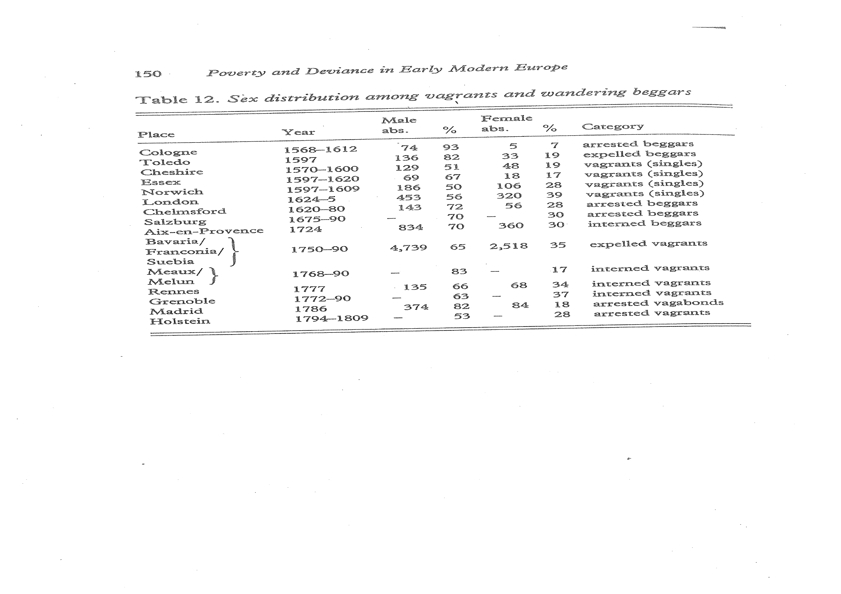

Slide 5
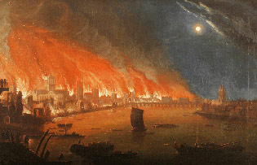
Great Fire of London 1666

Slide 6
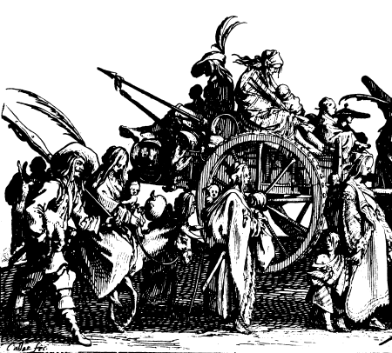
Gypsies by Callot c. 1621

Slide 7
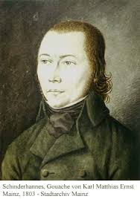
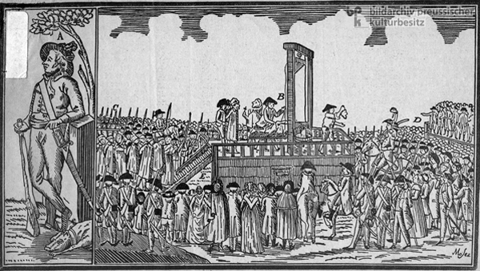
Schinderhannes: C18th German bandit

Slide 8


Schinderhannes on film

