Slide 1
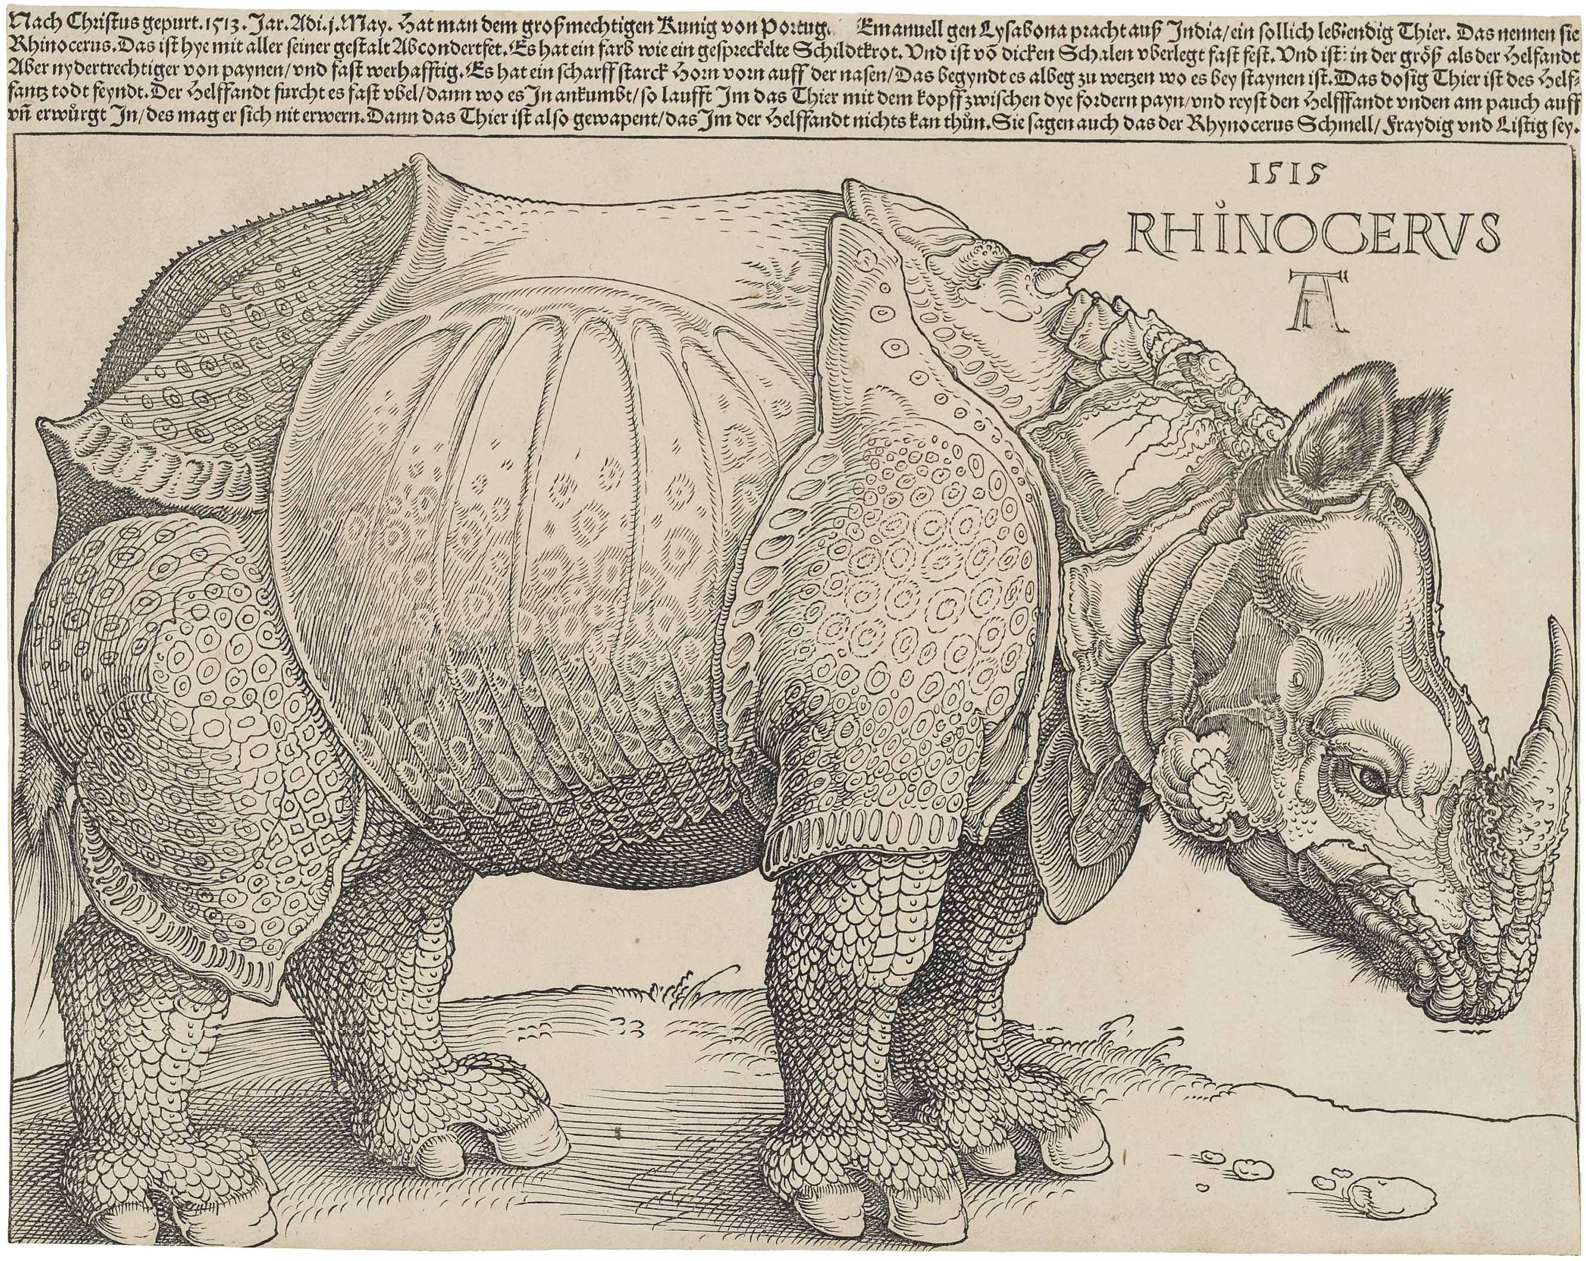

Slide 2
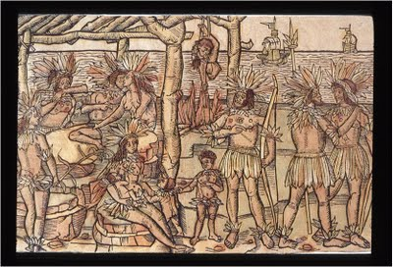
Johann Froschauer, ‘Amerikaner’, 1505

Slide 3
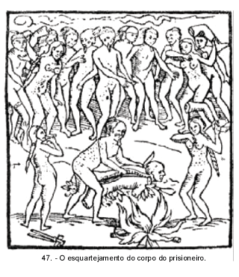
Hans Staden

Slide 4
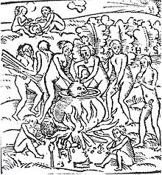
Hans Staden

Slide 5
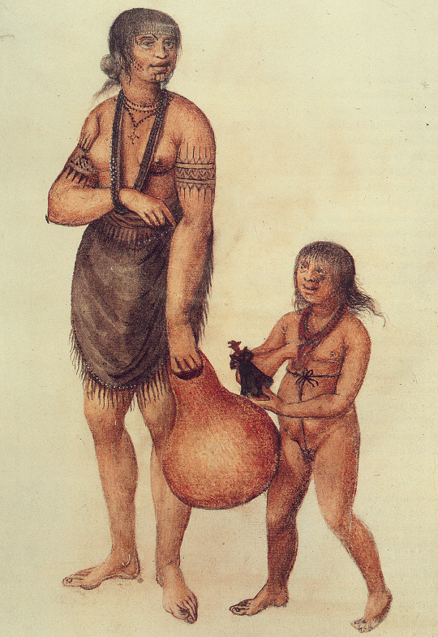
John White

Slide 6
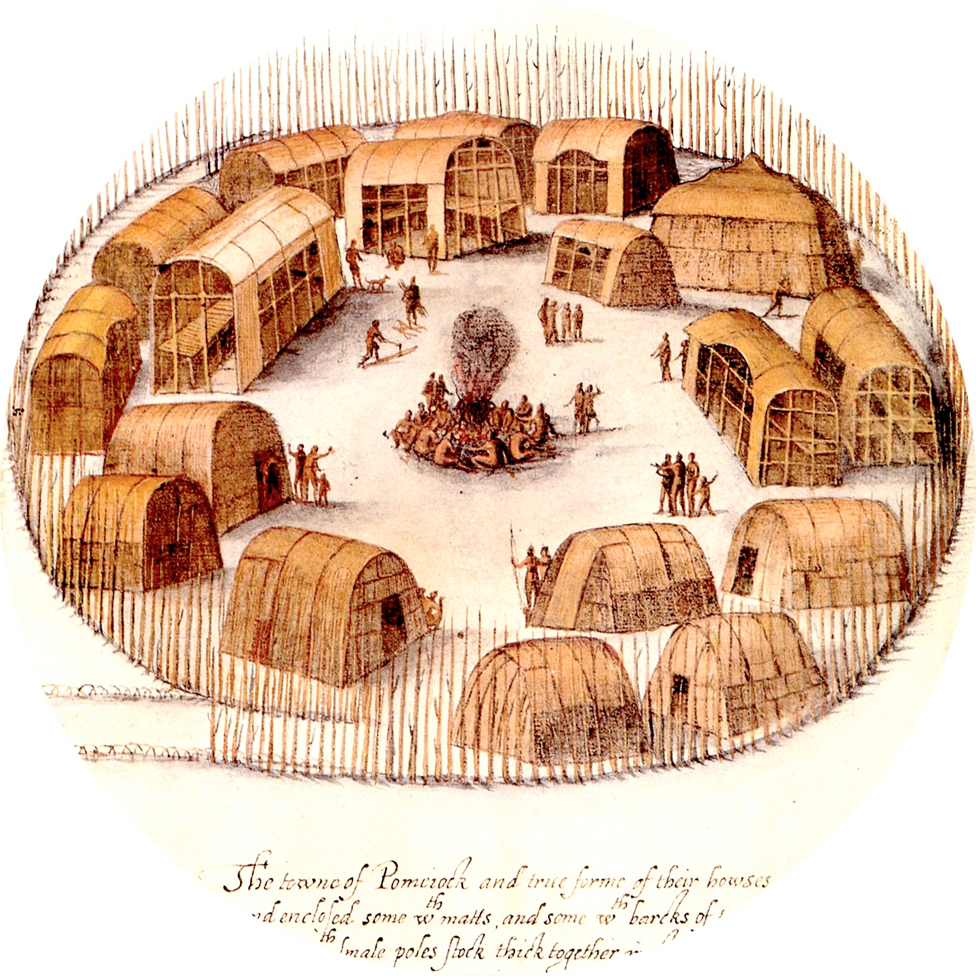
John White

Slide 7
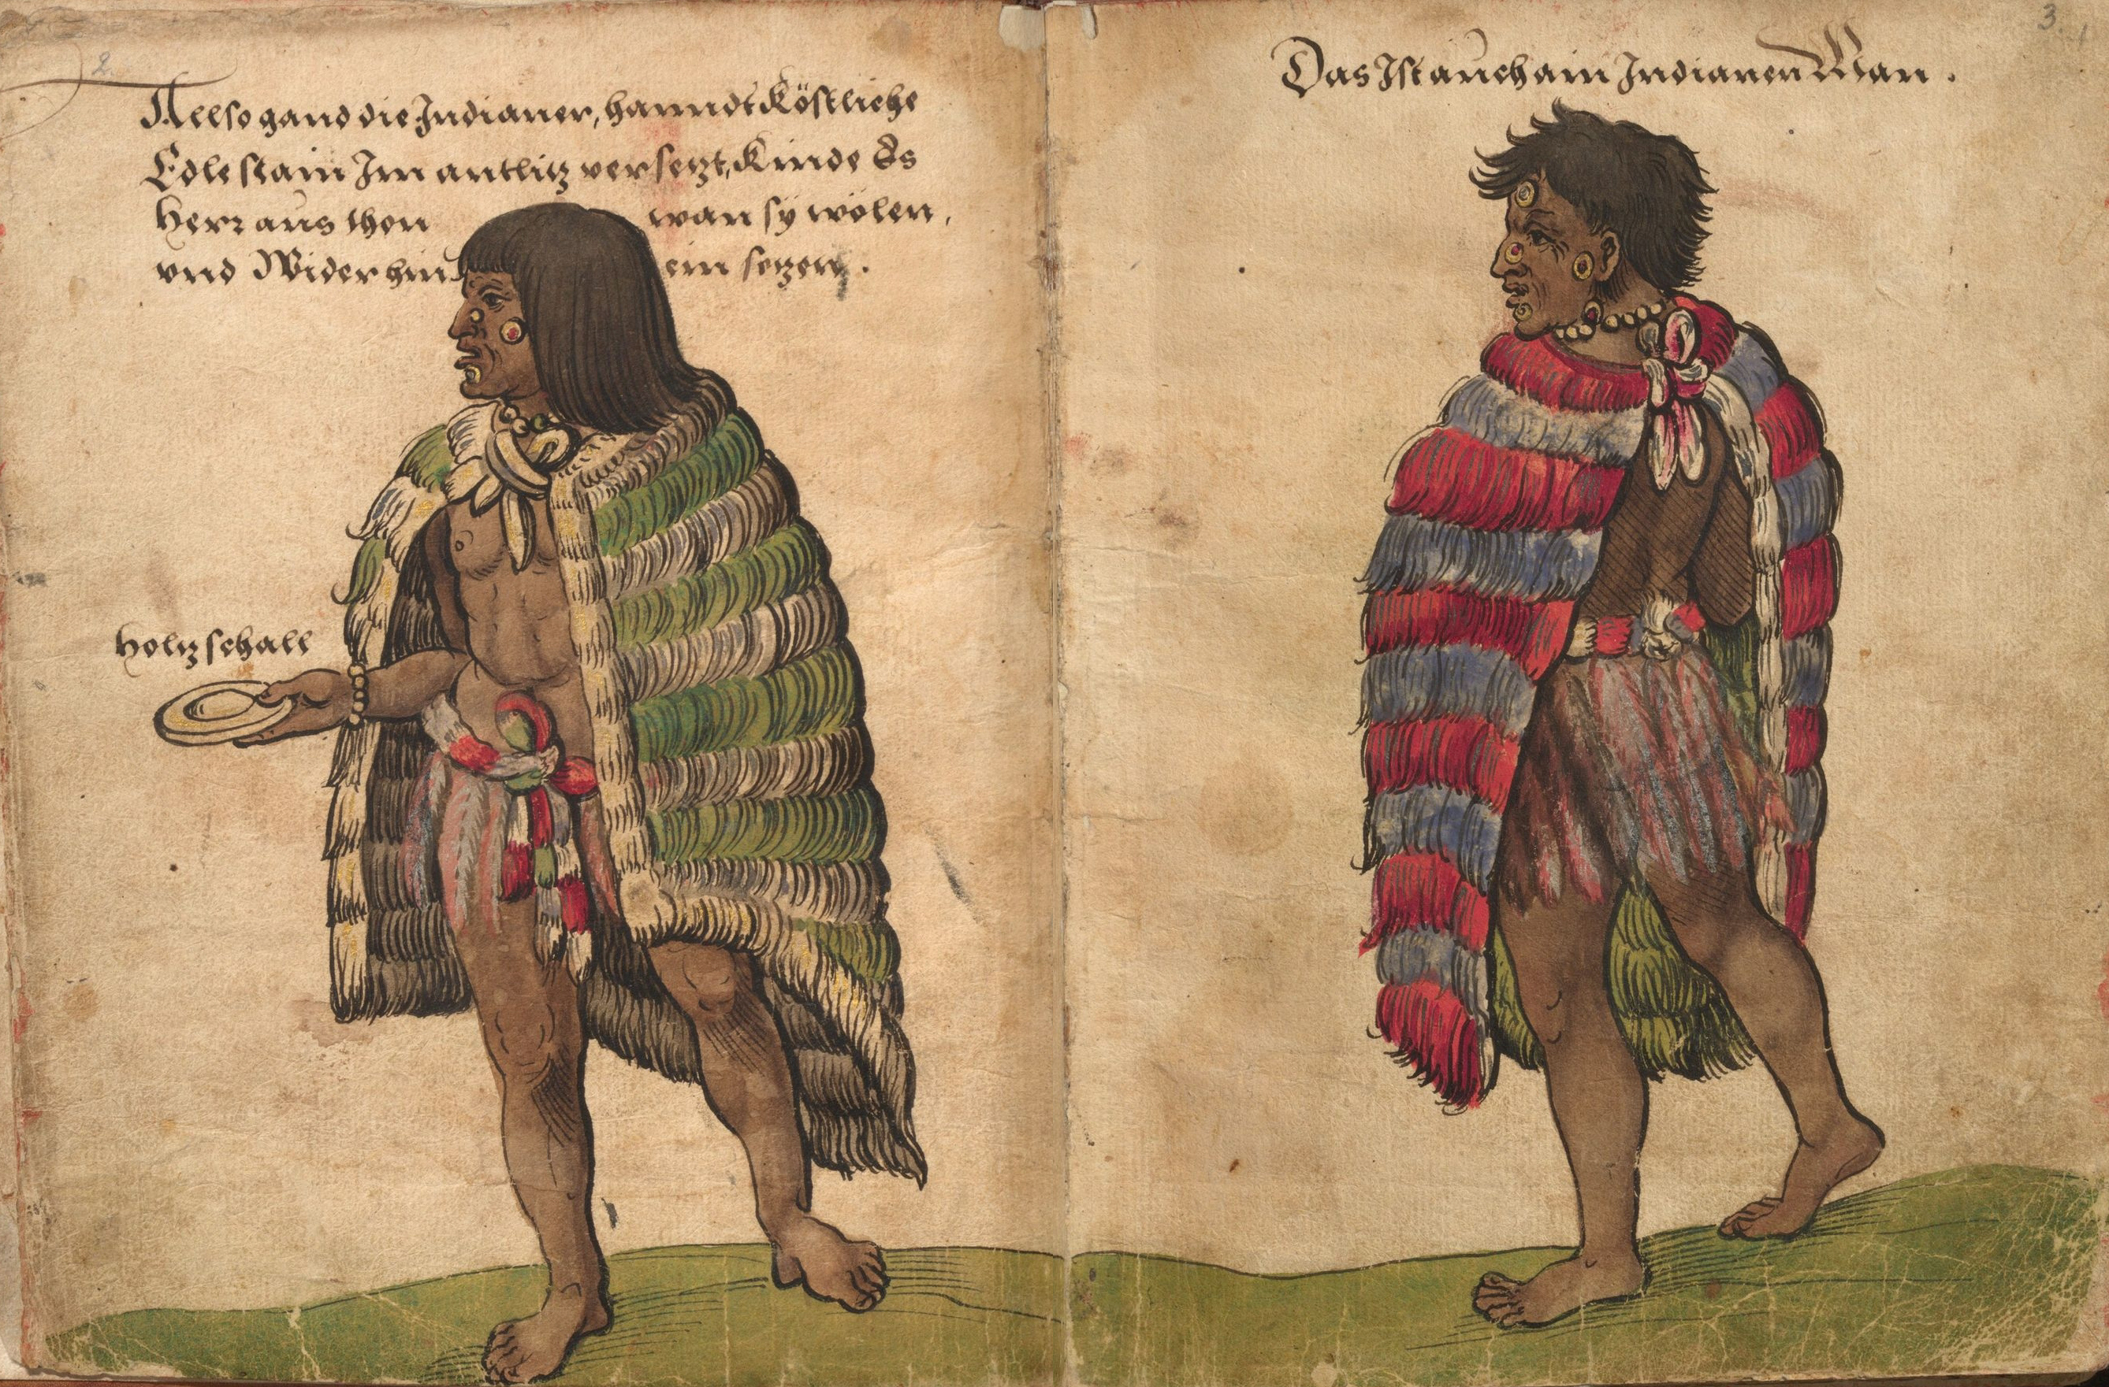
Christoph Weiditz, Mexican Indians, 1529

Slide 8
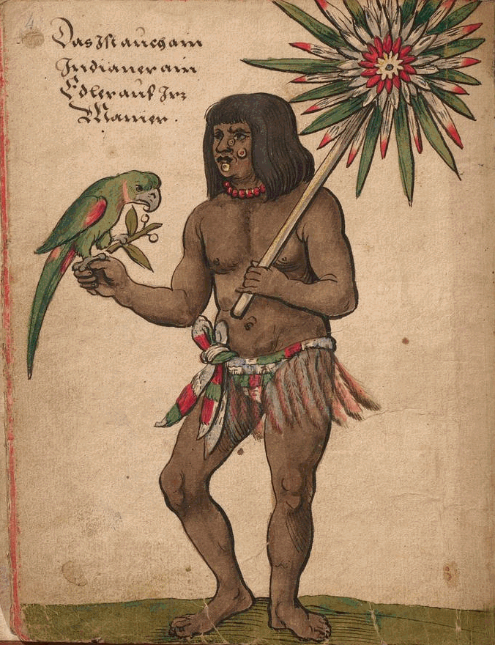
Christoph Weiditz

Slide 9
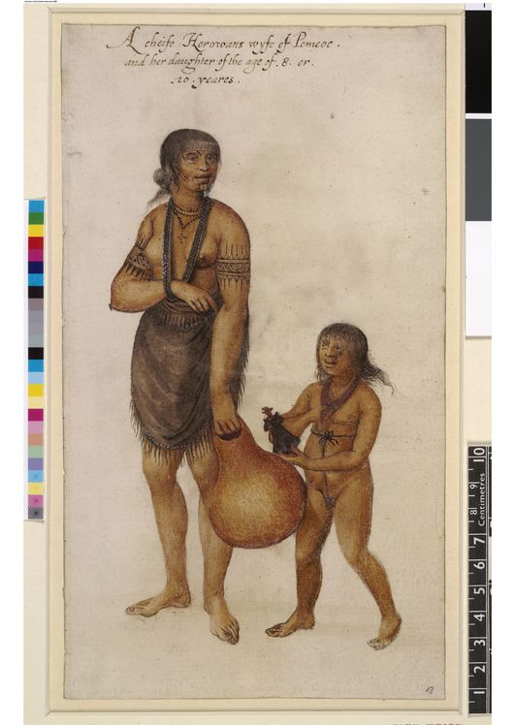
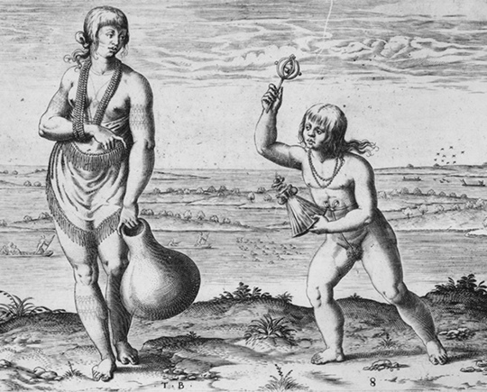

Slide 10
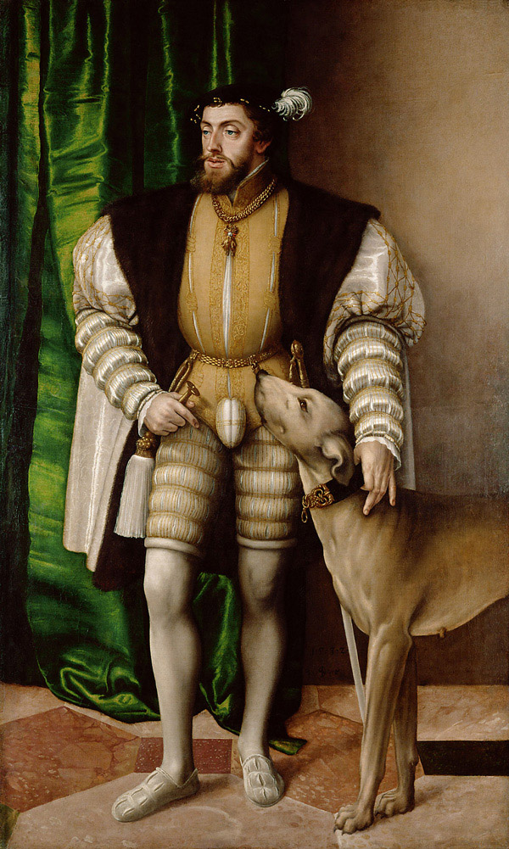
Jakob Seisenegger, ‘Portrait of Charles V’ (1532)

Slide 11
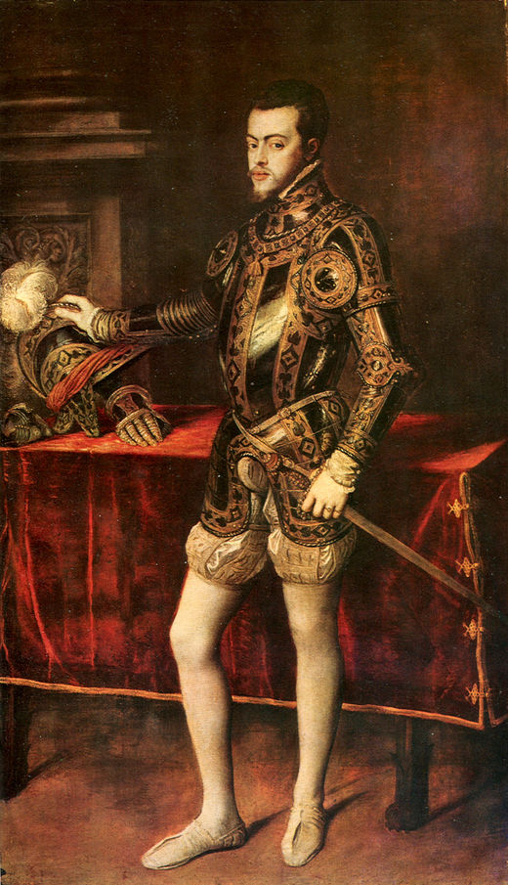
Titian, ‘Portrait of Prince Philip of Spain’ (c. 1551)

Slide 12
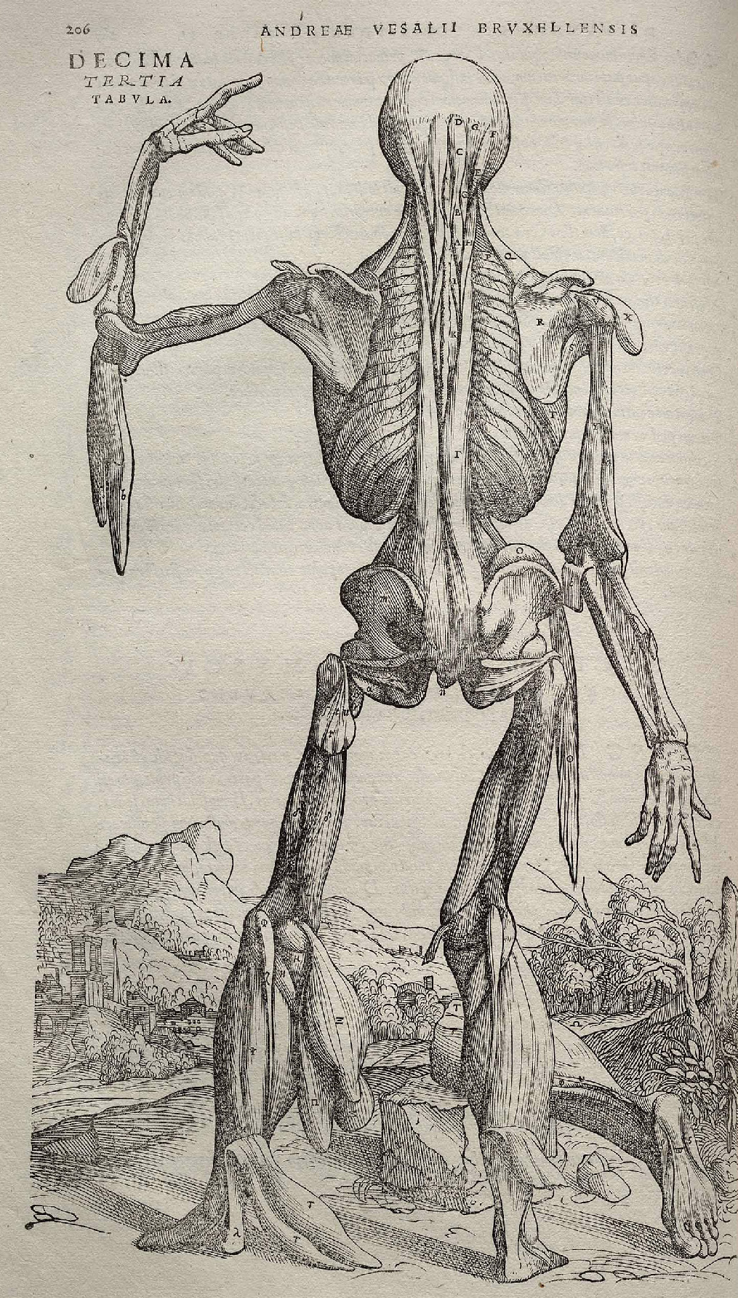
Vesalius

Slide 13
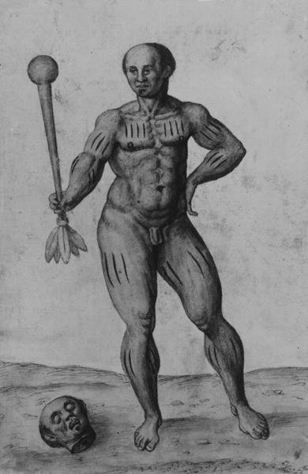
John White

Slide 14
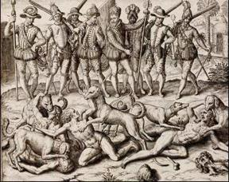
Theodor de Bry (monoscenic method’)

Slide 15
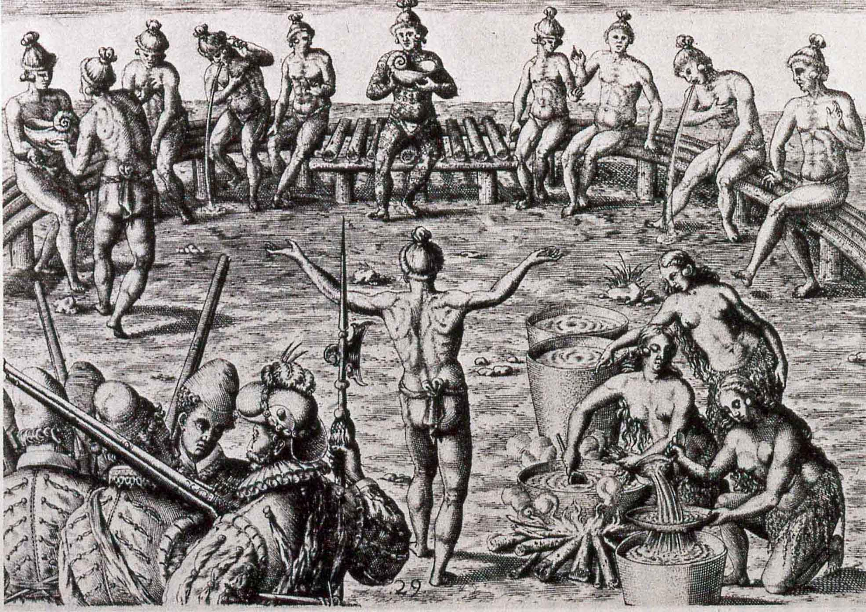
‘simultaneous method’

Slide 16
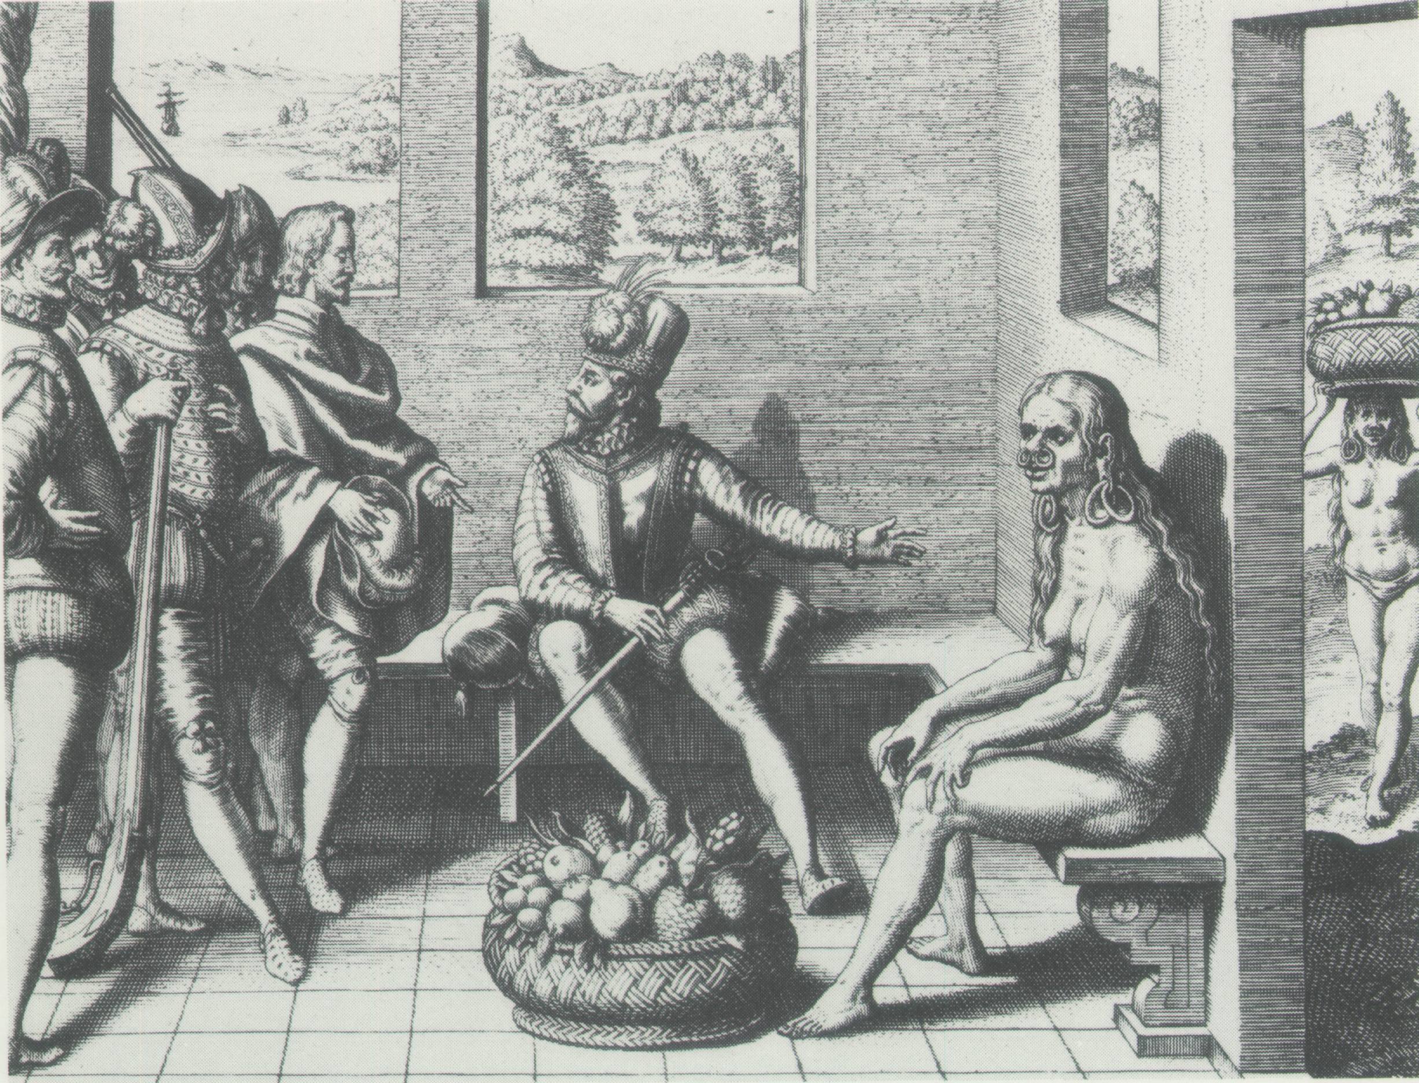
Theodor de Bry, ‘The Indian Woman of Cumana Province’ (‘rotative method’)

Slide 17
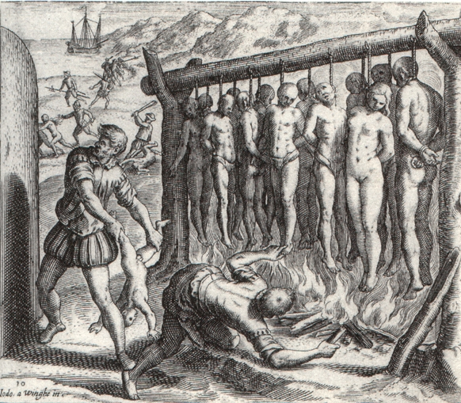
Theodor de Bry, ‘rotative method’

Slide 18
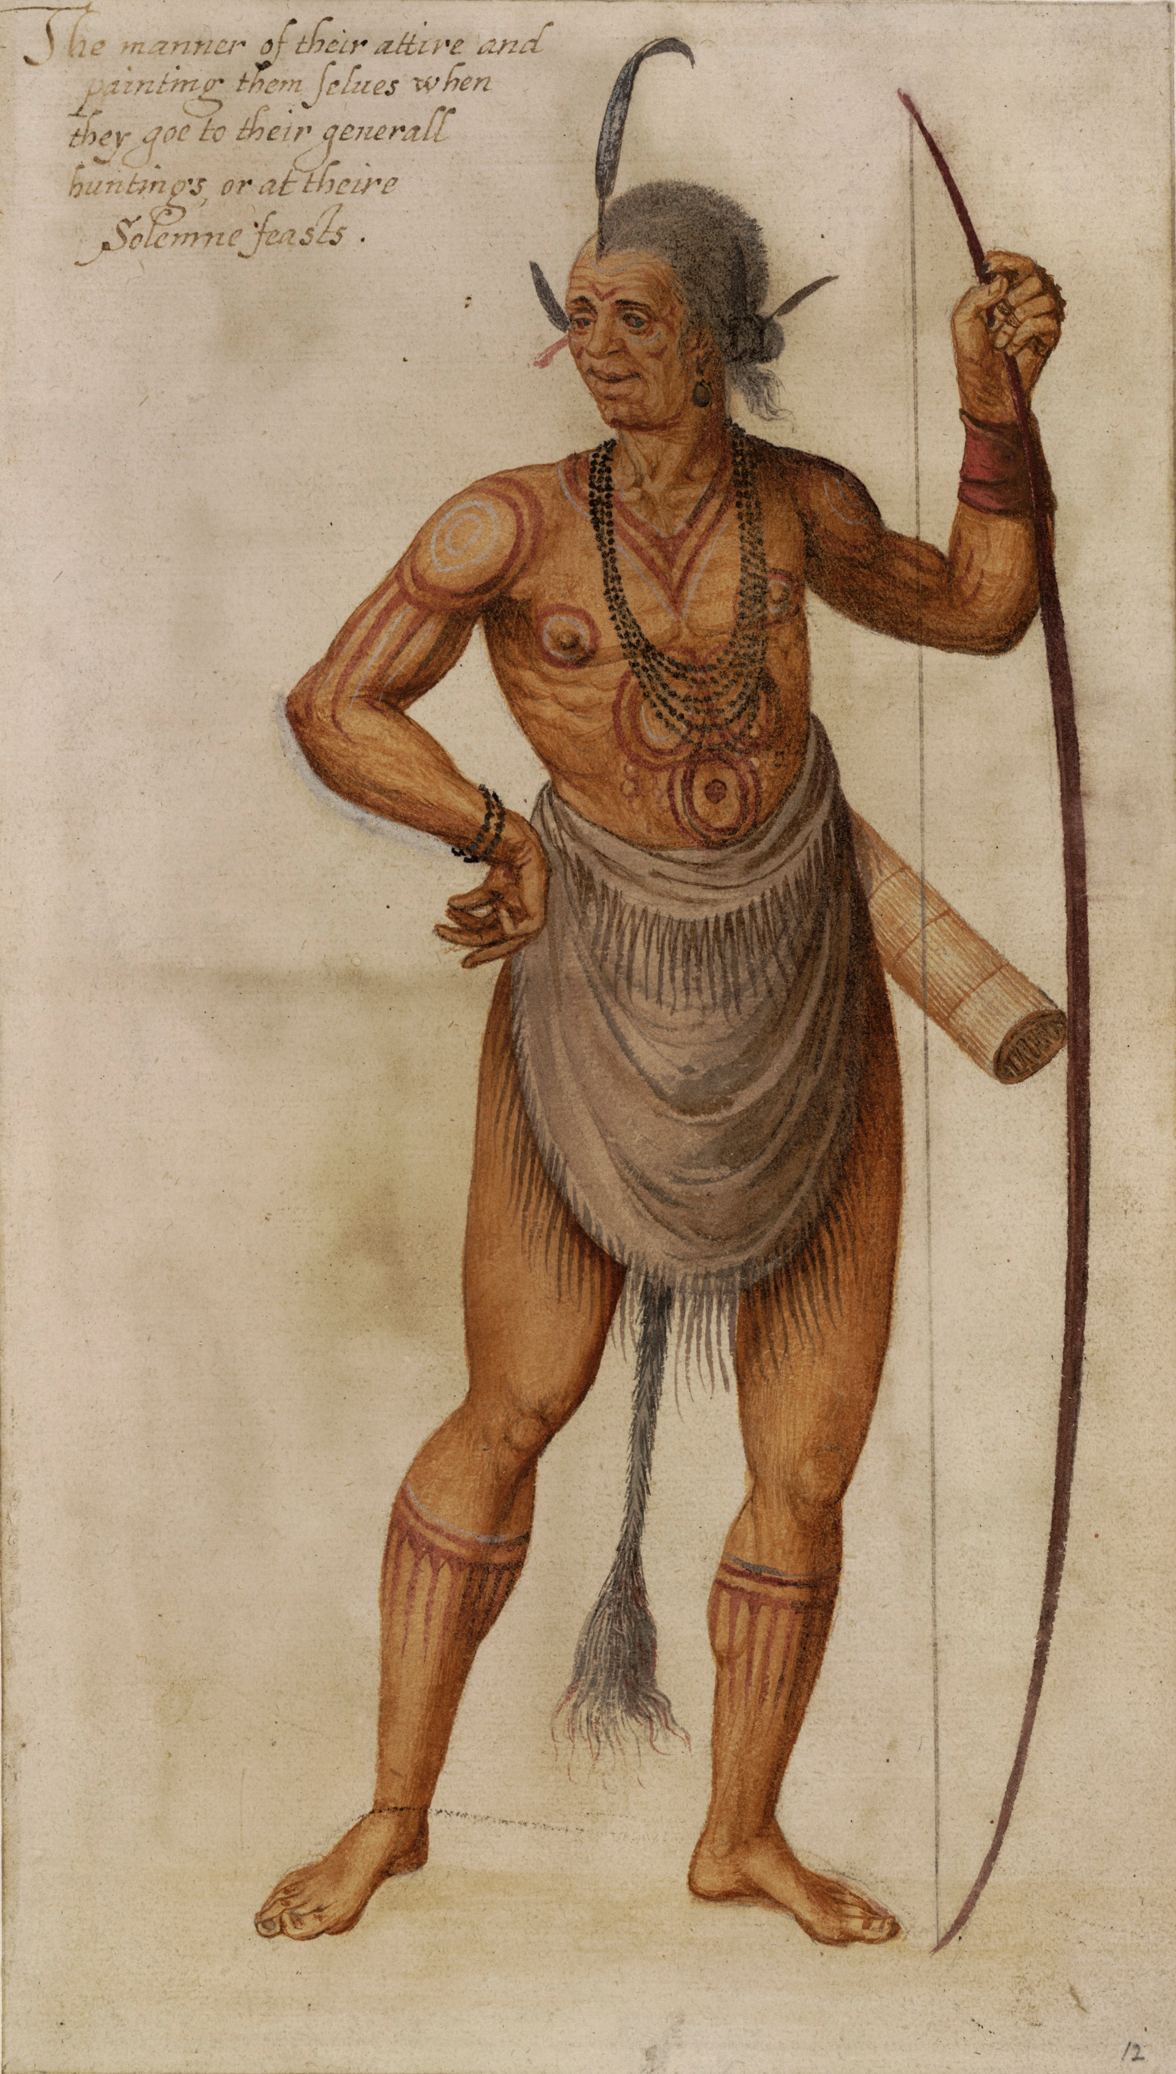
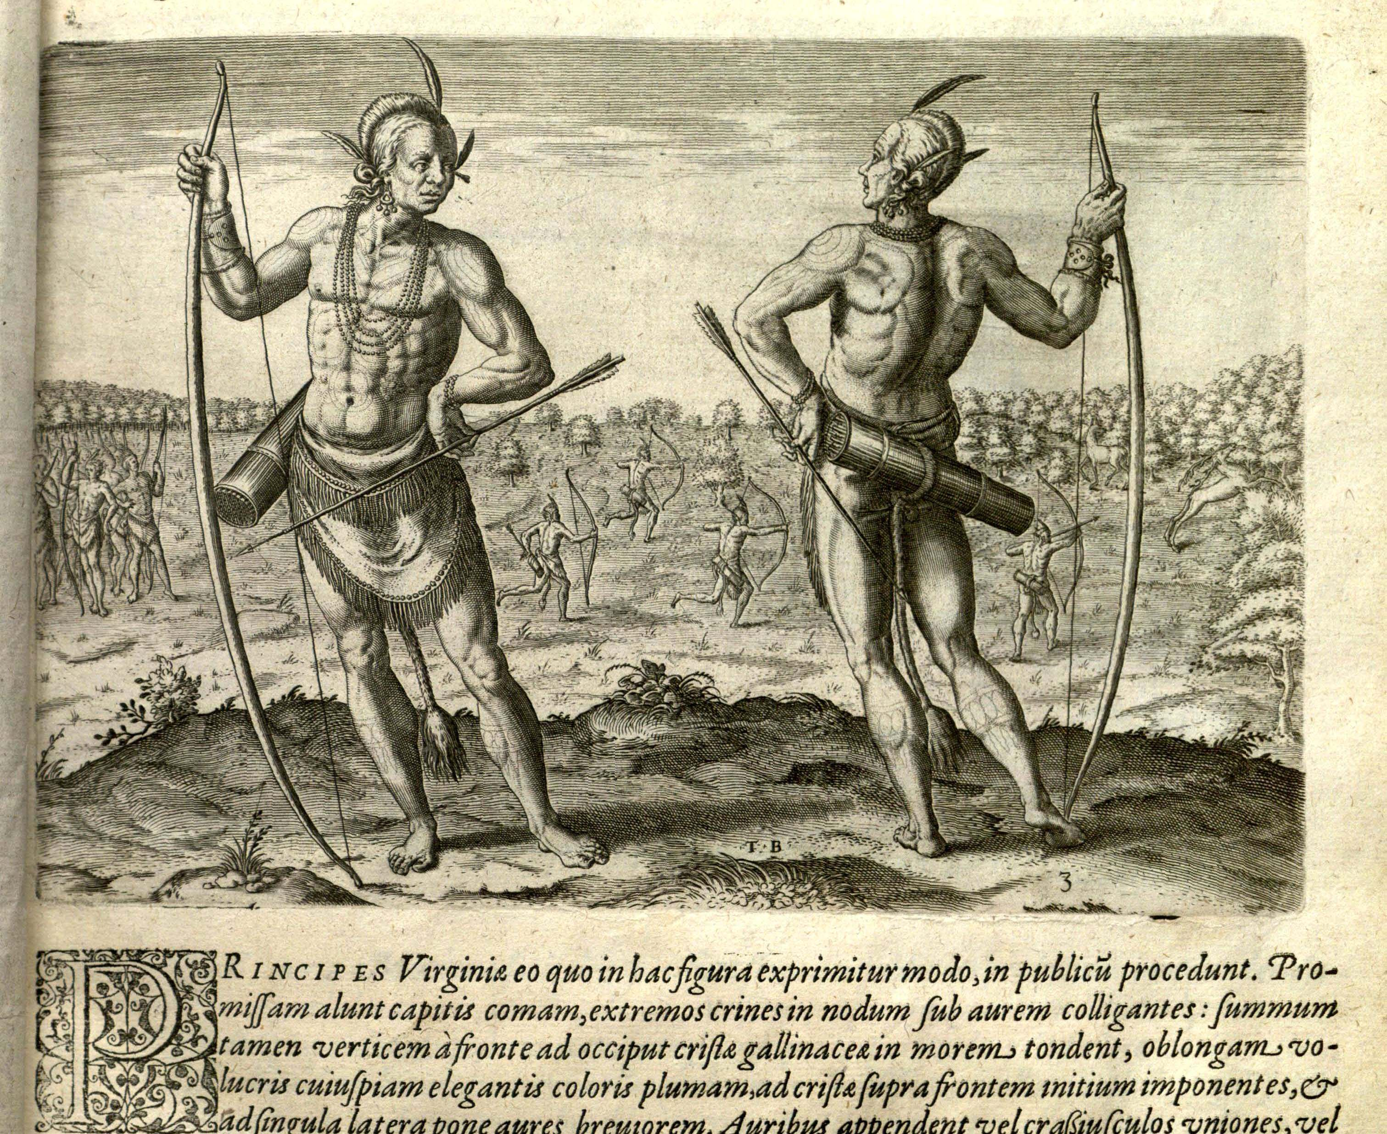

Slide 19
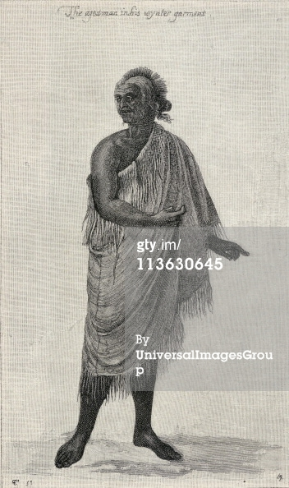
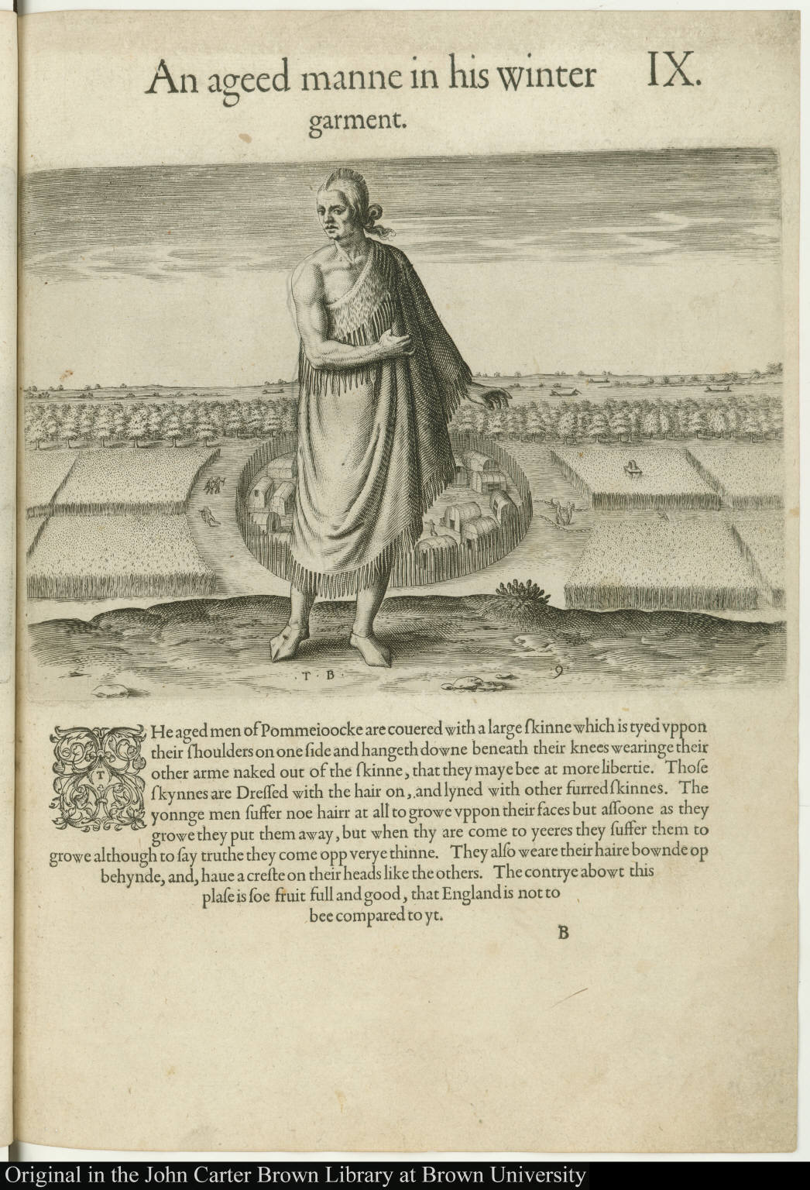

Slide 20
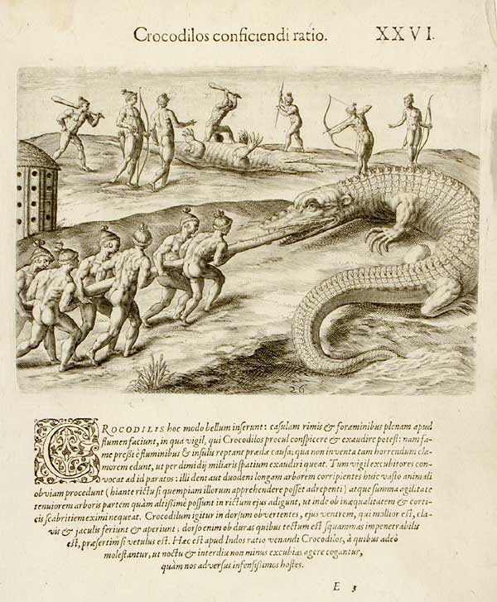
Theodor de Bry

Slide 21
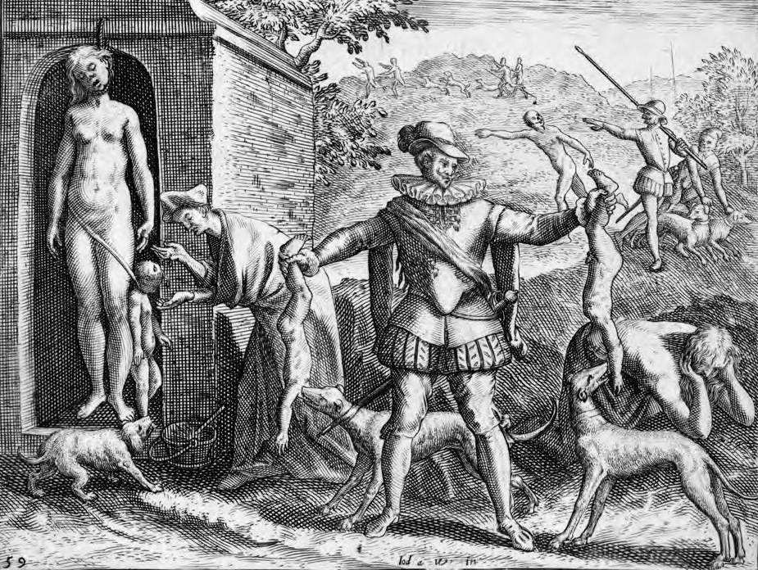
Theodor de Bry

Slide 22
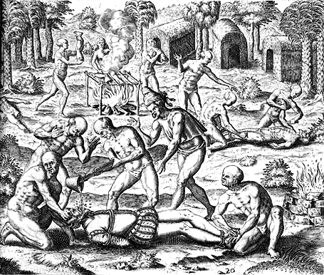
De Bry

Slide 23
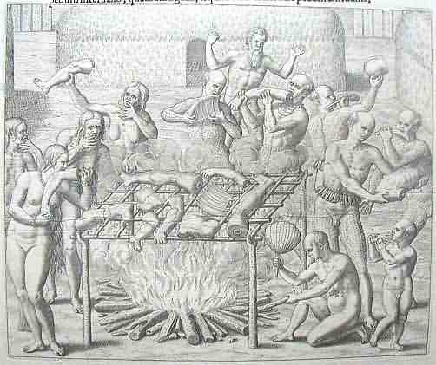
Theodor de Bry

Slide 24
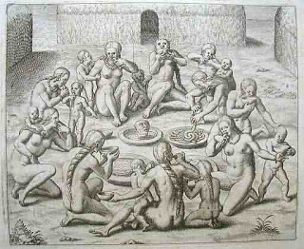
Theodor de Bry

