Slide 1
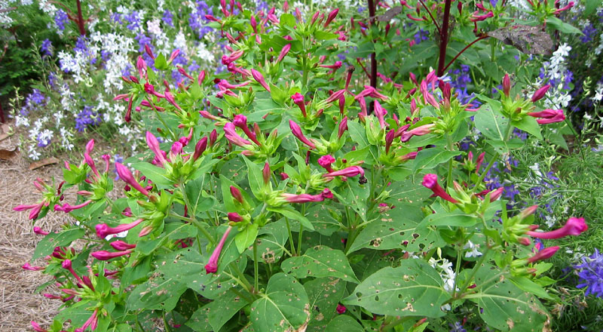
Mirabilis Jalapa

Slide 2
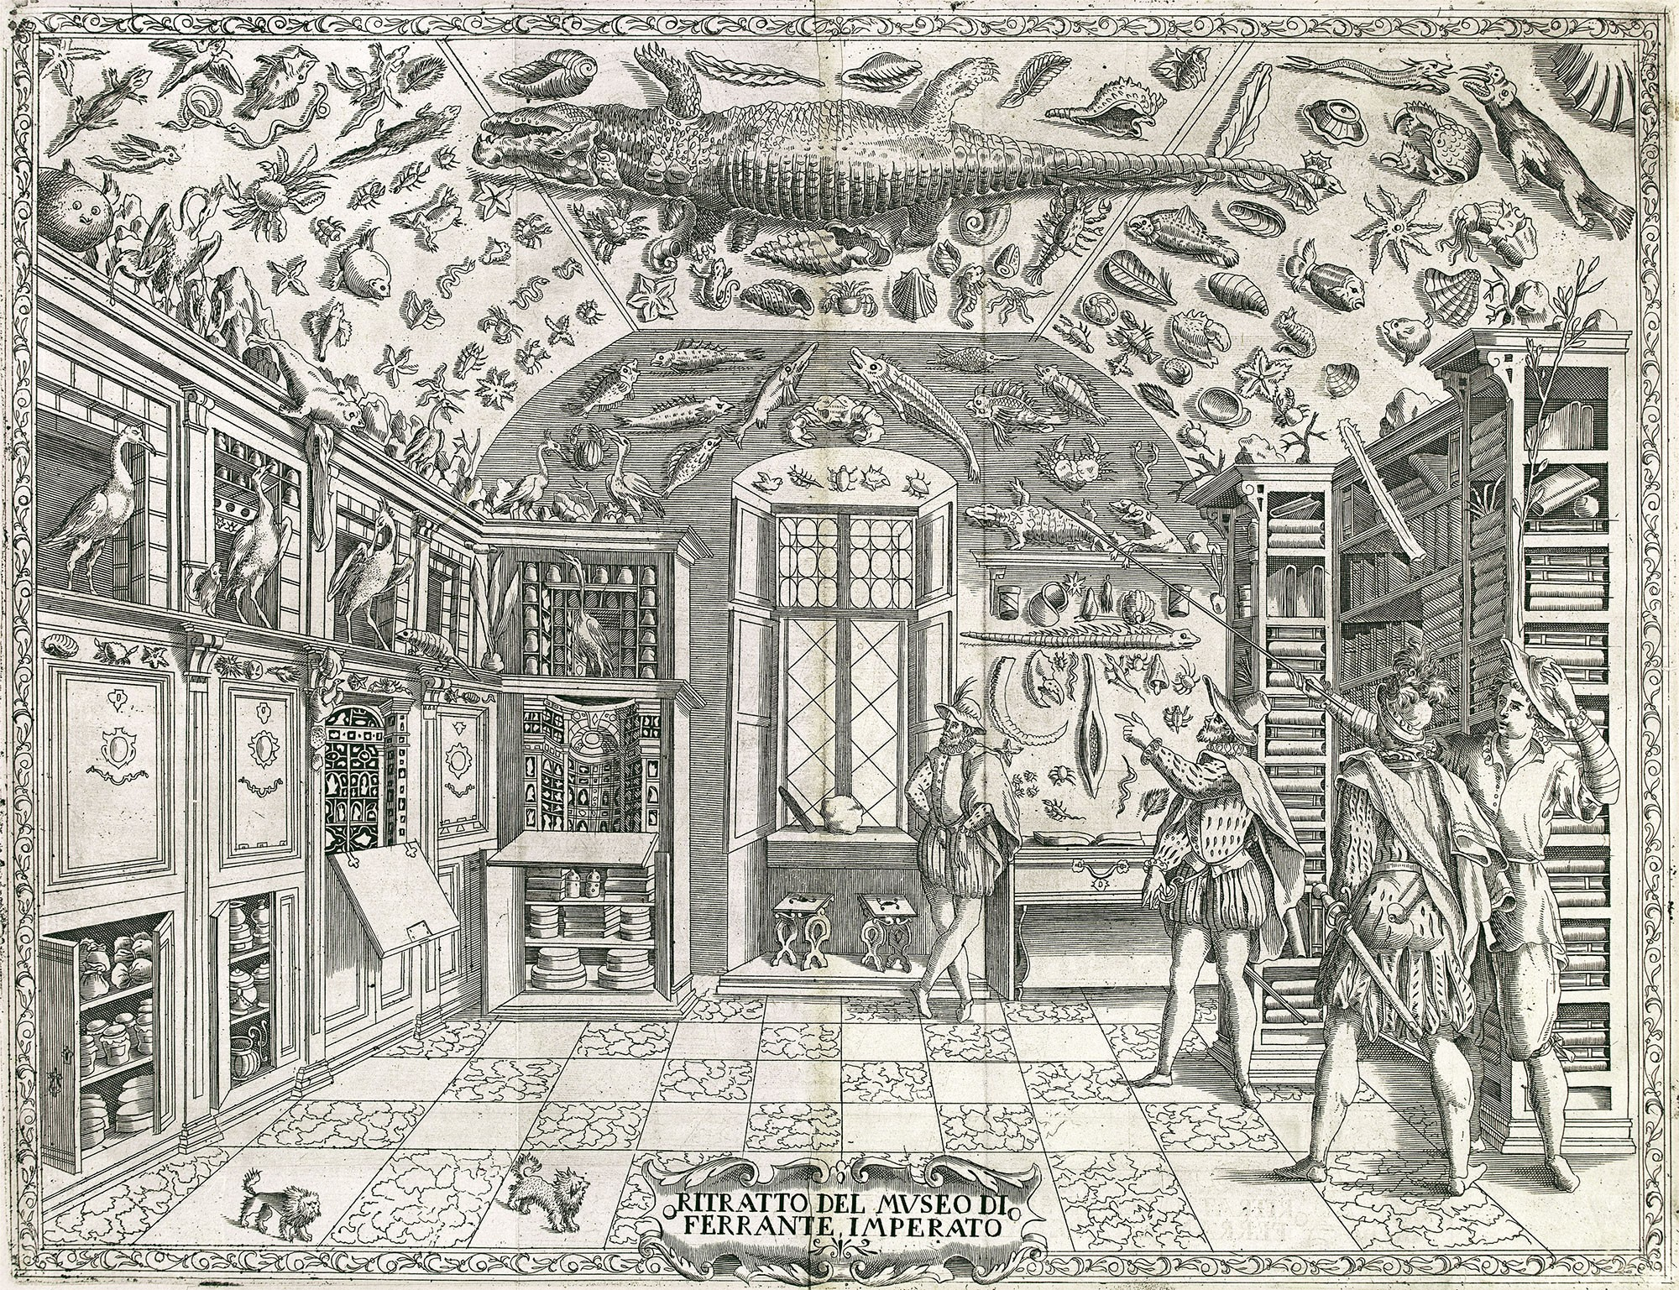
Ferrnate Imperato’s Kunstkammer, Naples (1599)

Slide 3
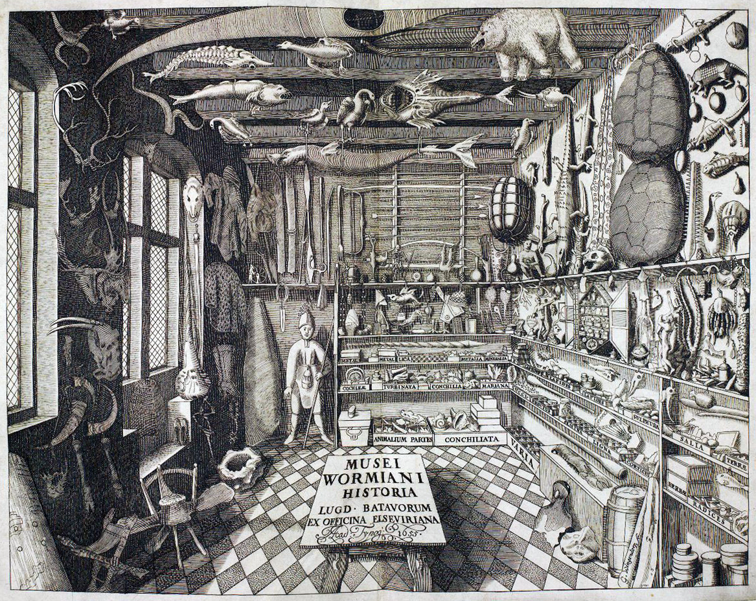
Ole Worm’s Museum, Copenhagen (1655)

Slide 4
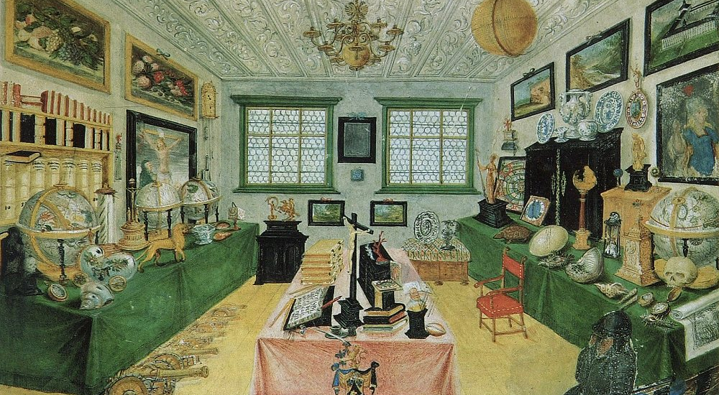
Dimpfel Family Cabinet, Regensburg (1668)

Slide 5
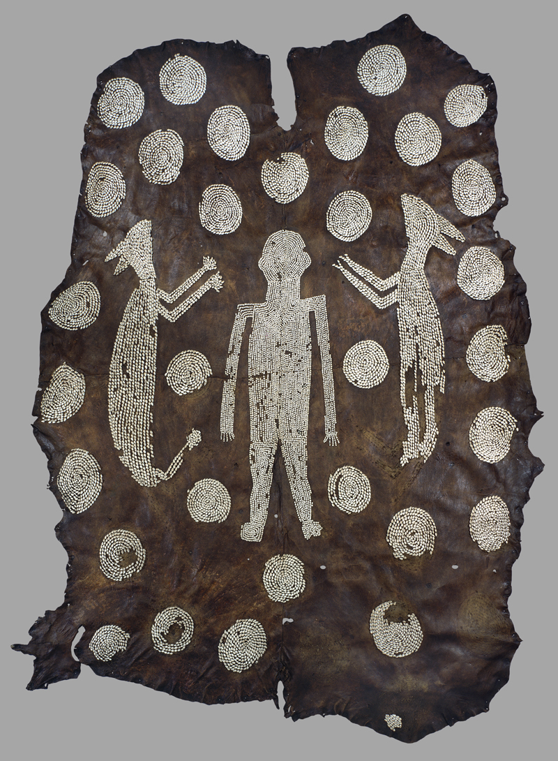
‘Powhatan’s Cloak’ (c. 1608)

Slide 6
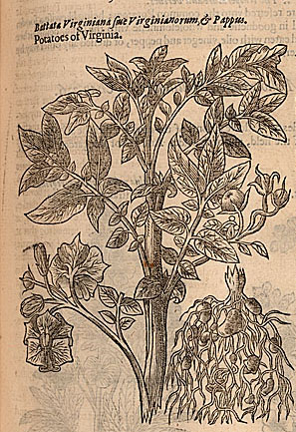
John Gerard, Herball (1597)
‘potatoes of Virginia’

Slide 7
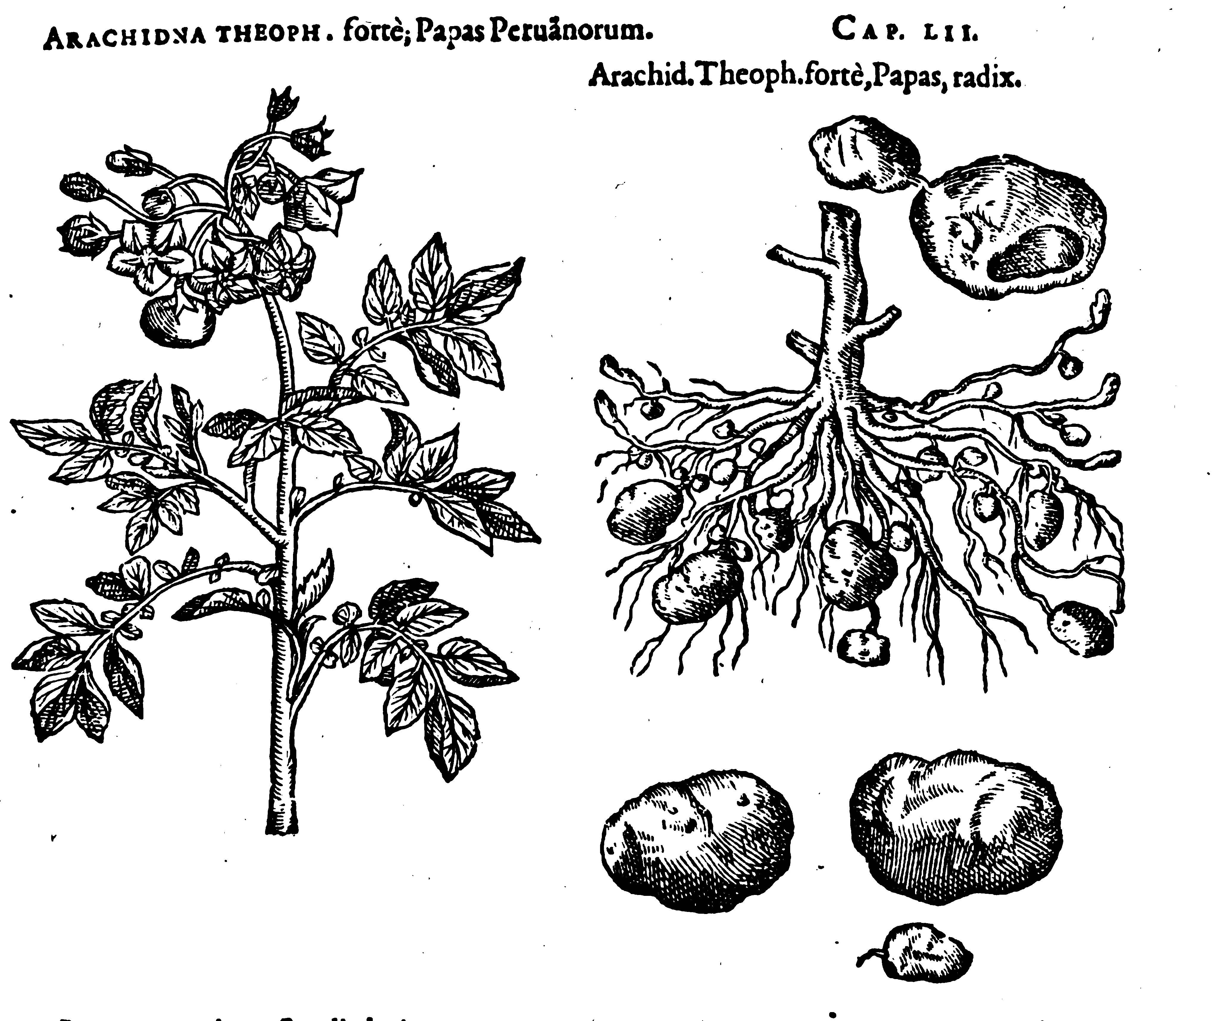
Carolus Clusius (Charles de L'Ecluse), Rariorum Plantarum Historia (1601)
Notes:
Clusius book 4,chap. 52, fol. 79.

Slide 8
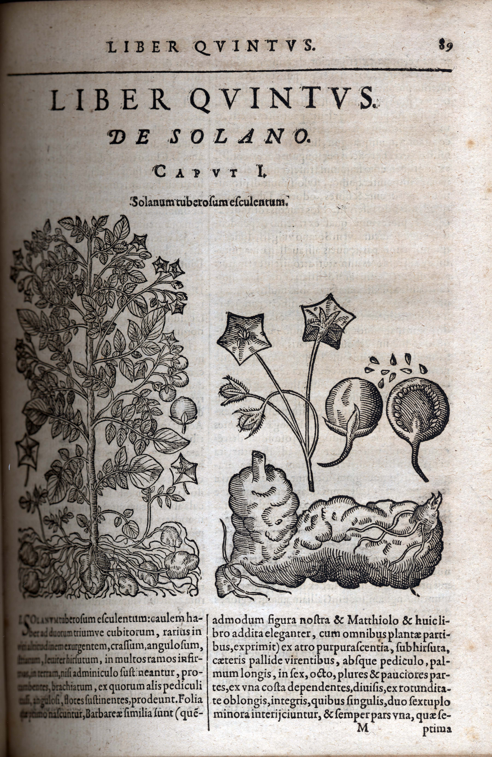
Gaspar Bauhin, Prodromos theatri botanici (1620)

Slide 9
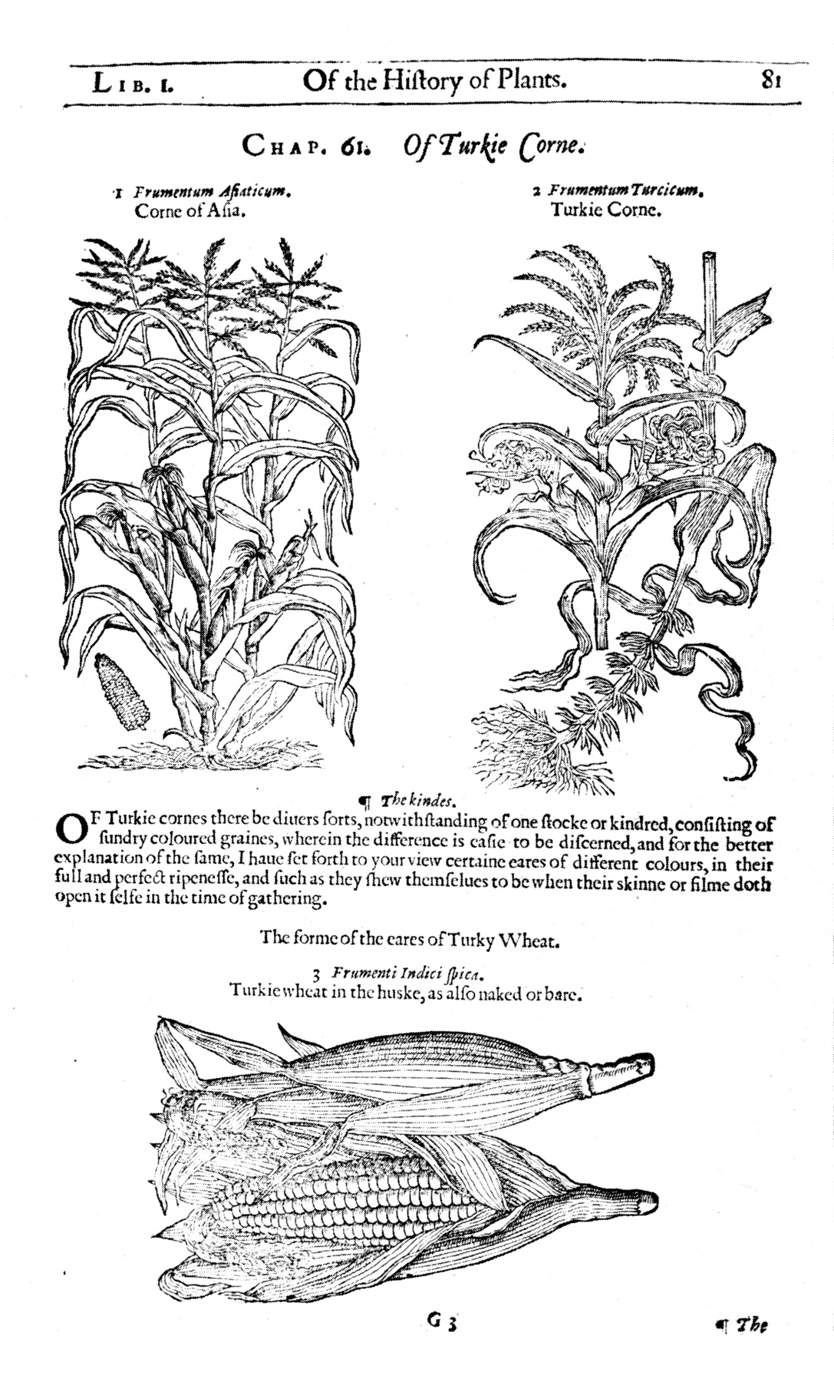
John Gerard, The Herbal or General History of Plants (1633)

Slide 10
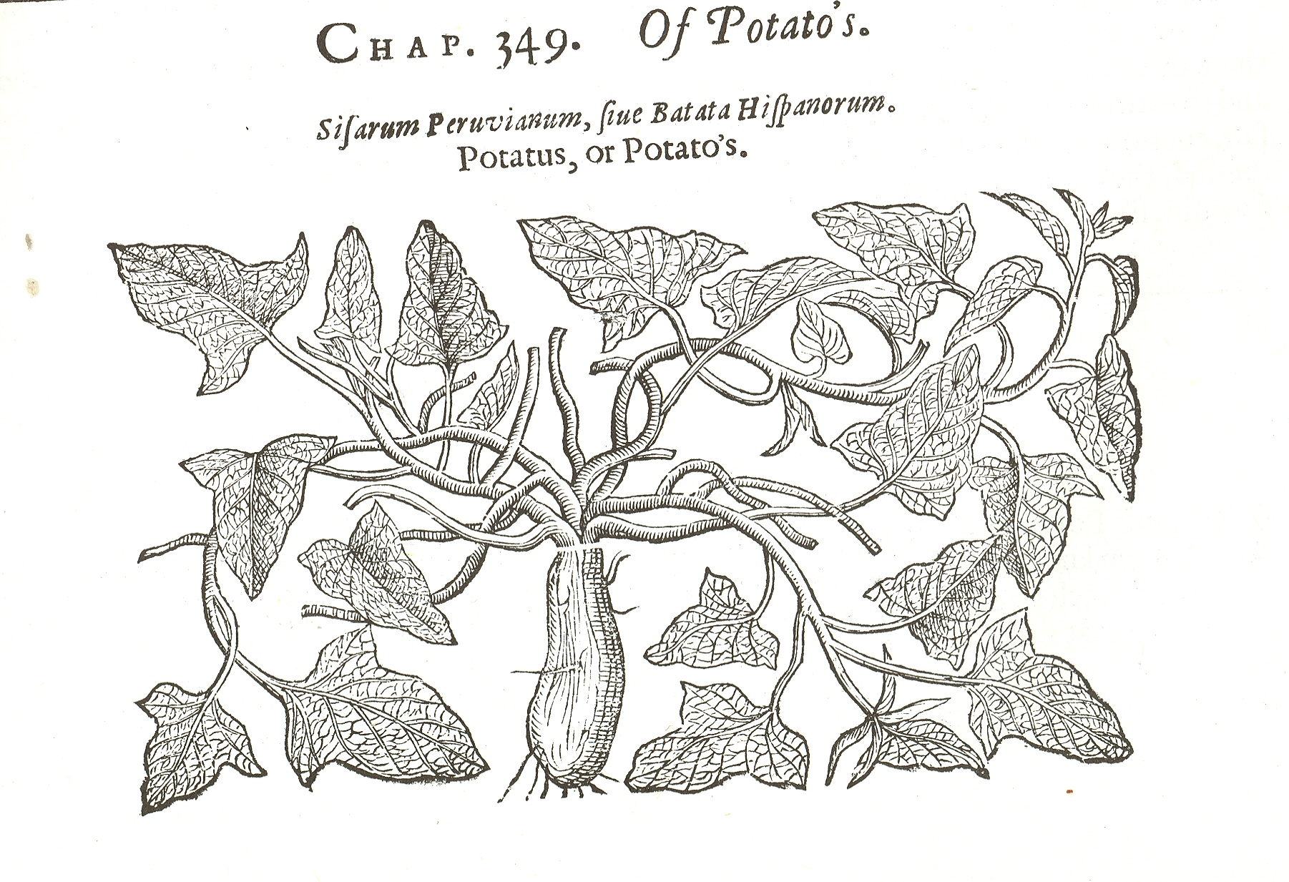
John Gerard, Herball (1597)

Slide 11
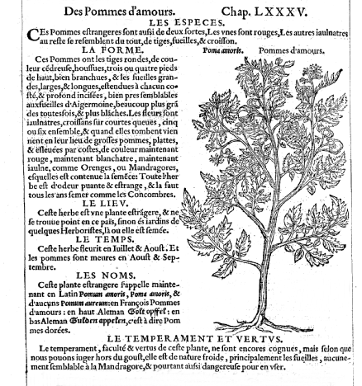
Rembert Dodoens, Histoire des Plantes (1557)

Slide 12
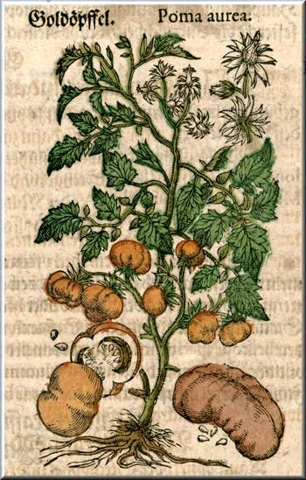
Pietro Andrae Matthioli, Kreutterbuch (1590)

