Slide 1
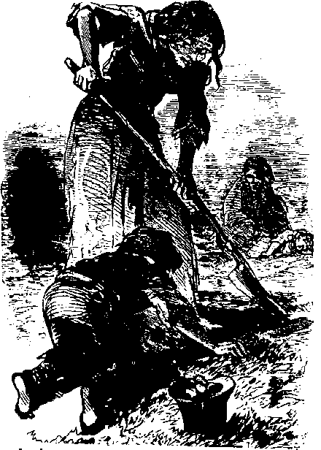
Lecture 2: The Great Famine
An Górta Mór

Slide 2
The Great Famine: Some key dates
1845
9 September: Potato blight first reported in Ireland
9-10 November: British Prime Minister Peel authorises importation of Indian corn
1846
30 June: Peel and the Tory government ousted by the Whigs: Lord John Russell heads the new administration
15 August: Food depots and public works closed down by Treasury
28 August: Poor Employment (Ireland) Act: Treasury loans for relief work
1847
26 February: Destitute Poor (Ireland) Act.
10 April: Peak of fever epidemic
8 June: Poor Relief (Ireland) Act: some outdoor relief granted
1849: 28 July: Passage of the Encumbered Estates Act

Slide 3
1. Pre-Famine Ireland
2. The cause and progress of the Famine
3. Relief measures
4. An avoidable disaster?
5. Legacies

Slide 4
Pre-Famine Ireland
By 1841 about four-fifths of the population of Ireland were rural-dwellers.
There was a huge contrast between the life-style of the world of the ‘Big House’ and that of the mass of labouring peasants.
There were also distinctions between tenant-farmers and labourers as well as distinctions among the various strata of tenant-farmer.

Slide 5
Pre-Famine Ireland
In 1841 approximately 40% of the houses in Ireland were one-room mud cabins.
There were strong regional variations - housing standards declined from east to west.
In the early nineteenth century 50% of the population spoke Irish (approximately 4 million people).

Slide 6
‘The one-roomed mud cabin had usually the natural earth as a floor; the smallest of them were about twelve feet wide and from twelve to twenty feet long. The roof consisted of sods of earth laid on wooden rafters and covered with a thatch of straw. Many had neither window nor chimney, so that the smoke from the fire escaped through the open door. Furniture in those mud cabins was Spartan…Few of the labourers had overcoats and their womenfolk and children generally went barefoot.’
Ó’Tuathaigh, Gearóid, Ireland before the Famine: 1798-1848, pp148-9.

Slide 7
The population of Ireland
1821: 6,802,000
1831: 7,767,000
1841: 8,175,000

Slide 8
Dependence on the potato
Increased dependence from the early 18th century onwards
On the eve of the famine the potato was the sole food of about one-third of the Irish people and it was a key component in the diet of a far larger number of Irish peasants

Slide 9
Famine
According to the Oxford Companion to Irish History famine is ‘a persistent failure in food supplies over a prolonged period’. (Oxford Companion to Irish History, p194)
Sen – famine is less commonly caused by an absolute shortage of food than by the lack of ‘entitlements’.

Slide 10
The course of the famine
1845: the harvest was one third deficient.
1846: three-quarters of the crop were lost.
1847: yields were average but little had been sown as seed potatoes were scarce.
1848: yields were only two-thirds normal.

Slide 11
Asenath Nicholson
Annals of the Famine in Ireland, in 1847, 1848 and 1849
‘The morning was unusually sunny but the horrors of that day were inferior to none ever witnessed. The road was rough, and we constantly were meeting pale, meagre-looking men, who were on their way from the mountains to break stones and pile them mountain high for the paltry compensation of a pound of meal a day… We met flocks of wretched children going to school for the bit of bread, some crying with hunger, and some begging to get in without the penny which was required for their tuition. The poor little emaciated creatures went weeping away…This day I saw enough, and my heart was sick, sick.’

Slide 12
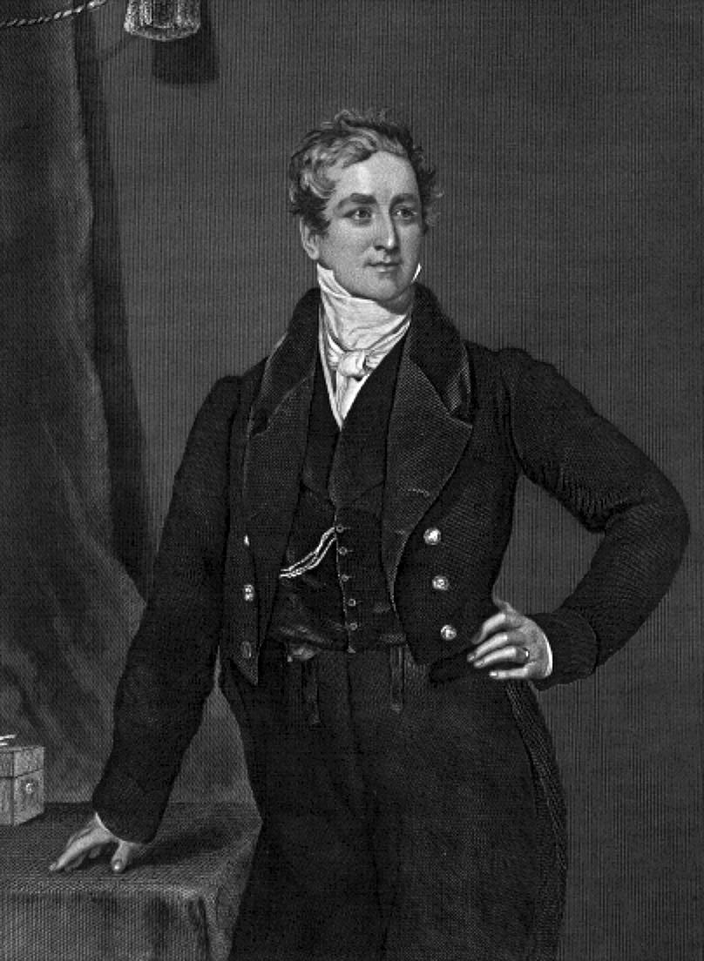
Sir Robert Peel
(1788-1850)

Slide 13
The Peel government’s relief strategy
to provide employment so that labourers could earn the cash necessary to purchase food
to ensure that local traders would not capitalise on the food shortage by raising prices to an exorbitant level.

Slide 14
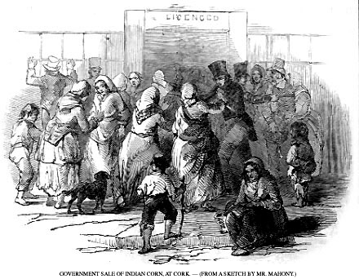
Indian Meal

Slide 15
The Peel government’s relief strategy
Nov 1 1845: Special relief commission for Ireland set up
Nov 1845:£100,000 worth of maize and meal ordered from the United States
Local relief committees set up
Public work schemes initiated in early 1846

Slide 16
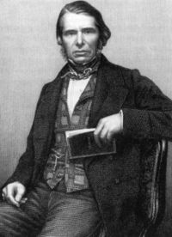
Charles Trevelyan
(1807-1886)

Slide 17
‘The State role in alleviating Irish distress ought to be confined to providing employment on public works, which, ideally, ought to be of a non-productive nature; the provision of food ought to be left to private enterprise, except in isolated areas where a very limited degree of State intervention seemed unavoidable; the cost of relieving Irish distress should, in the final analysis, fall on Irish shoulders.’
Ó’Tuathaigh, Gearóid, Ireland before the Famine: 1798-1848, p212.

Slide 18
Peel’s importation of Indian corn was not continued under the Russell administration.
Peel’s relief commission was wound up. Its functions were transferred to central government.
Russell’s administration extended the public works schemes.
The Whig government refused to interfere in the internal market in food or in the export of agricultural produce.

Slide 19
Peel’s public works had employed 100,000 men.
The Whig scheme employed some 750,000 men by the spring of 1847.

Slide 20
A U-turn in government policy in February 1847
Destitute (Ireland) Act
Ideology set aside – temporarily
Soup kitchens opened throughout the country
Food supplied directly to those in need without cost and without imposing a work test
At its height the kitchens supplied 3 million meals daily

Slide 21
Poor Law Amendment (Ireland) Act passed in June 1847
It altered existing poor law to cope with an almost permanent crisis
A separate Irish poor law commission was created
The number of Irish poor law unions was increased
The full cost of relief in any union was to be met by its ratepayers

Slide 22
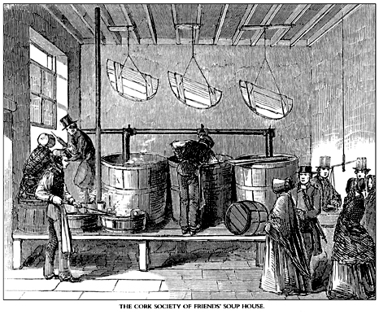
Soup Kitchens

Slide 23
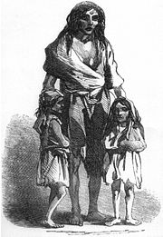
An 1849 depiction of Bridget O'Donnell and her two children during the famine

Slide 24
By mid 1848 more than half of the unions in Ireland were providing 800,000 people with relief, in the form of food rations, outside the workhouse enclosure.
Within the workhouses up to 900,000 people received relief in 1849.

Slide 25
Gregory Clause
‘An amendment to the Poor Law Act of 1847. …it prohibited the relief from poor rates of anyone occupying more than a quarter-acre of land and also (until the rules were changed in May 1848) their dependants. The restriction facilitated those landlords who wished to take advantage of the Great Famine to clear their estates of surplus tenants, but added significantly to misery and loss of life, as smallholders stubbornly refused to give up their foothold on the land.’
Oxford Companion to Irish History, p241

Slide 26
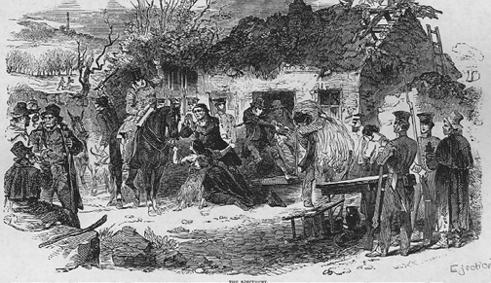
Evictions during the famine
In 1849 more than 90,000 people were evicted from their homes.
In 1850 a further 100,000 people were evicted.

Slide 27
Consequences
By 1851 Ireland’s population had decreased by about twenty per cent.
It is estimated that one million Irish people died during the Great Famine.
1.5 million Irish people emigrated between 1845 and 1855.
Sligo, Leitrim, Mayo, Galway, Clare, Limerick, Cork, Kerry and parts of Tipperary, along with Cavan and Laois were the hardest hit areas.

Slide 28
Between 1845 and 1851 the number of labourers and cottiers fell 40 per cent, the number of farmers 20 per cent.
One quarter of all farms disappeared between 1845 and 1851 and the average size of farms increased.
Irish agriculturalists moved away from tillage to pastoral farming

Slide 29
By 1851 less a quarter of the population spoke the Irish language
Only five per cent were monolingual Irish-speakers

Slide 30
Emigration
1842: 220,000 Irish people emigrated
1852 368,000 Irish people emigrated
Between 1849 and 1852 annual emigration never fell below 200,000

Slide 31
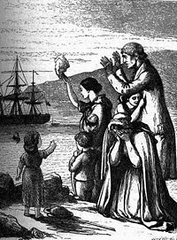
Emigrants Leave Ireland, engraving by Henry Doyle (1827-1892)

Slide 32
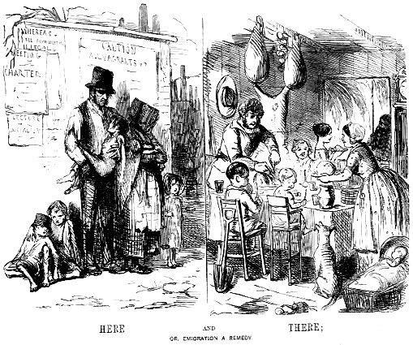

Slide 33
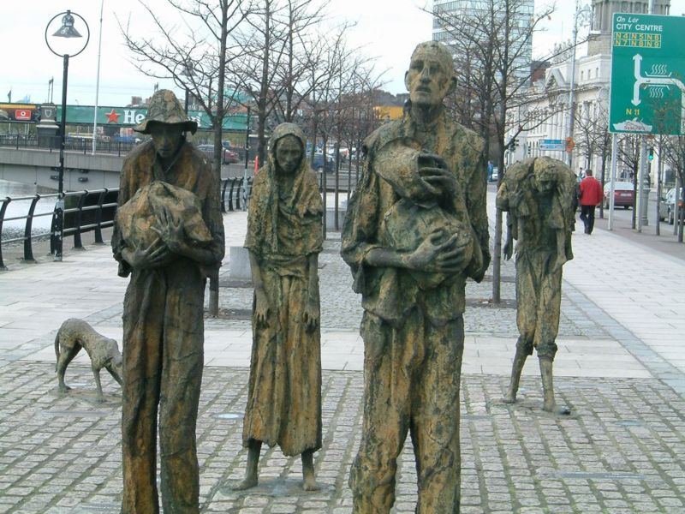
Famine memorial in Dublin

