Slide 1
Georgian Britain: The Seventeenth-Century Revolutions and their legacy

Slide 2
The First Revolution 1642-1660
Causes:
A long term reformation process – a war of religion?
Constitutional tensions – a Stuart tyranny? Structural problems with the state structure?
A British problem – structural tensions?

Slide 3
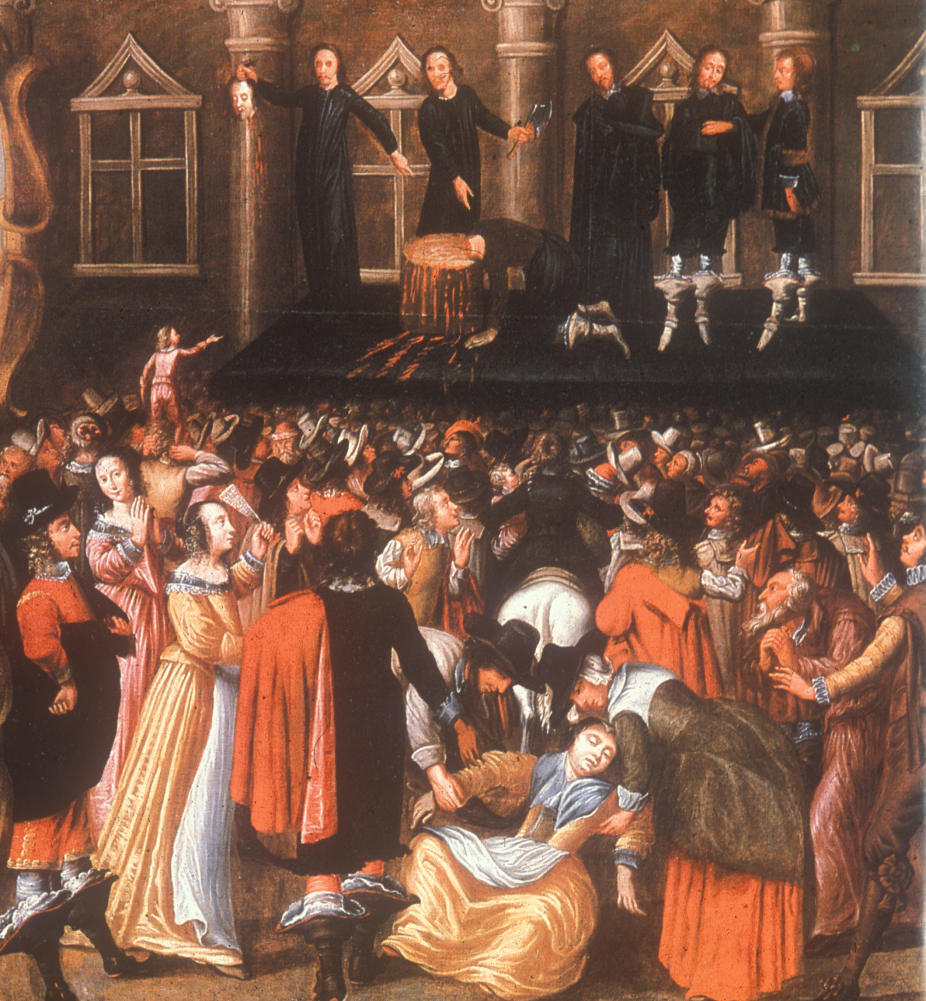

Slide 4
Legacies of 1649 (the regicide) and the creation of a Commonwealth
Republicanism; the perceived tyranny of parliament; doctrine of natural rights and the right of resistance
Social radicalism – abolition of the House of Lords; the Leveller tradition (1640s) and James Harrington (1650s)
Religious radicalism – the replacement of the historic episcopacy (Church govt by bishops) by presbyterianism (Church govt by elders); the birth of sectarianism (Baptists/Quakers) and toleration; the end of Protestant unity and uniformity?
Notes:
Inheritance tax!

Slide 5
The Legacy of 1649 and the creation of a Commonwealth
The collapse of government censorship of the press
The ‘British problem’
Fear of a standing army that could be used against the domestic population
High taxation – novel means of raising public revenue
A divided society: commonwealth as good or bad

Slide 6
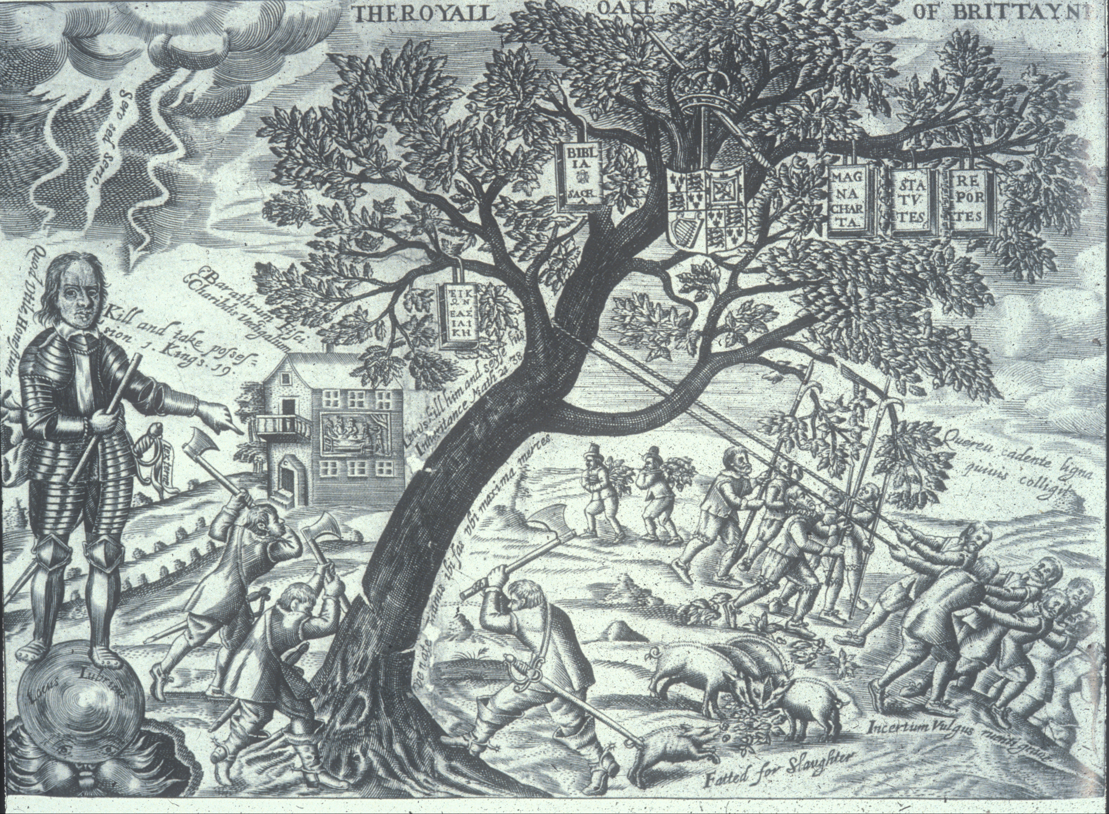

Slide 7
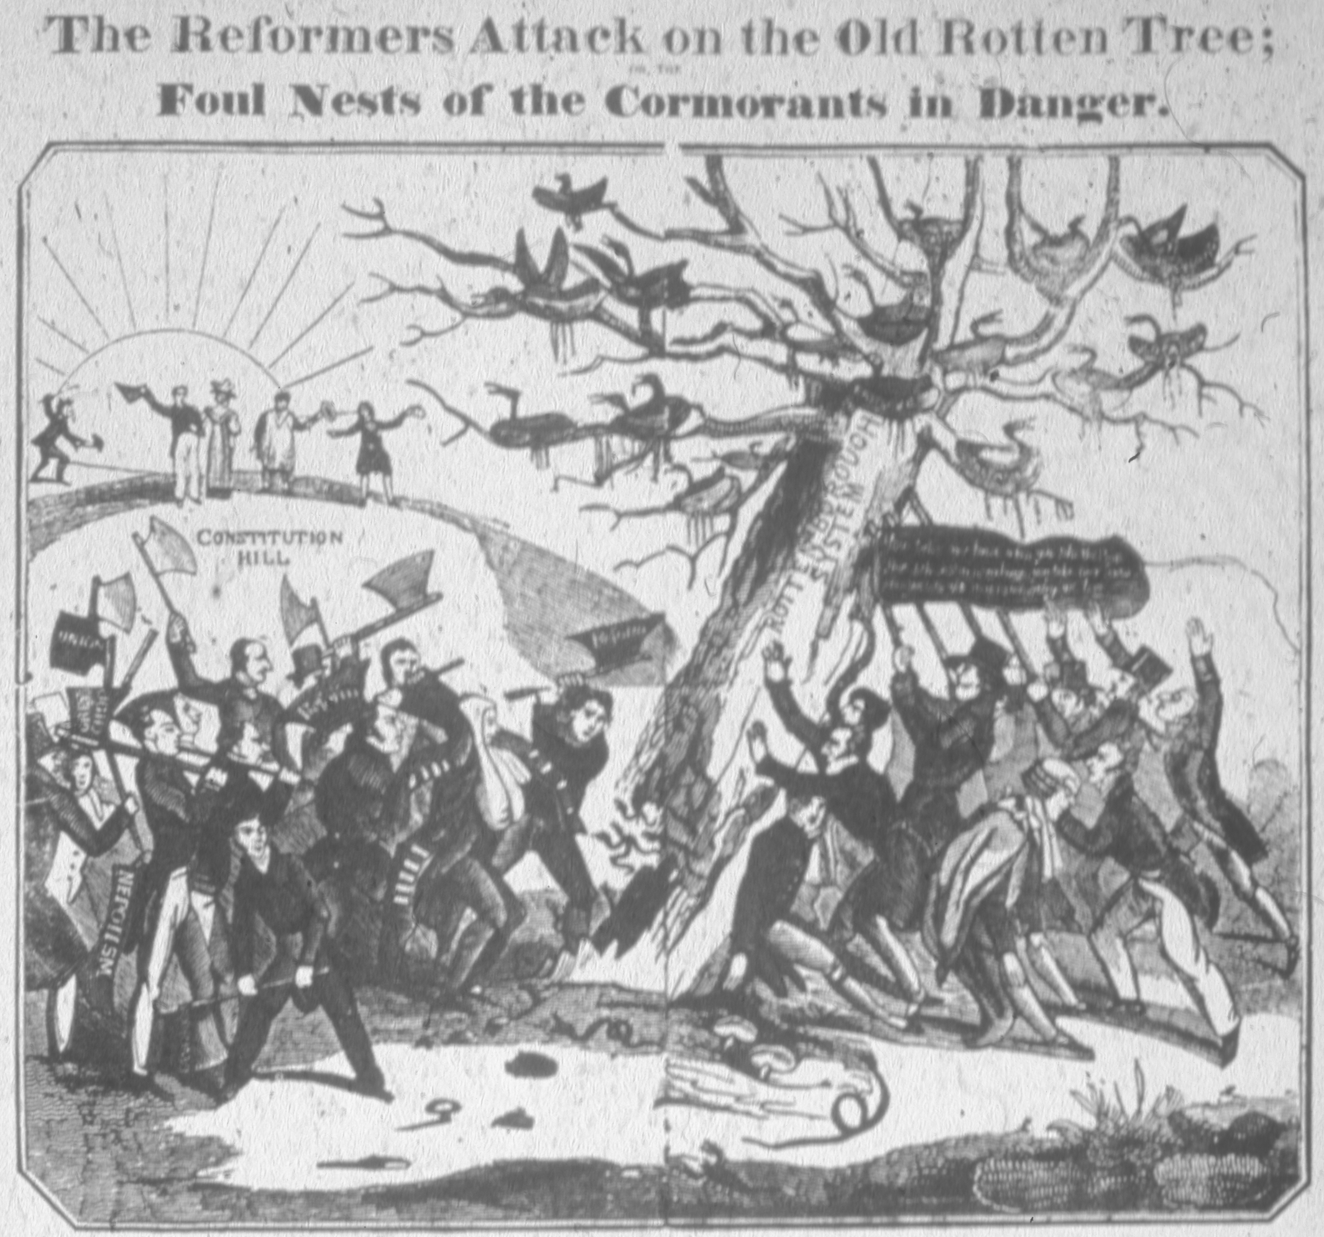
Notes:
1831

Slide 8
The Restoration
Reaction against the revolution led to
Intolerant religious settlement, including the Corporation Act (1661) and the Test Acts (1673 and 1678), which restricted office-holding to those who subscribed to the faith of the Church of England. These civil disabilities were not repealed until 1828.

Slide 9
The Second Revolution, 1688-9
Causes:
Fear of popery (Catholicism as threat to true religion, liberty and property [monastic lands])
Fear of arbitrary power – unlimited monarchical power unaccountable to the law
The disruption of the power of voluntary office-holders by governmental intrusion (moves to pack Parliament in 1668)
European war dictating William of Orange’s need for English resources to fight France

Slide 10
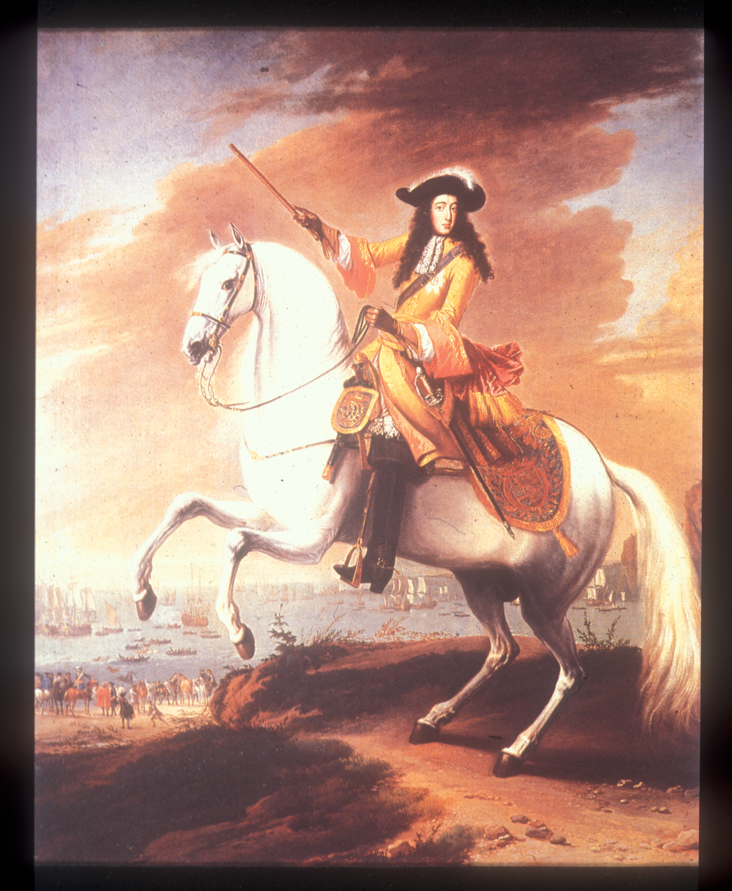

Slide 11
Legacies of The ‘Glorious Revolution’
Irish Catholics suppressed and dispossessed
Scotland emerging with a different (presbyterian) church and culture, but Parliamentary union in 1707
Religious toleration but also hostility to Dissenters and anti-popery
‘Liberty and property’
A Protestant monarch and succession
A ‘balanced constitution’: parliament and king, bounded by law and govern in tandem

Slide 12
Legacies of The ‘Glorious Revolution’
A free press – end of pre-publication censorship in 1696
The emergence of two-party politics (Whigs and Tories)
An outward-looking foreign policy, focused on the defeat of France on the continent and round the world
A financial revolution necessary to fund such wars
A Jacobite movement intent on regaining the throne for the Stuarts
A conspiratorial mindset

Slide 13
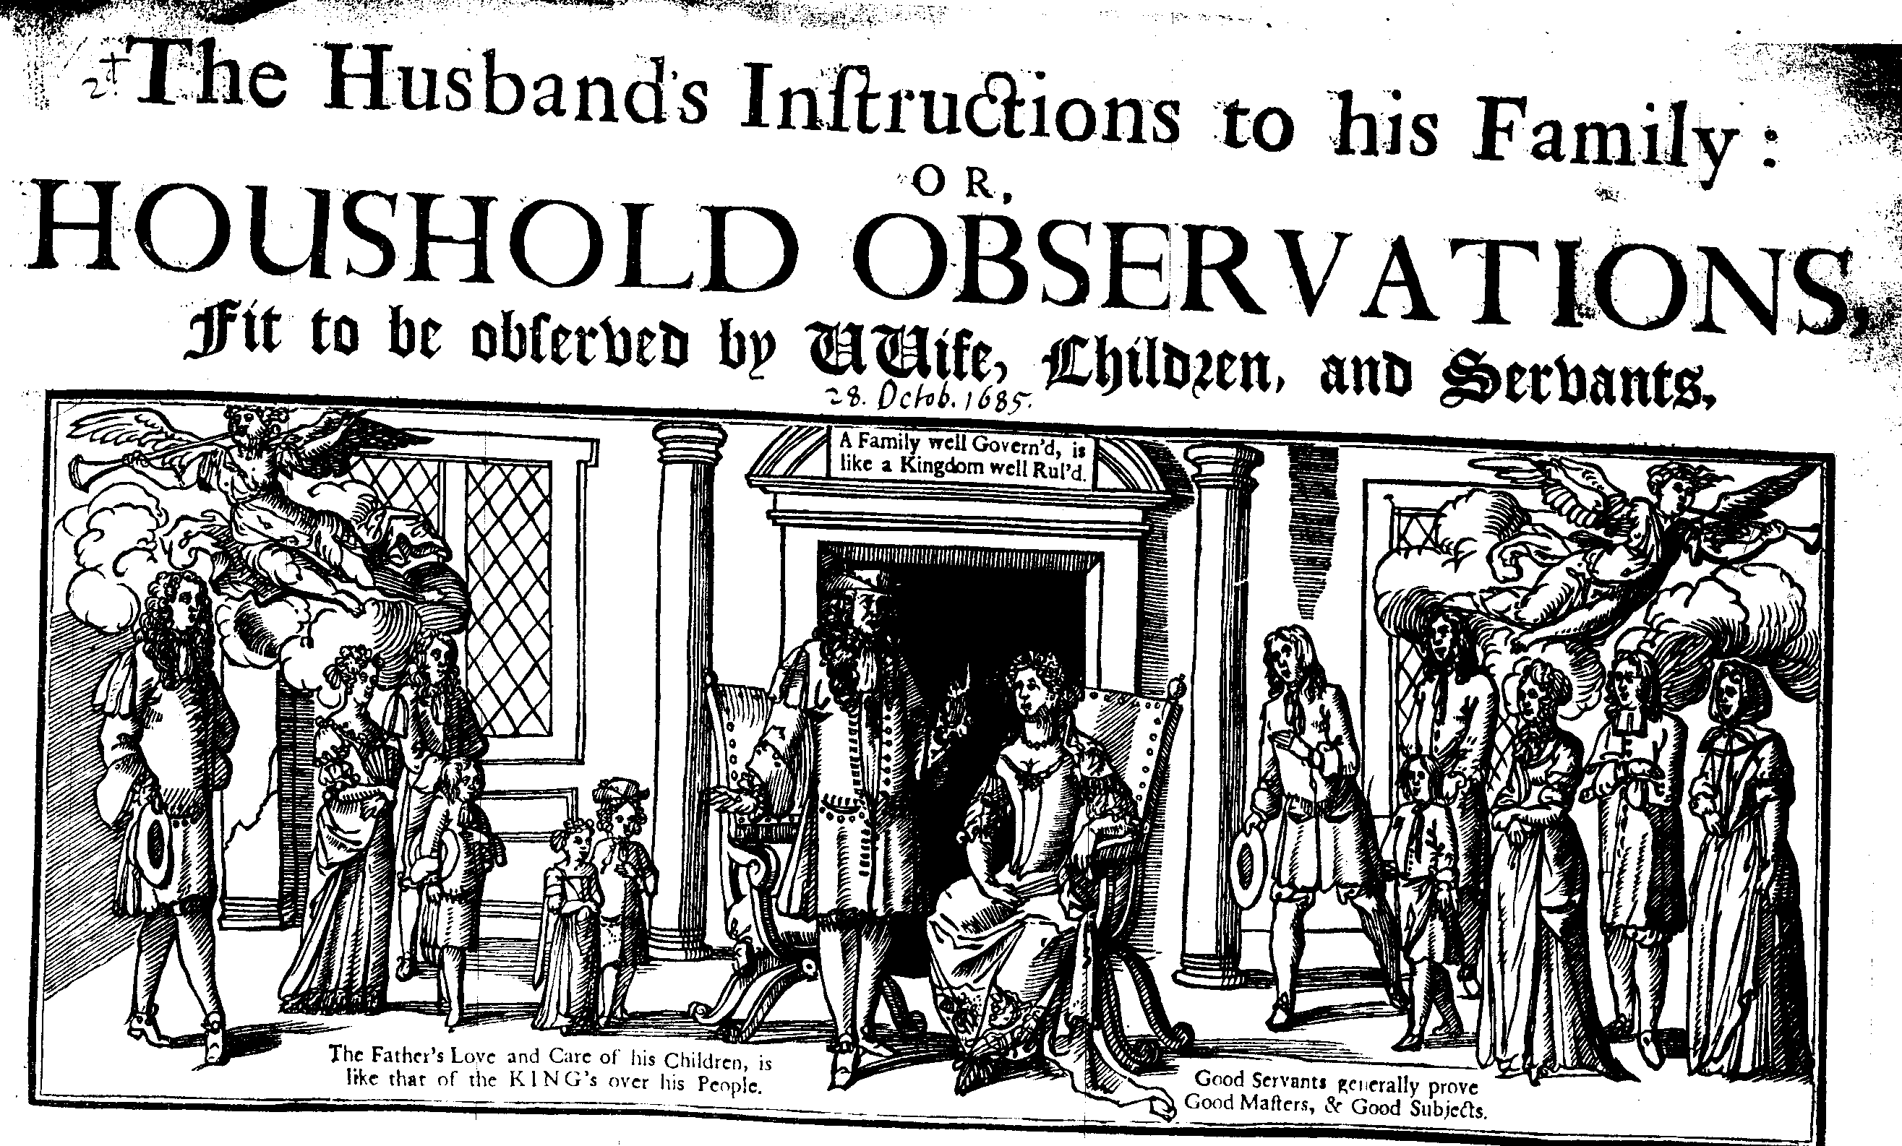
The challenge to patriarchal ideology – in the home as well as in the state?

Slide 14
The view back
The ‘Long Eighteenth Century’ as working through many of these problems, often with explicit reference to the seventeenth century past
The construction of British identity was influenced by contested versions of the past – passed on and debated in the press, in histories, in prints, in sermons.

Slide 15
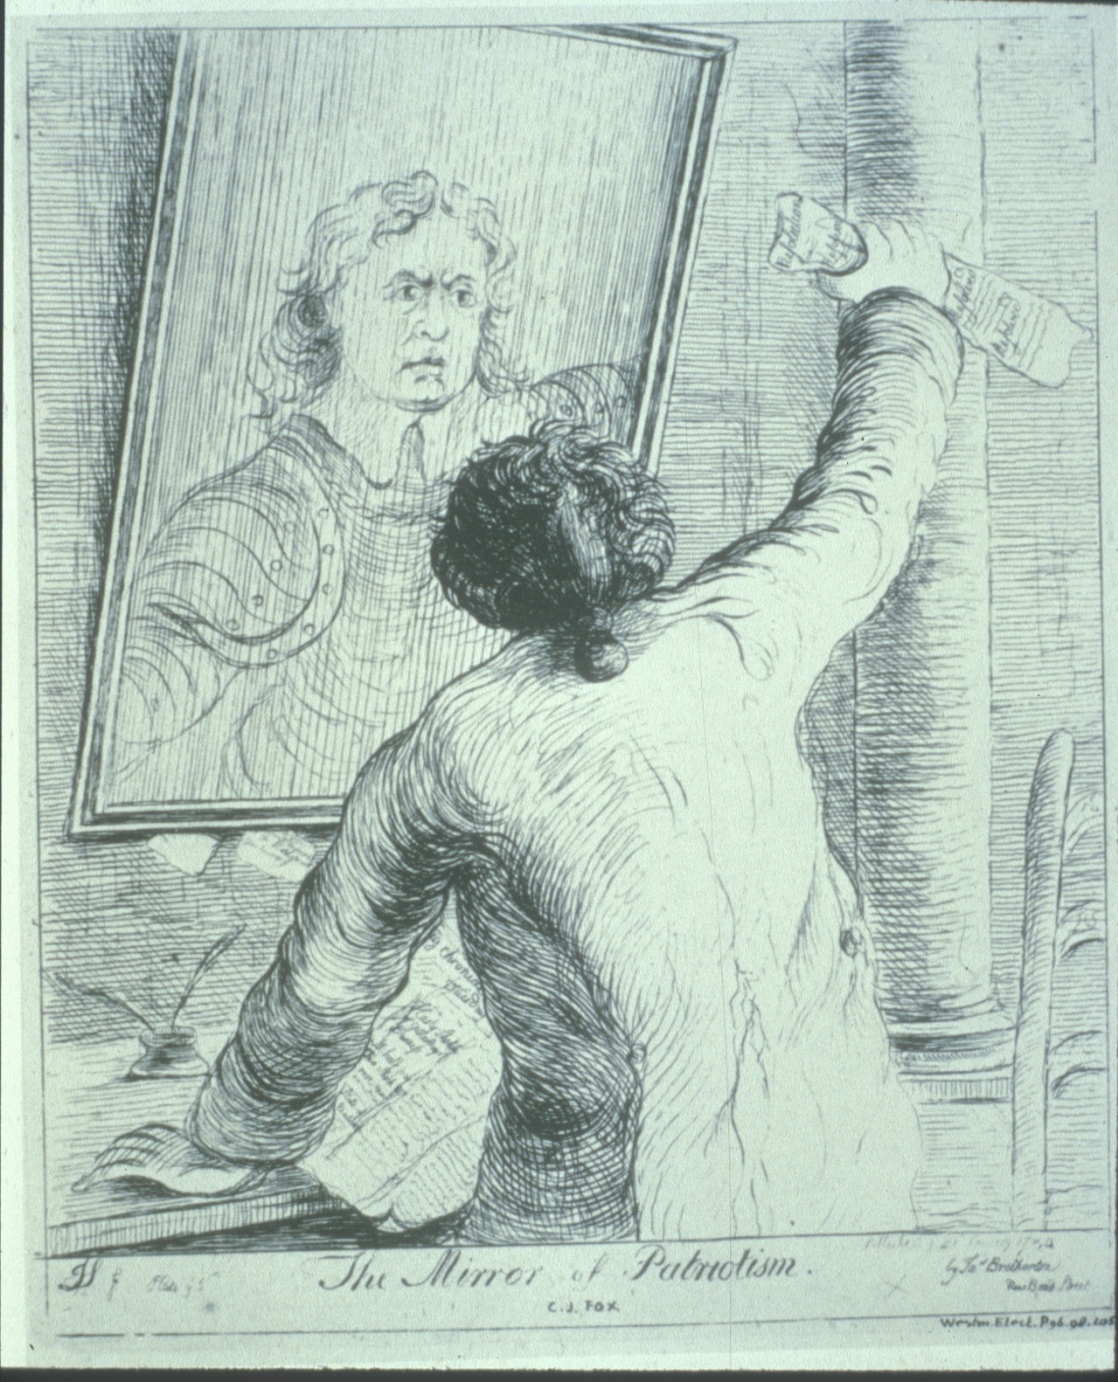
Notes:
James Sayers, The Mirror of Patriotism 1784

Slide 16
The Whig version of British history, or evolution NOT revolution
Burke in 1790s or Macaulay writing in early C19th:
Mid-C17th revolution as stirring seeds of liberty but peaceful revolution of 1688 ushered in parliamentary forms of government, secured Protestantism but also religious liberty, freedom of speech, financial stability and Britain’s emergence as a great power
1830s political reforms as necessary to keep that system (redistribution of seats had been tried during the 1650s).

Slide 17
Challenges to the Whig interpretation of the past
The Seventeenth Century, particularly the 1640s, could be resource for radical ideas:
Popular participation, popular sovereignty not just parliamentary sovereignty; a commonwealth (republican) tradition that was sceptical of royal power and of corruption
The right to resist and overthrow tyranny
The right to free speech and a free press
Radical religious ideas that often combined with notions of natural rights
A concern for the plight of the poor and a desire for reform
4/5 November, 30 January – contested rituals

Slide 18
The spectre of the past
John Wilkes in 1760s – popular agitation, and self-consciously drew on C17th heroes especially Algernon Sidney
American colonies – historians such as B. Bailyn chart the transmission and impact of British ideas in the colonies, with notions of republicanism, of hostility to corruption, of reform, of liberty, (but not anti-popery)

Slide 19
1788 Examples of the ‘radical’ memory of 1688 a century on
Public Advertiser 1 Nov. 1788: a worker named ‘Revolution’ urged the maintenance of the revolution principles which included the right of resistance.
Norfolk Chronicle 8 Nov. 1788 noted that a Norwich club drank to ‘Equal Liberty to all Mankind’
Manchester Mercury, 11 Nov. 1788 some drank to the toast ‘May every despotick government experience a Revolution’.
Revolution Society – propagandised a radical version of 1688: it held 41 toasts on 4 Nov. to C17th heroes such as Hampden, Milton, Lord Russell, Algernon Sidney and John Locke.

Slide 20
The struggle over the ‘revolution’ in the 1790s
The French revolution made such ideas seem very dangerous, leading to
Either the re-emphasis of the loyalist interpretation that stressed achievements within a monarchical framework [Association for Preserving Liberty and Property against Republicans and Levellers – formed 1792] or
A radical critique that sought to recover elements of past struggles or to mobilise popular discontent.
1790s as very important decade in the development of Britishness
Not surprising: identity is often negatively constructed (we are what we are not)

Slide 21
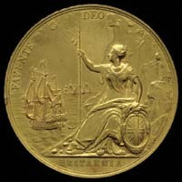
Britannia
Used since Roman times but became very popular as an image during the reign of Charles II, who used his mistress, Frances Stewart Duchess of Richmond as the model in 1667 (after war with the Dutch, from which England won New York) for coinage that established the idealised form of the image.
Notes:
Not previously used on coinage for 13 centuries

Slide 22
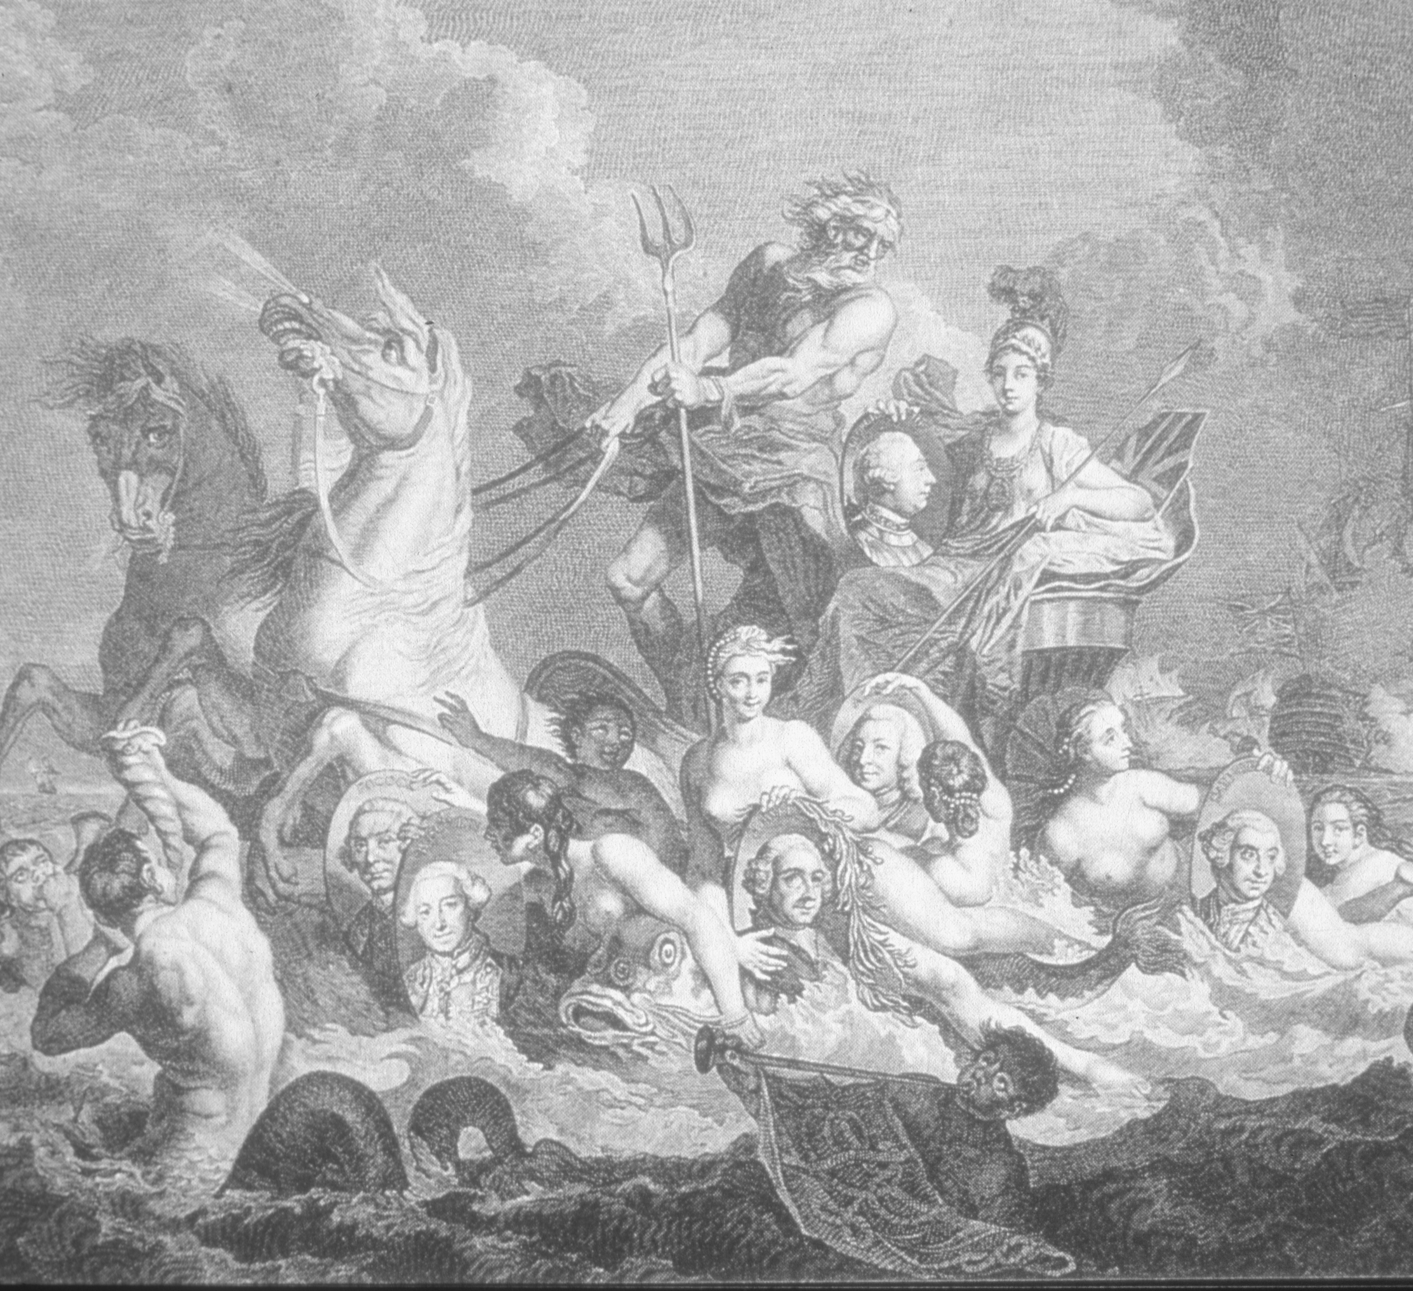
Notes:
Hayman triumph of Britannia 1765 – just after 7 yrs war

Slide 23
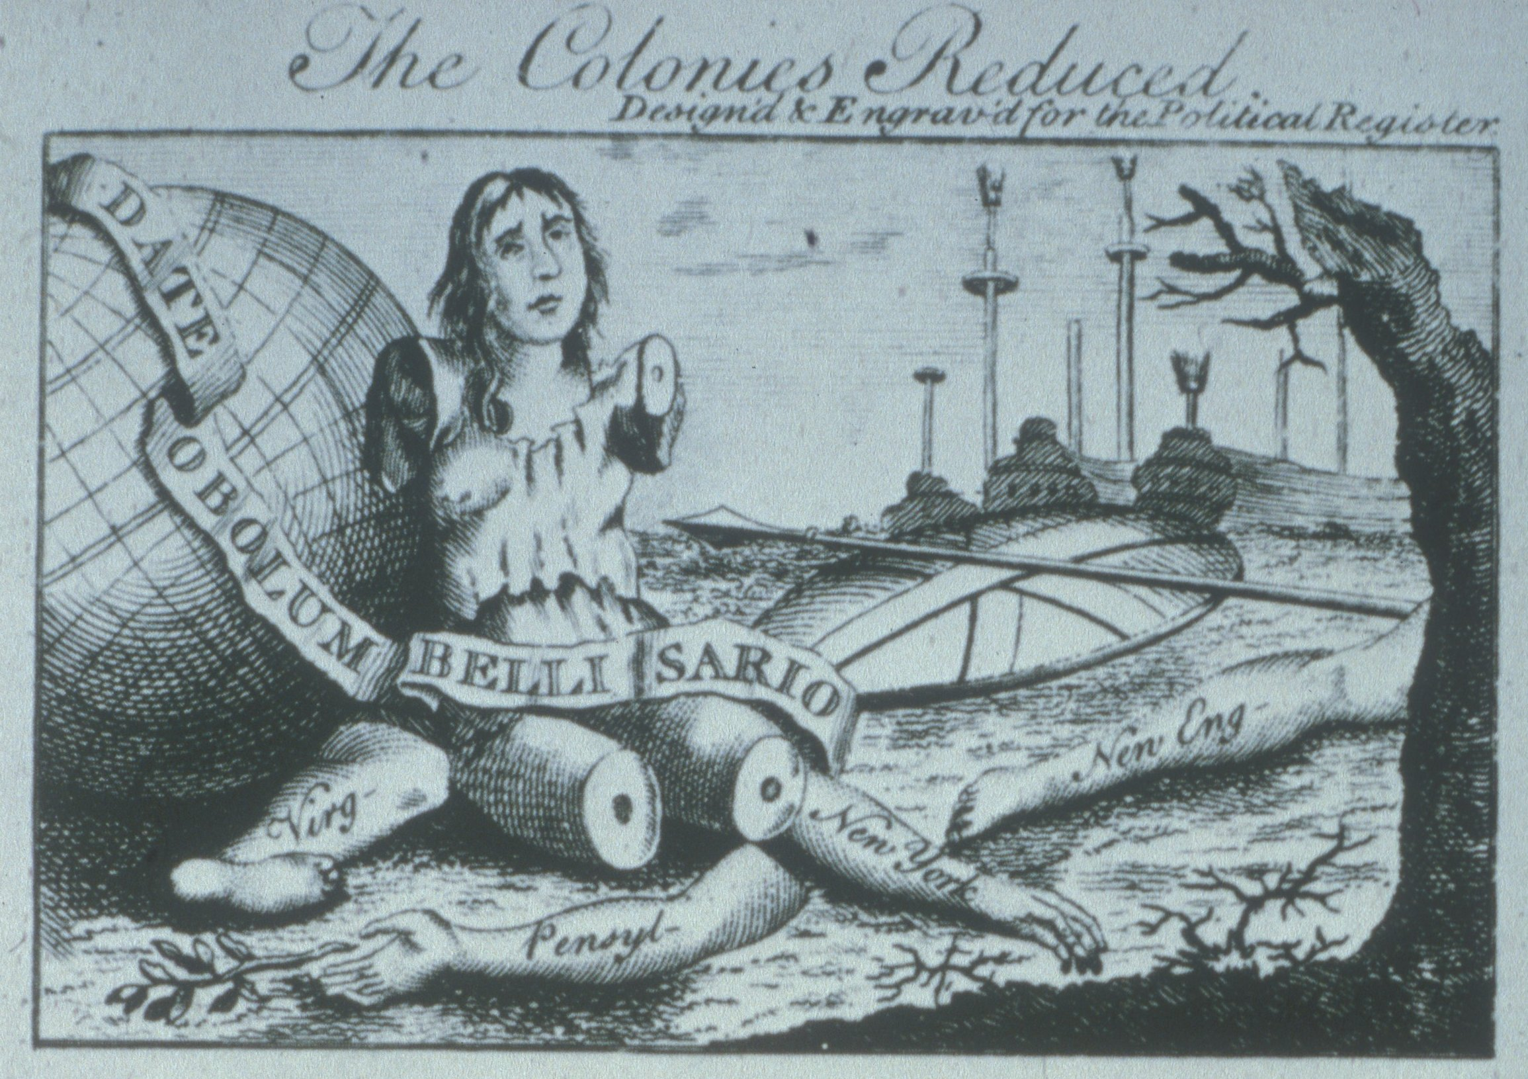
Notes:
1768

Slide 24
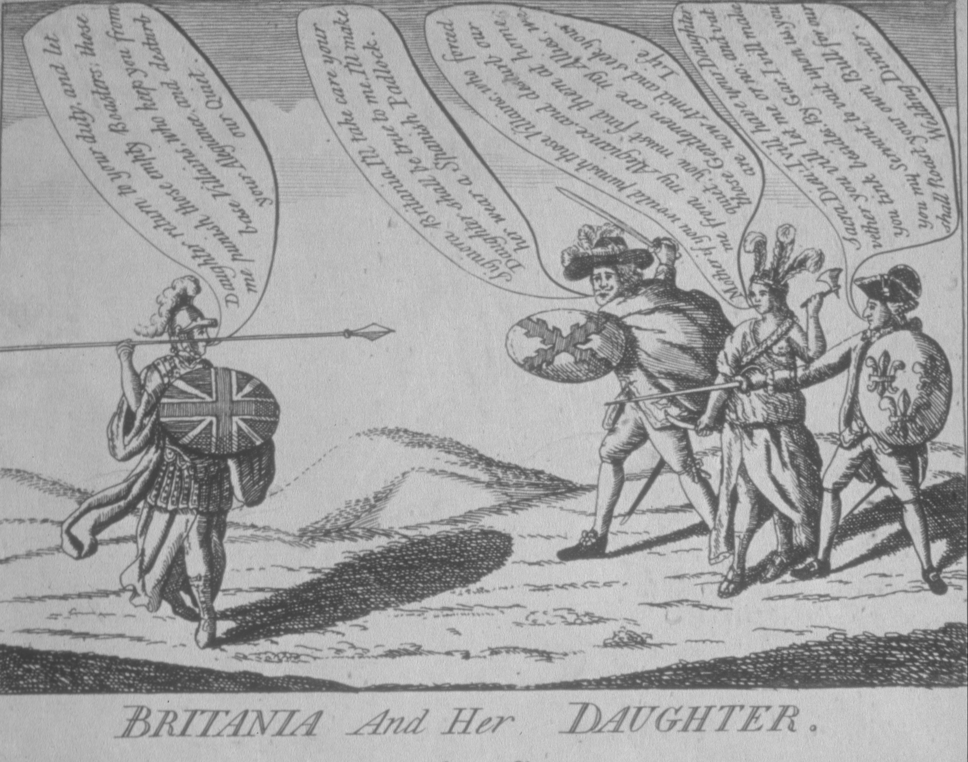
Notes:
1780 re America and two Frenchmen

