Slide 1
Print culture

Slide 2
Why is print important?
Role in fostering national identity
Role in undermining morality and piety
Role in popular politics and reform movements
Vehicle for ‘enlightenment’ ideas
As a commodity
Reading practices
Current debates about censorship and regulation?

Slide 3
Public opinion
Joseph Danvers MP for Totnes 1738: ‘I believe the people of Great Britain are governed by a power that was never heard of as a supreme authority in any age or country before... it is the government of the press.’
Habermas and the public sphere: press was vehicle by which the private reason of the bourgeois classes were made public.
By encouraging public intervention in politics the press acted to undermine traditional structures and forms of political life. As politics became more open it became more influenced by middle class.

Slide 4
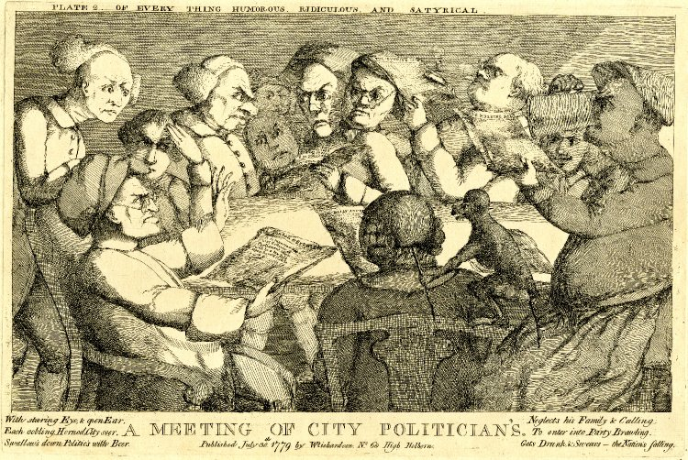
1779: A meeting of the politicians

Slide 5
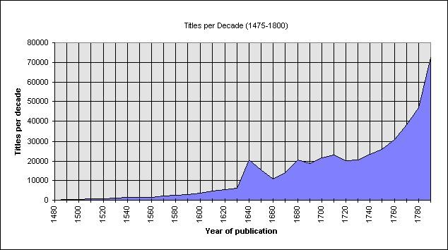
Output
(source: ESTC)

Slide 6
The end of censorship?
Pre-publication censorship lapsed 1695
But the government still monitored the press
1712 Stamp Act: a tax on paper, on advertisements, and on the size and pages of newspapers and pamphlets
Libel prosecutions [1792 libel act gave juries competence]
Seditious libel—more serious [Paine, 1792; and for selling Paine’s work]
General warrants [Wilkes]. 1763 John Wilkes was prosecuted for libel, for writing an article in his newspaper the North Briton that was fiercely critical of George III’s minister Lord Bute.

Slide 7
An unfree press?
A ban on reporting of parliamentary news existed until 1771 (though regularly printed 1731 onwards, sometimes in allegorical form; and earlier division lists)
1790s: increase in stamp duties 1789 and 1797; 1798 requirement for names and addresses of publishers on prints; 1799 registry of printing presses;
1792 proclamation vs tumultuous meetings and seditious writings; 1795 Treasonable Practices Act
1819 in wake of Peterloo Blasphemous and Seditious Libels Act [Richard Carlile got 6 yrs for republishing Paine in 1819; another 2 yrs for seditious libel in 1831-2]
70 prosecutions 1808-1821, 34 resulting in convictions; 36 prosecutions 1821-34, resulting in 27 convictions

Slide 8
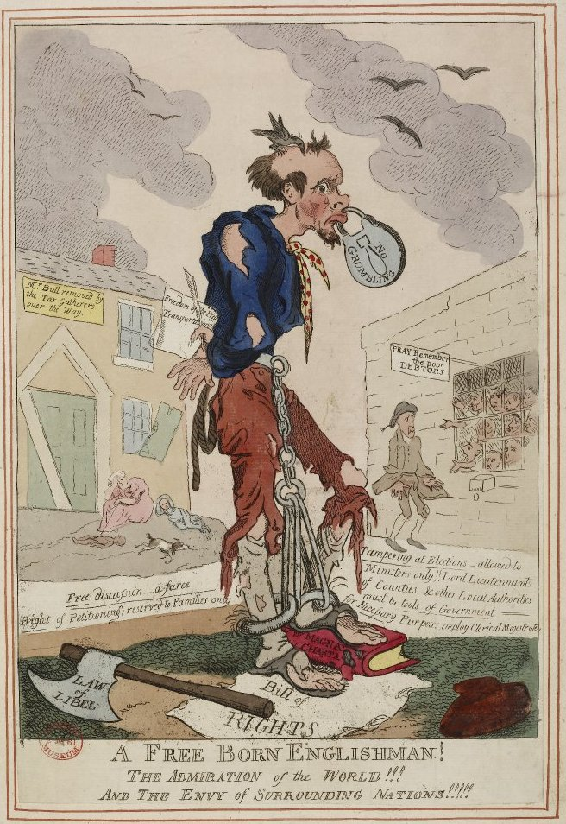
1795

Slide 9
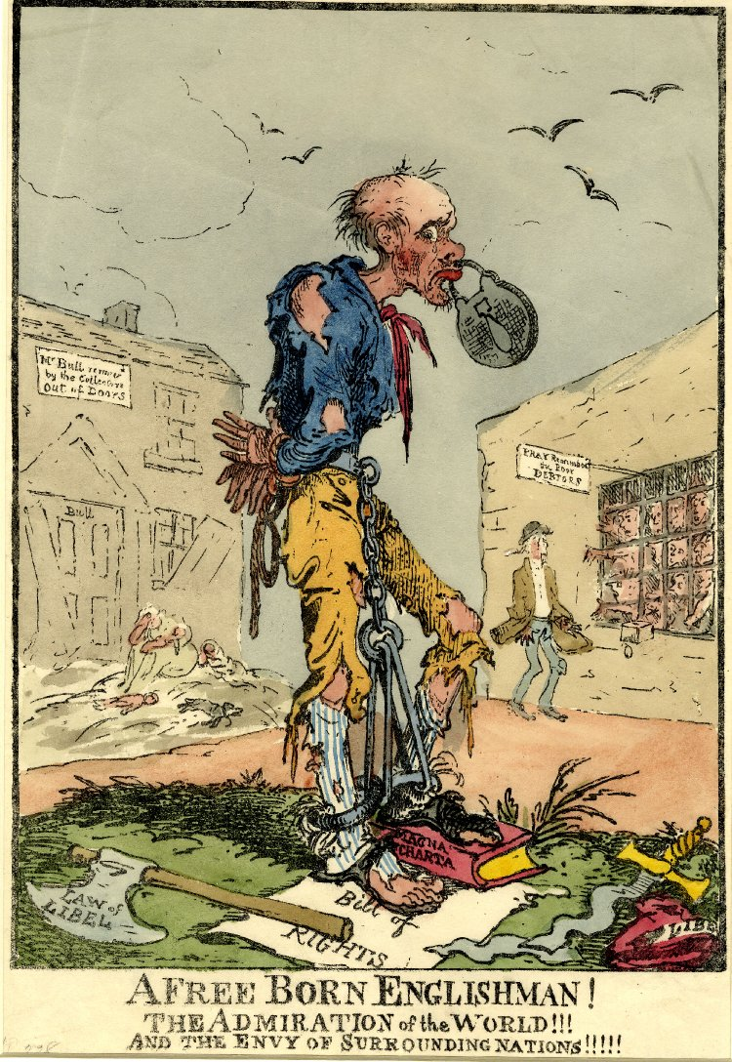
1819

Slide 10
Getting out the Government’s message
Government sponsored propaganda [Robert Harley relied on Defoe and Swift to write influential pieces
1742 enquiry found Walpole spent over £50,000 on propaganda.
London Journal was taken over in 1720s by govt and its publication increased from 650 to 3700 by 1731.
Also subsidy of the Daily Courant and Daily Gazetteer (in 1741 almost 11,000 copies of this sent for distribution per week ]

Slide 11
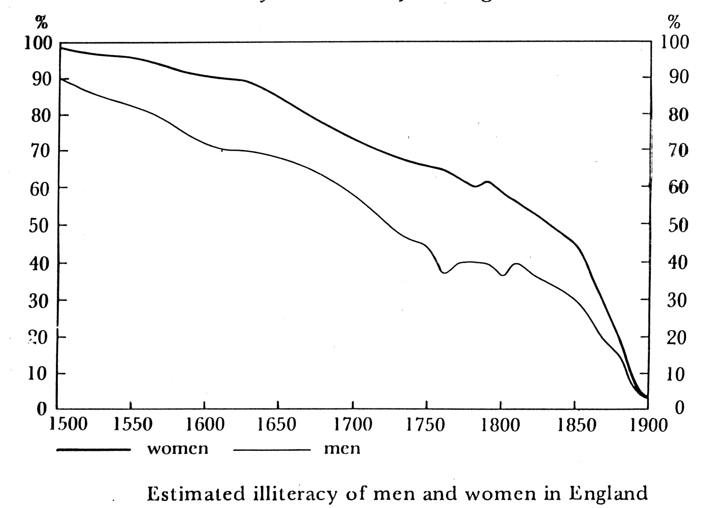
Who was able to read?
Literacy: In England literacy rates rose from about 30% in 1640 to about 60% by mid C18th, with female literacy at about 35-40%. In Scotland in 1750s it was about 65%. In France in 1680s about 30% of men and 14% of women could sign their names (caveat)

Slide 12
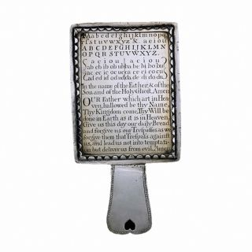
Literacy: Early Eighteenth Century Horn Book

Slide 13
How did people access print?
Postal system
Libraries.
Clubs and societies.
Booksellers

Slide 14
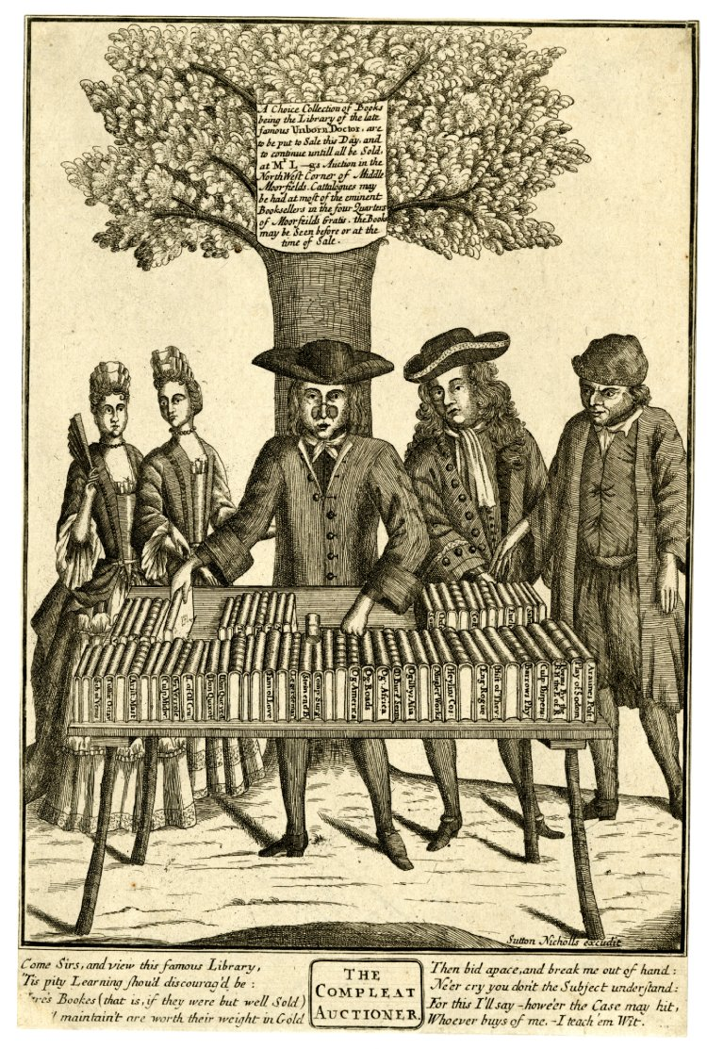
The Compleat Auctioneer

Slide 15
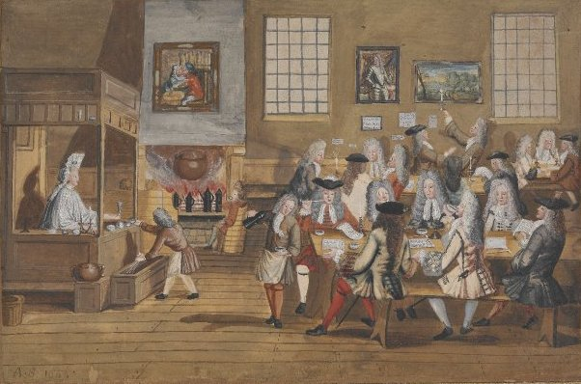
Coffee houses. In 1739 there were c. 551 coffee houses, 207 inns and 447 taverns in London.

Slide 16
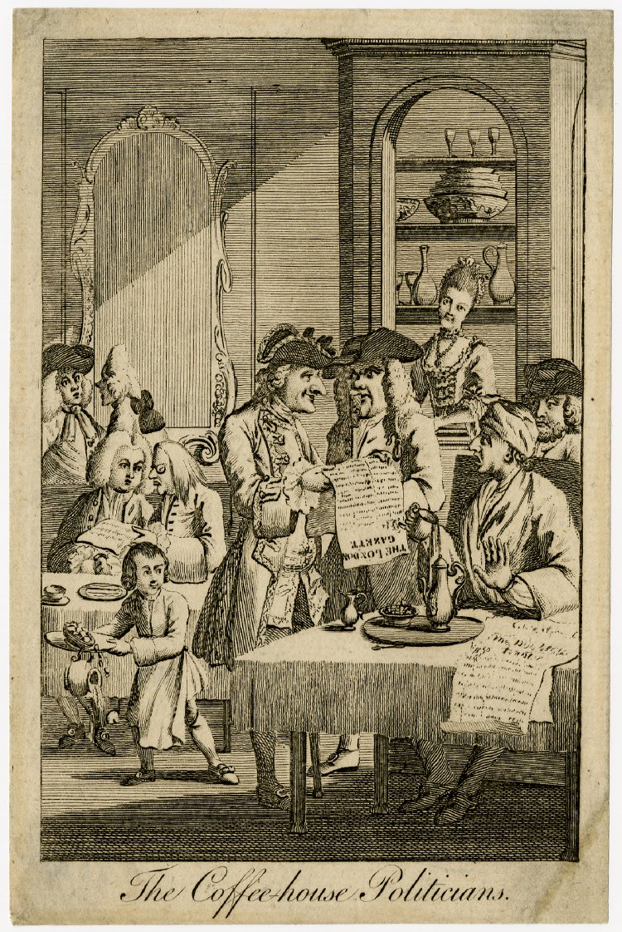
1730s coffee house politicians

Slide 17
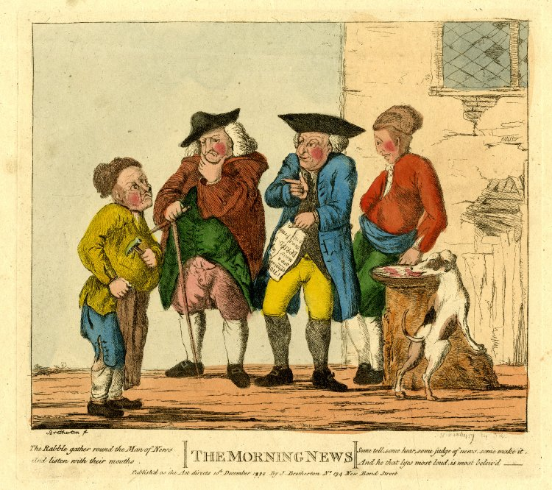
Multiple readers. In 1730s it was estimated that The Craftsman had 40 readers per issue, giving it a total readership of c.1/2m

Slide 18
Reading practices
Extensive/intensive reading [1773, Dr. Johnson ‘No Sir, do you read books through?’ ]
Letters to editors – evidence of interaction; and looking for moral guidance [Athenian Mercury 1690s]
Advertisements – commercial but also entertaining
Different levels of engagement with different kinds of texts—the Bible versus a newspaper

Slide 19
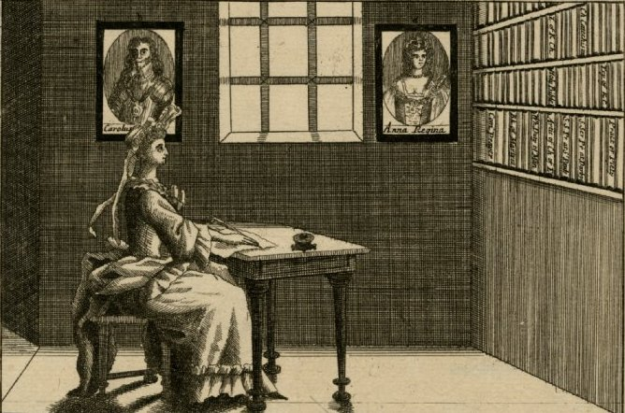
Single readers and notions of the interior self, also encouraged by reading novels
By end of C18th some 85-90 new novels a year were published in England.

Slide 20
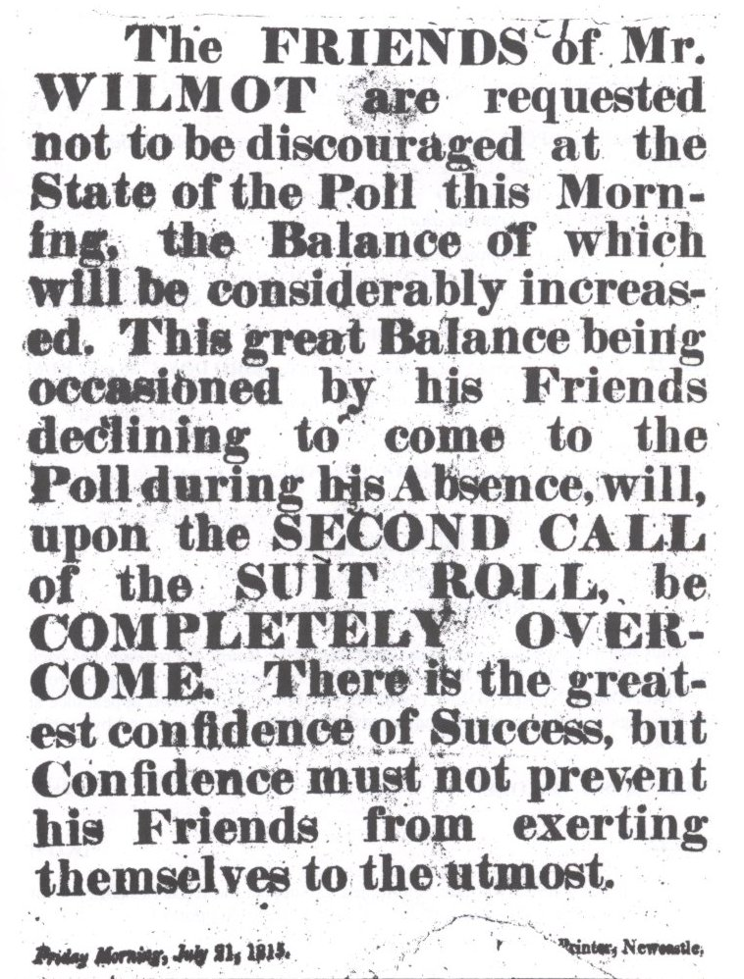
Genres
Must remember the continuing importance of religious works
Popular and cheap print: ballads, almanacs, handbills

Slide 21
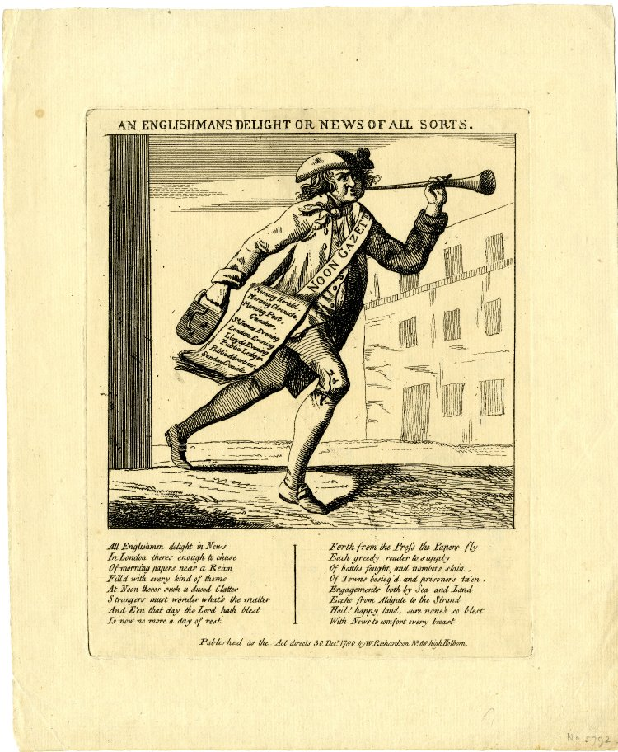
1780 Englishman’s delight in news

Slide 22
Newspapers
During a lapse of censorship 1679-82 papers had been twice weekly; then after 1695 there was a rapid spread of newspaper press: in 1695 tri-weeklies appeared; 1696 first evening newspaper; first daily paper in 1702; first Sunday-only appeared 1779.
France had no daily newspaper until last quarter of C18th; London had one in 1702 and had half a dozen by 1730s.

Slide 23
Newspaper Numbers
Overall consumption: c.2.5m in 1713; 9.4m in 1760; 12.6m by 1775; 16m by 1801.
Print-runs:
1712 Stamp Act returns show best-selling paper (Post Man) sold 3812 copies; in 1720s London Journal had 10,000 run; this type of figure was not exceeded before early C19th.

Slide 24
Provincial newspapers
earliest provincial paper was in Norwich in 1701; In mid 1720s there were 24 provincial ones, 41 by 1740s By 1780 there were 50 provincial newspapers. 9 in Scotland. By 1800 Scotland had 13 papers and twice as many again by 1820. By 1820 GB had over 300 papers in all.

Slide 25
Provincial newspapers
Most of the provincial papers padded out local news with material from London ones. This helped create national concept: easier to imagine the country.
Provincial papers had circulations of hundreds. Hampshire Chronicle 1781-3 had run of 1050-1100.
Other types of periodicals e.g Tatler (1709-11) and Spectator (1711-12).

Slide 26
Graphic satire: poking fun at the powerful
Social, moral, religious and political satire very popular from mid-century.
Hogarth’s depiction of Wilkes sold 40,000 copies in 4 weeks. a whole issue of the North Briton devoted to attacking Hogarth.

Slide 27
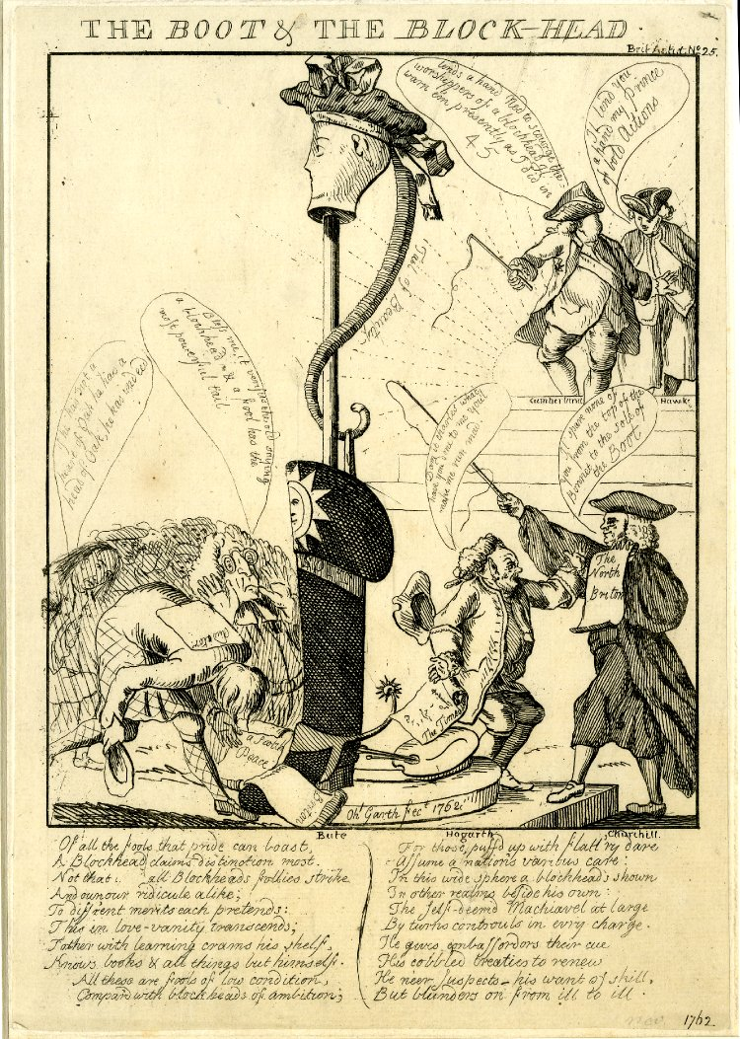
Boot and the Blockhead [Bute and Hogarth]

Slide 28
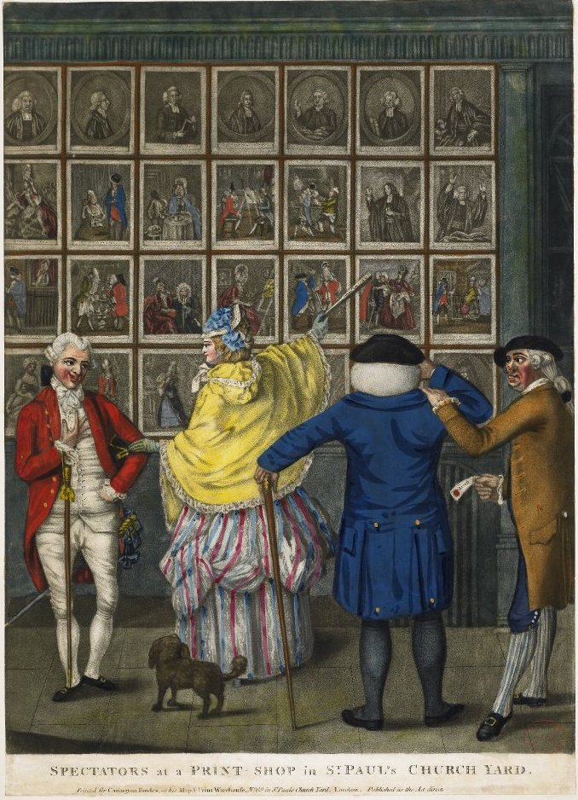
1774 Spectators at a print shop

Slide 29
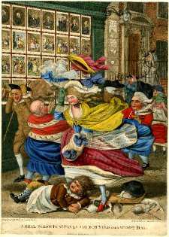
1783 print shop

Slide 30
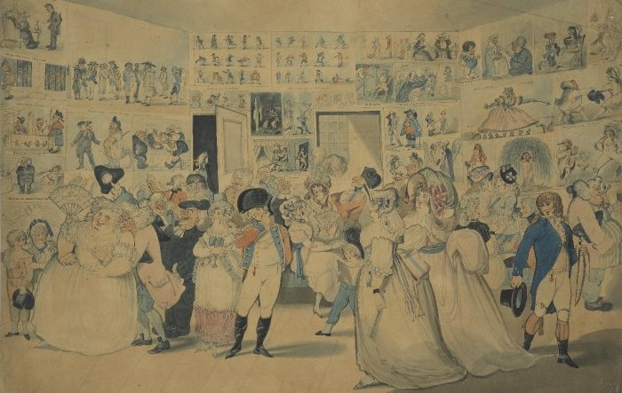
1794 exhibition of caricatures

Slide 31
The powerful catch on
From about 1782 Pitt was using them vs his opponents, attempts to discredit the patriot credentials of Fox
Impolite? The Duchess canvassing for her favourite member (1784); the Poll (1784)

Slide 32
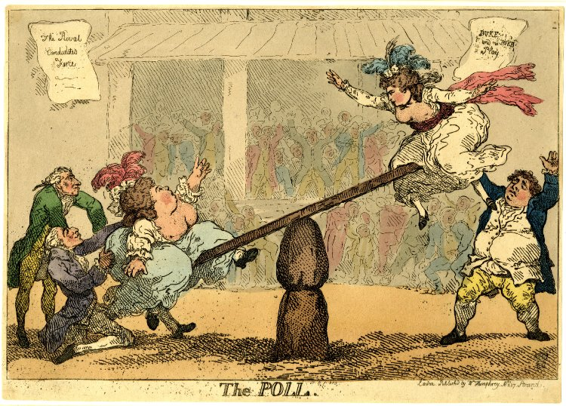

Slide 33
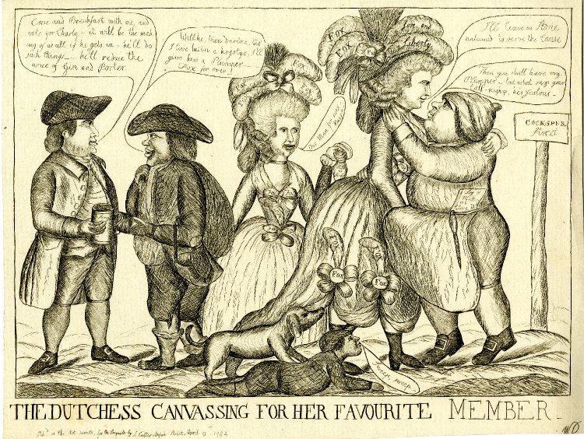

Slide 34
By 1830s the number of single prints fell - replaced by comic journal with text interspersed with cartoons.
Why? sexual and satirical humour found less favour – shift of manners and morals. Combination of text and picture in the new cheap press productions meant less demand.

