Slide 1

History 172
Modern France

Slide 2
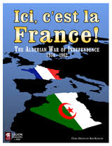
History 172 Modern France
Decolonisation
and
The Algerian War
(1954-1962)

Slide 3
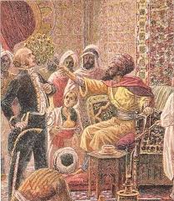
Algeria – not just a colony
Under Ottoman rule for more than 300 years
Conquered by Charles X
1830
Response to insult to French ambassador when he was whisked with a fly-swatter by the Dey
Did not save Charles X from revolution.

Slide 4
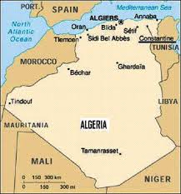
Algeria

Slide 5
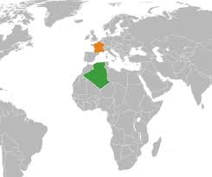
Algeria
Nearly four times larger than France

Slide 6
Algeria
Population in 1830s
Approx 3 million, mostly Muslims
Reduced by nearly 1 million in first 30 years of war
Mass expropriations, torture, mass killings
Military/private companies prepare the colony for European exploitation
Factories and farms, with cheap local labour

Slide 7
Tocqueville’s view
I think that all the means available to wreck tribes must be used…
I personally believe that the laws of war enable us to ravage the country and that we must do so by destroying the crops at harvest time, by making fast forays also known as raids the aim of which is to get hold of men or flocks.
Travail sur l’Algérie (1841)

Slide 8
Rule
Civil administration (dominated by colons)
Mixed areas (colon representative, French governor)
Indigenous communes under the régime du sabre (rule of the sword)

Slide 9
Colons
From Italy, Spain and France
French criminals (prisons)
Colons’ brutality criticized in France
Napoleon III: wanted to check colons’ dominance over Muslims, restricting the colons to coastal areas

Slide 10
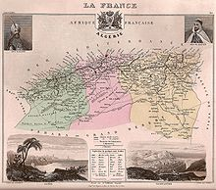
Coastal areas: Oran, Algiers, Constantine

Slide 11
World War II
Under Vichy until 1943, when the Allies arrived
Colons supported Pétain
Muslims saw in Allied arrival hopes for self-determination (Atlantic Charter of 1941 had called for self-determination – Roosevelt pushed for this).
Muslim delegates approach Free France with political demands. Response from officials:
‘I don’t care about reforms. I want soldiers first’.

Slide 12
Inequality persists after WWII
Average farm holdings
European 123.7 hectares
Muslim 11.6 hectares
Annual earnings from farms
European 2,800 pounds
Muslim 100 pounds

Slide 13
Inequality
Annual earnings (1955)
European 450,000 francs
Muslim 16,000 francs
Some political gains under Blum (1930s)
25K (of 6 million) Muslims receive citizenship
Jews receive citizenship but not Muslims in 1870 (the Crémieux decree)

Slide 14
Inequality
Literacy rates after WWII
Only 15% literate
1 in 5 boys can read French
1 in 16 girls

Slide 15
Sétif, 1945
One year anniversary of France’s Liberation
Anti-colonial demonstrators clashed with police… shots fired, both sides kill
Subsequent attack on colons in the countryside by Muslims: 103 killed
Reprisals: massacres, arrests, colons vigilante violence, air-bombings. Deaths: 10-15K to 45K

Slide 16
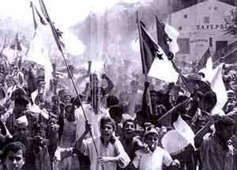
Sétif 1945

Slide 17
Post Sétif (1945-1954)
Initial calm after Sétif (leaders arrested)
OS (Opération spéciale)
Militant anti-colonialism
Ben Bella, leading figure
Brother died of wounds in WWI, fighting for France
He himself fought for France in WWII
Fought for De Gaulle, received medal
Fought attempts to seize his father’s land, shot someone
Went underground
CRUA – Comité révolutionnaire d’unité et d’action
Founded on day France is defeated at Dien Bien Phu
Revolutionary movement forged among Arab/Kabyle groups (both Muslim, traditionally hostile to each other)
‘Arm, train, prepare!’

Slide 18
1954: Founding of FLN Front de libération nationale
Grew out of prior factions and splits
Largely secular… opposed to political solutions (they had failed up until then to change the situation)
Rival liberation group: MNA (Mouvement national Algérien)
Civil war, in Algeria and France: 4000 killed in metropole

Slide 19
All Saint’s Day, 1954
Countrywide attacks on police, military and communications
Failure (started too soon in one area, which sent the alarm in advance of attacks in other areas)

Slide 20
Egypt
Nasser supports FLN, allows them to use Cairo for planning
Suez Crisis: France, along with Britain, seeks to undermine Nasser and assert control of the Suez
US and USSR pressure Europeans to leave
Nasser stands… continues support of FLN

Slide 21
Harkis
Algerians who sided with France. Why?
Already advantaged?
Tired of civil strife among Algerian resistance groups – hoped France could restore order
Harkis would be mercilessly targeted by FLN
Even today, Algerian hatred over the Harkis is a social and political hot issue
Despite efforts by Chirac (2001) to honour this group for fighting with the French, this refugee group in France is outcast by both the French and Algerians (they are forbidden entry to Algeria and do not receive the same level of benefits as French soldiers)…

Slide 22
Targets and Factional Strife
Colons in the countryside, many of whom move to cities for safety
Bombings and assassinations of colons in Algiers
Meanwhile, Algerian liberation factions operating within France conduct ‘Café Wars’
4K-10K killed or wounded in France in targeted assassination attempts
Jacques Massu – Brigadier General, WWII hero
Torture, coercion in the Battle of Algiers (1957)

Slide 23
1957
Massu attacks the Casbah neighbourhood of Algiers
Employs Nazi torture techniques
Electrocution of feet, throat and genitals
Won the battle of the Casbah but lost the war: repression breeds more resistance
Armed allies in war against ‘terrorism’ turn against France

Slide 24
Irony: relaxed colonial control in other countries
France extends more political freedom to other colonial areas: Madagascar, Morocco, Tunisia, French Caledonia

Slide 25
1958
Rumors of prime minister (Pflimlin) negotiating with rebels (French government had collapsed, yet again…)
Committee of Public Safety (colons) in Algiers mounts violent protest
Gaullist sympathizers in French Army in Algeria (Massu) seize Corsica in a coup… plan to invade Paris to force the installation of De Gaulle
Invasion of Paris cancelled: National Assembly puts De Gaulle into power

Slide 26
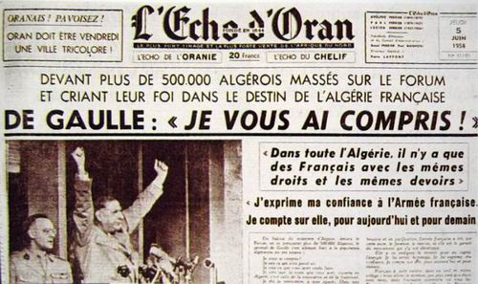
‘I understand you!’ De Gaulle to colons, 1958

Slide 27
Je vous ai compris!
De Gaulle travels to Algiers, confirms colons wishes to maintain colony
Soon, other French colonies are accorded freedom
De Gaulle maintains technological and economic assistance (post-colonial relationships)
Algeria? Not technically a colony, but a Department of France

Slide 28
Colons strike back
OAS – Organisation de l’armée secrète
Unhappy with de-colonisation noises in France
Paramilitary
Organised in Franco’s Spain (fascist)
‘Algeria is French and will remain that way!’
Torture
Assassination attempt on De Gaulle (1962)
Attempts on Jean-Paul Sartre

Slide 29
Savage War (1954-1962)
1.5 million dead
25K French soldiers
10K civilians
12K FLN purges
The rest, mostly Muslims (of about 8.7 million population in 1954)
Revolution
National? Socialist? Islam?
Civil War
Liberation factions
Harkis
Foreign war

Slide 30
Intellectuals weigh in
Sartre
Justified FLN violence
Historical movement
High-minded principles are irrelevant
‘The union of the Algerian people creates disunion of the French people’
‘Europe is springing leaks everywhere. De-colonisation has begun’
Psychology
Identity formation is naturally violent
Cold War

Slide 31
What this means for France?
Undermines universal republicanism
Massacres in Paris
October 1961
Algerian defiance of curfew
February 1962
Charonne

Slide 32
Evian Accords
Recognized Algeria as an independent nation
Colons to have options: French or Algerian nationality

Slide 33
Muslims in France
Universal republicanism disregarded in post-war nationality laws
Many formerly French Algerians lose their French nationality
Immigration from Algeria to France remains high in 1960s… status of Muslims as potential French citizens will remain problematic in coming decades.

Slide 34
Irony: France needs Muslim workers
The hatreds of the Algerian War are not left in Algeria
Many groups come to France for work
Economically useful, culturally segregated
Was French republican universalism inherently hypocritical or did history throw it off course and into hypocrisy?

