Slide 1
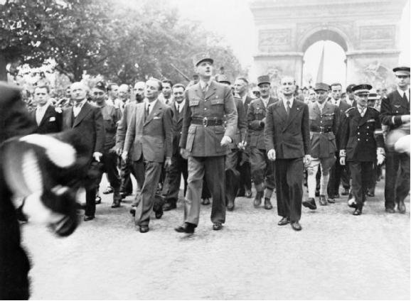
Fourth Republic
The End of the Thirty Years War of the 20th century

Slide 2
Ouradour sur Glane
http://www.youtube.com/watch?v=5TwrwJJ3G6w

Slide 3
Postwar Politics
‘From resistance to revolution’?
  Revolutionary Left tries to seize the occasion to direct postwar politics
  ‘They’re on the train for 1984, thinking it was 1848’
    Quip of British journalist
  Communist Party – apogee of influence
    USSR seen in a positive light (even by the conservative Catholic De Gaulle)
  De Gaulle oversaw Constituent Assembly until January 1946 – dissatisfied with role for executive
  4th Republic founded in October 1946
    Limited executive authority, much like in the 3rd Republic…

Slide 4
Postwar Politics
Vichy authorities and collaborators attacked
  Lower purge rates than in Belgium and Netherlands
  Body counts
    Rumors: 120K
    Reality: probably 10-12K
      Compare this to 15-30K during the Terror
    39K sentenced; 40K stripped of civic rights
    95K sentenced to ‘Civic Death’
    2K sentenced to death, only 700-800 were carried out
  Pétain: death sentence commuted by De Gaulle
  Laval: shot before a firing squad
The political ‘deck’ is cleared.

Slide 5
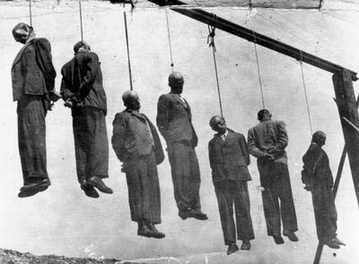
Executions of Collaborators

Slide 6
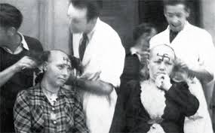
Les tondues
Women suspected of sleeping with Germans

Slide 7
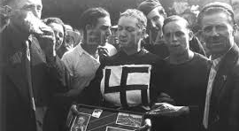
Les tondues

Slide 8
Postwar Politics
De Gaulle founds RPF party: center-right
  Rassemblement du Peuple Français
Out of power, he and his party gain influence over the course of the early Fourth Republic
Ancestor of the RPR and UMP

Slide 9
Fourth Republic, 1946-1958
Unpopular, despite progress
Referendum on Constitution
  1/3 Support it
  1/3 Reject it
  1/3 Don’t vote
  Inauspicious founding!
  Goal of constitution: reconcile parliamentary democracy with ministerial stability – failure:
  24 different governments during 4th Republic

Slide 10
Progress
Progress
  Women get the right to vote
    Résistantes!!!
    Communist Party supports this (as does USSR)
    Pushed by women delegates of the government-in-exile (run by De Gaulle in Algiers)
  Side note: notice the logic of citizenship rights
      One gets them for giving and sacrificing, not for being human

Slide 11
Economic Progress
After initial hiccups (1945-1948), dramatic economic growth
Trentes glorieuses (late 1940s to the 1974 oil crisis)
Higher economic growth than in UK
  Index of growth
  France 1938 = 57 1967 = 155
  UK 1938 = 67 1967 = 133
  Why different growth rates?
  Empire cost a lot; UK taxes were lower, so not as much public spending on infrastructure; welfare spending was lower than in France – less of a ‘New Deal’ in UK than in France

Slide 12
A mixed economy
State took control of
  largest banks
  Renault auto factories (whose owner was a collaborator)
  Gas, coal, steel and electricity
  Airlines
State planning and cultural subsidies
Notes:
See

Slide 13
Origins of the mixed state?
1930s
  Popular Front
  Christian Democrats
  Catholics (pro-natalist)
Vichy Years
  Technocrats
Post war
  Desire to use state institutions as ballast in otherwise turbulent political waters
  Social security (like NHS, but different)

Slide 14
State institutions to study and manage society
L’ENA -Ecole nationale d’administration
  Sciences Po: not a grande école but a grand établissement: feeder for ENA
L’INSEE - Institut national de la statistique et des études économiques
L’Institut national d’études démographiques
State planning

Slide 15
Culture
Ministry of Culture (André Malraux)
  Created in 1958
De-centralisation of theatre: much funding for performance art (eventually, special unemployment benefits for this group)
State funding for TV, film industry, radio

Slide 16
Different legacies of the social-cultural state
USA/UK
  Neo-liberalism
  Structural readjustments (austerity)
  Privatisation
France
  Such institutions had support from the left and the right, the Popular Front types, conservative Catholics and Vichyites…

Slide 17
International Organisations
United Nations
  Stronger than League of Nations
  International security
  Freedom and self-determination
Security Council
  US, UK, USSR, France, Republic of China (permanent members)
War crimes, Universal Declaration of Human Rights

Slide 18
Cold War
(4th and 5th Republics)
North Atlantic Treaty Organisation, 1949
  Protect Western Europe from USSR
  France’s relationship with Britain and US tense
  Strong pro-USSR sentiment in certain French sectors
  De Gaulle wants freedom to negotiate with Eastern Europe
  France gradually withdraws from NATO (1959-1966), but secretly agrees to return to NATO should East-West hostilities break out

Slide 19
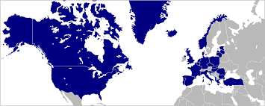
NATO

Slide 20
Post War Colonial Crises
Atlantic Charter (1941) and United Nations Charter (1945)
  Right to self-determination
UN Charter: ‘To develop friendly relations among nations based on respect for the principle of equal rights and self-determination’.
Principle is left vague

Slide 21
Colonial Crisis I – Indochina
French controlled: 1887 to 1954/6
Japanese controlled in WWII, until Aug 1945
WWII: US support Ho Chi Minh against Japanese control
Viet Minh = communists and nationalists
Battle of Dien Bien Phu (1954): France defeated in dramatic pitched battle
France gives up Indochina in 1956

Slide 22
Colonial Crisis II – Algeria
Controlled by France since 1830
Independence movements rise after WWII, despite promises of extending rights
  FLN (Front de libération nationale, 1954)
Pieds noirs (colonists) fight to keep French Algeria
More on Algeria, De Gaulle and the fall of the Fourth Republic in Week 9

Slide 23
Intellectual Currents
1950s and early 1960s
Existentialism and variants (Sartre, Camus)
  Free will, ethics, humanism, despite the world’s absurdity and inability to predict or even control cause-effect relations, permanent anxiety, existence over essence… For Sartre, tragedy resides in systems; for Camus, it resides in people and the inability for language to bind people together (he was proto-post-structuralist..)
Marxism (Historians, Communist Party strong)
  Often looked to USSR, though Sartre was pushed towards a more hardened socialism by the horrors of capitalism and racism in America
  Decolonisation (more in two weeks on this)
  Interested in binaries, class struggle, social oppression and the material-economic bases of inequality

Slide 24
Intellectual Currents
1950s and early 1960s
Structuralism (Claude-Lévy Strauss)
  Seek underlying structures of society
Annales School on history (Fernand Braudel)
  Histoire totale, longue durée, material development

Slide 25
Leading Intellectual/Political paradigms
Marxism (Sartre)
Conservativism (Catholicism, Gaullist, Poujadisme)
Liberalism (Raymond Aron)

