Slide 1
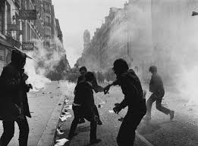
History 172
Modern France
May ’68
and
After

Slide 2
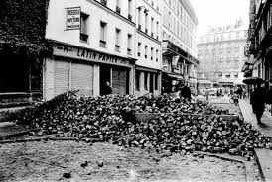
Barricades

Slide 3
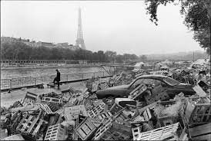

Slide 4
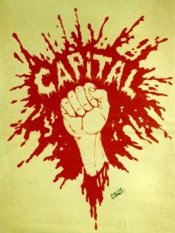

May 68 posters

Slide 5
Political context
De Gaulle – patriarchal, socially conservative
Slight increase in unemployment in 1967
  Strikes, lock-outs
  PCF and CGT, status quo (more about increasing worker benefits than overthrowing capitalism)
  Young workers more agitated
Sino-Soviet Split: Communists fragmented

Slide 6
Decolonization
Showed that republicanism could be challenged
  Potentially equated with authoritarianism masquerading as universal egalitarian morality
Political mobilizations of early 1960s
  Against curfews in metropole and Algerian war
  Far right groups attacked leftwing groups

Slide 7
Social and International Context
Generationalism
  Post WWII baby-boomers
  Consumerism at a new level
  Experiments in selfhood
Anti-Americanism
  Fire bombs at Chase Manhattan Bank and American Express in March 1968
  Daniel Cohn-Bendit (University of Nanterre) arrested for supporting the lycée students thought responsible for the fire bombs
Tier-mondisme
  Release from tutelage
  Che Guevara killed in November 1967-martyr for left

Slide 8
University context
Contraceptives legalized in 1967 (the pill, but required parental authorization)
Dramatic expansion of universities
Male students seek access to women’s residence halls at University of Nanterre
A Nanterre student was implicated and arrested in the bombing of American Express and Chase Manhattan in March 1968.
Protests at Nanterre (combining these two issues) on March 22. Movement called ‘22 mars’…
Dean of Faculty calls in police; closes campus for a month

Slide 9
Shift of agitation to Latin Quarter
Bastion of Dreyfusards and Popular Front
High concentration of youth (universities, colleges) and ideological conflict (right and left)
Protests on 3 May: against closure of Nanterre
  Spontaneous resistance to police
Sparks months of nationwide protests, strikes

Slide 10
Intellectual Context
Critiques of power
  Lacan, Barthes, Foucault (rising star)
  Students read heavily in the Marxist and communist traditions (Gramsci, Maoist literature)
Psychology, structuralism giving way to post-structuralism

Slide 11
Edge of post-structuralism
Existentialism (inherited from 1940s-1950s)
  Individual meaning in freedom
  Absurd universe
  Opposed to all embracing rationality
Structuralism giving way to post-structuralism
  What is structuralism? (pre-1968)
  What is post-structuralism? (post-1968)
    Return of history… essences are fabricated and dichotomies conceal hierarchies. Both have histories
    Structures are contingently made: they can be changed!!!

Slide 12
Spirit of post-structuralism
Play
Essences are not pre-ordained (this notion grows out of existentialism… all we can know is that we exist… what our ‘essences’ are is immaterial and irrelevant for thinking about who we are and how we should act…
Invention, creativeness
Emphasis on individuals but also non-orthodox forms of socialism
  Emphasis on consciousness and action
  From Marx to Gramsci, who was a Marxist but who took ‘culture’ more seriously…

Slide 13
Leftwing leaders emerge in student/teacher movements
Daniel Cohn-Bendit
  Anarchist
Jacques Sauvegeot
  Rebellious, romantic
  Leader of student union (UNEF)
Alain Geismar
  Communist but anti-PCF
  Soon to become Maoist

Slide 14
Politics of 1968
Individualist / anarchist
Cohn-Bendit
Communist, but anti-PCF (anti-Soviet)
  Trotsky (10% electoral support in 2002)
    Proletarian internationalism
      Opposed Lenin’s ‘Communism in One Country’
      Opposed Stalin’s authoritarian bureaucracy
    Working class emancipation and direct democracy
  Maoist
    Grassroots socialism … repudiation of ‘party elites’ who dictated political consciousness. (e.g., Sartre, Foucault, Kristeva)

Slide 15
Spread of strikes, demonstrations throughout May
Spreads to companies throughout France
  Unlike 1936 strikes, the movement hit not only private industry but state institutions as well
Spread to universities throughout France
  Many arrests, provoking more protest
Occupation of universities and factories
  High point is May, but continues in through July
Rabelaisian wit

Slide 16
Play, Rabelais, Creativity
Against paternal, traditional bourgeois culture
‘Culture is participation in the act of creation not the act of consumption’ (François Borella-Socialist Party, PSU)
News of events was conveyed by newspapers, not state-controlled TV (referred to as ‘His Master’s Voice’)
Protests even in small rural towns!
De Gaulle and Pompidou – no plans! Left the country for foreign visits

Slide 17

Sois jeune et tais-toi!

Slide 18
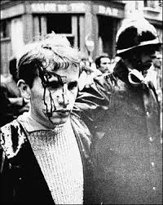
Riots

Slide 19
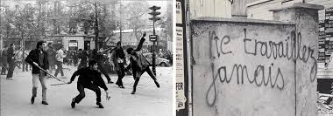
May 1968

Slide 20
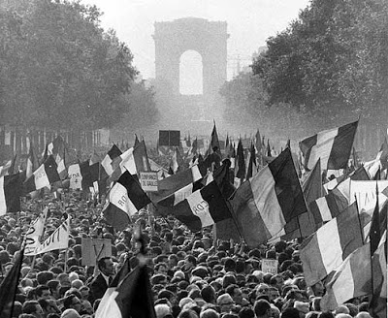
Pro De Gaulle demonstration
May 30, 1968

Slide 21
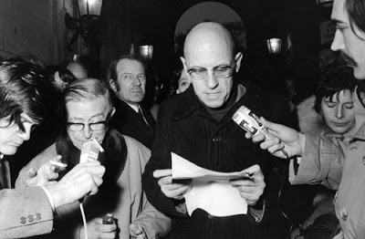
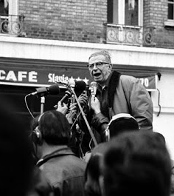
Sartre - Foucault

Slide 22
Reasons for Misrule
Feeling that PCF and WWII Liberation fighters had abandoned fighting spirit
Edgar Morin (sociologist): saw the ‘atrophy’ of a rationalised modern society, with ‘no communication with others’ and ‘alienation in a world of objects and appearances’
Psycho-babble? Some thought so: Raymond Aron (a liberal)

Slide 23
End of May Events
Pompidou (De Gaulle’s prime minister) takes charge in May, chooses to work with protest movements (no plan B)
De Gaulle
  Visits Massu in Germany, where Massu was head of French forces there… Why the visit??
  Returns on May 30
  Massive Gaullist march on the Champs Elysées
  Dissolves the National Assembly

Slide 24
June – energy subsides
Police were ruthless in ending strikes and stopping student protests
  One student protestor drowns
Why did May movements collapse so suddenly?
  General fear
  Lack of political experience of leaders
  Lack of desire of protestors and revolutionaries to seize power
Gaullists win elections at end of June
Nine months later, De Gaulle lost referendum on constitutional changes; steps down

Slide 25
A throwback, an anachronism?
Romantic student revolts – Victor Hugo style
Barricades and social justice – but demands were too broad
Daniel Lindenberg: ‘we were nearer to 1900 than 2000’
Guy Hocquenghem (gay activist): ‘May is closer to the 19th century than to us…’

Slide 26
New paths, legacies…
Sexual liberation
  Though already accepted to a degree by authorities by 1968
  Anti-bourgeois morality

Slide 27
Feminism
1971: Manifesto of the 343 whores (salopes)
  women who confessed to abortions (illegal) in Le Nouvel Observateur
    Including Simone de Beauvoir, Marguerite Duras, Catherine Deneuve, Jeanne Moreau
MLF: Mouvement de Libération des Femmes
  Women’s control over their bodies
  Abortion legalized in 1975

Slide 28
Feminist theory
Simone de Beauvoir
  The Second Sex
    Woman as ‘other’
    Existence precedes essence, which is constructed
Hélène Cixous
  Philosophy as phallocentric
  Against logocentrism
  Women should express themselves from and through the body…
Luce Irigaray
  This Sex Which is Not One
    Women as commodities and bearers of value for men
    Men are the ‘humanist’ actors… women, the items exchanged

Slide 29
Gay Liberation
Vichy laws banning same sex activities (1942) upheld under De Gaulle
Arcadie (1950s-60s)– Homophile movement, sociability
  Dances, educational events
  Urged outward conformity – anti-political
Gays and lesbians disrupt a radio broadcast demanding rights – 10 March 1971

Slide 30
Gay Liberation
Front homosexuel d’action révolutionnaire
  FHAR
    Militant
    Splintered with transsexual movement
Comité d’Urgence Anti-Répression Homosexuelle
  1979: changes in separate laws regarding age of consent and public sex violations.

Slide 31
Gay tolerance – a class issue?
Tolerance among elites
The ambivalent effects of discrete tolerance
  Weak public response to AIDS
Intolerance within middle and lower classes

Slide 32
1970s
Economic crisis: end of the Trentes glorieuses
Unemployment sets in
New directions in dirigisme
  State focuses more narrowly on successful companies
  Return of economic liberalism in West, but different in France, where the state technocracy is stronger
  Enarques… Ecole nationale de l’Administration
    Elites in the state and industry

Slide 33
1968 aims move to the centre
Giscard d’Estaing (President 1974)
  Gaullist… ‘reform’ conservatism
  Reduces majority age from 21 to 18
  Broke up state’s grip on radio and TV
  Total liberalisation of contraceptives and abortion
  Legalised divorce

Slide 34
Decline of Marxism, 1970s
USSR discredited
  1973-74: Gulag archipelago
    Soviet atrocities exposed
    Economy based on labour camps
    Imprisonment is systemic in communism
PCF’s attachment to Soviet Union discredited
Other strands of communism: fragmented

Slide 35
Liberalism and anti-totalitarianism
Resurrection of French liberalism
  François Furet revives de Tocqueville
  Marxist ‘orthodoxy’
    1789, 1793, 1917 – Marxists drew connections
    Violence of Terror—accidental, due to war
  Furet changes this
    1789, almost good because mostly liberal, except for
    Collective sovereignty of 1789=bad
    The Terror of 1793 was made by ideology
    1793=1917 → totalitarianism, not democratic freedom

Slide 36
New Interpretations of the French Revolution
Anti-totalitarians
  Saw in communism a kind of totalitarianism
François Furet and the Raymond Aron school at the EHESS in Paris (funded by US Rockefeller Foundation)
  Replaced Marx with Tocqueville
  In his Passé d’une illusion (1994): communism=utopianism
  Rousseauian and communist revolutions (1789, 1917) are doomed from the start
    Collective sovereignty – recipe for disaster and paranoia
    Moral regeneration – indoctrination, illiberal

