Slide 1
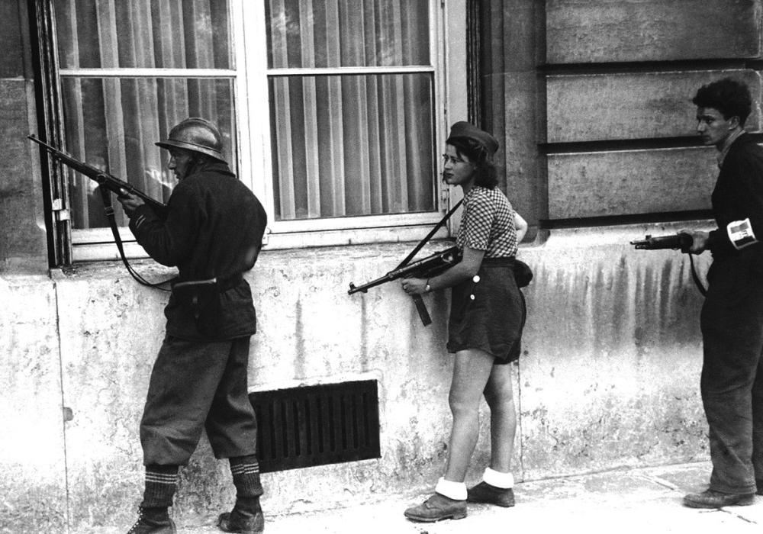
History 172 Vichy France
Collaboration and Resistance

Slide 2
Outline
Events
Vichy Government
Collaboration
Resistance
Liberation

Slide 3
German expansion
Seized Austria and Czechoslovakia (1938)
Nonaggression Pact with Stalin (1939)
Invasion of Poland (September 1939)

Slide 4
Drôle de guerre
War declared after Germany’s invasion of Poland (September 1939)
Eight months – no military action
France and Britain arm themselves

Slide 5
Fall of France
Invasion: 10 May – 22 June 1940
Blitzkrieg and War of Attrition
Original intentions vs. unexpected outcomes
British/French defense of Belgium-disastrous
Encircled by German troops who had seized forts
Even Hitler was surprised by the victories

Slide 6
Forces
Why did France fall?
Political
A divided France? Loss of faith in the republic?
Tactical
Simply outmaneuvered by German military
French military weaknesses
Maginot line – ended at Belgian border
Forces mobilized but inexperienced
Tanks dispersed instead of concentrated
Why did the Third Republic fall?

Slide 7
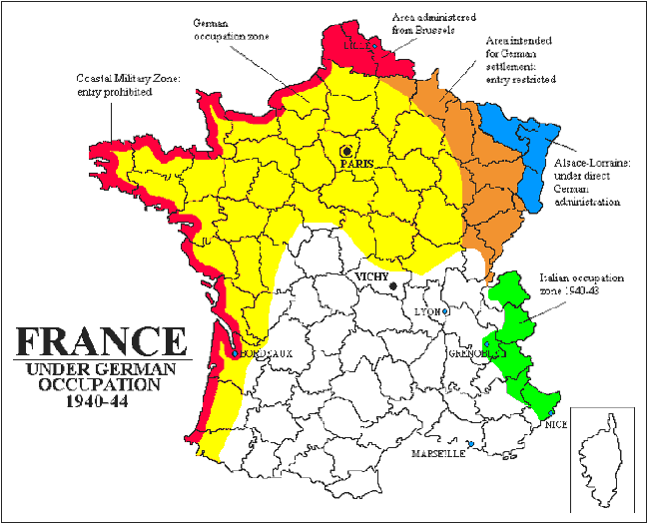
Bifurcated France

Slide 8
Worldwide conflagration
Germany, Italy and Japan – Axis powers
USSR, UK, USA, China – Allies

Slide 9
Britain’s early moves
Sunk French naval vessels in Algeria
Killed 1300 Frenchmen
Interned all Germans, including 50,000 Jewish refugees
Battle of Britain (August-September 1940)
Mostly an air/bomb war

Slide 10
Hitler’s vision
Secure the dominance of the German race
19th century nationalism and race theory combine
70,000 mentally disabled people killed (1939)
350,000 ‘outcasts’ sterilised (1934-1945)
Plan for the ‘annihilation of the Jewish race in Europe’ (Hitler-1939)

Slide 11
Death factories
Final solution
1941 – plan to liquidate all Jews
By end of 1941, 1 million Jews massacred
Auschwitz – 15,000 killed per day in ‘showers’
Hungarian and Polish Jews intensely targeted
Children killed immediately (couldn’t work)
Scientific experiments carried out on bodies and minds of prisoners
Gays targeted

Slide 12
Death toll
6 million Jews by 1945
33 million civilians overall in WWII
63 million deaths worldwide
(compared with roughly 37 million in WWI)

Slide 13
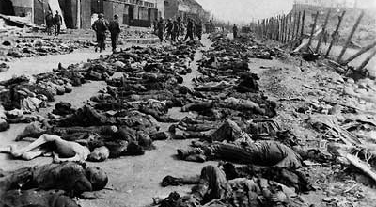

Slide 14
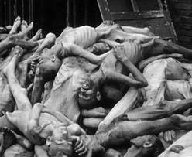

Slide 15
Turning point, 1942
US enters war in December 1941
Mussolini’s Italy: strategic blunders in the Mediterranean – Allies gain control of North Africa
German invasion of USSR: disastrous

Slide 16
Allied control of North Africa
Churchill – imperialist
Sought to ensure Britain’s control of Mediterranean and Middle East
Thwart French imperialism
From South to North – via Italy (1944)
US and USSR convince Britain to invade France
D Day – June 6, 1944
German surrender: May 8, 1945
Hitler commits suicide in bunker
Goebbels murders his own six children, shoots wife and himself

Slide 17
Occupied France
Struggle to survive
Requisitions for German war machine
Inflation, black-markets, barter
Class differences accentuated
Paris: 40-50,000 Germans
Malnutrition – French children of this generation were shorter
Mortality increased 42% in Paris

Slide 18
Life as usual
“Food was short, to be sure, but something could always be rustled up at dinner parties attended by a young aesthete with the right connections.” – Simone de Beauvoir
War Journal

Slide 19
Vichy
Based in the Auvergne
Marshal Philippe Pétain – Head of State
WWI hero, Verdun
From
liberté, égalité, fraternité to
Travail, famille, patrie

Slide 20
National Revolution
No constitution
Reactionary support (Charles Maurras’s Action française)
Cult of married women
Mother’s Day
Disincentives for married women to work
Pro-natalist state – financial incentives for child rearing
15,000 Jews were de-naturalised
Rounding up of Jews, Romani and Communists
Rhetoric of pro-small business; state sponsored consolidation
Centralised economy / Free unions banned
Worker deportations to Germany (15% of German workforce was French in 1944)

Slide 21
Spectrum, shifts
Collaborationists
Pétainists
resisters
Most – somewhere in the middle

Slide 22
Collaboration
Passive resistance or active collaboration?
Robert Paxton debate (1972)
Vichy France: Old Guard and New Order, 1940-44
Film: The Sorrow and the Pity (1971)

Slide 23
Collaboration
Reasons
Anti-semitism
Anti-communism
Quest for power through German support
Pétain: ‘I enter today on the path of collaboration’ (October 30, 1940)
Came from society and increasingly the state
Sectors of the Church, Army

Slide 24
Jewish Deportations
Initial obstacles: no religion indicated on French censuses since 1874…
Jews had to register with police: property and civil rights curtailed
In occupied and unoccupied zones between 1942-1944
Vél d’Hiv (Vélodrome d’hiver) and Drancy
76,000 Jews deported in 1940 (of an approx 300,000)

Slide 25
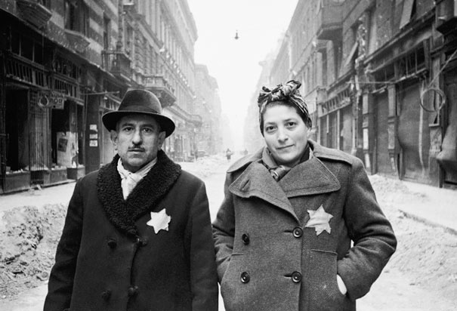
Star of David

Slide 26
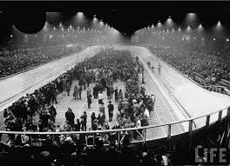
Vél d’hiv

Slide 27
Vél d’Hiv
No toilets
Little water and food
Suicides

Slide 28
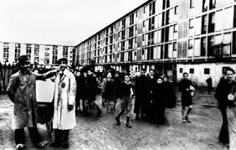
Drancy

Slide 29
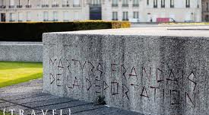
Deportation Memorial in Paris

Slide 30
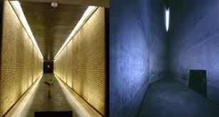
Memorial

Slide 31
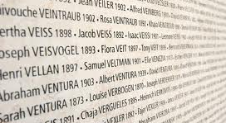

Slide 32
Resistance
Parts of Church
Témoignage Chrétien
Communists (biggest group of resistance)
Approx 30,000 killed
Free France
De Gaulle (London)
Shirked by Churchill and Roosevelt
Women participate

Slide 33

Cross of Lorraine anti-swastika, symbol of Free France

Slide 34
Early Resistance
Small, uncoordinated groups
Wide range of middle-class background
Many peasants
Unconnected to Free France (London)
Combat (central), Libération-sud (south)

Slide 35
Actions
Sabotage (explosives)
Train lines targeted
Assassinations (counter-productive)
Spying
Propaganda

Slide 36
Expands after 1942
Allied victories embolden resisters
Approximately 300-400,000
Supplies from Allies dropped to resisters in France
Impact on morale within France

Slide 37
Jean Moulin
Préfet before the war
Imprisoned by Germans for failing to accuse Senegalese French army of (German) massacre
Tried to unite various resistance groups after 1942 (at bequest of Free France in London)
Arrested, tortured, died in June/July 1943
Had he divulged what he knew, the Resistance may have been severely compromised

Slide 38
War’s End
German pinched from east (USSR), south and west (Allies)
Retreat of Germans: tragic in many parts
Ouradour sur Glane
https://www.youtube.com/watch?v=5TwrwJJ3G6w
Saint-Amand
For an eloquent philosophico-historical account: see Tzvetan Todorov’s A French Tragedy
Charles de Gaulle
Resisted attempts by Allies to have him replaced
Will head provisional government until Germany is defeated, French prisoners come home, Constitution is drafted
Will he prolong this and install himself as an authoritarian??

Slide 39
Legacy of Resistance
Immediate problem
Who gets credit? Politicized question
Many chose to remain discreet
French Communist Party – moral high ground
Said 70,000 killed in resistance (probably half that number)
Allowed France to forget collaboration
Struggle to define post-war politics
Communism, republicanism, authoritarianism?

Slide 40
Legacy of Vichy
State management of economy and culture
Technocracy, not social democracy? Or a combination…
Demographic studies
Media management
Funding for families
Dirigisme of industry

