Slide 1

Divided France
The Dreyfus Affair

Slide 2
Outline
Political and Cultural currents of the early Third Republic
The Boulanger Crisis (1889)
Religious tensions / nationalism
Education Reforms
Dreyfus Affair and Its Ramifications

Slide 3
The political topography
By 1879, conservative forces were weak. Republican form of government strengthens.
Fragmentation and decline of monarchists and Bonapartist forces
The rise of the ‘Opportunists’ and their 20 year predominance
Failed alliances of the Opportunists with the Left (Radicals), then Right (monarchists, bonapartists) in mid 1880s
Radicals want stiff policy against Germany and a progressive income tax – Opportunists want neither…
The rise and fall of Georges Ernest Boulanger – proto-fascism?

Slide 4
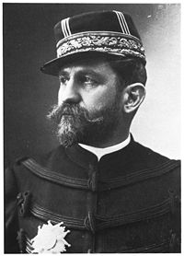
General Boulanger

Slide 5
Boulanger’s rise
Centrist (opportunist) politics weak in mid 1880s, when a centre-left (Opportunist-Radical) coalition formed
He attracted all sides
Republicans thought he was their man
Appointed Minister of War in 1885
Reformed soldiers’ barracks conditions
Military parades, led by him on a black horse
Sent in troops to put down strikes
Ordered soldiers to share rations with workers
Fiercely anti-Bismarck, anti-German

Slide 6
His rise and fall
Accepted support and money from left and right
Used local by-elections as plebiscites
Frightened government forces him to ‘retire’ from military
He wins Paris elections (1889)… coup d’état seemed imminent but he chose to wait for the upcoming national elections to seal his arrival to power
Government threatens to charge him with treason. Frightened, he fled to Belgium.

Slide 7
Impact of the Boulanger Crisis
Revived the republicans and the Opportunists
Revealed the limits of socialism in capturing the alliances of the working classes, who were attracted to this strong, charismatic but fiercely nationalist and anti-socialistic leader
Now the Right took over militancy, which had been dominated by the Jacobin Left (remember the levée en masse in French Revolution and the Commune’s bitter anti-German stance?)
Was Boulanger a proto-fascist? Intense demagoguery, highly emotional, authoritarian and chauvinistic.

Slide 8
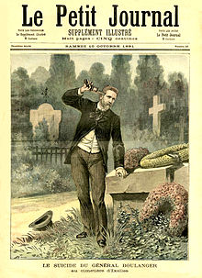
Suicide on Mistress’s Grave, 1891

Slide 9
Anarchism
A response to dramatic inequalities
City of Lights (Center, West) vs. City of Squalor (North, East)
Nearly 50% unemployment in recessions (1883-87, 1889, 1892), no social safety nets
Poor had no running water, 5x higher TB rates, shantytowns, raw sewage
Propaganda of the Deed
Political Violence as Message
Terrorist tactics:
Auguste Vaillant’s bomb in the Chamber of Deputies (Dec 1893)
Émile Henry’s bombing of the Café Terminus (Feb 1894)
Assassination of Sadi Carnot, France’s president (June 1894)

Slide 10
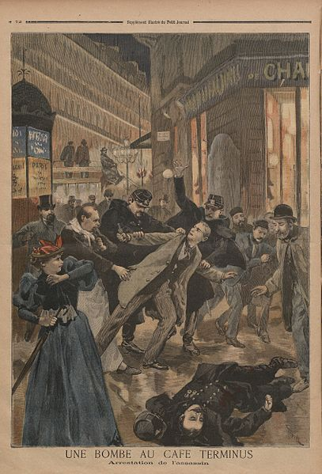
Bombing at the Café Terminus

Slide 11
Émile Henry explains
‘I had been told that society’s institutions were founded on justice and equality, and all around me I could see nothing but lies and treachery…
I turned into the enemy of a [bourgeois] society which I held to be criminal.
The factory-owner amassing a huge fortune on the back of the labor of his workers who lacked everything was an upright gentleman
I saw that, essentially, socialism changes the established order not one jot… it retains the authoritarian principle…’

Slide 12
Nationalism
The rise and consolidation of European nation states
Nationalism: A new kind of religion – call for sacrifice
Politics of nation-building
Taxes – effectively regressive
Forced conscription on masses who had little voice in government
Colonialism
European nationalistic competition on a global scale
But colonial expansion was often driven by army officers and traders on-the-ground more than central government

Slide 13
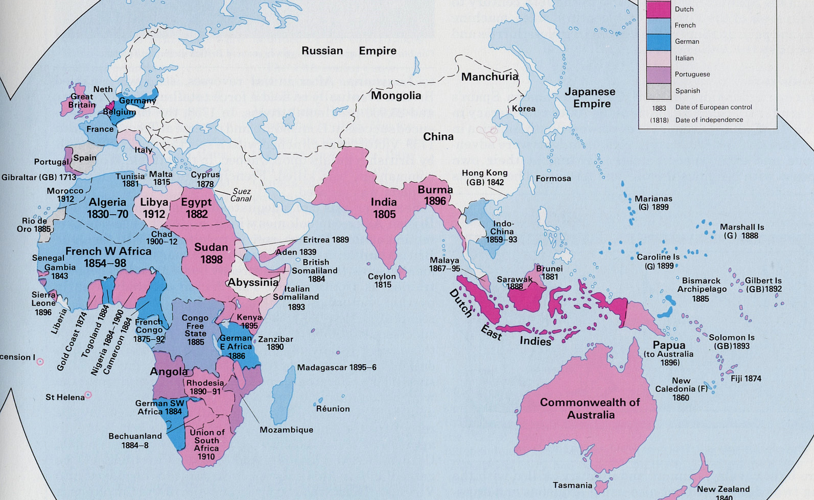
Empires, 1900

Slide 14
Religion and Ideas
Assumptionists
Radical new religious order, supported by Pope Pius IX in Rome
Hated republicans and socialists… highly intolerant of Protestants and Jews.
Interpreted the defeat of 1870 as God’s punishment for the sins and errors of the French Revolution and Enlightenment
Raised funds to build the Sacre-Coeur church: the nation’s ‘penitence’
Controversy: Its location at the site of the Commune struggle of 1871
An incessant provocation?
Shared with Darwinists a fatalistic view of poverty: ‘Some men work hard and live badly. Misery is a law of God to which they must submit. Society needs slaves’ – Louis Veuillot

Slide 15
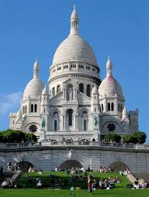
Sacre-Coeur ‘An incessant provocation to civil war’ OR…

Slide 16

Or a Smurf Church?

Slide 17
Positivism
Auguste Comte (1798-1859)
Objectivity
Materialism/Scientism
Roots in the Enlightenment, but society was more open to it by 19th c.
Man was like any other animal: Laws of social behavior could be discovered through the scientific method
Anti-clerical
Spreads through universities and freemasonry in latter half of 19th
Nearly all Radical deputies – of the ‘Radical’ party – were Freemasons by 1900

Slide 18
Education
Prior to the Ferry Laws of 1881-1882
Two education systems in 19th century: Church and Public
But religion was a required subject in public schools
Priests teach in public schools
Public schools, though increasing, were far from universal in France
Public schools benefitted wealthier families
The Church often undertook primary schooling in countryside
After the Falloux Law of 1850, almost half male students in secondary education were in Catholic schools

Slide 19
Ferry Laws
Free primary education for boys and girls (Condorcet’s dream)
Some funds provided by national government; departments required to pay
the rest
Outlawed religious education in public schools
Removed priests from teaching positions over 5 years
Anti-clerical in spirit
Thrust: French language, patriotism, secular morality
Result: poorly implemented. Tensions between Catholic and republican (often positivist) educators in the localities are exacerbated in 1880s and 1890s

Slide 20
Dreyfus Affair (1894-1906)
Venerable tradition of intellectuals engagés
Voltaire, the Calas Affair of the 1760s
The status of Jews in France
Citizenship granted in 1791
Increased assimilation in 19th century
Rise of anti-semitism accompanies assimilation in late 19th century
Jews as having no national commitments
As bourgeois financiers, capitalist oppressors
Anti-semitism on Left and Right
Edouard Drumont: journalist
Panama Company Affair: showed Jewish agents of the company bribing politicians and Drumont

Slide 21
The plot: 1894-1898
Spy documents written by a French officer found in German Embassy in Paris, in a waste-bin (Sept 1894)
Discovered by a cleaning woman, turned over to French counter-intelligence
Suspicion diverted to Captain Alfred Dreyfus
Jew from Alsace. Family chose French citizenship after Alsace was lost to Germany in 1870.
Condemned by the anti-Semitic press (notably, Drumont)
Key army officials fabricate false evidence
Convicted, ritually stripped of his finements and sword broken in public (1895)
‘More fun than the guillotine’ – Maurice Barrès
Sentenced to life on Devil’s Island (off coast of French Guiana), shackled, solitary confinement

Slide 22
Colonel Picquart convinced of Dreyfus’s innocence
Scheurer-Kestner (Senate) also convinced
Walsin Esterhazy’s banker identifies his client’s handwriting on the evidence published in the press
Court martial of Esterhazy in 1898
But Army maintains his innocence, effectively condemning Dreyfus again
Zola steps in….

Slide 23
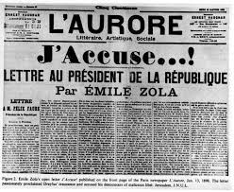

Slide 24
Zola: convicted of criminal libel (Feb 1898)
Fled to London
Returned a year later
Dreyfus: Court martialed again in 1899, to international outrage
Presidential pardon (not exoneration) offered shortly thereafter
Supreme Court exonerates him only in 1906

Slide 25
Camps
Dreyfusards: republicans, socialists, positivists
Justice, material evidence, but also anti-clericalism… Many Dreyfusards think that the Church and Army conspired together
Anti-Dreyfusards: Assumptionists, conservatives
National honour, patriotism, tradition
More complicated than rationality vs. religion
Revival of Old Regime religious struggles
(Protestantism, Judaism, Catholicism)
Dreyfusards suspected Jesuits behind the affair
Anti-Dreyfusards: hated Zola’s naturalism… could now marshal patriotism against it…
Families and friends become bitterly divided over the controversy…

Slide 26
Legacies of Dreyfus
Radicals dominated politics until WWI – they came out on the winning side
Anti-semitic sentiments become anathema in leftwing circles in France.
The mystique of the politically engaged intellectual was enhanced
Formation of political consciousness and a generation of political figures, left and right. Sets of values and ‘world-views’ about republicanism and patriotism formed in the course of conflict.

Slide 27
Impact
Republicanisation of the Army in the 1900s – end of the Old Regime?
Separation of Church and State – Napoleon’s Concordat of 1801 is overturned
Religious orders expelled from France (1902-1905)
No more state funding for churches and priests, and hence, religious education
Declining clerical recruitment and Catholic schools

Slide 28
Political Figures of the Dreyfus Controversy
Charles Maurras
Leading rightwing thinker: anti-Semitic, anti-republican, proto-fascist
Tried and convicted for collaborating with Germans after WWII
‘It is the revenge of Dreyfus!’
Léon Blum
Militated with socialists as a Dreyfusard
First Jewish and socialist prime-minister of France in 1930s
Republicanism: secular, social justice, citizenship for ALL!
‘Better Hitler than Blum’! Common phrase among far rightwingers and fascists in the 1930s… Fusion of anti-semitism and anti-socialism on the eve of WWII

