Slide 1
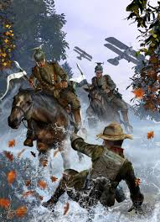
Hist 172 – Modern France
Societal Ferment
And
The Great War,
1900-1918
Notes:
The International (Billy Bragg): http://www.youtube.com/watch?v=Zk69e1Vcmvg

Slide 2
Outline
Ferment
  Cultural
  Social and political
WWI
  Origins
  Total War, home and western fronts
  A Lost Generation
  Post-War International Order

Slide 3
Cultural Ferment
Rise of avant garde
Rebellion against classical, rational and realist forms of representation and knowledge
Retreat into dreams, the subconscious, fantastical primitivism

Slide 4
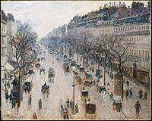
Camille Pisarro,
Bd Montmarte on a Winter’s Morning
Nervous movement, dream-like quality, post-impressionism
1897

Slide 5
Pablo Picasso (1881-1973)
Spaniard based in Paris in early 1900s
Blue period – obsessed with death
‘I paint objects as I think them, not as I see them.’ – modern art

Slide 6
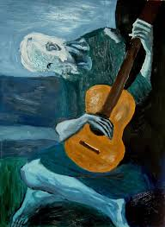
Picasso
The Old Guitarist (1903)

Slide 7
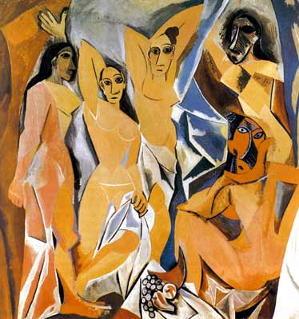
Picasso, on cusp of cubist turn
Les demoiselles (1907)
Note: African influence, in a context of European imperialism

Slide 8
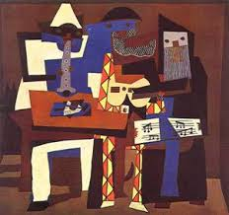
Picasso, Cubism

Slide 9
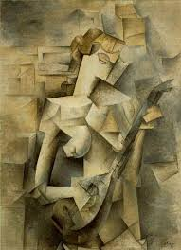
Picasso
Woman with Mandolin (1910)

Slide 10
Henri Bergson (1859-1941)
Philosopher, Nobel prize-winner (1927)
An Introduction to Metaphysics
  Intuition and memory are heterogeneous
  Build-up sense-perceptions across time and space
  ‘Rationality’ on the other hand is homogeneous, and therefore more limited

Slide 11
Rites of Spring, May 29, 1913
Sergei Diaghilev (choreographer)
Stravinsky (music)
Nijinski (danser)
Scandal: non-classical forms
  Violence, primitive art, dreamlike, nightmare-like
http://www.youtube.com/watch?v=J4qm1wyzHwI

Slide 12
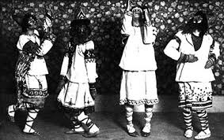
Rites of Spring

Slide 13
Socio-political ferment
The predominance of the Radical Party in politics facilitated social gains
  But the party moved right under Clemenceau to broaden its social base to include business
Strengthening of Socialist forces
  Uniting of socialist parties into the Section française de l’Internationale Ouvrière
  17% of national vote by 1914, but often hostile to women worker involvement

Slide 14
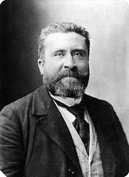
Jean-Jaurès
Socialist
Bring republicanism to the workplace
‘The workshop, work itself, production, property, these must be organised according to the republican principle.’ (1903)
Anti-militarist, assassinated in July 1914, start of WWI

Slide 15
Syndicalism
10 times bigger than Socialist Party by 1914 in terms of membership (1 million vs. 90,000 Socialists)
Equally hostile to women’s participation (only 89K of the 1 million, even though women constituted 40% of the workforce)
CGT: Confédération générale du Travail (still exists)
Class struggle in the workplace, not in the parliament (differed from Socialist party)
Bourses du Travail – local labour exchanges
Cultural education of workers
Mutual insurance schemes
Georges Sorel, ‘The General Strike’
  Causal force of history, but in the future

Slide 16
Anarchism
Distances itself from the assassinations and terrorism of 1890s
Infused in syndicalism, amplifying syndicalism’s revolutionary edge
But anti-political leanings deprived syndicalism of a political strategy. Strikes, but then what?

Slide 17
Class conflict on the eve of WWI
The Radical Party, initially leftwing, missed its opportunity in power to secure social reform
Strikes were prevalent in early 20th century, but strikers were of diverse ideological leanings (reformist, revolutionary, anarchist…)
Social justice on the agenda, but how to reconcile it with republicanism and maintaining the support of the middle classes -- conundrum

Slide 18
WWI - Origins
Intense nationalism
European competition for global empire
Weakening of central European and west-Asian empires in the face of rising ethnic nationalism
The thick web of alliances but also secret treaties between powers

Slide 19
Nationalism
Grew out of anti-Dreyfusard movements
Action Française
  Anti-republican
  Anti-Semitic, anti-freemason, anti-Protestant, anti-socialist
  Charles Maurras
    Writer
    Pro-war in 1914
    Pro-Church but agnostic… cult of the mystical power

Slide 20
Global Competition
In 1500, Europe controlled 7% of globe’s land
1800, 35%
In 1914, 84%

Slide 21
Motivations for Colonialism
Economic
  Traders often arrived first, before armies
  Raw materials for industrialisation
  Expanded markets
Moral
  Civilising mission
  Catholic and Protestant, though eventually aligned with secular republicanism
  Reform indigenous ‘abuses’

Slide 22
Imperialism and nationalism
Drive to control buffer zones, to prevent European rivals from encroaching on one’s own

Slide 23
French Empire, 1914
http://users.erols.com/mwhite28/frnc-emp.htm
Problems of the Balkans (for Austro-Hungarian Empire) and eastern Mediterranean (Ottomans)

Slide 24
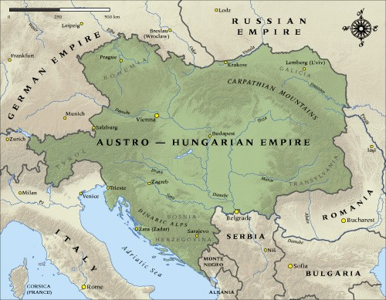
Weakened empires
Austro-Hungarian
  Faced with rebellious Slav populations supported by Russia

Slide 25
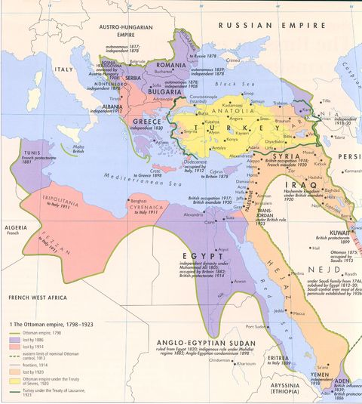
Weakened empires
Ottoman Empire
Faced with nationalist challenges from Caucuses and English encroachment in Middle East (Syria, Palestine, Iraq, Saudi peninsula bordering Red Sea.

Slide 26
Alliances
Triple Entente
Triple Alliance
Russia
France
United Kingdom
Germany
Austro-Hungaria
Italy

Slide 27
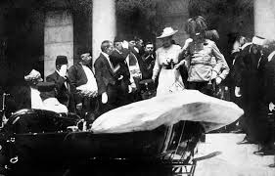
Assassination of arch-Duke Ferdinand
Heir to Austro-Hungarian Empire

Slide 28
Lead up to war
More than a month of diplomacy before war actually breaks out
Secret alliances, especially Italy, weigh on major belligerents’ strategies
Dynastic ties are overwhelmed by national rivalry (German Emperor was Queen Victoria’s Grandson; Russian Tsar’s wife was Victoria’s granddaughter)

Slide 29
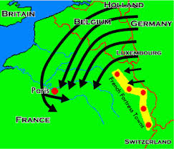
Schlieffen Plan

Slide 30
Old and New
Aviation – dogfights
Cavalry – like Napoleonic era
Submarines (German U-Boats)
Machine guns

Slide 31
Mass mobilisation
Millions head to war
‘A Jolly Little War’
  Excitement
  Belief that it would be a quick war
Parisian newspapers in 1914:
  ‘The war, for all its devastating appearances, only seems to be destructive… at least [those killed by German bayonets] will have died a beautiful death, in noble battle…with cold steel, we shall rediscover poetry’
England mobilises more quickly than Germany anticipated
Forces on all sides end up spread across a line running from Switzerland to the coastline of Belgium

Slide 32
Trench warfare
6250 miles of trenches
Barbed wire, six-eight feet deep
Sandbags
Beer/wine (Germany/France)
Some trenches had electricity
Rats
Lice
Mustard gas (Germans)

Slide 33
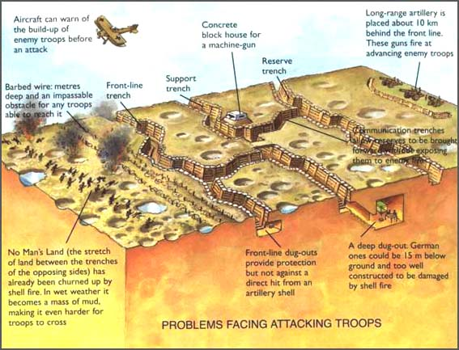
Trenches

Slide 34
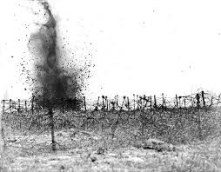
No Man’s Land

Slide 35
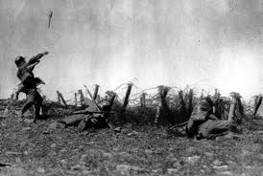
No Man’s Land

Slide 36
Front line trenches
Hell on earth
Constant shells, machine guns, grenades
Industrial Revolution meets War

Slide 37
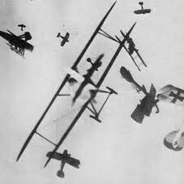
Dogfights

Slide 38
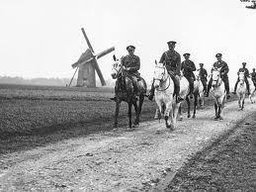
Cavalry

Slide 39
Home front
Leftwing largely supports war
  Socialists and syndicalists fear arrest, since arrest lists were well-known to have been drawn up before the war
Censorship / Propaganda
Sacred Union: Left and Right Unity
Soldiers resent false impression of war on home front

Slide 40
Britain’s disastrous strategy
Pushed by Churchill and Kitchener
  Attack German, Austro-Hungarian and Turkish strongholds, forcing these enemies to divert troops
  Lost battles in Gallipoli (Turkey)

Slide 41
Stalemate 1916-1918
Protracted war of attrition
Civilians targeted
Battle of Verdun (Feb-Dec 1916)
  800,000-one million killed

Slide 42
New belligerents, shifting sides
United States enters in 1916
  Sends 3.5 million troops
Russia withdraws in 1917
  Russian Revolution
Italy sides with Triple Entente forces

Slide 43
Soldier Mutinies
Soldiers defy commanders
Bleating sounds as they passed their officers

Slide 44
Deadly impact
9.4 million killed
  More than 6,000 per day
  900 French per day
21.2 million wounded, dismembered
50 million die of influenza, 1918-1919
Post-war situation
  Unemployment, inflation

