Slide 1
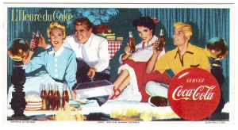
History 172-History of Modern France
Modernisation and Anti-Americanism

Slide 2
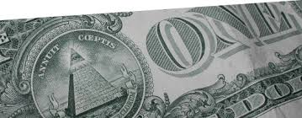
Mini-overview of
Post-war Global Economy

Slide 3
Bretton Woods 1944
Conference in New Hampshire
Allies meet to set up postwar economy
Currencies pegged to price of gold
  US held 2/3 of world’s gold supply – essentially, fixing the world economy to the dollar
  US is the only creditor nation after WWII
IMF to compensate for trade imbalances of payments

Slide 4
Why Bretton Woods?
US agenda: prevent postwar recession in US by recycling US surpluses abroad, giving battered countries with no financial credit the means to pay for American goods.
Should recycling of US surpluses be institutionalised at the global level or left to the discretion of US?
  John Maynard Keynes vs. Harry Dexter White
    K = create world institutions for guaranteeing wealth transfers (recycling), much like USA does internally among its federated states (but unlike Europe today, which refuses to create such institutions)
    W = Wants to preserve USA’s discretion to recycle surpluses abroad…
  Despite its refusal to subject itself to international economic institutions with sovereign economic authority, the US opted to willingly recycle its surpluses with a great degree of liberality

Slide 5
Results of Bretton Woods
Fix the dollar to gold, then world currencies to the dollar.
Dollars flow into Europe and elsewhere (aid, loans, investments), providing means to purchase US goods.
Much of the world is now at the mercy of decisions made in Washington and New York about global wealth flows

Slide 6
End of Bretton Woods
1971: Nixon takes the US (now running deficits rather than surpluses) off gold standard
Dollar becomes fiat money (Federal Reserve Bank and Treasury decide how much to print – no longer backed by gold but many countries are still pegged to dollar)
1970s-2000s: US to control world economy through running high debts!!
  Debts: government, trade and consumer
  Financialisation of the economy: debts became bundled with assets in obscure financial instruments, creating new kinds of money – bank wealth based on colossal but hidden debts…
Why? The trick now was to recycle other countries’ surpluses through Wall Street rather than recycling American surpluses abroad
  The great profits made in other producer countries as the result of American consumption (and Americans went into debt to buy those goods) made their way to Wall Street, where they got combined with financial products that conceal debts… indeed, debts themselves become money among banks, who trade them

Slide 7
Worldwide effect of this?
Small countries suffer deflation and crushing debts
IMF (International Monetary Fund) lends to weak countries in crisis, but on condition that they cut public spending (which shrinks their economies), privatize public assets (often natural resources) and pay back loans with interest (but now without the public assets or tax revenues of productive forces)
Downward deflationary spiral and indebtedness: violence, right and left wing revolutions

Slide 8
2008 Crisis
US banks go bankrupt, transfer their debts to the government books… private debts are thus nationalised
Other countries forced to do the same, even economically weak ones
Greek gov’t bails out its banks, but goes bankrupt in the process
Germany now in much the same positions as US after WWII
  Germany refuses to recycle its surpluses to spur production in weak Eurozone countries like Greece – it will lend but not recycle (or redistribute). The US opted to redistribute through aid after WWII, with great results for both Europe and US.

Slide 9
2008 Crisis
Germany today
  Could do as Keynes proposed to US in 1944:
    Push Europeanisation of economic institutions further: create European treasury that can recycle surpluses around Europe, the way the US Fed and Treasury do around the entire US (e.g., military bases in the deep south, which are thus spared from outright economic depression… national benefits, pensions, public works projects)
  G could do as US chose voluntarily to do after 1944 (after rejecting Keynes international economic regulatory institutions)
    Just give money (recycle its surpluses) to poor countries to provide them the means to purchase goods and generate productive power of their own
  What Germany is choosing to do
    Saddle bankrupt countries with more debt, forcing them to shrink their economies by prioritising debt repayment over investments to spur jobs and consumer demand

Slide 10

Now… with the future global economy in mind, let’s turn to what the US did after WWII for France and the rest of Europe…

Slide 11
US Financial Assistance
Blum-Byrnes Agreement (1946)
  France’s debt to US waved - $2 billion
US Marshall Plan (1948-1952) – Aid to Europe
  Accounted for 6.5% of France’s GDP in 1949
  Lowering of trade barriers;
  Grants, loans, technical aid
  Helped US economy

Slide 12
Demographic Growth
Baby-boom
  1946 (pop: 40.3 million) 1985 (55 million)
1/3 of population under 20 years old in 1950s
    Finally, population growth
    France’s early defeat in 1940 partially accounts for this
    Explosion in Education spending
      Need trained workers and smart managers for a complex economy
Dramatic urbanisation
  from 51% of total pop before WWII
  to 69% in 1985

Slide 13
Economic Progress
Les trentes glorieuses
Consumer Revolution
  Between 1946 and 1960s: 47% rise in spending
Wages Increase
  Despite population increase, wages rise
    40% increase in real wages between 1946 and 1960s
Agricultural or ‘Green’ Revolution
  Productivity increases 30% between 1946 -1962
  Results of industrial agriculture:
  better fed and live longer + urbanisation
  Ecological and health damage (cancer, diabetes)

Slide 14
Economic Progress
Consumer Revolution
  Between 1946 and 1960s: 47% rise in spending
Wage Increases
  Despite population gains, wages rise
    40% increase in real wages between 1946 and 1960s
Agricultural or ‘Green’ Revolution
  Productivity increases 30% between 1946 -1962
  Results of industrial agriculture:
  Better fed and live longer + urbanisation
  Ecological and health damage (cancer, diabetes)

Slide 15
Jean Monnet’s Reconstruction Plan
1946-1951
Revive steel industry in German territories under French Protectorate system
  France’s exploitation of the Ruhr area and Saar Protectorate (Germany)
  Ruhr came under International Authority in 1949 (pre-condition for the establishment of the Federal Republic of German)... That is, under the control of Allies
  Mined for coal, France does very well from this
Office of Planning established…
Monnet brought labour, communists and financiers to the table to hammer out policies for economic development

Slide 16
European Coal and Steel Community
1951-2002
ECSC founded in the Treaty of Paris (1951) – Belgium, France, West Germany, Italy, Netherlands and Luxembourg
Spurred by Robert Schuman, French Minister of Foreign Affairs – strongly supported by USA
‘to make war not only unthinkable but materially impossible’ – peace through economic bonds
Subsequent institutions: European Economic Community and European Atomic Energy Community (both 1967)
First step towards the European Union

Slide 17
Political Economy
Mix of dirigiste and liberal measures
  State spending on social, public and economic infrastructure
  But loans instead of more rigorous, coercive redistribution methods
  Inflation, initially high in early 1950s, was checked by mid to late 1950s

Slide 18
A Nation of Consumers
Highest per capita consumption rates in Europe by 1959
Frigo and formica – symbols of Americanisation
  By 1958: 11 million homes had radio sets
  By 1960s, 25% of all homes had frigo and washing machine, 3x increase since 1954

Slide 19
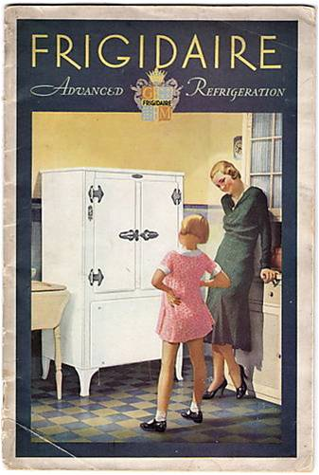
Frigos et formica

Slide 20
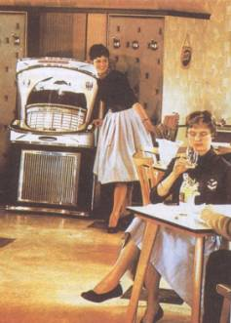
Music, dancing, youth culture

Slide 21
Jacques Tati, Mon oncle
http://www.youtube.com/watch?v=bW0bZBXJFZU
http://www.youtube.com/watch?v=LE9t98Gox60
The (modest) uncle from Paris visits his wealthy, ‘modern’ suburban sister (1st clip)
His brother-in-law gets him a job at the modern factory (2nd clip)
What messages does this film convey about modernisation?

Slide 22
Anti-Americanism
Strong on Communist Left
  American financial support = economic colonisation
Pierre Poujade’s populist right movement
  Small merchants and shopkeepers in villages and rural areas, hit hard by modernisation
  Pulled in some communist supporters

Slide 23
Communist criticism of USA
A civilisation of bathtubs and frigidaires
  Communist writer Louis Aragon
Saw Marshallisation and Coca-colonisation as against French interests
1949 dockworkers refused to unload American goods (Marseilles, Bordeaux)
Fear that US was making western Europe into a military base to attack USSR

Slide 24
Communist journal: L’Humanité
Titles
  ‘One can starve with a telephone’
  ‘Not everyone has a bathroom’
  Consumerism as ‘bourgeois’ elitism
  (note: today in Europe, there are enough empty houses to home more than twice the number of homeless people)

Slide 25
Jean-Paul Sartre
Initially ambivalent about US (1940s) but became a fellow traveller of the PCF and anti-American in 1950s
Played role of public intellectual to denounce anti-semitism (in the spirit of the Dreyfusards):
  Sartre focused on the Rosenberg trial in US
    Julius and Ethel Rosenberg: Jewish American family – convicted of spying for the USSR. Death penalty in 1953.
    The Rosenberg Trial is seen in France as part of American fanaticism and anti-semitism… moment of McCarthyism

Slide 26
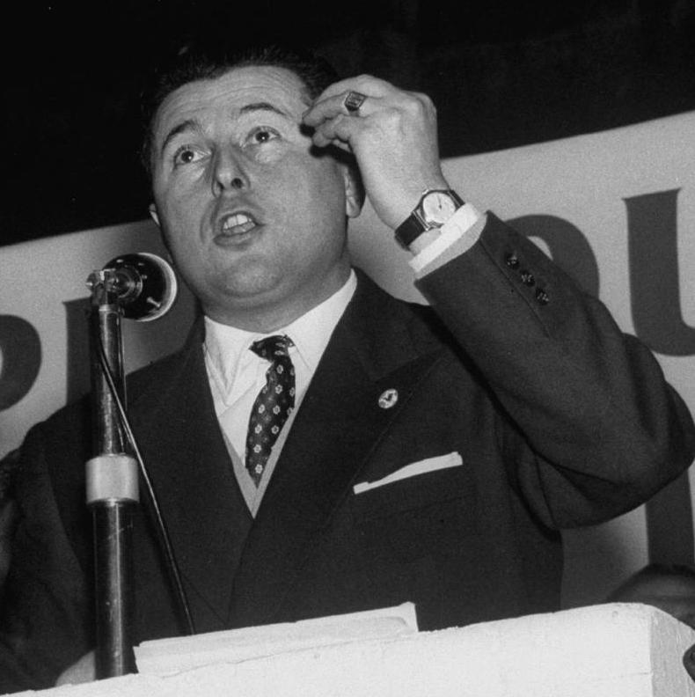
Poujadisme
Pierre Poujade
  Quasi-fascist in 1930s (supported Doriot’s movement against the leftwing Popular Front)
  Supported Vichy, before escaping to North Africa
  Gaullist after WWII (conservative)

Slide 27
Poujadisme
Union de défense commerçants et artisans (1953)
Conflated heavy taxes on this group with Americanisation – big businesses crushing the small
Against price-controls (implemented to reduce inflation… but inflation benefited small businesses)
400,000 members by 1955
Anti de-colonisation
Sharp anti-Semitic barbs (refused to see Jews as French)
Won 52 seats in the National Assembly in 1956
Faded in 1958 upon the rise of the 5th Republic

Slide 28
Coca-Cola
Targeted in anti-American campaigns, why?
  Seen as tool of foreign policy
  Head of company was a former Roosevelt advisor, who saw Coca Cola as a vehicle for spreading American democracy
  Heavy propaganda
  Economic concerns
    Coke’s repatriation of profits from France
    Threat to domestic wine and juice industries
  Health concerns (coke leaves? Phosphoric acid?)

Slide 29
Public affair
Coca-Cola fights back… doesn’t want France to set a precedent… Cold War politics?
CC chief gets US government to apply pressure on France
James Farley (chairman of CC): ‘CC was not injurious to the health of American soldiers who liberated France from the Nazis so that the Communist deputies could be in session today.’
French government acquiesces: April 1950

Slide 30
Soft-drink politics in 1999
Coca-Cola tries to buy the French soft drink Orangina, originally produced in Algeria in 1930s and sold in Europe after WWII.
Production moves to Marseilles in 1962 during Algerian War
French government blocks sale based on ‘anti-competition’ grounds in 1999.

