Slide 1
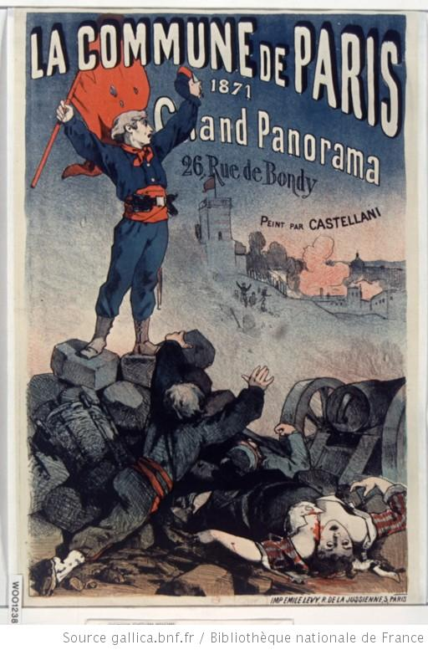
History 172 Modern France
The Paris Commune

Slide 2
Origins
Divided France
Rural: largely conservative, Catholic
Large cities: largely republican, with some socialism
Divided Paris
2 million:
500K industrial workers (mostly artisans)
350K other working class
100K foreigners (heavily Polish and Italian)
160K domestic servants

Slide 3
Divided Paris
1869 elections
In France: Bonapartists outvote Republicans
56% -- 43%
In Paris: Republicans outvote Bonapartists
75% -- 25%

Slide 4
Republicanisation of the Empire?
1852-1860
Little press freedom
National Assembly with little power
No tolerated opposition
1860-1870
More press freedom granted (though periodic)
More powers over the budget given to NA
More freedom of association in 1866, 1868

Slide 5
Currents of republicanism under the Empire
Jewish community
Protestant community
Commercial community
Lawyers
Painters (Manet, Pissaro, Degas, Renoir, Cézanne)

Slide 6
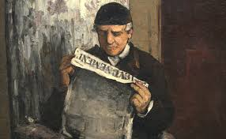
Cézanne The Artist’s Father

Slide 7
Napoleon III: Cesarian socialist, proto-Keynesian, closet republican?
Napoleon’s staff included a number of Saint-Simonians
Saint Simon: Technocracy of non-greedy industrialists: work and production should be prioritised
Distinct from financial-rentiers; Saint-Simonians promote public investment
The aim is ‘to improve as much as possible the conditions of the class that has no other means of existence except the work they do with their hands. This is the most numerous class.’
Saint-Simon, The Industrial System, 1821

Slide 8
Napoleon’s policies
Government debt spending for public works projects (Haussmannisation)
Social housing for poor (not enough, but some)
Purchase power of workers rises in 1850s-60s
Freedom for workers to associate (1866)
Retirement system implemented
Insurance for work accidents
Revokes an article of the Civil Code of 1804, which had given judicial priority to employers over employees

Slide 9
Napoleon III Unwilling emperor?
Dug his own grave?
Gave everyone more of a political voice
Allowed tensions between working class and bourgeois liberals to grow
Tocqueville’s paradox?
Oppression becomes less tolerable the more it is alleviated

Slide 10
Why court the liberals, socialists and syndicalists?
Loss of support from conservative Catholics who were furious with
Napoleon III’s Italian-unification policy (1861)
It undermined the Vatican
B) More open commercial policy with other European powers (hit countryside labour as cheap English imports arrived)

Slide 11
Economic growth Market dynamism + public investment and social spending
1848-1870 – most dynamic economic growth of century (compare w/1950-1980, ‘les trentes glorieuses’ of the 20th century)
Laissez-faire with foreign trade after 1860
Active state intervention in public education, research, infrastructure, works and housing
Depressed economy before and after Napoleon III

Slide 12
Prussian War, 1870
Otto von Bismarck: seeks to unify Germany
Modifies a telegram dispatch to make it appear that French foreign minister had been insulted
Like 1830 and Algeria, dishonour becomes pretext for war: France takes the bait
July 1870 to May 1871
Napoleon III captured at battle of Sedan
Republic declared on September 4, 1870
Adolph Thiers (Conservative liberal) takes charge
Unwilling republic until 1877…

Slide 13
Siege of Paris autumn 1870
German troops surround Paris to north and east. Small French army in Paris, weak.
National Guardsmen (300K strong), many from working class districts, take the lead, including radical syndicalists and marxists
First International (workers association, dominated by Marxists in 1870)
October 31: failed revolutionary uprising in city
Bourgeois flee – lower classes and radicals remain
Staple shortages (Parisian eat the zoo!)
Cold winter: Seine freezes

Slide 14
Capitulation to Germans
Jan 22, 1871: Another attempted uprising. Demands for a revolutionary commune and the placing of French army under civilian control
Jan 28: Thiers, head of the French Government for National Defence, signs armistice with the Germans
Alsace and Lorraine lost to Germans
French army would be disarmed
Punitive indemnities to be paid to Germans
February elections: large group of monarchists are elected.
Some republicans and socialists win seats for Paris, including Victor Hugo, Garibaldi, Louis Blanc

Slide 15
Disarming Paris, March 1871
Thiers tries to seize canons away from National Guard but he had demoralised and weak army to do so
March 18: attempt to seize canons fails. Soldiers defect and join National Guard
Government vacates Paris, to plan and retake it later

Slide 16
The Paris Commune
National Guard Central Committee declares itself the government of Paris
Seizes control of government offices

Slide 17
The Commune
Lasted only ten weeks – legendary in its accomplishments
Working classes move freely through wealthy neighbourhoods
Revolutionary calendar, red flags, Phrygian caps

Slide 18
The Commune
Closed churches, arrested Arch-bishop
Declared separation of church and state
Abolition of night work for bakers
Pensions for wives and children of killed National Guardsmen
Abolition of interest on commercial debts
Return of pawned items
Cancellation of rents owed during war
Workers could take over businesses abandoned by owners -- cooperatives

Slide 19
How to fund all of this?
Loans (Rothschilds Bank)
Bank of France
Lent the commune 400,000 francs per day
Why not seize the Bank of France’s gold reserves? Fatal error?
Cynically, Thiers approved the loans… he didn’t want the Commune to seize the gold since he needed 5 billion francs as war indemnities to Germany

Slide 20
Commune’s survival
Communards attempt to attack Versailles but are stopped
Those armed Communards caught by government: shot

Slide 21
‘La semaine sanglante’ ‘The bloody week’, end of May
MacMahon’s army stormed into Paris on May 21
Armies drive through the boulevards and cut through buildings
Merciless punishments: firing squads, in serial batches
‘Tous les Parisiens sont coupables!’
Hôtel de ville: burned down by army
Tuileries Palace burned by Communards
Archbishop executed by Communards

Slide 22
Massacre
Army takes central Paris, then Bastille and pushed up to Père Lachaise cemetery, where prisoners were brought by batches of hundreds to be lined up against a wall and shot

Slide 23
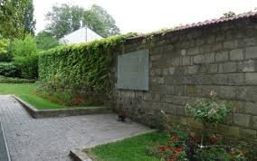
Mur des fédérés

Slide 24
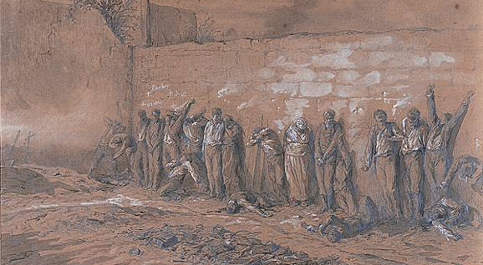
Mur des fédérés

Slide 25
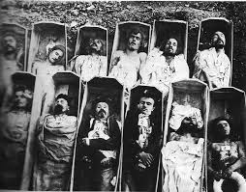
The repression of the Paris Commune

Slide 26
Death toll
Killed by Communards
66-68 hostages
Killed by Versailles army
Estimates range from 6,000 to 20,000
Official report by government, which matches the city government numbers for funding burials: 17K

Slide 27
Decline of working class population
Census:
1866: 24,000 shoemakers
1872: only 12,000
Disappearance of 10,000 of 30,000 tailors during the two censuses
6,000 of 20,000 cabinet makers remain in 1872
Employers, large and small, complained of lack of workers after the Commune

Slide 28
Exiles
United States, Switzerland, Britain
Show trials (1871-1873), execution and exiles
Louise Michel, ambulance women
Active in denouncing Thiers government’s capitulation
Fought at Père Lachaise, arrested
Defiant stand in show trial; deported to New Caledonia, where she supported the indigents against French colonists

Slide 29
Third Republic born in defeat and civil war?
Thiers elected president on Aug 31, 1871
Was reimbursed for his burnt-down house during Commune
Official versions (hundreds of them in bookstores) distorted events
Bourgeois fears: working class were a different race
Near return to monarchy: 1877, when President MacMahon, who had led the attack on Paris in 1871, attempts a royalist coup but fails
Republicanism takes root in 1880s and 1890s
Divided between socialists and liberals

Slide 30
Sacre-Coeur
September 1870: Defeat of French was thought to express God’s punishment for France’s moral decay since the French Revolution
24 July 1873: National Assembly funds the building of church, ‘To expiate the Commune’s crimes’.

Slide 31
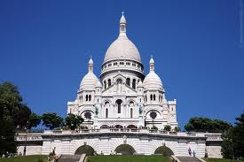
Sacre-Coeur

Slide 32
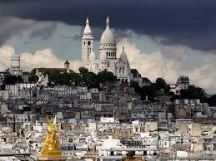
Sacre Coeur

Slide 33
Political topography in late 19th century France
Royalism withers
Bonapartism: occasionally resurfaces, but doesn’t last (Boulanger incident)
Republic is stabilised until WWII
Universal suffrage, freedom of the press, free and compulsory education… Goals of French Revolution
Tensions remain
Class
Gender
Society vs State
Religion
Colonialism

Slide 34
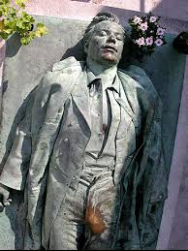
Who was Victor Noir (1848-1870)

Slide 35
Duels
Duelling: culture of honour
Relationship to print
Libels and insults in print merit an honourable vengeance
Two political newspapers duel
Republican La Revanche and loyalist L’Avenir de la Corse
Napoleon III’s cousin, Prince Bonaparte, challenges editor of La Revanche to a duel in L’Avenir de la Corse
Victor Noir, a journalist for La Revanche, is sent to see the prince on behalf of La Revanche’s editor to set the terms for the upcoming duel
Words fly, Prince Bonaparte shoots Noir dead
Noir becomes a ‘republican’ hero and martyr
More than 100K participate in funeral procession through streets of Paris (much like the parade of the radical journalist Marat after his assassination in 1793, during the French Revolution)

Slide 36
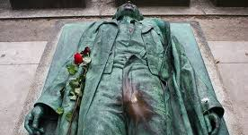
Who was Victor Noir?

Slide 37
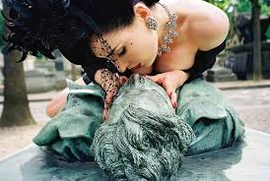
Victor Noir: cult tomb today in Père Lachaise Cemetery Attempts to fence it off are publicly opposed

Slide 38
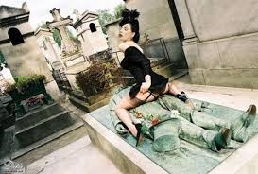
Victor Noir

