Slide 1
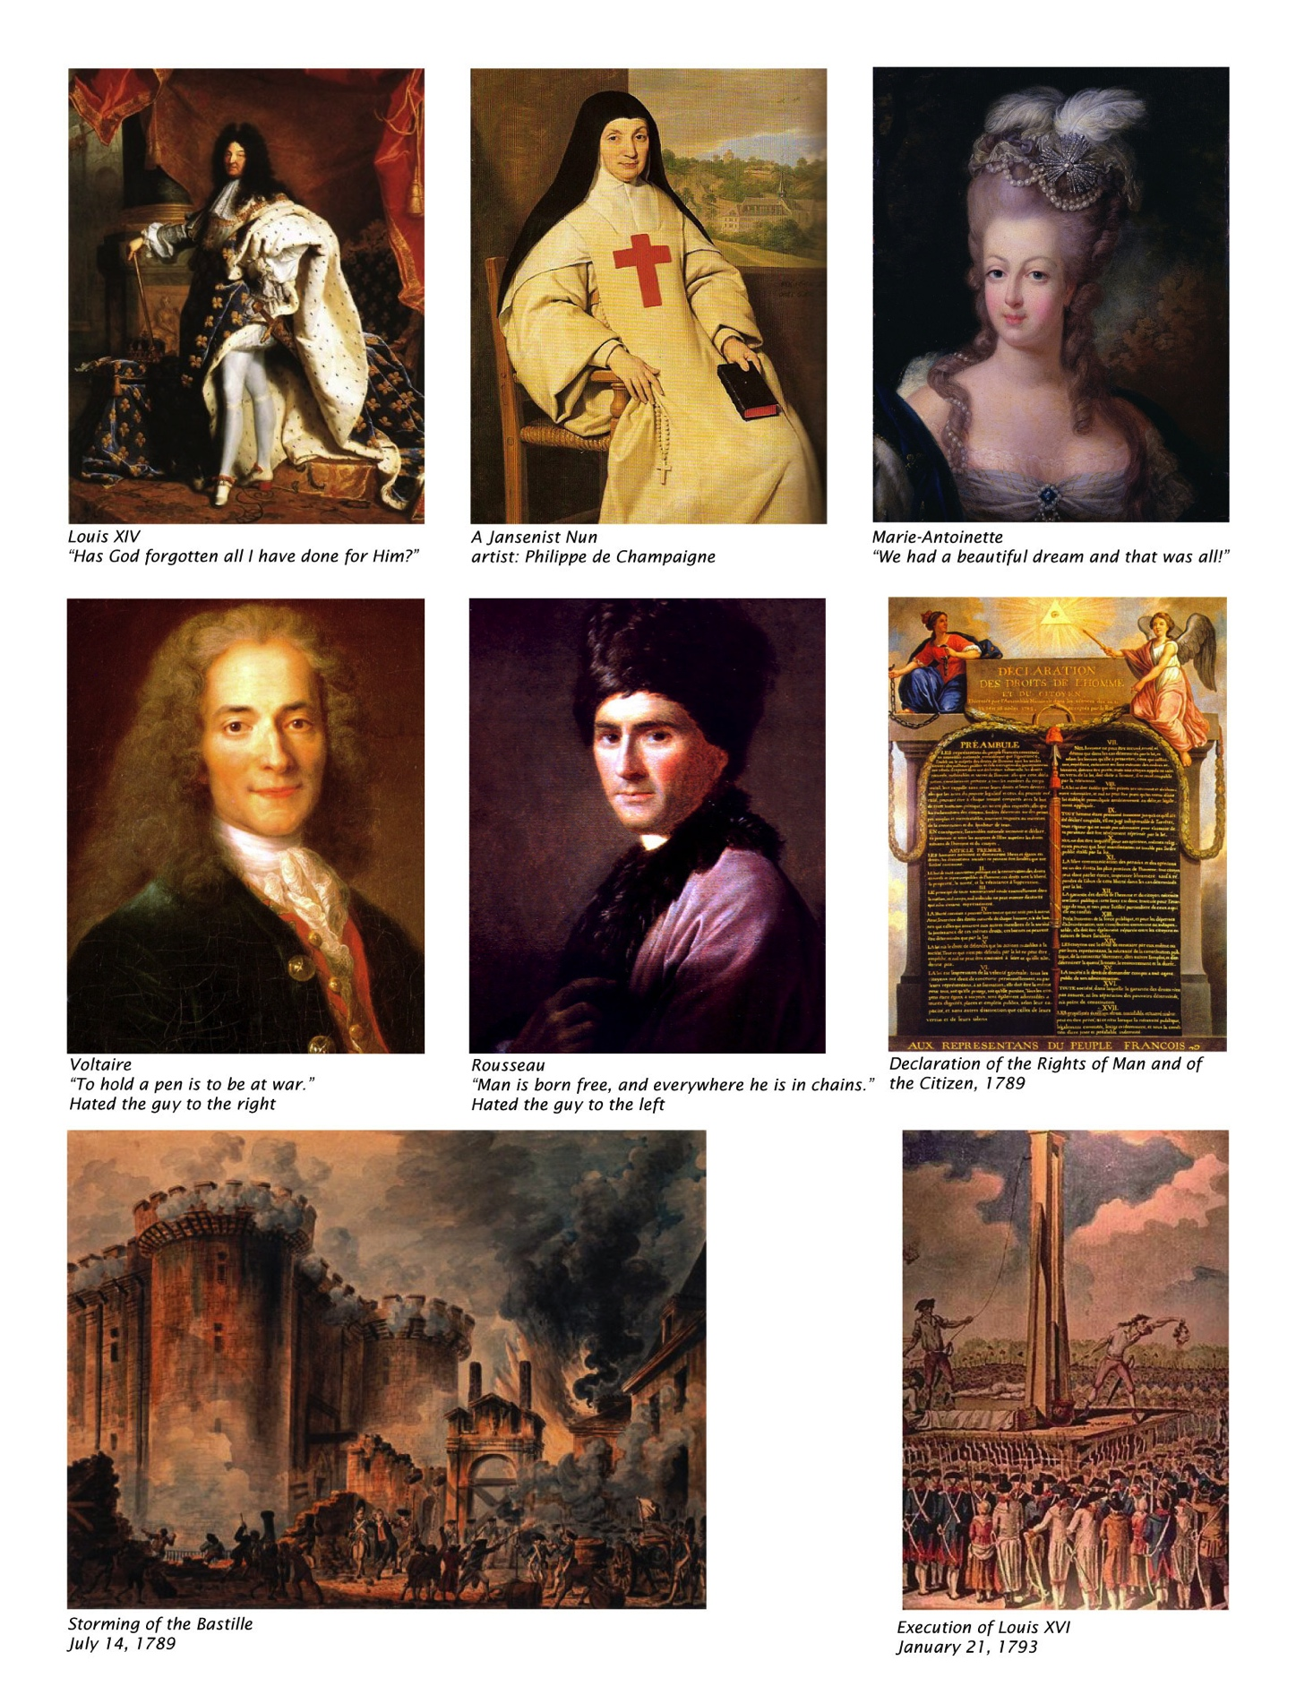
HI172 Modern France
Lecture 1
The Old Regime

Slide 2
Themes of Module
Legacies of the Enlightenment
Religion and secularisation
Rationality versus political will; tolerance and universalism
Rise of the nation and nationalism
Legacies of the Revolution
Panoply of –ism’s (liberalism, republicanism, socialism)
Social justice
War, revolution, civil unrest
Modernisation: economy, technology, urban space
Imperialism
Class and gender

Slide 3
What a fusion of the old and new regimes might look like
http://www.youtube.com/watch?v=rAaWvVFERVA

Slide 4
Old Regime
Dynasties, not nation states
Logic of dynasties:
‘Love and Marriage’
NO
WAR and marriage
Subjects and souls
NOT
Humans and Citizens

Slide 5
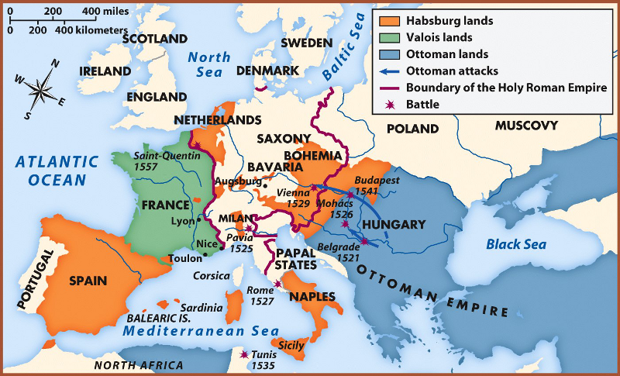
Dynastic Map of Continent, 16th c

Slide 6
Demographics of France
Largest kingdom in Europe, aside from Russia
1250 ad: 18 million
Late 17th century: 20-22 million
Late 18th century: 26-27 million
4/5 peasants living in villages
Low growth with intermittent catastrophes
Bubonic plague (last bout: Marseilles 1720)
Famines, disease, periodic cold
18th century breakthrough: potato

Slide 7
Population
1789 (26 million)
Clergy and nobles: 500k
Bourgeois (professionals, merchants): 1 million
Non-agrarian workers: 2 million
Vagabonds: 1.5 million (spike towards 1789)
Peasants: 21 million
Effects of population increase
Wages go down
Soldiers for revolutionary armies
Property crisis (more children survive into adulthood)
Vagrancy, brigandage on highways

Slide 8
Death is the Centre of Life
25% are dead by age of one
Another 25% by age of twenty
10% live until age of 60
If you live until 80: quasi-mystical, legendary role
Women
Elite and poor live different lives
Marriage for peasant women
Late 20’s: dowries, didn’t menstruate until age of 20, high rates of death in childbirth
10-15% never marry: domestic servants, prostitutes (elites→ nuns)

Slide 9
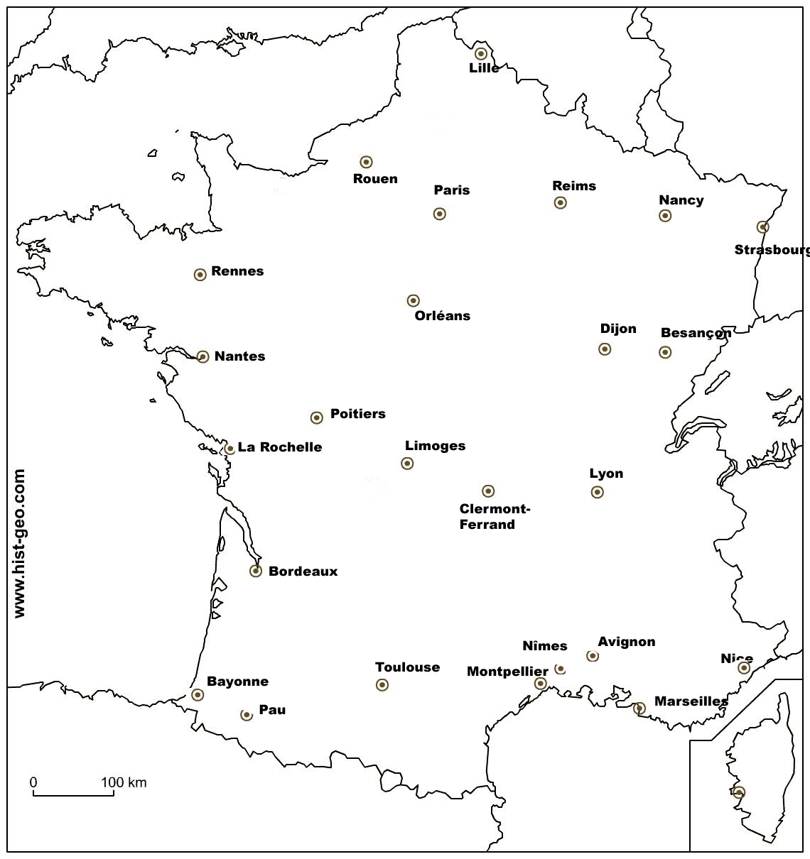
Cities

Slide 10
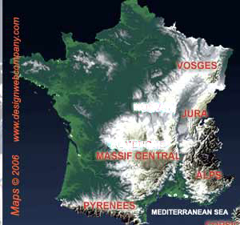
mountains

Slide 11
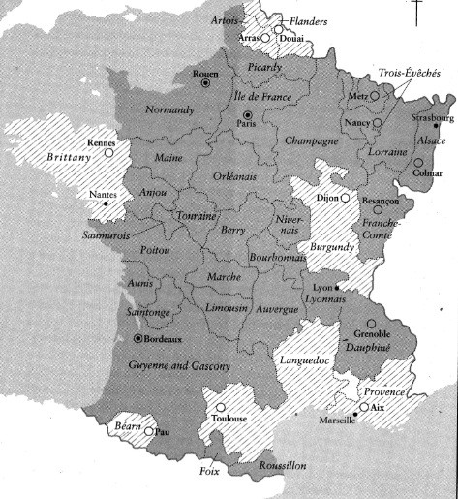
Regions: pays d’état vs. pays d’élection

Slide 12
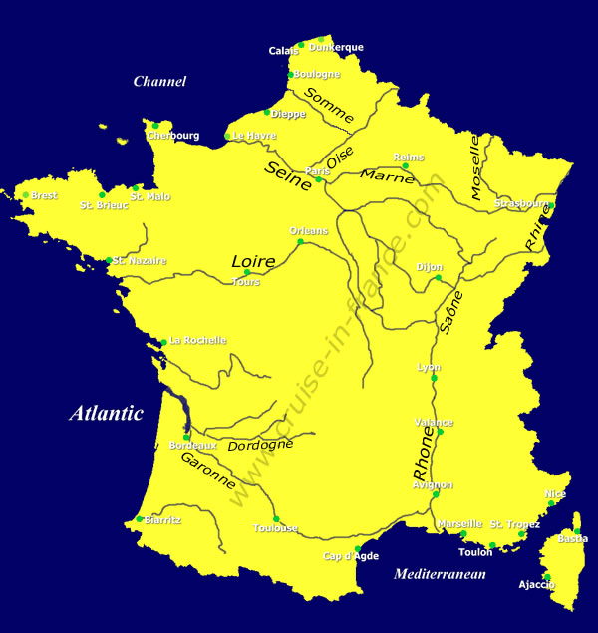
Rivers

Slide 13
Society of Orders
Clergy
Regular vs. secular
High ecclesiastics to poor parish priests
Nobles
Noblesse d’epée vs noblesse de robe
Commoners
Wealthy bourgeois to poor peasants

Slide 14
Society based on privilege
Privilege: lettres patentes
Privilege largely defined who one was
Esteem, status, deference
Financial considerations
Judicial considerations
Guilds and corporations
Parlements
Cities (corporations with specific sets of privileges)

Slide 15
Clergy – Religion
Wars of Religion (1560s-1590s)
Edict of Nantes
Limited toleration of Protestants (Calvinists)
Revocation of the Edict of Nantes (1685)
Jansenism
Augustinian strand within Roman Catholicism
Perceived by kings as a threat – repression
Parlements take up Jansenism and combine it with constitutionalism (influenced by Montesquieu)

Slide 16
Secularisation
Michel Vovelle’s examination of wills between 1700 and 1789)
Less focuses on afterlife
More property and belongings owned by 1789
Anti-clericalism (yes, for France) but also secular approach to religious knowledge (study of bible)
Secularisation or inward piety
Exceptions: e.g., Brittany, Vendée (western France)
Explodes in counterrevolutionary violence in 1790s
Official status of Catholicism contested 1789-1905

Slide 17
Nobles
Noblesse d’épée vs. noblesse de robe
Attributes
Men were nobles; wives took the status of husbands
Often the particle ‘de’ but not always
Most frequent: baron
Least: duke
Coat of arms
Fiefs and seigneuries (some commoners could have seigneuries, in which case the privilege and status were attached to the land, not the person)

Slide 18
Honorific status
Can wear sword
If convicted of capital offence: never hanged but decapitated
Cannot be merchant or doctor (though efforts to change this over 17th and 18th century)
High officers in army
Do not pay the taille (main royal tax)

Slide 19
Venality
Purchase of offices and sinecures
Raises quick cash for king
Market for offices (a kind of property, but not entirely)
Could be bequeathed if one paid a tax
Offices generated revenues
Tax Farms
Kind of privatized exchequer combined with merchant and investment banks… not very transparent

Slide 20
Units of society
Parish
Tithe
Parish church
Religious and administrative functions
Seigneurie
Before 18th c – largely self-contained society
Economic, justice, religion
18th
Absenteeism, squeeze seigneurie for both markets and feudal dues..
Capitalism and feudalism combined
Land rents (increase over 18th)
Feudal dues: banalités, cens

Slide 21
Changes in nobility
Honour + Honnêteté
Courage, racial blood + civilized, polite behavoir
Might buy one’s way into nobility
Purchasing noble lands (southern France)
Purchase office
Recherches de noblesse
From vassalage to clientelism
Some taxes imposed over 18th century

Slide 22
Absolutism: myth or reality?
Divine right absolutism and great chain of being
From vassalage to court clientelism in early modern period (16th-18th century)
Versailles
Fixed court; source of influence and patronage
Social collaboration
Taxes and redistribution to elites
Venality of office

Slide 23
Changes in kingship
Ritual
Coronations
Royal Entries
Cathedrale of Reims
Constitutionalism

