Slide 1
The Cookbook As Historical Document

Slide 2
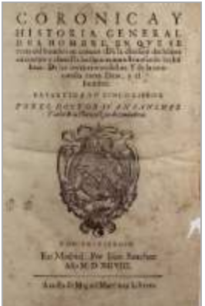
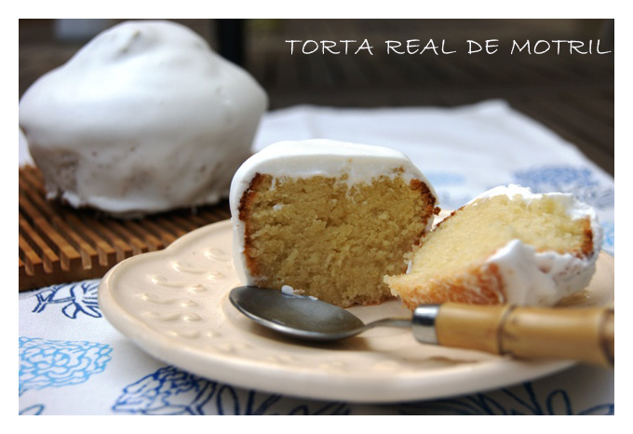
Juan Sánchez, Corónica y historia general del hombre (1598).
‘There is no need for me to explain blancmange, or ‘torta real’ or lamb stew, or any of the other dishes that women invent every day, as anyone can look these up in a cookbook.’

Slide 3
A Brief History of Cookbooks

Slide 4
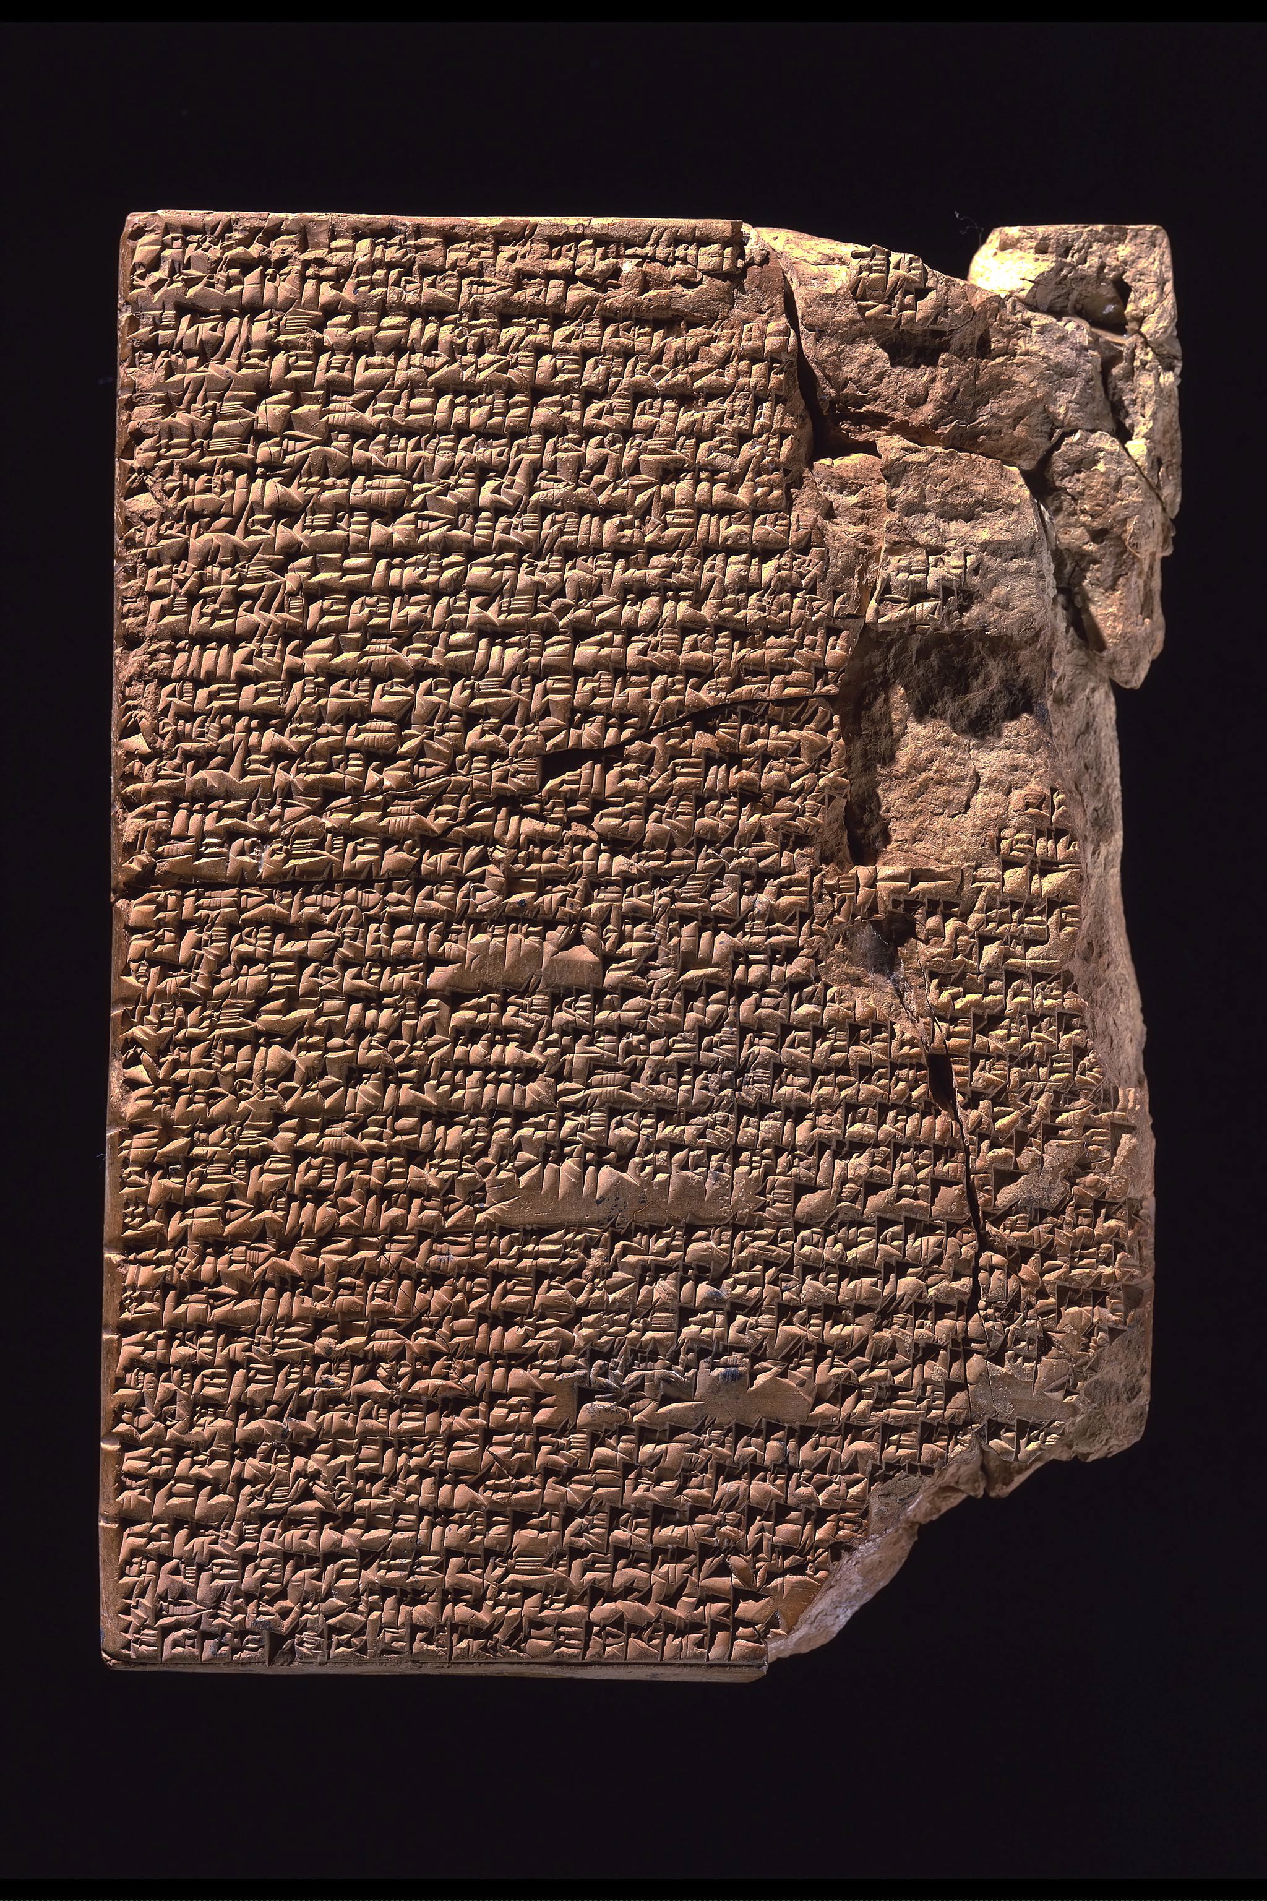
The Oldest Known Cookery Book three Mesopotamian cuneiform tablets (c.1750 BCE)
Contains 25 recipes for stews . . .

Slide 5
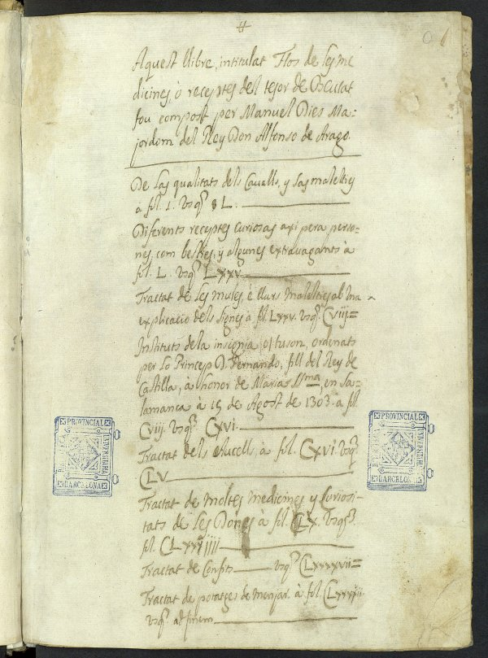
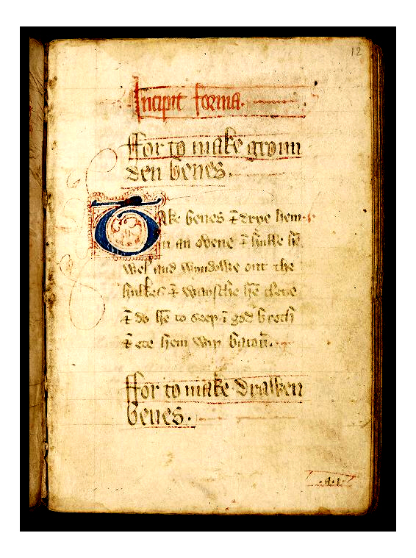
Some Medieval Cookery Books
Libre de Sent Sovi, c. 1324 (Catalan cookbook and health manual)
The Forme of Cury, c. 1390 (an early English cookery book, probably by Richard II’s cook)

Slide 6
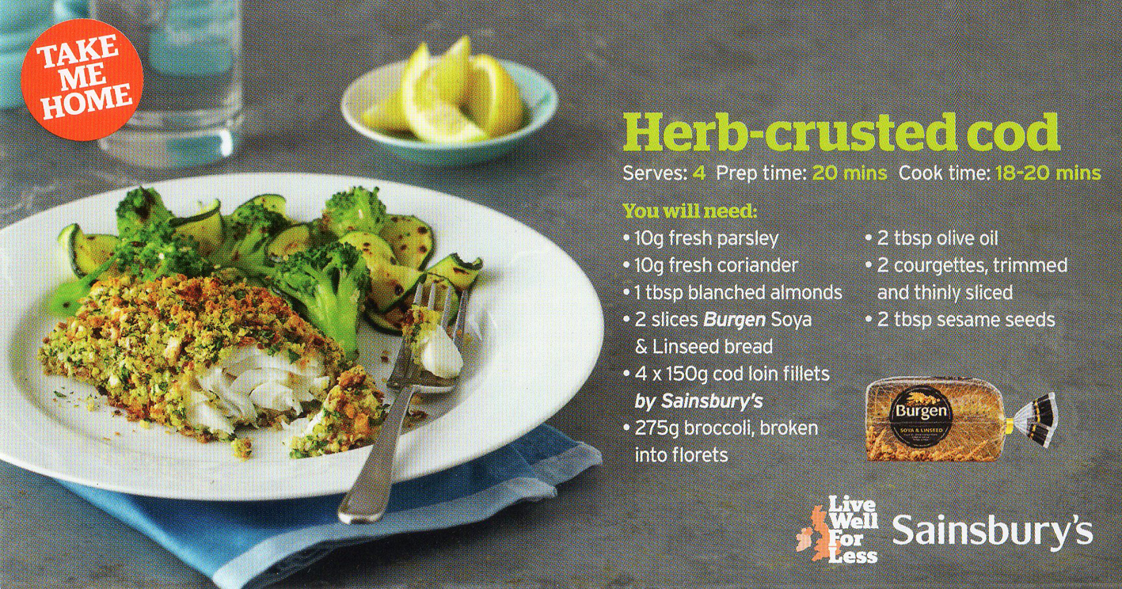
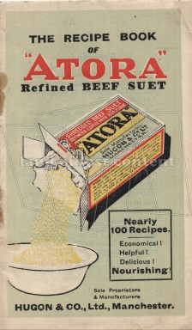
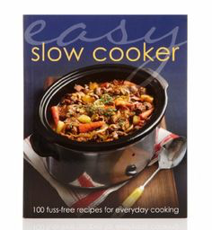
Cookbooks and the Modern Food System
Cookbooks for
industrial foods
new domestic appliances
supermarkets

Slide 7
What can we learn from cookbooks? (other than how to cook. . . )

Slide 8
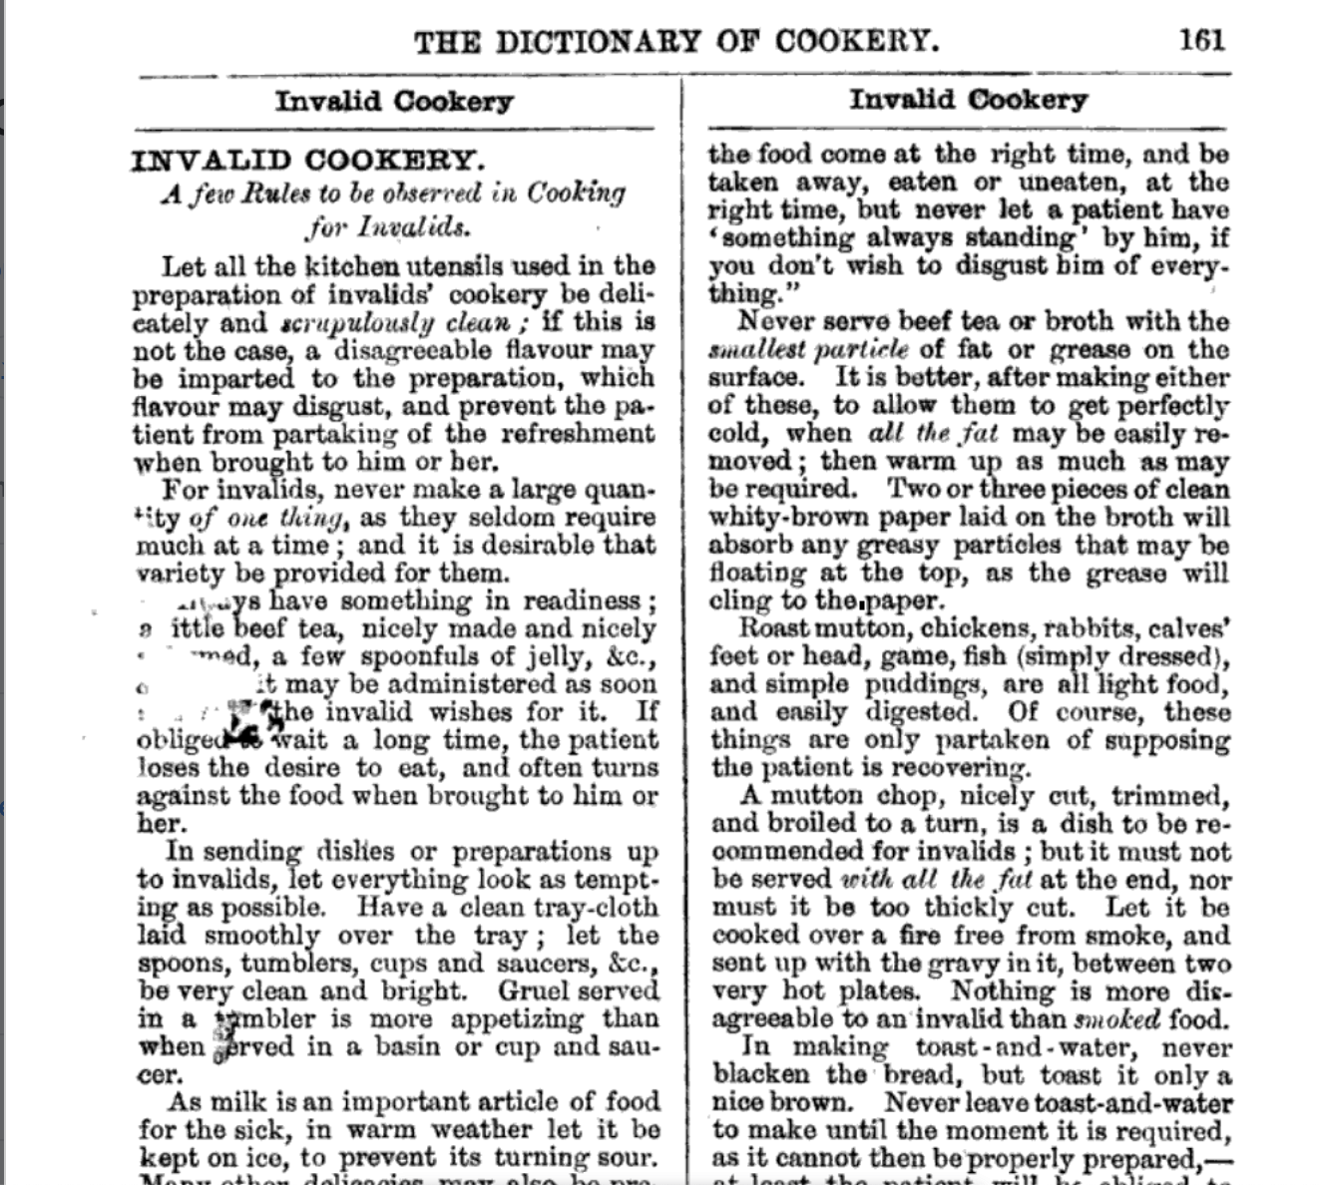
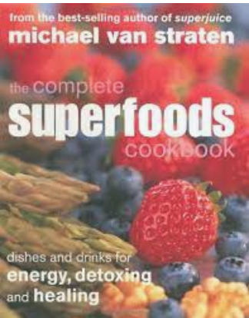
Cookbooks can reveal . . .
prescriptive ideas about what we should eat
(ideas about health, recommended diets …)
Isabella Beeton, Mrs Beeton’s Dictionary of Every-Day Cooking (London, 1865).

Slide 9
Cookbooks can reveal . . .
prescriptive ideas about what we should eat
lived experience and daily life
(cooking technologies, typical ingredients, preferences, presence of particular foods, commercial or trading networks)

Slide 10
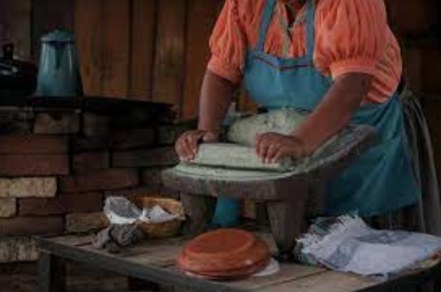
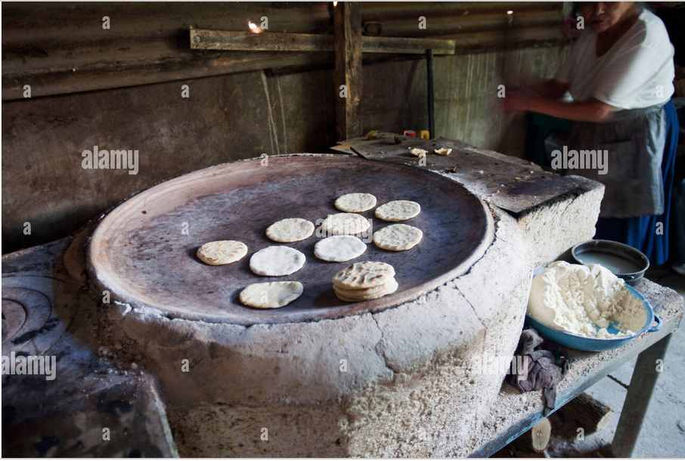
An Example from Colonial Mexico
An 18th-century manuscript cookbook that includes no recipes reflecting indigenous culture . . . BUT the cooking instructions do reflect indigenous cooking technologies such as using a metate or griding stone or cooking on a comal.

Slide 11
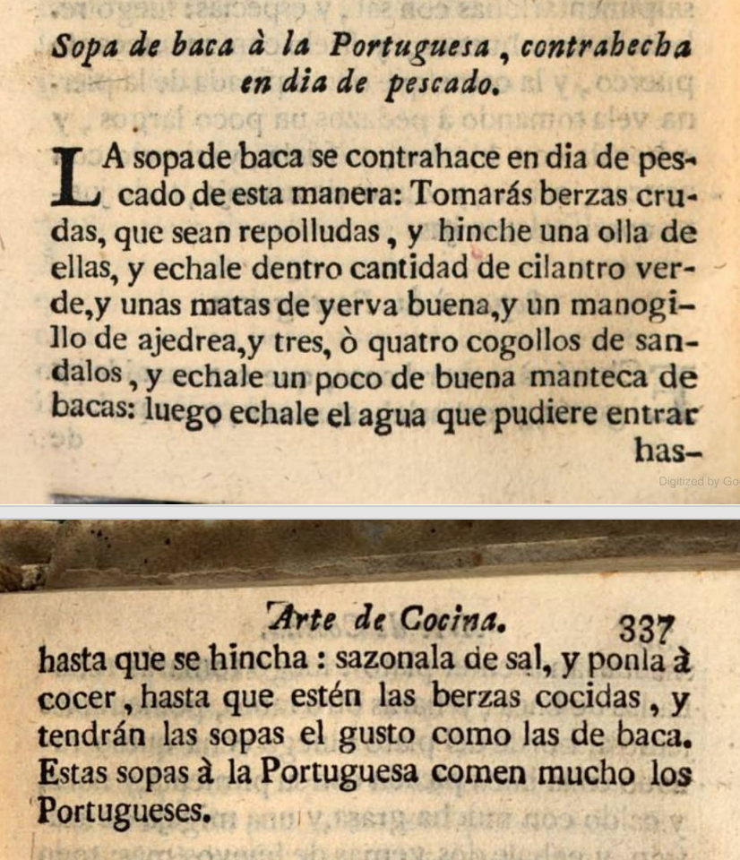
Cookbooks can reveal . . .
prescriptive ideas about what we should eat
lived experience and daily life
regional and national identities
(dishes labelled as regional or national, nation-building discourse)
‘Beef soup in the Portuguese Style. . . These Portuguese-style soups are much eaten by the Portuguese.’
Francisco Martinez Montiño, Arte de cocina, pasteleria, vizcocheria, y conserveria (Madrid, 1778; first published 1611).

Slide 12
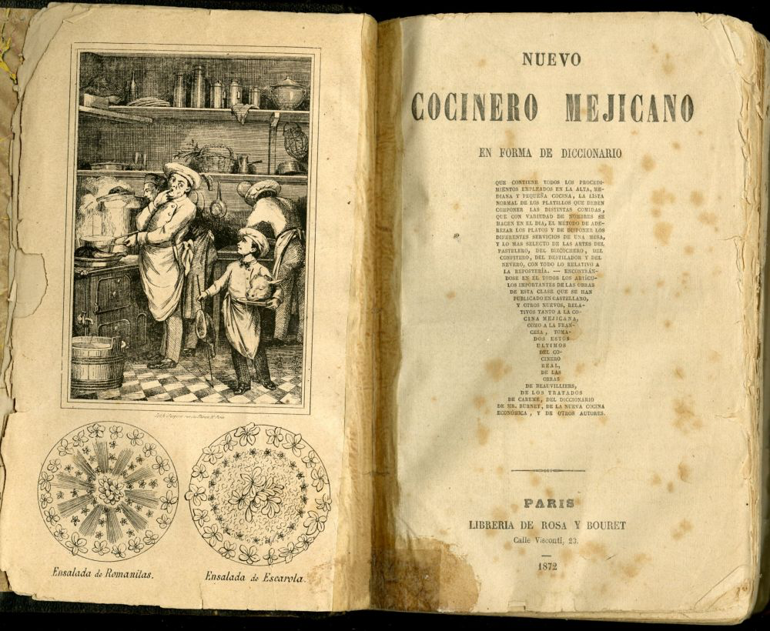
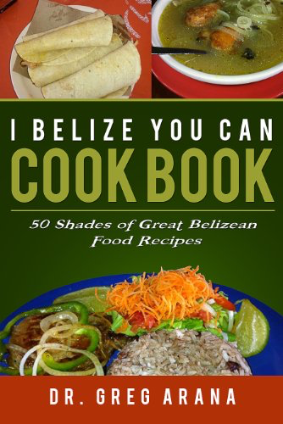
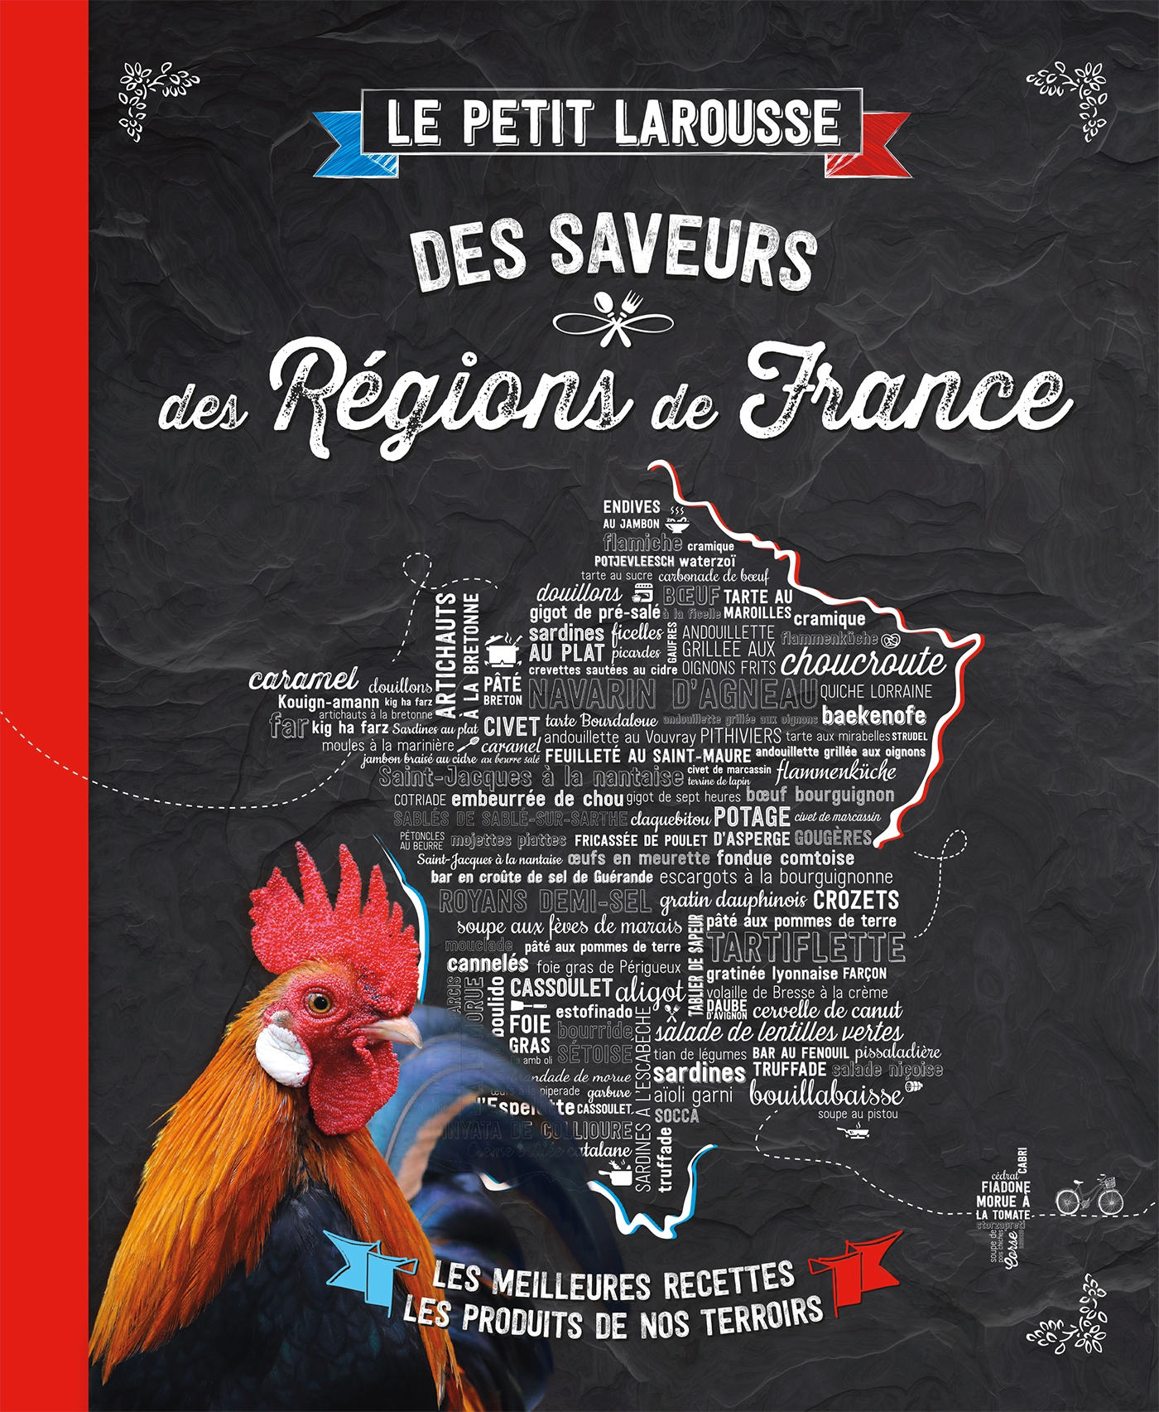
Cookbooks as Sites of Nationalism
Cookbooks are ‘highly effective instruments in the creation and consolidation of national identity’.
Kaori O’Connor, ‘The King’s Christmas Pudding: Globalization, Recipes, and the Commodities of Empire’, Journal of Global History 4 (2009).

Slide 13
Cookbooks can reveal . . .
prescriptive ideas about what we should eat
lived experience and daily life
regional and national identities
ideas about race and identity

Slide 14
Cookbooks, Race, and Racism A Cuban Example
‘By silencing, ignoring, trivializing, and mocking nonwhite Cubans and their culinary traditions, the writers of nearly every cookbook from 1900 to 1959 endeavor to position Cuba as principally European and white.’
Christine Folch, ‘Fine Dining: Race in Prerevolution Cuban Cookbooks’, Latin American Research Review 43:2 (2008).

Slide 15
Cookbooks can reveal . . .
prescriptive ideas about what we should eat
lived experience and daily life
regional and national identities
ideas about race and identity
ideas about accuracy and expertise
(the growing importance of quantification, or of first-hand experience)

Slide 16
The Growing 19th-century Emphasis on Precision
William Kirchiner’s 1817 The Cook’s Oracle boasted ‘a precision never before attempted in former cookery books’ because his cookbook gave ‘the quantity of each article . . . accurately stated by weight and measure’.
Isabella Beeton insisted that ‘among the most essential requirements of the kitchen are scales and weighing machines’.
By 1867 the French cook Jules Gouffré could promise that he had not written a single recipe ‘without having constantly the clock under my eyes and the scales in my hand’.

Slide 17
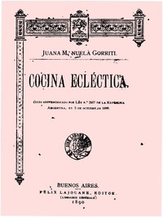
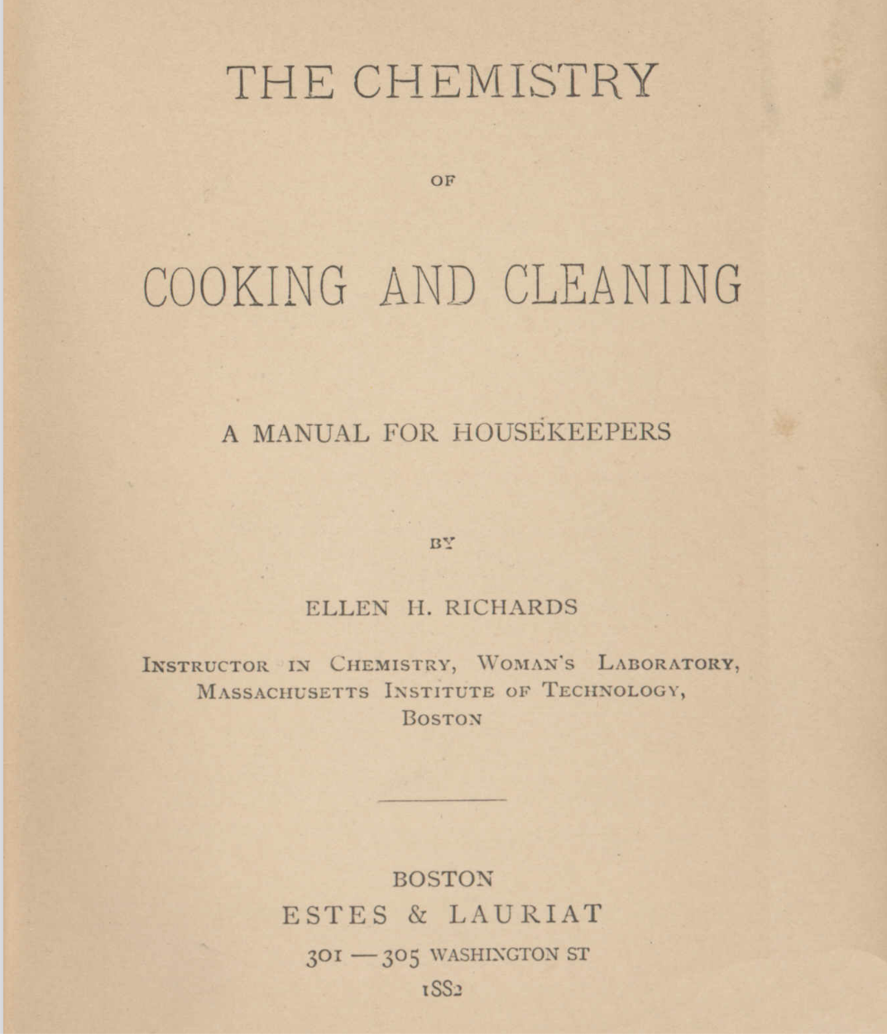
Cooking: Science for Women
The kitchen as laboratory
Model kitchen designed by Ellen Richards, 1890s
Juana Manuela de Gorriti, Cocina ecléctica [Eclectic Cookery (1890).
Gorriti described cooking as ‘a science particularly suited to women’.

Slide 18

Cookbooks can reveal . . .
prescriptive ideas about what we should eat
lived experience and daily life
regional and national identities
ideas about accuracy and expertise
ethical and aesthetic systems and values

Slide 19
Cookbooks as ‘Complete Food Ideologies’
Cookbooks are ‘complete food ideologies . . . a way of thinking about the world that is part of a larger esthetic, political, or social mindset’.
Ken Albala, 'Cookbooks as Historical Documents', Oxford Handbook of Food History, ed. Jeffrey Pilcher (2012).

Slide 20
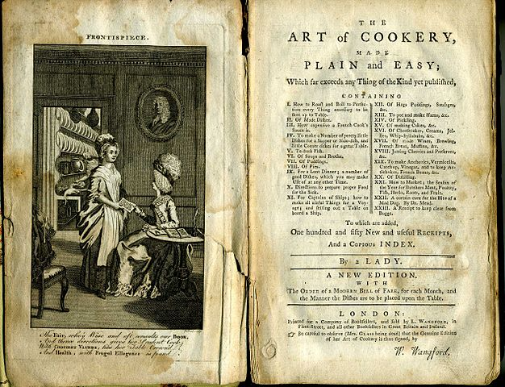
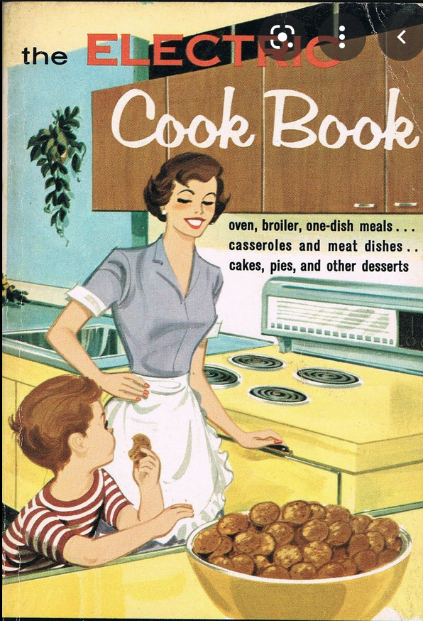
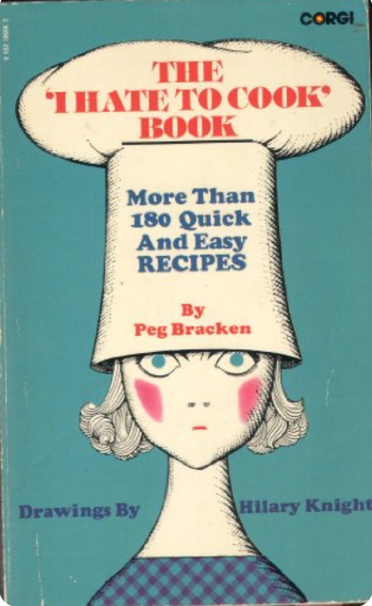
women and cookbooks

Slide 21
Janet Theophano, Eat My Words: Reading Women’s Lives Through the Cookbooks They Wrote (2002).
‘For hundreds of years women of diverse backgrounds have found the homely cookbook a suitable place to record their stories and thoughts as well as their recipes.’
‘The cookbook, like the diary and journal, evokes a universe inhabited by women both in harmony and in tension with their families their communities and the larger social world.’

Slide 22
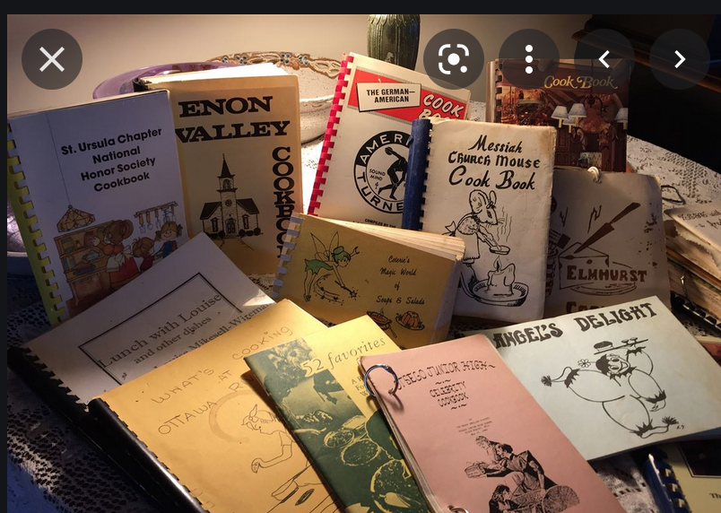
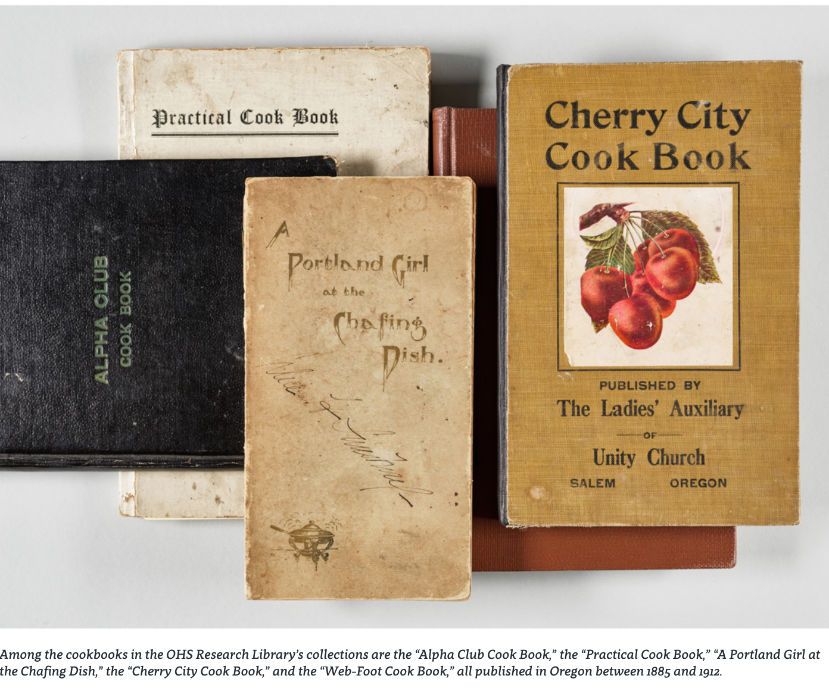
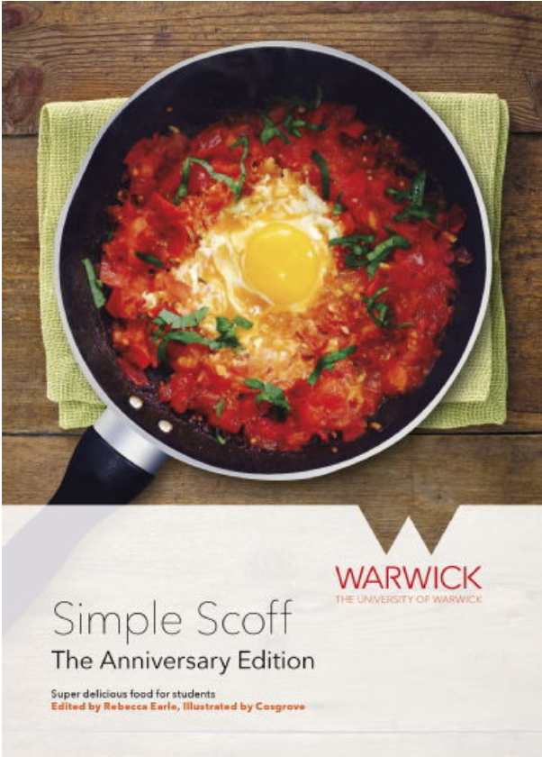
‘Compiled’ or ‘Community’ Cookbooks

Slide 23
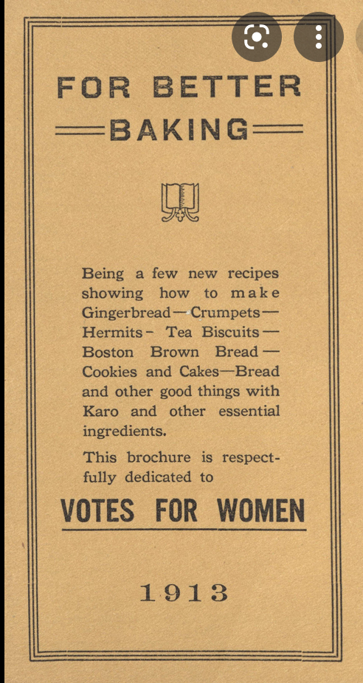
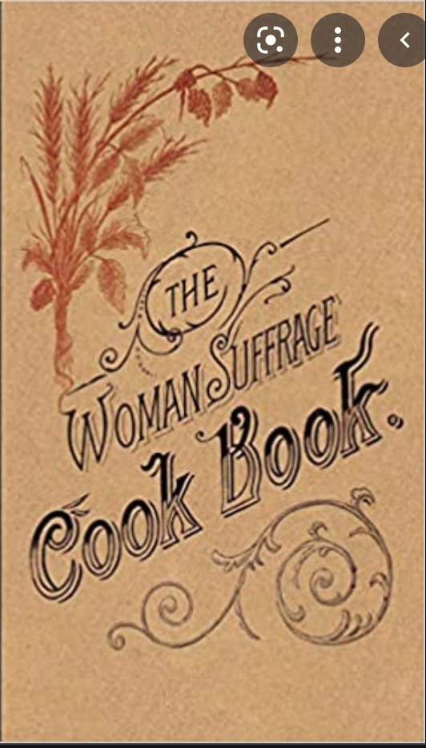
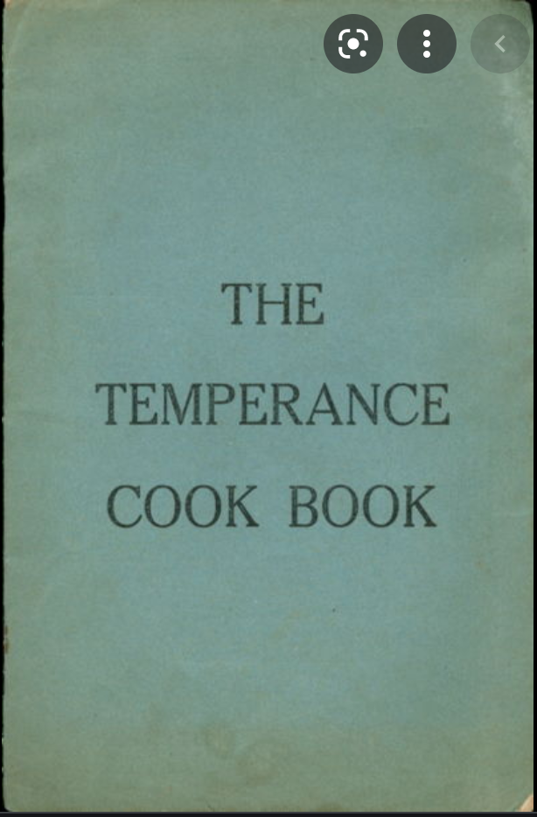
‘Politicised Domesticity’

Slide 24
‘Politicised Domesticity’
‘While few women had a public voice in running the major institutions of 19C society (they were often excluded, for example, from handling church money), their voices were heard, at least to some extent, when they participated in community cookbooks.’
Anne Bower, ‘Cooking Up Stories: Narrative Elements in Community Cookbooks’, Recipes for Reading: Community Cookbooks, Stories, Histories, ed. Anne Bower (1997).

Slide 25
Recipes Sharing as ’Feminine Knowledge’?
Recipe sharing is an ‘almost prototypical feminine activity’.
Exchanging recipes, and recognising the importance of such exchanges, is a ‘“feminine” knowledge’.
Susan Leonardi, ‘Recipes for Reading: Summer Pasta, Lobster à la Riseholme, and Key Line Pie’, PMLA 104 (1989).

Slide 26
Cookbooks as Literature
We can analyse cookbooks using literary concepts:
setting (references to or photographs of particular places)
voice (of contributors, or the editor)
characters (anecdotes about the people whose recipes are described)
Plot
Anne Bower, ‘Cooking Up Stories: Narrative Elements in Community Cookbooks’, Recipes for Reading: Community Cookbooks, Stories, Histories, ed. Anne Bower (Amherst, 1997)

Slide 27
Some of Bower’s Cookbook ‘Plots’
The ‘historical’ plot
The ‘differentiation’ plot

Slide 28
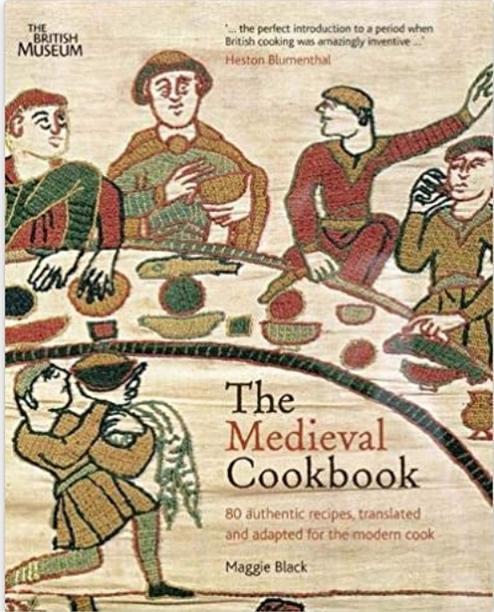
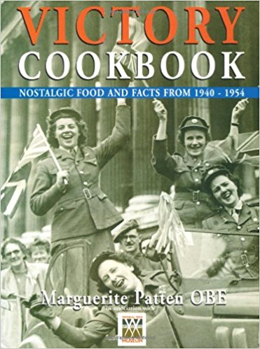
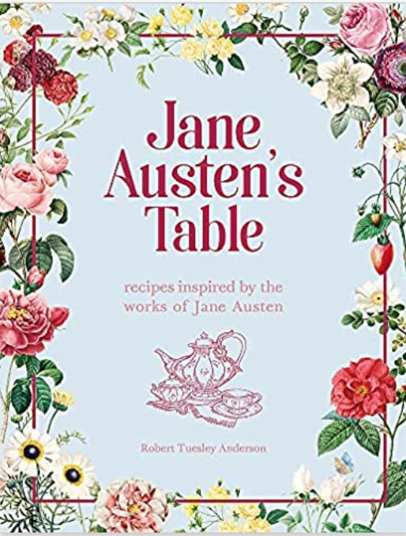
The Historical Plot

Slide 29
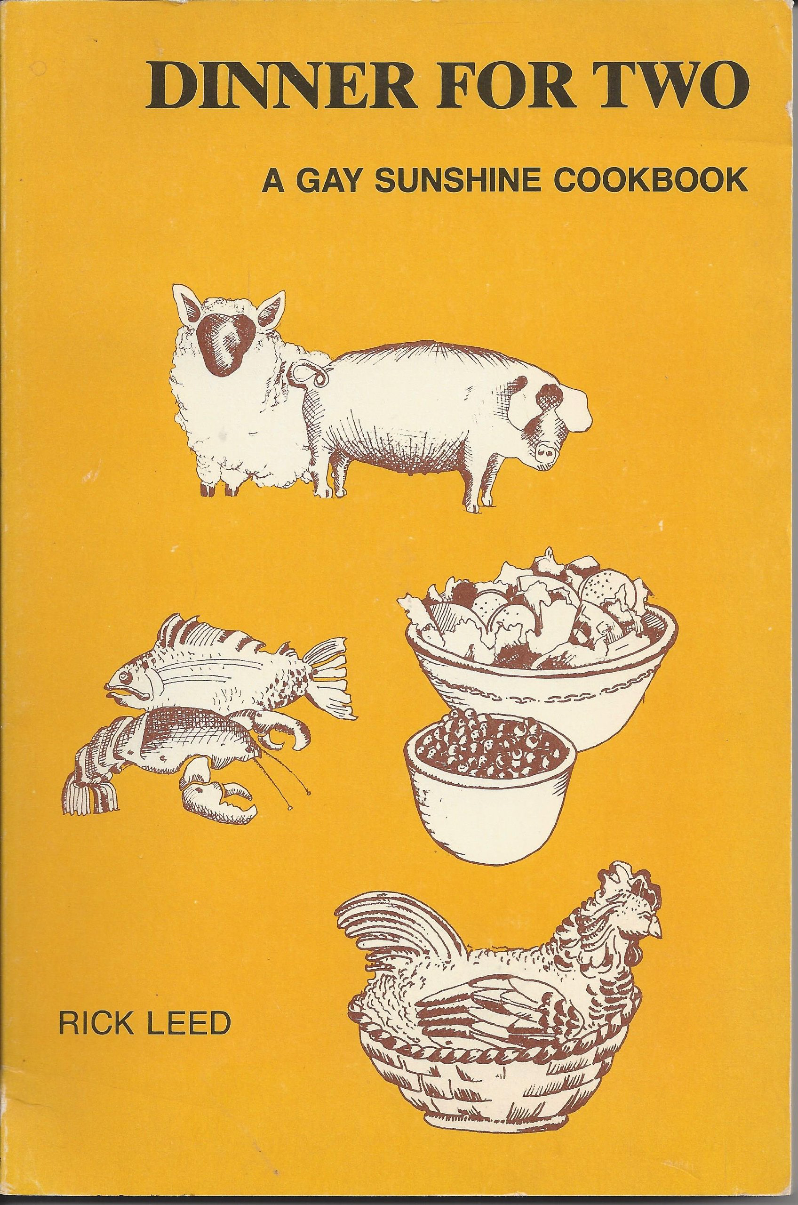
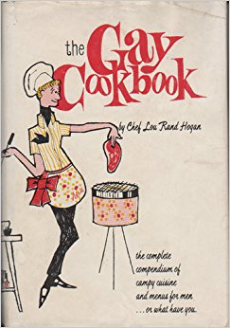
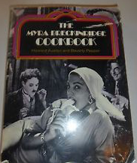
The Differentiation plot: Gay Cookbooks

Slide 30
Barbara Wheaton’s 5 Approaches for Studying Cookbooks
Read the cookbook to study the ingredients
Read it for what it says about the kitchen, the cooking methods and the equipment
Read it to understand the meals it aims to create
Read it to find the voices of the author, the publisher, the intended reader and the person eating the food
Read it as a material, physical object

Slide 31
‘To read a text and then to write about it is to seek to connect not only with the author of the original text, but also with a community of readers.’
(Patrocinio Schweickart )
‘A recipe event’

