Slide 1
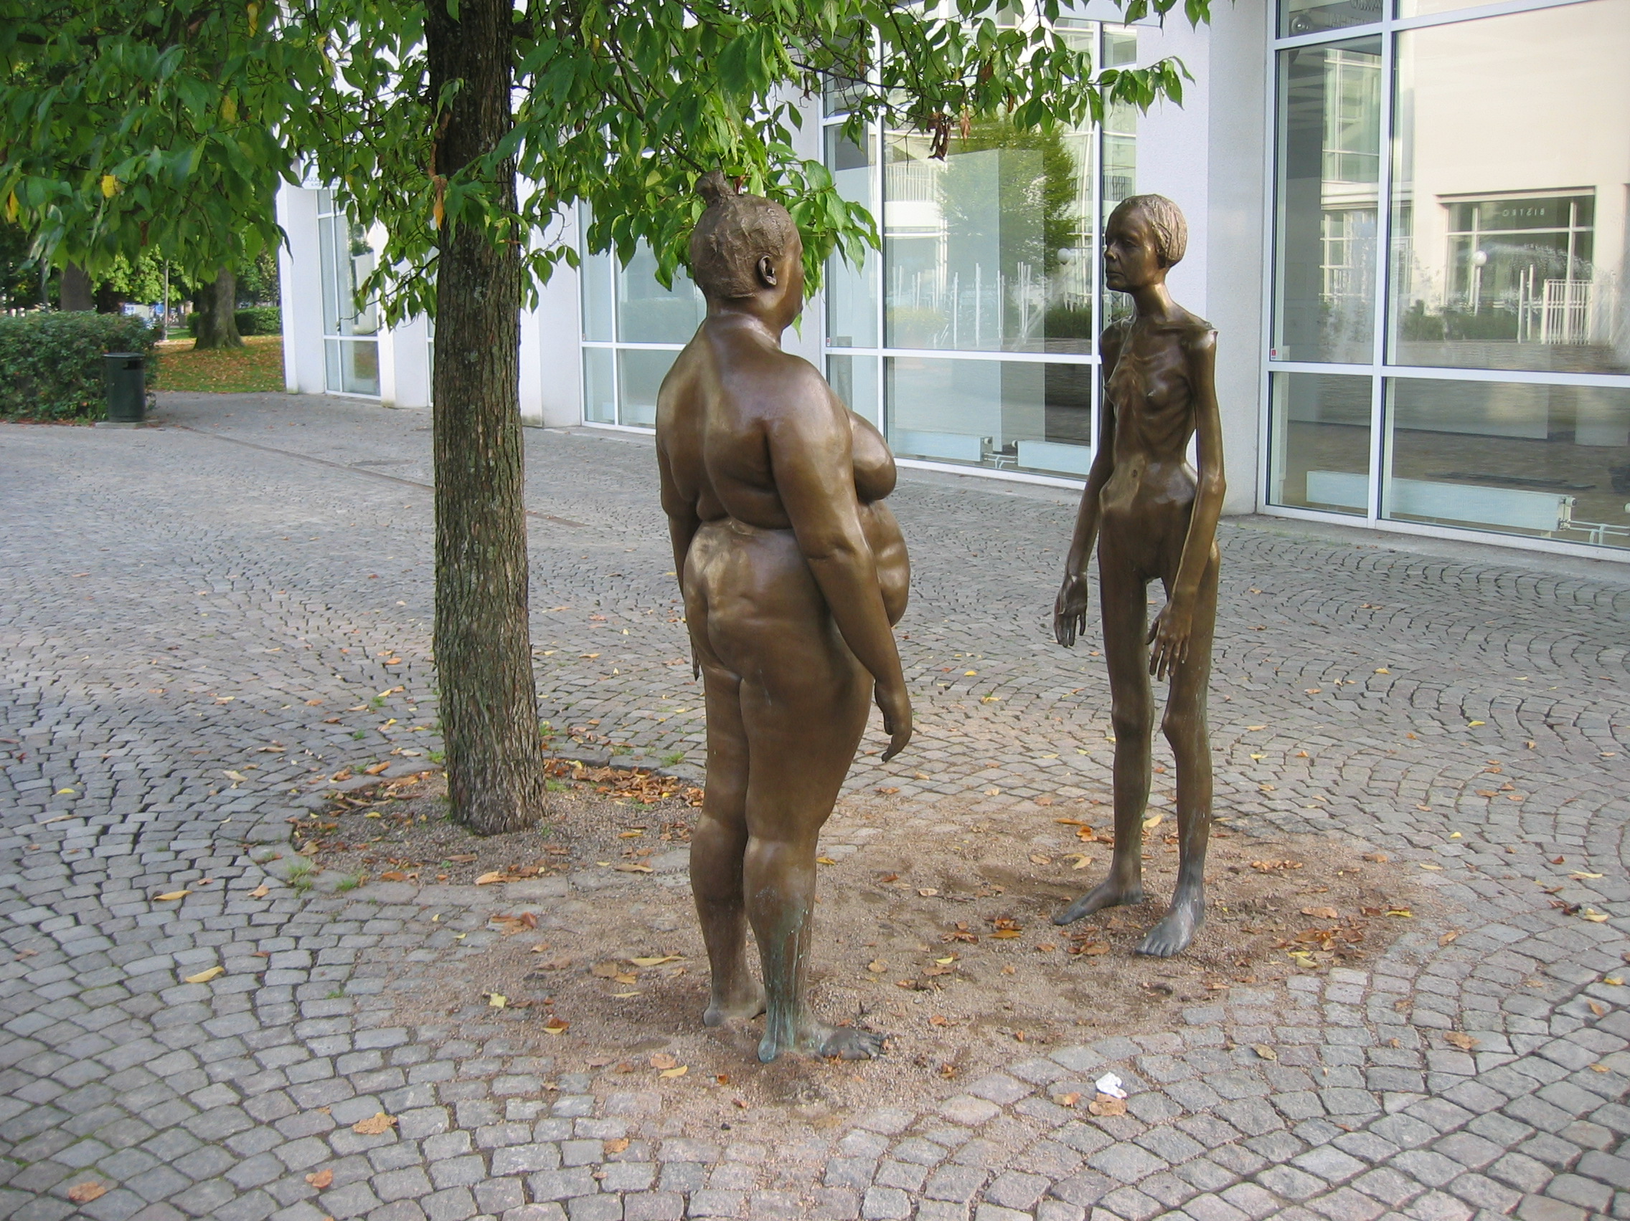
Dieting, Discipline and Fat as a Feminist Issue
Marianne Lindberg De Geer, ‘I Think of Myself’ (2005), Växjö, Sweden.

Slide 2
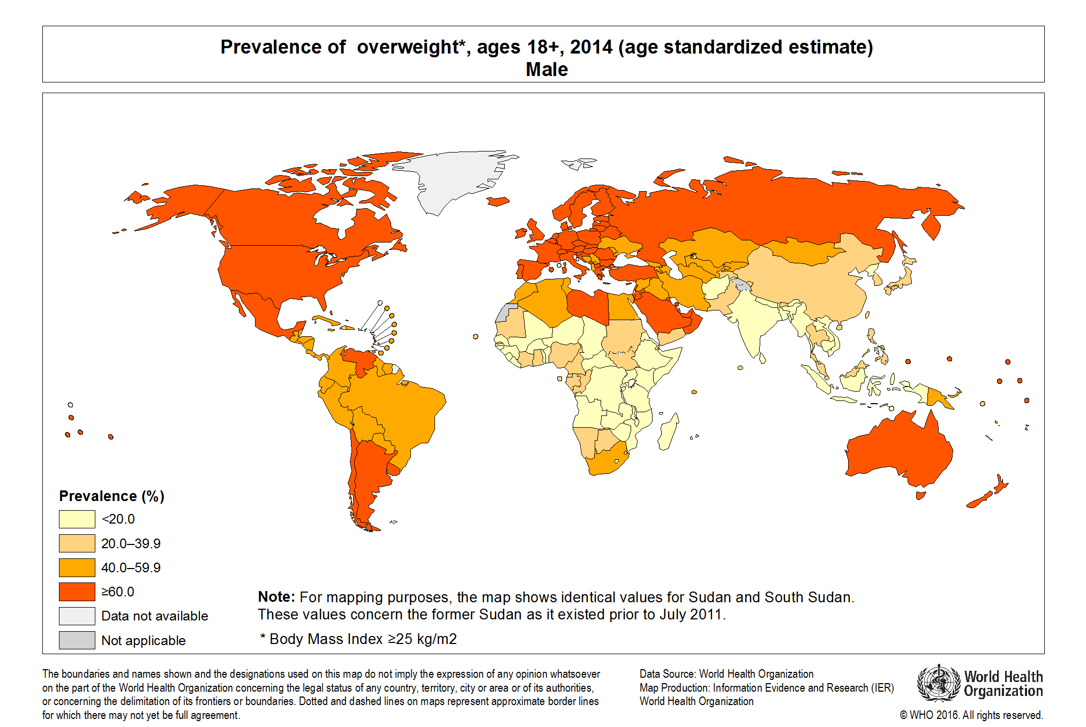

Slide 3
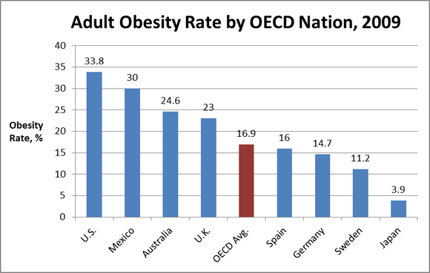

Slide 4
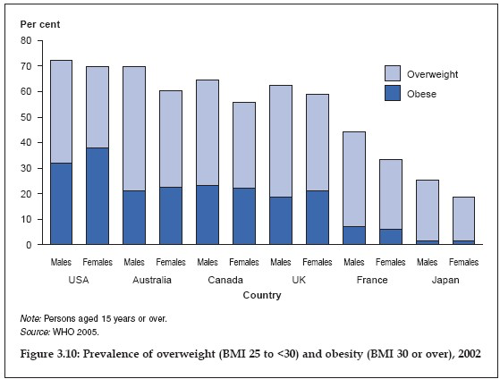

Slide 5
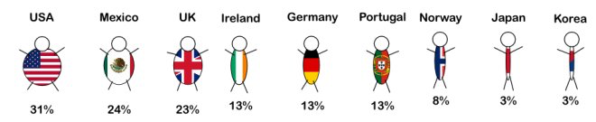

Slide 6
‘Fat Profits’?
‘The global weight loss and weight management market is expected to reach $206.4 billion by 2019 from $148.1 billion in 2014, growing at a CAGR of 6.9% from 2014 to 2019’ (PR Newswire, 23 April 2015)
‘Companies growing fat as you slim: The growth of the weight loss market’ (Metro, 30 Jan. 2014)
‘Fat profits: how the food industry cashed in on obesity’ (Guardian 7 Aug. 2013)

Slide 7
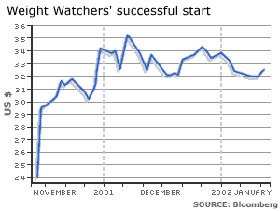
Weight Watchers share prices since flotation in 2000

Slide 8
Foucault and Docile Bodies

Slide 9
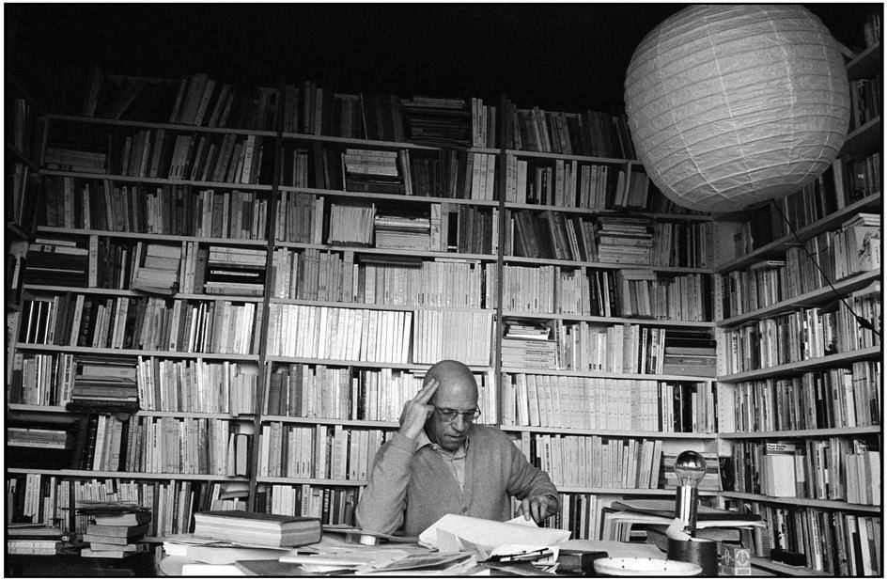
Michel Foucault (1926-1984)

Slide 10
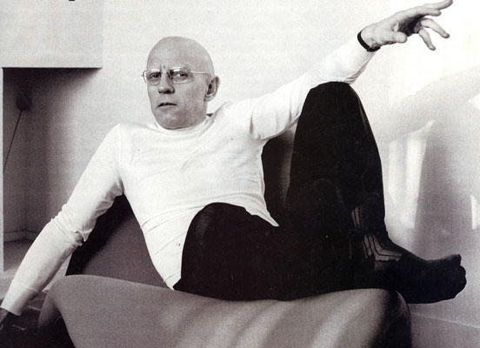
Foucault ‘Postmodernism’

Slide 11


Discipline and Punish (1975)
‘docile bodies’

Slide 12
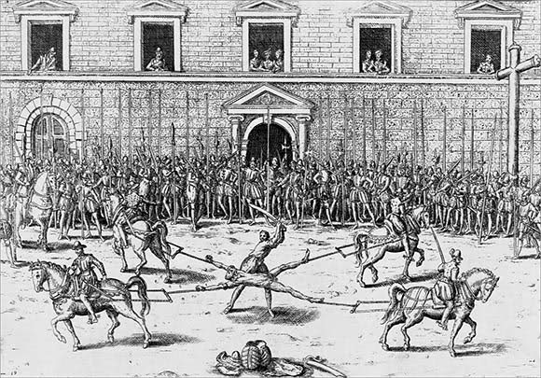
From ‘sovereign power’. . .

Slide 13
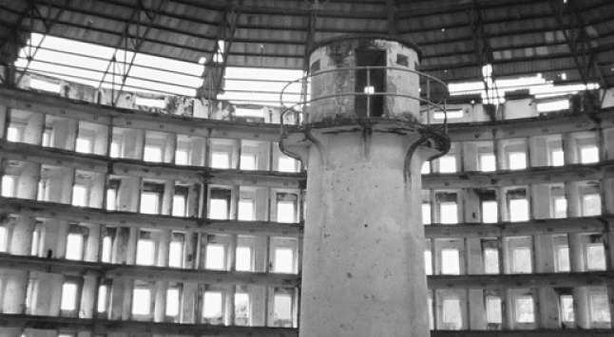
to ‘docile bodies’

Slide 14
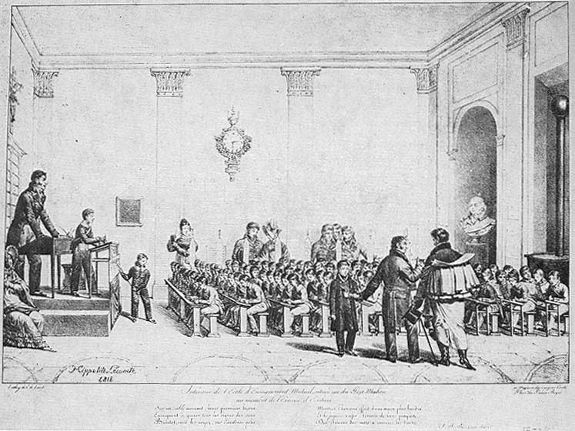
‘docile bodies’ behaving appropriately

Slide 15
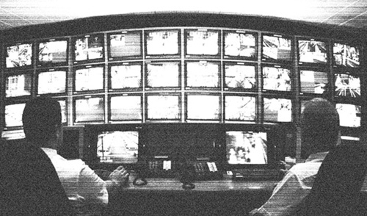
Hierarchical observation

Slide 16
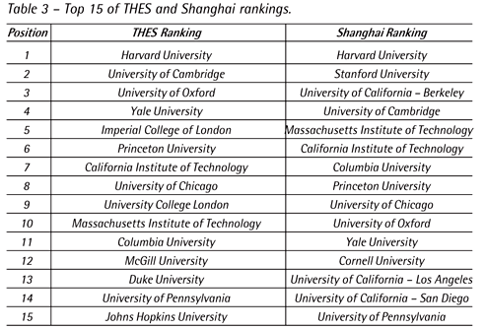
Normalising judgement

Slide 17

Examination

Slide 18
Foucault, Power/Knowledge (1980)
The nature of power is to
‘circulate through progressively finer channels, gaining access to individuals themselves, to their bodies, their gestures and all their daily actions’.

Slide 19
Dieting and Discipline

Slide 20
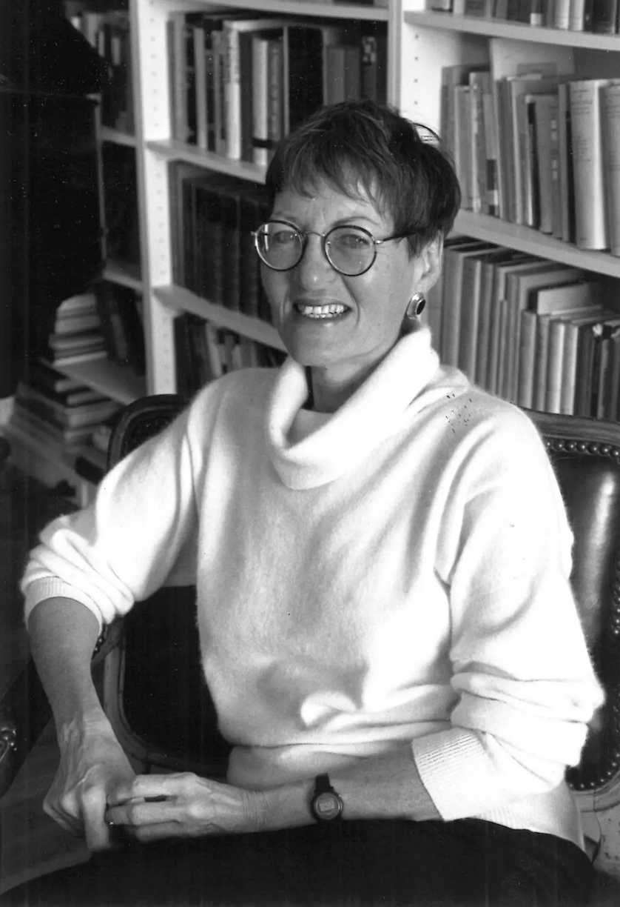
Sandra Lee Bartky 1935-2016

Slide 21
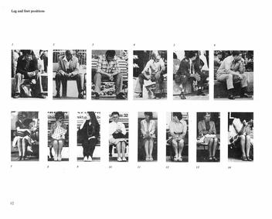
Marianne Wex, ‘Let’s Take Back our Space’ project (1979)

Slide 22
Sandra Lee Bartky, ‘Foucault, Femininity, and the Modernization of Patriarchal Power’, Feminism and Foucault: Paths of Resistance, eds. Lee Quinby and Irene Diamond (1988).
‘Dieting disciplines the body’s hungers: appetite must be monitored at all times and governed by an iron will. Since the innocent need of the organism for food will not be denied, the body becomes one’s enemy, an alien being bent on thwarting the disciplinary project.’

Slide 23
Bartky, ‘Foucault, Femininity, and the Modernization of Patriarchal Power’
‘The woman who checks her makeup half a dozen times a day to see if her foundation has caked or her mascara has run, who worries that the wind or the rain may spoil her hairdo, who looks frequently to see if her stockings have bagged at the ankle or who, feeling fat, monitors everything she eats, has become . . . a self-policing subject, a self committed to a relentless self-surveillance.’

Slide 24
Katharina Vester, ‘Regime Change: Gender, Class and the Invention of Dieting in Post-Bellum America’, Journal of Social History 44:1 (2010).
Nineteenth-century dieting advice promised men ‘that their influence, political power and social privileges would grow as their waistlines slimmed’.

Slide 25
Vester, ‘Regime Change’
‘The male body exhibiting visible self-control was used as testimony for the biological superiority of men over women, class privilege, and white supremacy. Expert discourses establishing hegemonic body ideals and administering disciplinary practices, such as medical advice, beauty manuals, literature and the newly emerging genre of diet advice in magazines and newspapers, presented men’s dieting as part of that claim.’

Slide 26
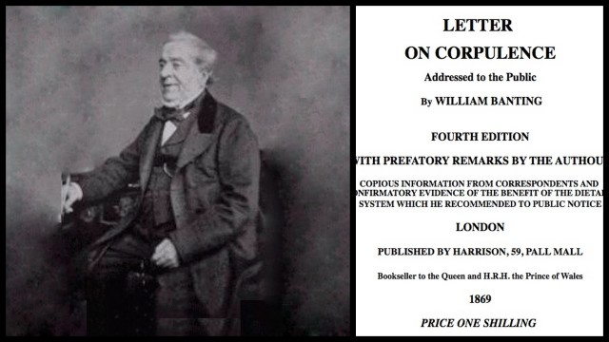
William Banting
‘banting’—dieting

Slide 27
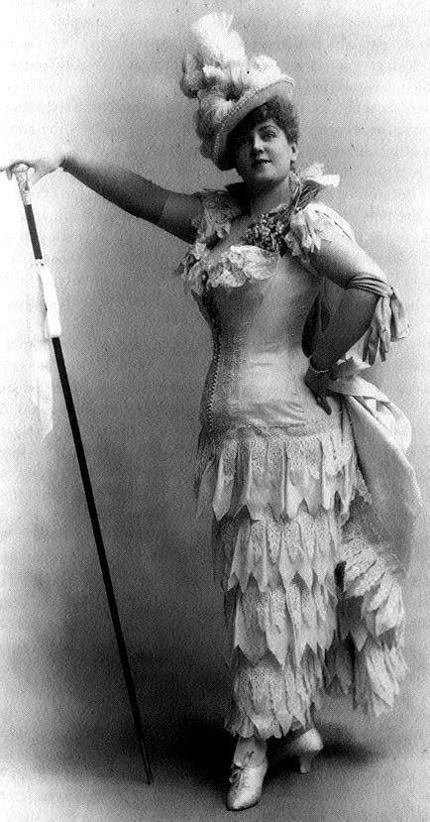
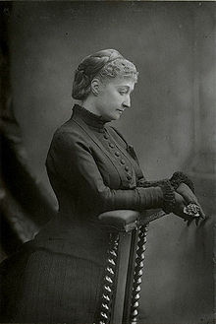
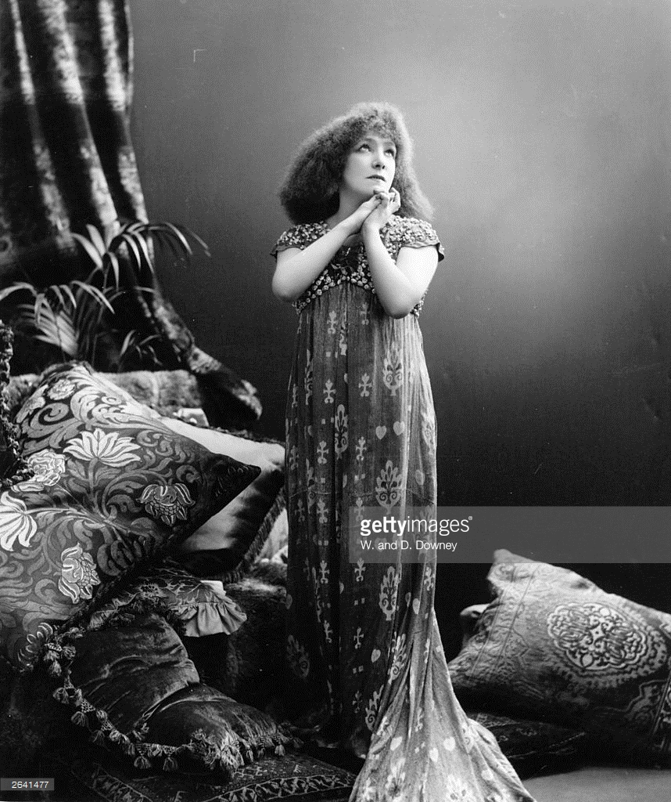
“I would give the world to be as plump as Miss –.’ How to be Plump (Chicago, 1878).
Sarah Bernhardt
Lillian Russell
Empress Eugénie

Slide 28
Vester, ‘Regime Change’
In the late nineteenth-century dieting for women was ‘a means to discipline the female body but also . . . a form of resistance against Victorian ideals of femininity’.

Slide 29
Neoliberal bodies?
Dieting, discipline and personal responsibility. . .
By the mid twentieth-century a thin body had become ‘a sign of an ability to resist temptation and unwanted appetite, a guarantor of moral reliability’.
(Peter Stearns)

Slide 30
The Evidence of Experience

Slide 31
Joan Scott, ‘The Evidence of Experience’, Critical Inquiry 17:4 (1991).
‘It is not individuals who have experiences, but subjects who are constituted through experience.’

Slide 32
The Appetite as Voice

Slide 33
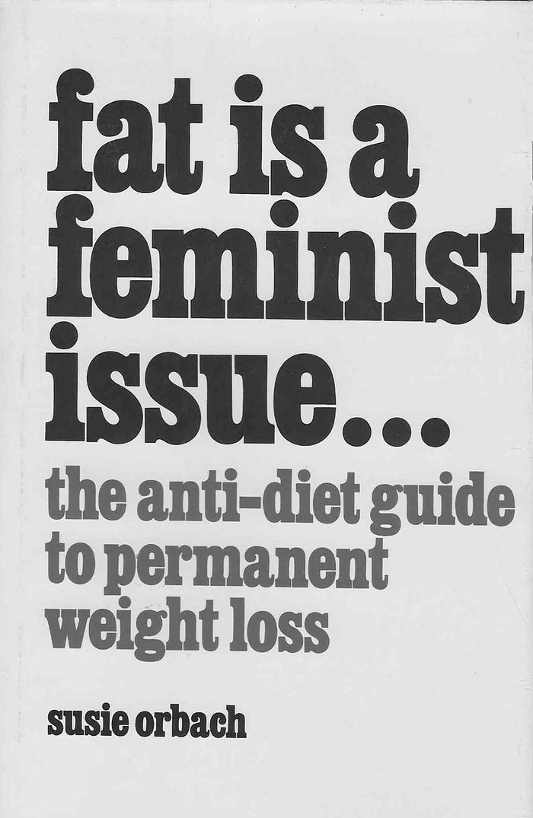
Susie Orbach (b. 1946)
1978

Slide 34
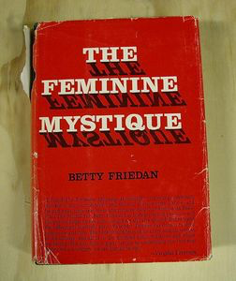
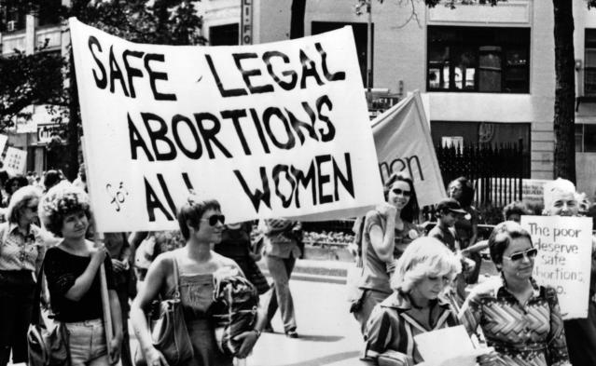
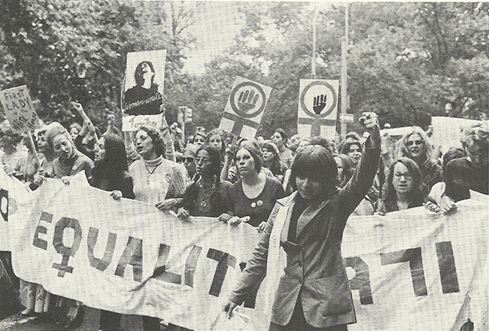
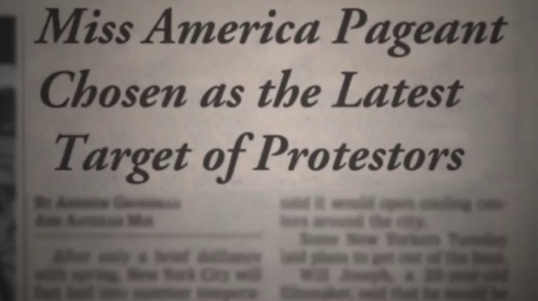
Second-Wave Feminism

Slide 35
Susie Orbach, Fat is a Feminist Issue (1978).
‘Since women are taught to see themselves from the outside as candidates for men, they become prey to the huge fashion and diet industries that first set up the ideal images and then exhort women to meet them. The message is loud and clear—the woman’s body is not her own. The woman’s body is not satisfactory as it is. It must be think free of “unwanted hair,” deodorized, perfumed and clothed. It must conform to an idea physical type . . . To ignore them means to risk being an outcast.’

Slide 36
Orbach, Fat is a Feminist Issue
‘Fat is a social disease, and fat is a feminist issue.’
‘What is it about the social position of women that leads them to respond by getting fat?’

Slide 37
Orbach, Fat is a Feminist Issue.
‘Compulsive eating and being fat have become one way to avoid being marketed or seen as the ideal woman: “My fat says ‘screw you’ to all who want me to be the perfect mom, sweetheart, maid and whore. Take me for who I am, not for who I’m supposed to be. If you are really interested in me, you can wade through they layers and find out who I am.”

Slide 38
Orbach, Fat is a Feminist Issue. Mothers and Daughters
‘My fat says to my mother: “I’m substantial. I can protect myself. I can go out into the world.”.’
‘My fat says to my mother: “Look at me. I’m a mess; I don’t know how to take care of myself. You can still be my mother.”.’

Slide 39
Orbach, Fat is a Feminist Issue.
‘Feminism has taught us that activities that appear to be self-destructive are invariably adaptions, attempts to control the world.’

Slide 40
Orbach, Fat is a Feminist Issue.
‘Fat is a way of saying “no: to powerlessness and self-denial, to a limiting sexual expression which demands that females look and act a certain way, and to an image of womanhood that defines a specific social role.’

Slide 41
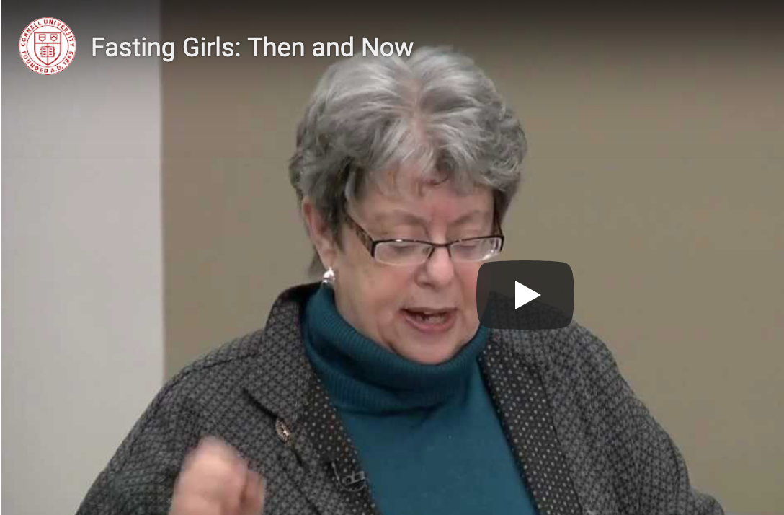
Joan Jacob Brumberg (b. 1944)

Slide 42
Joan Jacob Brumberg, ‘The Appetite as Voice’, Food and Culture: A Reader, ed. Carole Counihan and Penny Van Esterik (1997).
‘Young women searching for an idiom in which to say things about themselves focused on food and the body.’

