Slide 1
Food and the Environment

Slide 2
Food and Environmental Sustainability
30% of GHGs emissions attributed to food production and distribution.
53% of the world’s fisheries are fully exploited, and 32% are overexploited, depleted, or recovering from depletion.
65% of Africa’s arable land is now degraded. Overgrazing is the main cause of this.

Slide 3
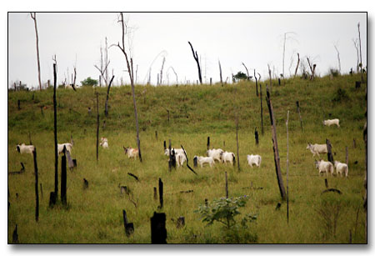
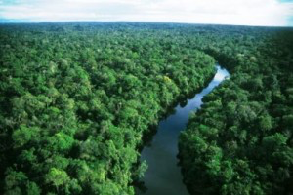
Amazonia
Cattle grazing in Amazonia
Without cattle

Slide 4
Jeremy Rifkin, Beyond Beef: the Rise and Fall of the Cattle Culture (1993)
Rifkin denounces the
‘devastating environmental, economic and human toll of maintaining a worldwide cattle complex’.

Slide 5
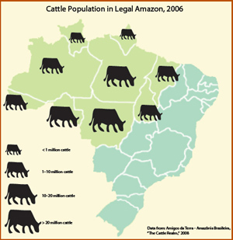
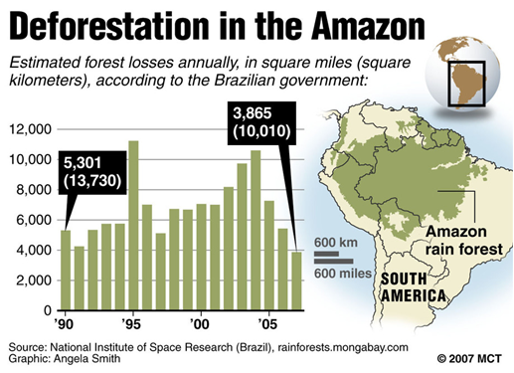
Cattle and Deforestation in the Amazon

Slide 6
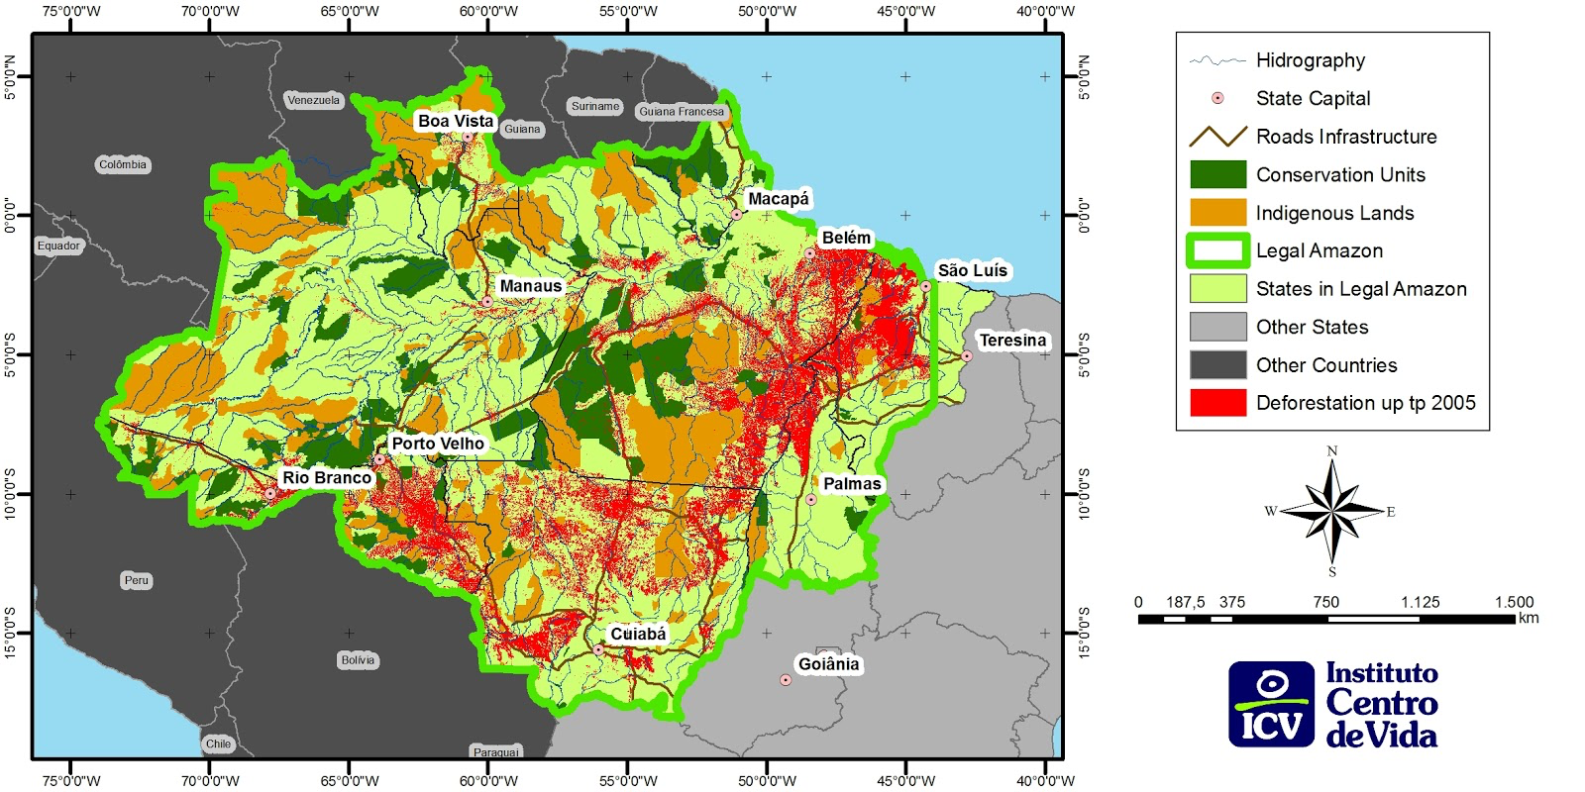
Deforestation in the Brazilian Amazon

Slide 7
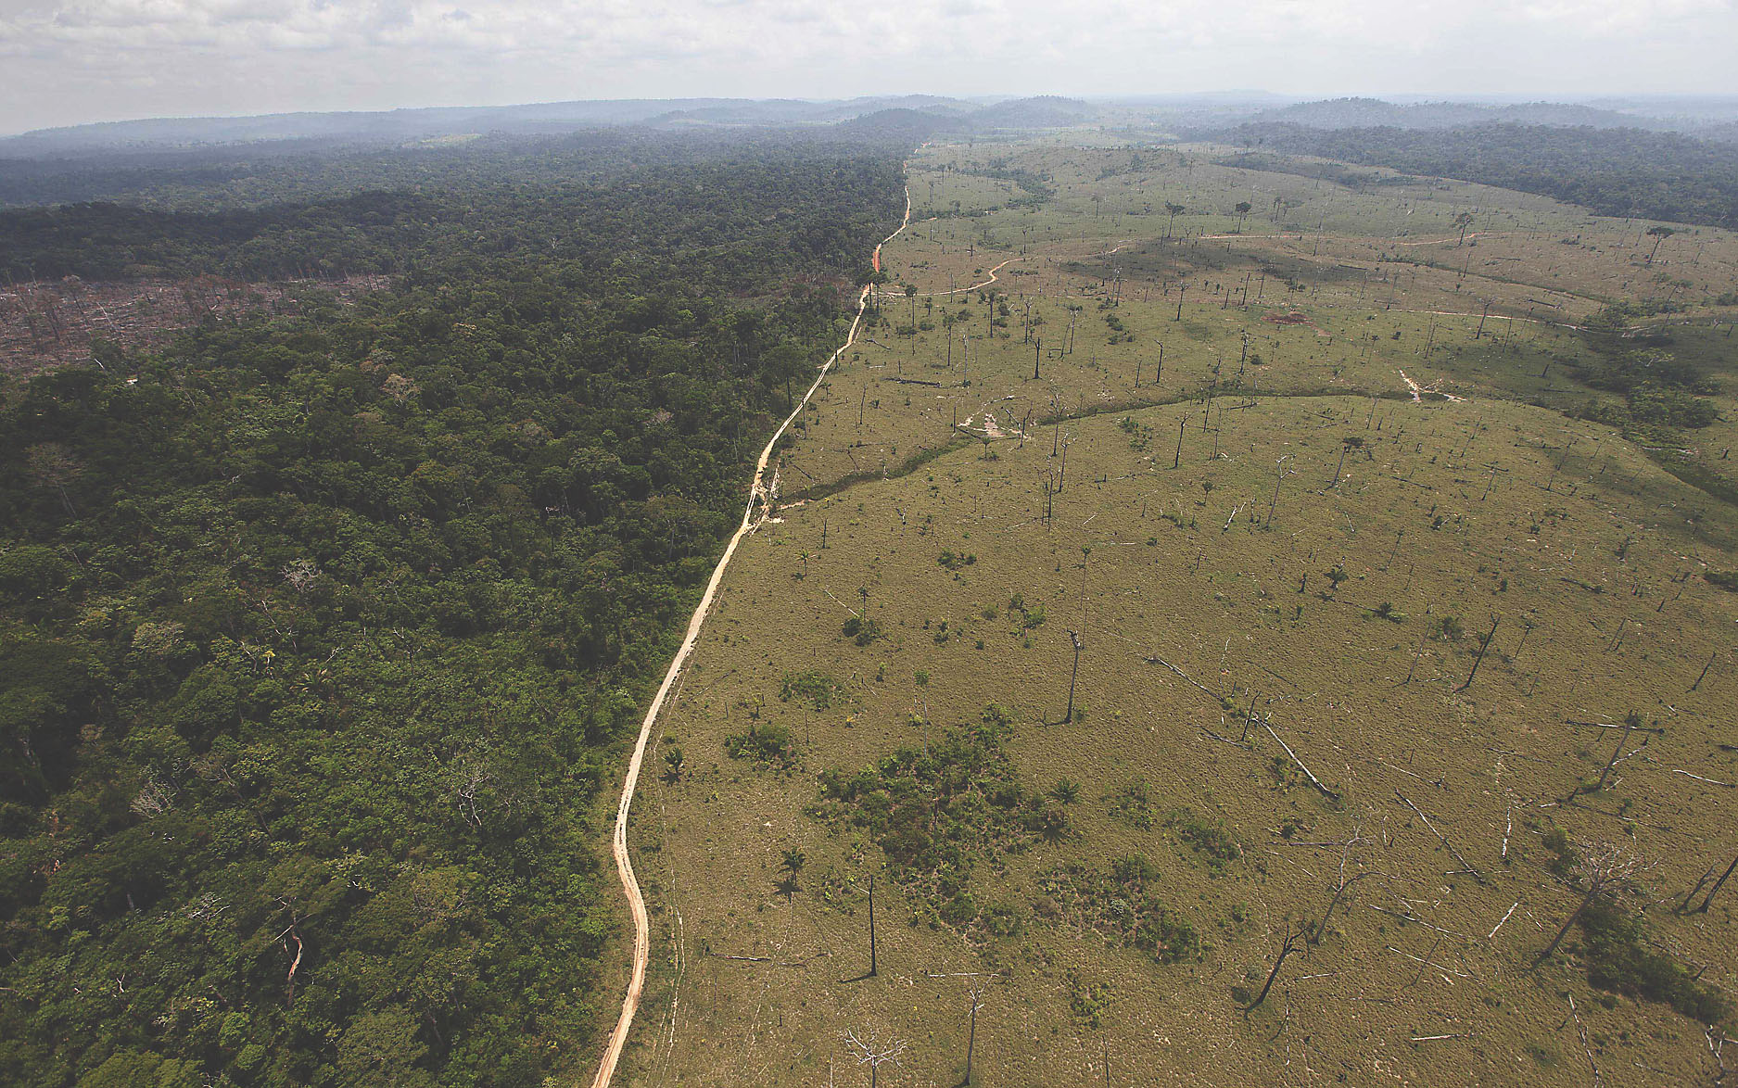
deforested area near Novo Progresso in the northern Brazilian state of Para (2013)

Slide 8
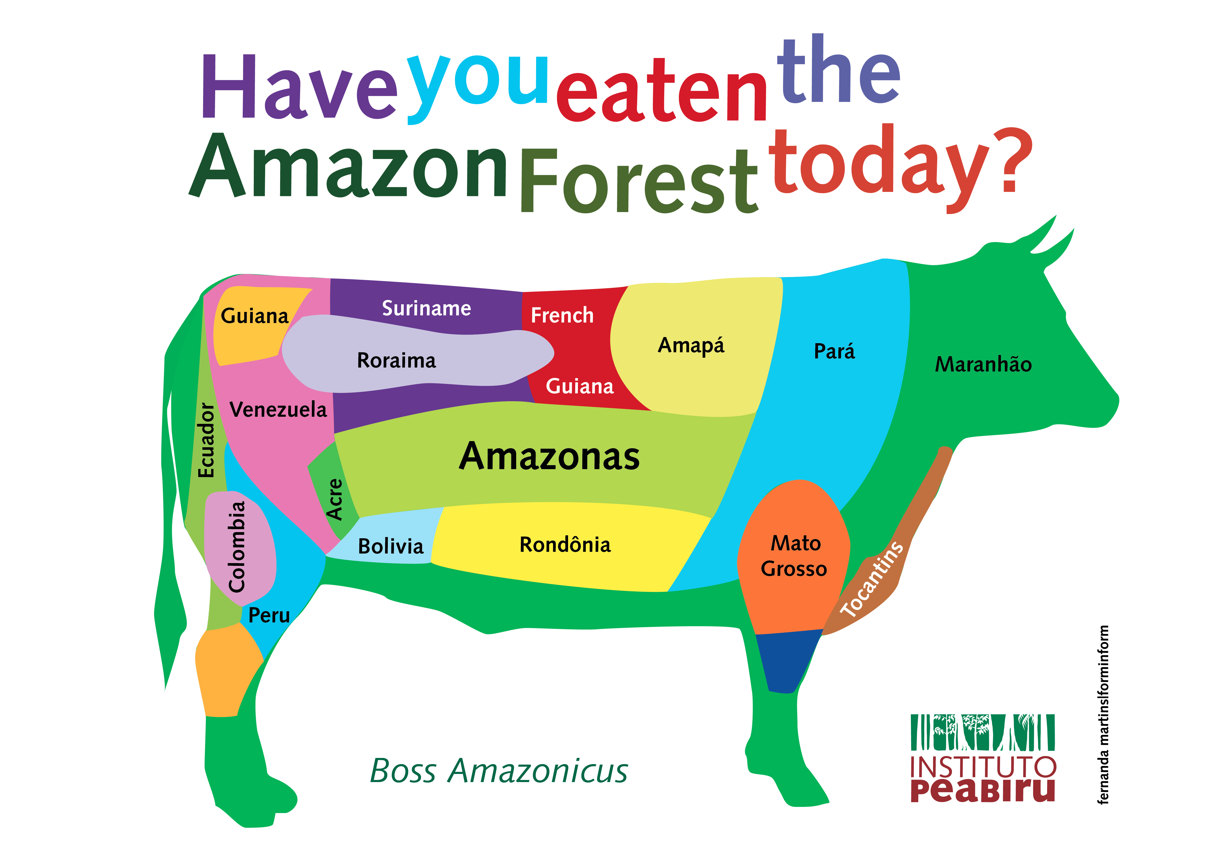

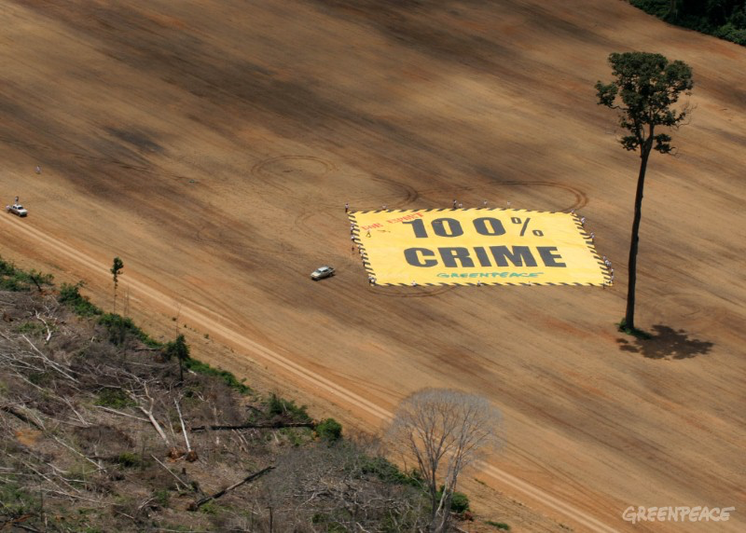
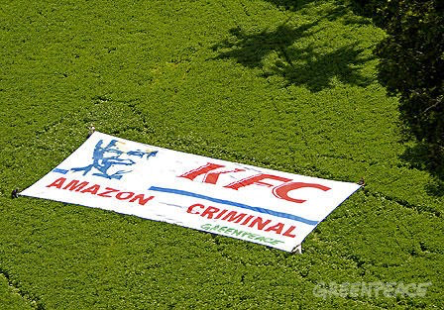

Slide 9
Last term we looked at the . . .
close links between colonialism, unfree labour and the production of commercial food crops such as sugar, coffee, tea, cacao, bananas . . .

Slide 10
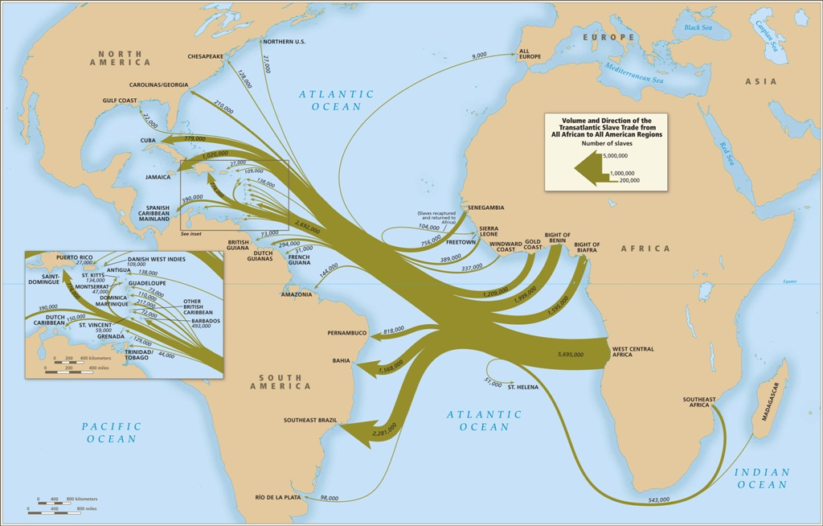
Atlantic slave trade

Slide 11
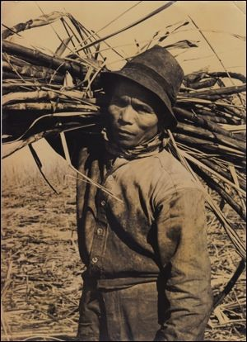
Melicio Labrador carrying sugar cane in Hawai’i

Slide 12
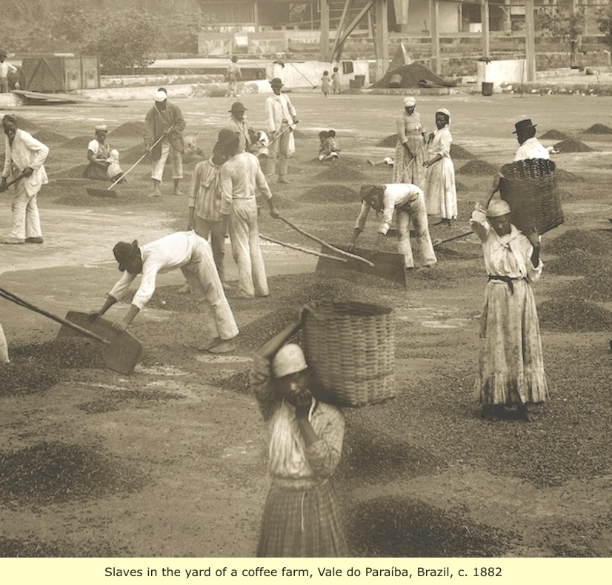
Enslaved workers on a Brazilian coffee plantation (1880s)

Slide 13
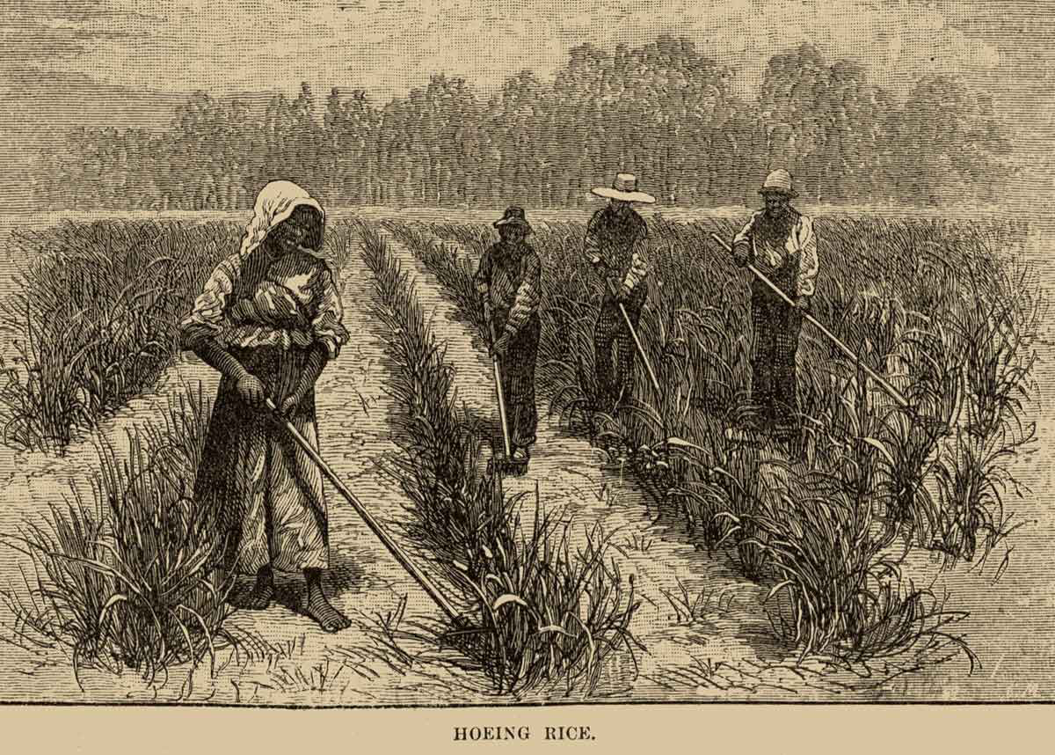
Enslaved workers tending rice on a North American plantation

Slide 14
Today let’s consider the
close links between colonialism, unfree labour, the production of commercial food crops
AND environmental change

Slide 15
Sterling Evans, ‘Agricultural Production and Environmental History’, The Oxford Handbook of Food History, ed. Jeffrey Pilcher (2012).
‘However profound the [environmental] changes wrought by [ancient] agrarian empires, they paled in comparison to the transformations of the industrial era.’

Slide 16
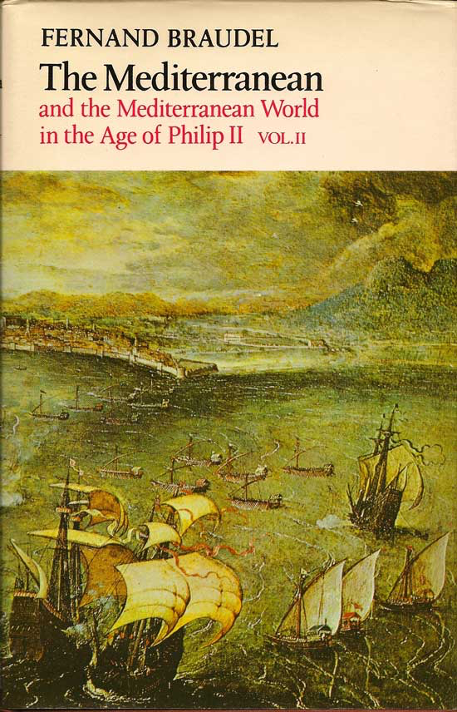
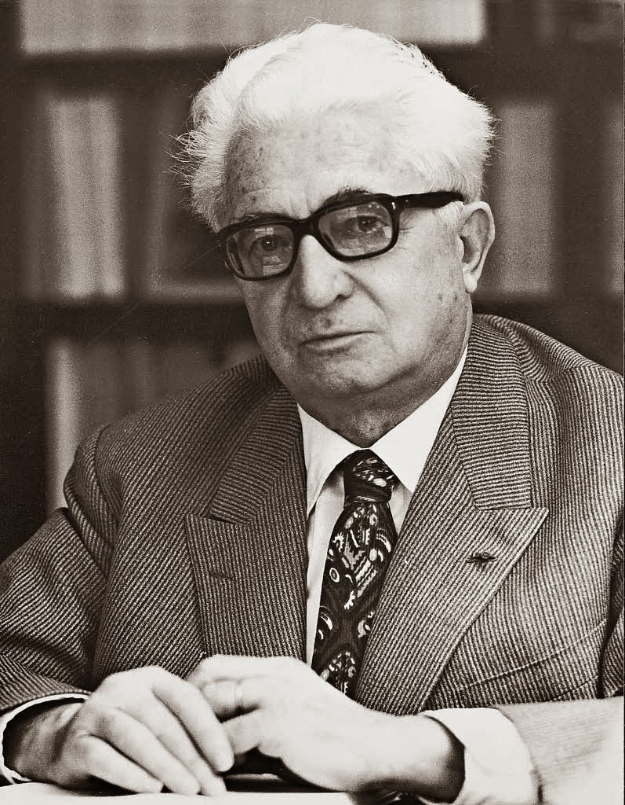
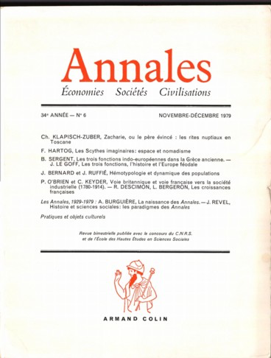
The history of the history of the environment
Annales school (very influential 1930s-1960s)
Fernand Braudel:
longue durée vs. histoire évènementielle

Slide 17
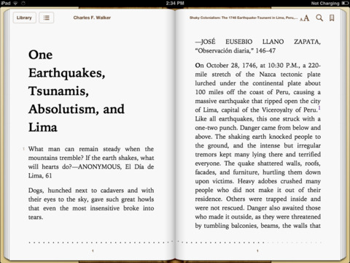
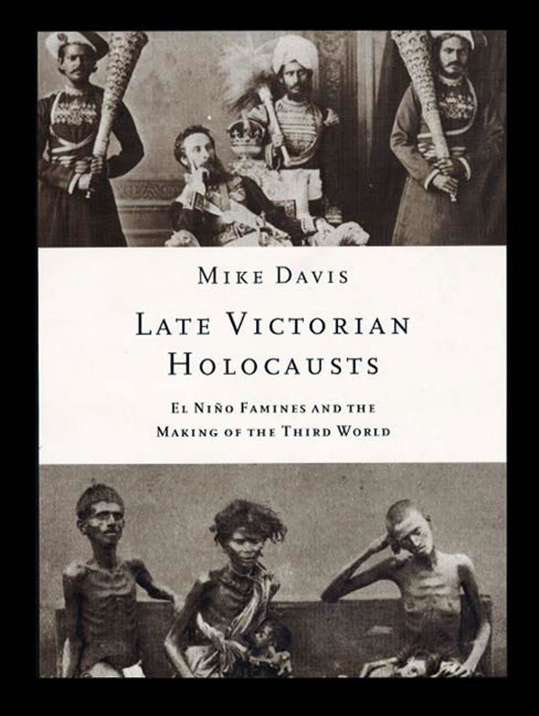
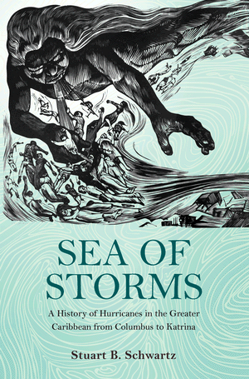
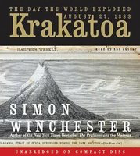
Histories of hurricanes, tsunamis, El Niño, volcanoes . . .

Slide 18
William Beinart and Lotte Hughes, Environment and Empire (2007).
‘European imperialism was . . . inseparable from the history of global environmental change.’

Slide 19
‘Ecological Imperialism’
(Alfred Crosby’s term)

Slide 20
sugar

Slide 21
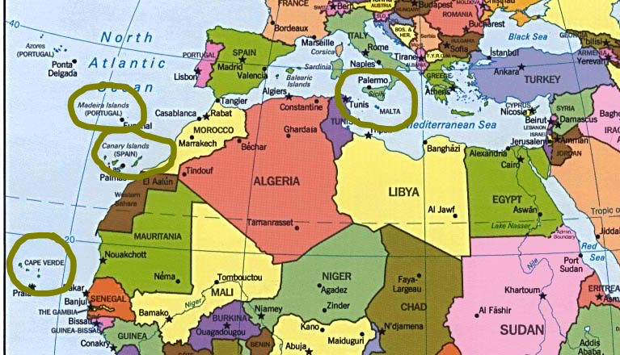
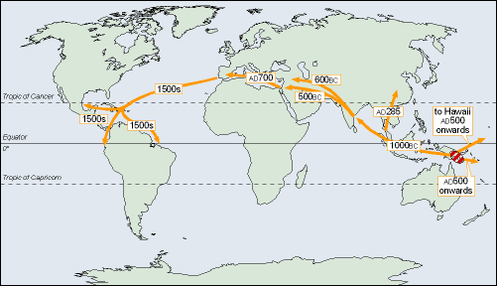
The spread of sugar
Early sites of cultivation

Slide 22
Jason W. Moore, ‘Sugar and the Expansion of the Early Modern World-Economy: Commodity Frontiers, Ecological Transformation, and Industrialization’, Review 23:3 (2000).
‘The sugar commodity frontier illustrates the fundamentally restless nature of world capitalism.’

Slide 23
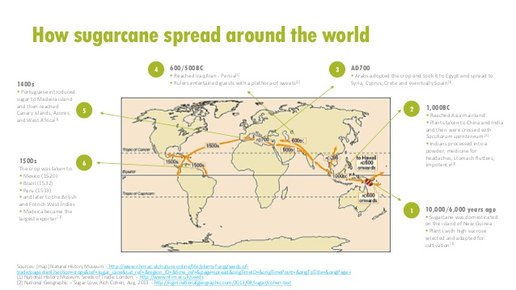

Slide 24
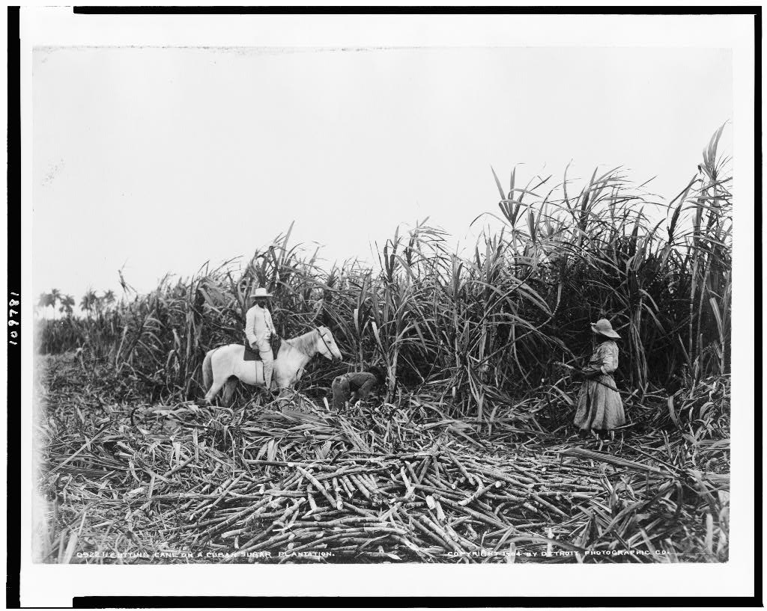
Cuban sugar plantation, 19th century

Slide 25
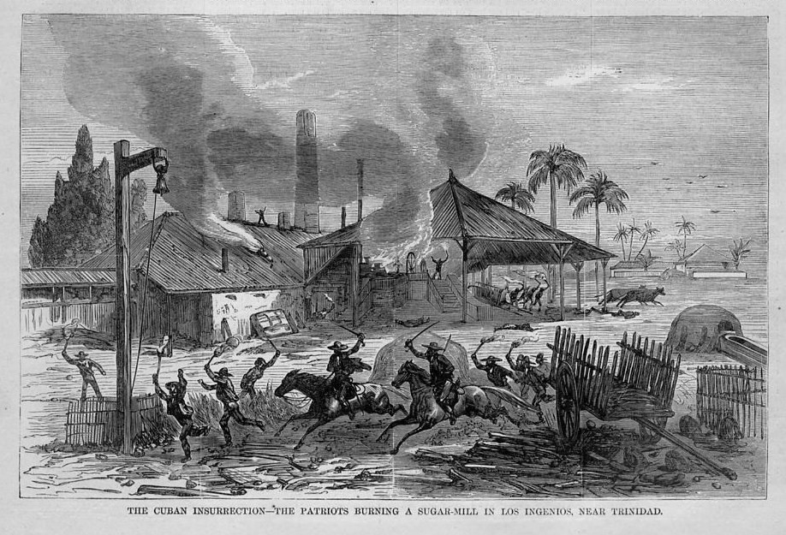
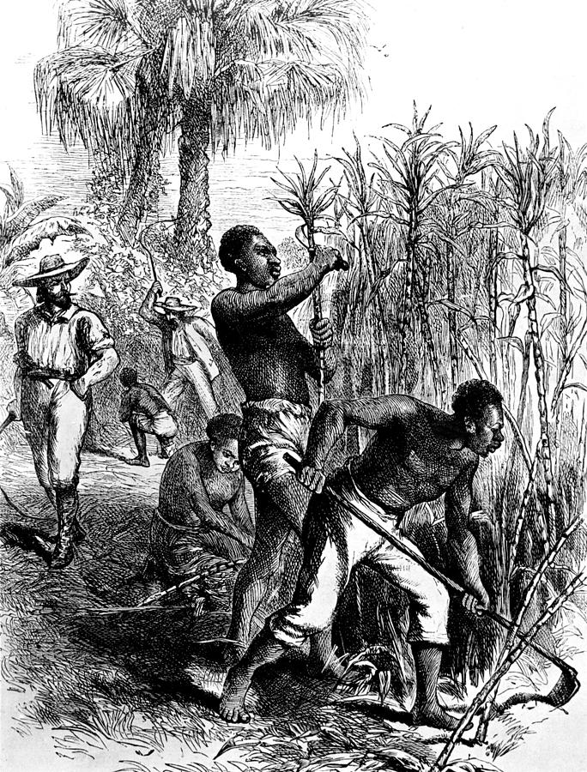
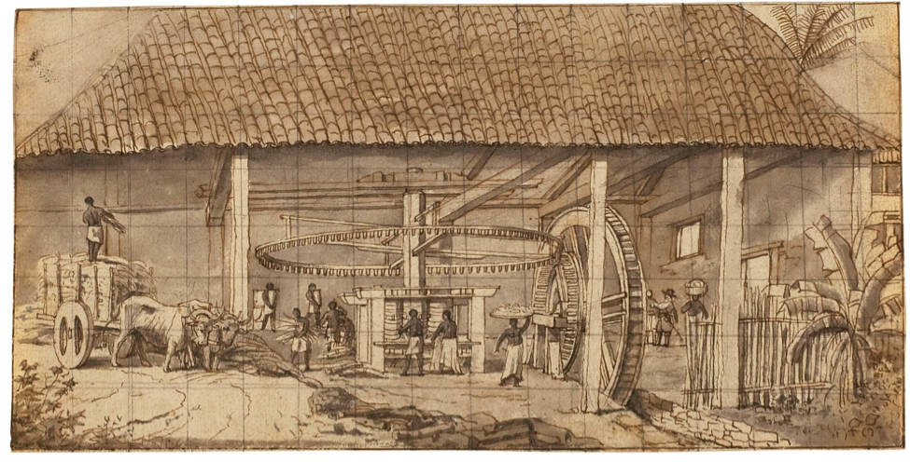
Sugar cultivation in the Americas: a modern industrial process reliant on enslaved labour

Slide 26
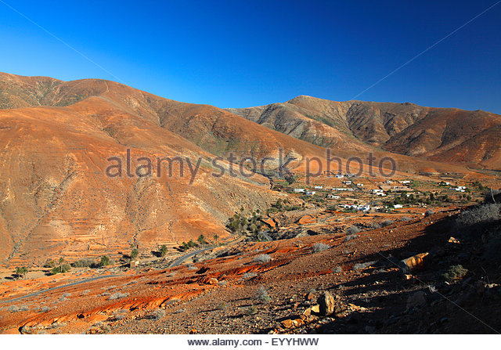
village in deforested mountains Vegas de Rio Palmas, Canary Islands

Slide 27
Moore, ‘Sugar and the Expansion of the Early Modern World-Economy’.
‘The link between sugar and deforestation was evident from the very beginning of sugar cultivation in the New World.’

Slide 28
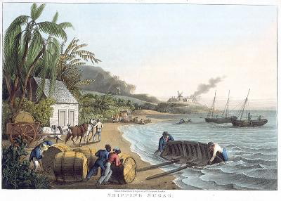
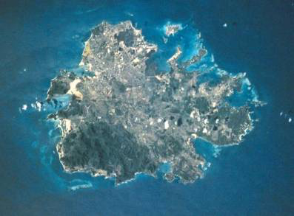
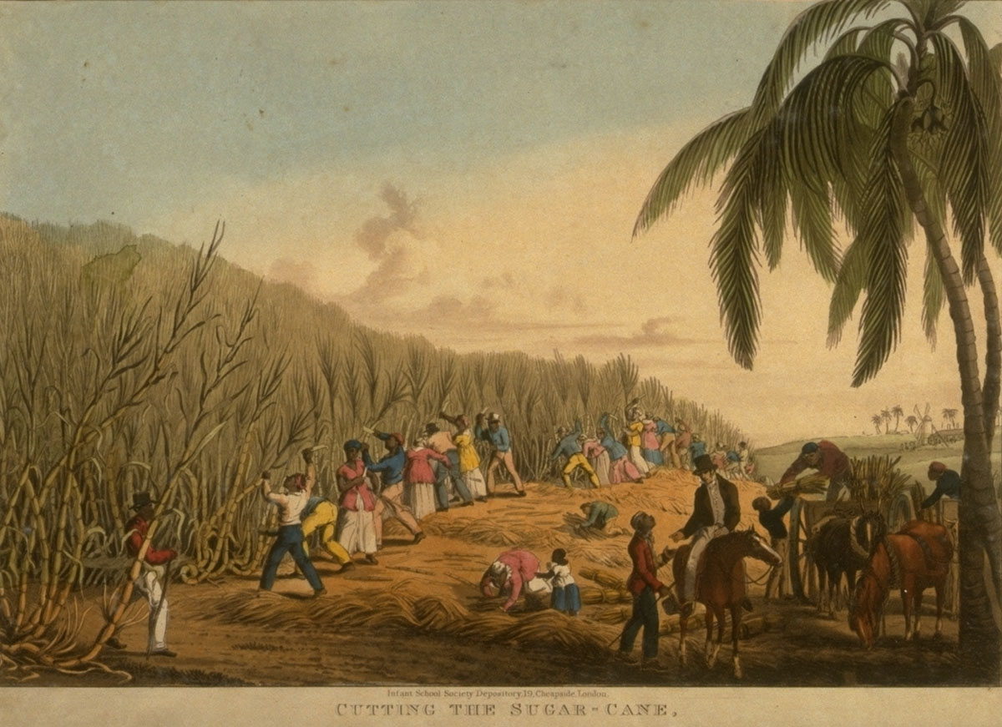
Deforestation in Antigua
Antigua 1820s
Antigua today

Slide 29
Environmental consequences of colonial sugar cultivation
deforestation
loss of soil fertility
silting of rivers
soil erosion
increased rainfall

Slide 30
William Beinart and Lotte Hughes, Environment and Empire (2007).
‘Sugar crushed an earlier landscape as well as hundreds of thousands of lives.’
(I would say: millions of lives.)

Slide 31
Moore, ‘Sugar and the Expansion of the Early Modern World-Economy’.
‘Early modern capitalist expansion [is] a socio-ecological process’.

Slide 32
Moore, ‘Sugar and the Expansion of the Early Modern World-Economy’.
‘Ecological exhaustion at the point of production was complemented by an environmentally destructive multiplier effect which led to, inter alia, deforestation , massive soil erosion, siltation, climate change, and other effects in the case of sugar. . . I contend that the contemporary global ecological crisis is not rooted in the so-called Industrial Revolution per se, but in the logic of capital itself—with or without Satanic Mills.’

Slide 33
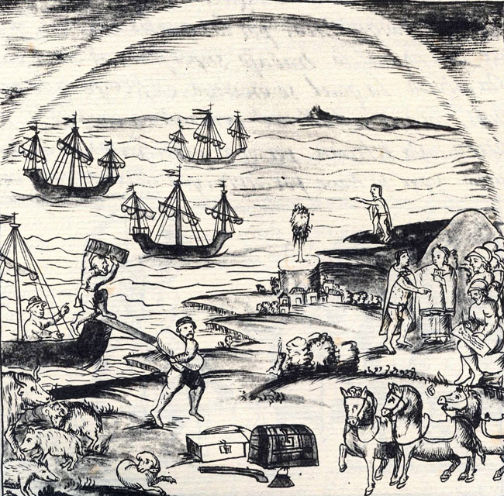
The Columbian Exchange: livestock Florentine Codex (16th century)

Slide 34
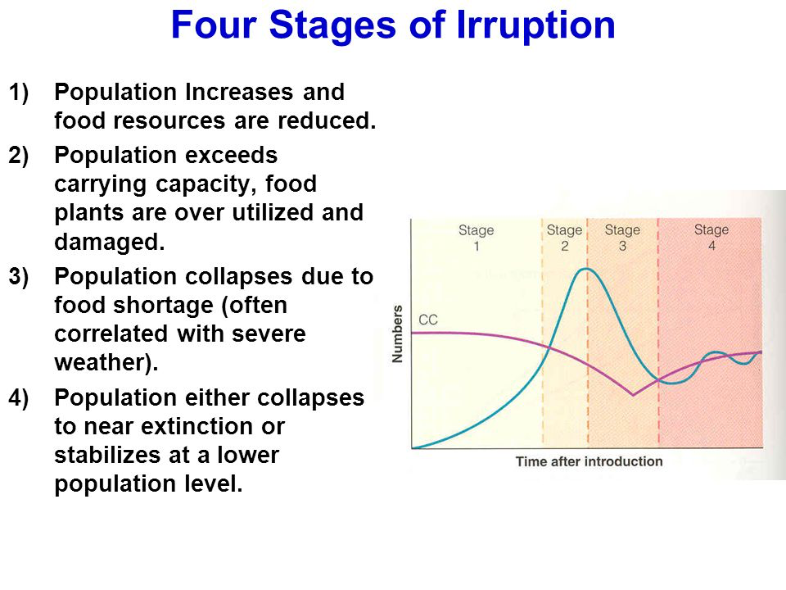
‘ungulate irruption’

Slide 35
Elinor Melville, A Plague of Sheep: Environmental Consequences of the Conquest of Mexico (1994).
In colonial Mexico, after the introduction of sheep, ‘land became fit only for sheep. It was not inherently poor’.

Slide 36
‘Green imperialism’
(Richard Grove’s term)

Slide 37
John Locke, Second Treatise of Government (1689)
God made the world for everyone, but . . .
‘it cannot be supposed that He meant it should always remain common and uncultivated. He gave it for the use of the Industrious and Rational.’

Slide 38
Richard Grove, ‘Climatic Fears: Colonialism and the History of Environmentalism’, Harvard International Review 23.4 (2002).
‘It was in the tropics that the destructive environmental impact of globalization made its most obvious impact to the observer.’

Slide 39
Grove, ‘Climatic Fears’.
‘History shows that only serious state intervention to control capital or corporate interests can hope to deal with the deadly risks of climate change, forest loss, and species extinction.’

Slide 40
‘Ecologically Noble Savages’
vs. ‘Ecological Imperialism’??

