Slide 1
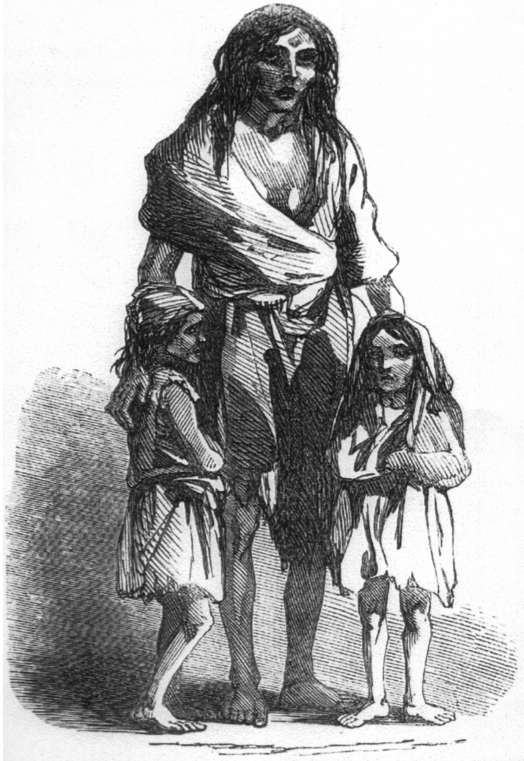
Famine, Entitlement and Inequality
Bridget O’Donnel and her children
(from Illustrated London News 1847)

Slide 2
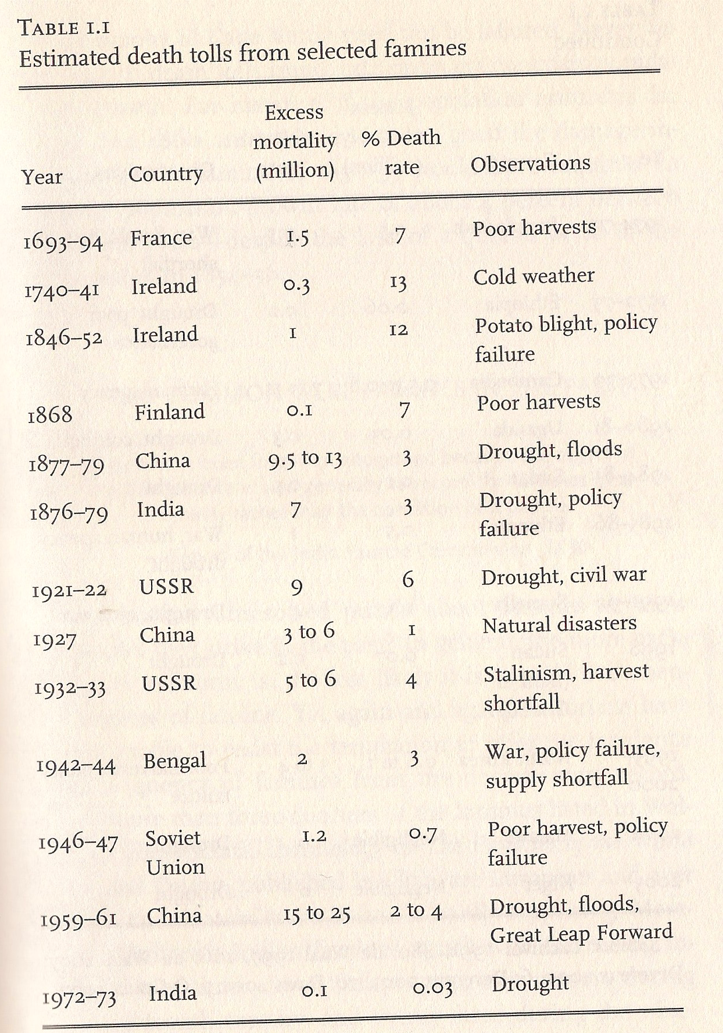
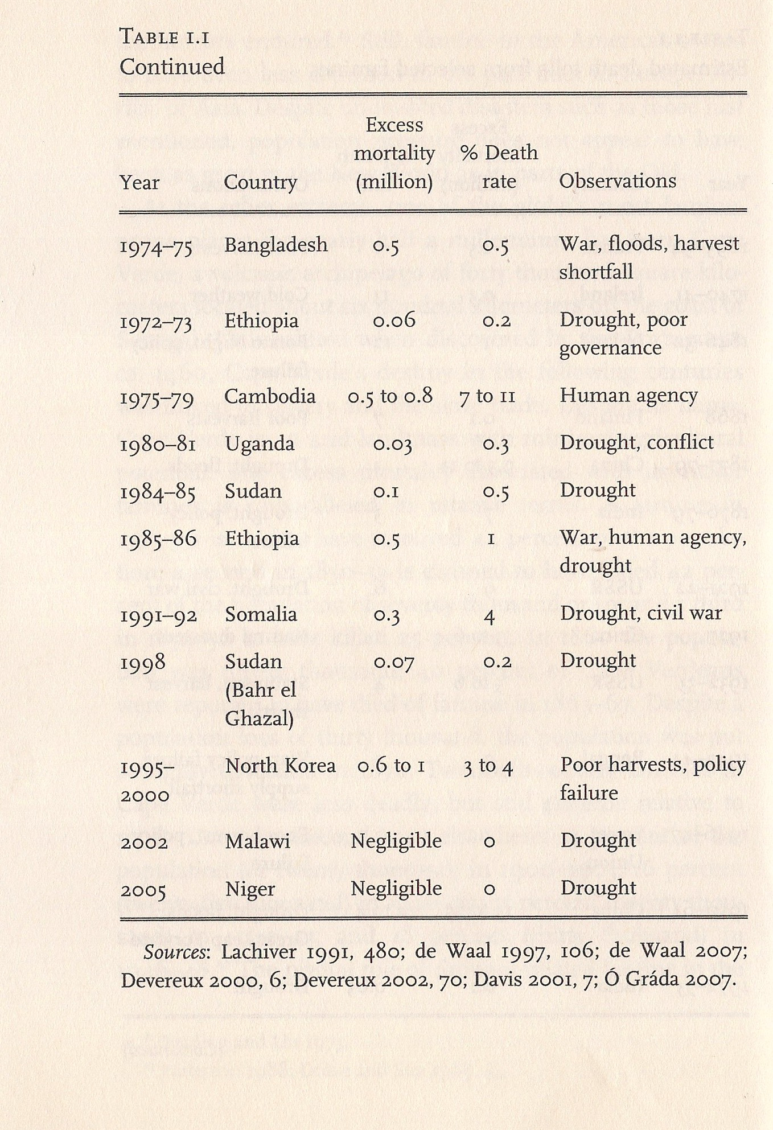
Estimated Death Tolls from Some Modern Famines
From Cormac O’Gráda, Famine: A Short History (2009)

Slide 3
The Russian famine of 1921
http://www2.warwick.ac.uk/services/library/mrc/explorefurther/digital/sara/oddments/russianfamine
Victor Animatograph Company of Davenport, Iowa, USA (Modern Records Centre, University of Warwick).

Slide 4
What is a famine?
Many definitions—including ‘insider’ definitions based on the categories used by people with direct experience of famine.
See Stephen Devereux, Theories of Famine (1993)

Slide 5
A Technical Definition of Famine
Increase in daily death rates
Increase in number of ‘wasted’ children (i.e. children who weigh significantly below the mean)
Increase in deficiency diseases (especially kwashiorkor)
(From O’Gráda, Famine: A Short History)

Slide 6

Cormac O’Gráda’s definition
‘a shortage of food or purchasing power that leads directly to excess mortality from starvation or hunger-induced diseases’
(Famine: A Short History)

Slide 7
Symptoms of Famines
Rising prices
Food riots
Increase in crimes against property
Significant number of deaths from starvation
Rise in temporary migration
Fear of, and emergence of, infectious diseases
(from O’Gráda, Famine: A Short History)

Slide 8
Do more women die than men?
(O’Grada says no)
Greatest mortality usually among young children but young children usually have the highest death rates even in normal times
Deaths from starvation vs. deaths from disease (typhus, dysentery, cholera . . .)

Slide 9
Hunger and the Market: Food Riots
Food riots aimed at merchants
Suspicion that ‘there’s no famine at all really . . . It’s profiteers, cornering the market’ (to quote from Alessandro Manzoni’s 1827 novel The Betrothed)
Legislation to prevent hoarding
Food riot in Dungarvan, County Waterford (1846)

Slide 10
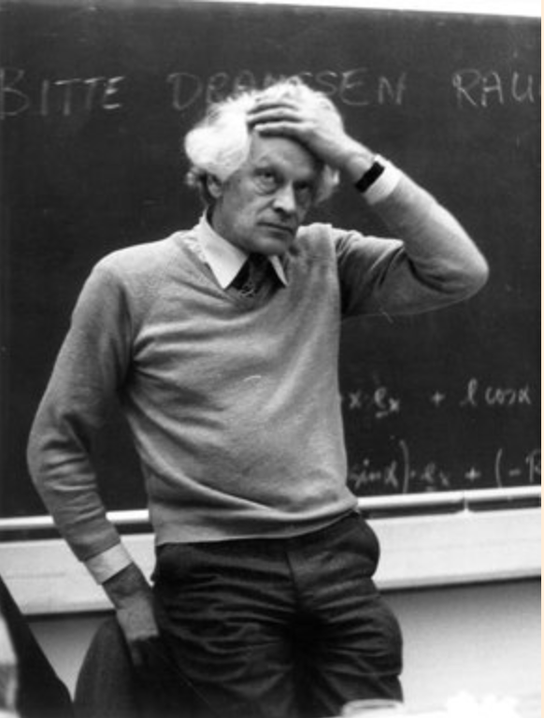
‘Moral Economy’
E.P. Thompson, ‘The Moral Economy of an English Crowd in the Eighteenth Century’, Past & Present (1971).
Does the state have an obligation to ensure adequate food supplies?

Slide 11
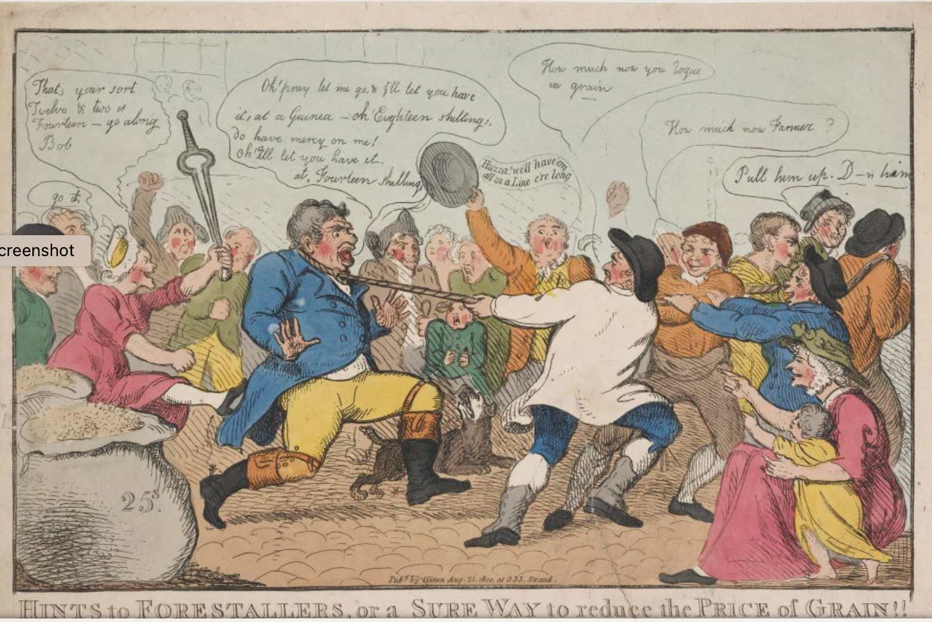
A 'forestaller’ is dragged along to the cheers of a crowd. One shouts: “How much now you rogue in grain?”
Isaac Cruikshank, ‘Hints for Forestallers, or a Sure Way to Reduce the Price of Grain’, 1800

Slide 12
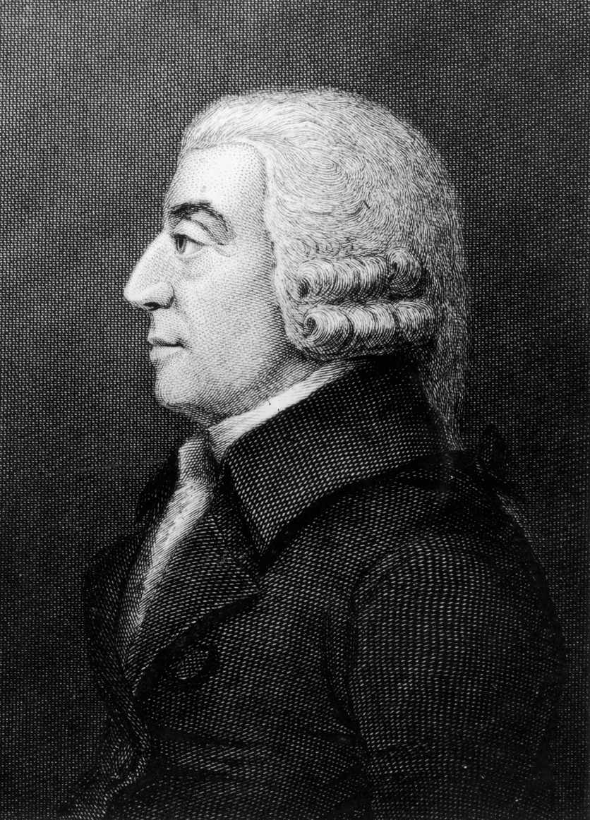
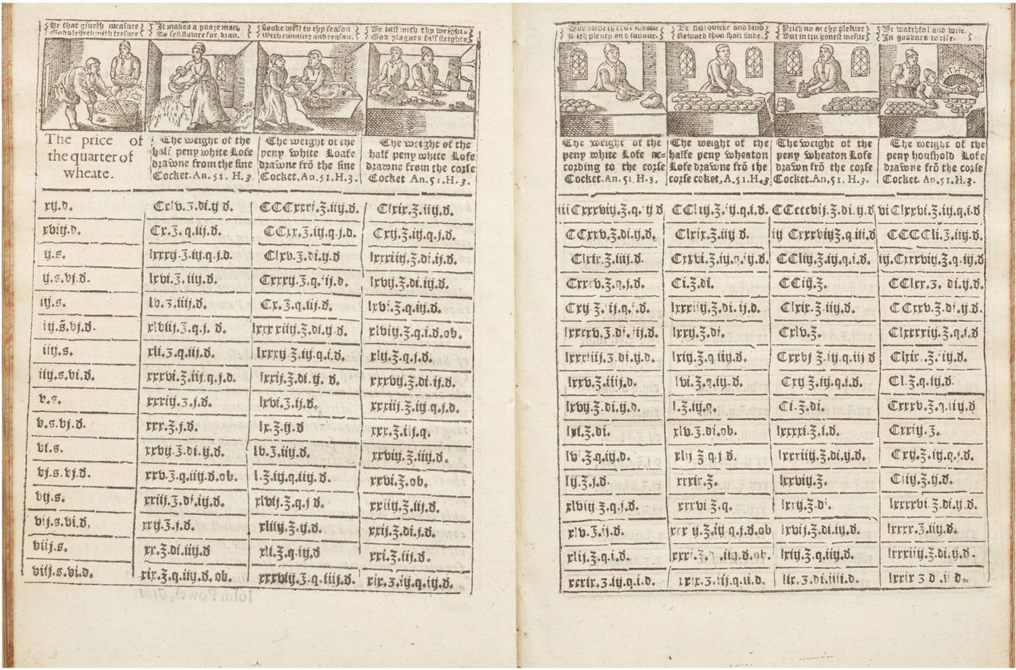
What is the best way to prevent famine?
‘Moral economy’/state intervention
The free market (a new, late 18th-century idea)
The assize of bread (1626).
The assize set a maximum price for bread.

Slide 13
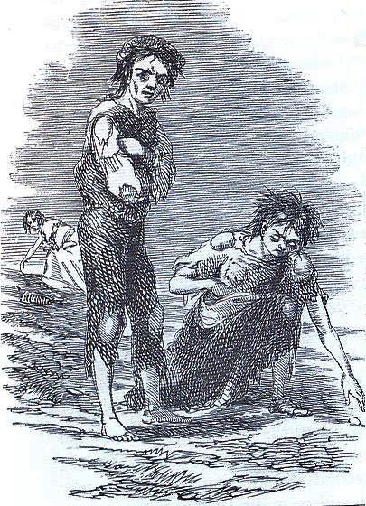
Great Irish Famine
1 million deaths
1 million emigrants
(approx.)
from a population of
8.5 million
Potato crop failures
1845, 1846, 1848, 1849
Image from Illustrated
London News (1847)

Slide 14
From the point of view of British economists and administrators, the problem was that in Ireland there were a lot of people engaging in non-capitalist agriculture.
From this perspective ‘the famine was seen, quite literally, as a godsend’.
David Lloyd, ‘The Political Economy of the Potato’, Nineteenth-Century Contexts (2007).

Slide 15
From Peasants to a Rural Proletariat?
‘The position occupied by [Irish cottiers*] is no longer tenable and it is necessary for them to live by the wages of their labour. They must still depend for their subsistence upon agriculture, but upon agriculture conducted according to new and very improved conditions. . . The people will henceforth principally live upon grain, . . . which they will purchase out of their wages.’
Charles Trevelyan, ‘The Irish Crisis’, Edinburgh Review (1848)
* A cottier is a peasant or small-holder.

Slide 16
Markets and Famines
‘Firm believers in the market mechanism were often disappointed by the failure of the market to deliver much.’ (Amartya Sen)

Slide 17

Amartya Sen
Nobel Prize-winning Indian economist
‘entitlement’ approach to understanding famines

Slide 18
Amartya Sen, Poverty and Famines: An Essay on Entitlement and Deprivation (1981)
‘Starvation is the characteristic of some people not having enough food to eat. It is not the characteristic of there being not enough food to eat.’
Starvation is about ‘the relationship of persons to the commodity’.

Slide 19
In other words,
Famine is NOT usually caused solely by
‘FAD’
(Food Availability Decline)

Slide 20
Sen, Poverty and Famines
food is often exported in famines
‘Famines can arise in all-over boom conditions.’
‘It is important to distinguish between decline in food availability and that of direct entitlement to food.’

Slide 21
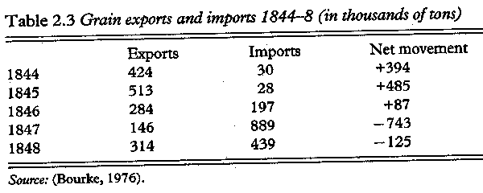
Irish grain imports and exports

Slide 22
'Entitlement’ Approach
Different types of entitlement to food, including:
trade-based entitlements: you traded for the food
production-based entitlement: you owned the resources that went into making it
own-labour entitlement: you grew it
inheritance and transfer entitlement: you were given it

Slide 23
‘Exchange entitlement’
the set of all the commodities that an individual can acquire in exchange using the varied entitlements that they possess

Slide 24
Factors determining a person’s exchange entitlement include
whether you can find employment
what you can earn by selling your non-labour assets
what you can produce with your own labour and resources
the cost of purchasing resources and the value of products you can sell
social security benefits you are entitled to and taxes you must pay

Slide 25
An Entitlement Approach to Starvation
Starvation is not simply about food shortages but whether a person’s exchange entitlement will permit them to acquire enough food.
‘Starvation . . . is a function of entitlement and not of food availability as such.’ (Sen)

Slide 26
Sen, Poverty and Famines
‘The mesmerizing simplicity of focusing on the ratio of food to population has persistently played an obscuring role over centuries, and continues to plague policy discussions today much as it has deranged anti-famine policies in the past.’

Slide 27
Sen, Poverty and Famines
‘The entitlement approach places food production within a network of relationships, and shifts in some of these relations can precipitate gigantic famines even without receiving any impulse from food production.’

Slide 28
Sen, Poverty and Famines
‘The entitlement approach views famines as economic disasters, not as just food crises.’

Slide 29
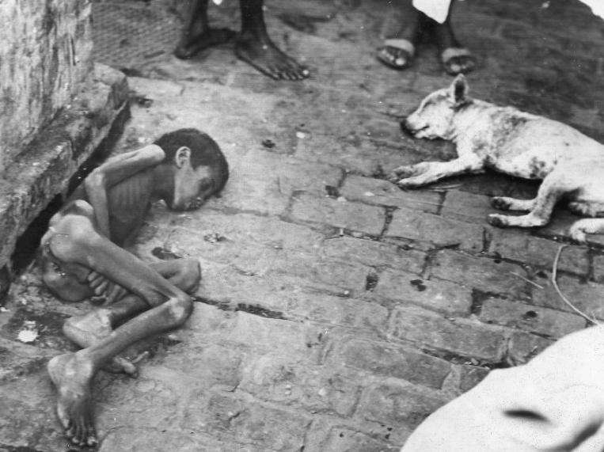
Great Bengal Famine of 1943-1944
2 million ++ deaths

Slide 30
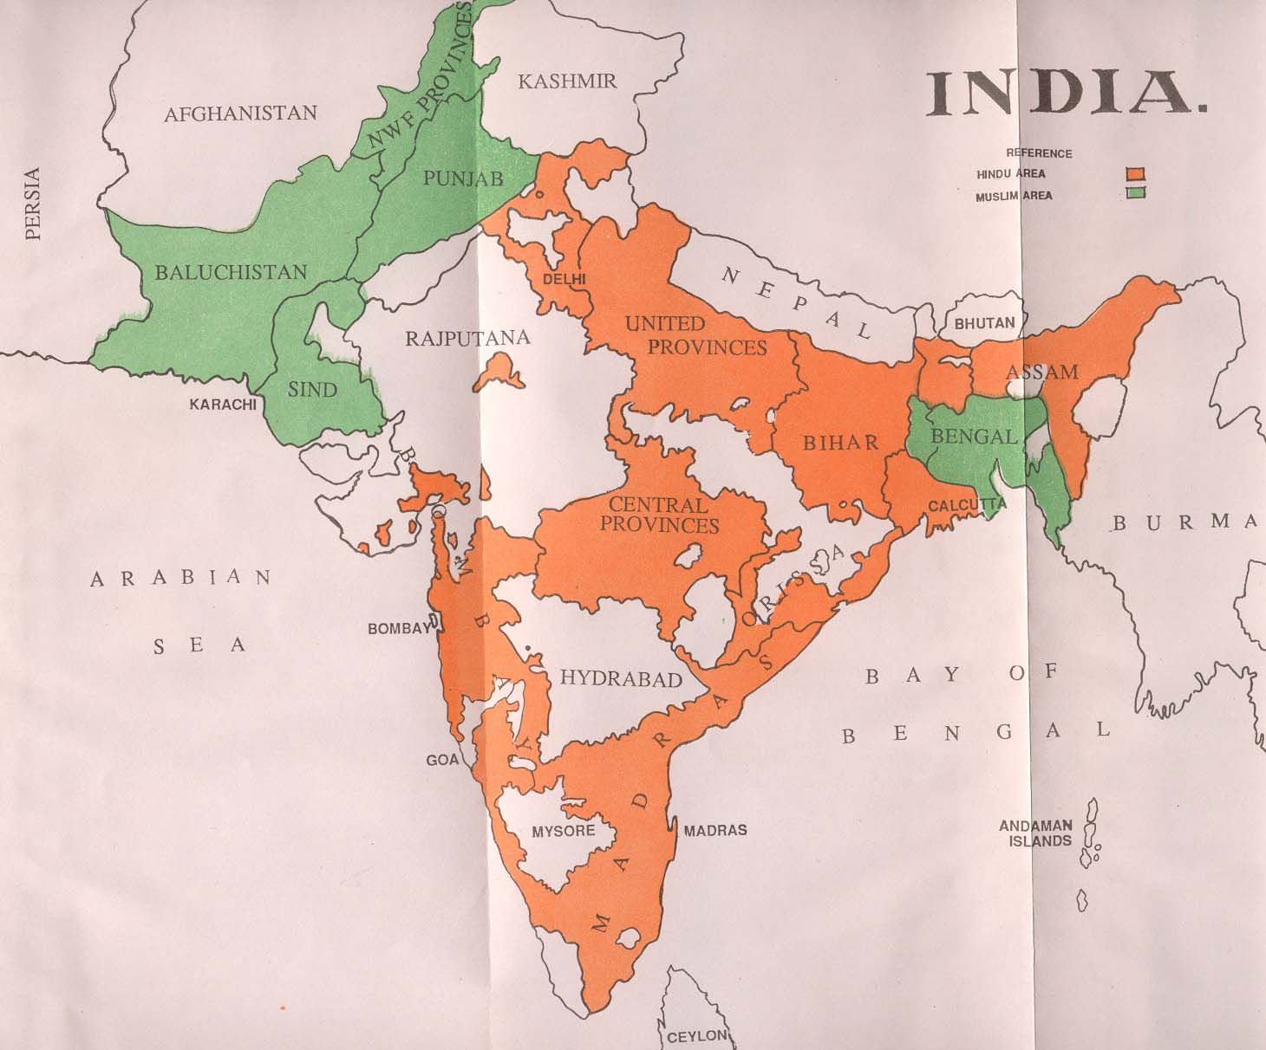

Slide 31
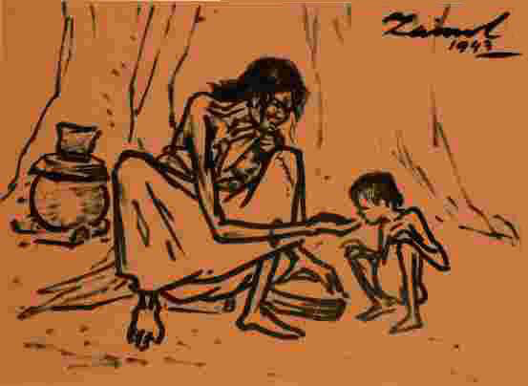
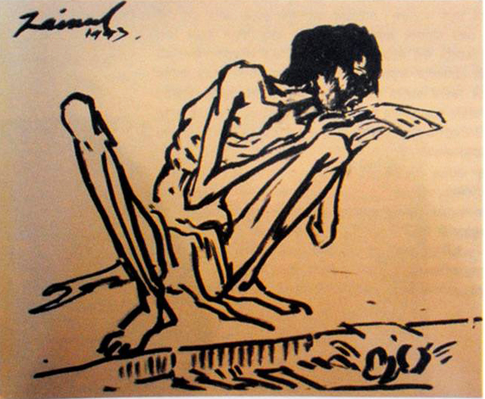
Drawings of the Bengal Famine by the Bangladeshi artist Zoinul Abedin.
The drawing on the right formed the cover of Ela Sen, Darkening Days (1943), which described the famine. (The book was banned by British authorities.)
British Museum, https://www.britishmuseum.org/collection/object/A_2012-3027-1

Slide 32
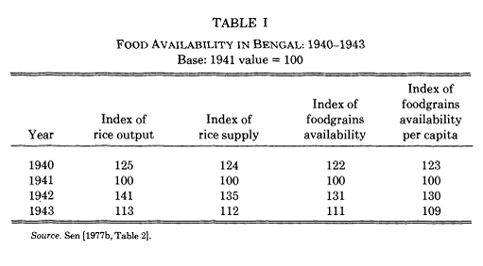

Slide 33
Markets and Famines: different views
‘Firm believers in the market mechanism were often disappointed by the failure of the market to deliver much.’ (Amartya Sen)
‘The historical record suggests that the integration of markets and the gradual eradication of famine are linked.’ (Cormac O’Gráda)

