Slide 1
Kosher (Jewish) and Halal (Muslim) Food Regulations
A Secular Food Science Perspective
Joe M. Regenstein
Professor Emeritus of Food Science
Head: Cornell Kosher and Halal Food Initiative
jmr9@cornell.edu
Warwick University
February 23, 2017

Slide 2
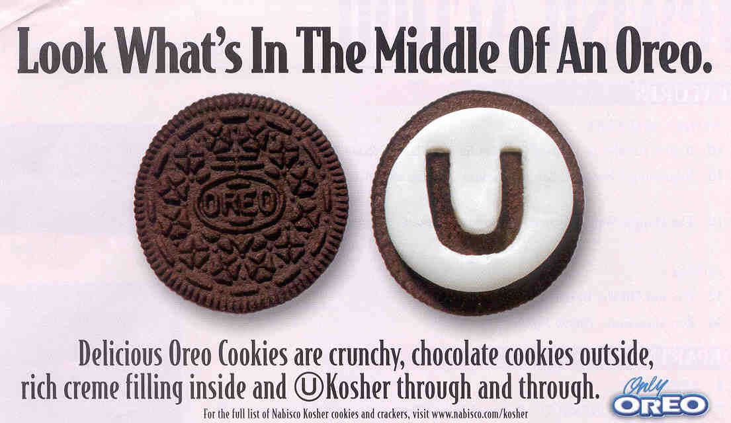
What do the Words Themselves Mean?
Kosher = Fit or Proper Treif = Not Kosher
Halal = Lawful Haram = Prohibited

Slide 3
Initial Clarifications
Kosher food is not blessed
A product is or is not kosher according to whether it follows the rules not because the rabbi (Jewish religious leader) is there.
Essentially the same rules hold for halal except that at the time of slaughter in addition to having to follow the rules, a prayer must be said over each animal.
Basically a third party audit!

Slide 4
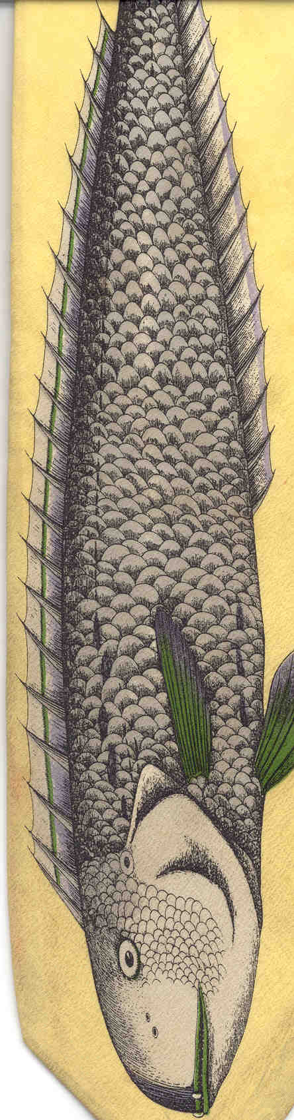
Kosher Laws
Generally covers four major areas:
1. The allowed animals
Ruminants
Split hoof and chew their cud
E.g., cow, sheep, goat, deer, giraffe
Traditional domesticated birds
But not ostrich, emu, rhea
Fish with fins and removable scales
Insects: Locust and grasshoppers

Slide 5
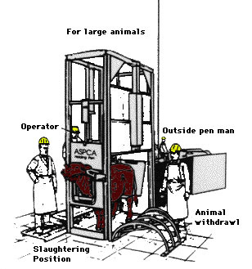
Kosher -- Part II
2. The prohibition of blood
Specific slaughter requirements
Inspection of animals after slaughter
Deveining, removing blood
vessels and some nerve
Salting and soaking
All products derived from
animals must be obtained
from kosher animals, e.g.,
gelatin, tallow, fat derivatives (emulsifiers, glycerol)

Slide 6
Kosher -- Part III
3. Separation of milk and meat
Third category: pareve or neutral
Makes kosher marked products valuable to many other groups, e.g., some allergies and other groups like vegetarians
4. Prohibited grains at Passover, a holiday in the spring
Brings the kosher laws into the plant kingdom
Offers a lot of gluten-free products

Slide 7
There are many other laws that are not covered by this limited description. Many of these other laws are very important to the production of the modern kosher food supply.

Slide 8
Some Areas of Additional Kosher Laws
Jewish cooking
Jewish baking
Jewish cheese
Old (Yashon) versus New (Chodesh) Flour
Kitnyos on Passover
Orleh – the status of new fruit (under four years old)
Grafting
Sabbath and Holiday rules
(All need to be taken into account when thinking about producing kosher products – easier to do upfront)

Slide 9
Halal
1. Prohibition of specific animals, most specifically PORK but goes beyond food
2. Prohibition of drugs and intoxicants, most specifically drinking ALCOHOL (ethanol, ethyl alcohol) including as an ingredient, such as in vanilla flavor
3. Prohibition of blood: Specific slaughter requirements that are very similar to kosher (can be both simultaneously)
4. Prohibition of vermin and filth

Slide 10
How Do You Tell That a Food is Kosher or Halal?
Because it says so specifically on the product
It has a kosher (hechsher) or halal marking on it
The buyer has a “letter/document” from a “recognized” authority attesting to the product’s status

Slide 11
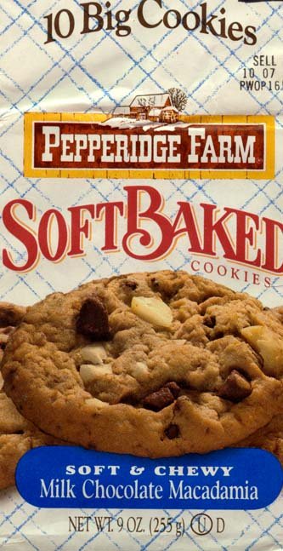

Pepperidge Farms
Notice that the Hechsher (kosher symbol) is the same size as the
net weight statement --- clearly
an advertising symbol

Slide 12
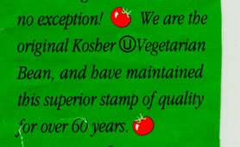
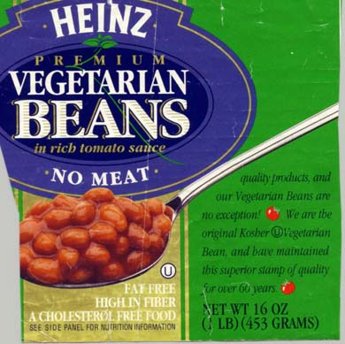
Heinz Vegetarian Beans
Vegetarian Bean:
Superior Stamp of Quality

Slide 13
Who Provides Kosher Supervision?
National supervision agencies
Some are communally owned and others are privately owned
They have become global
Will certify in Turkey
Local Community Supervisions
Often called a “Vaad”
Individual Rabbis
Some of these are also global

Slide 14
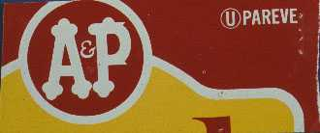
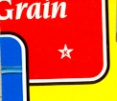


Examples of a Few Hechshers
The Four Major Mainstream Supervisions

Slide 15

The Generic K (or H)
The Generic K --- nobody owns it!
Consumer has no idea who is doing the certification
Importance of having a trademark

Slide 16
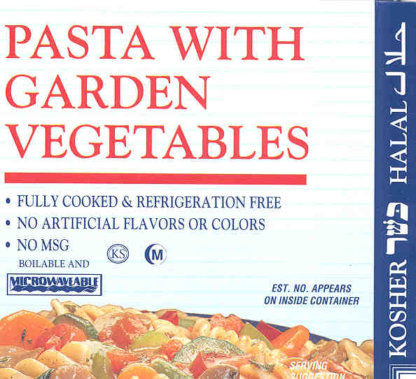
Dual Certified Product – Both Kosher and Halal
Arabic
And
Hebrew
Many more dual-certified products in the US marketplace today

Slide 17


What Do I Mean by “Mainstream Supervision”?
The de facto dominant standard for the American Orthodox Jewish Community covering over 90% of kosher products
Represented nationally by the “big five” national supervision agencies:
OU, Kof-K, Star K, OK, and CRC
Many local communal organizations and individual rabbis subscribe to the same standard

Slide 18
Mainstream -- Part II
The existence of the mainstream is a fact, not a judgment on my part
The mainstream does not use exactly the same standards as exist in Israel or Europe but they are close
The US standard is continually evolving -- current trends are definitely moving towards stricter standards
(An absolute must for ingredients – critical for export to US, Europe, or Israel)

Slide 19
The Food Industry View
Kosher and Halal are an important part of the food industry worldwide
Importance to the industry is not religious but business
Many food companies are involved in kosher and/or halal food productions because it is a good business decision!

Slide 20
Who Buys Kosher and Halal Foods in the US?
Jews (6 million)
Muslims (7 million)
Vegetarians and Vegans (7 million)
Hindu/Buddhist and other eastern religions
People with specific allergies
Quality conscious consumers
Consumers who do not trust the FDA (>inspection)
Consequence: 40% of processed foods in the US are kosher
Notes:
Vegetarians--Avoid Meat (Poultry and Red Meats) Products
Lacto-Ovo Vegetarians
Buy Dairy and Pareve Products
Vegans
Buy Pareve Only
Pesca-Lacto-Ovo Vegetarians
Buy Dairy and Pareve Products
Allergies
To Dairy Products -- buy pareve
To Grain Products -- buy Passover
To Legume Products -- buy Passover

Slide 21
Halal Demographics
Halal
US: Estimate of about 4-8 million Muslims
How many are committed to Halal?
Most do not eat pork
Many fewer keep Ramadan
Worldwide: Over 1.3 billion Muslims
Many countries require Halal certification before products can be imported

Slide 22

Beyond the Basic Requirements
Kosher transportation required
There are kosher “trucking” companies and kosher holding and storage
Parallel storage systems in place for kosher and non-kosher
oil/shortening and industrial
alcohol in the US

Slide 23
Equipment Kosherization
Often the key to making kosher practical in the “real world” of industry is permitting changing the status of a production line
Need for Equipment Kosherization
Ability to make non-kosher equipment kosher
Makes it possible for kosher/halal to work in the real world

Slide 24



Equipment Kosherization Simplified
Cold: Simple washing
Hot (>120F, >49C) Moist: Normal cleaning, 24 hour idle time, flood with boiling water
Hot Dry: Heat to glowing

Slide 25
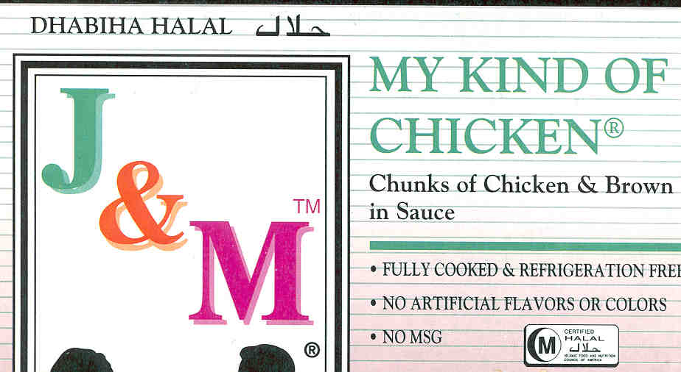
The Halal Market
Just getting started
More developed in other countries although often generic H – not accountable
Need for US companies to have certification to be able to export
Are also developing a “product marking” system
Are seeing more “halal”
markets in many urban
areas in the US

Slide 26
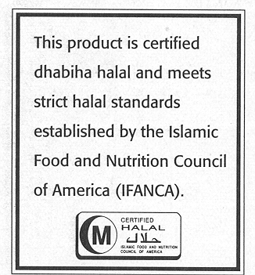
The Major US Symbol to Mark Products as Halal

Slide 27
“The intellectual difference of opinion in my community is a blessing.”
The Prophet Muhammad (pbuh) (c. 570 – 632)

Slide 28
An American Perspective
The importance of freedom of religion
The need to respect internal differences within the religion
The multiple supervisions provide that diversity consistent with freedom of religion
The role of government is to prevent fraud by providing a level playing field: Truth in Labeling and Consumer Right to Know
In the area of religion, governments should not be defining the religious standards, which inevitably disrespects some of their citizens

Slide 29
Dealing with Europe:
Animal Welfare
New emphasis on animal welfare
Undertones of anti-Semitism and Islamophobia
Need to focus on improving animal welfare for the halal slaughter of animals
May become a more important issue if and when Turkey tries to become a member of the EU

Slide 30
The knife
Development of a halal knife that is twice the width of the animal’s neck and straight edged and of a restraining device for holding sheep/goats for smaller slaughterhouses

Slide 31
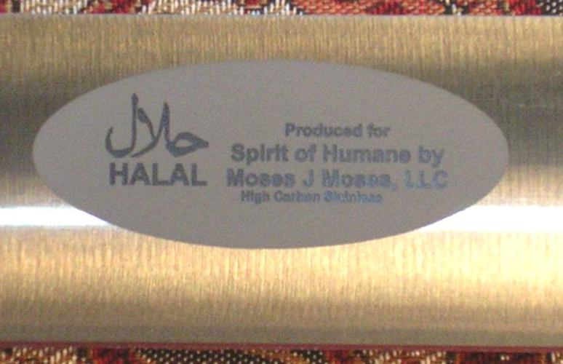
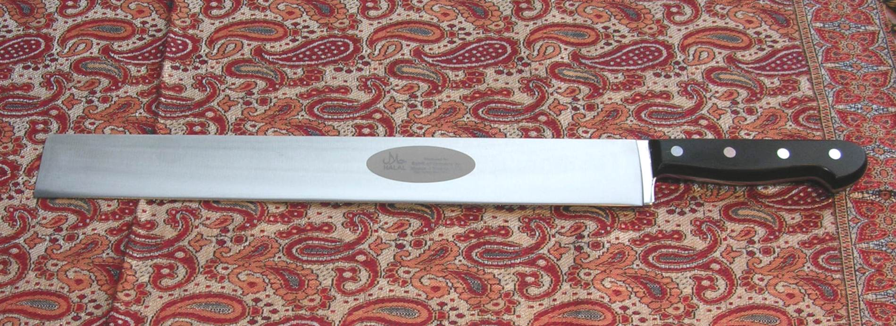

Slide 32

A Major Breakthrough A Knife Sharpness Testing Instrument (Anago, Ltd., Hamilton, New Zealand)

Slide 33
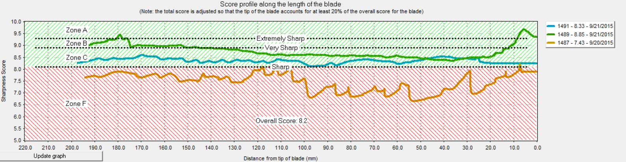
Testing Knives
Data generated at Cornell, September, 2015, with the help of Peter Dowd from Anago, Ltd.
Orange: The knife shown in the picture above (Muslim knife) before specific sharpening
Blue: Same knife quickly sharpened by a Jewish slaughter man trained to sharpen knives
Green: A well sharpened Jewish slaughter knife owned by the Jewish slaughter man

Slide 34
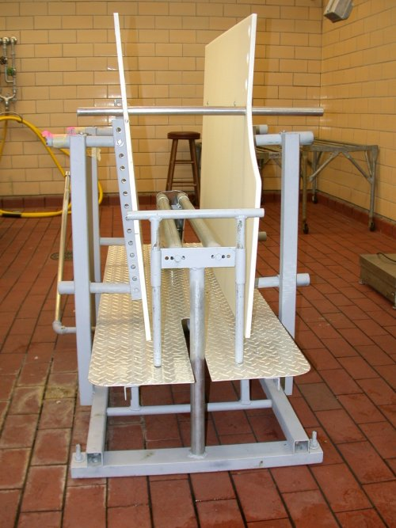
A proper
small-scale
restrainer

Slide 35
The Temple Grandin Head-Holder
Its role is to prevent the head from any movement, which can compromise the slaughter religiously and for animal welfare
Must not restrict the access of the slaughter-man to the animal
Should be partially released just after slaughter, but still keep the animal bleeding
After unconsciousness can release fully

Slide 36
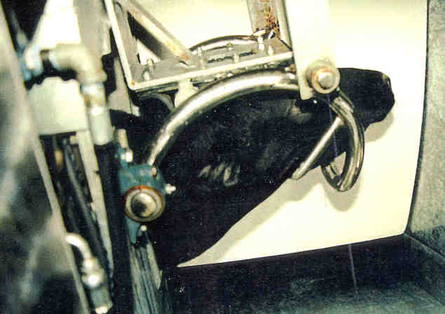

Slide 37
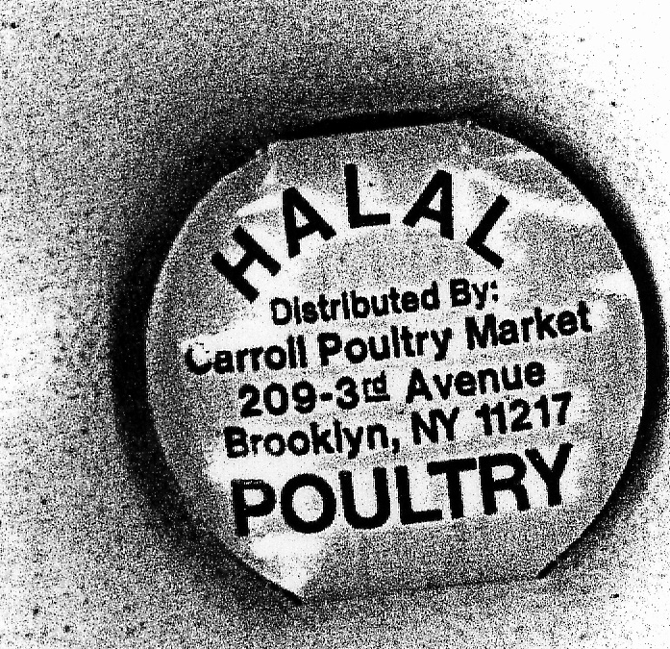
Are These Health Laws?
Kosher
No
Trichinosis in pork as an example
No cysts in mummified pork
Over 10 day incubation period
Halal
Yes, but as a “philosophical” set of
health concerns and not a modern
scientific health system

Slide 38
Contact JMR:
Copies of this presentation can be made available electronically. For a comprehensive article on kosher and halal, go to the web site: ift.org. Go to on-line journals. Go to Comprehensive Reviews, Vol. 2, Issue 3. For an 80 minute talk, go to cybertower.cornell.edu. (Also hear Dr. Grandin.) A 2 credit course is being offered by Kansas State University. [We hope to have the article in Chinese later this year.]
JMR9@cornell.edu

