Slide 1
Healthy Foods, Dangerous Foods

Slide 2
BBC2 Horizon: ‘Clean Eating: The Dirty Truth’ 19 Jan. 2017
Clip.

Slide 3
Ruby Tandoh, ‘Bad Fad: Ruby Tandoh on How Clean Eating Turned Toxic’, The Guardian 23 Jan. 2017.
‘There are many toxic layers to the wellness phenomenon. It is no coincidence that the faces of wellness are unfailingly young and thin, overwhelmingly white and all the talk of purity against that backdrop of privilege leaves a rather unsavoury taste in the mouth. Wellness is also the unprincipled driftings of the publishing houses with whatever currents lead them to a quick buck. It is the evangelism of wellness bloggers, picking up and shrugging off whatever label will give them the most page views. At its core, it is idea that food is medicine. It all sounds silly when the fictions of wellness are brought together.’

Slide 4
Some numbers
• £627m The value of the free-from market in 2016, according to market research firm Mintel. Growth of 52% is predicted over the 2016-21 period, to see the market reach £952m.
• 27,595,369 The number of posts on Instagram with #cleaneating
• £3tr Estimated value of the global wellness economy in 2015
• 495,191 Books sold by Ella Mills, AKA Deliciously Ella
• 219,158 Books sold by Amelia Freer, author of Eat. Nourish. Glow
• 186,477 Books sold by Jasmine and Melissa Hemsley, authors of The Art of Eating Well
• 122,123 Books sold by Madeleine Shaw, author of Get the Glow: Delicious and Easy Recipes that will nourish you from the Inside Out, and Ready, Steady, Glow; Fresh, Fast Food Designed for Life
• 100, 247 Books sold Natasha Corrett and Vicki Edgson, authors of Honestly Healthy: Eat with Your Body in Mind, the Alkaline Way
(Source: The Guardian 23 Jan. 2017)

Slide 5
Food and Health: a Long History

Slide 6
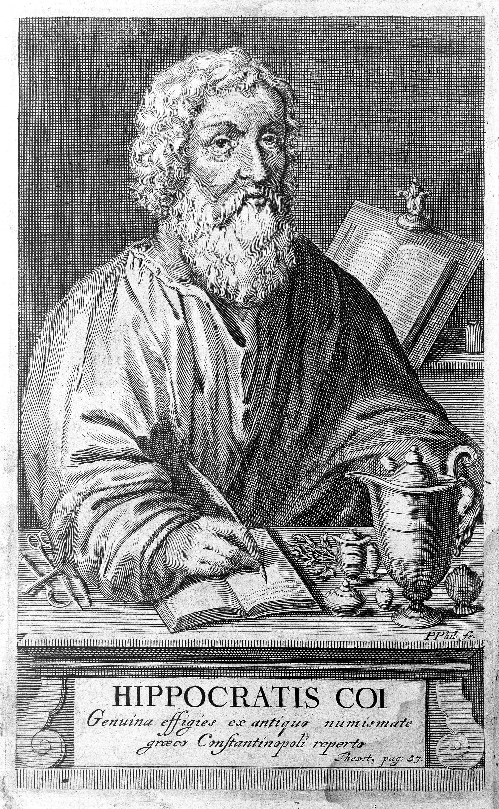
Hippocrates (circa 460BC-370 BC)
(as imagined in 1665)

Slide 7
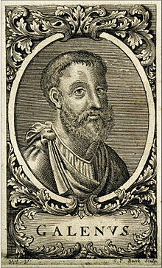
Galen (circa 130-210 AD)
(as imagined in the 18th century)

Slide 8
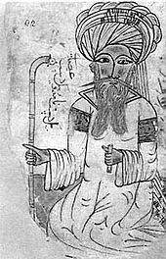
Abu Ibn Husayn Ibn ‘Ad Allah Ibn Sina (known in the West as Avicenna) (980-1037)
(as imagined in 1271)

Slide 9
Roch Le Baillif de La Rivière, Le demosterion (1578)
‘The absolute foundation of health consists almost entirely in eating and drinking.’

Slide 10
Sebastian Brant, Narrenschiff (1494).
‘He is a fool . . . who does not wish to live correctly according to the diet that the doctor has given to him.’

Slide 11
Michael Schoenfeldt, ‘Fables of the Belly in Early Modern England’, The Body in Parts: Fantasies of Corporeality in Early Modern Europe, eds. in David Hillman and Carla Mazzio (1997).
‘The stomach assumed a position of particular importance in early modern regimes of mental and physical health.’

Slide 12
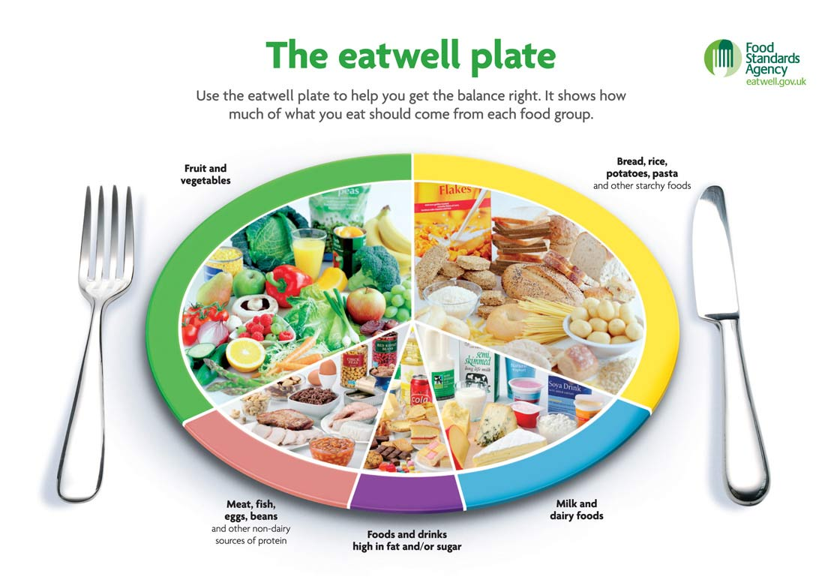
UK nutritional guidelines: the eatwell plate

Slide 13
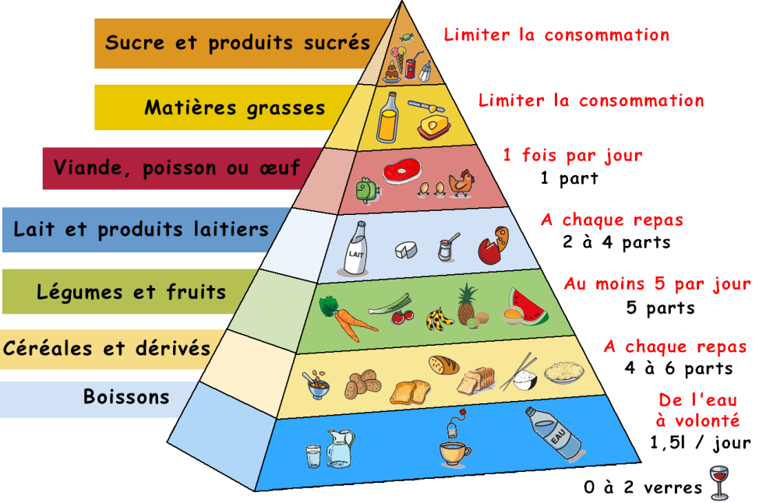
French nutritional pyramid

Slide 14
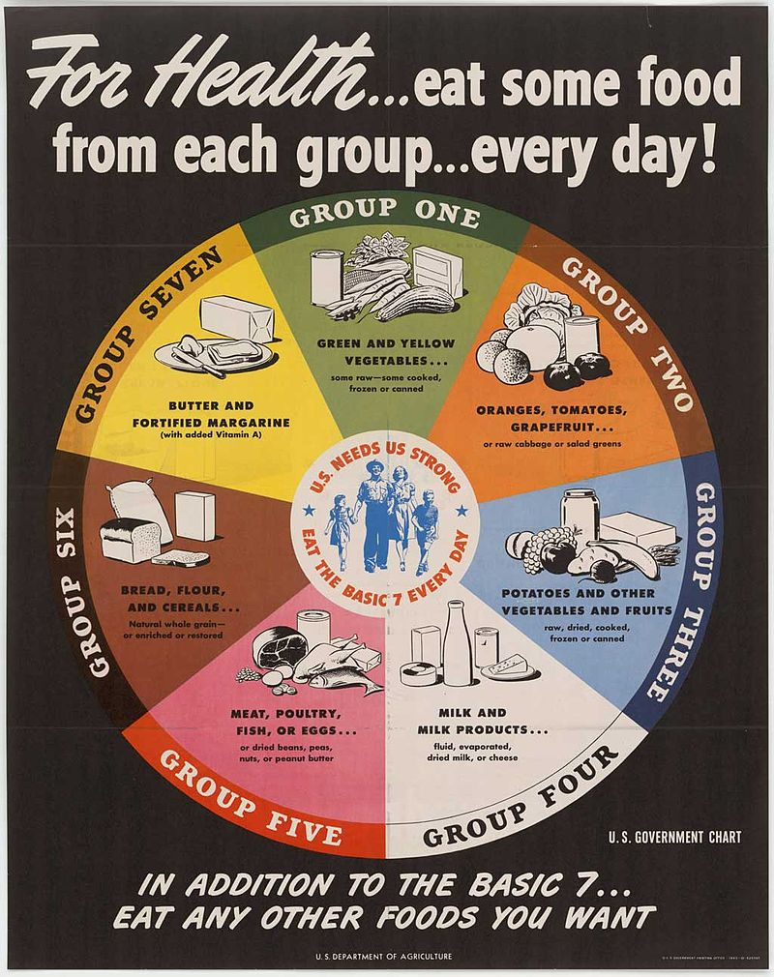
Some official dietary recommendations
Code Alimentaire (1910-12) France
BMA Diet (1933) UK
League of Nations Standard (1935)
Recommended daily allowances (1941) USA
US ‘Basic 7’ (1943)

Slide 15
Harvey Levenstein, Fear of Food: The History of Why We Worry About What We Eat (2012).
‘Home economists helped justify their role in the educational system by teaching how proper eating would avoid life-threatening diseases.’

Slide 16
Fears and Fads

Slide 17
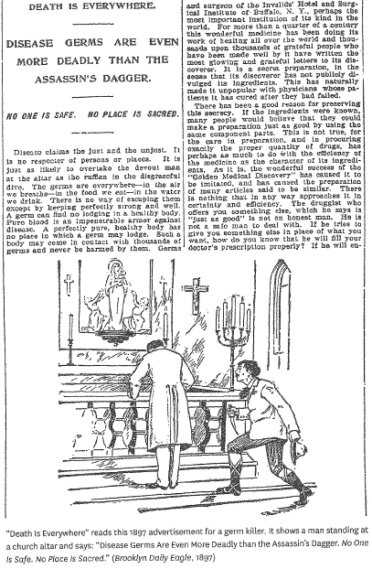
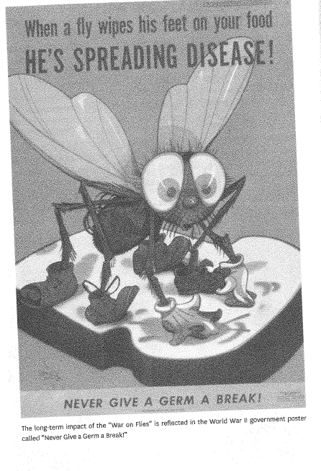
A little context . . .
The germ theory of disease
hidden contagions
The germ as assassin

Slide 18
Milk: dangerous or a perfect food?

Slide 19
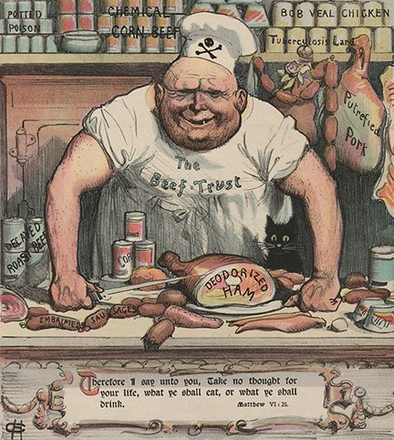
Meat as contagion
TB

Slide 20
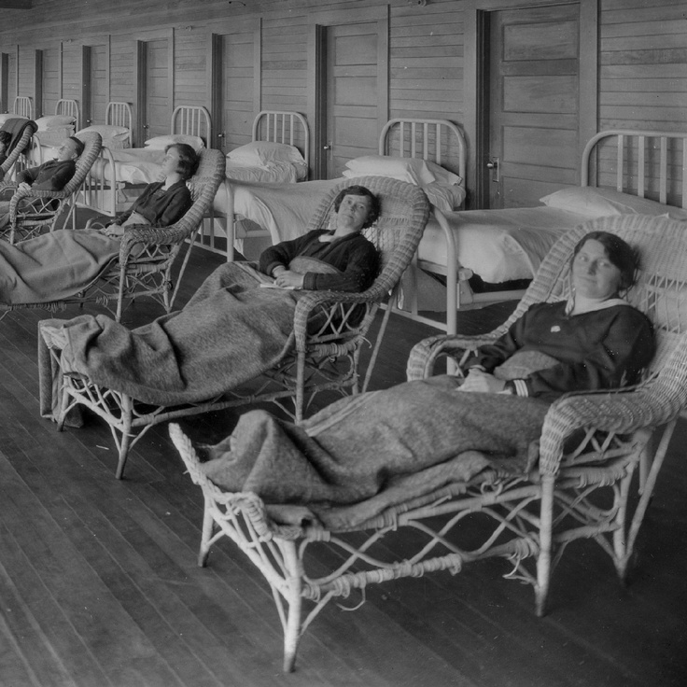
Tuberculosis Sanatorium

Slide 21
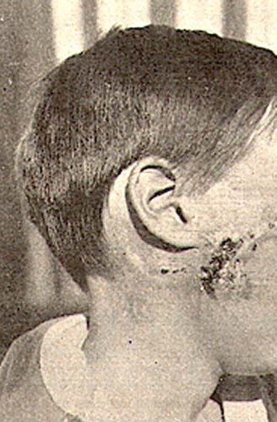
Facial infection of a boy that contracted bovine tuberculosis by drinking milk from an infected cow (1923).

Slide 22
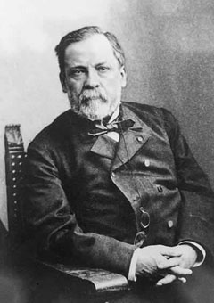
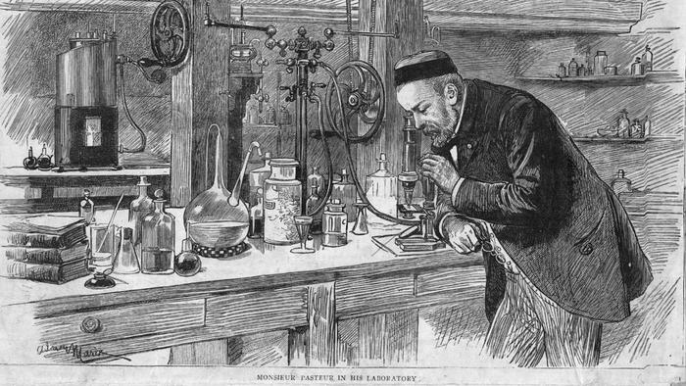
Louis Pasteur and Pasteurisation
making milk ‘safe’

Slide 23
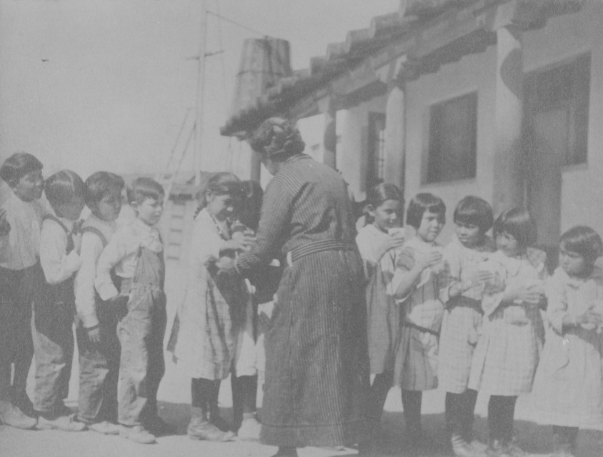
Milk being served to Pueblo children at Isleta Day School (New Mexico) to ward off tuberculosis.
Milk as a healthy drink for children

Slide 24

World War Two poster
Milk as a healthy drink for adults

Slide 25
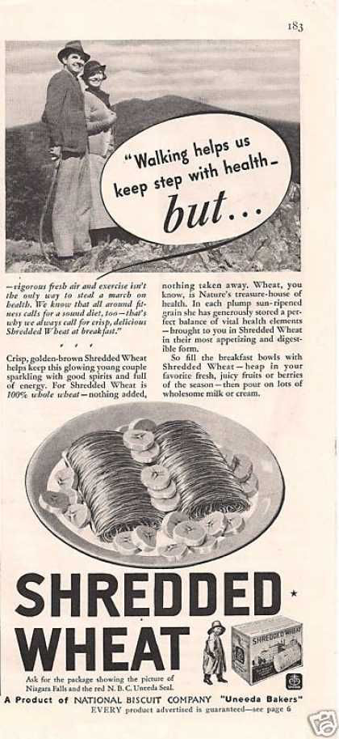
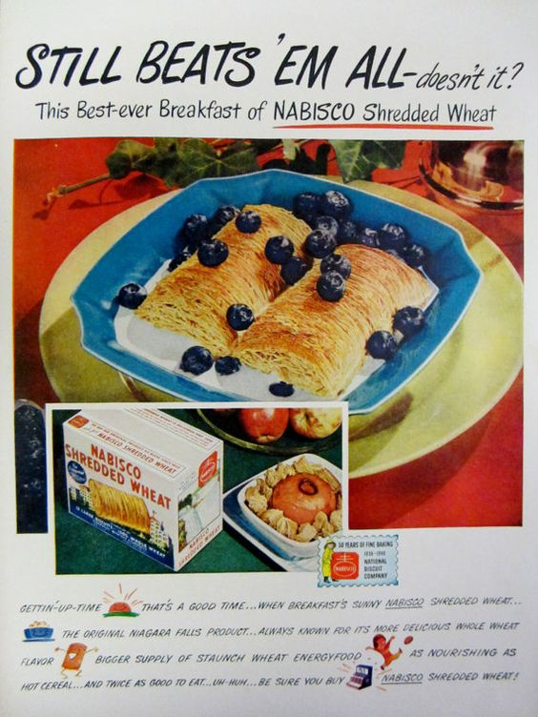
Breakfast cereals + milk A perfect healthy breakfast?
1948 advert for Nabisco Shredded Wheat
1935 advert

Slide 26
Levenstein, Fear of Food.
‘It all amounted to impressive testimony of the on-going effectiveness of advertising campaigns such as those mounted by Kellogg’s and Nabisco in the early twentieth century. This represented yet another irony: that many of the fears that originated in the industrialization of the food supply were ultimately dissipated by the kind of packaging and marketing that were integral parts of it.’

Slide 27
‘industrial food’
Foods that reflect a complex of new, 19th-century technological developments in:
preserving
mechanisation
retailing
transport
Jack Goody, ‘Industrial Food: Towards the Development of a World Cuisine’, Cooking, Cuisine and Class (1982).

Slide 28
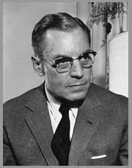
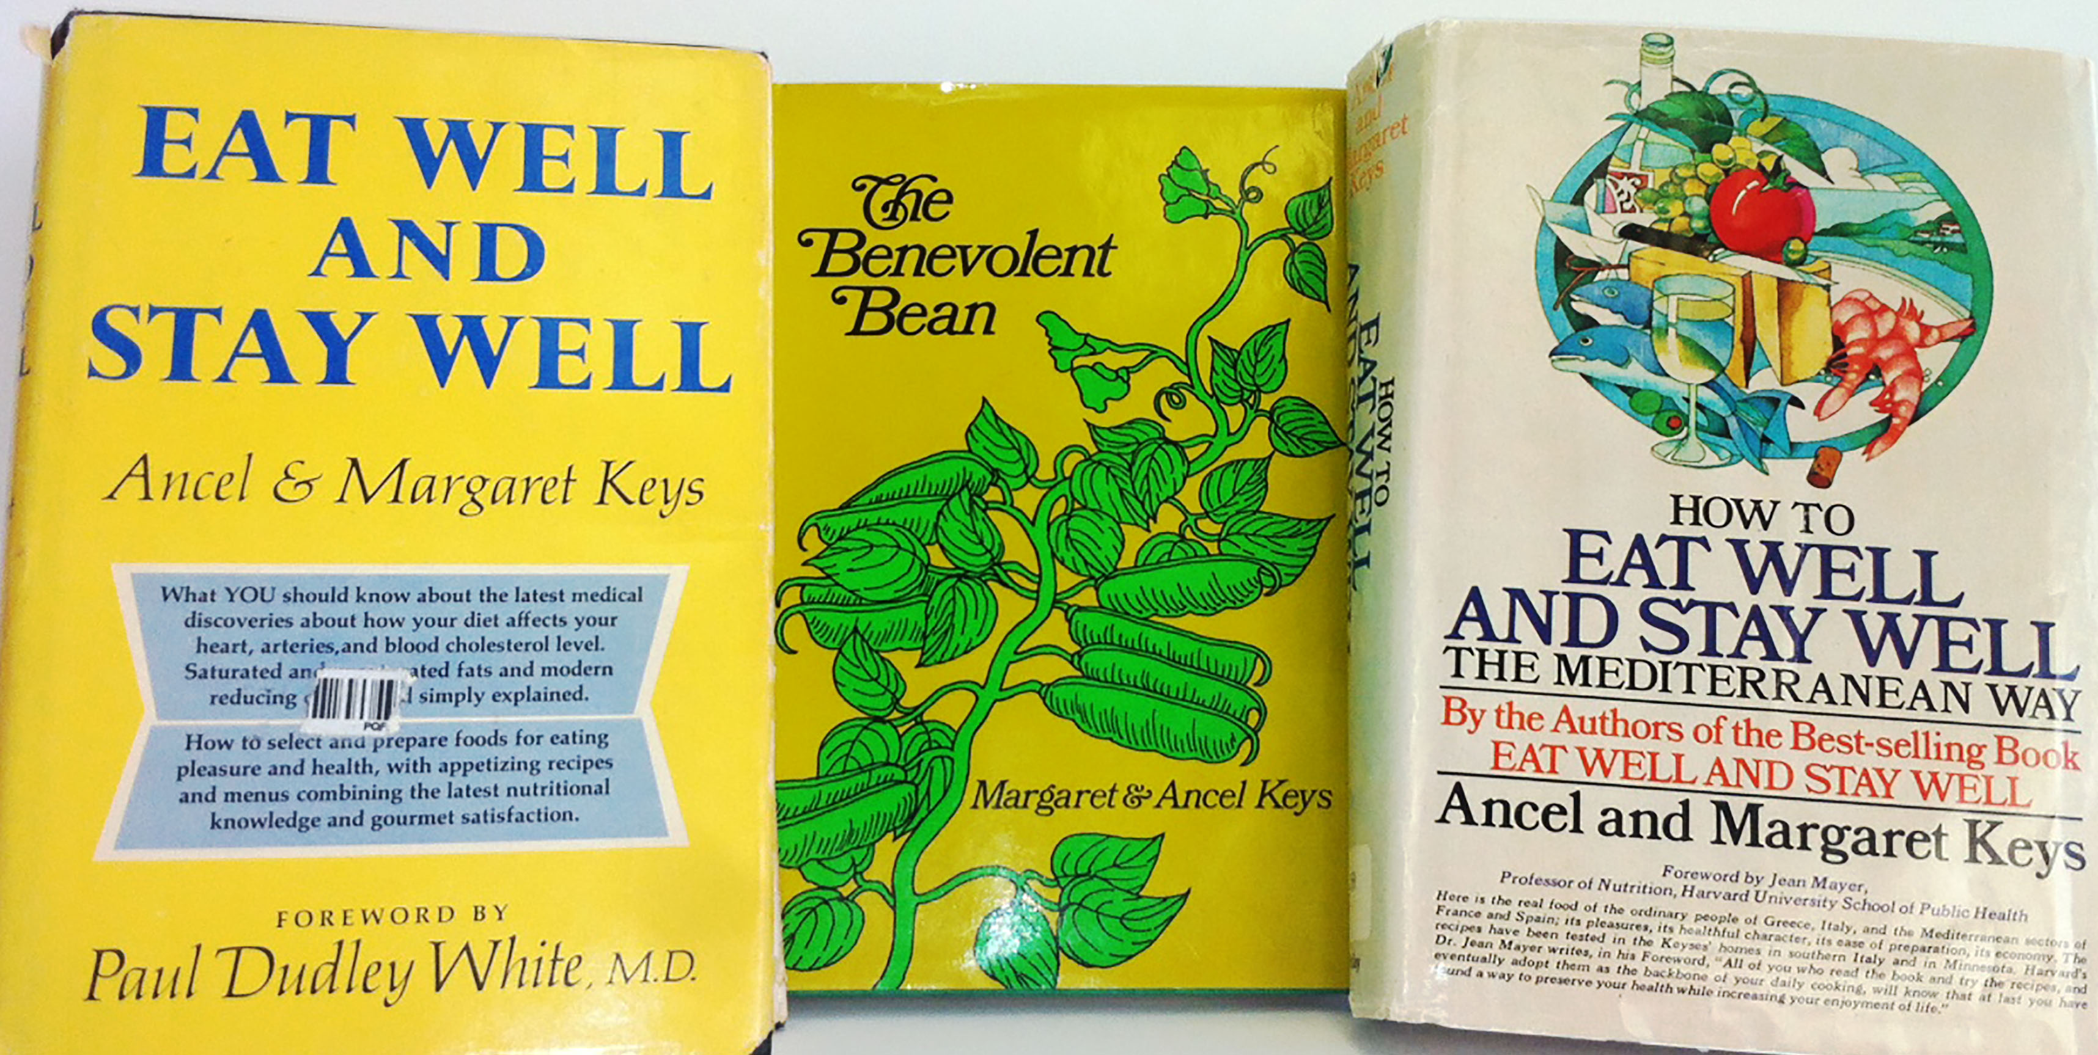
Ancel Keys and the Mediterranean diet

Slide 29

American Heart Association endorsement for Florida Grapefruit Juice

Slide 30
Yoghurt

Slide 31
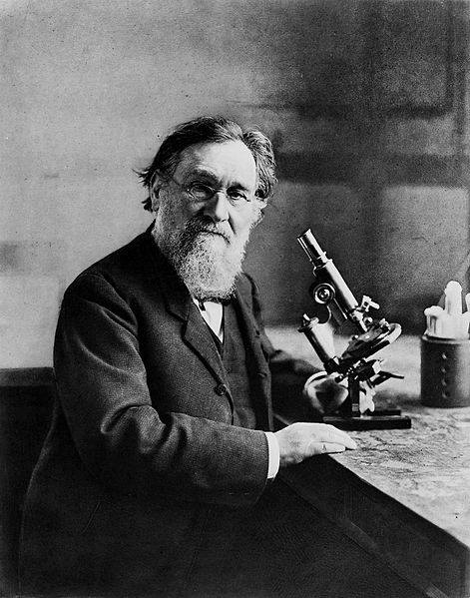
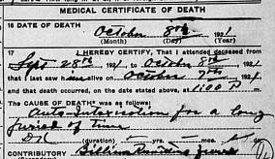
Elie Metchnikoff
‘autointoxication’

Slide 32
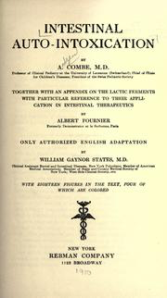
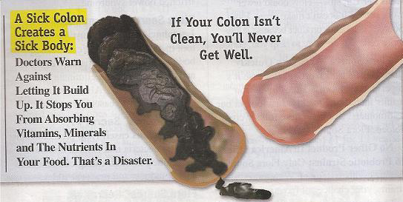
‘Thanks to germ theory, constipation was transformed into an even greater menace: autointoxication.’ James Whorton, Inner Hygiene: Constipation and the Pursuit of Health in Modern Society (2000).
The idea lives on . . . .

Slide 33
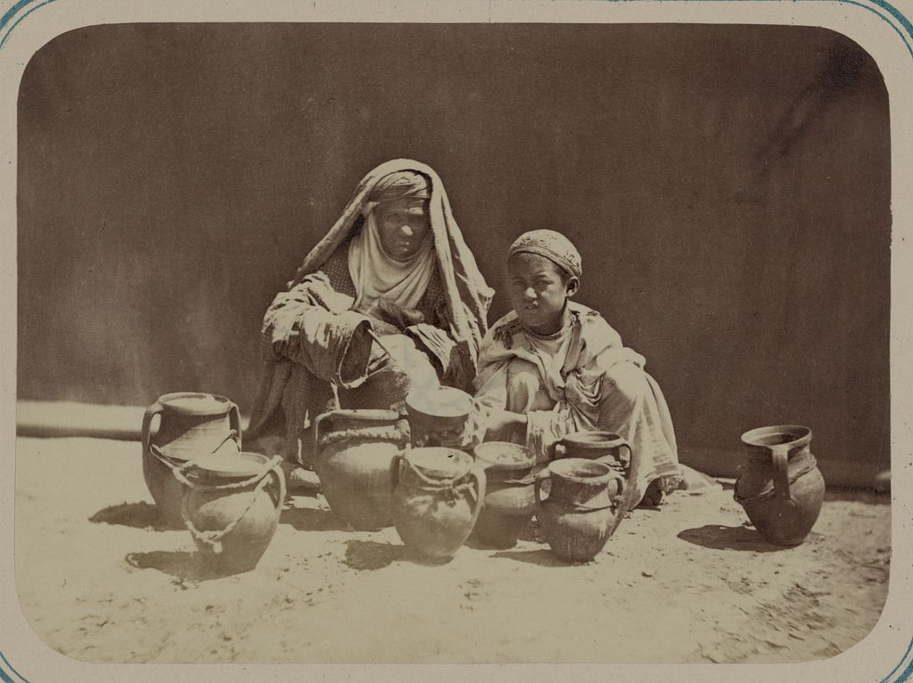
Yoghurt for sale in Turkestan.

Slide 34
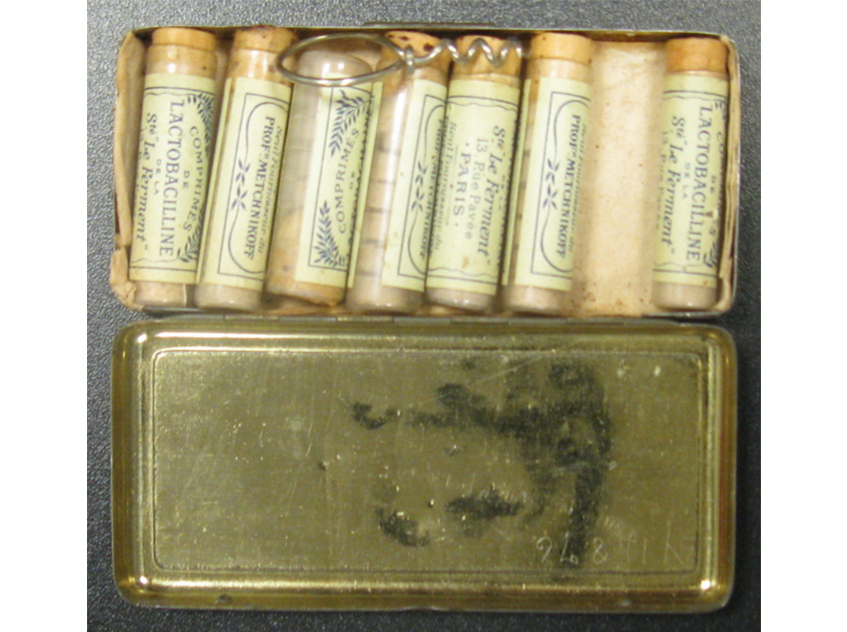
Lactobacilline pills (early 20th century)
The package insert states that they are composed of ‘pure cultures of lactic bacilli’ prepared according to instructions of Professor Metchnikoff

Slide 35
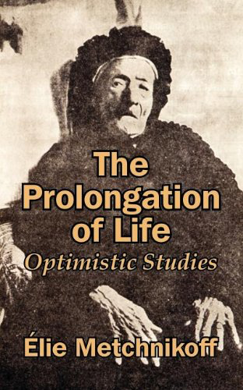
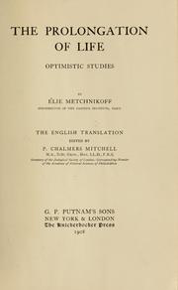
Metchnikoff, The Prolongation of Life (1907

Slide 36
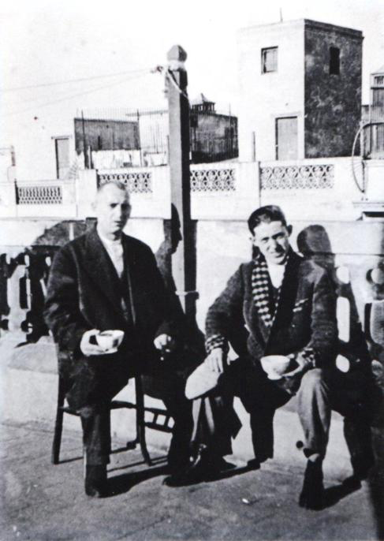
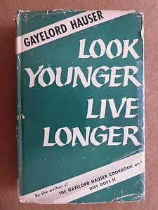
The continued rise of yoghurt
Danone
Gayelord Hauser
Danone
Danone founder Isaac Carrasco

Slide 37

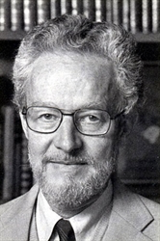
Jerome Rodale and Hunza apricots

Slide 38
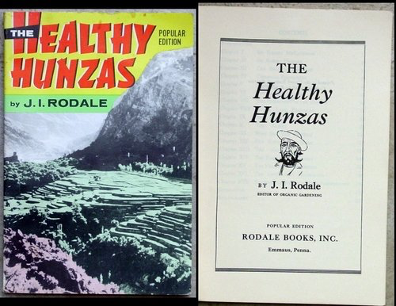
Healthy Hunza (1948)

Slide 39
Levenstein, Fear of Food.
‘The fact that low socioeconomic status is the greatest risk factor for heart disease would seem to indicate that the best way to reduce deaths from it would be to reduce poverty. But of course there are few experts who advocate this solution. To do so would run counter to the whole tenor of the times, in which Americans search for individual, rather than collective, solutions to their problems, and seek to blame peoples’ afflictions on their lifestyle choices, rather than on their social circumstances or the luck of the draw.’

Slide 40
natural food movement
counterculture/counter cuisine (Warren Belasco)
Diet for a Small Planet and How the Other Half Dies
‘nutritional-industrial complex’ (Michael Pollan)
local foods, organic farming

Slide 41
From 1960s radicalism to neoliberalism?
The ‘new health consciousness’: an ‘ideological formation that defined problems of health and their solutions principally , although not exclusively, as matters within the boundaries of personal control’.
(Robert Crawford, ‘Health as Meaningful Social Practice’, Health 10:4 (2006).)
The natural food movement: ‘a dietary ideal that was meant to be socially disruptive but subtly, and inadvertently, promoted some of the same values and characteristics that were part and parcel of neoliberal ideals of good citizenship’.
(Charlotte Biltekoff, Eating Right in America: The Cultural Politics of Food and Health (2013).)
‘In the end the message of personal responsibility prevailed.’
(Biltekoff, Eating Right in America.)

Slide 42
Does the focus on healthy eating promote . . .
‘a kind of educated, responsible consumption that was a hallmark of good neoliberal citizenship’ ??
(Biltekoff, Eating Right in America)

