Slide 1
Food and Religion
A man asked the messenger of Allah: ‘Which act in Islam is the best?’
Muhammad replied: ‘To give food, and to greet everyone, whether you know them or not’.
Book of Greetings 6, Hadith 845

Slide 2

In June 2016 a pig’s head was left outside a mosque in Québec City.
The card reads ‘Bon appétit’.
(Earlier this week a gunman killed six worshipers at the same mosque.)

Slide 3
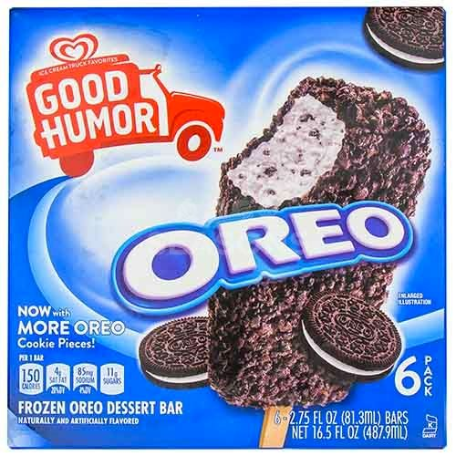

Industrial Kosher:
Oreo Ice Cream Bars

Slide 4
Roger Horowitz, Kosher USA: How Coke Became Kosher and Other Tales of Modern Food (New York, 2016).
Horowitz describes the
‘remarkable success of the Orthodox (a small minority of Jews) to insert a particular interpretation of kosher requirements into the practices of a secular food system’.

Slide 5
Hinduism
Debates about the status of beef
‘Caste on the Menu Card’

Slide 6
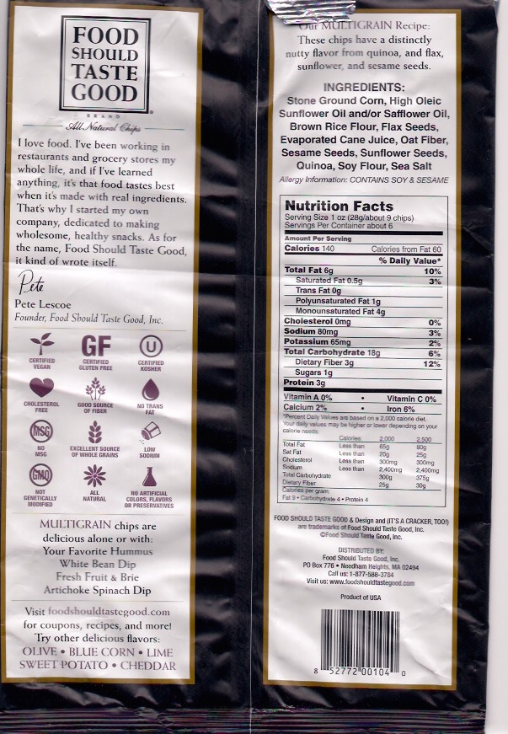
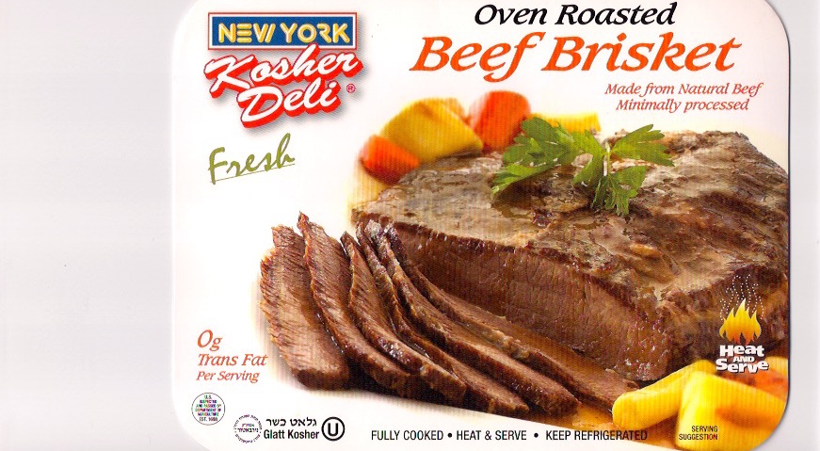
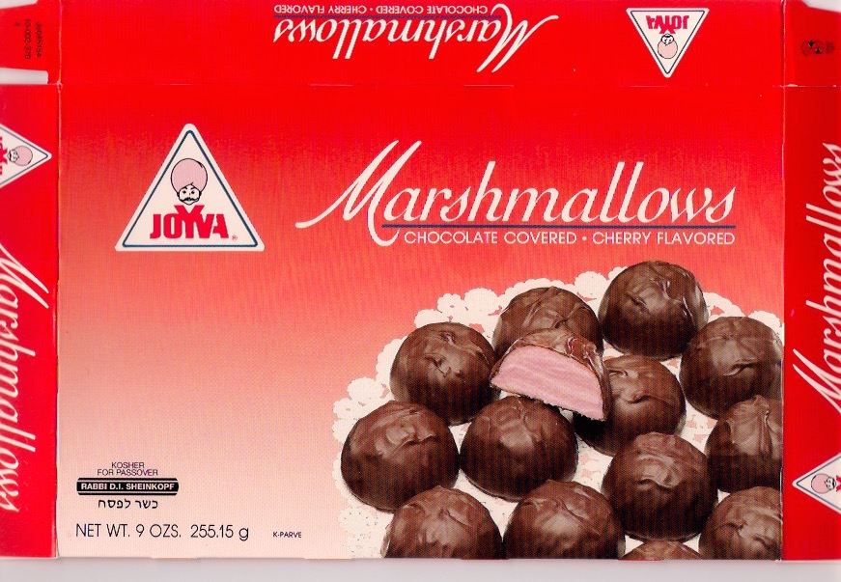
Various kosher certifications

Slide 7
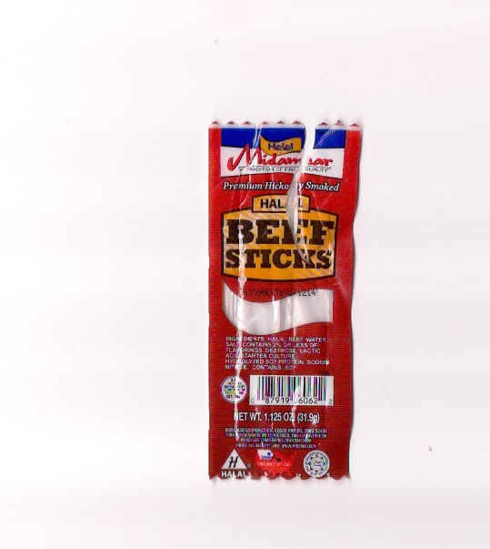
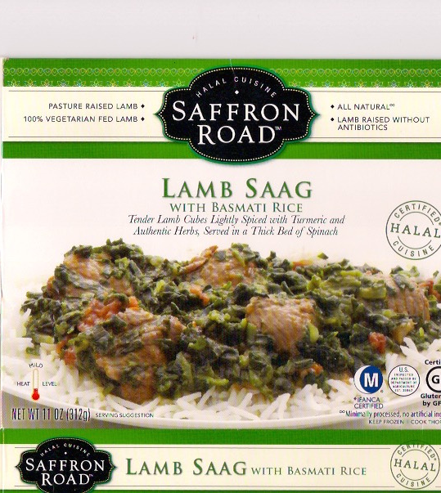
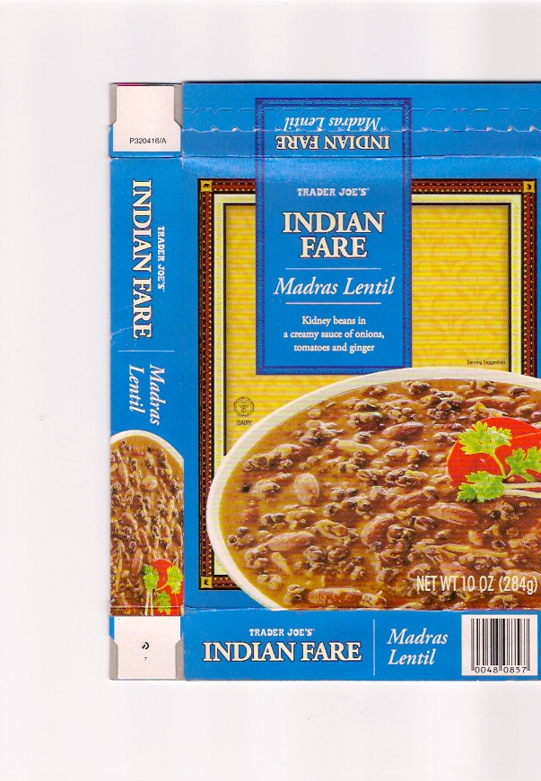
Various halal certifications

Slide 8
Religious food regulations

Slide 9
Religious food regulations on . . .
prohibited foods
who can prepare your food
whether you can eat your food with non-co-religionists
the utensils used to prepare the food
the manner in which any animals were slaughtered
the combinations of foods on the table at any moment
the consumption of particular foods at particular times. . .

Slide 10
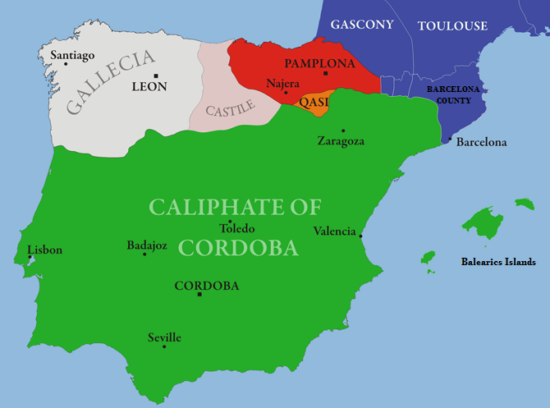
Spain circa 1000 AD: a religious food frontier
pork
No pork

Slide 11
Lope de Vega, El primer rey de Castilla (1598-1603)
A character explains that he has hung a side of bacon outside his door
‘so that the King will know that I am neither a Moor nor a Jew’.

Slide 12
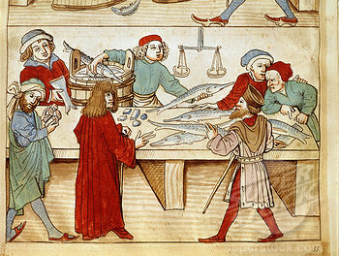
Buying fresh pike in the 15th century
Fasting and other Christian food-practices helped create ‘imagined religious communities’

Slide 13
Marcie Cohen Ferris, Matzoh Ball Gumbo: Culinary Tales of the Jewish South (Chapel Hill, 2012).
‘Food is a bridge between southern culture and the Jewish experience . . .The degree to which southern Jews either embraced local cuisine or preserved Jewish foodways defined their identity in the South. Food became a barometer, a measuring device that determined how southern Jews acculturated while also retaining their own heritage. . . . The act of eating in the Jewish South reflects how Jews balanced their Jewishness in a world dominated by white and black Christian southerners.’

Slide 14
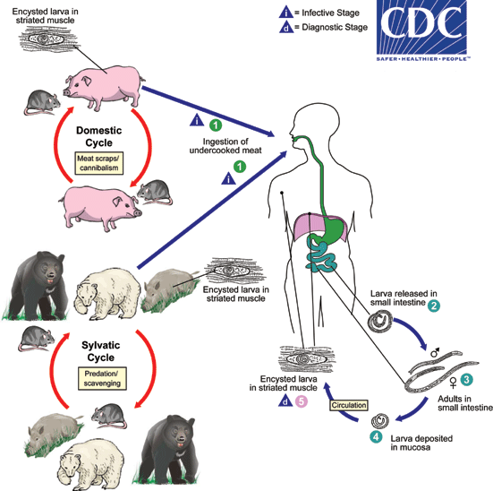
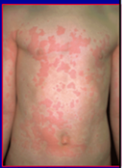
Life cycle of Trichinella spiralis
Typical trichinosis rash

Slide 15
The trichinosis theory reflects the
‘Western tendency to seek explanations in terms of disease’.
Frederick Simoons, Eat Not this Flesh: Food Avoidances from Prehistory to the Present (1994).

Slide 16
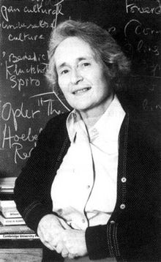
Mary Douglas
Purity and Danger (1966)
‘Dirt’ is ‘matter out of place’:
something that does not
conform to our
normal scheme of classifications

Slide 17
Mary Douglas on Dirt
‘Dirt then, is never a unique, isolated event. Where there is dirt there is system. Dirt is the by-product of a systematic ordering and classification of matter. . . Shoes are not dirty in themselves, but it is dirty to place them on the dining-table; food is not dirty in itself, but it is dirty to leave cooking utensils in the bedroom, or food bespattered on clothing; similarly, bathroom equipment in the drawing room; clothing lying on chairs; out-door things in-doors; upstairs things downstairs; under-clothing appearing where over-clothing should be, and so on. In short, our pollution behaviour is the reaction which condemns any object or idea likely to confuse or contradict cherished classifications.’
Mary Douglas, Purity and Danger: An Analysis of Concepts of Pollution and Taboo (1966).

Slide 18
GUEST LECTURE!
‘Religion and the Food System’
Professor Joe Regenstein (Cornell University)
(the man behind the kosher Oreo . . .)
Thursday, 23 February 2017 (Week 7)
17.00 - 18:30 Oculus 0.04
All Welcome

