Slide 1


Slide 2
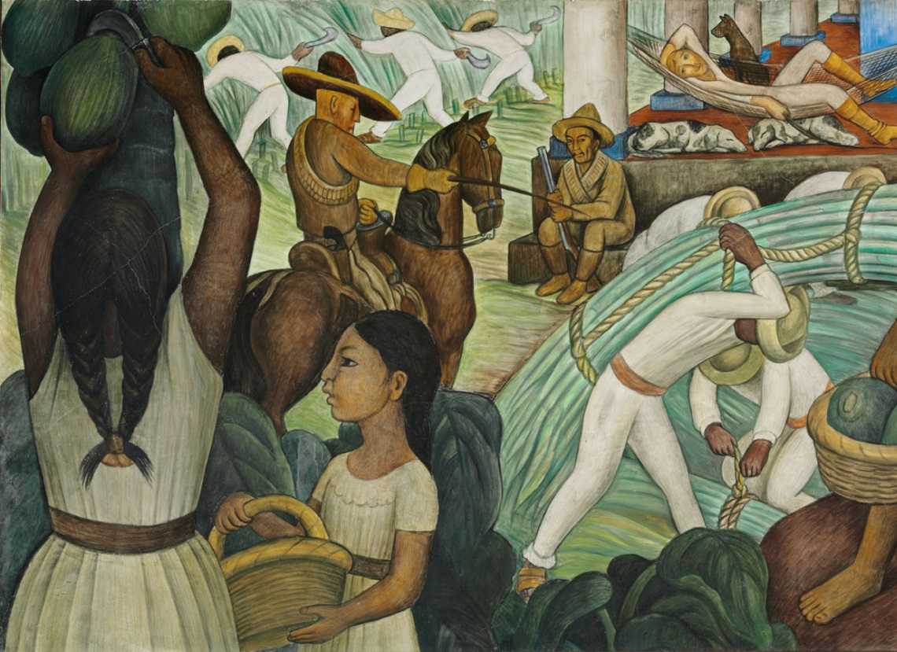
The social relations of capitalism reproduced through sugar

Slide 3
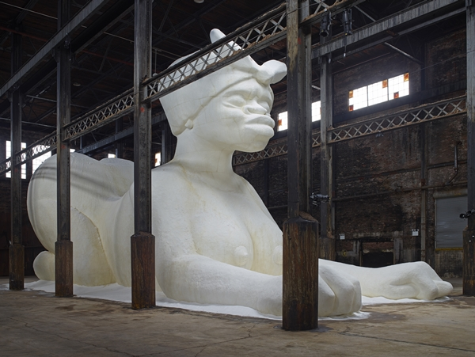
But first, three cheers for historians!

Slide 4
Appropriating Value in the Production Process
Change and Contestation in the Sphere of Production
Governing Labour: The Role of the State in Accumulation
Conclusions

Slide 5
1. Appropriating Value in the Production Process

Slide 6
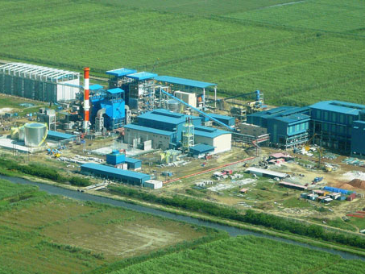
Factories in the fields: industrial discipline extended over agriculture

Slide 7
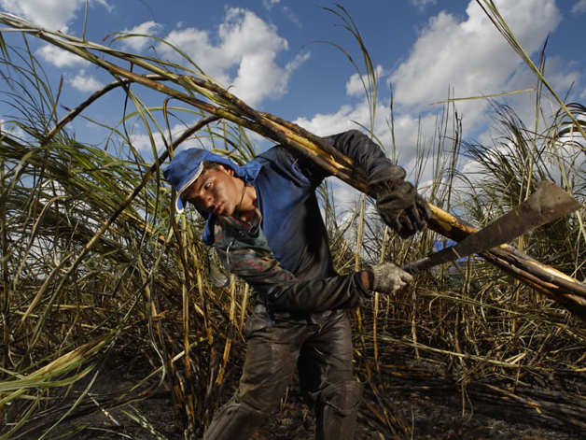
Appropriating surplus value, i.e. unpaid labour:
(1) Increase the workload

Slide 8
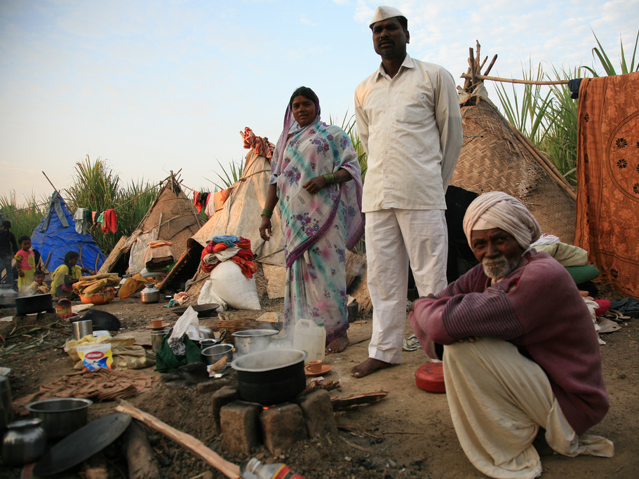
(2a) Lower the wage through indebted migrant labour

Slide 9
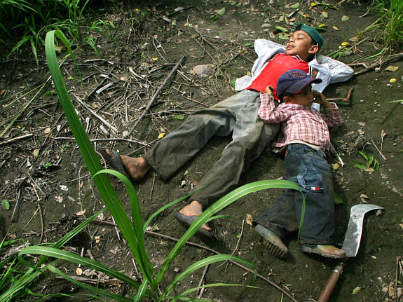
(2b) Lower the wage through child labour

Slide 10
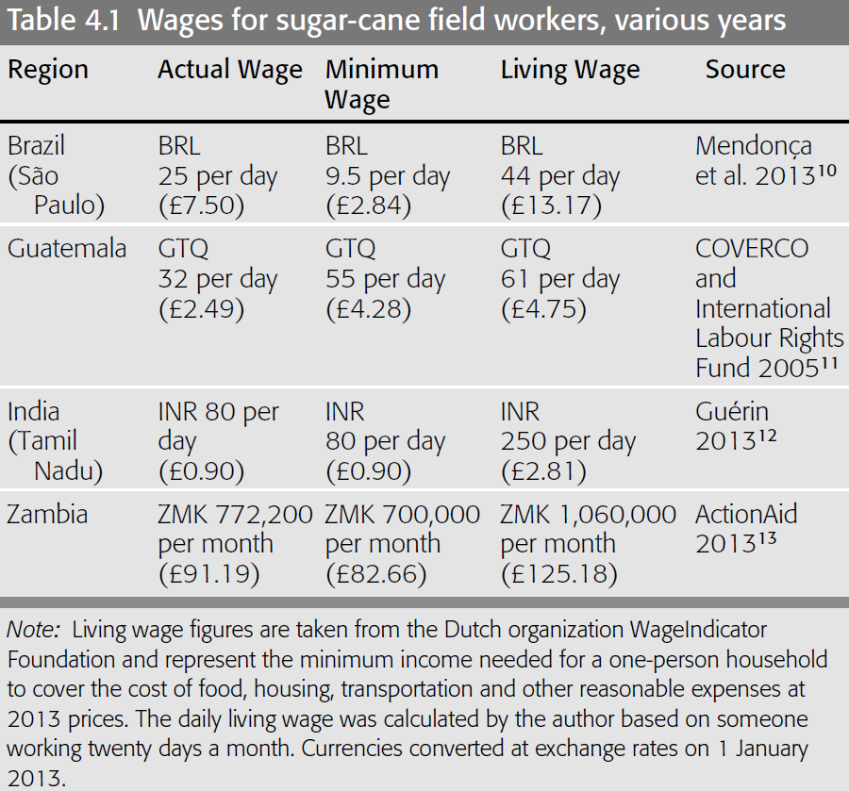

Slide 11
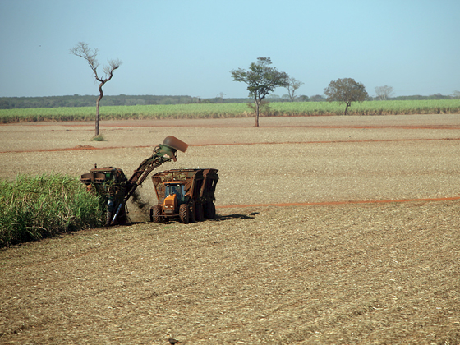
(3) Increase labour productivity via mechanisation

Slide 12
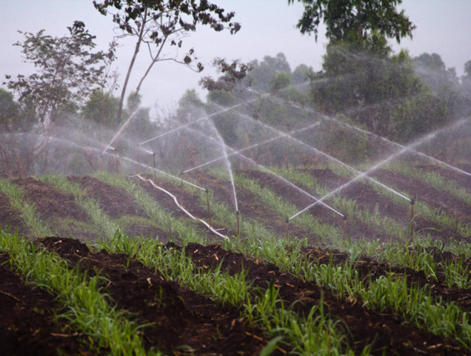
Surplus value can be augmented by the ‘free gifts’ of nature…

Slide 13
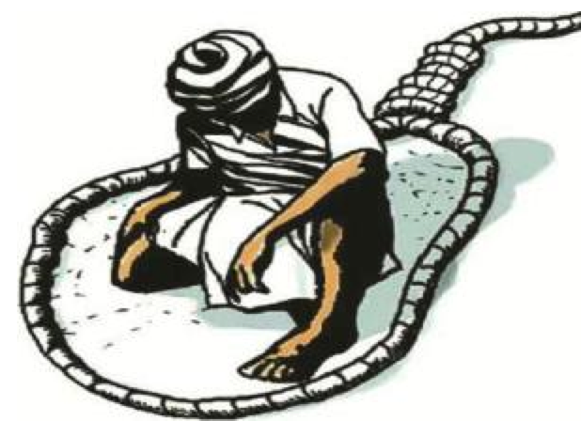
…but bargained away by buyers, banks and landowners
Notes:
https://www.youtube.com/watch?v=xnCGmnml1CI&index=2&list=PLD7C088057172C9FC

Slide 14
2. Change and Contestation in the Sphere of Production

Slide 15
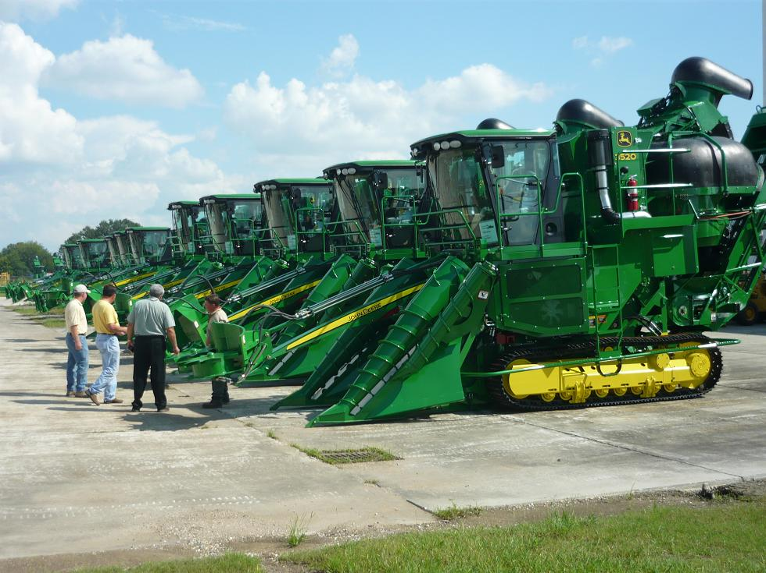
‘Modernisation’ is leading to mass redundancy…

Slide 16

…and alternative jobs can be hard to find

Slide 17
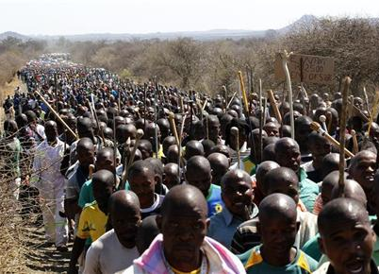
For those workers that remain employed, unions have demanded fairer pay…

Slide 18
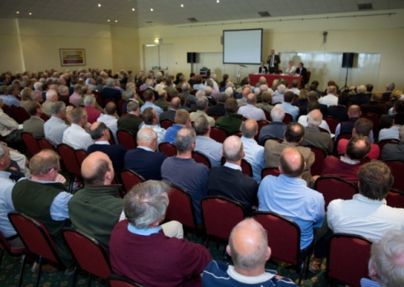
…while farmers’ unions have demanded fairer prices

Slide 19

Labour can also act collectively through direct ownership, e.g. a cooperative

Slide 20
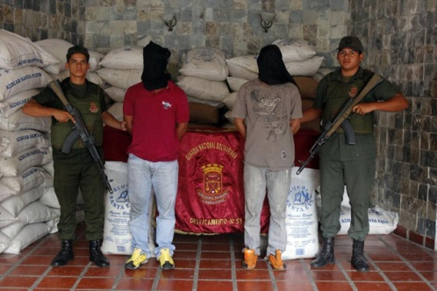
Like corporations and cooperatives, state-owned businesses can develop their own pathologies too

Slide 21
3. Governing Labour: The Role of the State in Accumulation

Slide 22
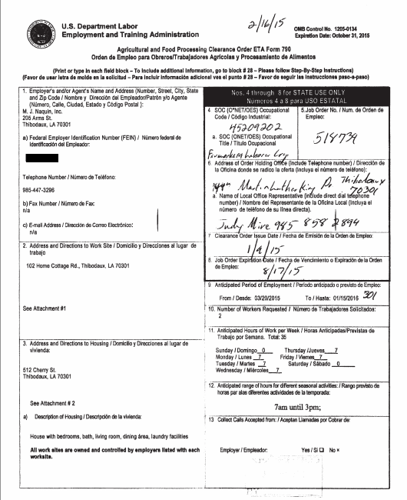
State management of ‘flexible’ labour

Slide 23
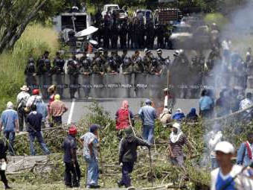
State repression of labour ‘unrest’

Slide 24
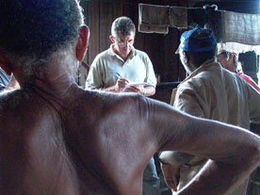
State protection by criminalising, blacklisting and shaming abusive employers

Slide 25
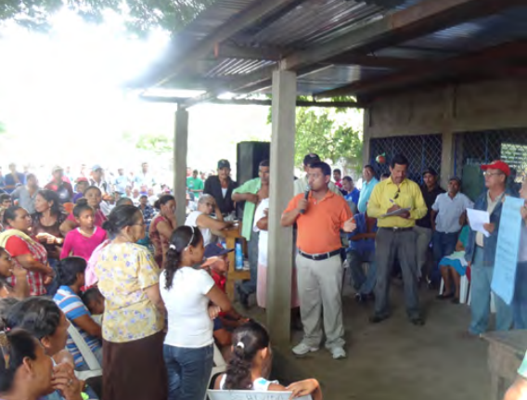
Going beyond the state: transnational campaigns

Slide 26
4. Conclusions
Sugar producers are under pressure to discipline labour and squeeze surplus value out of them.
The techniques they use to do this call on established hierarchies of inequality.
But through their own efforts or in conjunction with the state and civil society, labour can fight its own battles.

