Slide 1
Oral History
An (incredibly brief) introduction
Jenny Crane & Gareth Millward
Notes:
GM: 3 ; 4 ; 5 ; 6
JC: 7 ; 8
GM: Sierra ; H1N1
JC: NHS70 ; Voices ; ChildLine

Slide 2
Part I
What is oral history?

Slide 3
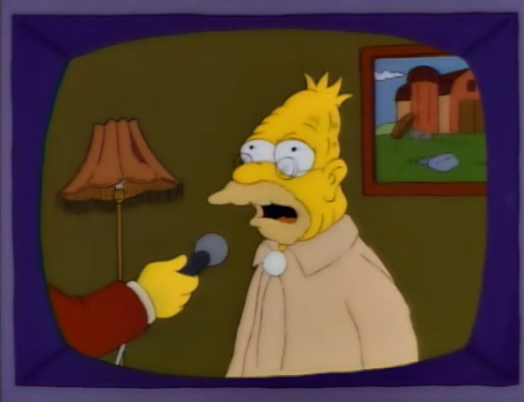
What is oral history?
Spoken testimony as historical evidence
“A source of new insights and perspectives that may change our view of the past”
For more, see the Oral History Society
Notes:
OHS’s front page:
Oral history is the recording of people’s memories, experiences and opinions. It is:
A living history of everyone’s unique life experiences
An opportunity for those people who have been ‘hidden from history’ to have their voice heard
A rare chance to talk about and record history face-to-face
A source of new insights and perspectives that may challenge our view of the past.
Right: Grandpa Simpson, “My son is not a communist”

Slide 4
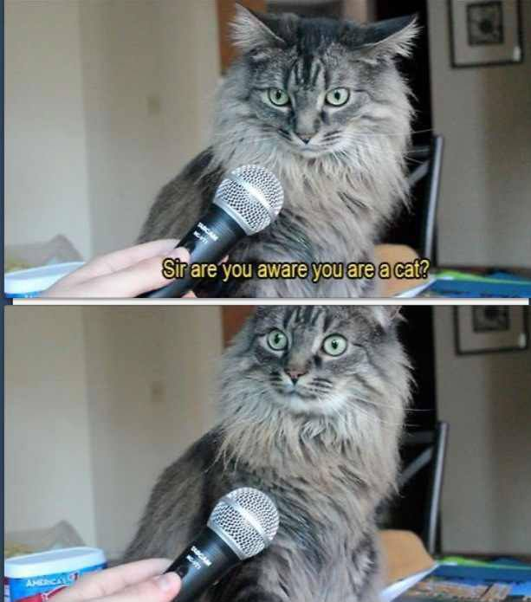
Where did oral history come from?
Growth since 1980s
Improved, accessible recording equipment
New historiographical approaches
BUT – is it “robust”?
And is it really “accessible”?
Notes:
Right: common meme

Slide 5
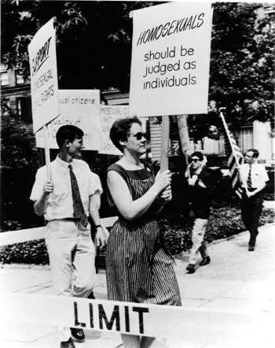
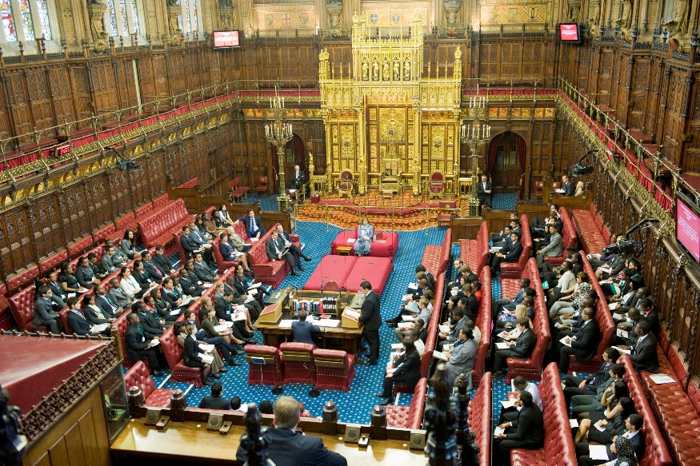
Whose history?
A “history from below”?
Or a new “history of the elites”?
Notes:
Left – Wikipedia entry for “Pride”
Right – Wikipedia entry for House of Lords

Slide 6
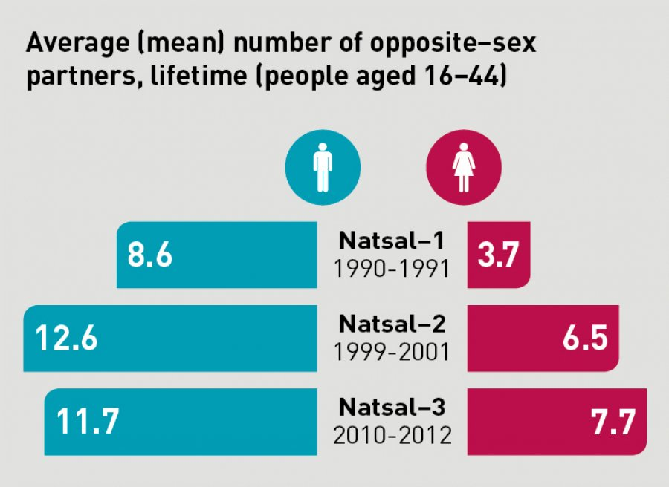
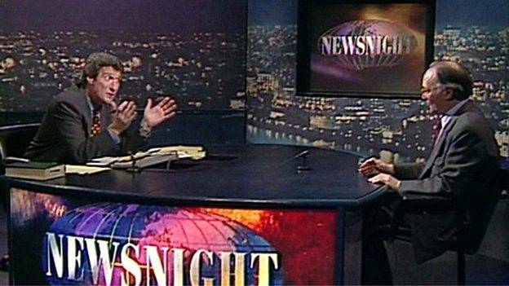
Is it history?
Is it journalism?
  No.
Is it sociology?
  Maybe.

Slide 7
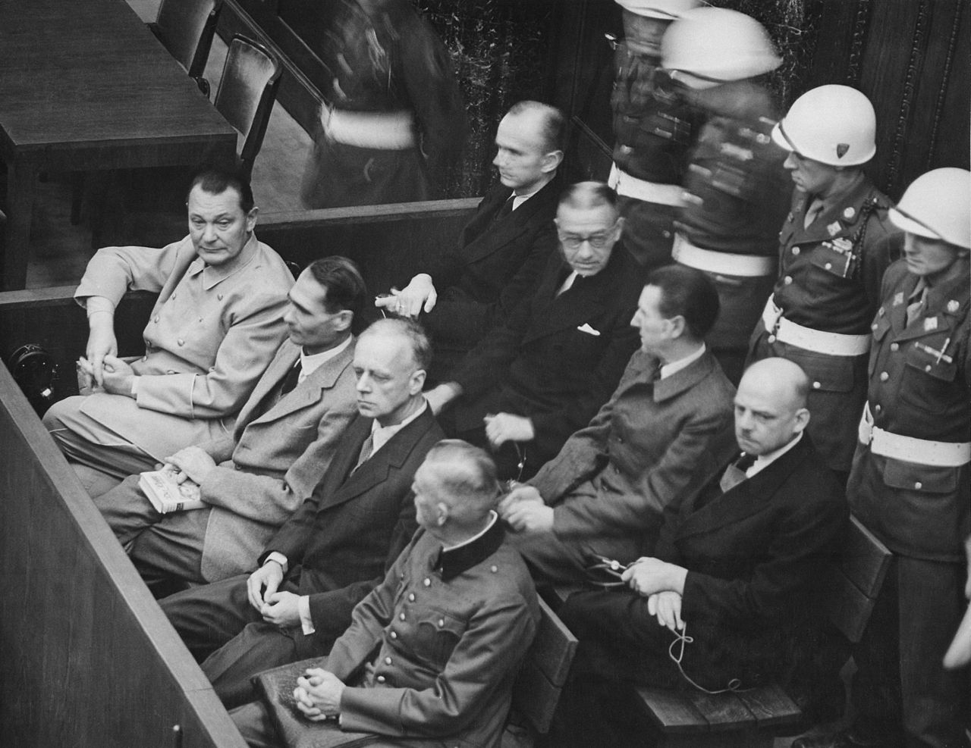
Research ethics
You must get ethical approval before interviewing anyone
This is to protect your interviewees, the university, and you
“Ethics” is not the same as morality…

Slide 8
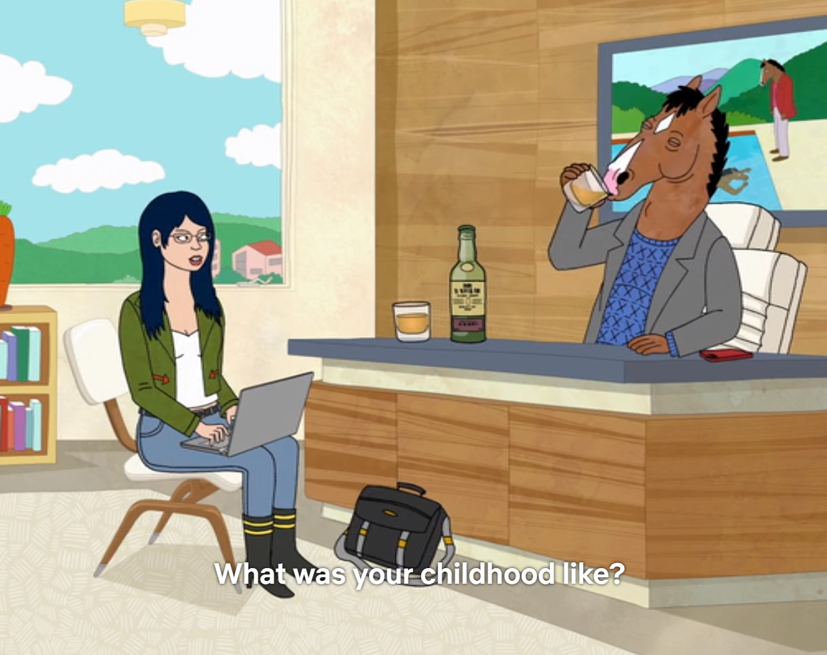
Some final considerations…
What are our data?
Should we – “fact check”?
How do we deal with “informed consent”?
Are our interviewees co-authors?
Should we anonymise?

Slide 9
Part II
Some examples

Slide 10
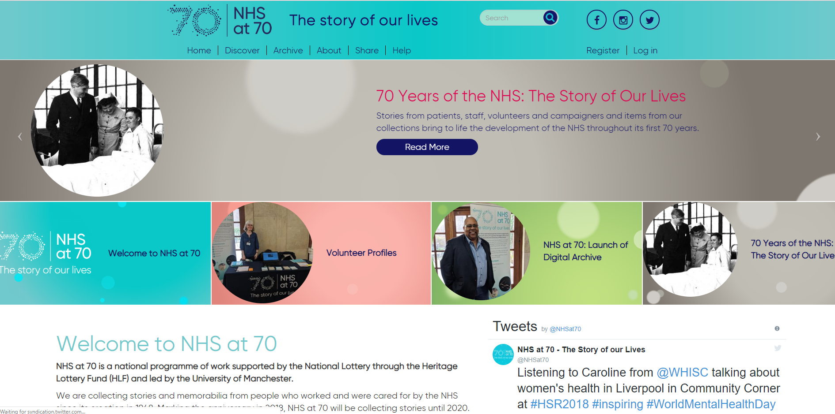
NHS70

Slide 11
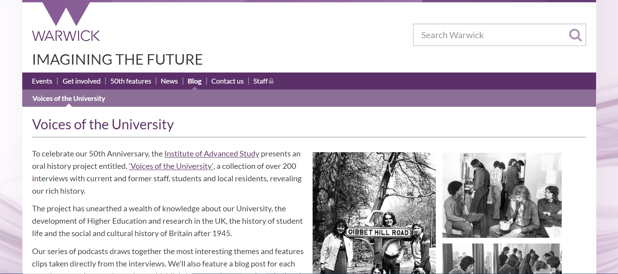
Voices of the University

Slide 12
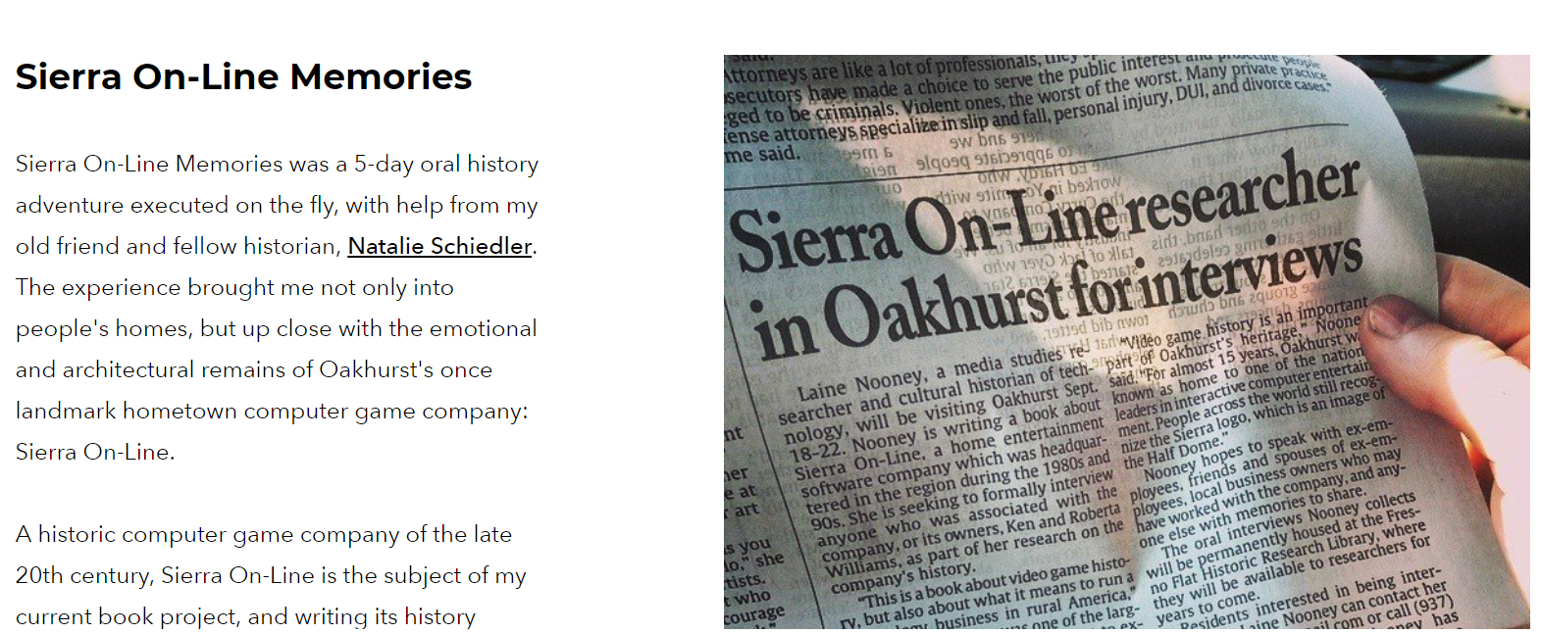
Sierra On-Line Memories

Slide 13
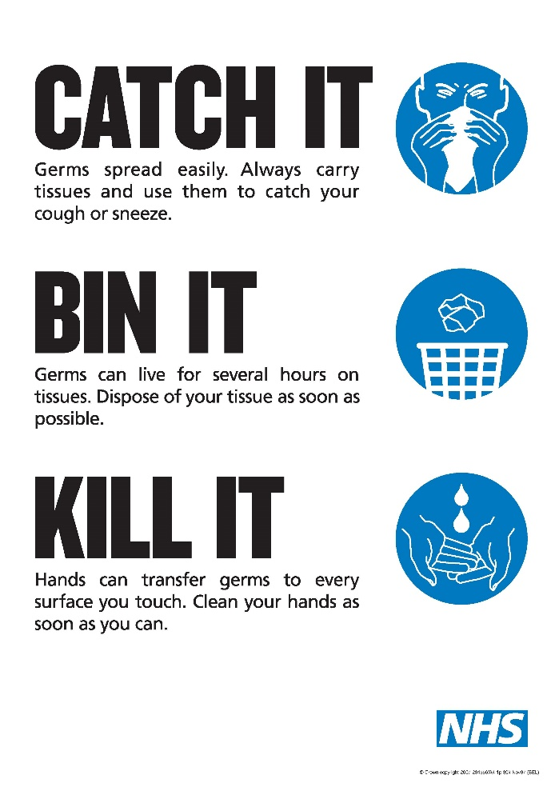
Bird ‘flu

Slide 14

ChildLine

Slide 15
Resources
British Library archive
Witness seminar transcripts
Oral History Society and Oral History Journal

