Slide 1

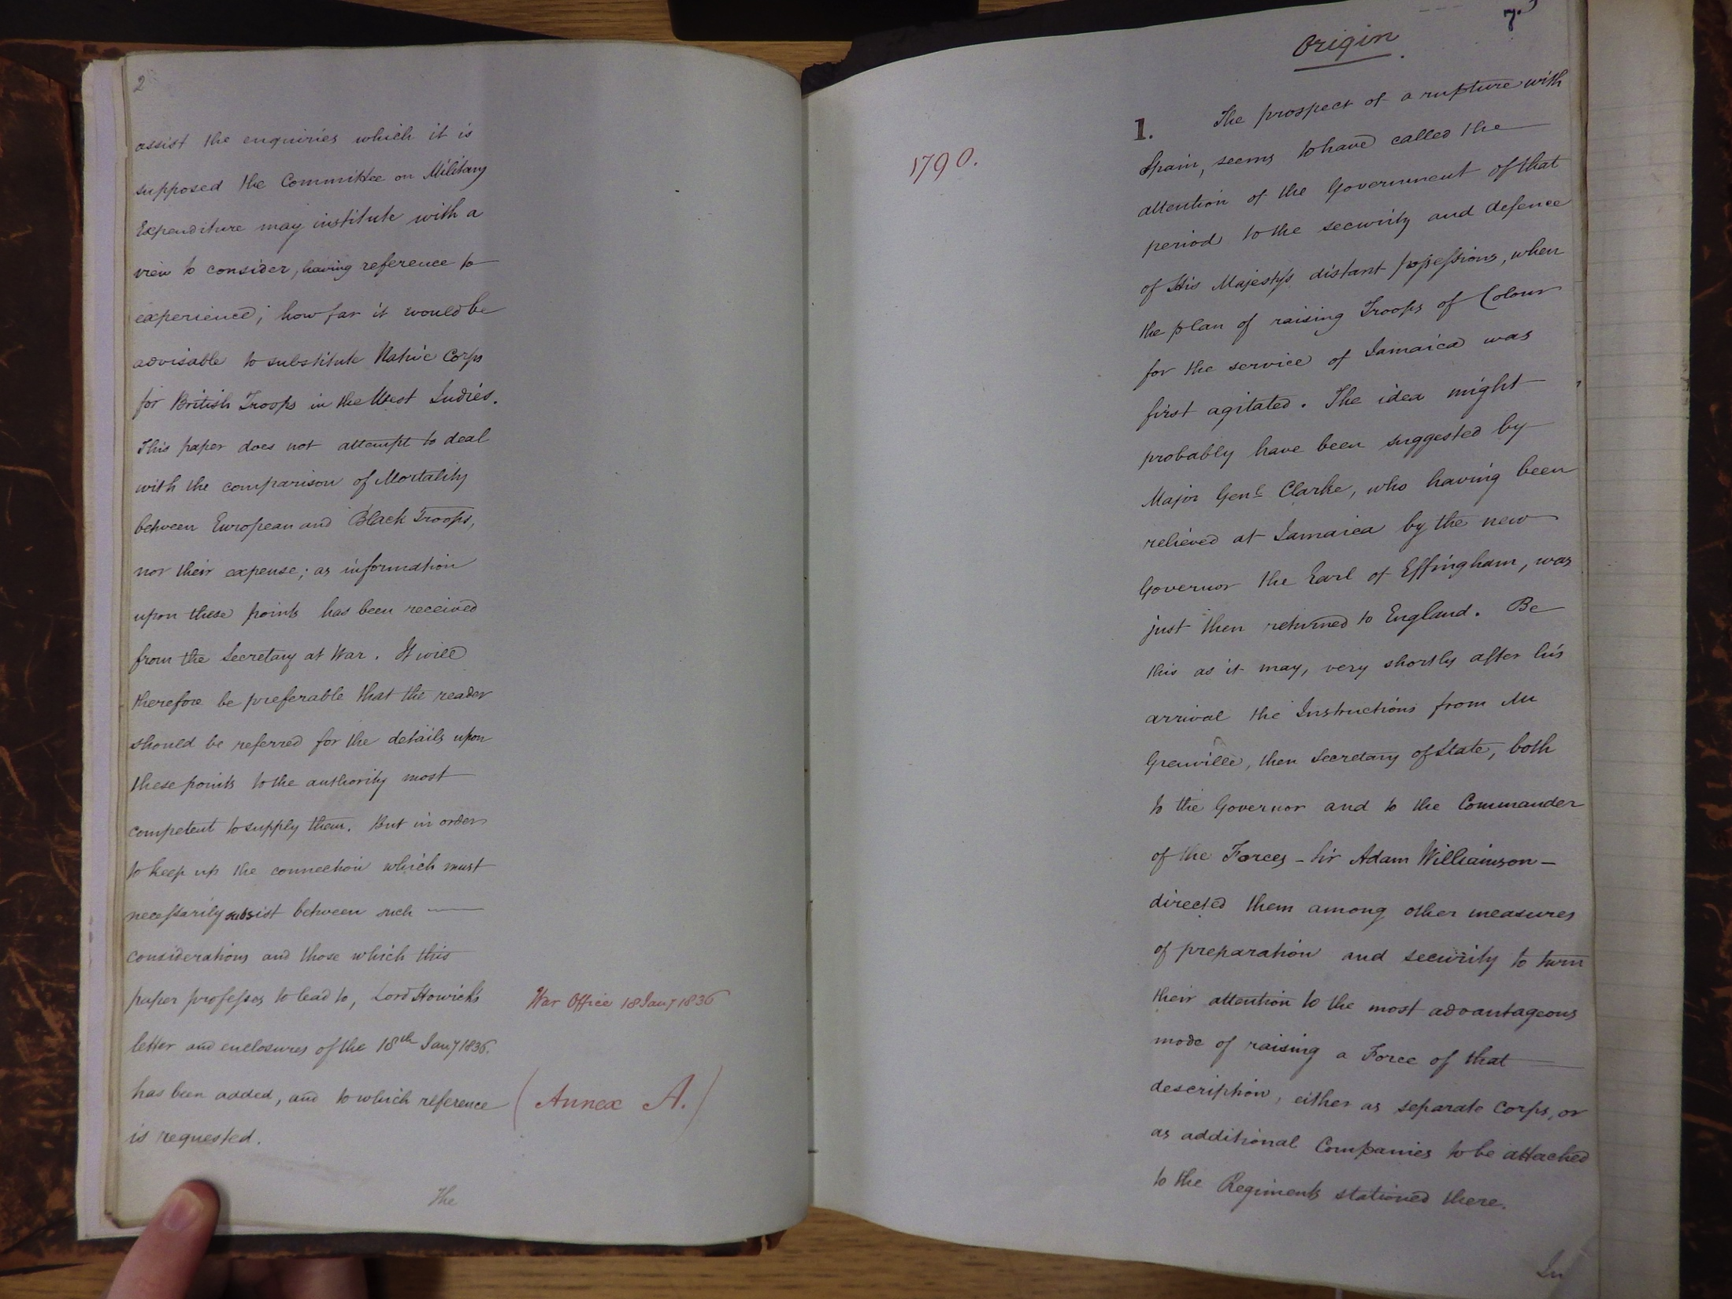
The History Dissertation
Introductory session
Dissertation tutor:
Prof Tim Lockley

Slide 2

Main Features of the Dissertation
The dissertation is compulsory for all History single honours final-year students: it is also available as an option for all joint degree students. It is weighted at 30 CATS i.e. 1/4 of your final year – and you should devote a considerable amount of time to it.
The dissertation must be based on a module you have taken, either a final-year History or CAS module, or a second year module. If you studied abroad and wish to chose one of those modules, please see me about it.
Joint degree students who wish to do a History dissertation must attach it to a History module
The dissertation length is 9,000 words, excluding footnotes and bibliography. The penalty for any further overshoot is a deduction of 1 mark for each 100 words, or part thereof, over 9,000 words.
An outline of what is required can be found on the History website: http://www2.warwick.ac.uk/fac/arts/history/students/modules/dissertation
More detail will be found in handbook, which you should read as soon as possible. http://www2.warwick.ac.uk/fac/arts/history/students/modules/dissertation/guidance

Slide 3
Term 1 Lectures
There will be 4 one-hour talks and sessions. They will be held at the same time and place as today’s lecture (1-2pm Tuesday in the Arts Ctr Conference Room)
Tuesday, 2 October 2018: 1-2pm. Introduction by the module director.
Tuesday, 9 October 2018: 1-2pm. Accessing primary sources and archives, module director
Tuesday, 16 October 2018: 1-2pm. Oral History, Dr Gareth Millward, CHM
Tuesday, 23 October 2018: 1-2pm. Writing it up – the process of organising material and putting it into a coherent and well-argued whole – Prof. Susan Carruthers.

Slide 4
Timetable – term 1
Term 1.
Week 1-2 Identify a suitable topic.
By Friday Week 2 complete the history form
http://www2.warwick.ac.uk/fac/arts/history/students/modules/dissertation/topic/
If choosing a 2nd yr module use HI33A as a generic code
We will notify you of your supervisor during week 3
Week 3-10 meet supervisor regularly

Slide 5

Supervisor
Each of you will receive regular personal guidance from a supervisor throughout the dissertation process.
The supervisor will be allocated by the department, bearing in mind the subject of the dissertation.
Should aim to meet with your supervisor at least 5 times over the year
You can see other members of staff during their office hours for bibliographic advice etc, if you think it would be helpful

Slide 6
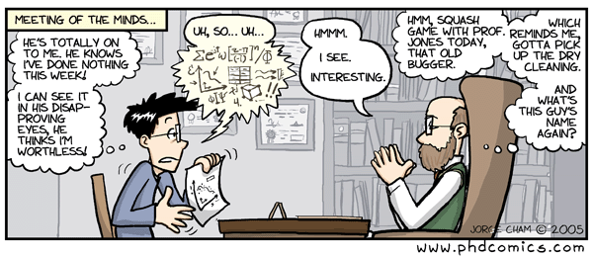
How to work with a supervisor
Your first port of call for support/advice should be your supervisor.
You should come with a clear idea of what advice / support you need
They will comment on any plans or outlines that you produce.
Make sure that you make good use of your supervisor – don’t hesitate to ask for supervision meetings, they don’t need to be in normal office hours.

Slide 7

First tasks
Warning: thinking required!
Which module do you want to base your dissertation in?
What aspect of that module particularly interests you?
A Special Subject should provides you plenty of access to the sort of primary sources that are expected in a dissertation.
An advanced option might offer more breadth, or a trans-national, or interdisciplinary approach
You might be able to explore historical theories and methods more clearly in Historiography.
A second year module gives you a stronger and clearer background in the subject matter as you have already completed the module [NB the tutor from last year might have left or be on leave – making bibliographic advice harder to come by]

Slide 8

Sources
You will need to consult a lot of sources for the dissertation:
Secondary: Work in print (normally), such as articles in journals, essays in edited collections, books, etc. You will need these to provide the background, to aid you in framing your research questions, your introduction and conclusion. The historiography of your topic is likely to be a significant part of the dissertation and this will come from the secondary literature.
Primary: might include: newspapers, memoirs, correspondence (published and unpublished), Parliamentary Papers, archival records relating to organizations and institutions, literary texts (such as novels and plays), early modern political and religious tracts, contemporary medical texts, or oral and visual source materials (interviews, photographs, paintings etc.). [more about sources next week]
You should talk to your supervisor about creating a reading list – a typical reading list will be several pages long.

Slide 9

Originality
What can you say that is new about a given topic?
Originality really signifies one or two things – or both:
  Opening up a new line of enquiry that no-one else seems to have thought of.
  Going back to the existing historiography and giving it a new twist. In this case it is likely to be your ability to reinterpret the existing material, to point out its flaws and limitations, and present logically and clearly a new case that is important.
Commonly, it entails looking for some new source – a collection of letters, or a first-hand account of some kind – that adds a new dimension to an existing field of scholarship or which tackles a topic that no-one seems to have looked at before or thought to be of much importance.

Slide 10
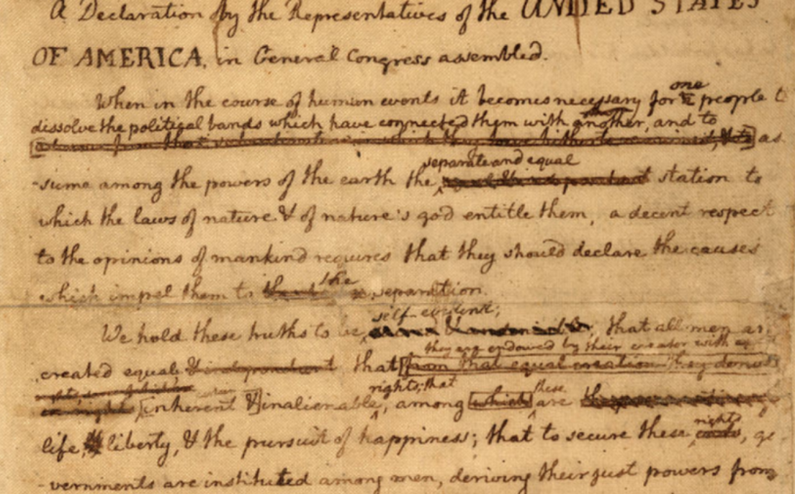
The process of writing a dissertation (1)
Start with a topic that interests you. What are the interesting questions about it? For example, why did such-and-such happen in such-and-such a way? Or, why is an existing historical interpretation unsatisfactory, in your opinion?
Try to answer each question with a hypothesis. As you continue your reading and the research, you should constantly revise the hypothesis in the light of what you have found.
By the end of the dissertation, you should be satisfied that you have adequately addressed and answered the question[s] that you started out with.

Slide 11
The process of writing a dissertation (2)
It helps if you structure your dissertation into different sections.
Introduction, which sets out the topic, identifies what others have written on this topic, debates about the subject. You should make it clear which aspects of the topic that you are (or are not) going to address. This need only be a couple of paragraphs in length, but it is important to try to get the tone right and to interest your reader in what follows.
Sections or Chapters (These can be given a brief title or merely numbered). Each covers a particular aspect of the wider topic and they should progress logically from one to the other. In a dissertation of 9,000 words you might have 3 or 4 or 5 of these. This should help you and your readers to think more clearly about the natural divisions of the topic, the stages in your argument and the balance between different strands of interpretation and documentation.
Conclusion. This might be rather shorter than the introduction, but it should be a conclusion rather than a summary: what have you proved or shown?

Slide 12
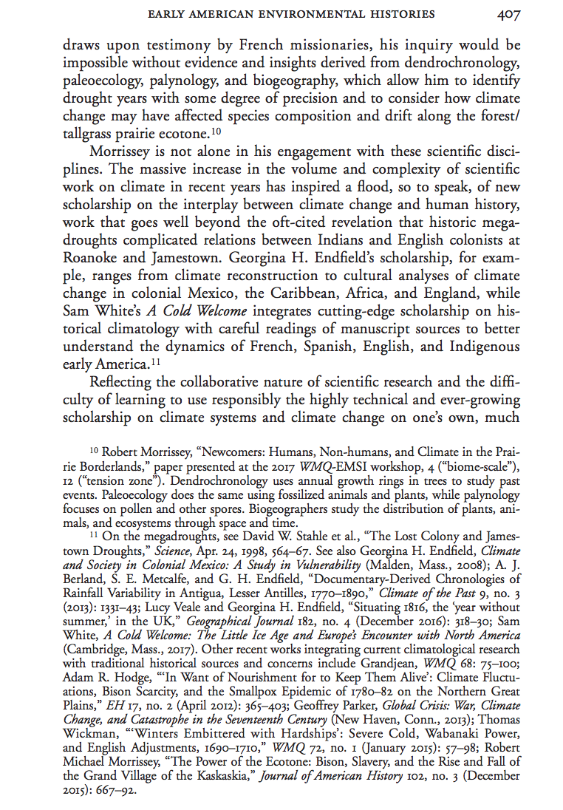
References
You must reference your material through footnotes. Proper citation is necessary to avoid any impression of plagiarism.
Do not include too many footnotes or make them too long, or use the footnotes to go off on a tangent. Although footnotes are not included in the word limit, you can be marked down for having over-long footnotes that contain material that could be in the main text.
You should also have a bibliography of all works consulted at the end of the dissertation.
Consult the ‘Undergraduate Style Guide’.
https://warwick.ac.uk/fac/arts/history/students/modules/hi203/resources/styleguide
Also, see how other, professional historians use footnotes.
Keep quotations in the text relatively short so as to leave adequate room for your analysis and interpretation. Or, if you think a long passage is warranted, make sure that you analyse it: don’t assume that its meaning and significance is self-evident.

Slide 13
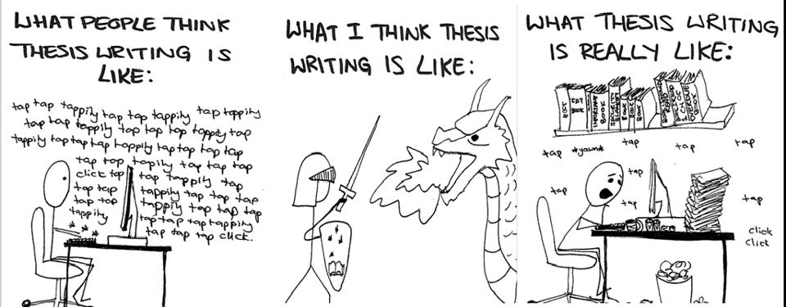
Writing-up
Do not underestimate the writing-up time
Draft, re-draft, and repeat (lots of times)
Be a brutal editor
Don’t forget to leave enough time to proof-read your work.

Slide 14

Timetable – submission process in term 3
submitted online via Tabula noon Wed week 2 Term 3 (May 1, 2019) in word-processed form.
no need to submit a hard copy.
should be anonymised, with only your student number on the title page.
Late submission will be penalized. The rule is as follows: ‘Where an extension has not been granted, or where an extension request did not reach the Director of Undergraduate Studies before the deadline for the assessed work, such assessed essays handed in late will be subject to a penalty of 5 percentage marks per working day’.

