Slide 1
Race and Slavery
Europe in the Making
Dr Lydia Plath

Slide 3
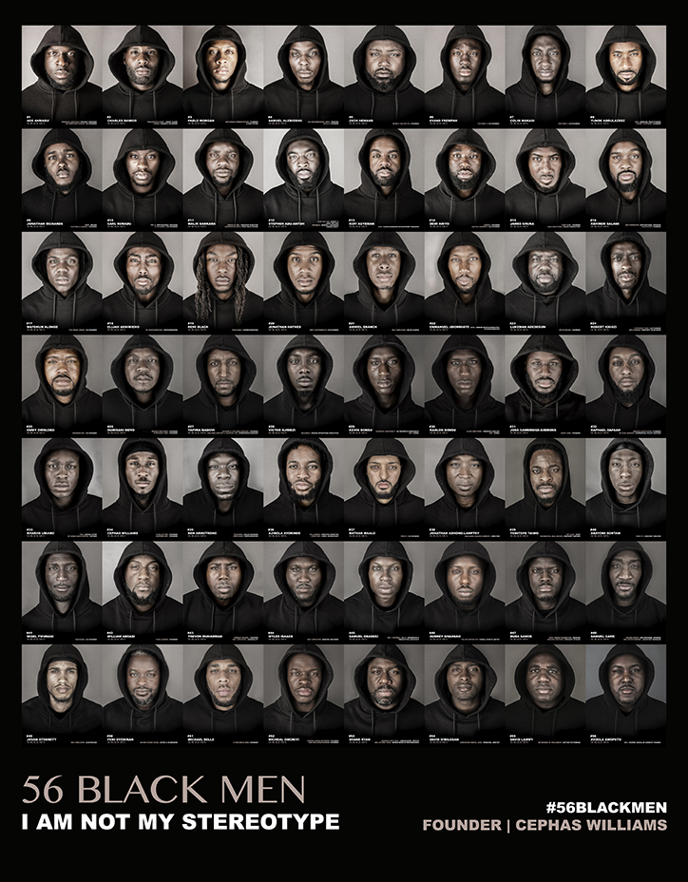
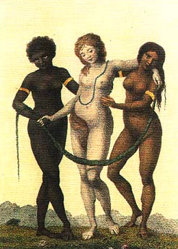
What is “race”?
No biological meaning
Social “construction” / “invention” / “idea”
Varying categorizations
Historically and culturally contingent
Lived reality of racism
‘Europe Supported by Africa and America’
William Blake, c.1777

Slide 4
The language we use to talk about slavery and race
“enslaved” instead of “slave”
“enslaver” instead of “master”, “mistress”, “slaveholder”, “slaveowner”, “planter”
Laura Adderly: “all words we “know to talk about enslaved people of African descent in these Americas prove insufficient, both for the brutality against them, and for their remarkable overcoming.”
Content note: this lecture includes primary sources that describe people of colour in the past in outdated and racist ways.
P. Gabrielle Foreman et al. “Writing about Slavery/Teaching About Slavery: This Might Help” community-sourced document, https://naacpculpeper.org/resources/writing-about-slavery-this-might-help/

Slide 5
Outline
Historians on “race”
Early understandings of “race”
Slavery
The experiences of enslaved people

Slide 6
1: Historians on “Race”

Slide 7
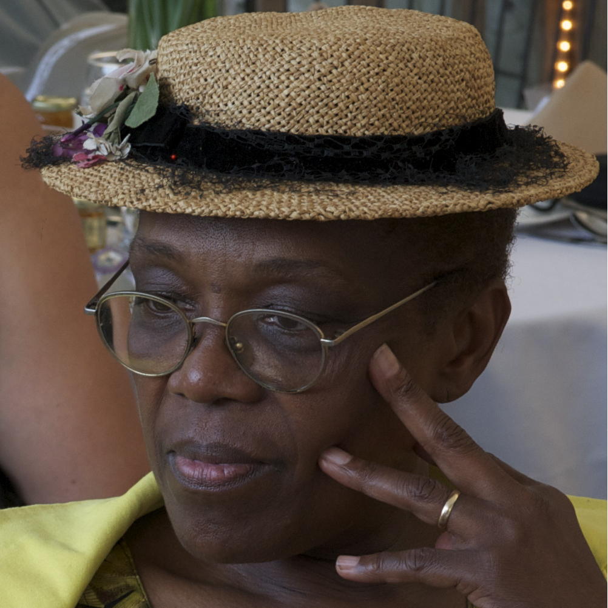
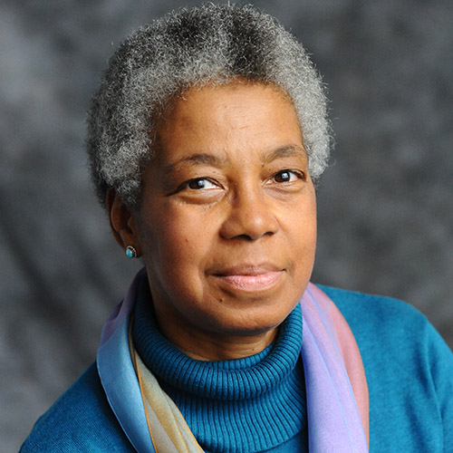
Fields & Fields: “race” vs “racism”
“The term race stands for the conception or doctrine that nature produced humankind in distinct groups…”
“Race is the principle unit and core concept of racism”
“Racism refers to the theory and practice of applying a social, civic, or legal double standard based on ancestry, and to the ideology surrounding such a double standard . . . not an emotion or state of mind . . . Racism is first and foremost a social practice . . . an action and a rationale for action”
Karen E. Fields & Barbara J. Fields, Racecraft: The Soul of Inequality in American Life (Verso, 2014)

Slide 8

Kendi: The purpose of racist ideas
“The common conception that ignorance and hate lead to racist ideas, and that racist ideas initiate racist policies, is largely ahistorical. It has actually been the inverse relationship – racial discrimination has led to racist ideas which has led to ignorance and hate.”
“the principal function of racist ideas in American history has been to suppress resistance to racial discrimination and its resulting racial disparities.”
Ibram X. Kendi, Stamped from the Beginning: The Definitive History of Racist Ideas in America (2016)

Slide 9
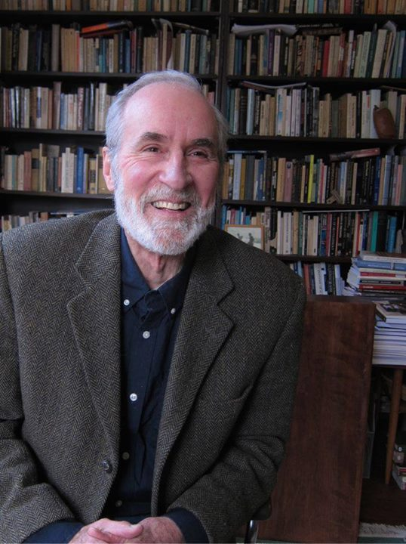
Race as “modern”?
“All in all, race is the modern West’s worst idea.”
“race and racism were conceptual realities that emerged in, and were an integral part of, of the modern world.”
Richard H. King, Race, Culture, and the Intellectuals, 1940-1970 (2004).

Slide 10
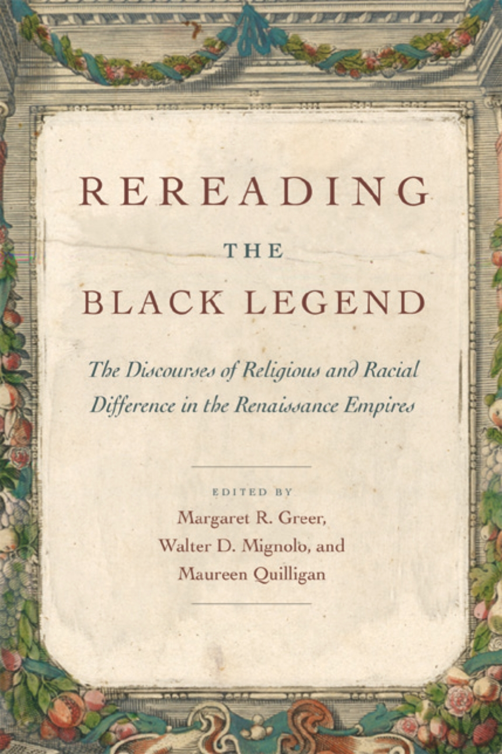
Race as early modern?
Is the claim that “race” was invented in the 18th century a British / US –centred idea? Hispanic colonialism started much earlier
‘The history of racism as we know it today began to be articulated right then, in the sixteenth century, and there, in the Atlantic world.’
Margaret Greer, Walter Mignolo and Maureen Quilligan, eds., ‘Introduction’, Rereading the Black Legend: The Discourses of Religious and Racial Difference in the Renaissances Empires (2007).

Slide 11
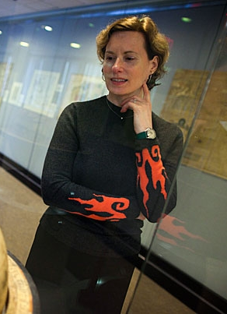
Chaplin: Race as “Atlantic”
“racism in its present form is a specific product of Atlantic history. . . this idea was peculiar to the Atlantic world created by European colonization.”
“The history of slavery makes especially clear that racism took strong hold in the western Atlantic, with powerful implications for the populations that mingled in the Americas, for the social structures of colonial societies, and for ideas of political rights on either side of the Atlantic. It is the continuing legacy of these implications that interests us in race and makes it necessary for us to see how it so deeply marked the modern world.”
Joyce E. Chaplin, “Race” in Armitage and Braddick (eds), The British Atlantic world, 1500-1800 (2009)

Slide 12
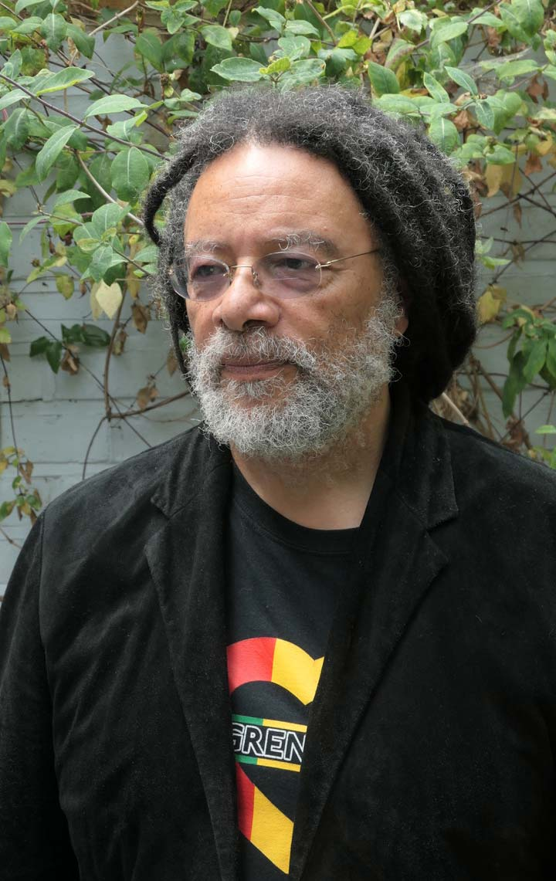
Paul Gilroy on the “Black Atlantic” (1993)
“Striving to be both European and black requires some specific forms of double consciousness … The contemporary black English, like the Anglo-Africans of early generations and perhaps, like all blacks in the West, stand between (at least) two great cultural assemblages, both of which have mutated through the course of the modern world that formed them”
“a nationalistic focus… is antithetical to the rhizomorphic*, fractal structure of the transcultural, international formation I call the black Atlantic”
* An aggregation of threads intertwining like the strands of a rope

Slide 13
2: Early understandings of “race”

Slide 14
Early-Modern Racial Ideas
Less clear than it will be later that race was seen as a fixed, inheritable identity – could change or assimilate
Not necessarily linked to skin colour
Monogenesis

Slide 15
Early-Modern Racial Ideas
“In Africa ‘terrible heat reigns and all the people born there are black’, whereas in parts of Peru the climate was very temperate ‘and the people of those lands are white’.”
  José de Acosta, Natural and Moral History of the Indies, trans. Frances López-Morillas (2002 [1590]).
“[Indians are] a sort of white men in America (as I am told) that only differ from us in having no beards”
Richard Bradley, A Philosophical account of the works of nature (London, 1721)
‘[Africans are] black as coal. Here, thro’ custom, (being Christians) they account themselves white men’
Journal of a Voyage up the Gambia (London, 1723)
‘Negroes are a race of people who appear to be different from the rest of mankind… but whether these are an original race, or whether the difference arises from the climate, the vapours of that particular soil, the manner of breeding their children, and from the mothers forming of their features, is not here determined.’
Francis Moore, Travels into the inland parts of Africa (London, 1738)

Slide 16
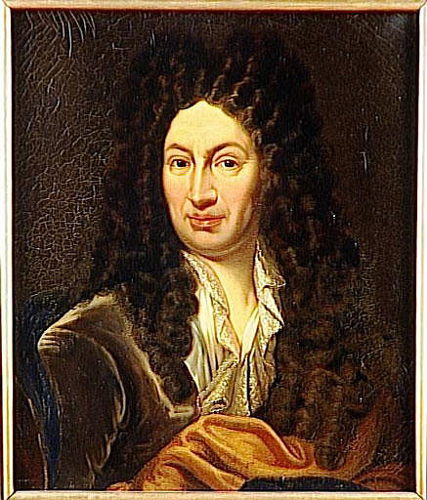
Francois Bernier “A New Division of the Earth” (1684)
Europe, North Africa, Middle East, and parts of south Asia:
  “For while the Egyptians, for instance, and the Indians are very dark, or rather sunburnt, this colouring is merely accidental for them, and results merely from the fact that they are exposed to the Sun”
  “As far as the Americans are concerned, they are really mostly oliveskinned and their faces have a rather different shape from ours. Nevertheless I do not consider that that difference is so large as to warrant making them a special type distinct from our own.”
Sub-Saharan Africa:
  “The following features justify considering the Africans a distinct type: (i) their thick lips and their snub noses, for very few of them have aquiline noses and medium-sized lips (ii) the blackness that is their essential trait and whose cause is not, as people think, the heat of the Sun - for if you transport a Black man and a Black woman to a cold country, their children will continue to be black and so will all their descendants until they intermarry with white women. The explanation for their distinct type must therefore be sought in their sperm and their blood, both of which are, however, the same colour as in all the other types (iii) their skin is quite oily, supple and polished, except for the areas roasted by the Sun (iv) their beards consist of only three or four strands (v) their hair is not truly hair but instead a sort of wool similar to the coat of one of our hunting-spaniels and (vi) their teeth are whiter than the finest ivory and the whole inside of their mouths, like their lips, is red as Coral.
East Asia and Eastern Russia
  “The inhabitants of all those Countries are really white; but they usually have large shoulders, their faces are flat, they have snub noses, and their eyes are oval-shaped and come to a point at each corner.”

Slide 17
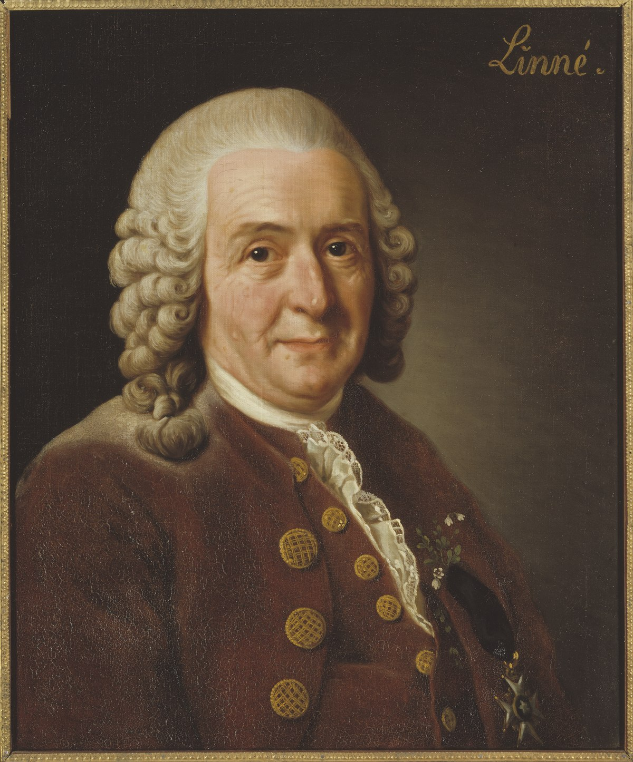
Carl Linnaeus, Systema Naturae (1758)
American. Red, choleric, erect. Hair black, straight and thick; Nostrils wide; Face freckled; Beard scanty. Obstinate, content, free. Paints himself with fine red lines. Regulated by habit.
European. white, sanguine, brawny. Hair abundantly flowing. Eyes blue. Gentle, acute, inventive. Covered with close vestments. Governed by customs.
Asiatic. Yellow, melancholy, rigid. Hair black. Eyes dark. Severe, haughty, covetous. Covered with loose garments. Governed by opinions.
African. Black, phlegmatic, relaxed. Hair black, frizzled. Skin silky. Nose, flat. Lips tumid. Women’s bosom a matter of modesty, Breasts give milk abundantly. Crafty, indolent, negligent. Anoints himself with grease. Governed by caprice.
Notes:
Humours:
Sanguine (blood) – courageous, hopeful, amorous
Choleric (yellow bile) – easily angered, bad tempered
Melancholic (black bile) – despondent, sleepless, irritable
Phlegmatic – calm, unemotional
Tumid = swollen; indolent = lazy; caprice = impulsive

Slide 18
3: Slavery

Slide 19
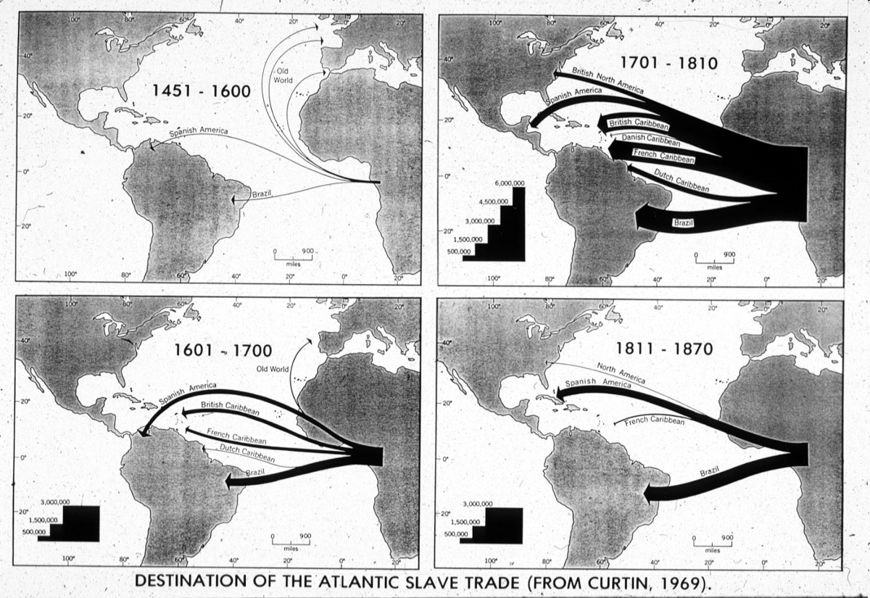
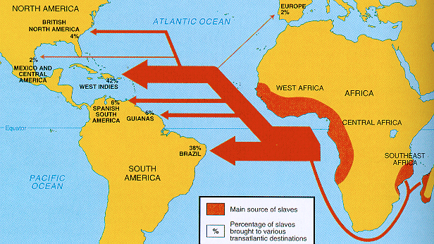
The Atlantic Slave Trade
Europeans exploited national and ethnic tensions in Africa – existence of “slaves” already; could trade for luxury goods (triangular trade)
Racist stereotypes about “strength” and “civilisation”
c. 10m Africans, 1500-1900

Slide 20
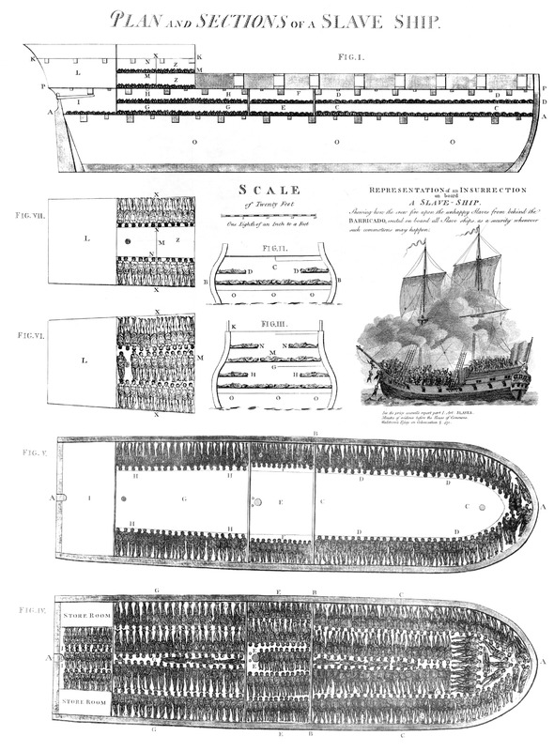
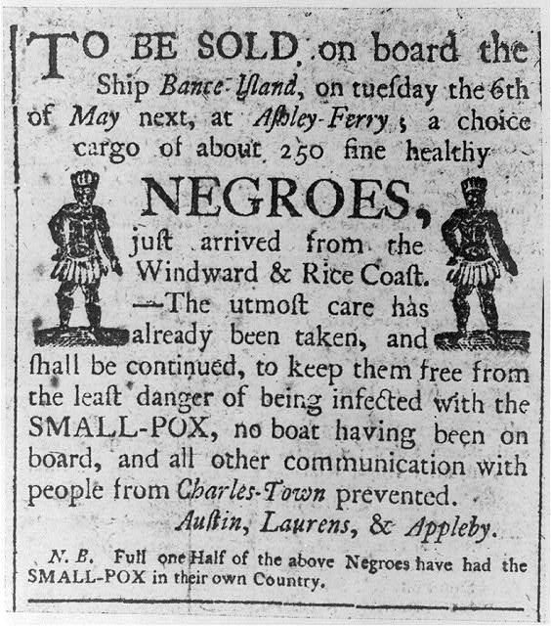
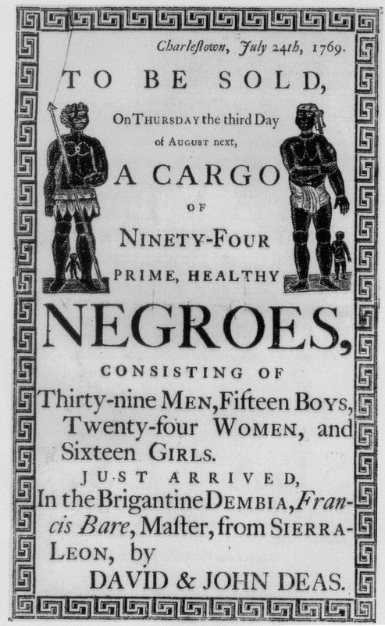
The Atlantic Slave Trade
Advertisements, South Carolina, 1760s
Plan of the British Slave Ship Brookes, 1789

Slide 21
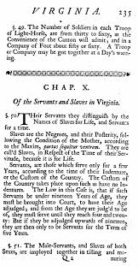
Defining “slavery” in North America
First Africans brought to North America in 1619
Slavery takes time to be legally codified in colonial Virginia
Permanent ownership of one person by another
Hereditary via the mother

Slide 22
Race, Slavery and the Law in British North America
“WHEREAS some doubts have arrisen whether children got by any Englishman upon a negro woman should be slave or ffree, Be it therefore enacted and declared by this present grand assembly, that all children borne in this country shall be held bond or free only according to the condition of the mother.” (1662)
“It is enacted that all servants. . . which shall be imported into this country either by sea or by land, whether Negroes, Moors, mulattoes or Indians who and whose parentage and native countries are not Christian at the time of their first purchase by some Christian. . ., are hereby adjudged, deemed and taken to be slaves to all intents and purposes any law, usage, or custom to the contrary notwithstanding.” (1682)

Slide 23
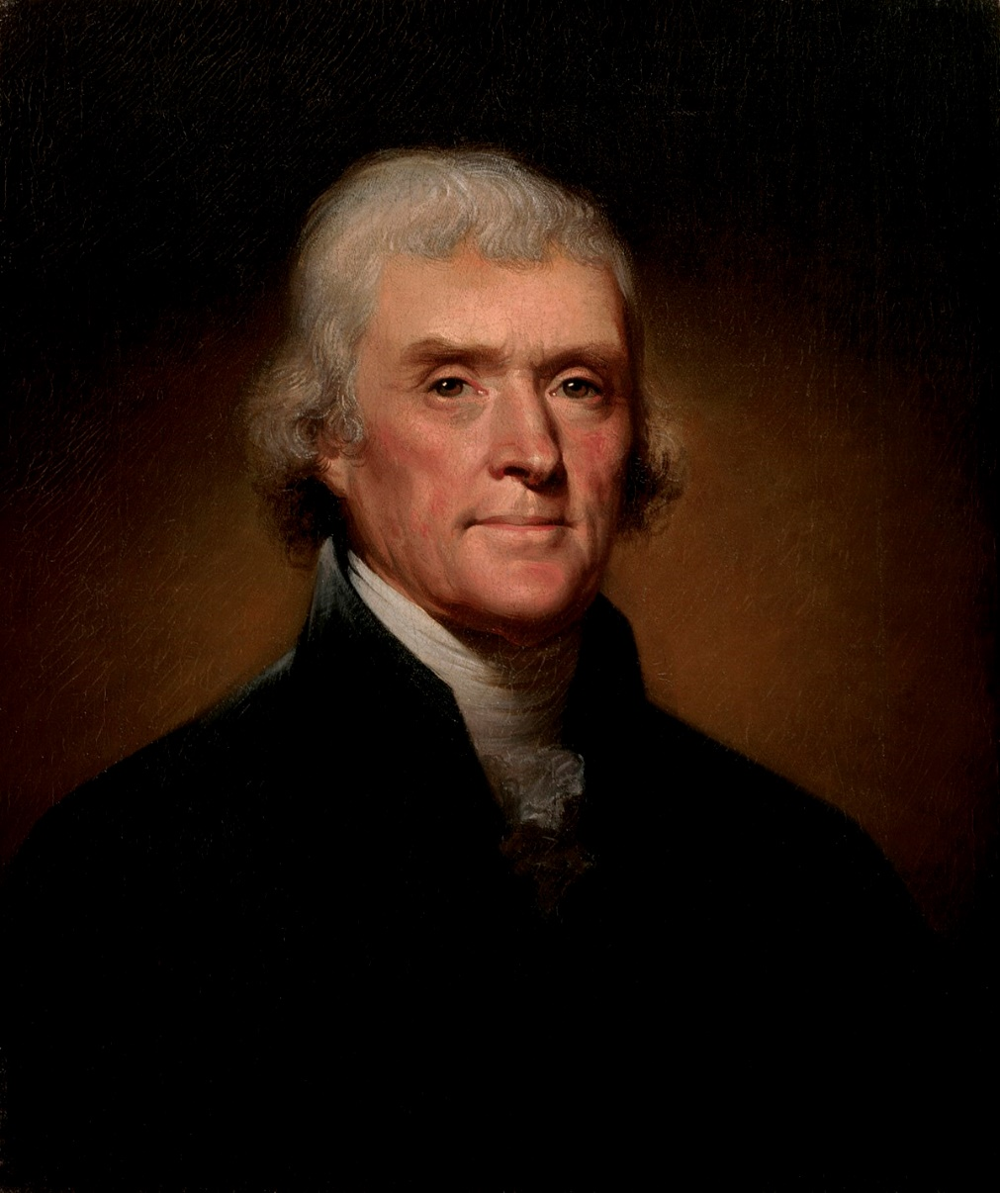
Race in Proslavery Thought
“The first difference which strikes us is that of colour… the difference is fixed in nature. And is this difference of no importance? . . . there are other physical distinctions …They seem to require less sleep. A black, after hard labour through the day, will be induced by the slightest amusements to sit up till midnight, or later, though knowing he must be out with the first dawn of the morning. They are at least as brave, and more adventuresome. But this may perhaps proceed from a want of forethought, which prevents their seeing a danger till it be present… They are more ardent after their female: but love seems with them to be more an eager desire, than a tender delicate mixture of sentiment and sensation. Their griefs are transient… In general, their existence appears to participate more of sensation than reflection... An animal whose body is at rest, and who does not reflect, must be disposed to sleep of course… This unfortunate difference of colour, and perhaps of faculty, is a powerful obstacle to the emancipation of these people.”
- Thomas Jefferson, Notes on the State of Virginia (1787)

Slide 24
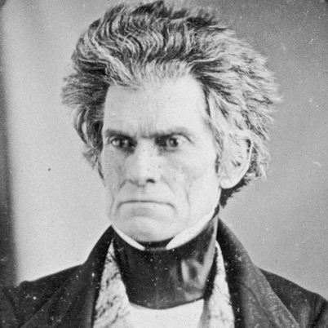
Race in Proslavery Thought
“I hold that in the present state of civilization, where two races of different origin, and distinguished by color, and other physical differences, as well as intellectual, are brought together, the relation now existing in the slaveholding States between the two, is, instead of an evil, a good–a positive good…. Never before, has the black race of Central Africa, from the dawn of history to the present day, attained a condition so civilized and so improved, not only physically, but morally and intellectually.”
- John C. Calhoun, ‘Slavery a Positive Good’ (1837)

Slide 25
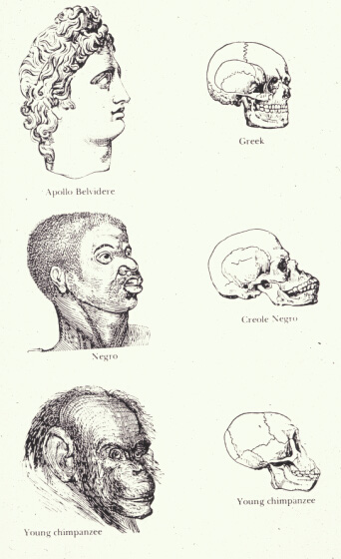
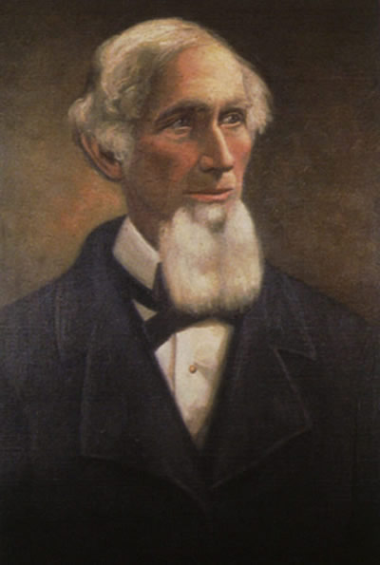
Race in Proslavery Thought
“. . . the negro achieves his greatest perfection, physical and moral, and also greatest longevity, in a state of slavery”
Josiah Nott, Types of Mankind
(1854)
Notes:
Humours:
Sanguine (blood) – courageous, hopeful, amorous
Choleric (yellow bile) – easily angered, bad tempered
Melancholic (black bile) – despondent, sleepless, irritable
Phlegmatic – calm, unemotional
Tumid = swollen; indolent = lazy; caprice = impulsive

Slide 26
4: The experiences of enslaved people

Slide 27
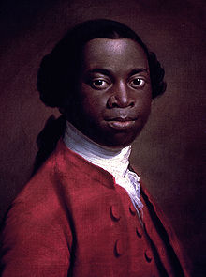
Olaudah Equiano on his first encounter with white people (1789)
“I was now persuaded that I had gotten into a world of bad spirits, and that they were going to kill me. Their complexions too differing so much from ours, their long hair, and the language they spoke, (which was very different from any I had ever heard) united to confirm me in this belief . . . When I looked round the ship too and saw a large furnace or copper boiling, and a multitude of black people of every description chained together, every one of their countenances expressing dejection and sorrow, I no longer doubted of my fate . . . I asked them if we were not to be eaten by those white men with horrible looks, red faces, and loose hair.”
“I asked them if these people had no country, but lived in this hollow place (the ship): they told me they did not, but came from a distant one. 'Then,' said I, 'how comes it in all our country we never heard of them?' They told me because they lived so very far off. . . I asked how the vessel could go? they told me they could not tell; but that there were cloths put upon the masts by the help of the ropes I saw, and then the vessel went on; and the white men had some spell or magic they put in the water when they liked in order to stop the vessel. I was exceedingly amazed at this account, and really thought they were spirits. I therefore wished much to be from amongst them, for I expected they would sacrifice me: but my wishes were vain.”

Slide 28
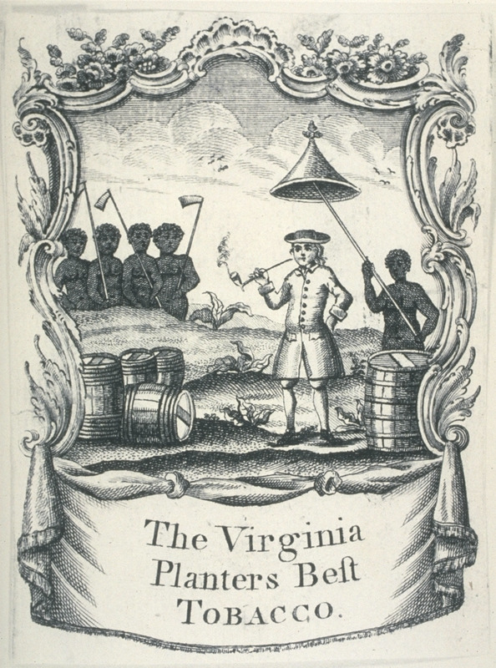
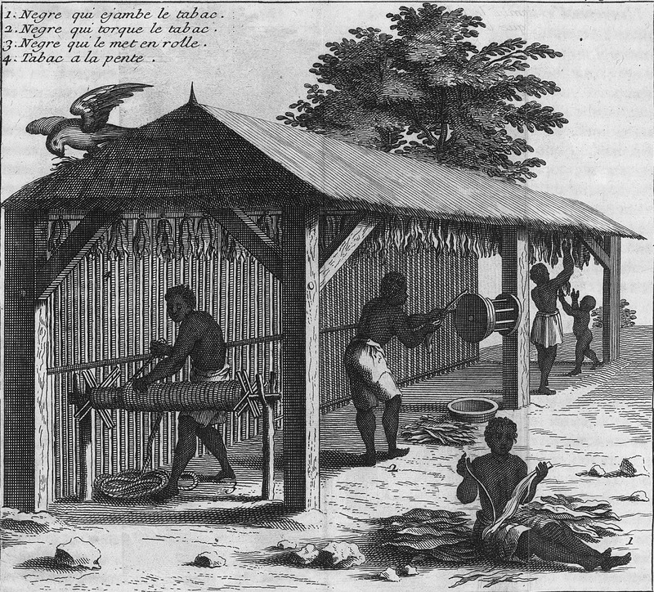
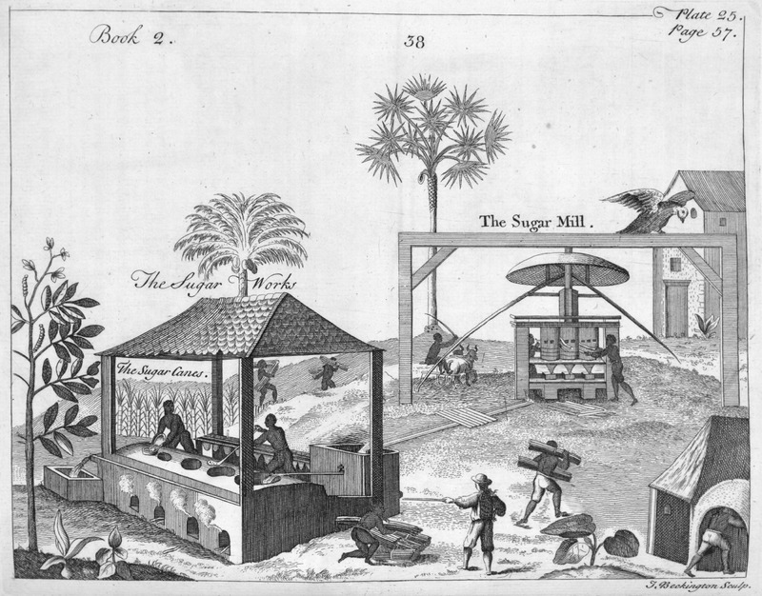
Labour
Sugar Works, French West Indies, 17th cent.
Tobacco Production, Virginia, 18th cent.
Tobacco Production, French West Indies, early 18th cent.

Slide 29
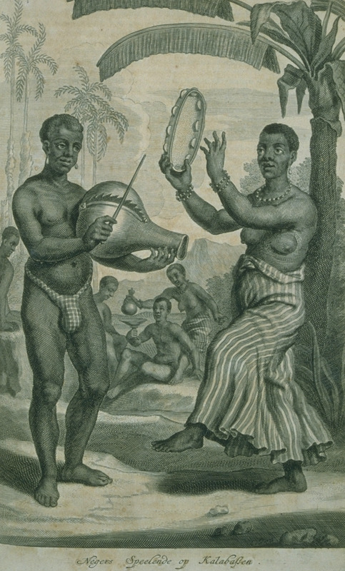
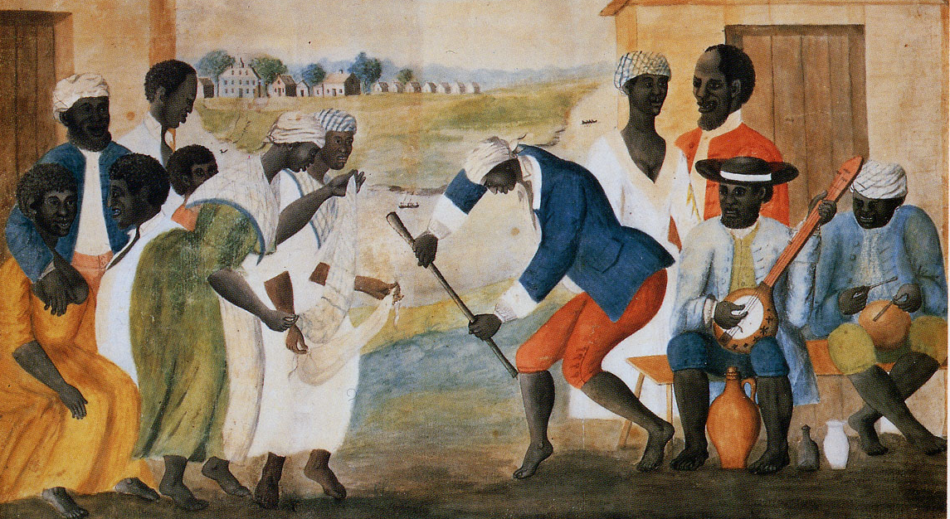
Culture
Plantation Dance, South Carolina, ca. 1785-1795
Musical Instruments, Brazil, 17th cent.

Slide 30
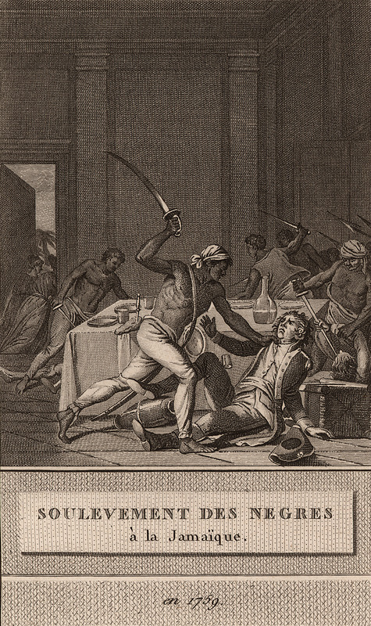
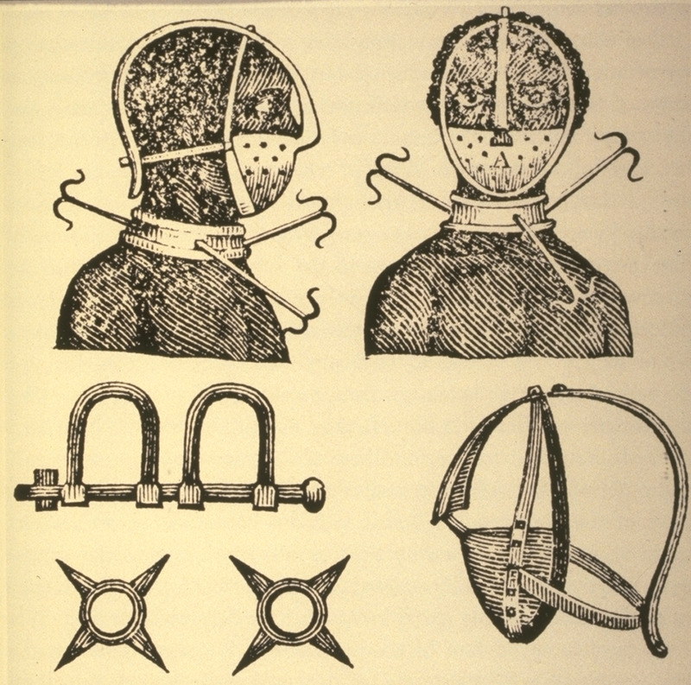
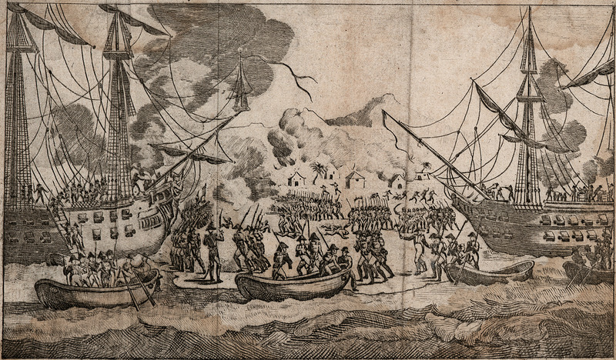
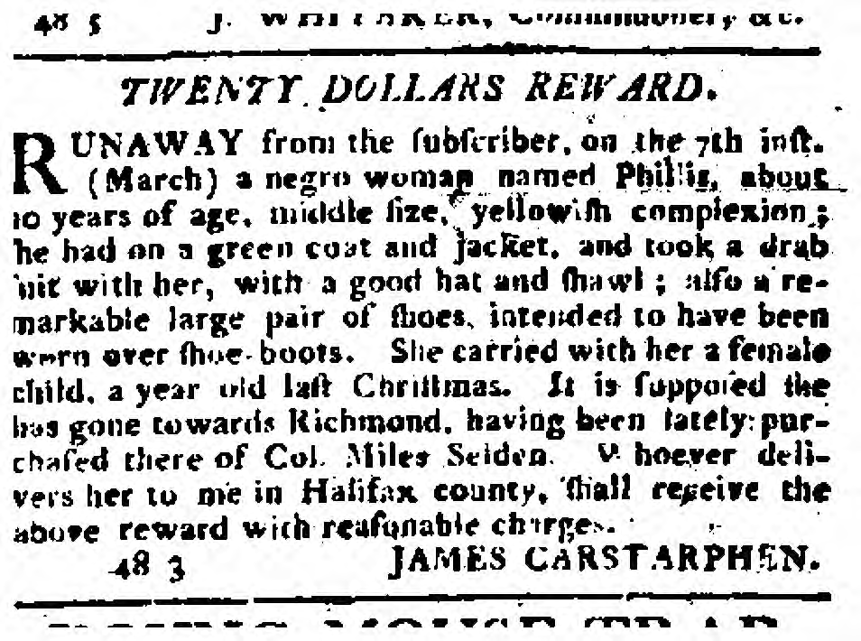
Violence, Rebellion and Resistance
Iron Mask, Neck Collar, Leg Shackles, and Spurs, 18th cent.
Haitian Revolution, 1790s-1804
Slave Revolt, Jamaica, 1739
Advertisement, North Carolina, 1799

Slide 31
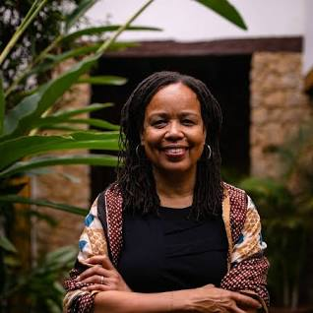
Saidiya Hartman, “Venus in Two Acts” (2008)
“How can narrative embody life in words and at the same time respect what we cannot know?”
“The intention here isn’t anything as miraculous as recovering the lives of the enslaved or redeeming the dead, but rather laboring to paint as full a picture of the lives of the captives as possible. This double gesture can be described as straining against the limits of the archive to write a cultural history of the captive, and, at the same time, enacting the impossibility of representing the lives of the captives precisely through the process of narration.”

