Slide 1
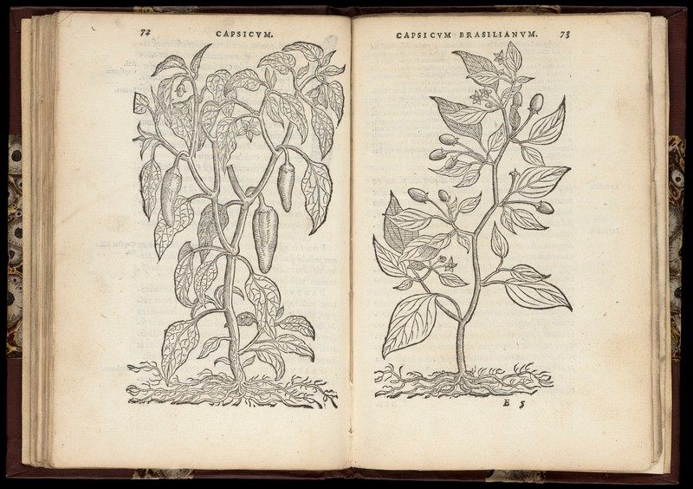
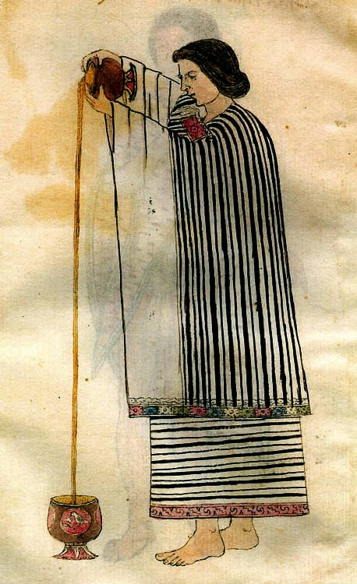
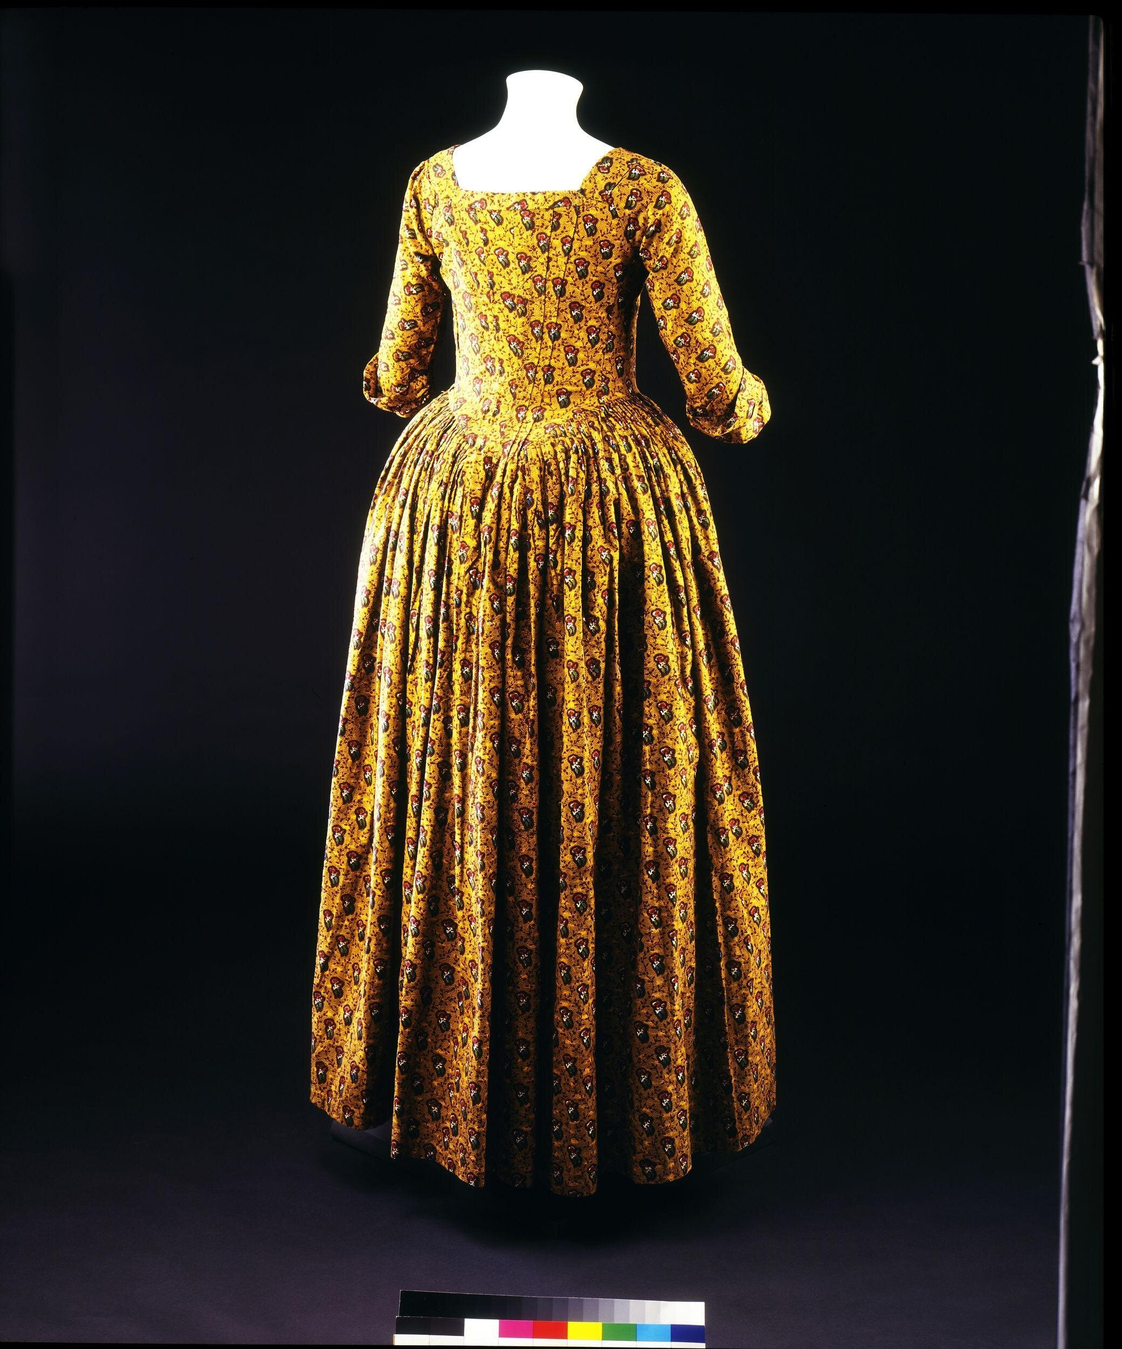
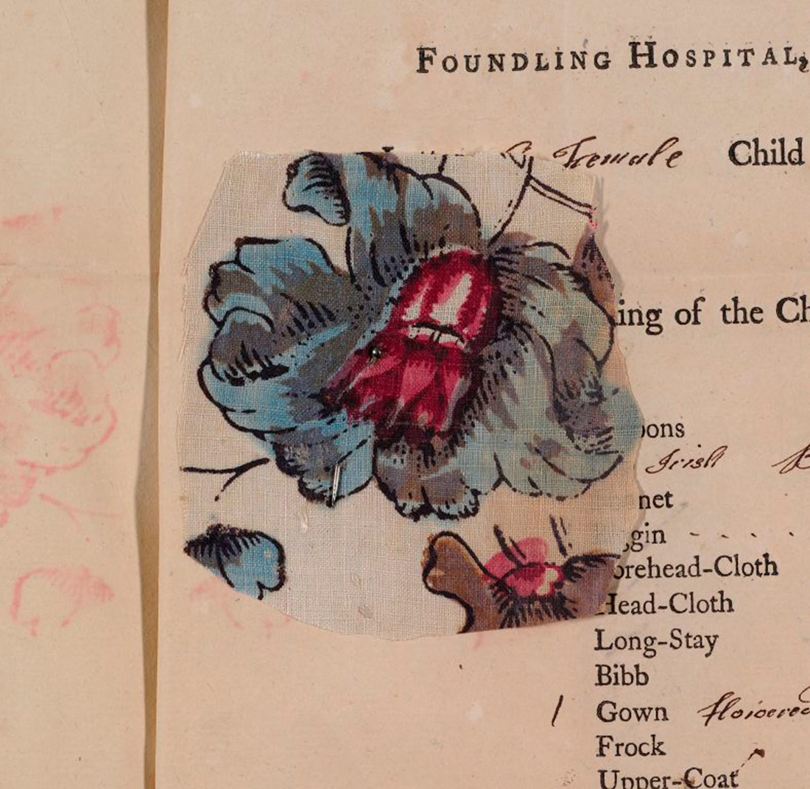
Global Influences on European Culture:
Food, Fashion & Material Culture
Dr Sarah Johanesen
sarah.Johanesen@warwick.ac.uk

Slide 2
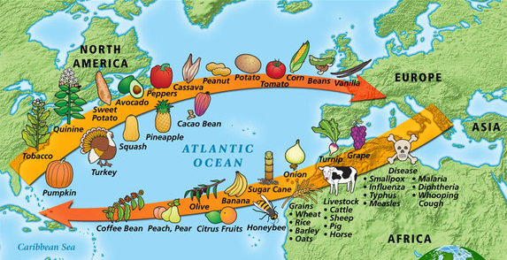
Alfred Crosby, The Columbian Exchange: Biological and Cultural Consequences of 1492 (1972).

Slide 3
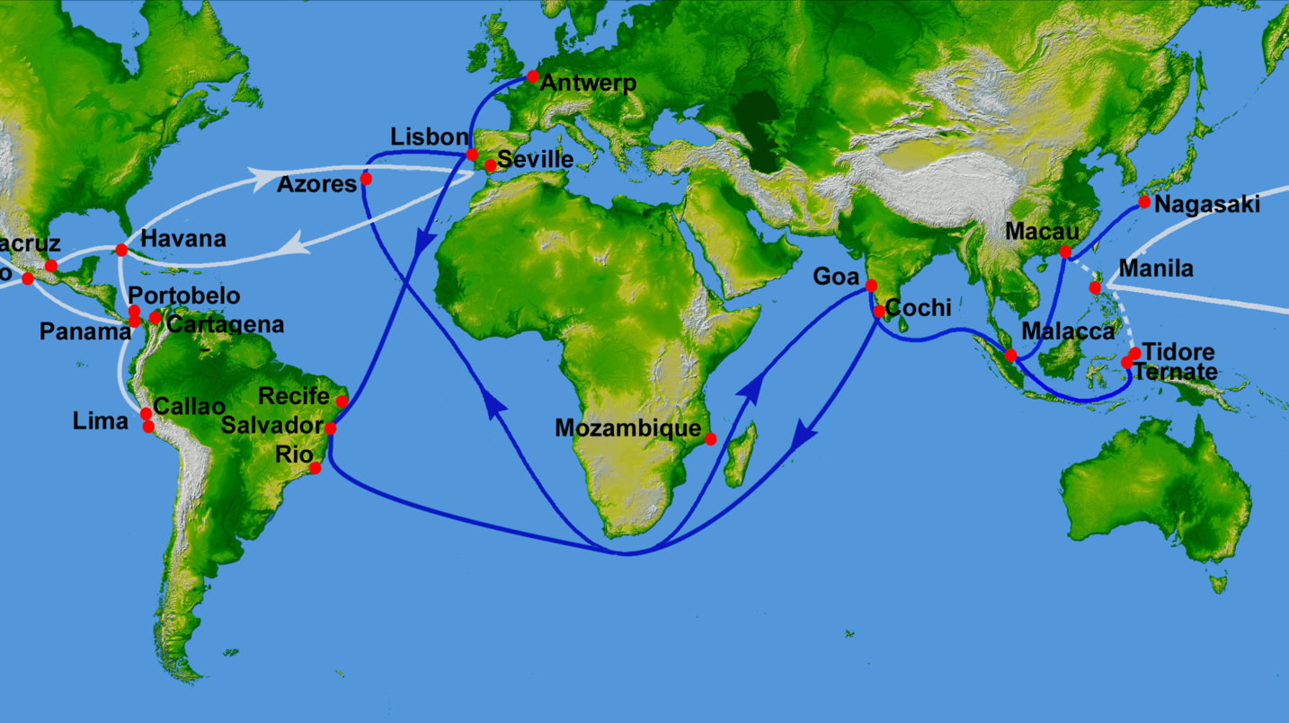
Constantinople:
Conquered by Ottomans 1453
Blue Lines = Portuguese trade routes established after Vasco de Gama’s voyage of 1498
White Lines = rival Manila-Acapulco Galleons / Spanish Treasure Fleet established in 1568

Slide 4
‘Dietary innovation, like dietary exoticism, put at risk the body accustomed to its usual and proper fare – the stuff that came off the land where the body itself lived and that was prepared as it was traditionally prepared. The exotic might indeed have magical powers, but those powers could harm as well as nourish or cure.’
Steven Shapin, ‘You Are What You Eat: Historical Changes in Ideas About Food and Identity’, Historical Research, 87.237 (2014), 377-392.

Slide 5
New World Foods
Analogy to “old world” products - assimilation into Europe’s medical and culinary frameworks e.g.
Black Pepper: hot and dry, helps cure an increase of wet and cold humours in the body (Galenic medicine),
Chilli Pepper: believed to be related to black pepper, and to have the same properties, can be grown locally and cheaply in Europe.
(left) ‘Capsicum’ (chilli pepper), woodcut (1574), Wellcome Collection.

Slide 6
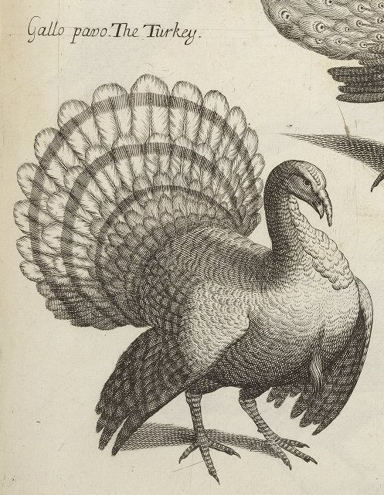
New World Foods
Naturalising Turkeys
Quickly associated with guinea fowl and that bird’s superior characteristics: delicacy and ease of digestion.
Turkeys originally coveted objects of courtly exchange.
A bird of status & wealth, a culinary curiosity
A naturalised foodstuff
‘The Turkey’, Folger Shakespeare Library.

Slide 7
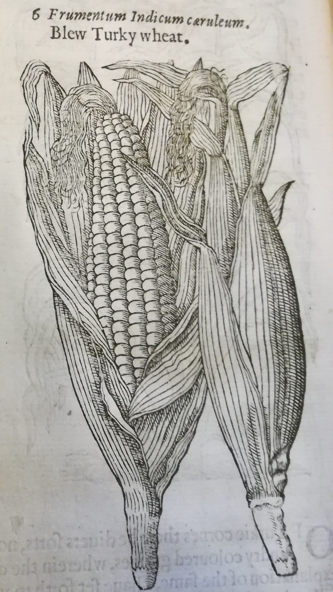
New World Foods
Naturalising Maize
Associated with “barbarous” indigenous bodies,
Considered unfit for human consumption.
‘Although the barbarous Indians which know no better are constrained to make a virtue of necessity and think it a good food, whereas we may easily judge that it nourisheth but little and is of hard and evil digestion, a more convenient food for swine than for men’ – John Gerard
Transforming European bodies into ‘Indian’ ones
  (Rebecca Earle, The Body of the Conquistador)
Animal fodder → famine food → food for the poor →
grain assimilated into European cooking (e.g. polenta)
Maize as depicted in Gerard’s Herball

Slide 8
Chocolate
‘Loathsome to such as are not acquainted with it, having a scum or froth that is very unpleasant taste. Yet it is a drink very much esteemed among the Indians, where with they feast noble men who pass through their country. The Spaniards, both men and women that are accustomed to the country are very greedy of this [product]. They say they make diverse sorts of it, some hot, some cold, and some temperate, and put therein much of that "chili"; yea, they make paste thereof, the which they say is good for the stomach and against the catarrh’.
- José de Acosta, Historia Natural y Moral de las Indias (Seville, 1590).
Woman pours chocolate in Codex Tudela, Mexico, 16th century.

Slide 9
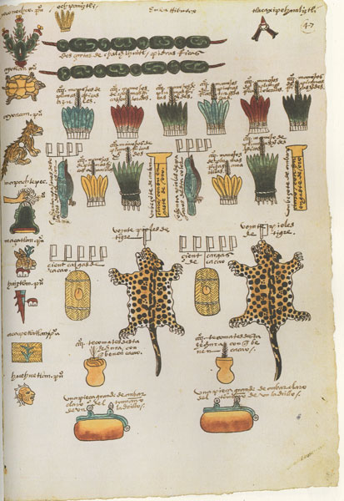
Chocolate
Acosta: ‘Loathsome to such as are not acquainted with it’
Fundamental part of Mesoamerican diets, described as the food of the gods.
So important that cacao beans often used as currency.
Drinking of chocolate a critical component of Mesoamerican ritual and culture.
  Used in official ceremonies & religious rituals, feasts & festivals, as funerary offerings, tribute, and for medicinal purposes.
‘Tribute from Soconusco’,
Codex Mendoza (c. 1541).

Slide 10
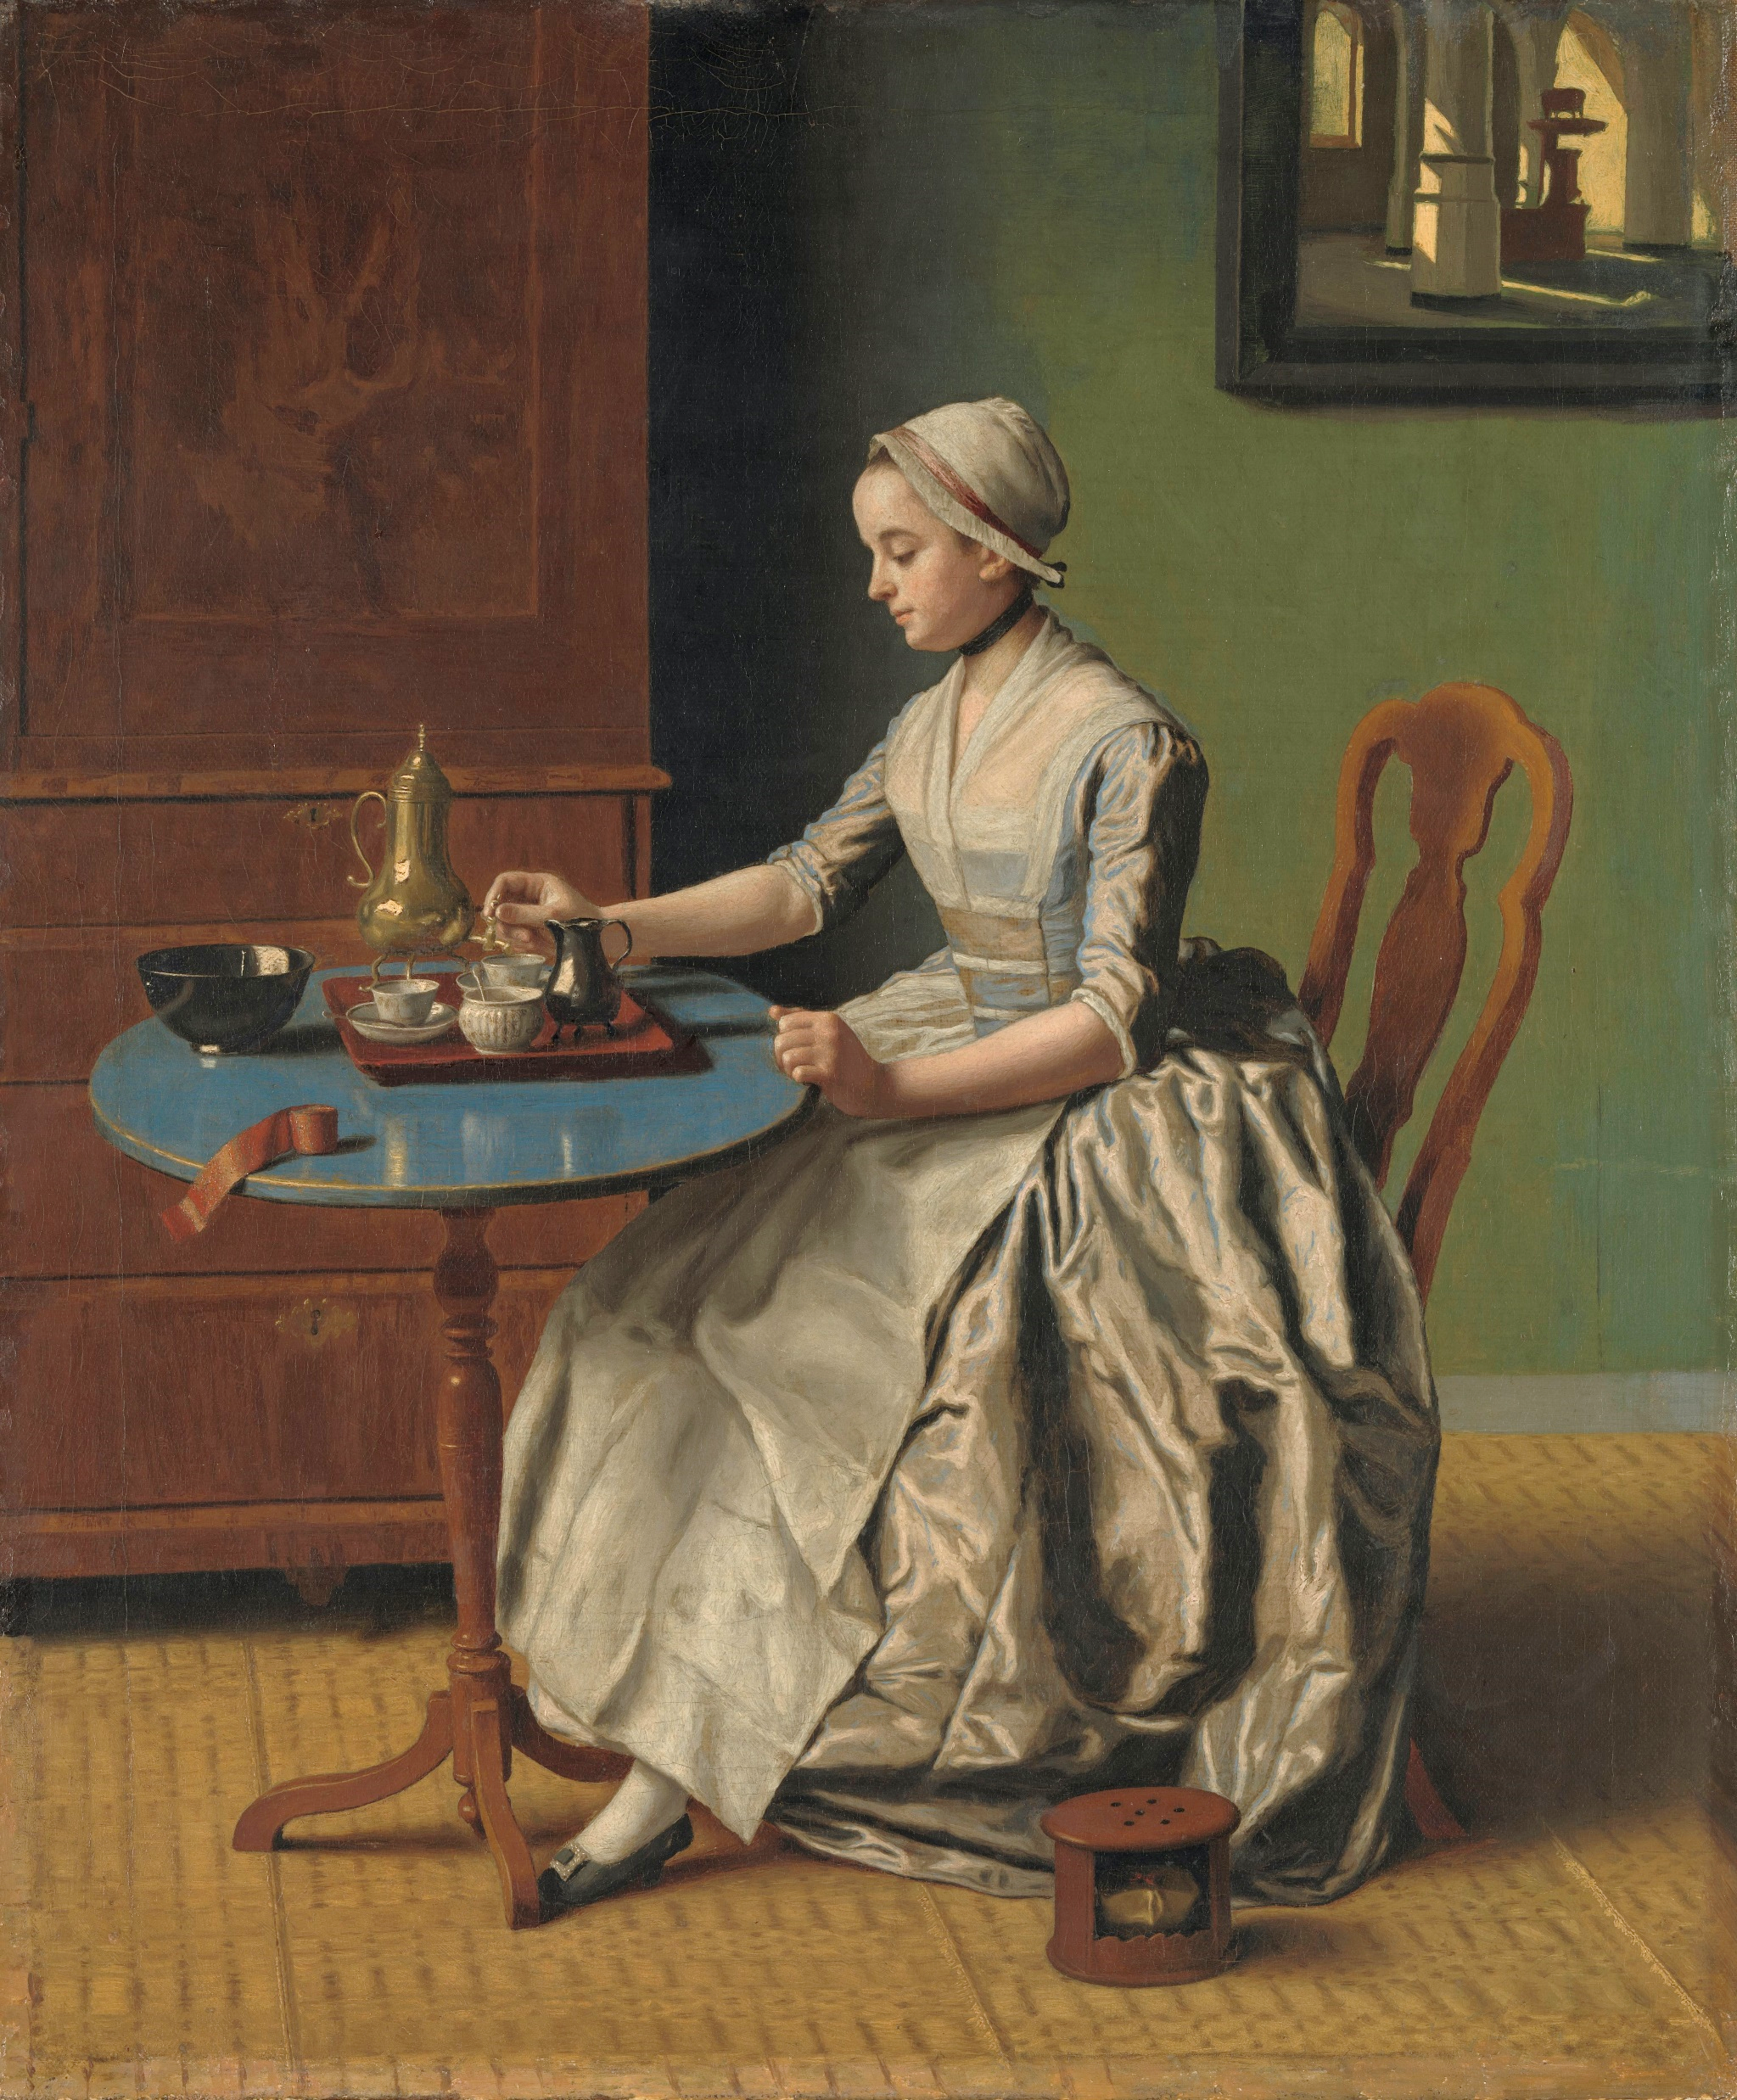
Chocolate Goes Global
Biological Determinism: Popularity because of addictiveness?
Cultural Constructivism: Chocolate ‘Europeanised’ both materially and symbolically.
Medicinal Good: classified along Galenic lines.
Humorally flexible: Cacao = cold but other ingredients (e.g. chilli pepper) = hot.
Said to increase vitality, alleviate melancholy, treat fevers and dysentery.
Social Good: Disentangled from indigenous
  context.
Adapted to European tastes – sugar & vanilla.
Jean-Étienne Liotard, ‘A Lady Pouring Chocolate’ (1744)

Slide 11
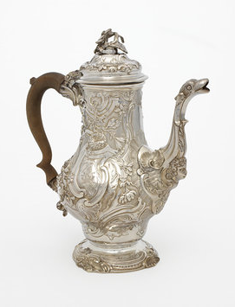
Chocolate Pot
Place of origin: London
Date: 1750-51 (hallmarked)
Maker: Samuel Courtauld
(1720-1765)
Materials and Techniques: Raised, cast,
            chased, engraved silver & carved shell
Collection: Victoria & Albert Museum

Slide 12
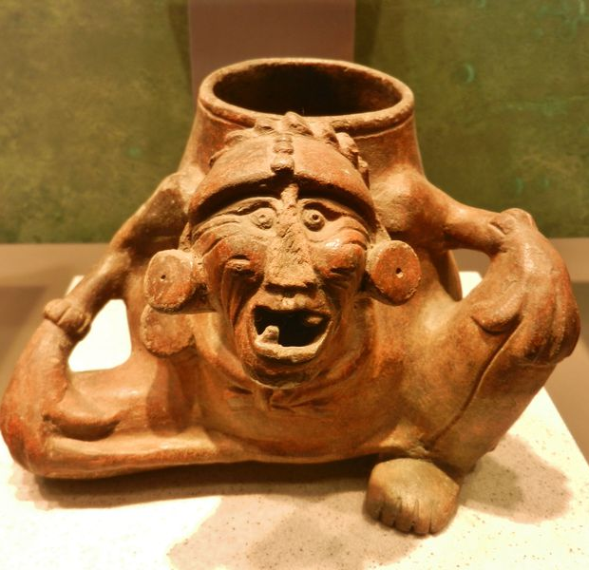
Chocolate Pot
          (below) Mayan earthenware chocolate pot

Slide 13
Chocolate: Entangled Knowledge?
Marcy Norton, Sacred Gifts, Profane Pleasures (2008): popularity of chocolate connected to its indigenous characteristics.
Humoral classification dependent on Mesoamerican influence.
Francisco Hernández: observations of indigenous practice shaped his medical understandings of chocolate. If being used to treat excess heat, its elemental quality must logically be cold.

Slide 14
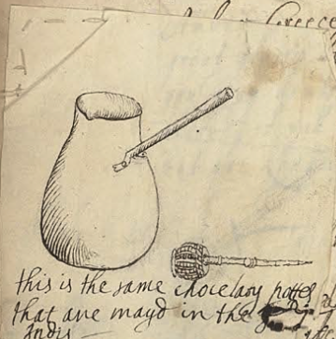
Chocolate Pot
Depiction of chocolate pot and molinillo in Lady Ann Fanshawe’s Recipe Book (1665), Wellcome Collection.

Slide 15
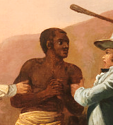
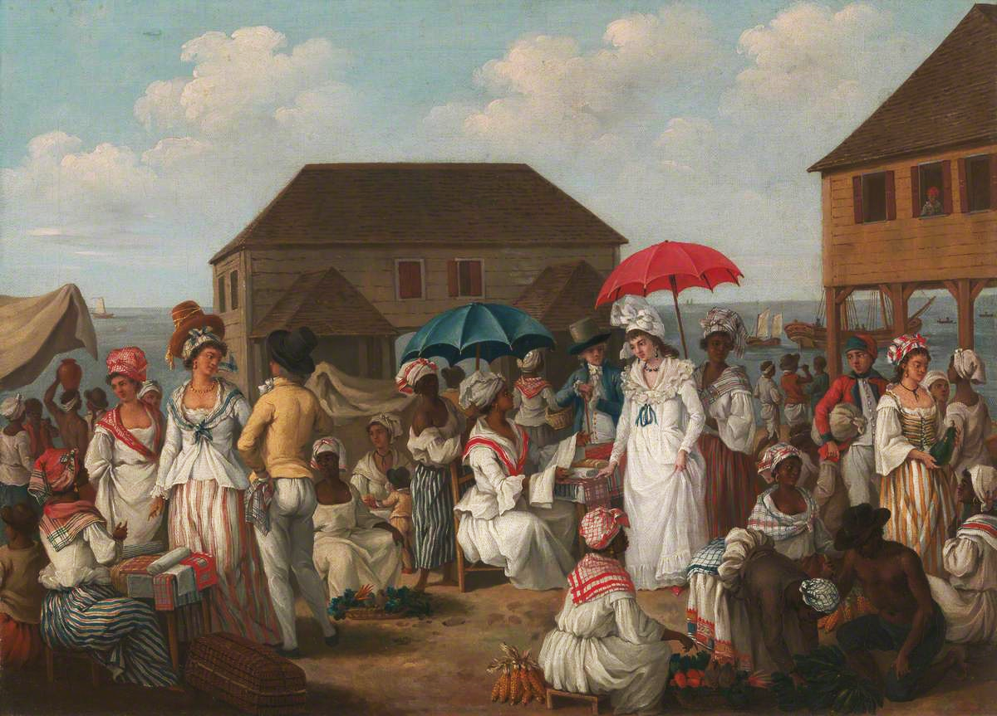
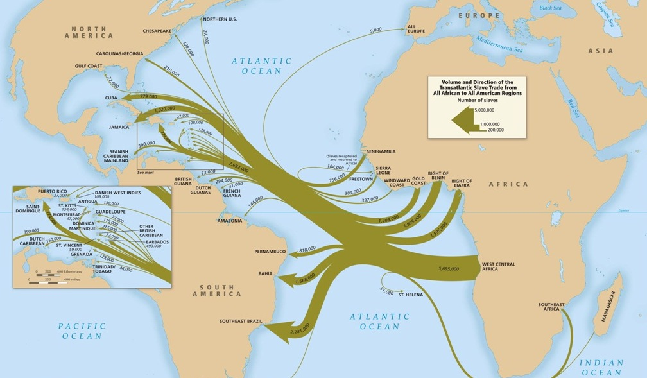
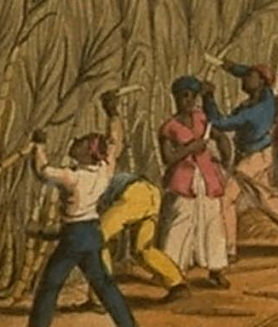
Blood & Sugar
Cultivated in the Azores, Cape Verde, Madeira etc. with enslaved labour by late fifteenth century.

Slide 16
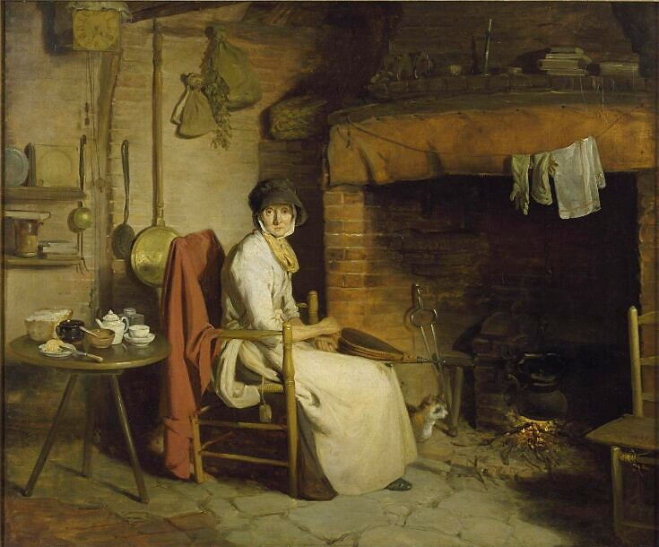
Blood & Sugar
‘Sugar, then, was a cornerstone of British West Indian slavery and the slave trade, and the enslaved Africans who produced the sugar were linked in clear economic relationship to the British labouring people who were learning to eat it.’
- Sidney Mintz, Sweetness and Power: The Place of Sugar in Modern History (New York, 1985), 175.

Slide 17
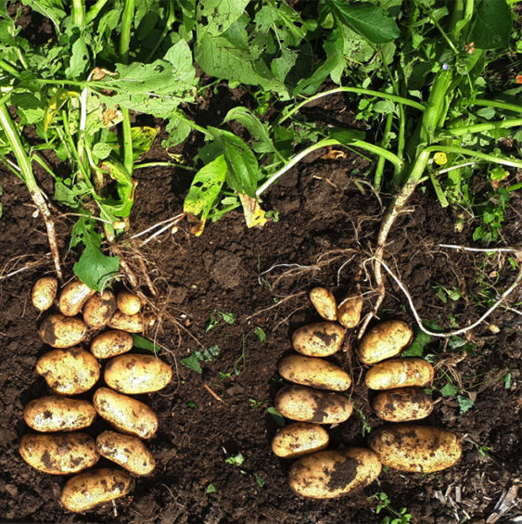
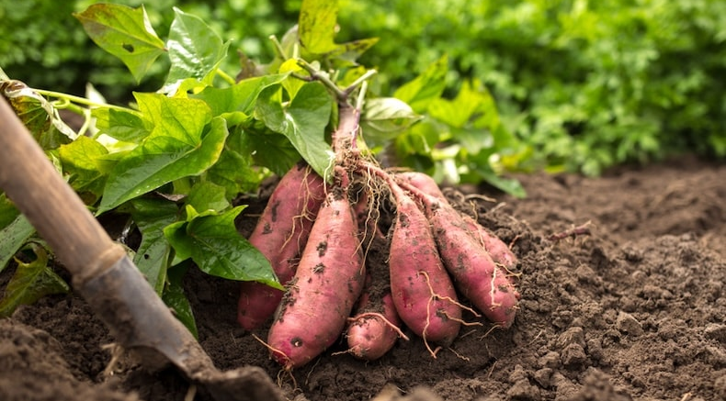
Counting Calories
‘The culture of eating needs to be given more importance, because the calories contained in the food consumed by labourers were the petrol of the early modern economy.’
- Craig Muldrew, Food, Energy and the Creation of Industriousness: Work and Material Culture in Agrarian England, 1550-1780 (2011).

Slide 18
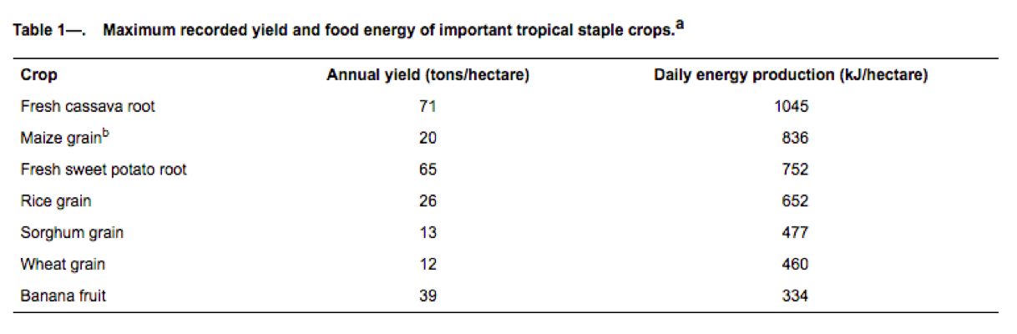
Counting Calories

Slide 19
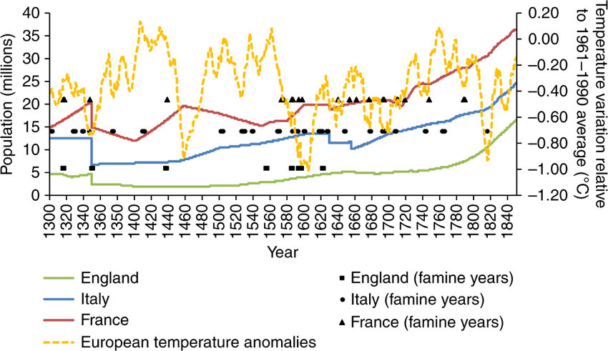
Productivity & Population Boom
Took time to incorporate many foods into diets,
Population rebound until 18th century?
Changes to land ownership and technology: e.g. enclosure, crop rotation.
Increased access to foreign markets via global trade and to additional land via colonisation.

Slide 20
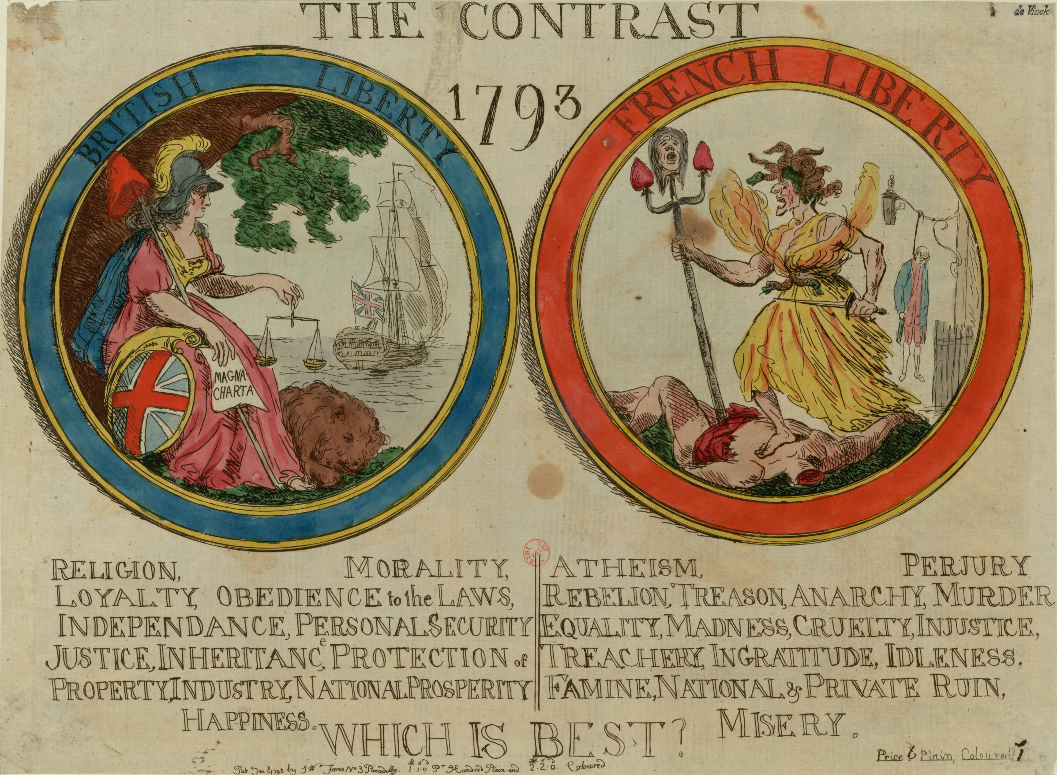
Food & Empire
By the 18th century foods produced, in British colonies ‘became the empire’s most ubiquitous symbols, and their advertisement retail, preparation and consumption reflected and contributed to British discussions and perceptions of the empire.’
- Troy Bickham, ‘Eating the Empire: Intersections of Food, Cookery and Imperialism in Eighteenth-Century Britain’, Past and Present, 198 (2008), 71.

Slide 21
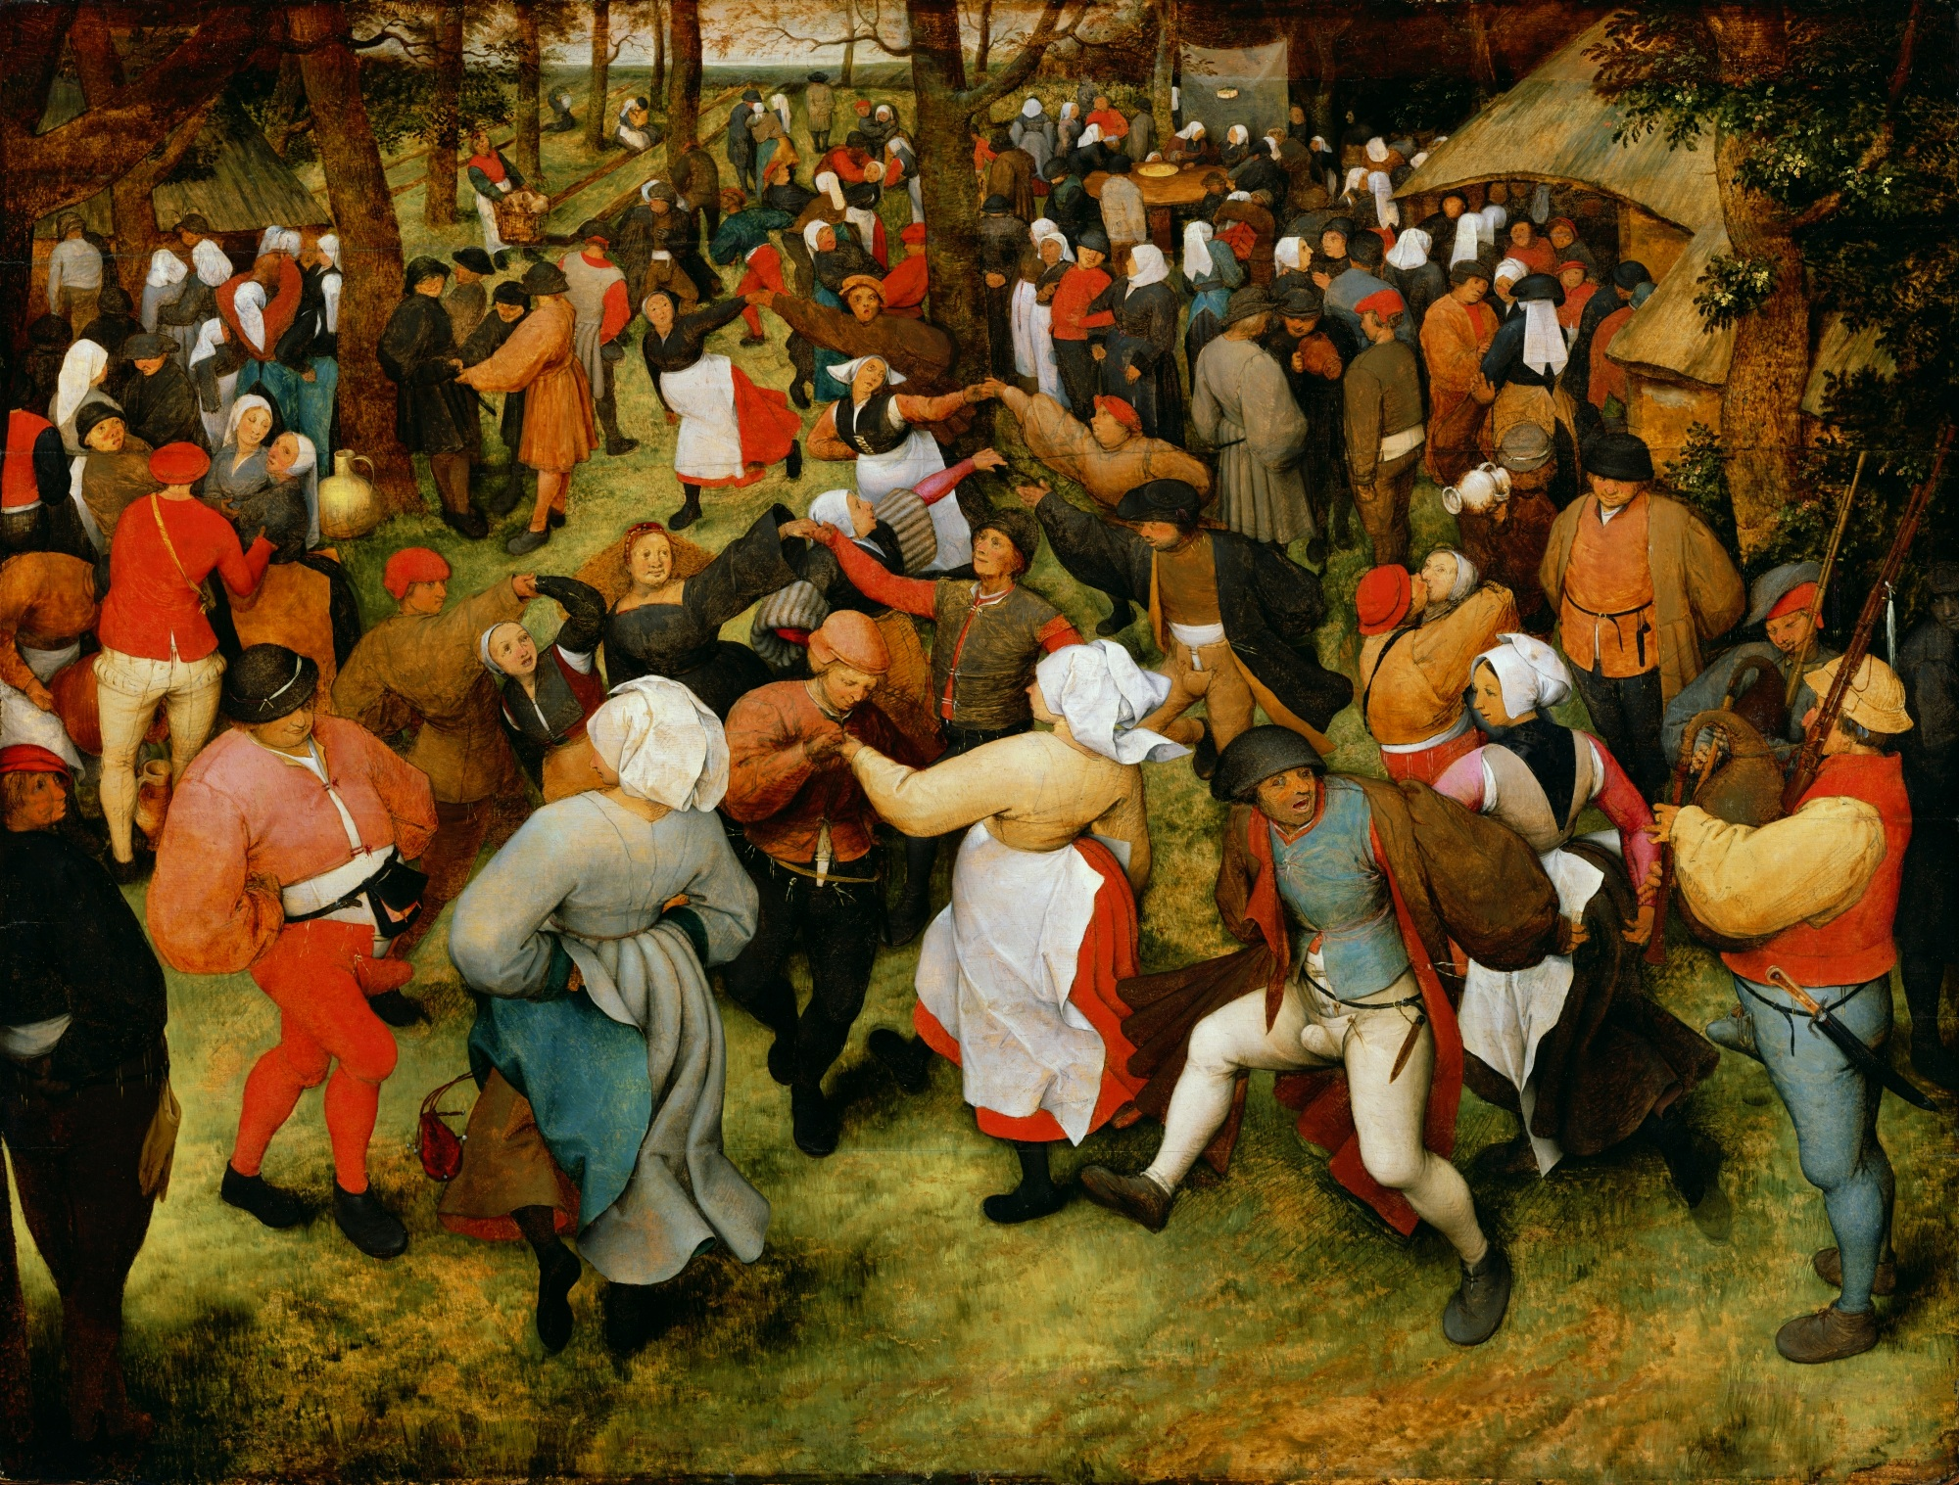
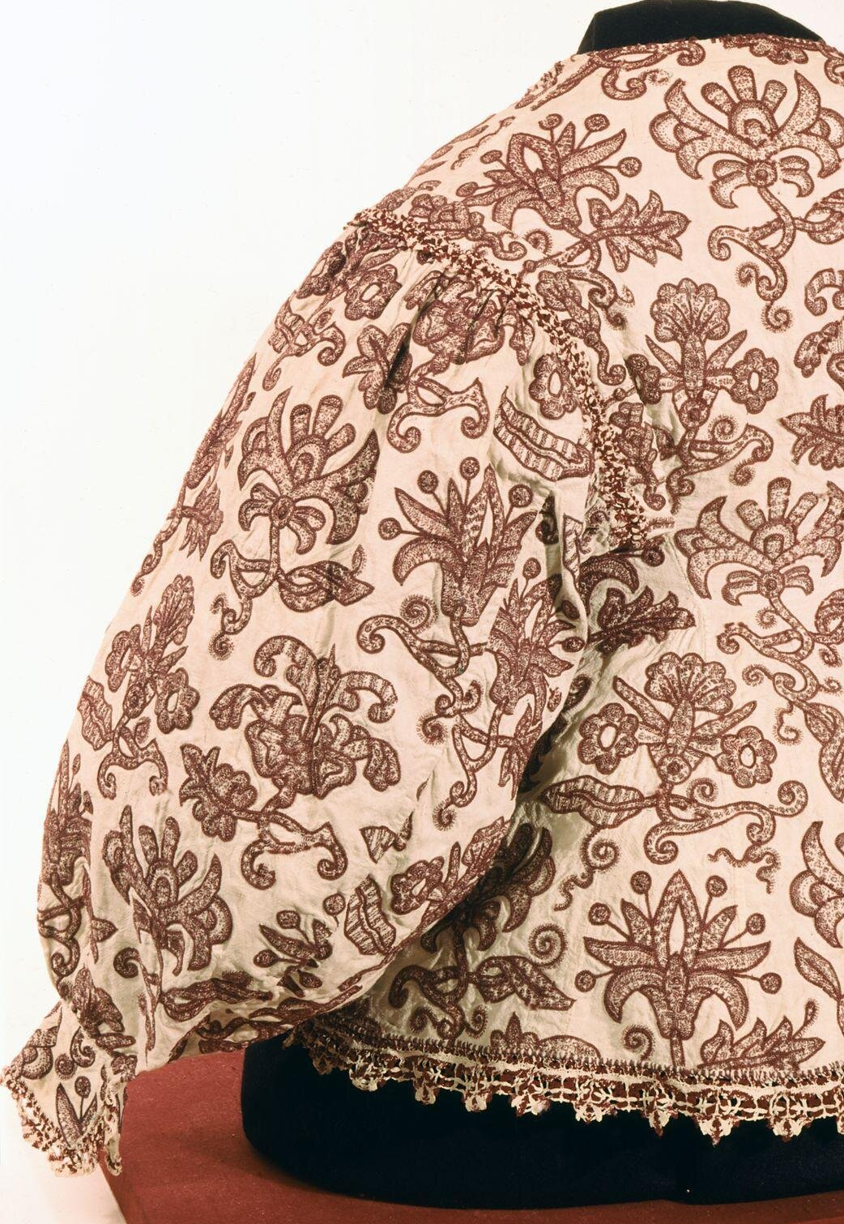
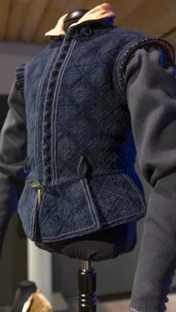
Transforming Textiles
Above, example of wool woven to imitate velvet: reconstruction of 17th century artisan’s doublet by Refashioning the Renaissance Project.
Above, detail of women’s waistcoat c.1630s. Linen, embroidered with red wool crewelwork, bobbin lace trimming.
V&A Collections.
Detail from Pieter Bruegel the Elder, The Wedding Dance (c.1566) Detroit Institute of Arts.

Slide 22
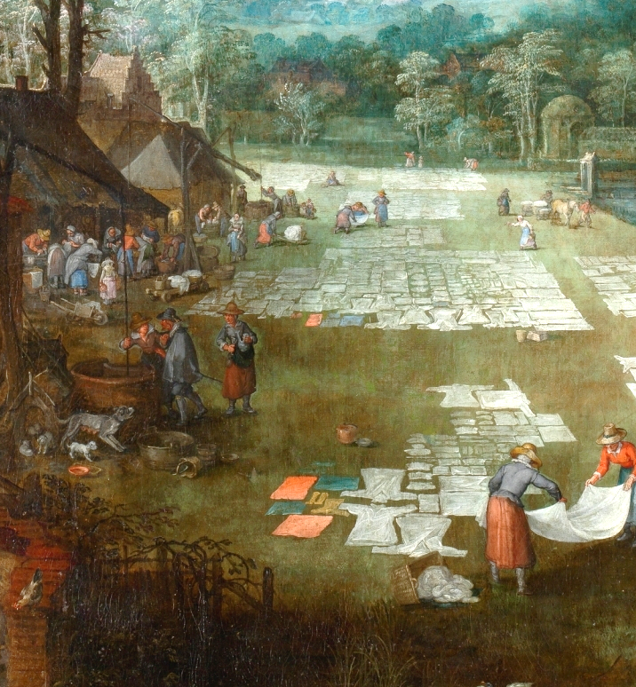
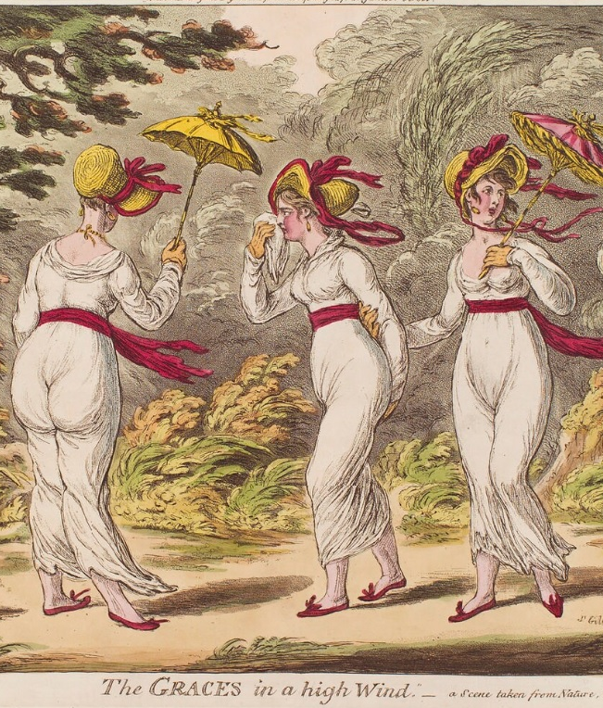
Transforming Textiles
(above left) detail from Pieter Bruegel the Elder, Market and Washing Place in Flanders (c.1620), Museo Nationale del Prado. (above right) James Gillray, The Graces in a High Wind (1810), National Portrait Gallery

Slide 23
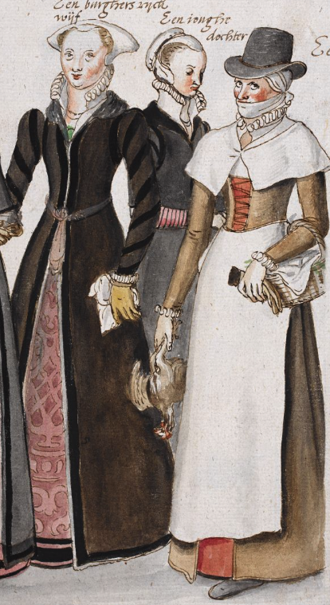
Transforming Textiles
Dress, made 1780-1785
Cotton, block-printed and lined with linen
Made in England
Could be informal wear for the wealthy, or Sunday Best for working class.
Consumer Culture
e.g. Maxine Berg, Nancy Cox, Claire Walsh etc.

Slide 24
Proliferation
London Foundling Hospital token, 1759

Slide 25
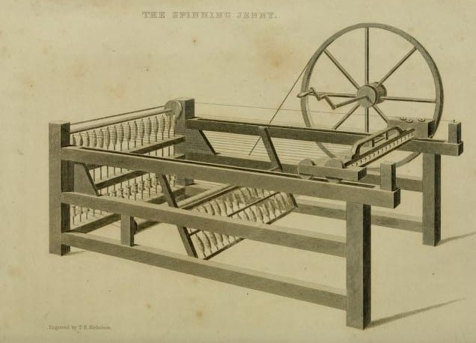
Industrial Innovation
‘The East India trade changed both the industrial and the cultural environment of Europe, altering forever Western decor and Western dress, while setting the model to be followed by later industries. Material culture was transformed in the process.’
- Beverly Lemire, ‘Fashioning Cottons: Asian Trade, Domestic Industry and Consumer Demand, 1660-1780’, in The Fashion History Reader: Global Perspectives, ed. by Giorgio Riello and Peter McNeil, (New York, 2010), 210.

Slide 26
An Anxious World of Goods
Men went clothed in ‘the same colour that the sheep bore them’,
‘men were stronger than we, healthfuller, fairer complexioned, longer living, and finally, ten times harder than we, and able to bear out any sorrow or pains whatsoever. For be sure this pampering of our bodies, makes them weaker, tenderer, and nesher, than otherwise they would be if they were used to hardness and more subject to receive any kind of infection or malady. And rather abbreviate our days by many years’
- Phillip Stubbes, The Anatomie of Abuses (London, 1583).
‘Since our Wealth has increas’d and our Navigation has been extended, we have ransack’d all parts of the Globe to bring together its whole Stock of Material for Riot, Luxury, and to provoke Excess.’
- George Cheyne, The English Malady(London, 1733), 49-50.

Slide 27
Material Culture can improve understanding of micro- and macro-scale historical problems.
Unprecedented increase in global trade and interaction. More access to global goods.
Fundamental shifts in how goods produced and circulated, with long-term impacts.
Important to think how and why material things become integrated into society and culture – this can restore significance of Indigenous and African knowledge to history.
Global context – challenges Western Exceptionalism.

