Slide 1
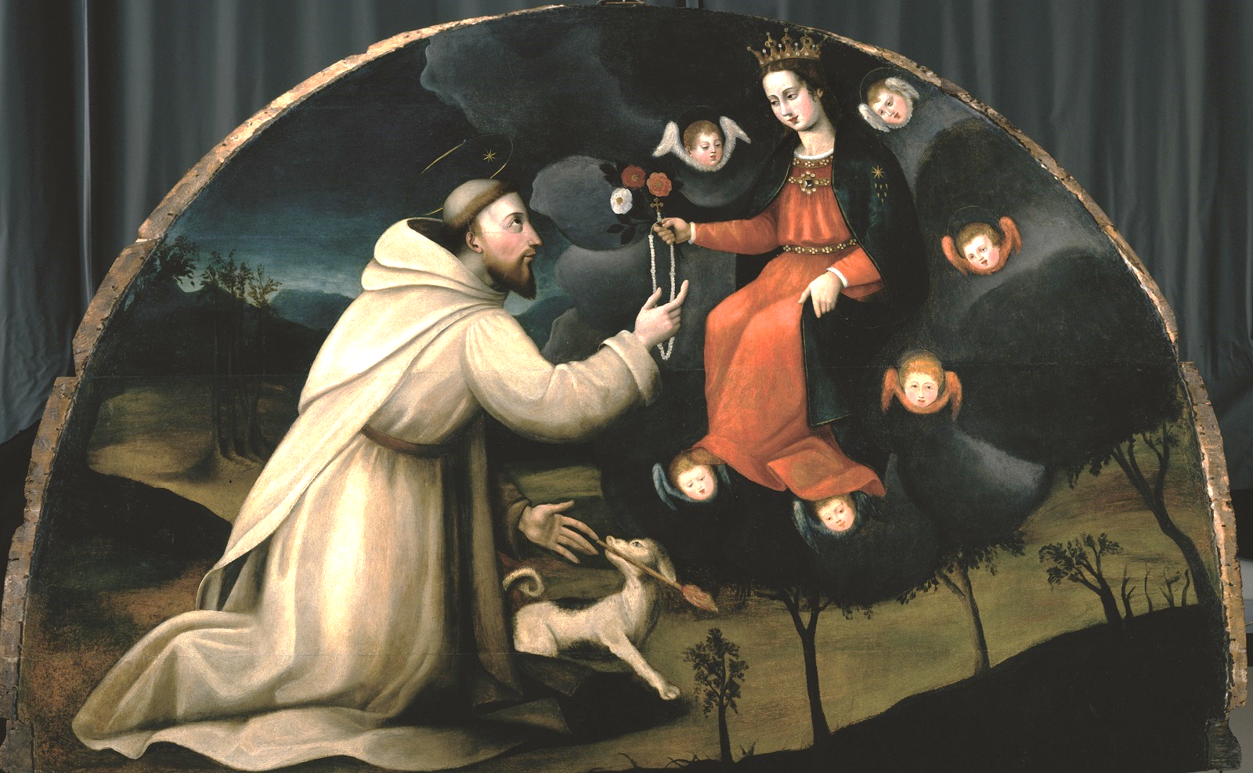
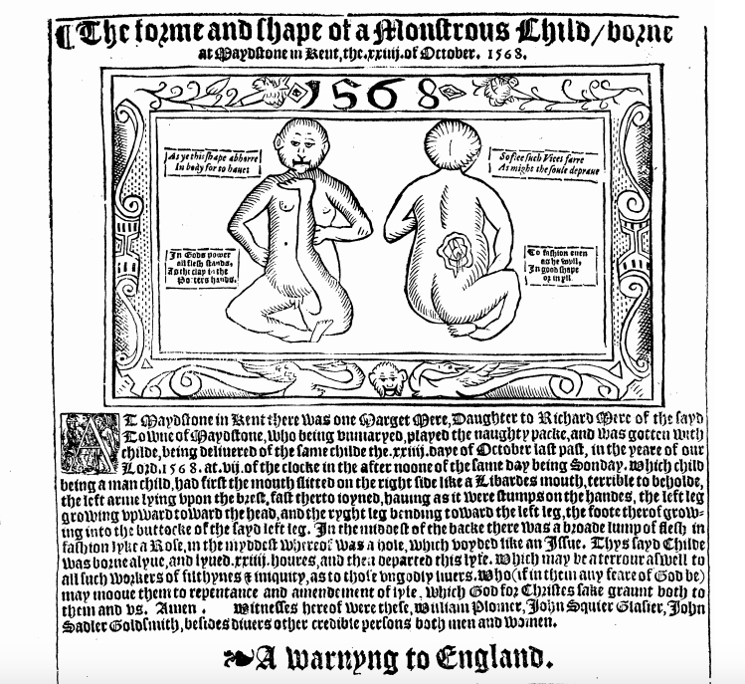
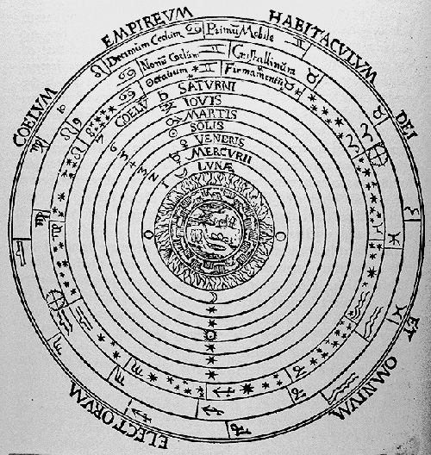
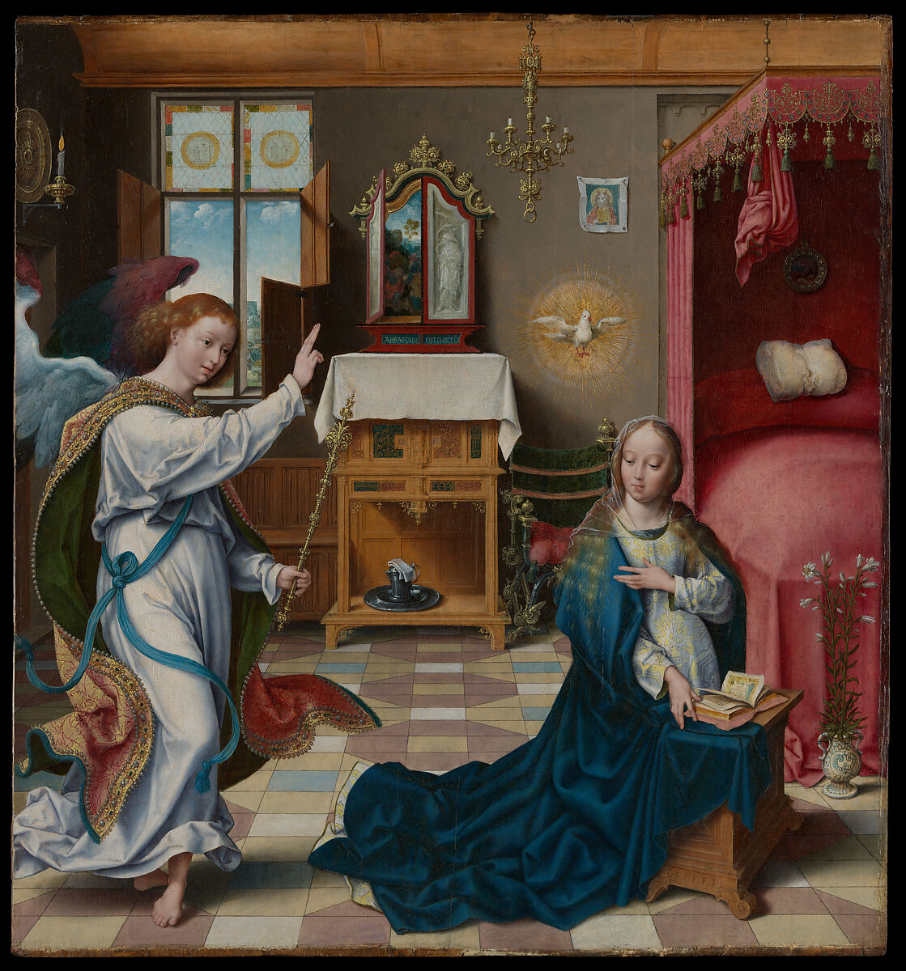
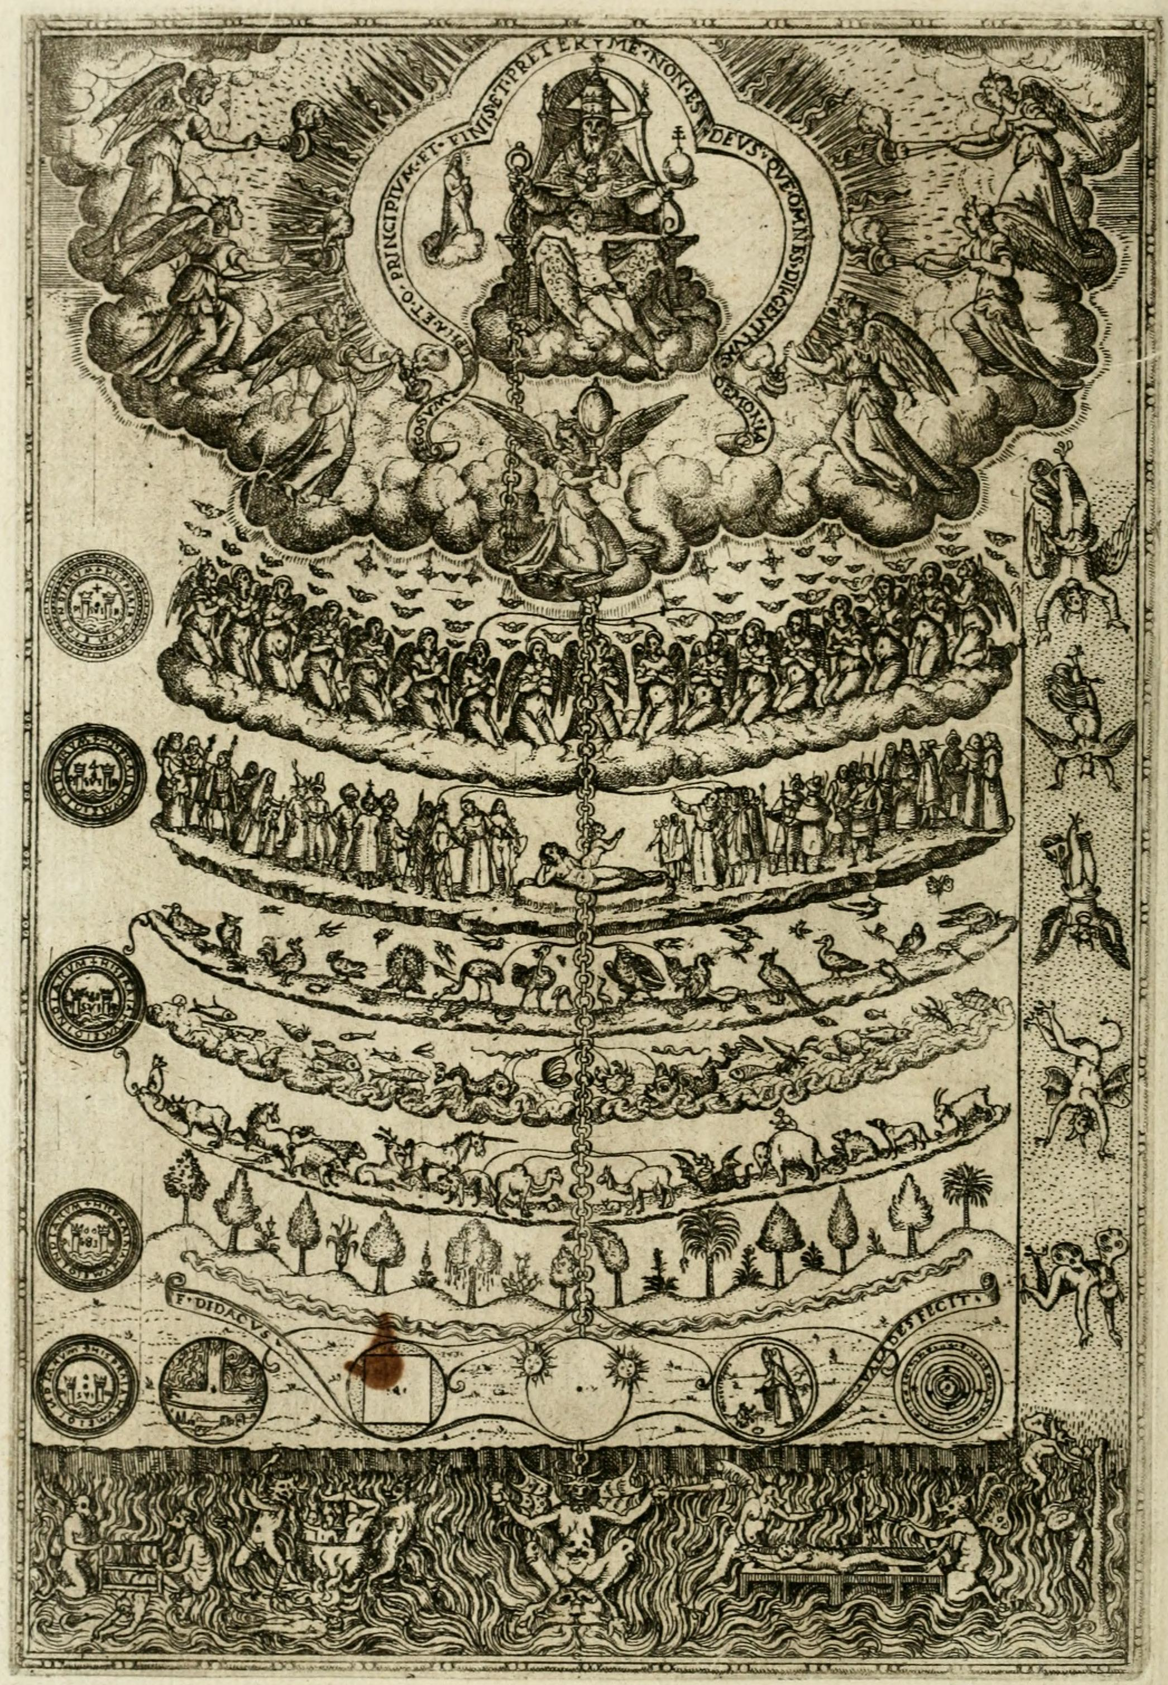
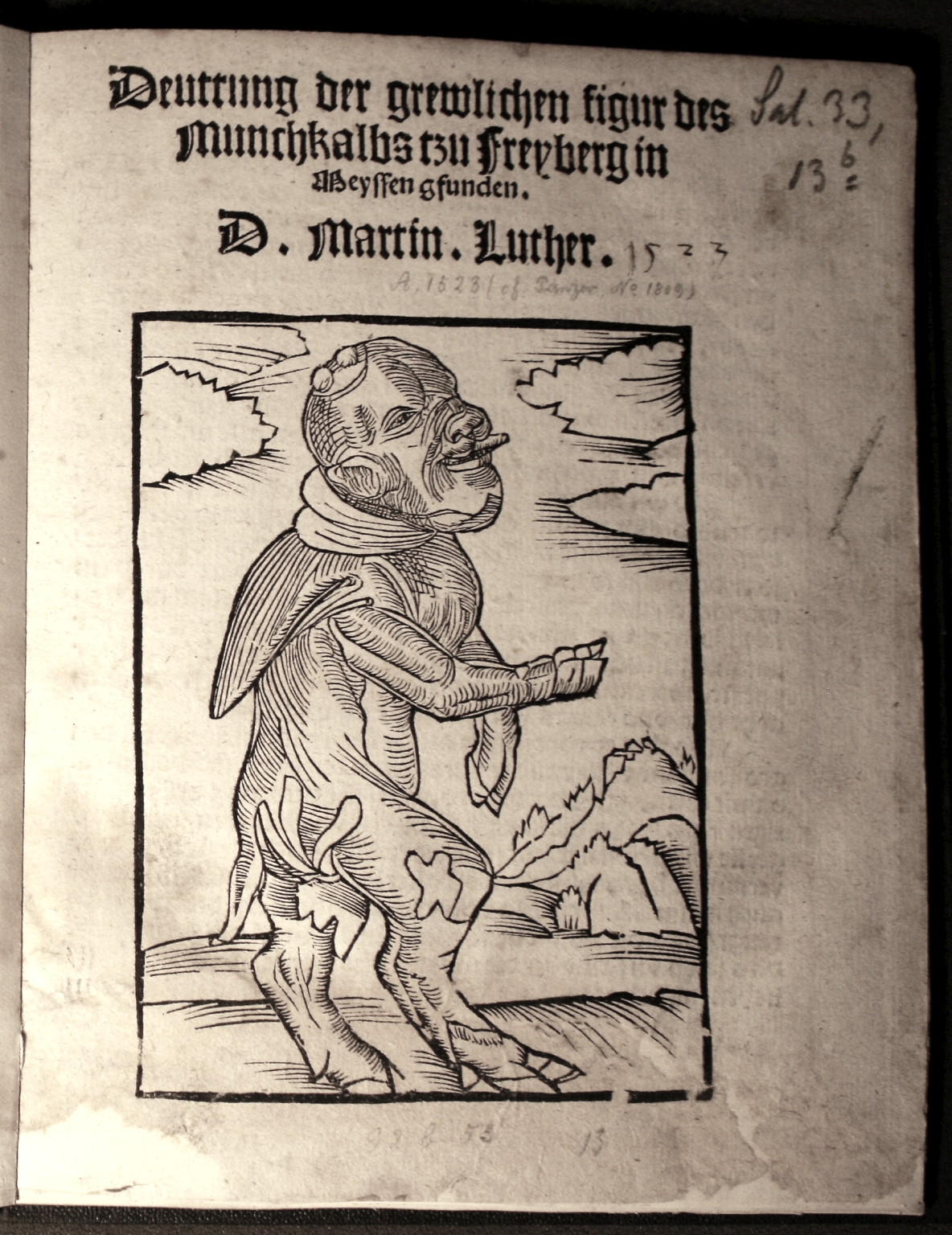
Europe in the Making, 1450-1800 (HI113) Early Modern Cosmologies
Dr Sarah Johanesen
sarah.johanesen@warwick.ac.uk
Content Warnings (Lecture & Readings)
pregnancy & childbirth, miscarriage, sexual assault, incest, abuse, and ableist language

Slide 2
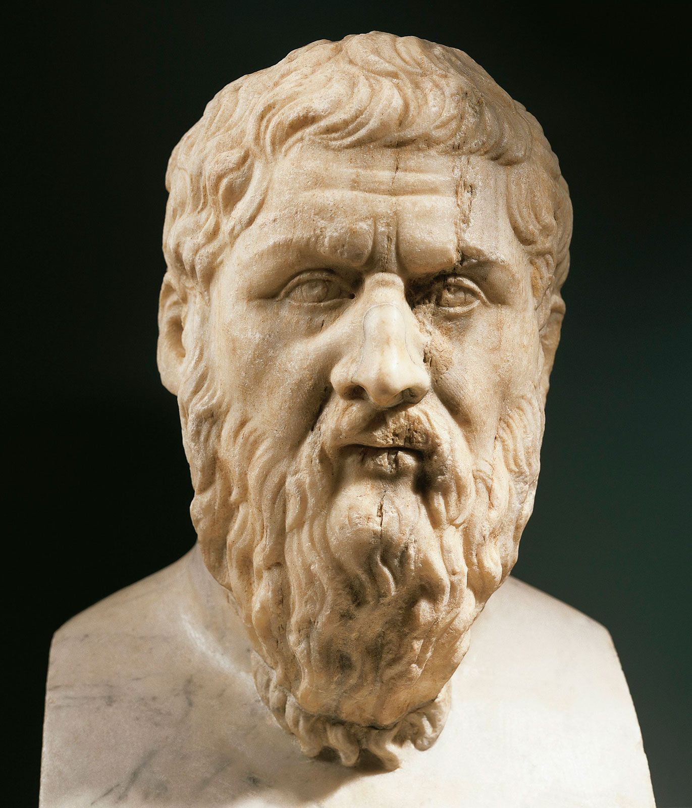
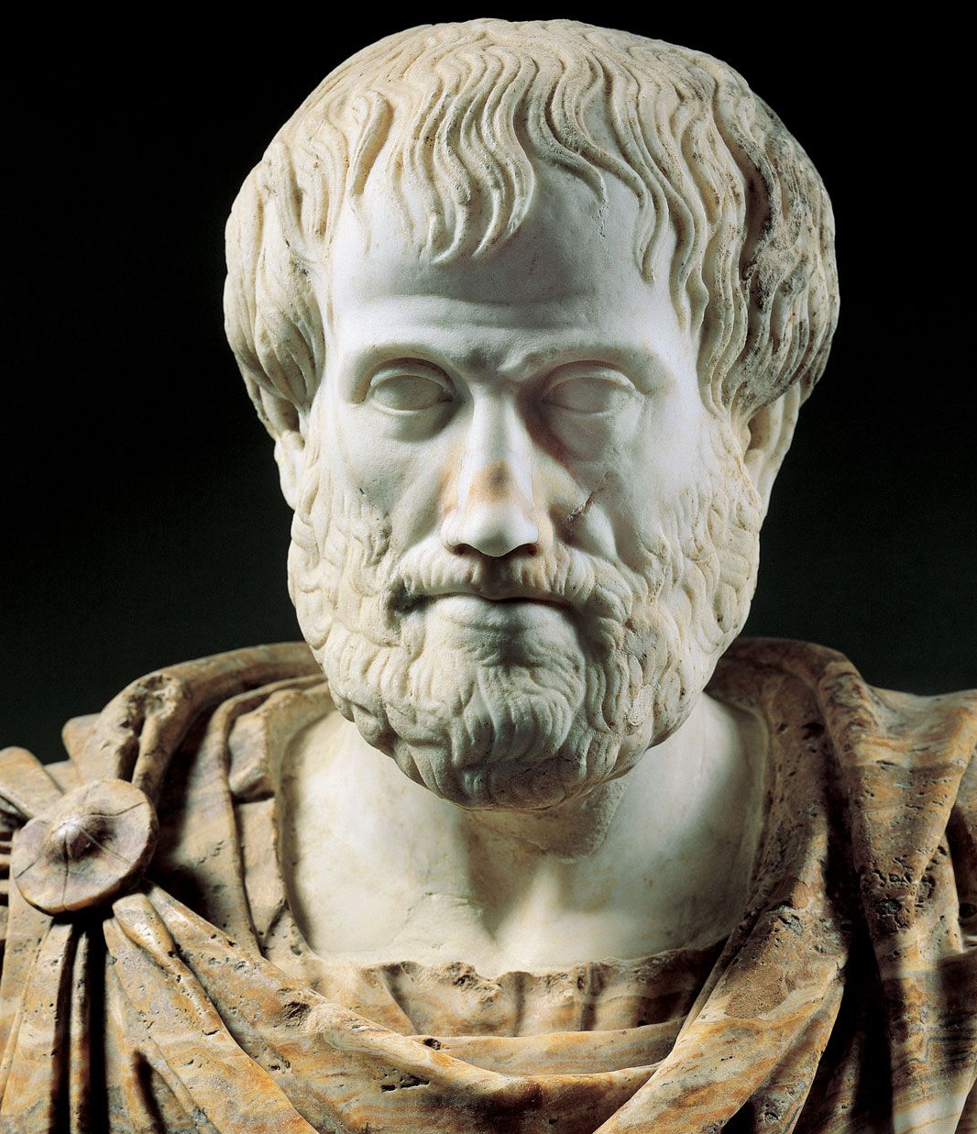
The Great Chain of Being
(Right) Image from Didacus Valades, Rhetorica Christiana (Perugia, 1579).
Plato
Aristotle

Slide 3
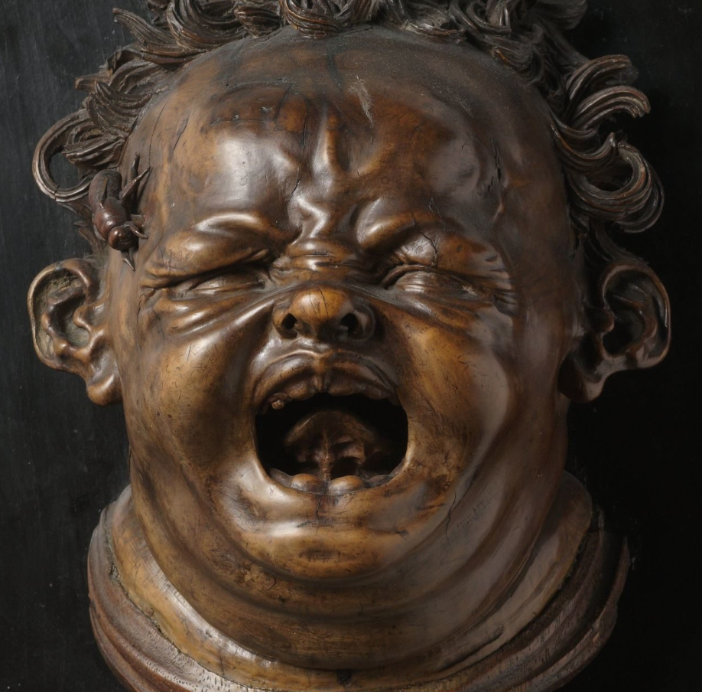
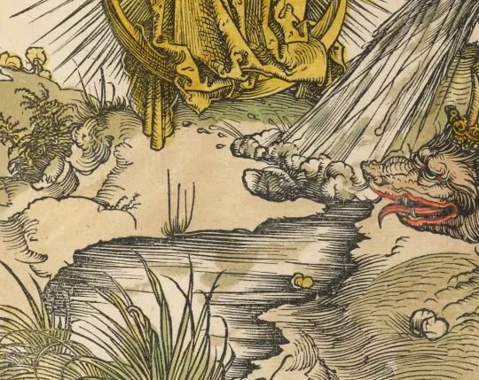
“Natural”
Physical world sensed by humans and explained through “natural causes”.
Matter behaving as God intended.

Slide 4
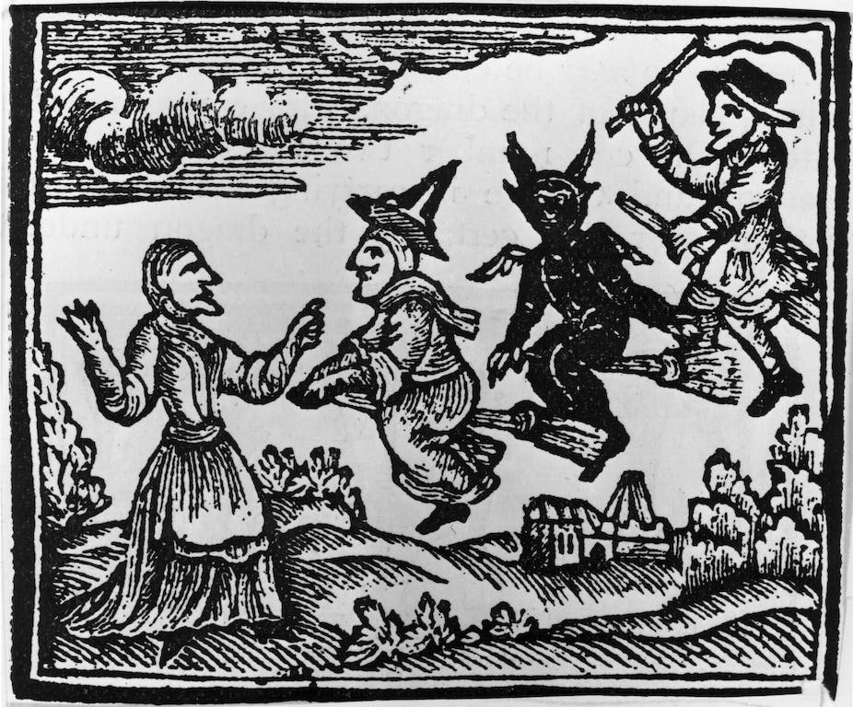
“Natural”
Physical world sensed by humans and explained through “natural causes”.
Matter behaving as God intended.
“Supernatural”
Colloquial: anything beyond human understanding and/or appearing to deviate from the natural order.
Technical: things which only God could do, i.e. work beyond/above the natural law, to intervene in the physical world and human affairs. Genuine miracles.

Slide 5
“Natural”
Physical world sensed by humans and explained through “natural causes”.
Matter behaving as God intended.
“Supernatural”
Technical: things which only God could do, i.e. work beyond/above the natural law, to intervene in the physical world and human affairs. Genuine miracles.
“Preternatural”
Technical: Occurrences which seemed beyond nature but were only beyond human comprehension.
‘wonders’ / ‘marvels’ / ‘providences’
Angels, witches, demons etc, manipulating natural forces beyond normal human capability. Required great secret knowledge, and God’s permission.

Slide 6
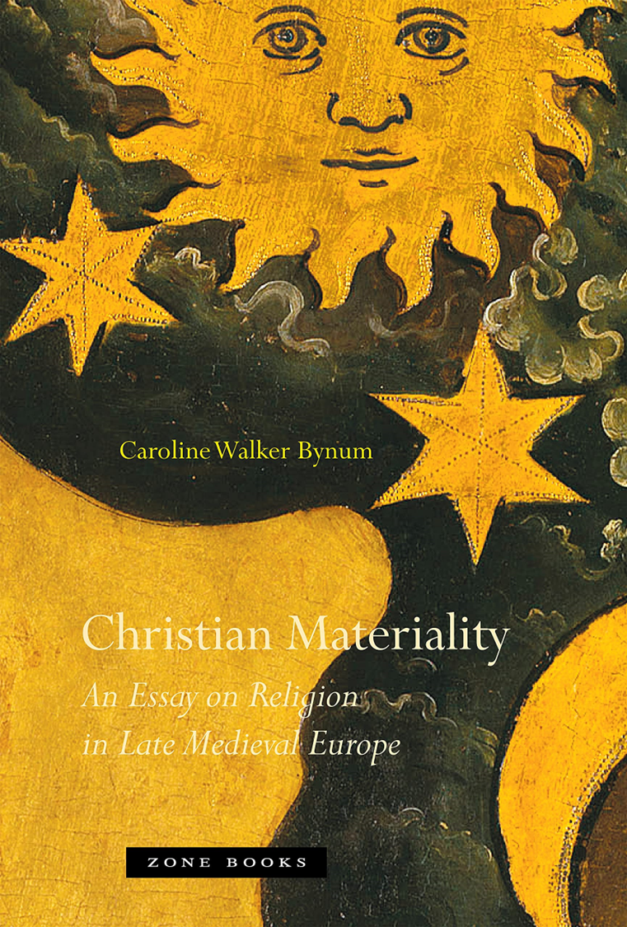
Caroline Walker Bynum, Christian Materiality: An Essay on Religion in Late Medieval Europe (2011)
Late medieval anxiety over the distinction between miracle and wonder.
Martin Luther:
‘we have no longer any need of miracles; the Gospel doctrine has been established by signs and wonders sufficient, so that no one has any cause to doubt them.’
Sermons on the Gospels For the Sundays and Principal Festivals of the Church-Year, ed. by J. A. Shulze (1884), p. 246.

Slide 7
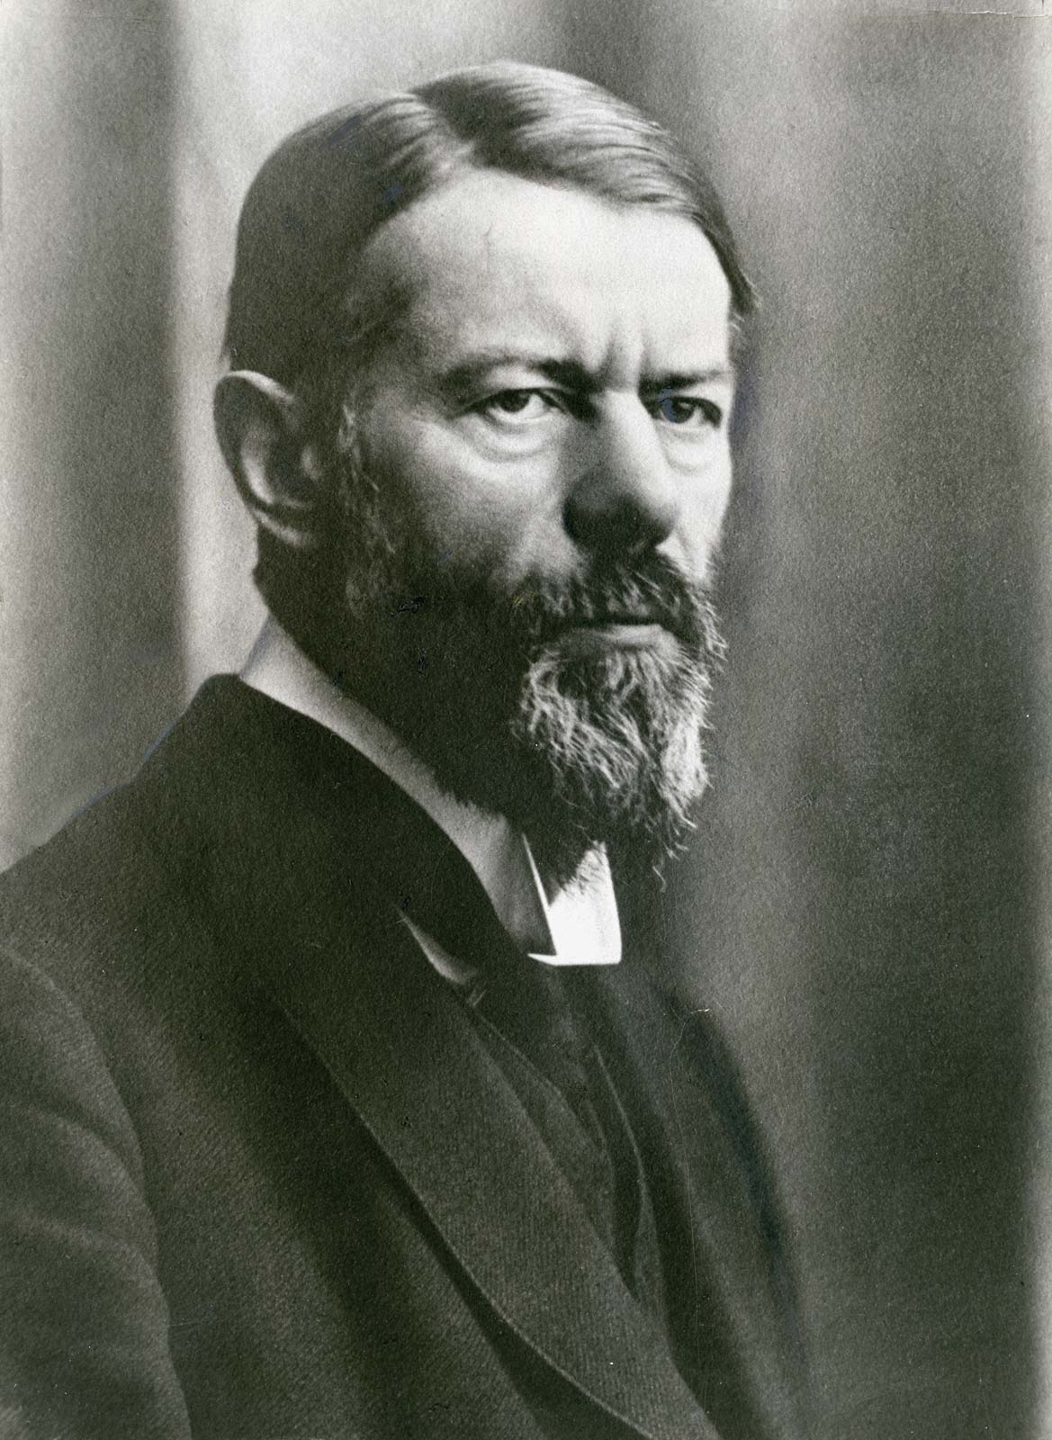
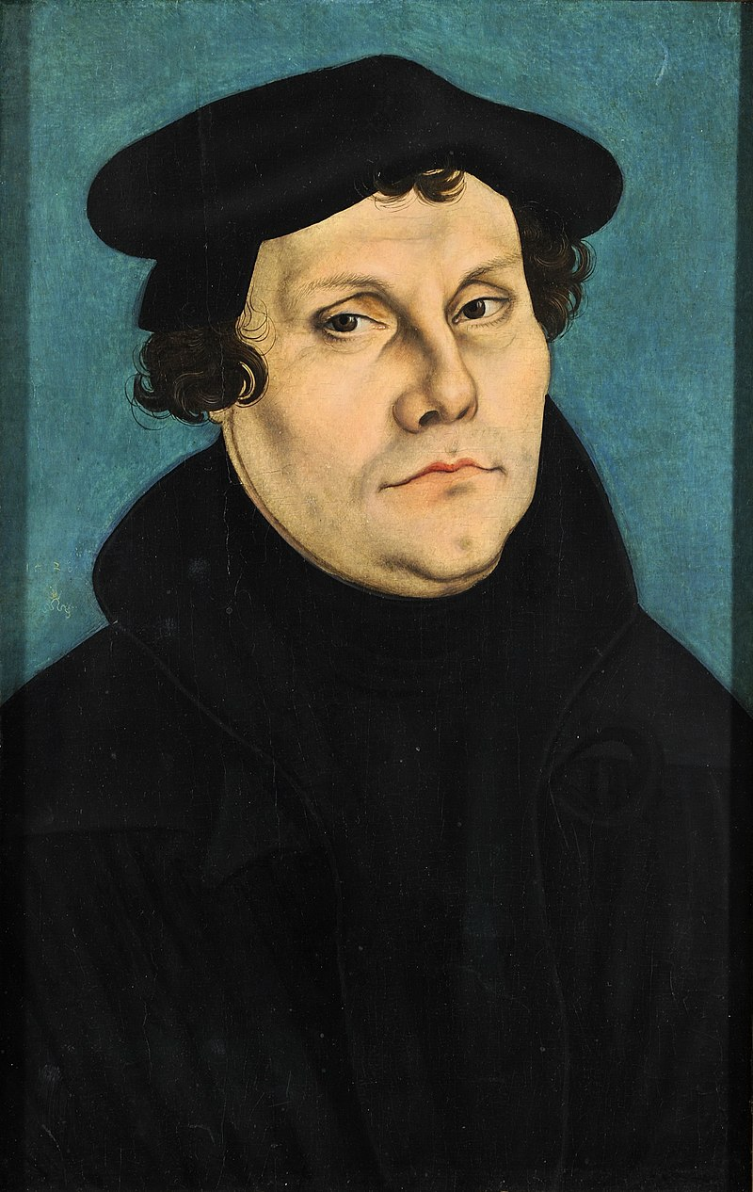
Disenchantment?
Max Weber (1864-1920)
German sociologist
Protestant Reformation causes
‘disenchantment of the world’
Revisionists:
Robert Scribner – ‘incombustible Luther’
Ute Lotz-Heumann & Alexandra Walsham
Reformation ‘modified and curtailed, rather than wholly rejected, the traditional
‘economy of the sacred’’
– Walsham, ‘The Reformation and 'The Disenchantment of the World' Reassessed’, Historical Journal, 51 (2008), p. 500.

Slide 8
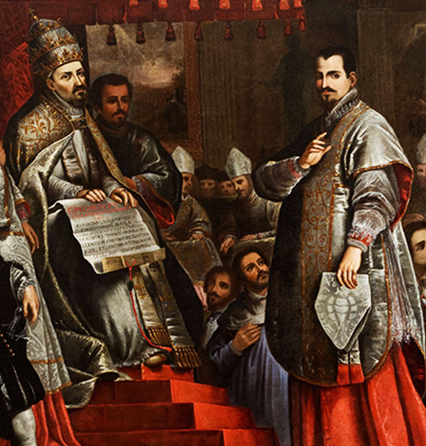
Disenchantment?
Catholic scepticism
David Gentilcore:
used records of Congregation of Rites
Established 1588
To verify saints, and their miracles,
before they were canonised.
Physicians and surgeons as expert witnesses: especially on whether the cure was permanent.

Slide 9
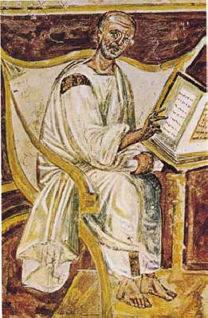
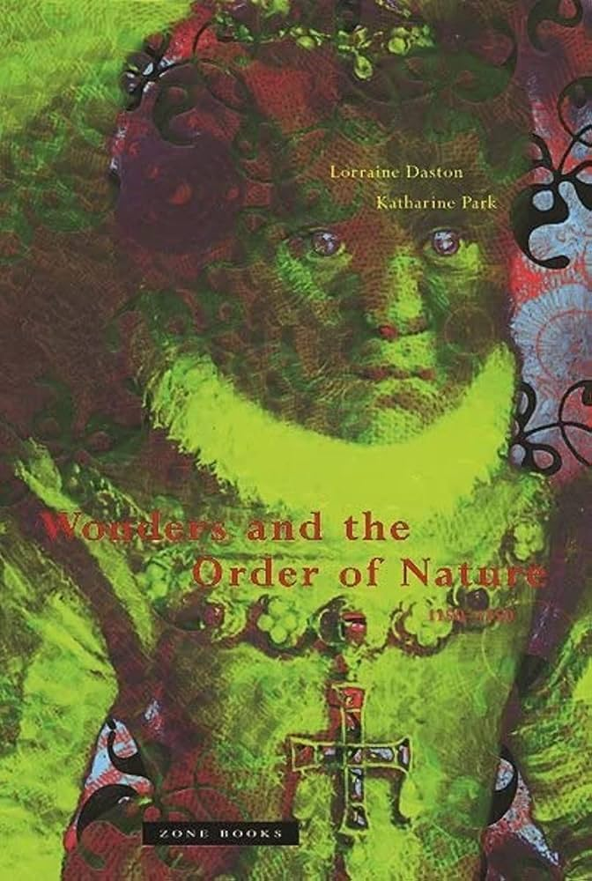
Divine Providence
St Augustine (354-430 CE)
All creation:
reveals its unseeable Creator,
is a manifestation of God’s divine plan,
demonstrates God’s power.
God’s care for creation shown through:
Comfort and aid,
Instruction through reward,
Instruction through chastisement.
Lorraine Daston & Katherine Park, Wonders and the Order of Nature: 1150-1750 (1998)
- no straightforward progression but multiple explanatory models co-existing and persisting.

Slide 10
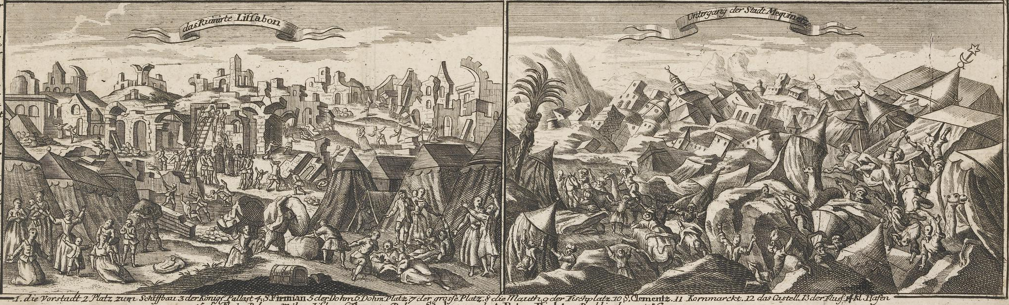
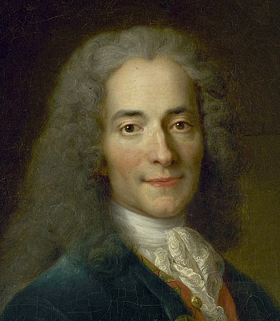
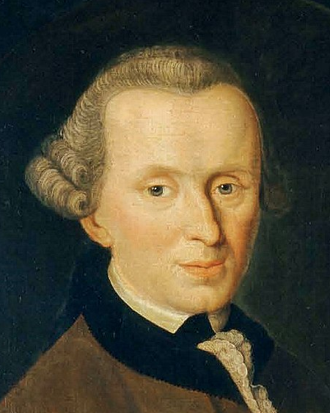
Lisbon Earthquake
1 November 1755 (All Saint’s Day)
(Below) Detail from Das ruinirte Lissabon, Germany, 1756, British Museum.
Voltaire:
Poem criticising idea that it was divine punishment.
Immanuel Kant:
Earthquakes caused by natural processes not immorality.

Slide 11
Lisbon Earthquake
Andrew Cowan Scottish Protestant
letter to Francis Russel, 1755/6 in Rory Cunningham, ‘A First-Hand Description of the Aftermath of the Great Lisbon Earthquake’, Notes and Queries, 66: 1 (2019)
‘It’s Certain had this Catastrophe Happened in any other day of the Year, or hour of the day, then it did, would have been less Fattal to Catholicks, & more so to Protestants, It being all Saints day, a Great Festival to the Former, who were at that verey Hour Crowded in their Churches (where most of them was Killed)’
‘Nothing (less than a Miricle) can cure them; Unless Another Earthquake Accompanied, with a Deluge, Swallow up the one Half & Drown the other (which God Forbid) I rather by far a Miricle should save e’m, Bad as they are’

Slide 12
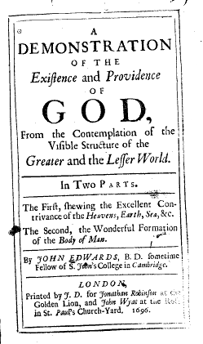
John Edwards, A Demonstration of the Existence and Providence of God from the Contemplation of the Visible Structure of the Greater and the Lesser World (London, 1696).
‘A Man may be a Philosopher and a Christian: He may (nay he must) acknowledg a first Cause, though he holds that there are secondary ones: Divine and natural Agents are not inconsistent.’
(p. 144, my emphasis)
Secondary, physical causes:
‘Heat’, ‘Inundations of the Sea’ causing ‘Commotion and disorder in the Earth’. (p. 151)

Slide 13
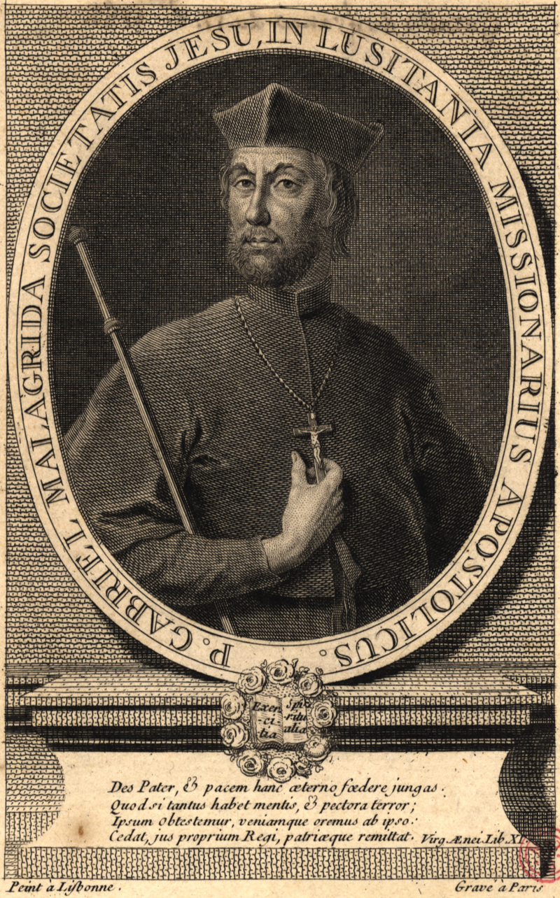
Lisbon Earthquake
Gabriel Malagrida, Jesuit Preacher
Juizo da verdadeira causa do Terremoto (Lisbon 1756), pp.3-4.
‘the only destroyers of so many houses and palaces, the devastators of so many temples and convents, the murderers of so many of their inhabitants, the fires that devour so many treasures, the ones that still bring them so restless, and out of their natural firmness, they are not comets; They are not stars, they are not vapours, or exhalations, they are not phenomena, they are not contingencies, or natural causes; but they are only our intolerable sins.’

Slide 14
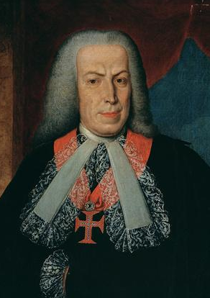
Lisbon Earthquake
Sebastião de Melo, Marquis of Pombal
Secretary of State
Nov. 1756
Persuaded the King to banish Malagrida and all Jesuits from the Royal Court.

Slide 15
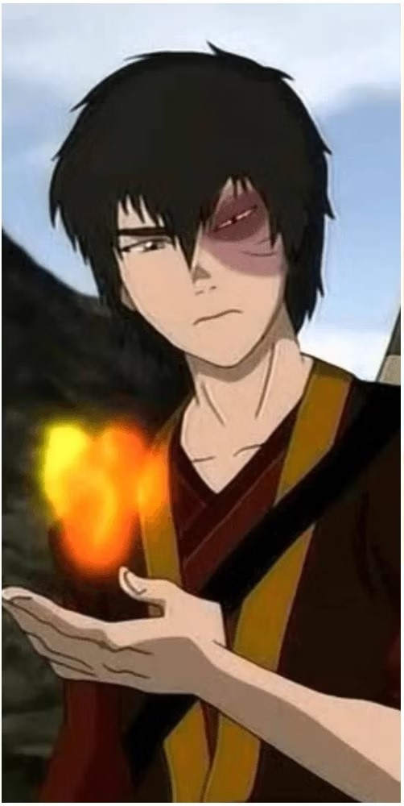
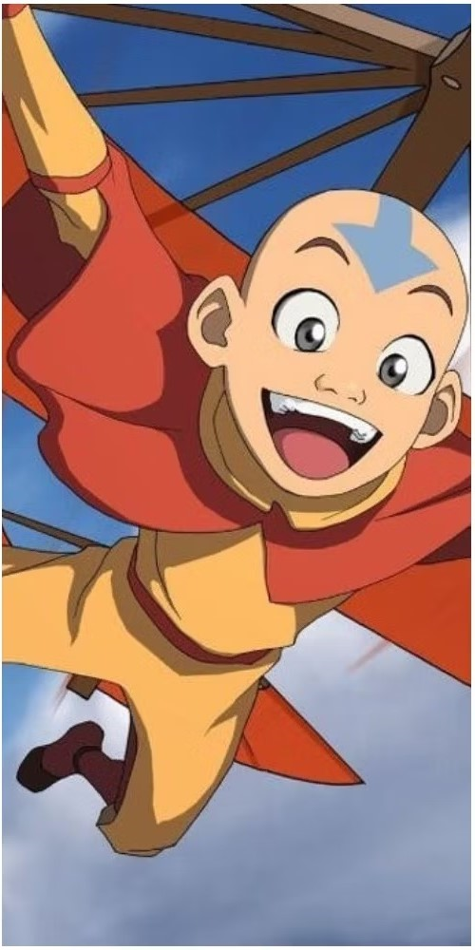
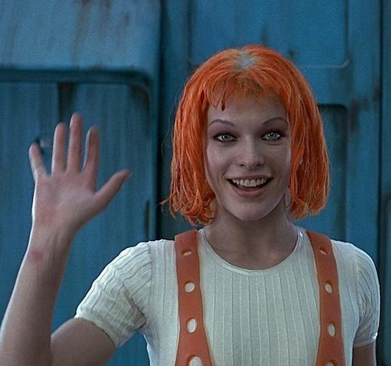
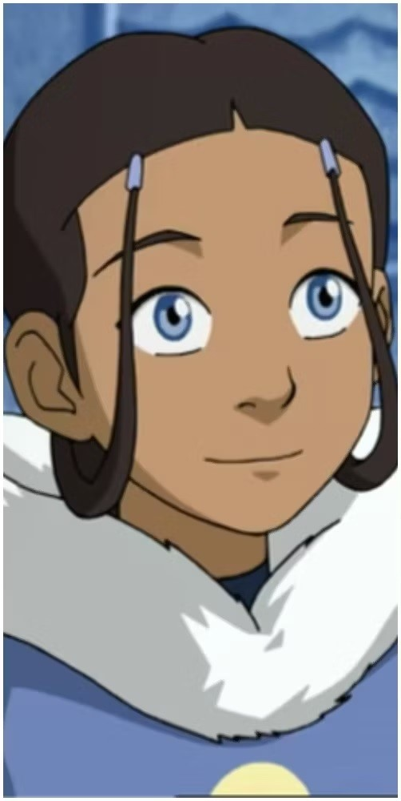
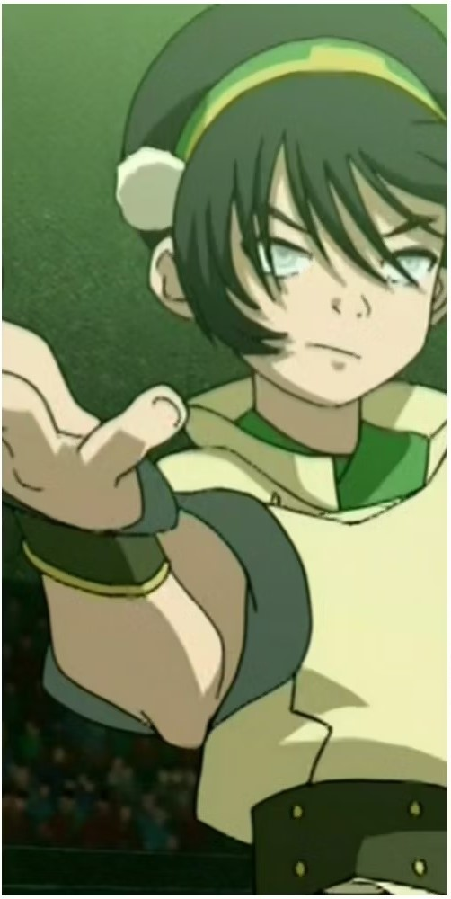
Natural Causes
‘they are not comets; They are not stars,’
Aether

Slide 16
Natural Causes
‘the Celestial Bodies have a Virtue and Power on all Things Below: Both those which are Animate and Inanimate do someways feel the Operation of them’
- Edwards, Demonstration, p. 69

Slide 17
Natural Causes
‘they are not vapours,’
Edwards, Demonstration:
Clouds = ‘moist Vapours drawn up and thickned into Water in the middle Region of the Air:’
Thunder & Lightning = clouds filled with ‘hot and dry,
sulphureous and nitrous Vapours’, surrounded by cold clouds, then exploding
Geothermal activity = ‘violent Eruptions of the
inclosed Vapours’ – sulphurous vapours
Miasma theory = noxious vapours carry disease
through air

Slide 18
Natural Causes
Edwards, Demonstration:
‘God hath appointed the Heart … to yield a continual stock and supply of Subtile Vapours from its warm Blood exhaled through the Jugular Arteries into the midst of the Brain and the Vessels … which, when they are there sufficiently sublimated and refined, are thence diffused with great force into the Nervous Chanels and the whole Body.’
Spirits = type of vapour, produced in the blood, through which the soul interacts with the world

Slide 19
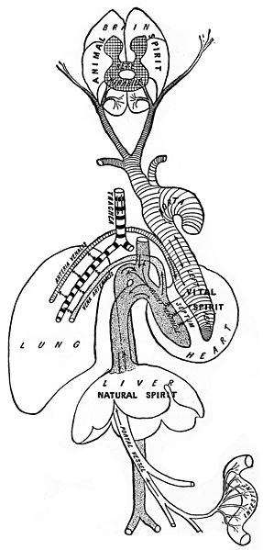












Natural Causes
The soul directs the spirit (spiritus):
‘to the eye, to see with; to the eare to heare; to the nose to smell; to the bowells, stomack, and liuer, to nourish, to the heart, to maintaine life:’
Timothie Bright, A Treatise of Melancholy … with the Physicke Cure (1586), pp. 46-7.
Spiritus, Latin: n.
air, breathing,
light breeze,
ghost,
mind,
energy

Slide 20
Natural Causes
Spirits = type of vapour, produced in the blood, through which the soul interacts with the world
Natural spirits: generated by the liver (centre of nutrition)
& circulated through veins.
Vital spirits: natural spirits refined by the heart (which
regulates blood-flow & body temperature), which then travel via the arteries.
Animal spirits: vital spirits transformed through contact
with the air. Passing through the brain, circulating through the nerves.

Slide 21

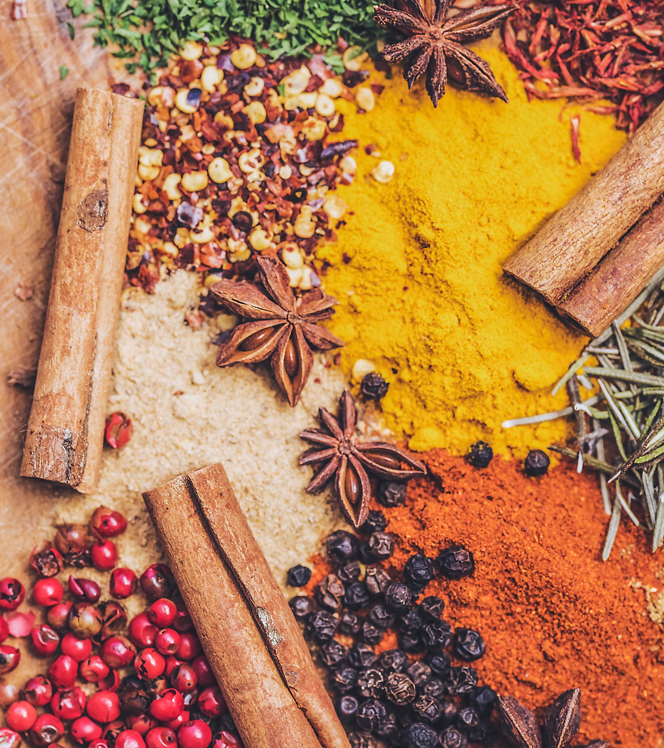


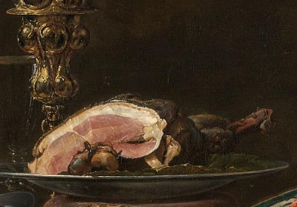
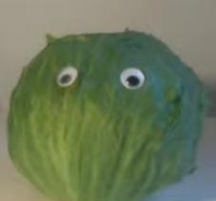

Natural Causes
Hippocrates (c.460-c.370 BCE)
Humoral theory
Galen
(129-216CE)
Sanguine
(Hot, Wet)
Prone to Optimism
Air
Phlegmatic
(Cold, Wet)
Prone to Apathy
Blood
Sanguine
Wet
Hot
Phlegm
Yellow
Bile
Water
Phlegmatic
Complexion
Fire
Choleric
Cold
Dry
Choleric
(Hot, Dry)
Prone to Anger
Melancholic
Black
Bile
Melancholic
(Cold, Dry)
Prone to Sadness
Earth

Slide 22
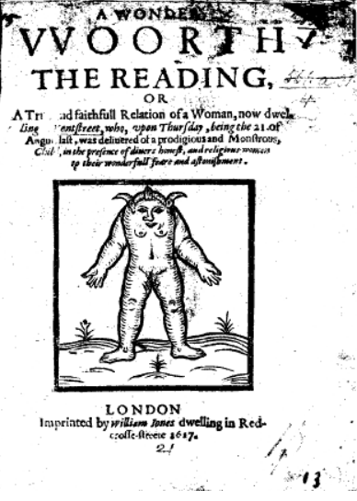
“Monstrous” Births
‘Renaissance writers frequently used monstrosity to imagine what we now call disability.’
Elizabeth Bearden, Monstrous Kinds (2019), p. 5.
St Augustine:
Monstrosity:
still part of Creation/Nature,
meaning beyond human understanding,
sign of God’s unlimited power.
Monstrare, Latin: v. to show, reveal, or teach
Monstrum, Latin: n. a portent or omen

Slide 23
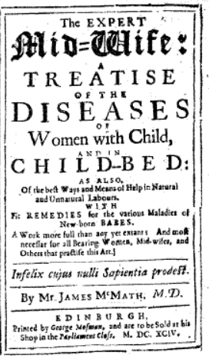
“Monstrous” Births
James MacMath, M.D., The Expert Midwife: A Treatise of the Diseases of Women with Child, and in Child-Bed (London, 1694), pp. 27-8.
‘On Monstrous Conceptions’
1st Cause: (supernatural)
‘remarkable Instances of Divine Vengeance, or Manifestations of the Works of God’
2nd Causes: (natural)
‘the Embryo receives the ailment of its … Monstrosity, and Ruine: partly … from the Ineptitude, Defect, or Excess, … of the Influent, or Animal Spirits:’

Slide 24
“Monstrous” Births
James MacMath, The Expert Midwife, pp. 27-8.
2nd Causes: (natural)
‘the Mothers strong Imaginations (which works wonders in them, not only at the moment of Conception, but after when big, yea not long before the Labour) the Impressive force is made highly conspicuous, marvelously altering the Infant (now already formed) and marking upon it, (as it were Wax) this and … other things she tossed in her mind, … exactly represented in the Brain, and impressed upon the Animal Spirits, and Arterious Blood, and therewith convoyed to the Womb’.

Slide 25
“Monstrous” Births
James MacMath, The Expert Midwife, pp. 27-8.
Women should be ‘wary of entertaining, or musing more deeply, such Imaginations, or fixedly beholding ugly Pictures, Images, Monstruous, or Frightful things, either with pleasure or abomination, (at) the time of Conception, or Gravidation:’

Slide 26
“Monstrous” Births
Julie Crawford:
Births took place in everyday situations.
The forme and shape of a Monstrous Child (1568)
Margaret Mere ‘being unmarried, played the naughty pack and was gotten with child’.

Slide 27
“Monstrous” Births
The forme and shape of a Monstrous Child (1568)
Margaret Mere ‘being unmarried, played the naughty pack and was gotten with child’.
The gaping mouth ‘doth full well declare’ human greed.
Lack of fingers signify sin of idleness.

Slide 28
“Monstrous” Births
Detail from Plautilla Nelli, ‘St Dominic receives the Rosary’ (c.1570s)
Jennifer Spinks
Monk Calf
b. Freiberg, 1522
Martin Luther pamphlet 1523

Slide 29
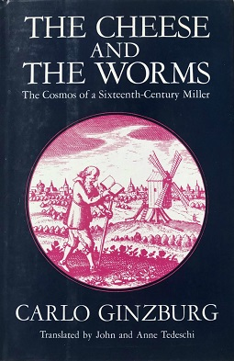
How to approach unfamiliar belief systems as historians?
Ginzburg’s Cheese and the Worms (1976)
Menocchio, Italian miller, executed 1599.
‘All was chaos, that is earth, air, water, and fire were mixed together; and of that bulk a mass formed - just as cheese is made out of milk - and worms appeared in it, and these were the angels.’
Take past ideas and beliefs seriously: we learn more.
Knowledge does not stand apart from the society and culture which produced it.

