Slide 1
Europe in the Making
Conclusions- Peter Marshall

Slide 2
Themes we’ve covered:
A lot!
Social, cultural, economic, religious and political interactions in various zones and regions
The Indian Ocean, the Americas, the Mediterranean
How European identity shaped and formed by these contacts and encounters, but also how challenged and contested
For this final lecture:
Summary of main transformations in period 1450-1800
But also emphasis on what didn’t change, or changed more slowly
‘Continuity and change’ a perennial, historical theme
But particular relevance to ‘early modern’ period: very name implies ambiguous era of transition

Slide 3
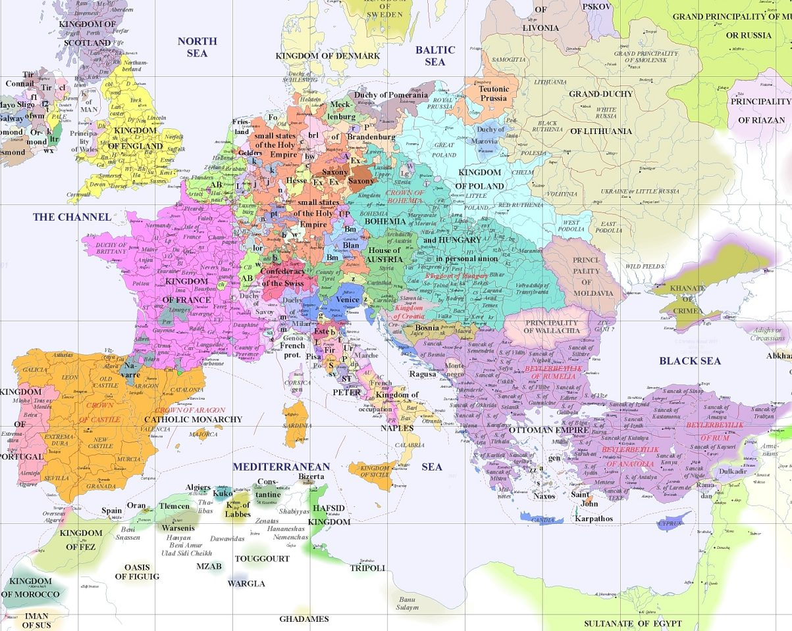
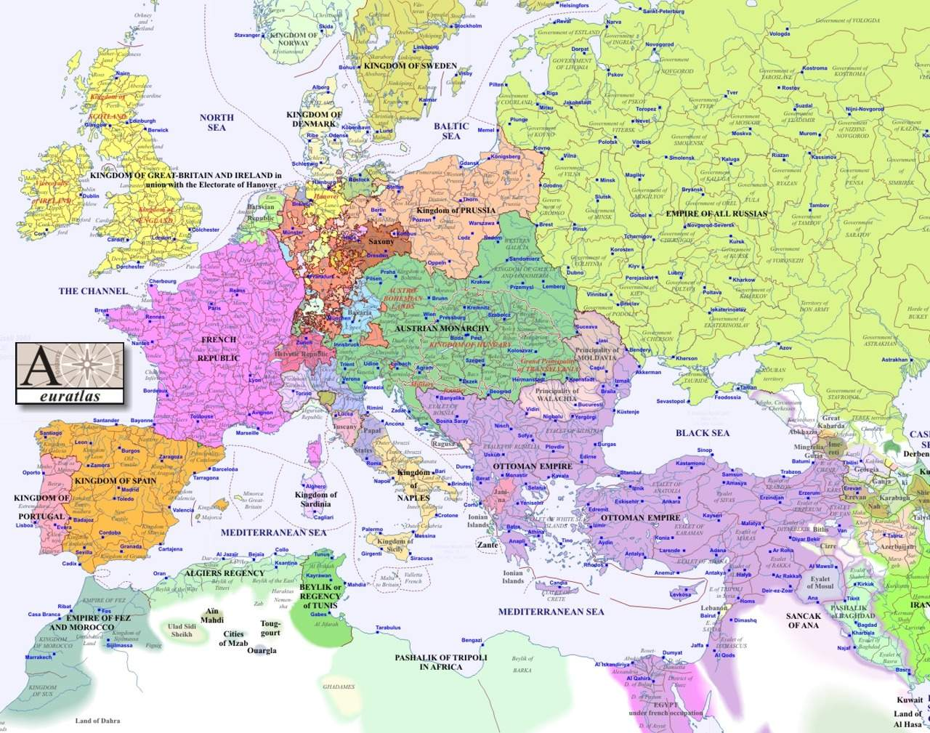
Map of Europe, 1500 and 1800

Slide 4
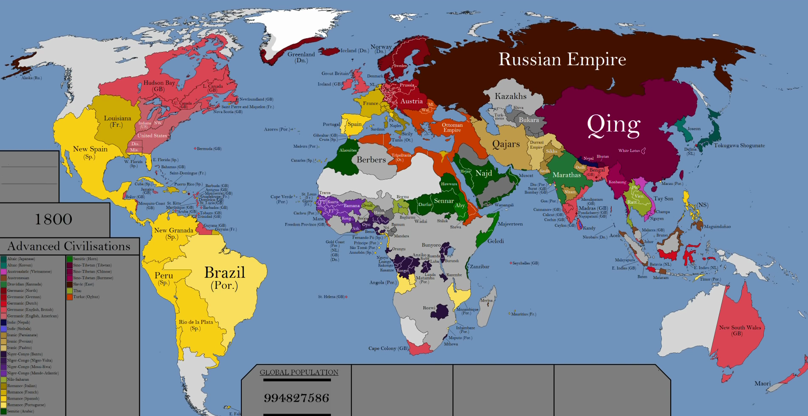
World Map 1800

Slide 5
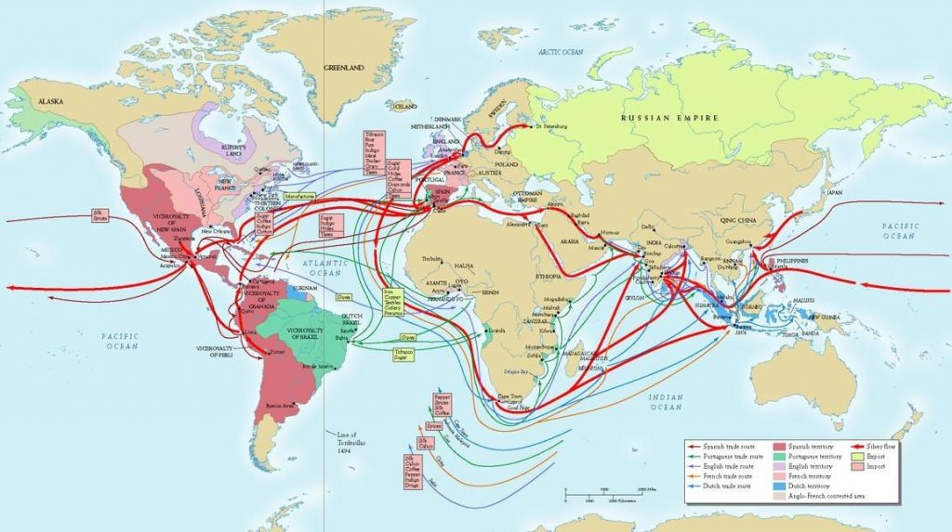
Economic changes
Urbanisation
Development of a global economic system
Expansion in consumption
Creation of new products, imitations and import substitutes
Intercultural trade (Jan de Vries)
Repercussions of this expansion

Slide 6
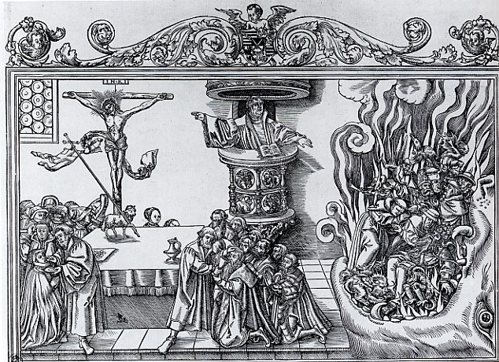
Religion
Protestant and Catholic Reformations
Emergence of Christianity as global religion
Elite distrust of popular religion (‘superstition’)
Political fragmentation along confessional lines
Displacement of peoples
Religious pluralism and (very) gradual emergence of toleration

Slide 7
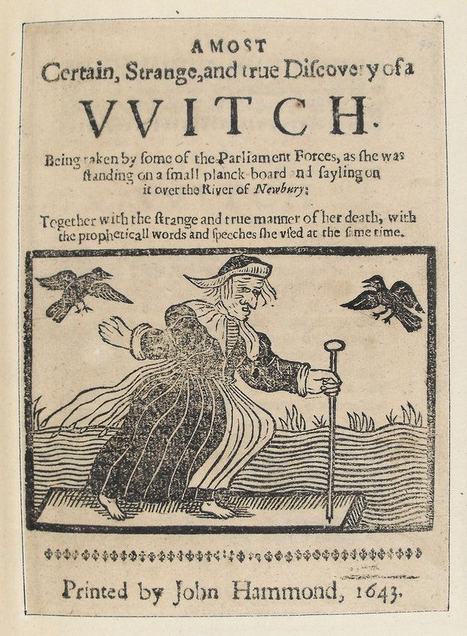
Culture
Rise of the printing press
Rise in literacy rates; emergence of coffee houses, salons and a ‘public sphere’
Elite vs popular culture
Rise, and decline, of witch-hunts

Slide 8
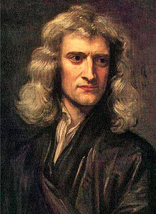
Scientific developments
New scientific discoveries which led to widening horizons; acceptance of ‘heliocentric’ universe
Role of individuals (Coperncus, Kepler, Galileo, Newton)
But discoveries were supported by princely courts and other institutions, such as laboratories, museums, botanical gardens, universities, salons
Enlightenment’s focus on reason, progress and experiment

Slide 9
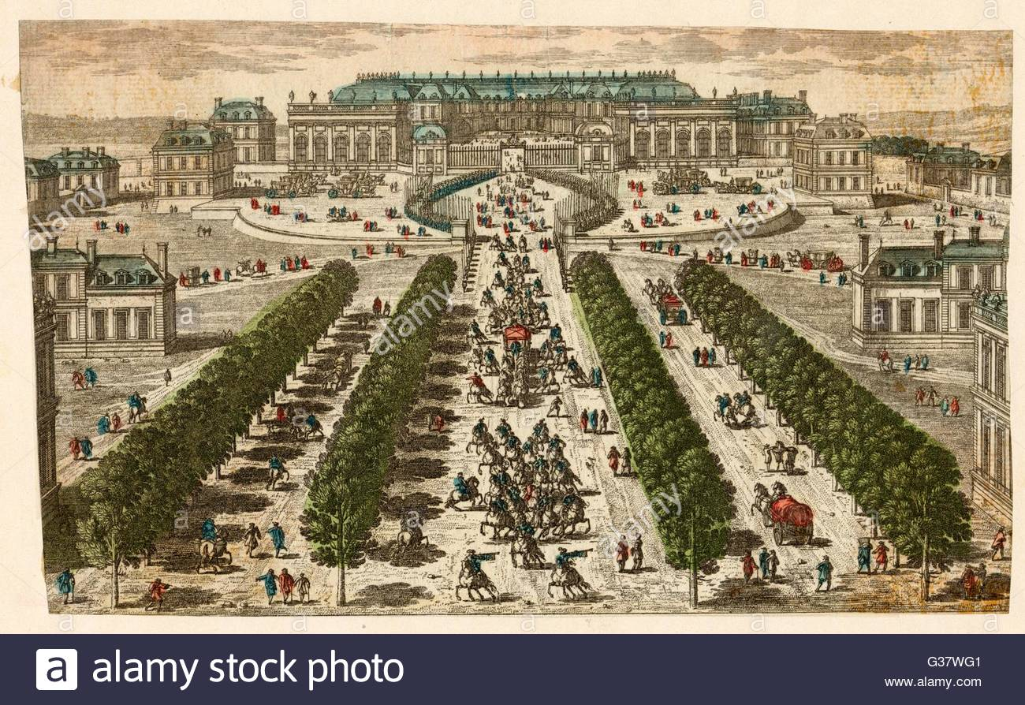
Political Developments
Rise of Britain, Russia, Austria and Prussia
Efficiency in administrative systems; professionalisation; reduction of independent ‘seigneurial’ power
Move towards professionally trained and well-equipped standing armies
Lavish representation of power in art and architecture
Abstract idea of government; ‘absolutism’
Questioning the state’s role in the economy
Power was challenged various ways

Slide 10
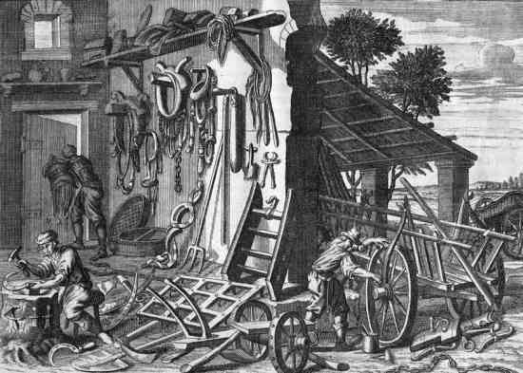
What did not change (or changed very slowly)?
Rural life: peasantry still overwhelming majority
Social structure and hierarchy: the nobility and the gentry still in place
Gender relations: the resilience of patriarchy
Economic inequalities
The place of religion and the Church: limited ‘secularization’

Slide 11
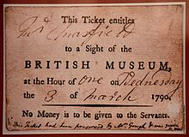
Conclusions
imagine someone falling asleep in 1500 and waking up in 1800: what would be the biggest and most striking changes they would notice?

