Slide 1

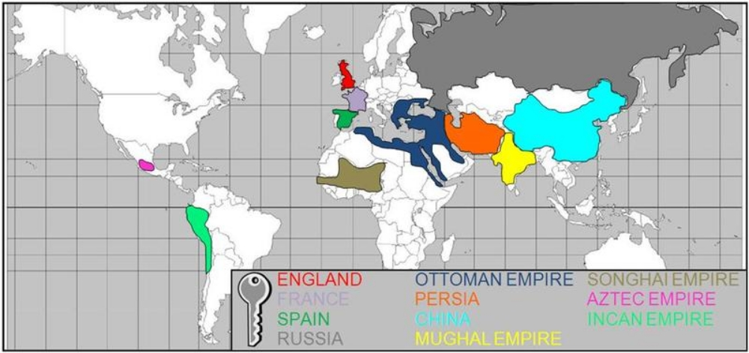
EUROPE &
GLOBAL ECONOMIES

Slide 2
Continuity & Change in the Global Economy
The European economy, c.1500
    Rural and Urban
    Trade
    The World beyond Europe
Changes in the economy 1500–1750
    Population
    Manufacture
    Trade
Europe & the wider world: globalisation & divergence

Slide 3
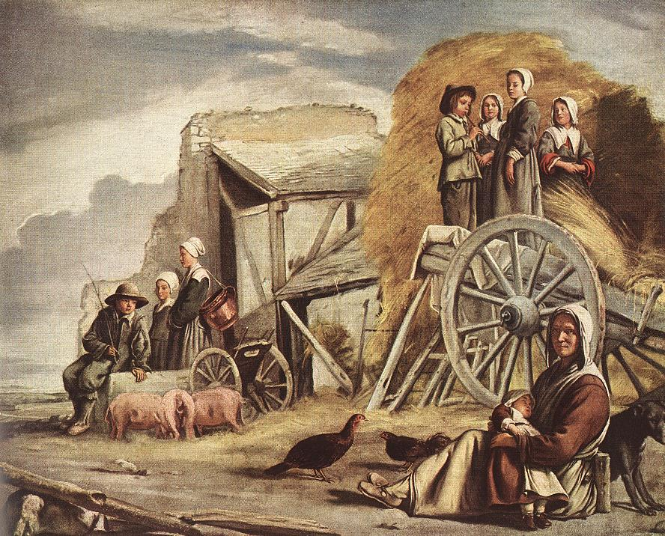
The European Economy c. 1500

Slide 4
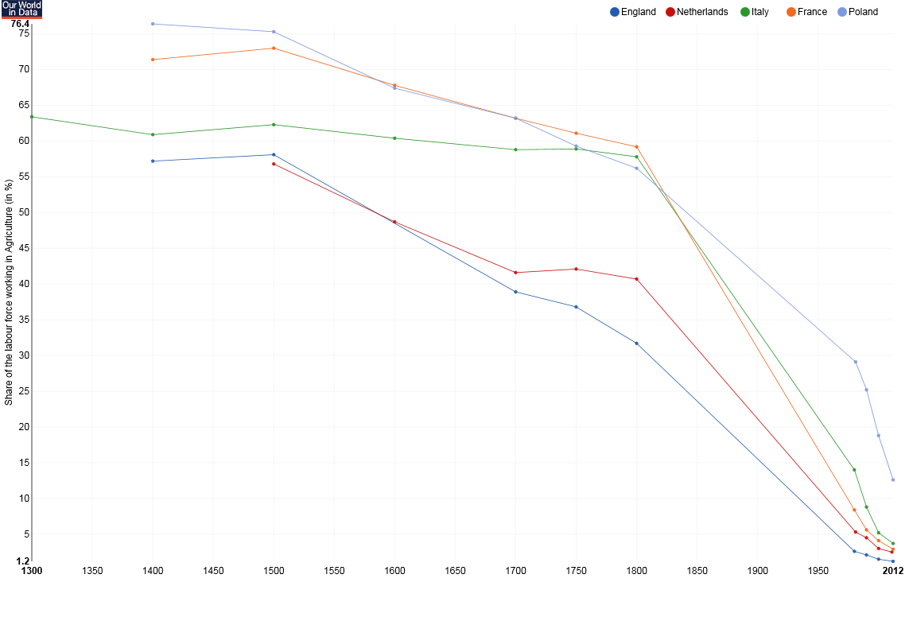
Percentage of workforce employed in agriculture, 1300-2012
https://ourworldindata.org/employment-in-agriculture

Slide 5
Percentage of the entire workforce employed in Agriculture
1500 |  | 2012
Italy | 62.3 % | Italy | 3.7 %
Poland | 75.3 % | Poland | 12.6 %
France | 73 % | France | 2.9 %
England | 58.1 % | England | 1.2 %
Netherlands | 56.8 % | Netherlands | 2.5 %
 |  | United States | 1.5 %
 |  | India | 51 %
Billions of Hectares of Land Under Cultivation
1500 |  | 2005
 | 0.8 billion |  | 4.83 billion
https://ourworldindata.org/yields-and-land-use-in-agriculture/

Slide 6
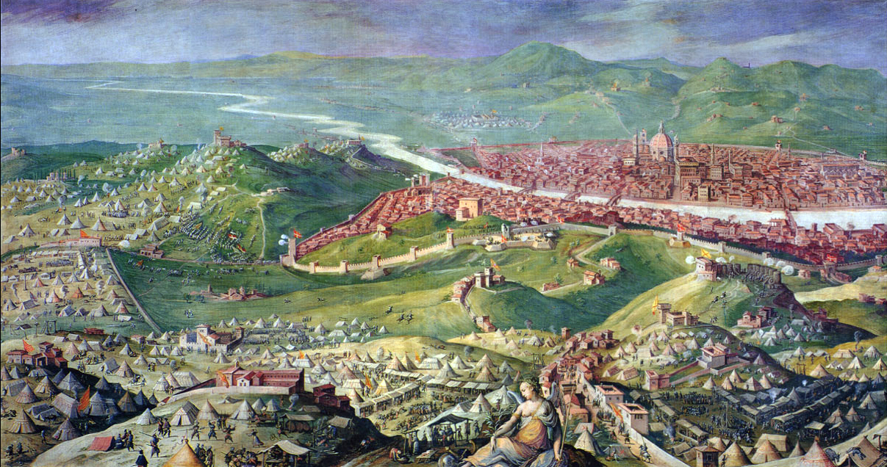
Town and Country
1530 Siege of Florence by Giorgio Vasari, 1558

Slide 7
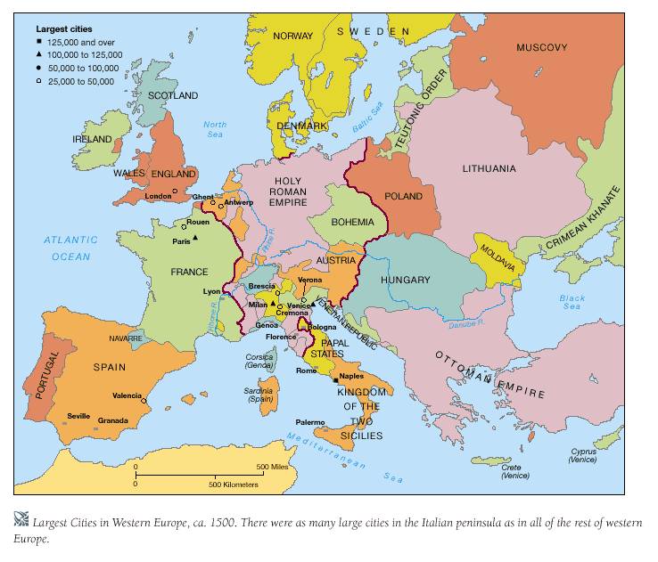

Slide 8
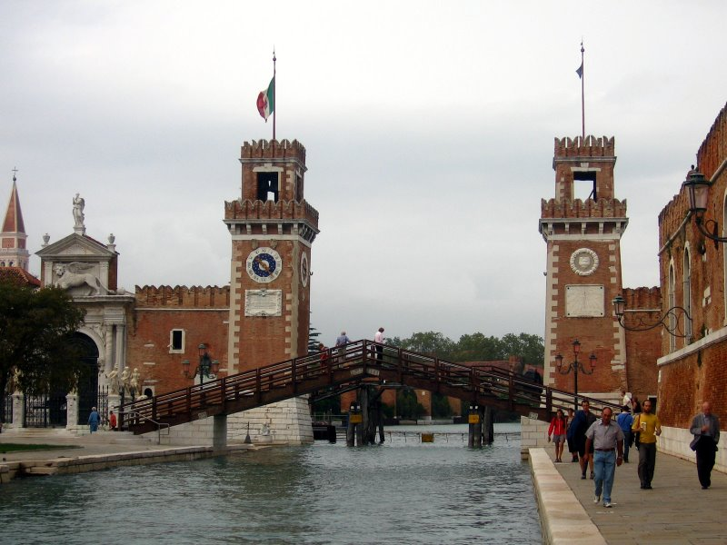
Trade
The Arsenale in Venice

Slide 9
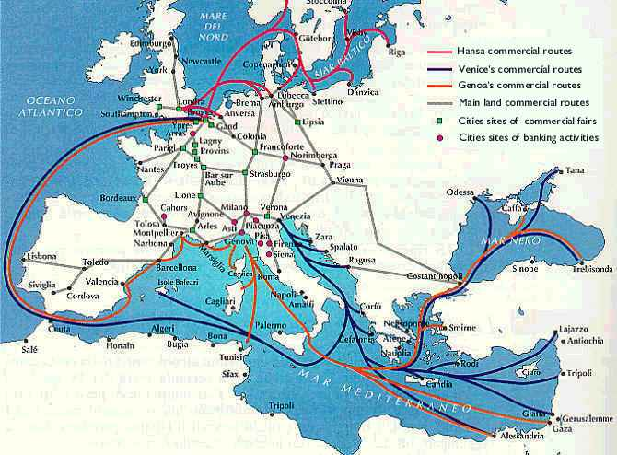

Slide 10
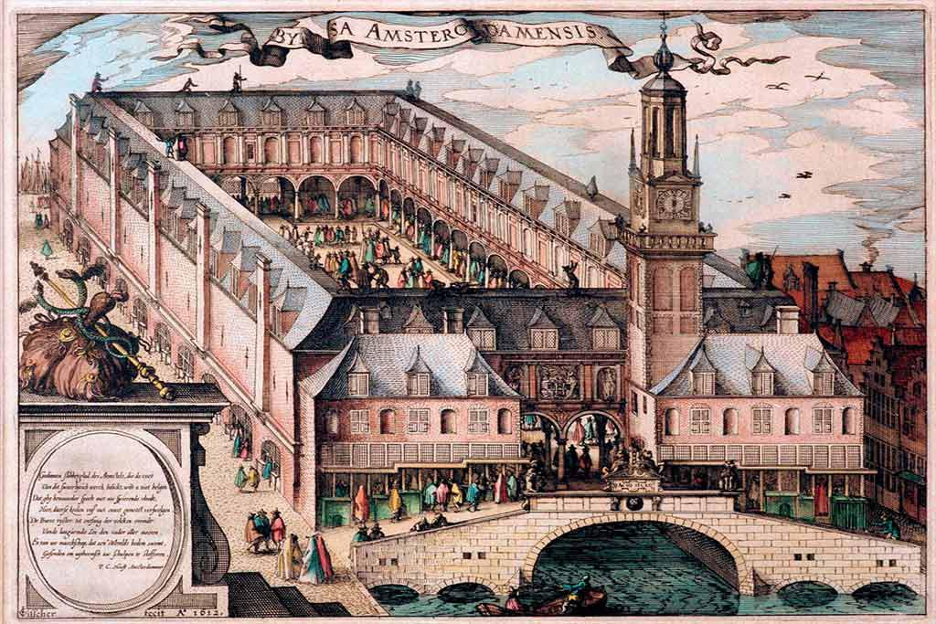
Amsterdam Exchange, built 1611

Slide 11
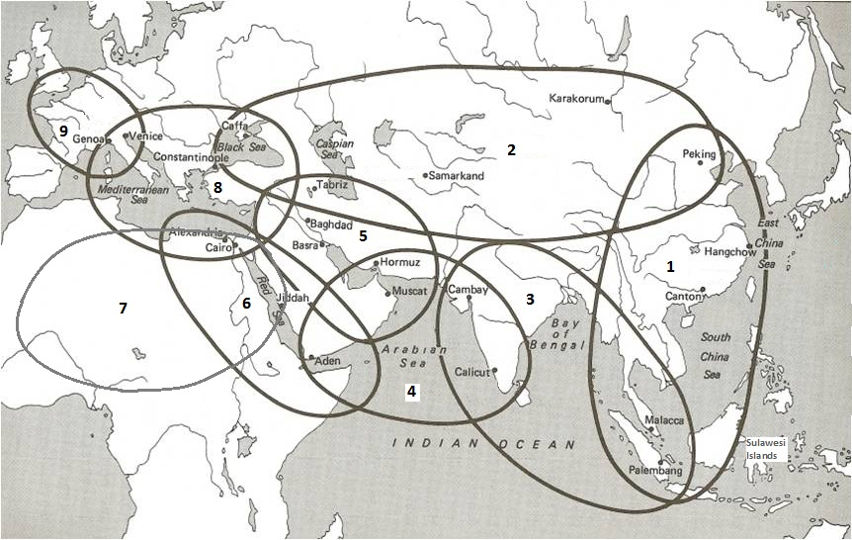
The World Beyond Europe: Polycentric Trade

Slide 12
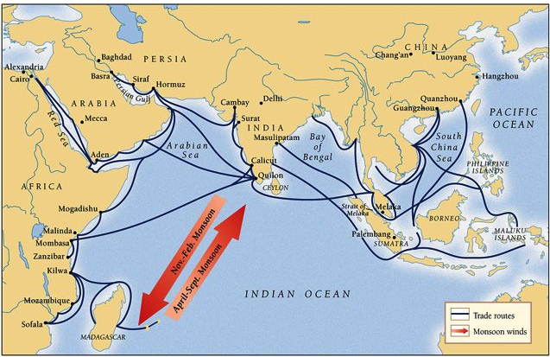

Slide 13
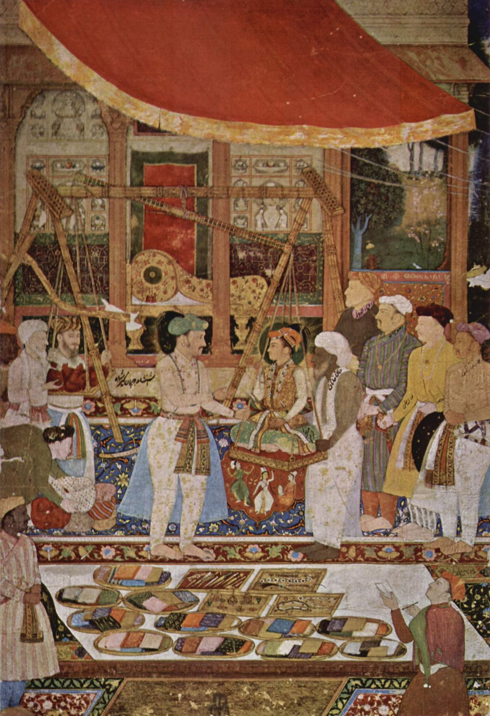
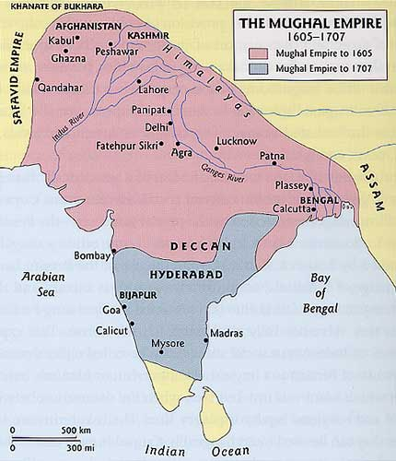
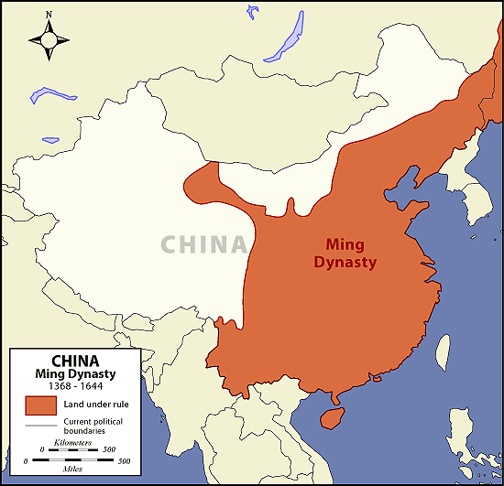
India and China

Slide 14
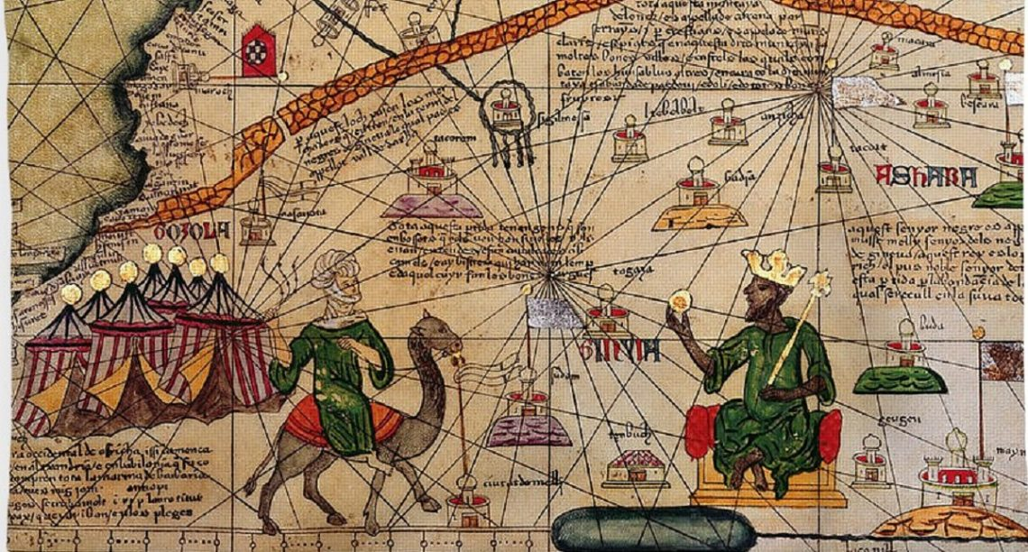
Mansa Musa, ruler of Mali c. 1312-1337:
Catalan Atlas of Abraham Cresques (1375)

Slide 15
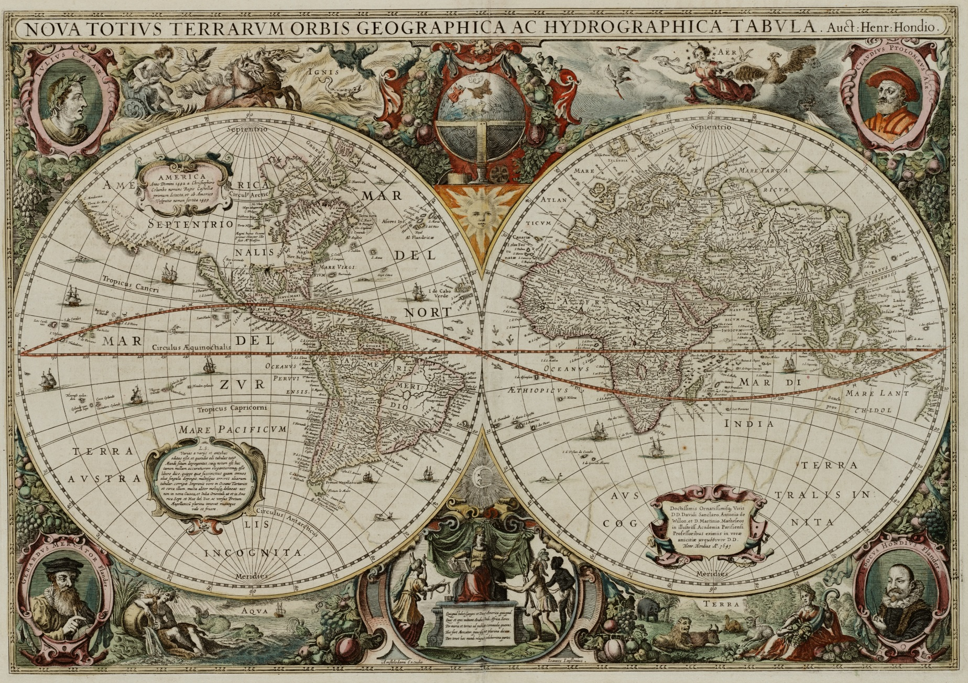
Changes in the Global Economy, 1500-1750

Slide 16
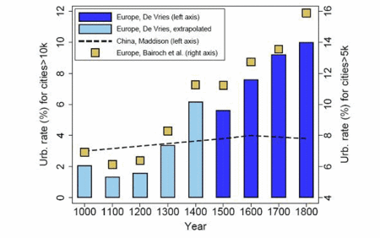
Population and Urbanisation
Dramatic population rise in some areas; increased European population as a whole: 75 million in 1500 and 110–120 million in 1700
  (De Vries, 1984, p. 36)

Slide 17
The Population of some major Italian cities in 1600 and 1700
 | 1600 | 1700
Bologna | 62,000 | 15,000
Brescia | 24,000 | 11,000
Milan | 130,000 | 65,000
Verona | 54,000 | 31,000
Venice | 140,000 | 46,000
Italy | 13.2 m | 10.8 m

Slide 18
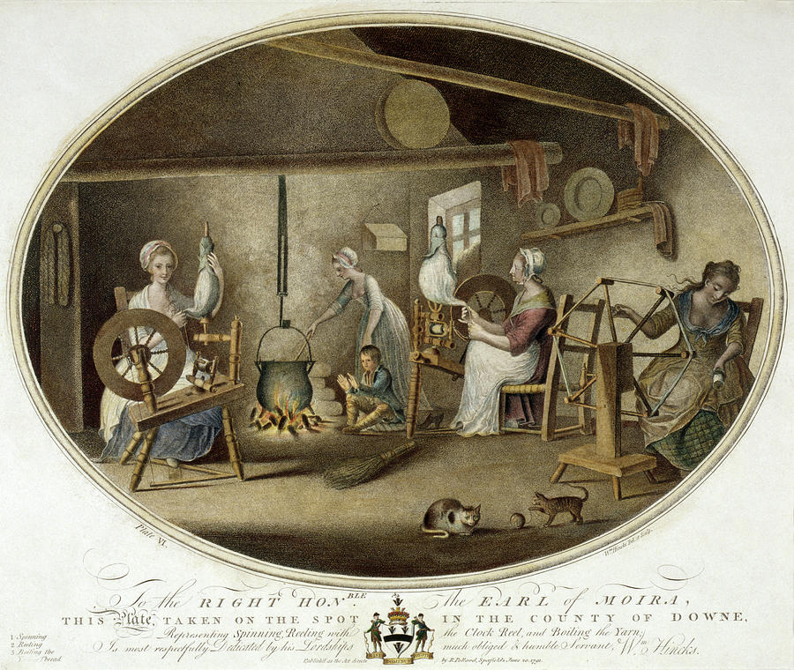
Manufacture
Proto-industrialisation
Domestic production
Decentralised
Labour-intensive
  ‘Systematic, wide-scale and decentralized manufacture prior to the Industrial Revolution and the establishment of factories’

Slide 19
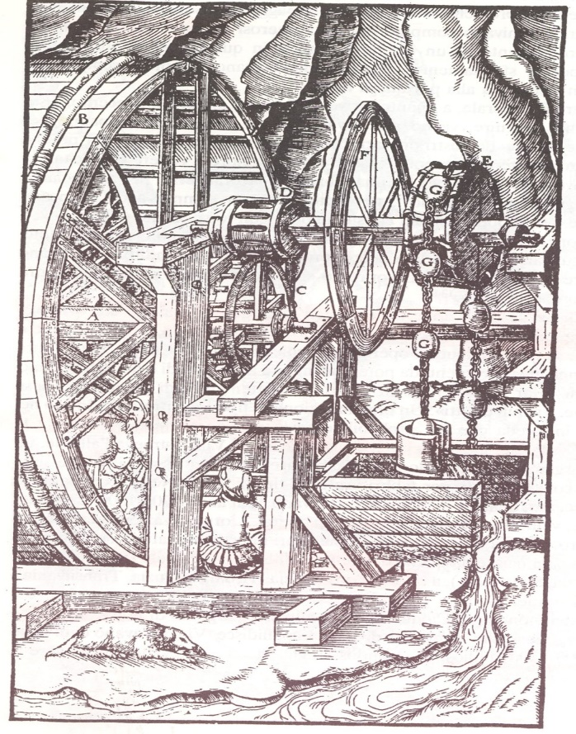
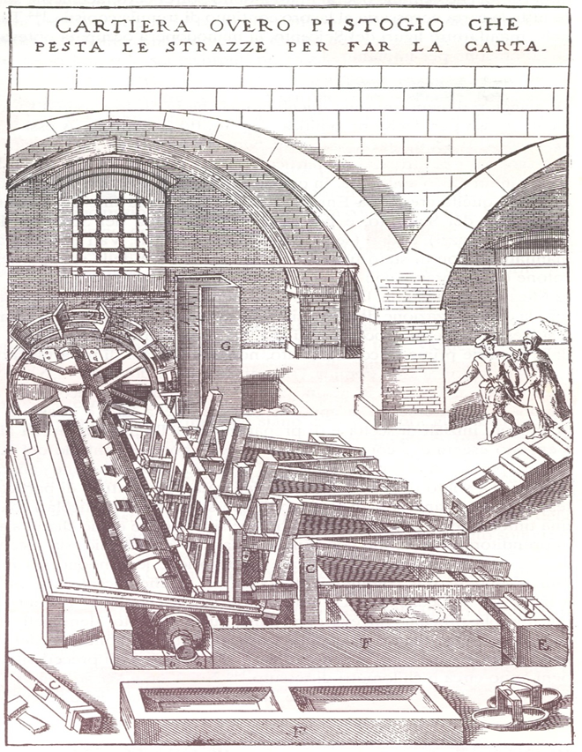
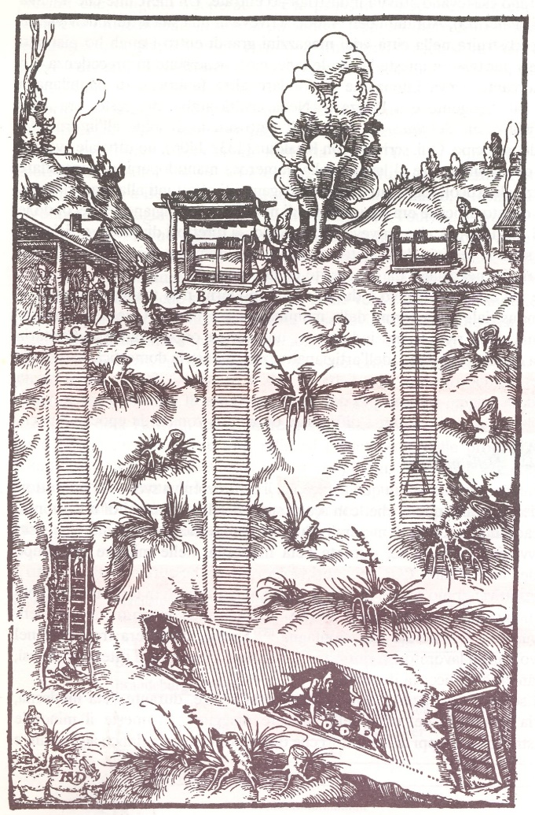
Mining and Paper Industries

Slide 20
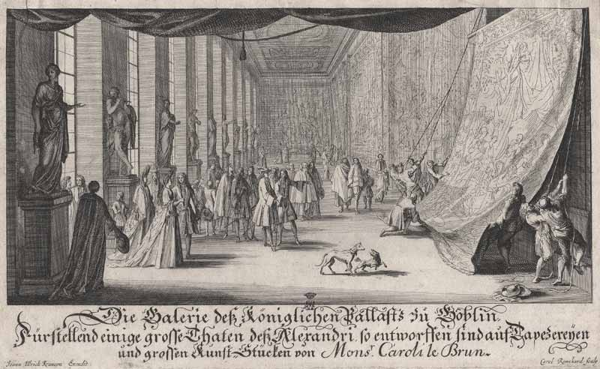
Gallery of the Gobelins Tapestry Factory, c. 1735

Slide 21
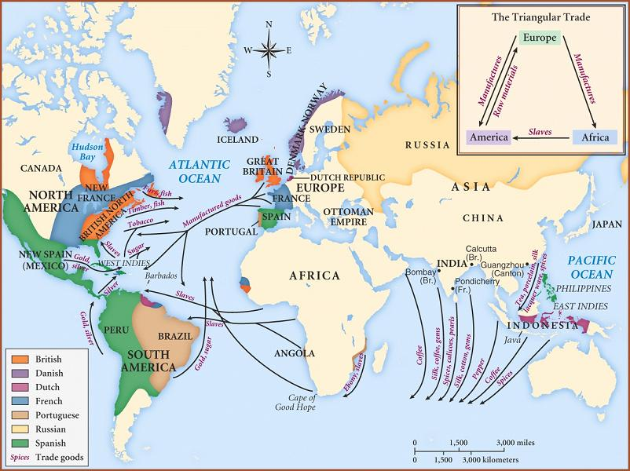
Trade: Atlantic

Slide 22
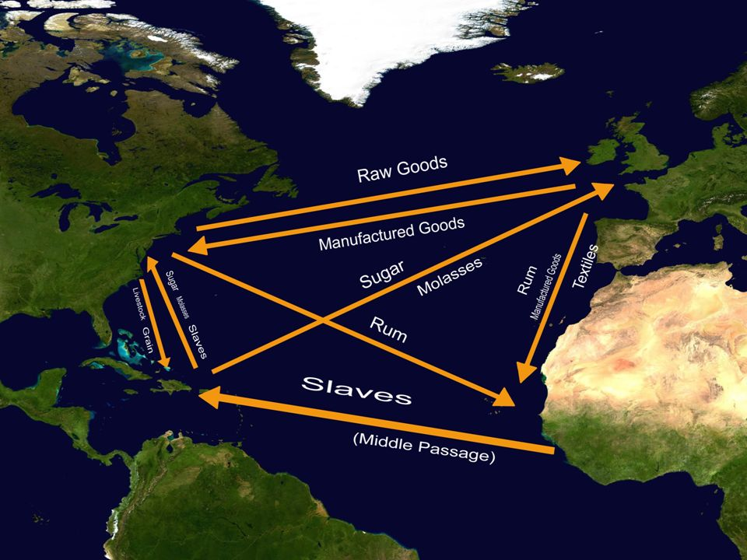

Slide 23
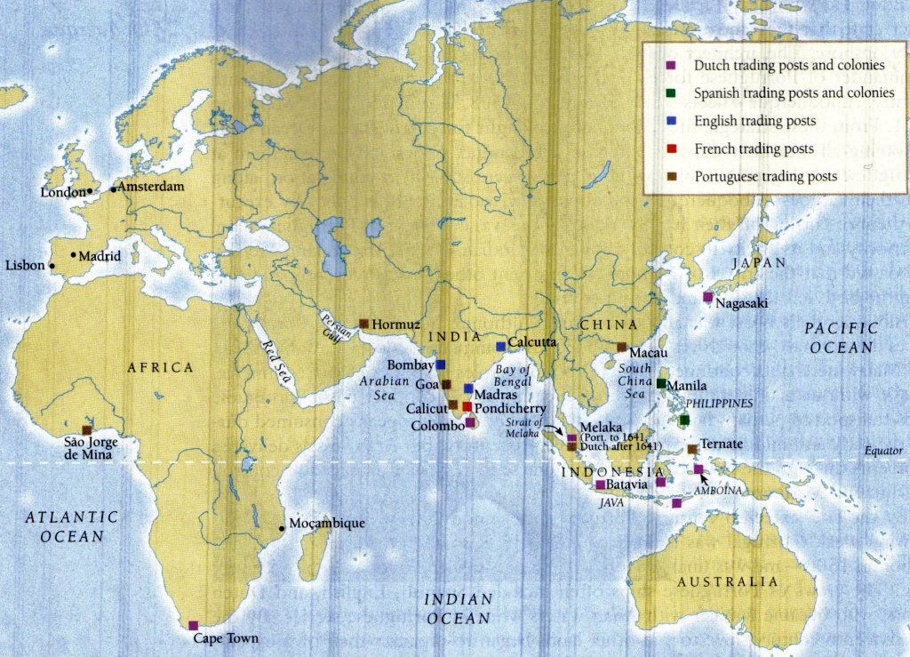
Trade: Asia

Slide 24
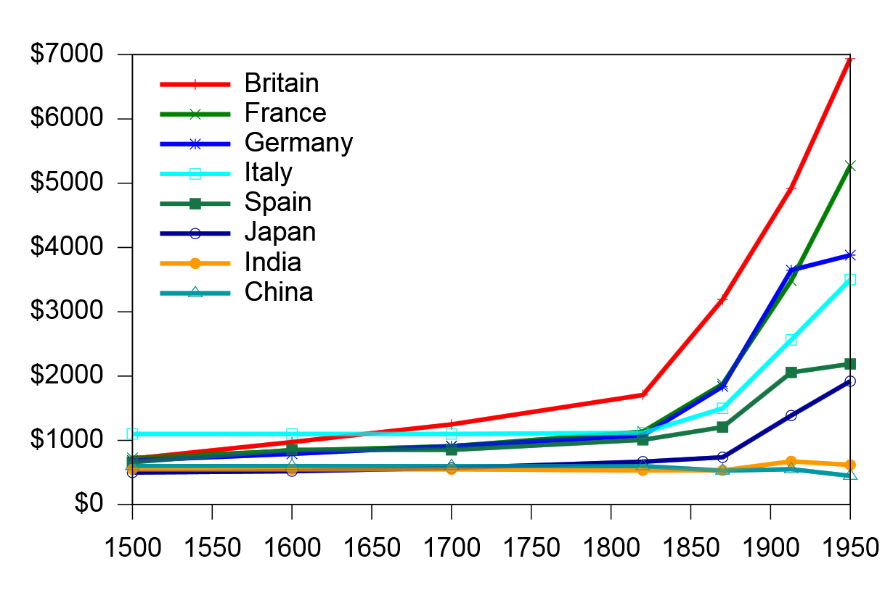
Europe and the wider world: ‘divergence’
References:
Kenneth Pomeranz, The Great Divergence (2000).
Prasannan Parthasarathi, Why Europe Grew Rich and Asia did Not (2010).

Slide 25
Conclusions
European population doubled 1500-1800
Expansion of trade within and outside Europe
Development of new industries
Became key player in Global Economies
BUT: Substantial regional differences in economic development

