Slide 1
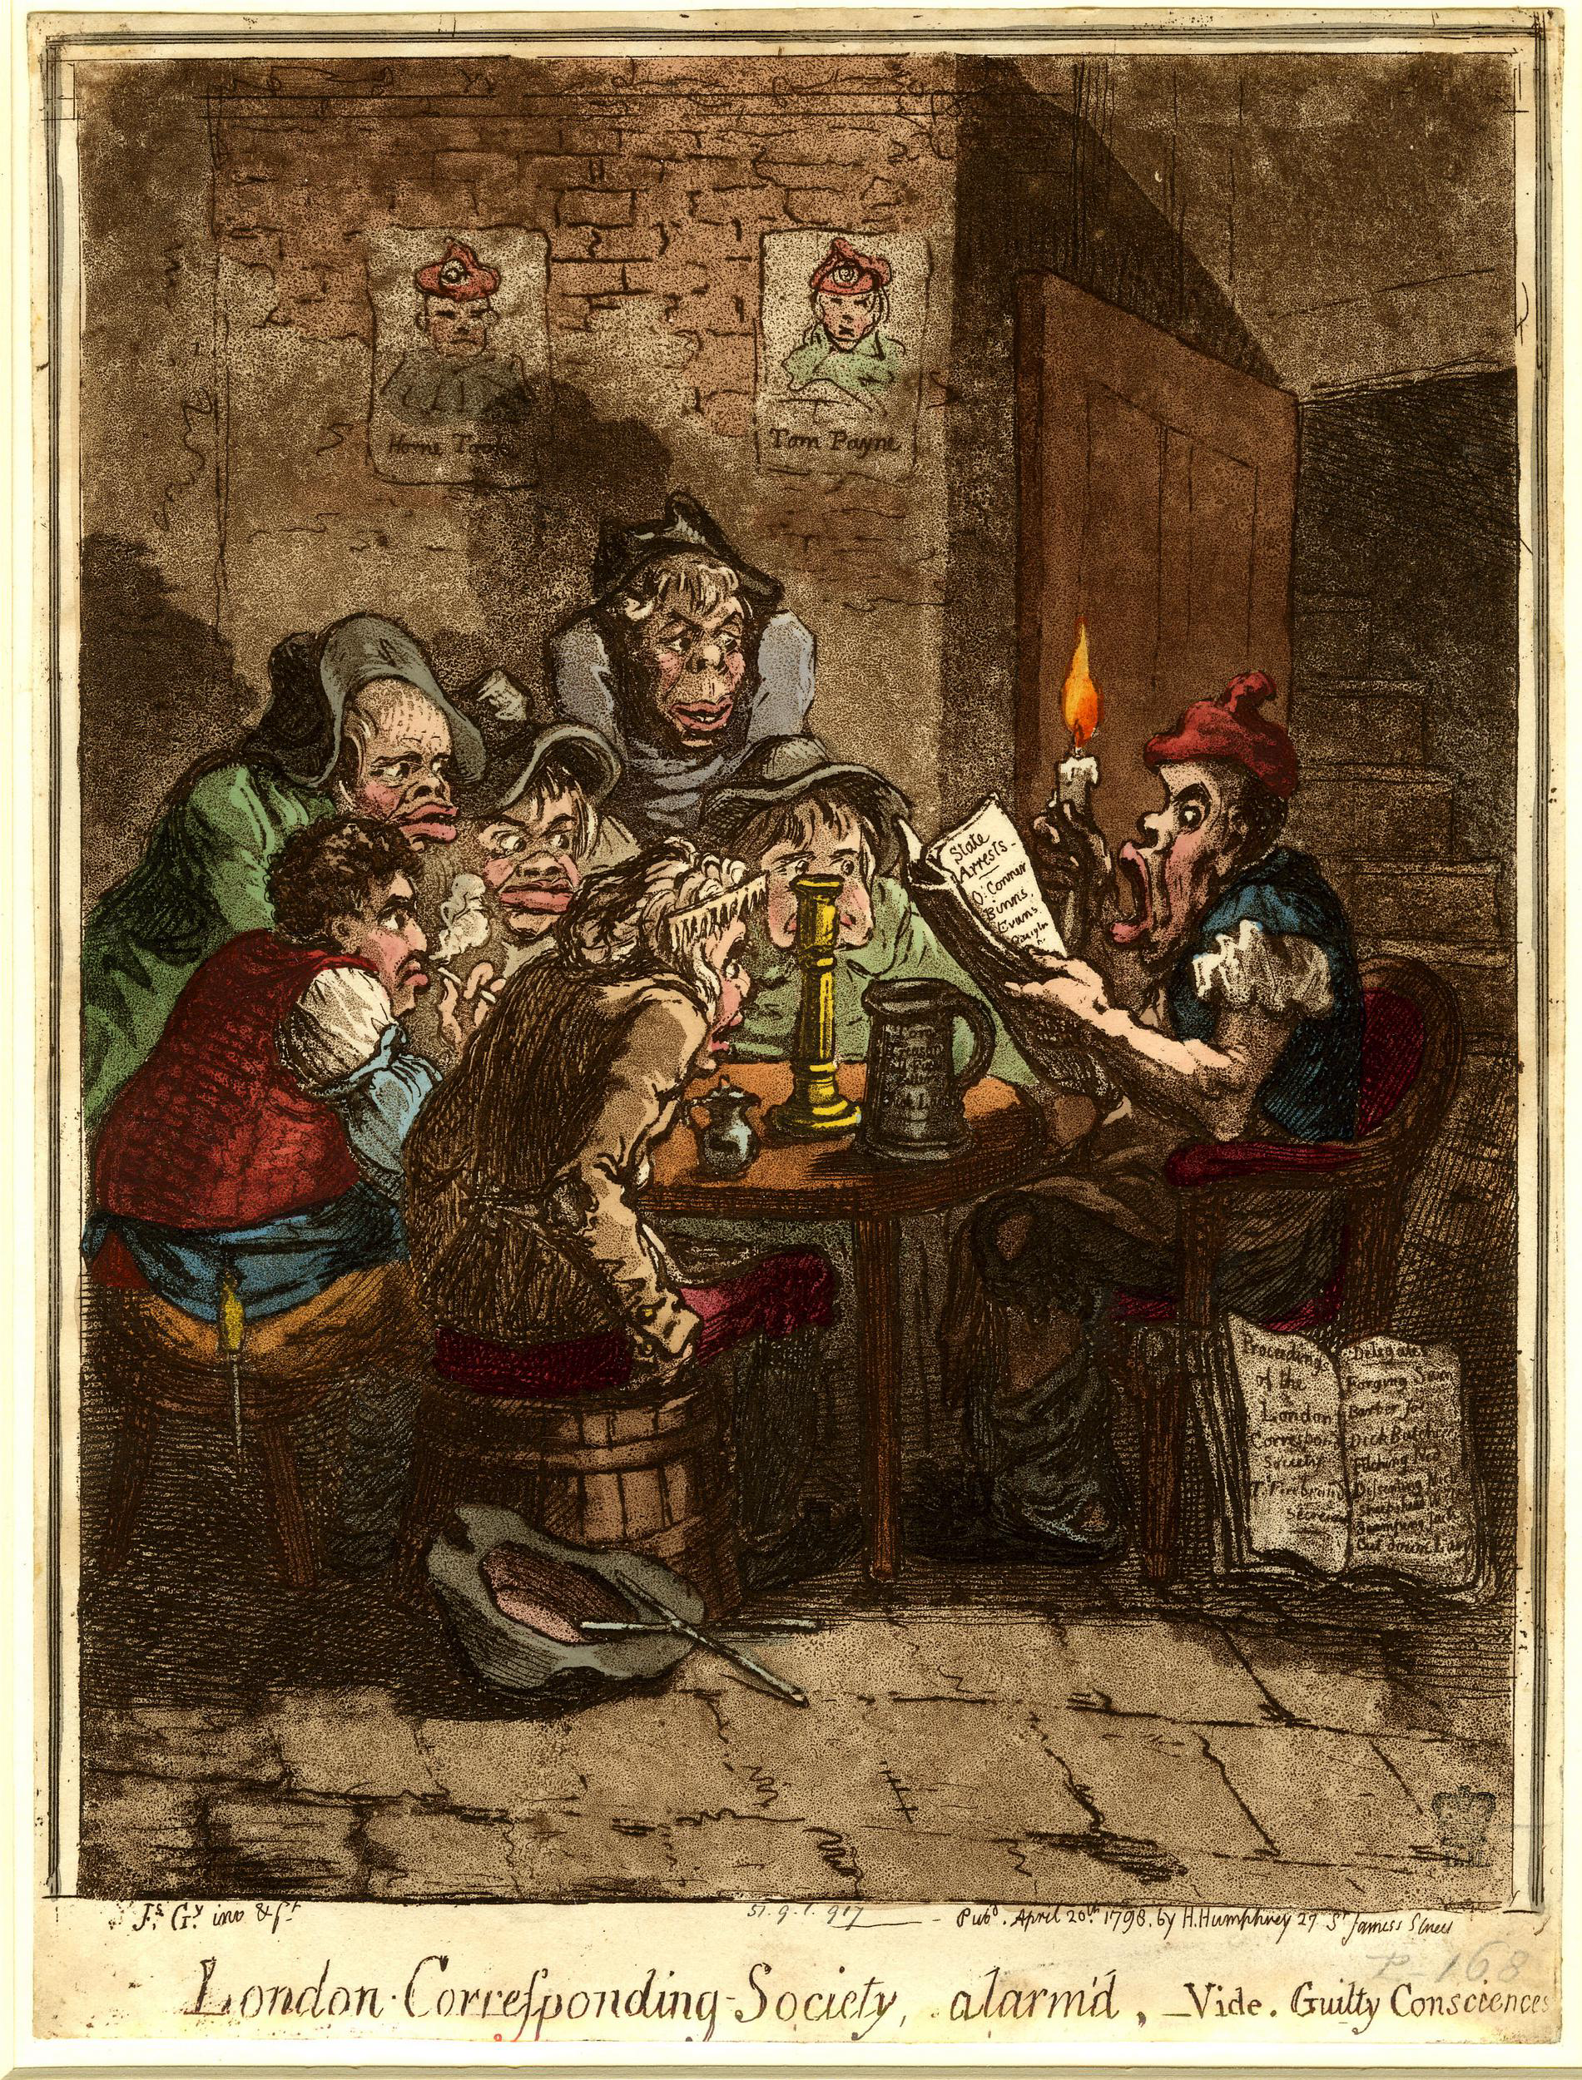
Popular Politics and Protest
HI113 Europe in the Making
Dr Natalie Hanley-Smith
Natalie.Hanley-Smith@warwick.ac.uk

Slide 2
Outline
Historiography
Ideologies
Practices
Protest

Slide 3

Historiography
Political History
The development of ‘social history’.
The Annales School
Communist Party Historians’ Group
George Rudé, The Crowd in History: A Study of Popular Disturbances in France and England (1964)
E. P. Thompson, The Making of the English Working Class (1963)
N. Zemon-Davis, “The Rites of Violence: Religious Riot in Sixeteenth-Century France’, P&P 59 (1973)
Interdisciplinarity – influences from the social sciences

Slide 4
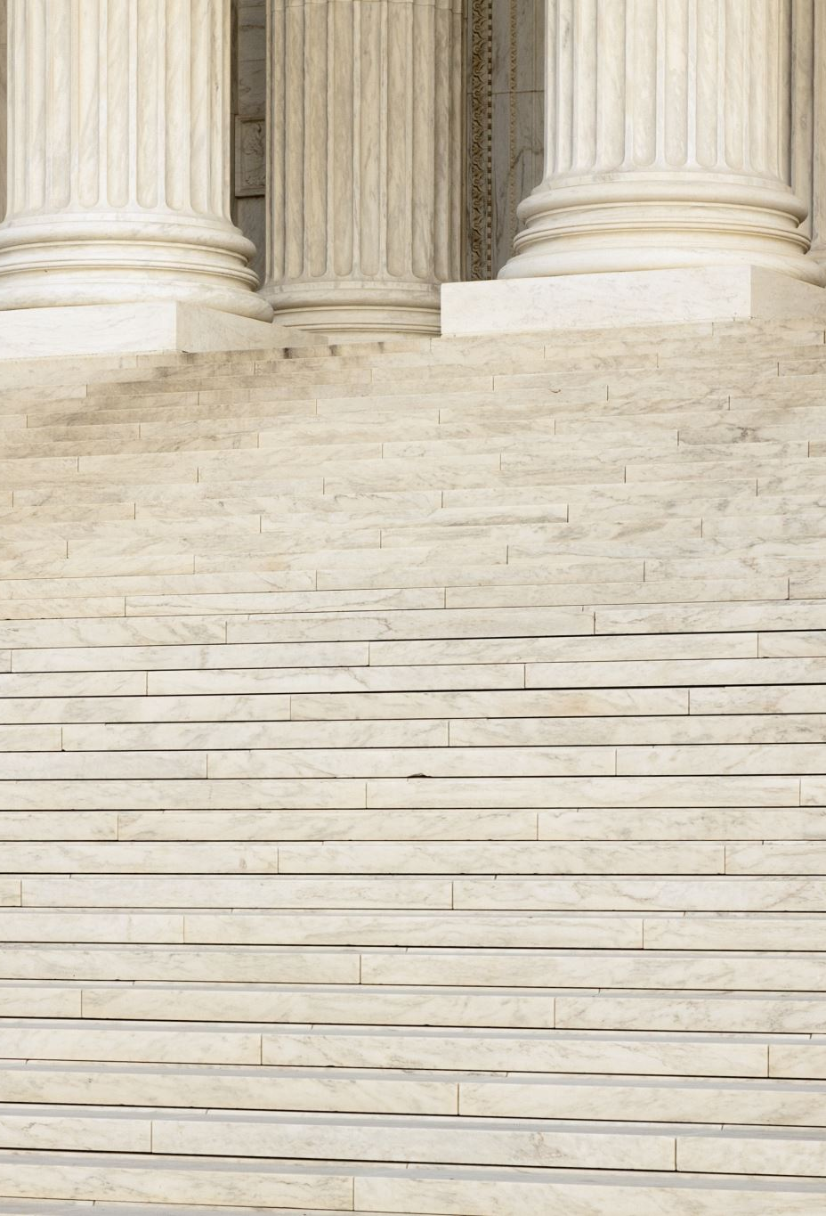
Broadening the Scope of Political History
POLITICS: ‘an ongoing bargaining process between those who claim governmental authority in a given territory (rulers) and those over whom that authority is said to extend (subjects)’.
Wayne Te Brake, Shaping History: Ordinary People in European Politics, 1500-1700 (1998).
Contribution and involvement of groups not traditionally studied by political historians: e.g., women, working men, immigrants, religious nonconformists…

Slide 5
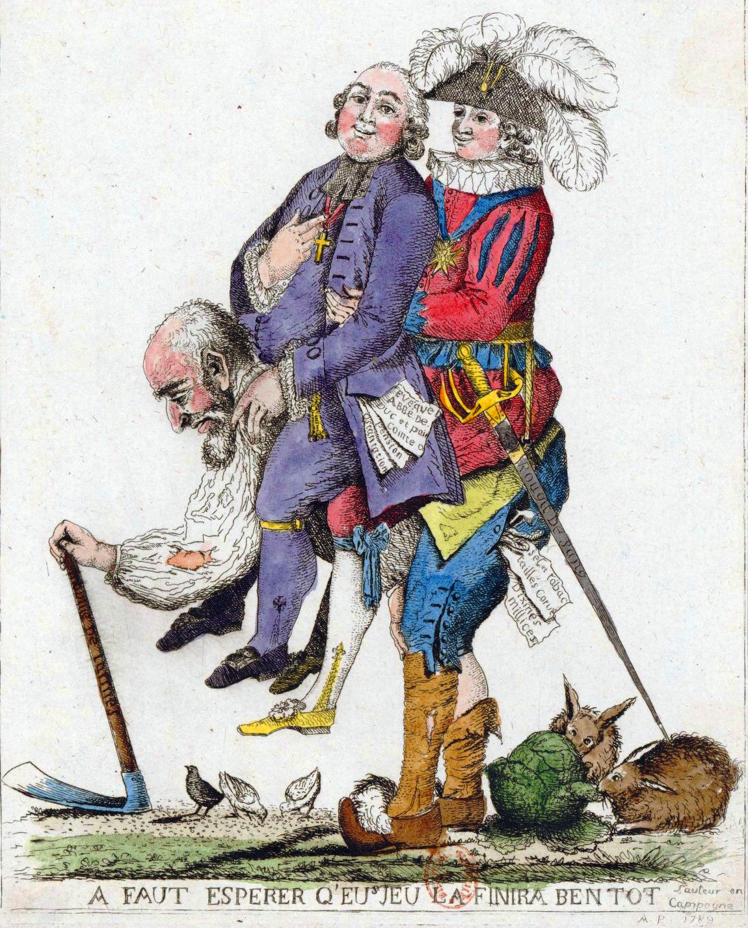
Ideologies
The Three Estates:
- Clergy (who pray)
- Nobility (who fight)
- The People (who labour)
Paternalism
- responsibilities and obligation
- rights that were protected?
E. P. Thompson’s “Moral Economy”.

Slide 6
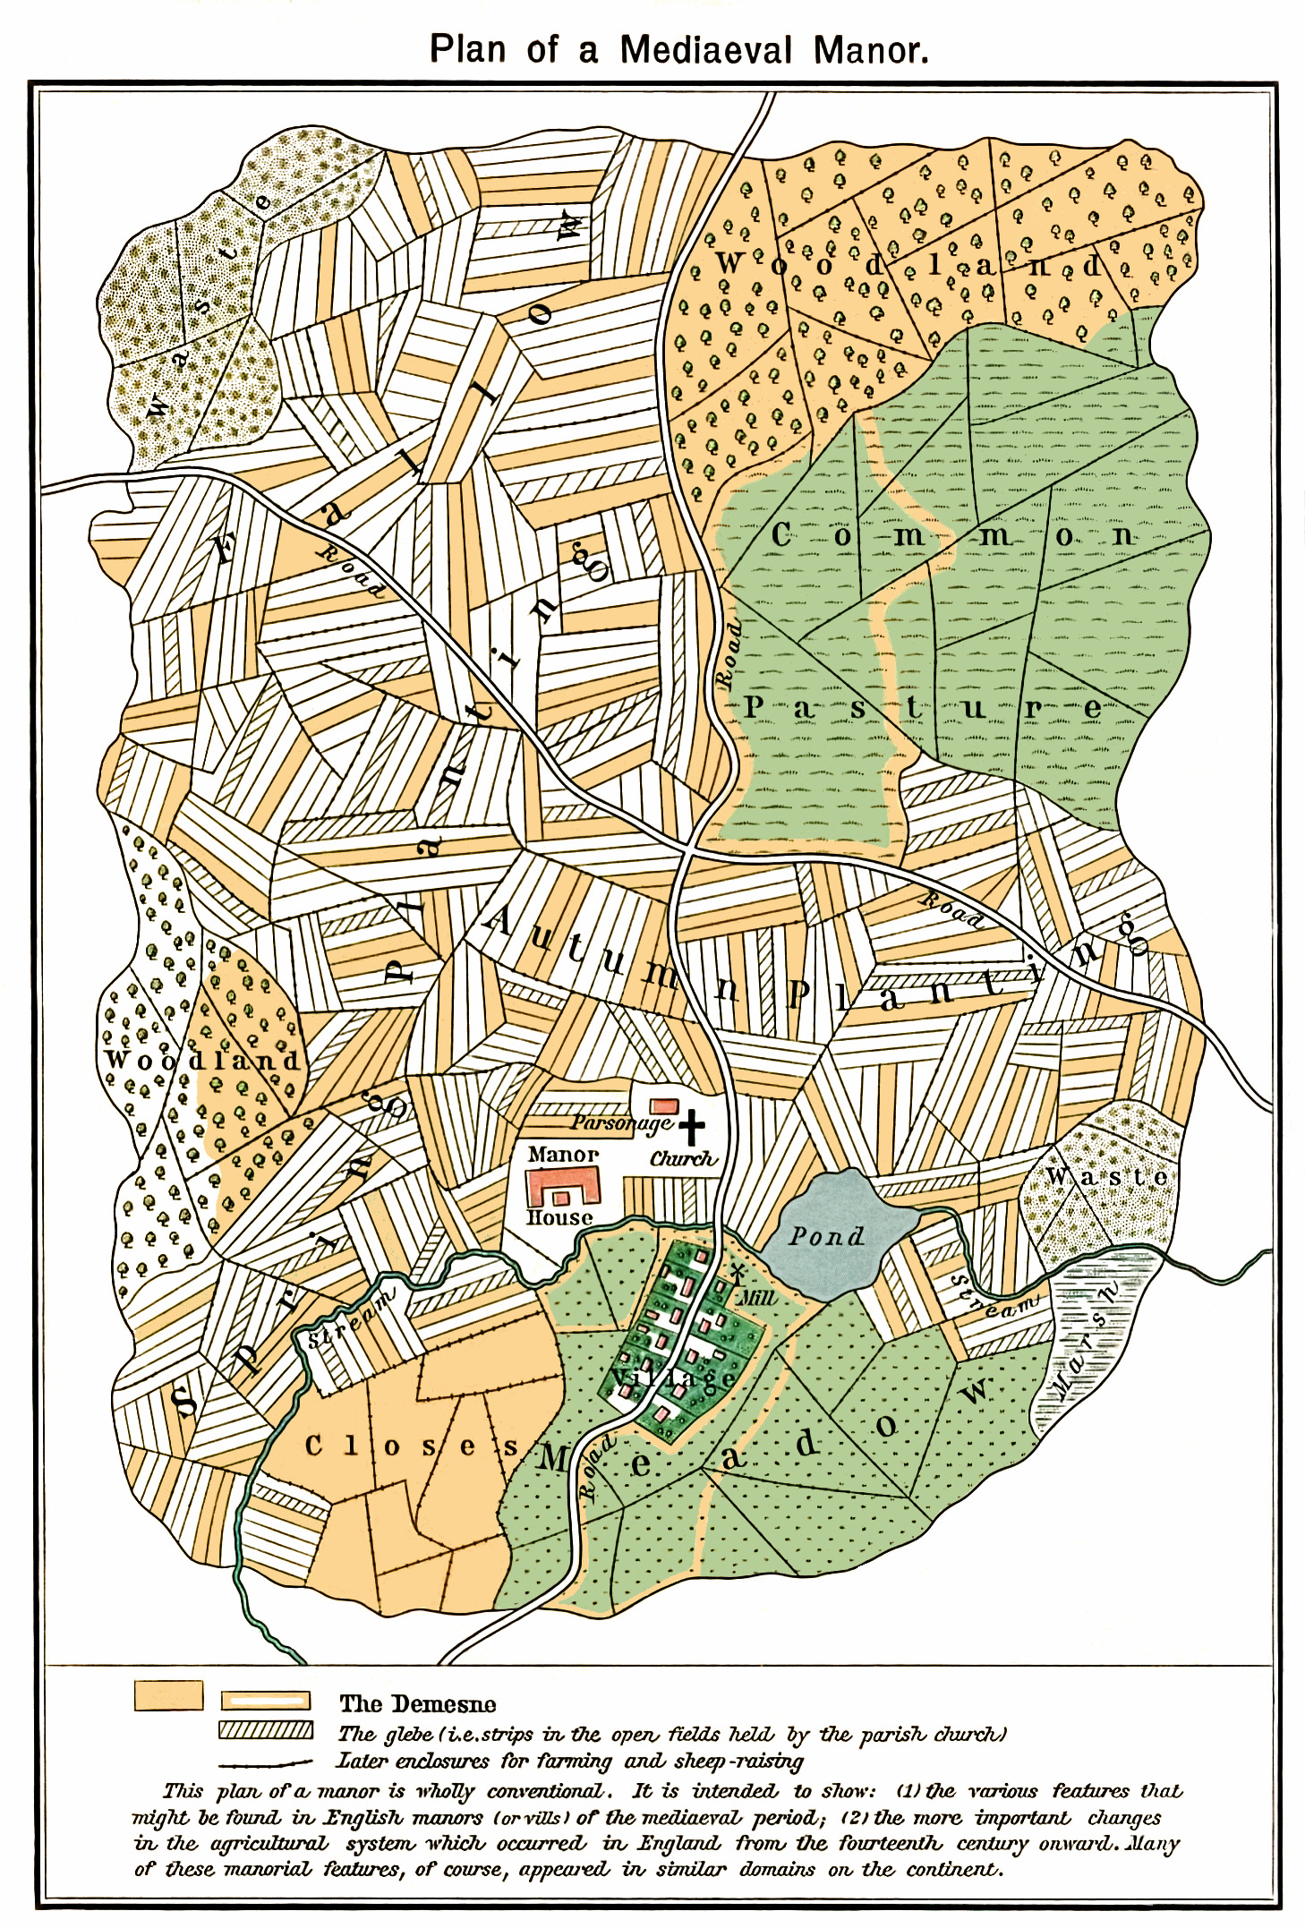
Practices: Local Government
RURAL
The Manor
- Lords and serfs
- Some involvement in local government
Independent Village Commune
- Ruler (secular or ecclesiastical)
- Assembly of all householders
- Elected officials (mayor, etc.)

Slide 7
Practices: Local Government
Urban
Town Charters
- citizens more freedoms than rural counterparts
- Burghers voluntary association
Complex government
- General assembly of all male householders
- Smaller council of elected individuals
- Aldermen
- Leader (Mayor/Burger Meister)
- Guilds - influence

Slide 8
‘Communalism’, Peter Blickle
Collective decision making
Elected individuals who were held accountable
Decisions made in the interest of the common good

Slide 9
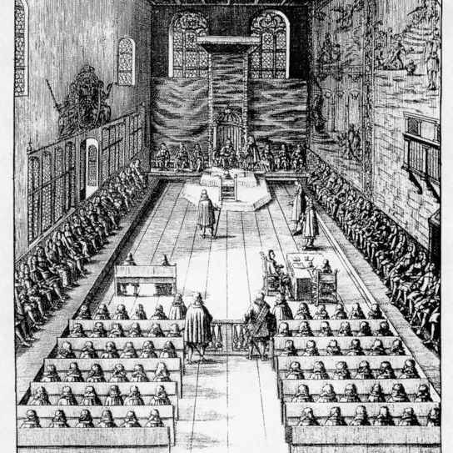
Practices: Regional/national Government
Legal Courts
Secular and ecclesiastical
Representative Assemblies
Diets
- The central imperial Diet, Regensburg Town Hall, seating plan, 1675.

Slide 10
Forms of Protest
Audiences
Petitions
Riots
Rebellions
Revolutions
Aims, processes, ideologies, and customs.

Slide 11
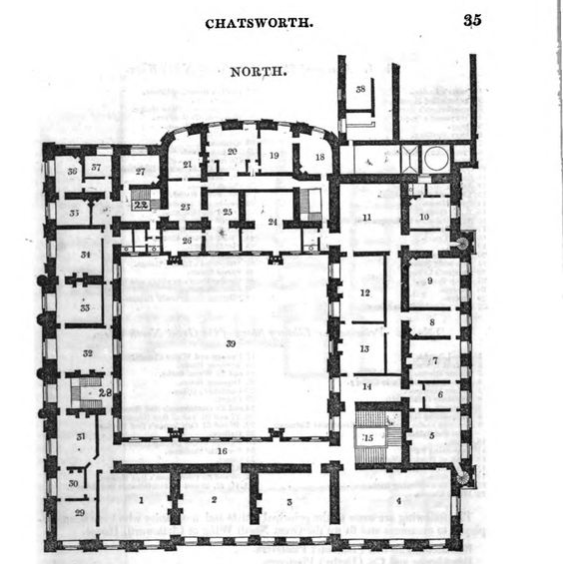
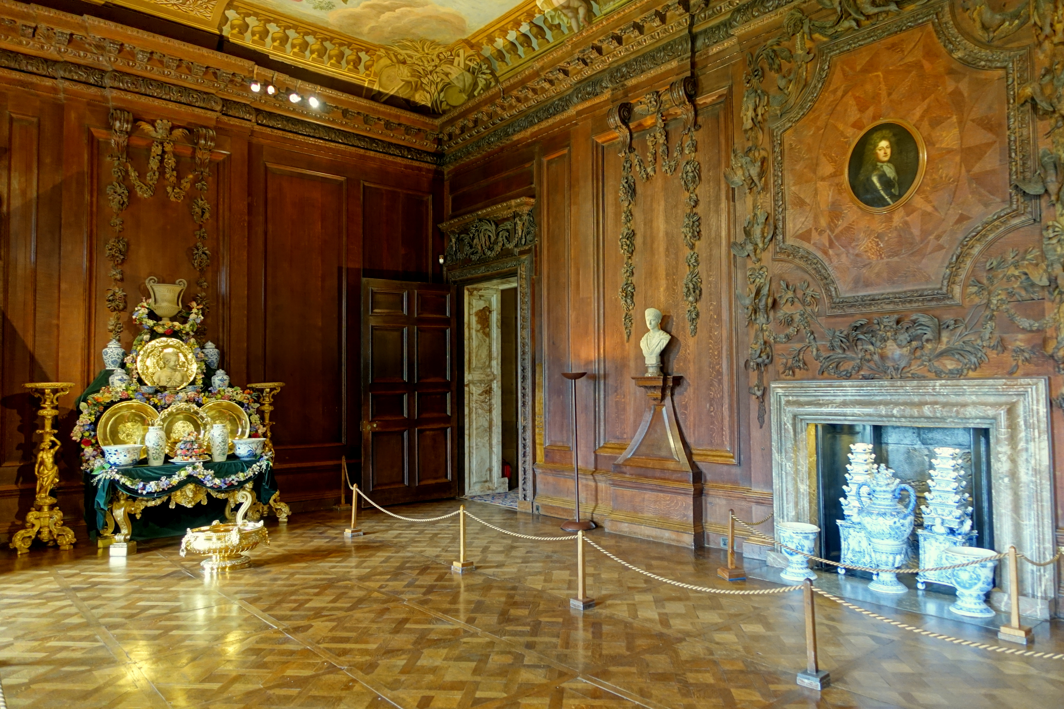
An Audience

Slide 12
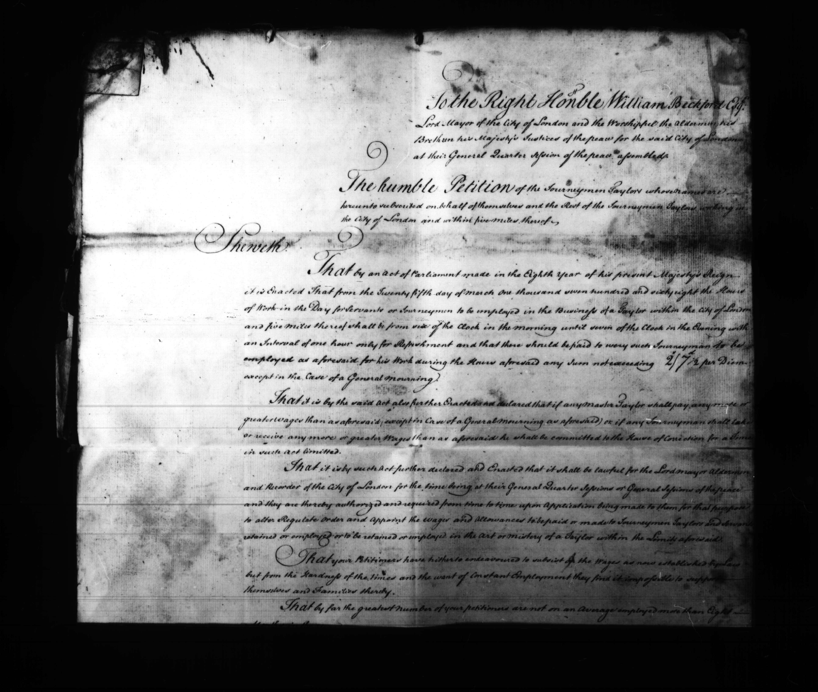
Petitions
Clemency, redress, solutions
Power of Petitioning in 17th century England
City of London Sessions: Sessions Papers - Justices' Working DocumentsSL | PS, 29th October 1767 - 18th February 1771.

Slide 13
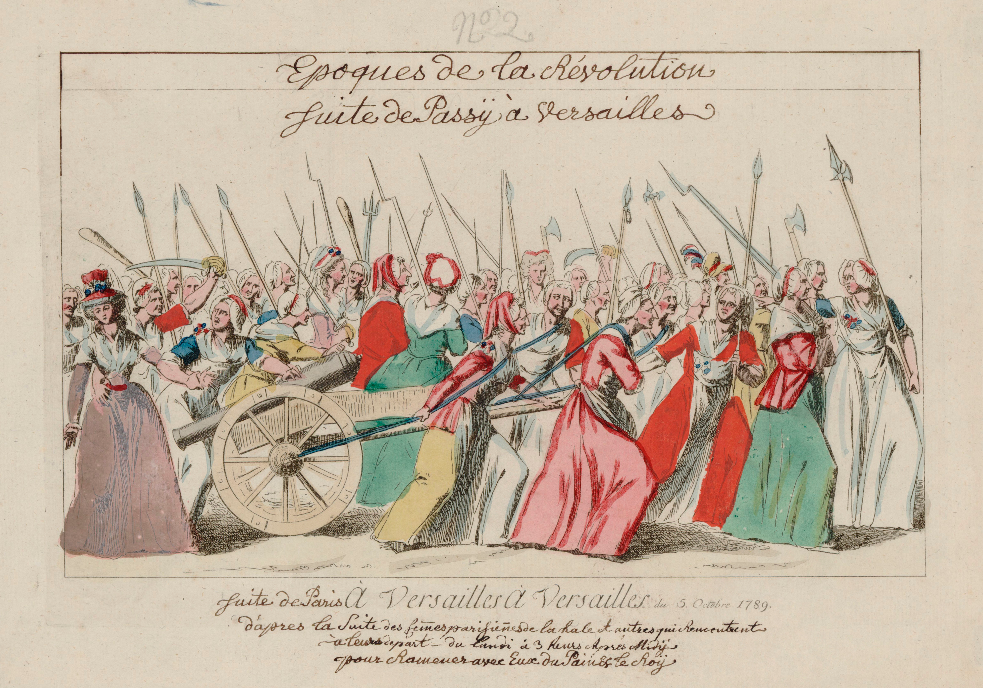
Riots
‘Riot’ – a problematic term?
Risings
Fight for your rights!
Often initiated by women
Theft and destruction
Some tolerance from elite authorities, but a limit.
Women’s March on Versailles, 5 October 1789.

Slide 14
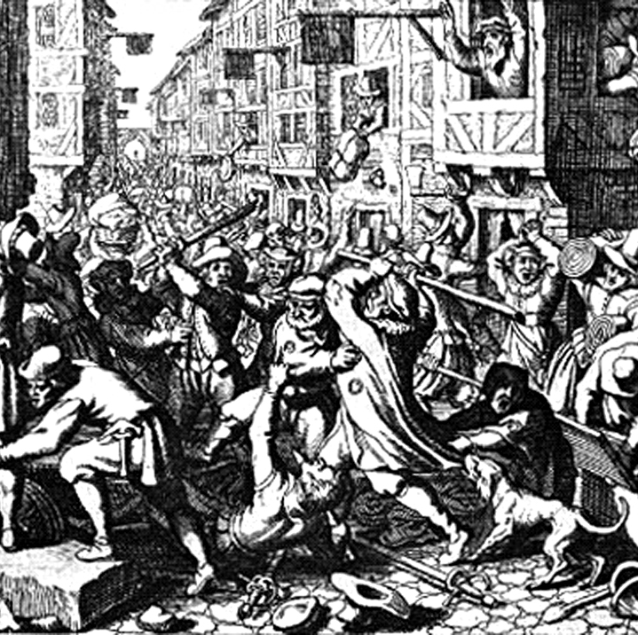
Rebellions
Fettmilch Rebellion, Frankfurt, 1612-1616
Rife antisemitism
Corrupt council
Internal and external attempts to facilitate negotiations
Judengasse pillaged
Leader executed and many fined

Slide 15
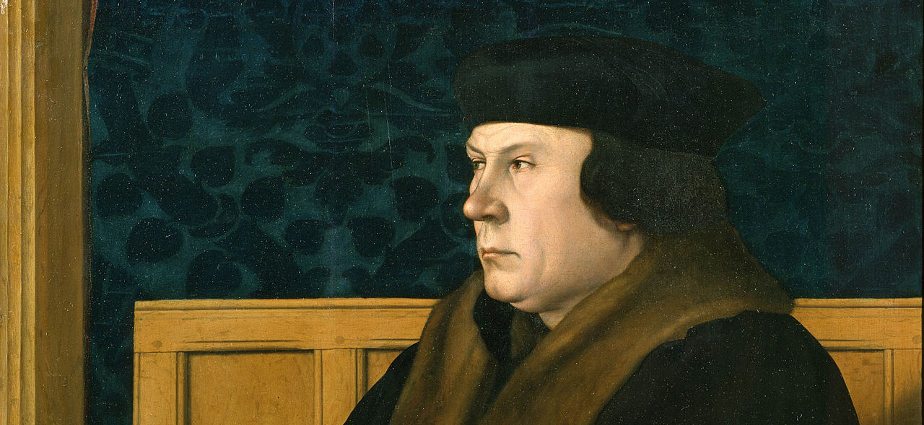
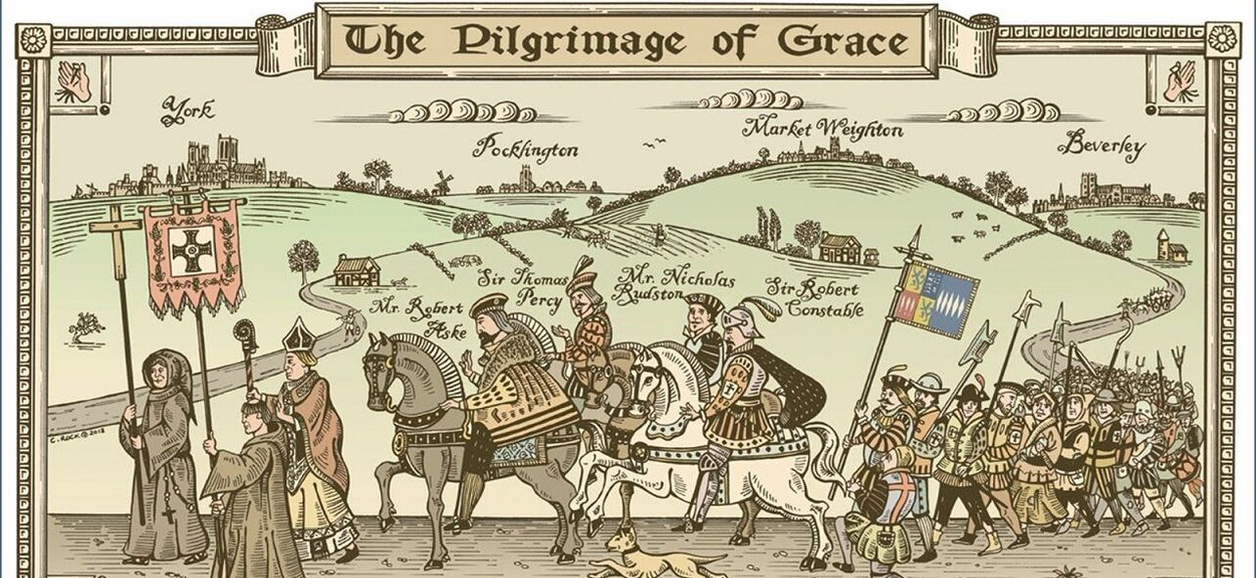
Rebellions
The Pilgrimage of Grace, England, 1536
Religious, political, economic factors.
List of demands issued, included return to papal authority and end of enclosure
Around 200 executed for participating

Slide 16
The German Peasant’s War, 1524/5
Largest and most widespread uprising
religious, political, and economic factors
Martin Luther, Against the Murderous, Thieving Hordes of Peasants (1525)
Violently suppressed by military groups
The Twelve Articles of the Peasants:
The First Article. – ‘First, it is our humble petition and desire, as also our will and resolution, that in the future we should have power and authority so that each community should choose and appoint a pastor.’
The Fifth Article. – ‘In the fifth place we are aggrieved in the matter of wood-cutting, for the noble folk have appropriated all the woods to themselves…be free to every member of the community to help himself to such fire-wood as he needs in his home.’

Slide 17
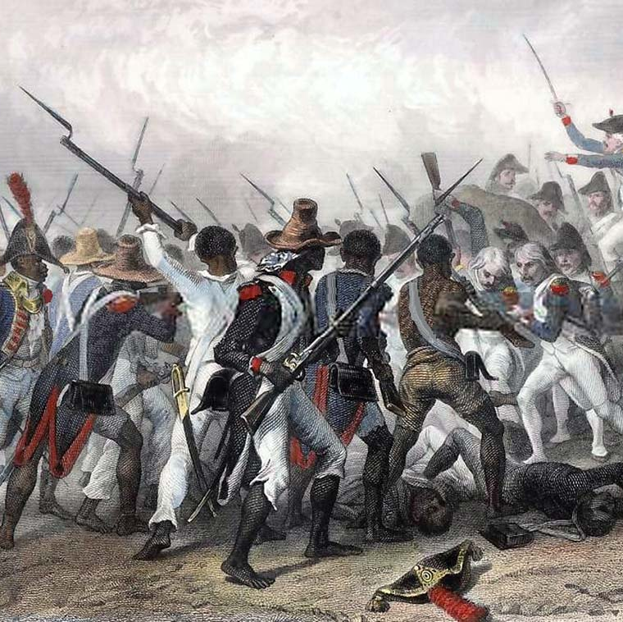
Revolutions
Enlightenment influences: equality, individualism, liberty, consent.
America and France
Global impact:
- The Haitian Revolution
Attack and take of the Crête-à-Pierrot (March 24, 1802) by Auguste Raffet.

Slide 18
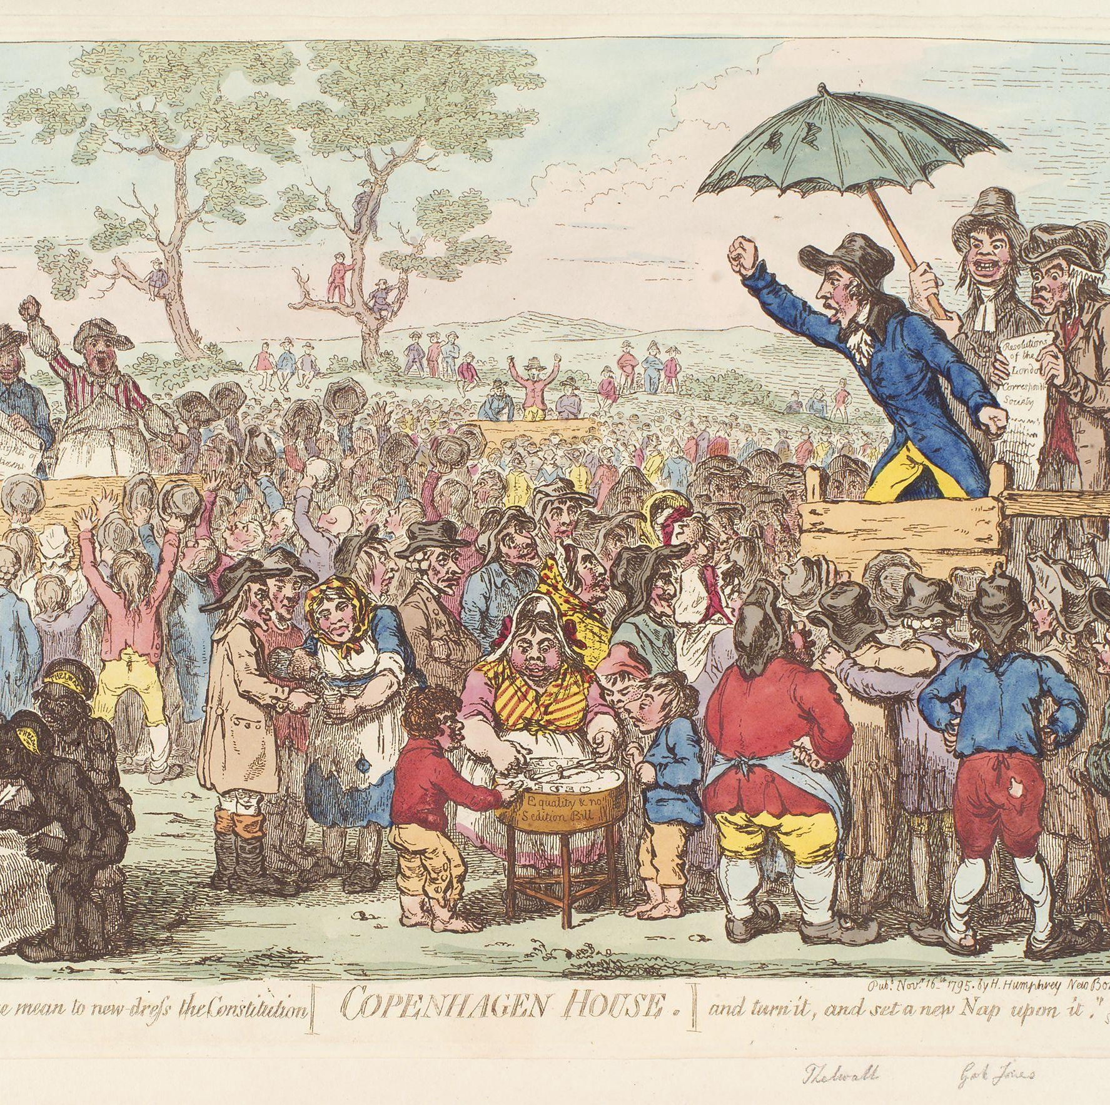
Radical Popular Politics
The London Corresponding Society (est. 1792)
Accessible for working men
The meeting in Copenhagen Fields (Islington) 1795.
Attempts from British government to suppress.

Slide 19
Conclusions
Ordinary people participated in politics in diverse ways
Rights to subsistence and to protection
Urban and rural/local and regional
Resistance and protest took many forms and prompted various responses from elite authorities

