Slide 1
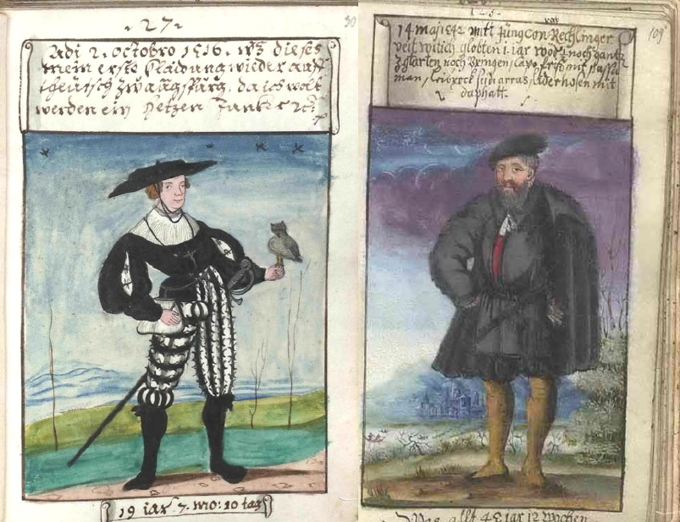
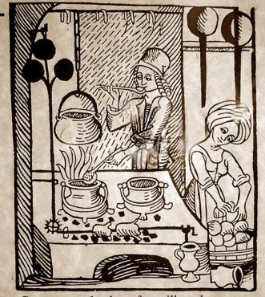
Food, Fashion and Material Culture
Rebecca Earle
Mathhäus Schwarz’s Klaidungsbüchlein, or “Book of Clothes” (1520-60), in which he documented his clothing from infancy to old age. Here are the images of him at 19 and in middle age.

Slide 2
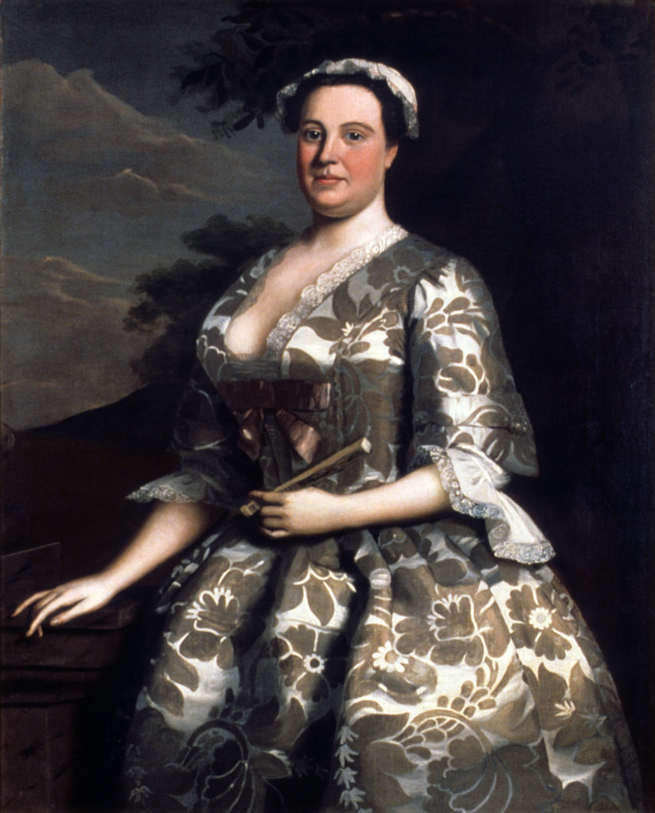
‘Portrait of a Woman in Silk’
Robert Feke, Portrait of Ann Shippen Willing (1746)
Winterthur Museum

Slide 3
Four Lives Connected in a Silk Dress
Anne Shippen Willing (whose portrait was painted)
Robert Feke (who painted her portrait)
Simon Julins (who wove the silk for her dress)
Anna Maria Garthwaite (who designed the pattern for the silk )

Slide 4
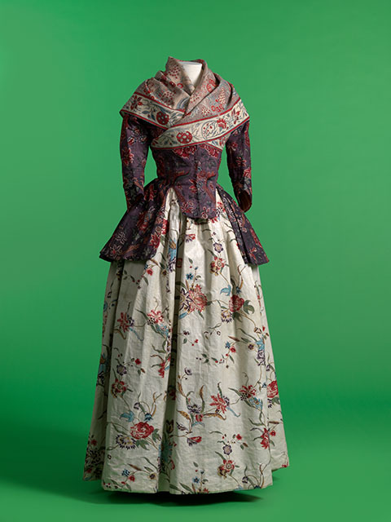
The World in a Dress…
‘The single dress of a woman of quality is often the product of a hundred climates.’
The Spectator (1711).
Chintz jacket and neckerchief with glazed printed cotton petticoat. 1770–1800. MoMu, Antwerp.

Slide 5
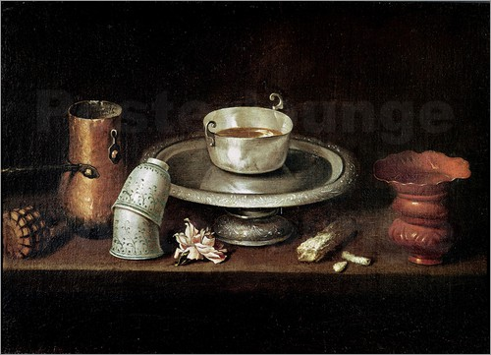
Global Culinary Encounters
In 1697 the British merchant Samuel Sewell was in Maryland, where he breakfasted with the colony’s Lieutenant Governor. Their meal was ‘Venison and Chockalatte’. ‘I said’, Sewell recorded in his diary, that ‘Massachusetts and Mexico met at his Honour’s Table’.
Juan de Zurbarán, Still Life with a Bowl of Chocolate (1640)
(Fine Arts and Archaeology Museum, Besançon)
Samuel Sewell

Slide 6
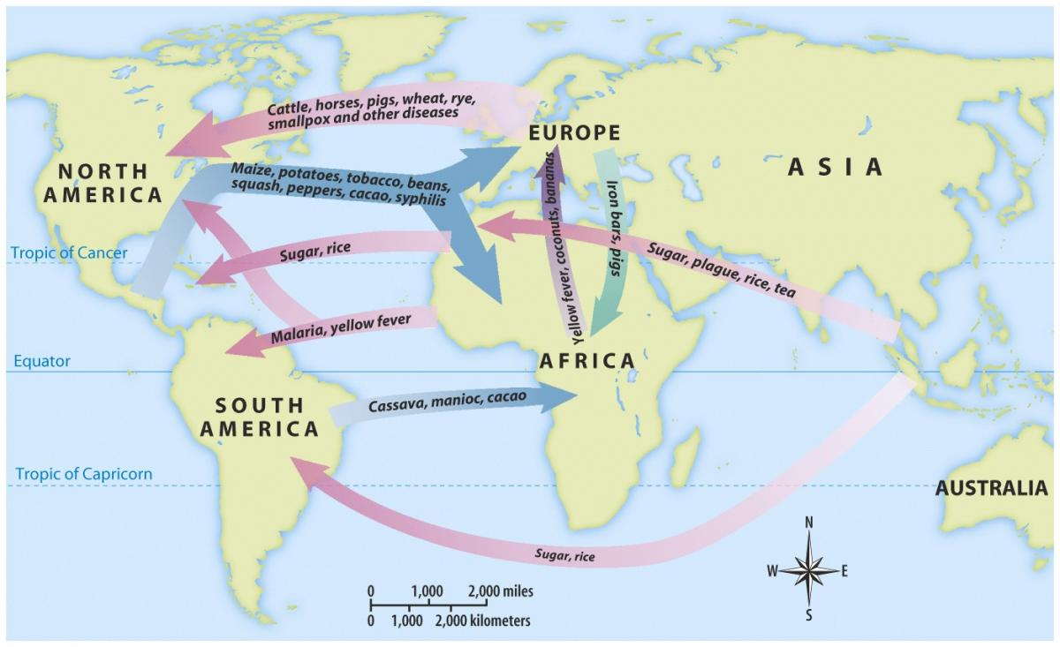
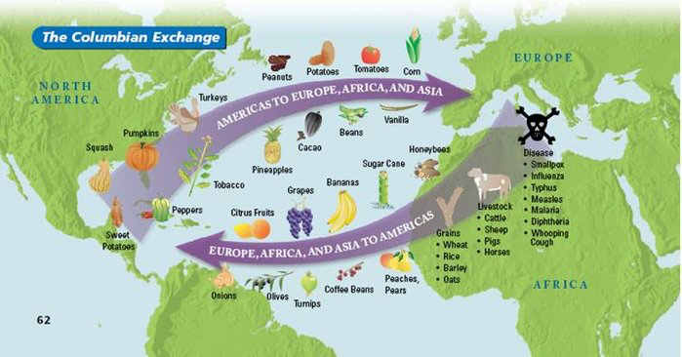
The ‘Columbian Exchange’
(Alfred Crosby, The Columbian Exchange: Biological and Cultural Consequences of 1492 (1972).)

Slide 7
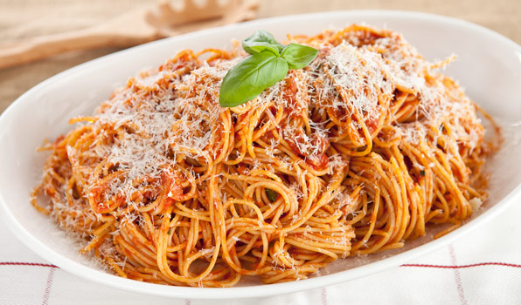
The Columbian Exchange
‘Before the Columbian Exchange, there were no oranges in Florida, no bananas in Ecuador, no paprika in Hungary, no tomatoes in Italy, no coffee in Colombia, no pineapples in Hawaii, no rubber trees in Africa, no cattle in Texas, no donkeys in Mexico, no chili peppers in Thailand and India, no cigarettes in France, and no chocolate in Switzerland.’
‘Columbian Exchange’, Wikipedia, http://en.wikipedia.org/wiki/Columbian_Exchange
The Columbian exchange today:
New world tomatoes
Old world wheat and cheese

Slide 8
The ‘Columbian Exchange’
‘The global diffusion of foods had never received so powerful a forward thrust as that provided by the Columbian Discovery.’
(Sidney Mintz, ‘The Old and New World Exchange (Pleasures of the Table)’.)
‘The arrival of Europeans in the New World unleashed a series of changes that altered the history of food.’
(John Super, ‘The Formation of Nutritional Regimes in Colonial Latin America’, Food, Politics and Society on Latin America, eds. John Super and Thomas Wright (1985).)

Slide 9
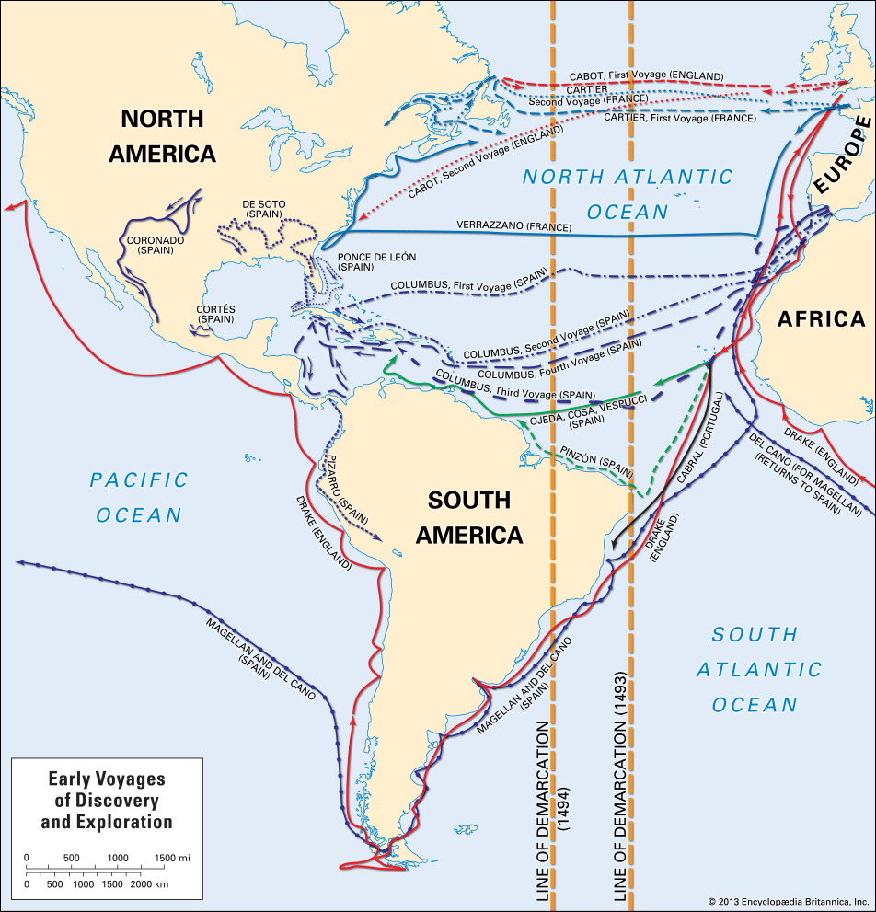
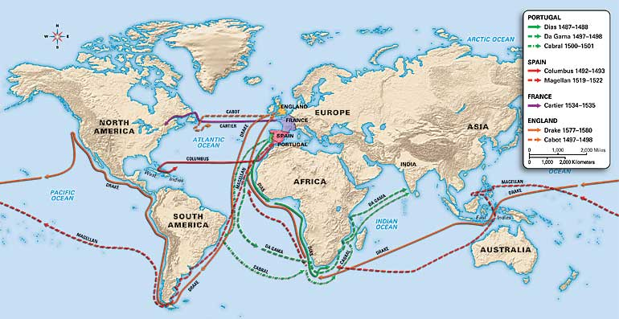
Early early-modern European voyages

Slide 10
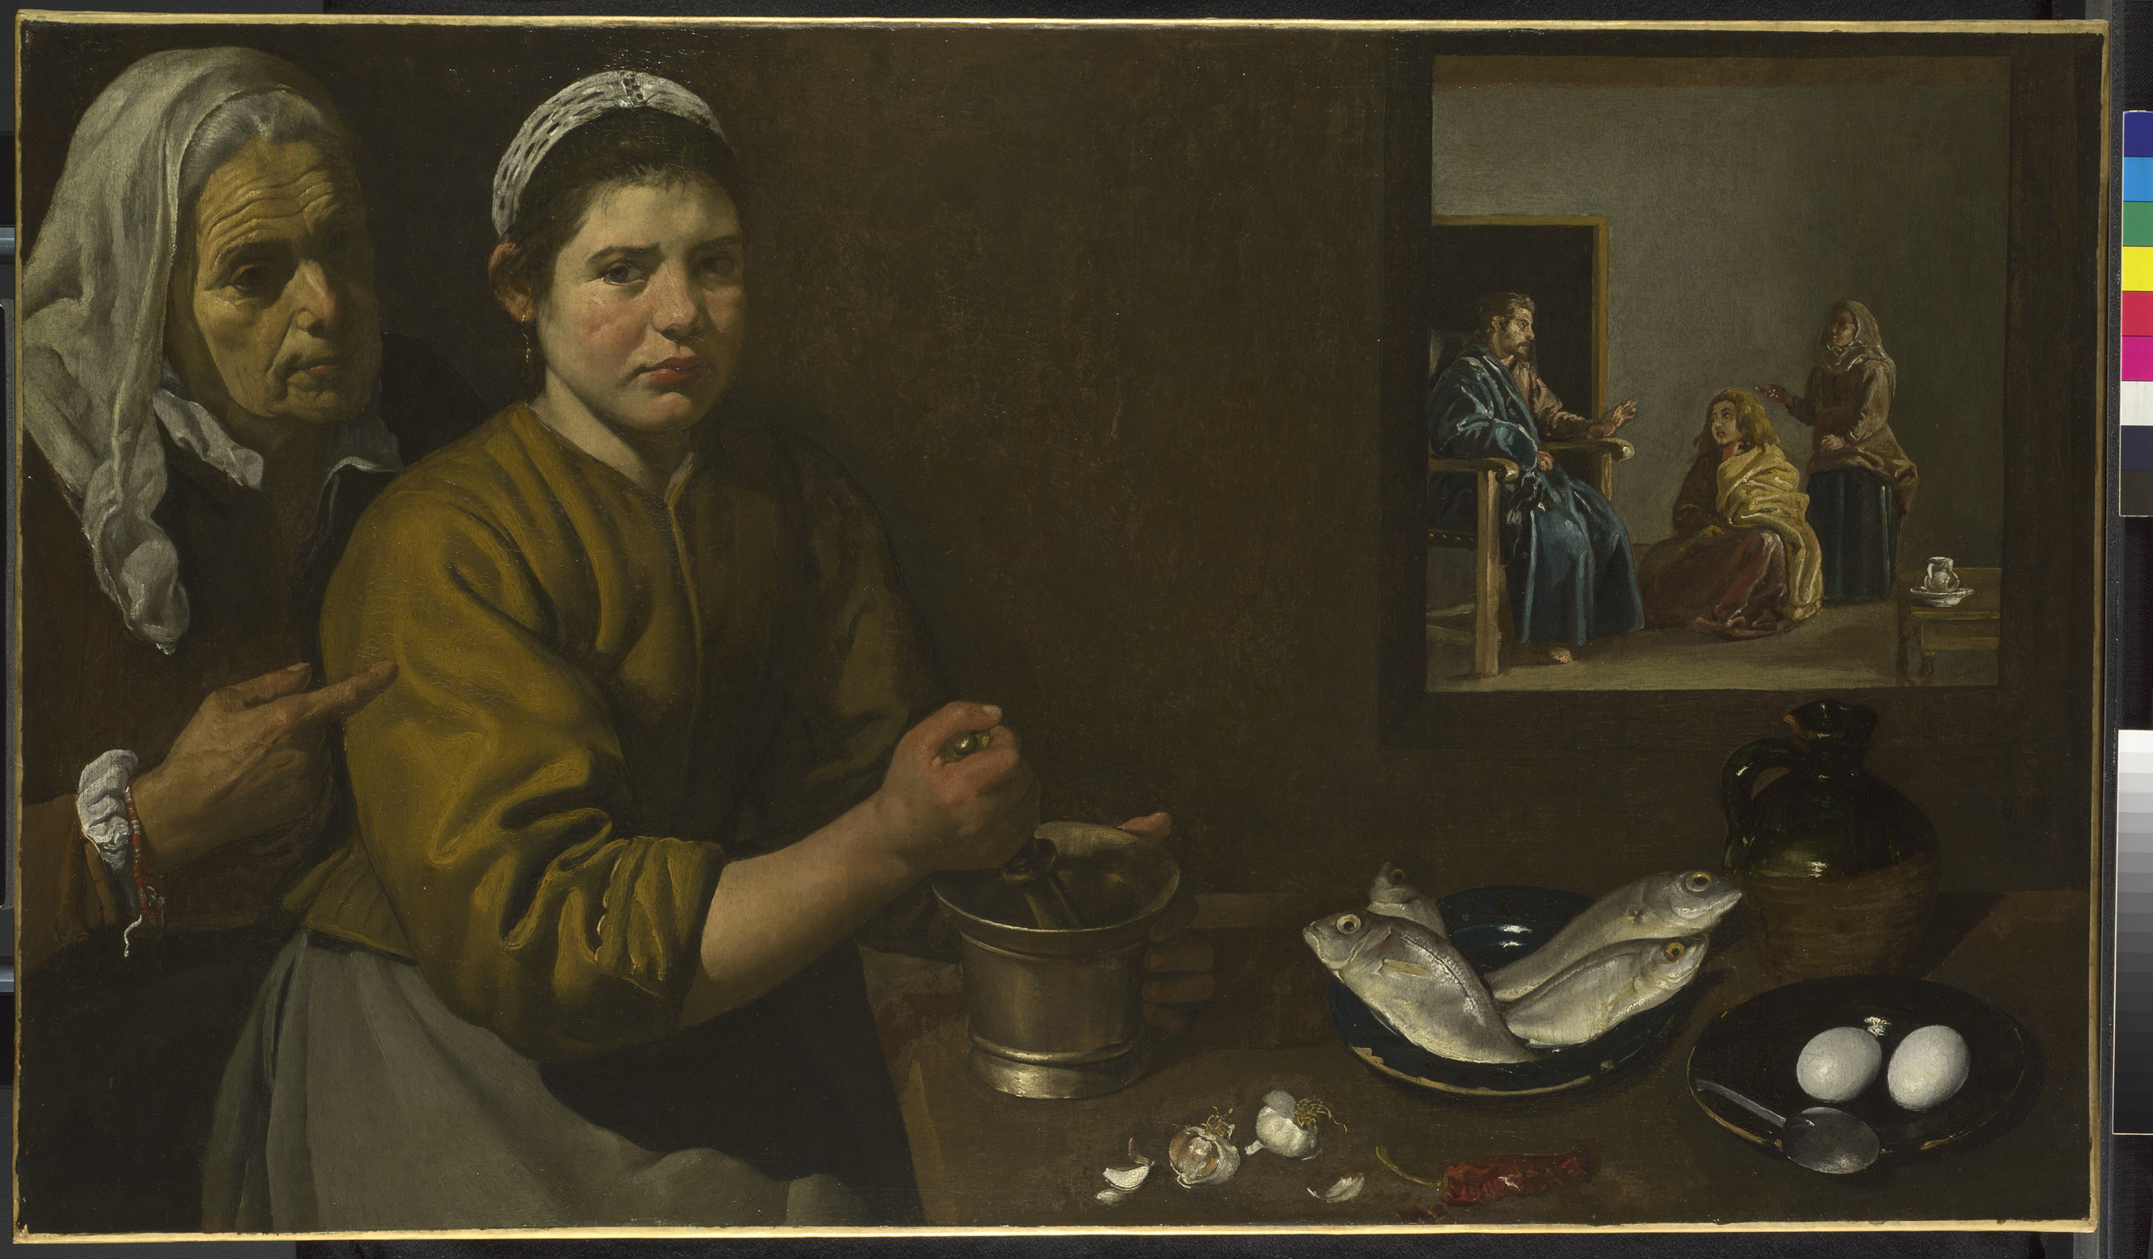
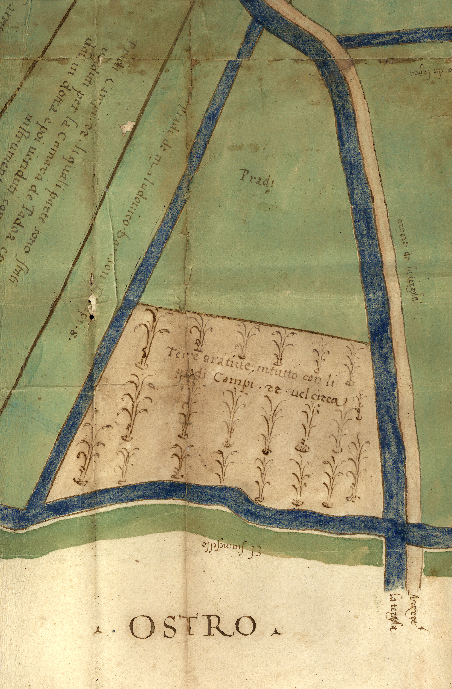
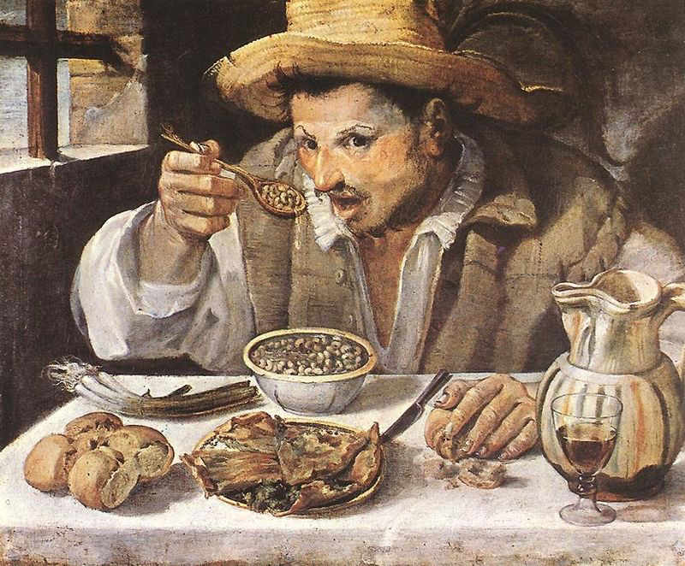
Foods from the Americas changed how Europeans Ate.
Sketch of agricultural fields near Padua, 1549
maize
New-world beans
Annibale Carracci, The Bean-Eater (1580-90), Palazzo Colonna, Rome
Diego Velázquez, Kitchen Scene with Christ in the House of Martha and Mary (1618), National Gallery, London
Chile pepper

Slide 11
People at the time noticed these changes...
‘Since our Wealth has increas’d and our Navigation has been extended, we have ransack’d all parts of the Globe to bring together its whole Stock of Material for Riot, Luxury, and to provoke Excess.’
George Cheyne, The English Malady (London, 1733), 49-50.

Slide 12
Global Connections, Colonialism & New Ways of Eating
‘[Enslaved people] captured in Africa learned to eat salt cod fished by British settlers in North Atlantic. Transported African slaves in the Caribbean colonies of Europe produced a transplanted Asian crop, sugar, to sweeten English workers’ tea—[itself] a Chinese crop grown in colonial plantations in India and Ceylon. To close the circle, colonial rule brought new ingredients to old as well as new colonies. The dishes of India, China, Thailand, and Indonesia adapted Mexican chillies, just as Asian indentured laborers brought mangoes and curries to the cuisine of the Caribbean.’
Harriet Friedmann, ‘Food Politics: New Dangers, New Possibilities’, Food and Agrarian Orders in the World-Economy, ed. Philip McMichael (Westport, 1995), 18.

Slide 13
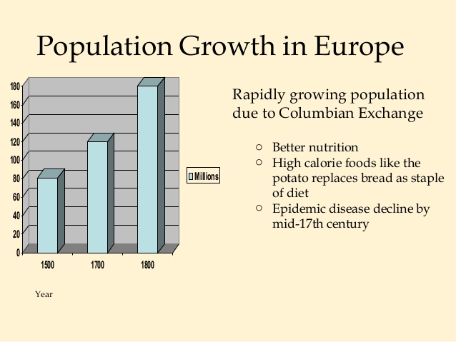
Did Nourishing Foods from the Americas Lead to Population Growth in Europe?
‘Is there a connection between Christopher Columbus and the population explosion?’
Alfred Crosby, The Columbian Exchange (1972).

Slide 14
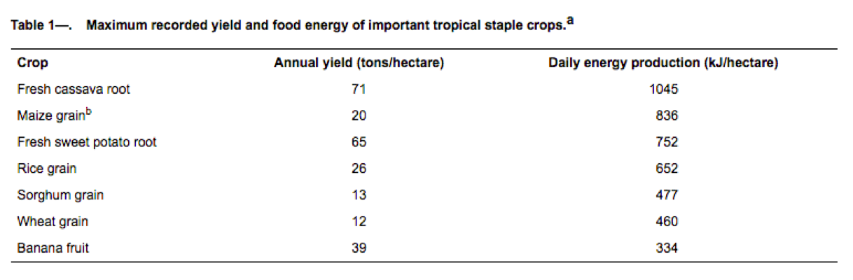
Caloric yield per hectare
(i.e. how many calories you get from a hectare of land sown with that crop.)

Slide 15
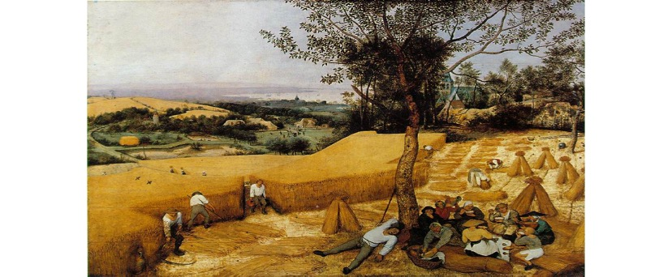
Were English agricultural labourers more productive because they were eating a more nourishing diet?
‘Over the period from roughly 1650 to 1780, the output of English agriculture increased substantially while employing a smaller percentage of the population than it had former-ly.’
Craig Muldrew, Food, Energy and the Creation of Industriousness: Work and Material Culture in Agrarian England, 1550-1780 (2011).
Pieter Bruegel the Elder, The Harvesters (1565).
Metropolitan Museum of Art, New York.

Slide 16
Craig Muldrew, Food, Energy and the Creation of Industriousness: Work and Material Culture in Agrarian England, 1550-1780 (2011).
‘The culture of eating needs to be given more importance, because the calories contained in the food consumed by labourers were the petrol of the early modern economy.’

Slide 17
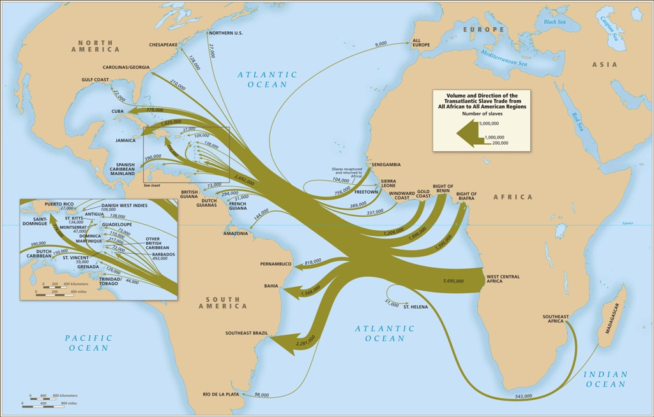
Transatlantic slave trade

Slide 18
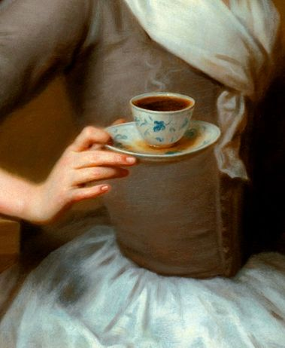
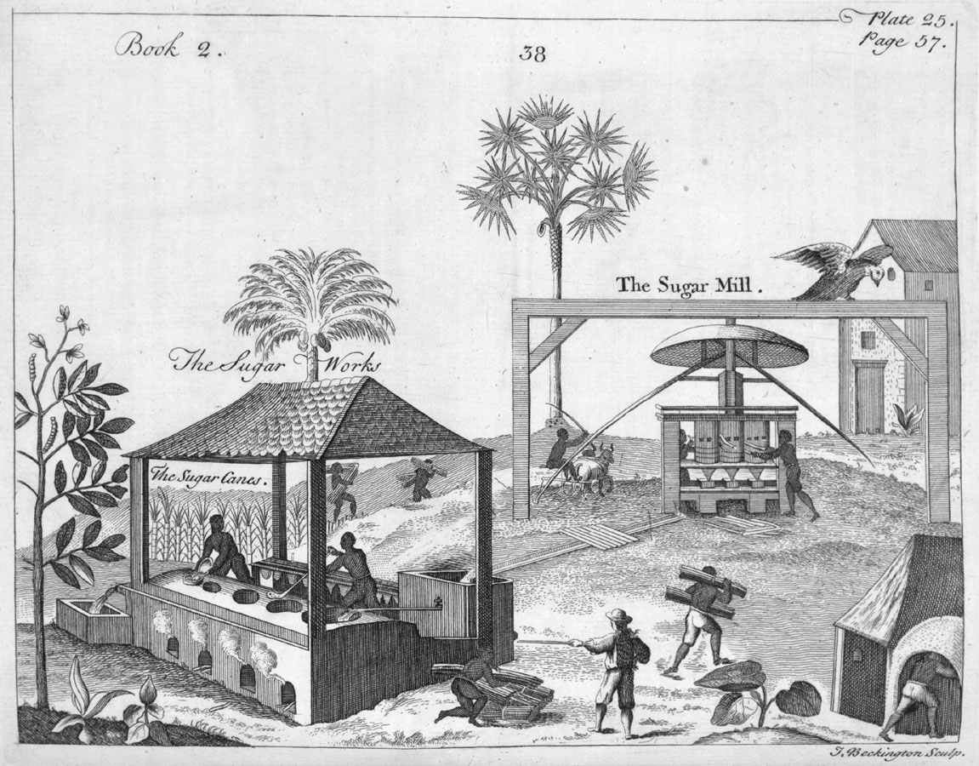
Sugar, Slavery and Sweet Tea
‘Sugar, then, was a cornerstone of British West Indian slavery and the slave trade, and the enslaved Africans who produced the sugar were linked in clear economic relationship to the British labouring people who were learning to eat it.’
Sidney Mintz, Sweetness and Power: The Place of Sugar in Modern History (New York, 1985), 175.
“The Sugar Works”: Pierre Pomet, A Complete History of Drugs (London, 1748).

Slide 19
Groceries brought the empire home….
By the 18th century foods produced in British colonies ‘became the empire’s most ubiquitous symbols, and their advertisement, retail, preparation and consumption reflected and contributed to British discussions and perceptions of the empire.’
Troy Bickham, ‘Eating the Empire: Intersections of Food, Cookery and Imperialism in Eighteenth-Century Britain’, Past and Present 198 (2008), 71.

Slide 20
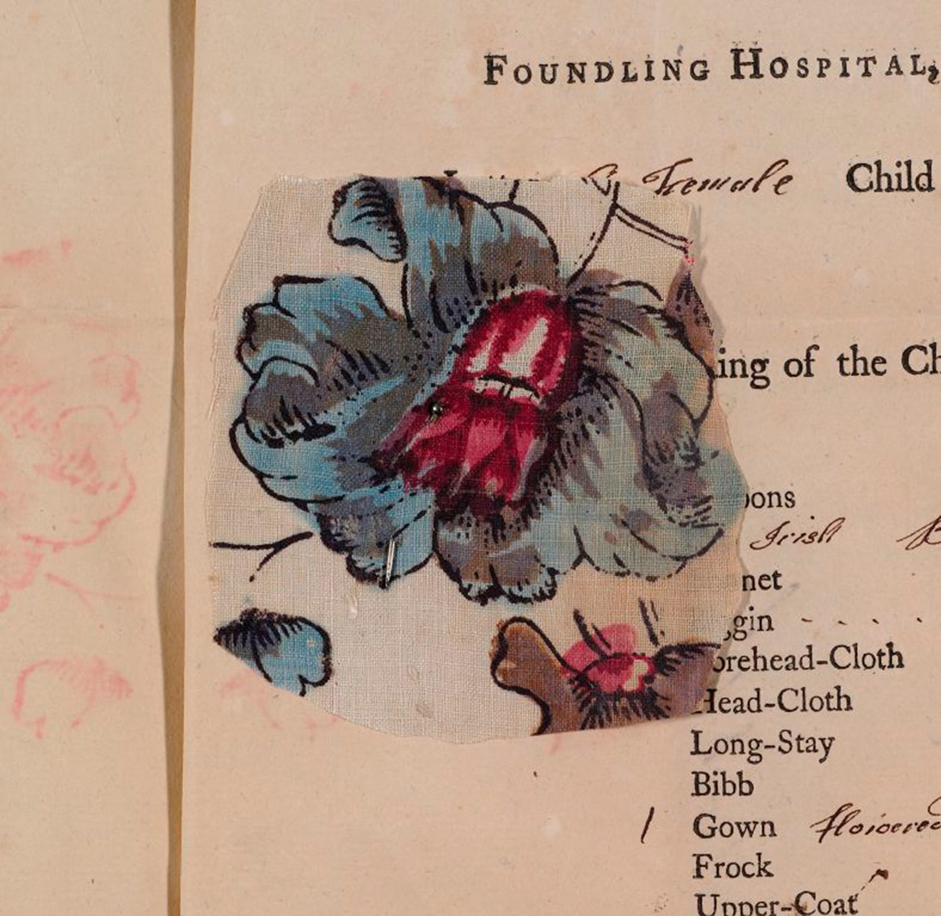
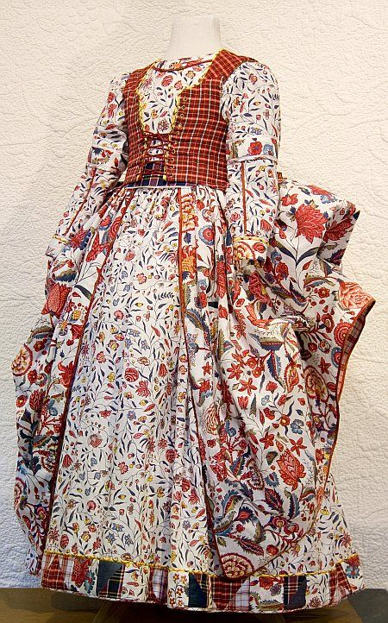
Indian printed cottons in Europe

Slide 21
Indian Cottons Changed How Europeans Dressed
‘The East India trade changed both the industrial and the cultural environment of Europe, altering forever Western decor and Western dress, while setting the model to be followed by later industries. Material culture was transformed in the process.’
Beverly Lemire, ‘Fashioning Cottons: Asian Trade, Domestic Industry and Consumer Demand, 1660-1780’, The Fashion History Reader: Global Perspectives, eds. Giorgio Riello and Peter McNeil, Routledge (New York, 2010), 210.
18th century chintz petticoat and jacket © Victoria and Albert Museum, London

Slide 22
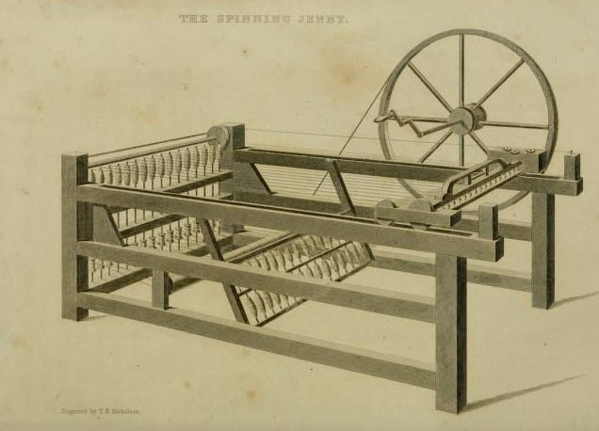
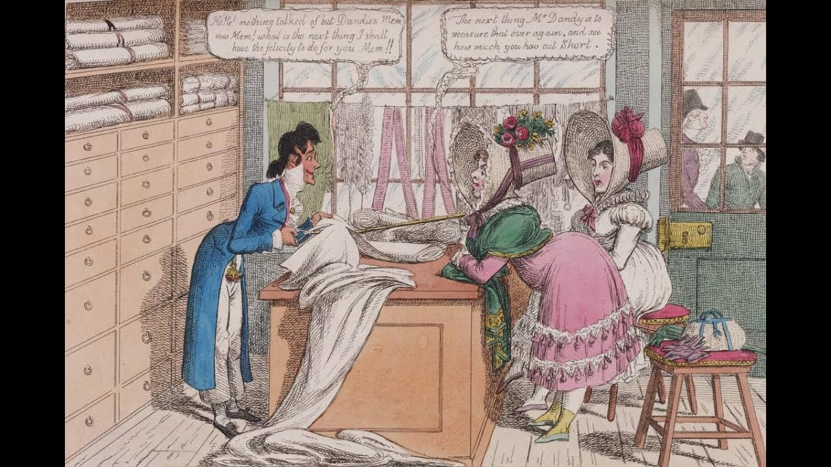
Indian Cottons and the Industrial Revolution
‘The case of cottons, then, is an example of the ways in which consumer desires can lead to large-scale transformations in systems of production.’
Prasannan Parthasarathi and Giorgio Riello, ‘From India to the World: Cotton and Fashionability’, The Oxford Handbook of the History of Consumption, ed. Frank Trentmann, Oxford University Press (Oxford, 2012), 147.

Slide 23
To Conclude…
Studying food and drink in early modern Europe makes most sense when we situate the topic in a global context.

