Slide 1
Global trade and Global Economies
Aysu Dincer

Slide 2
Lecture Structure
The World beyond Europe
Changes in the economy 1500 – 1750
Population
Manufacture
Global Trade
Organization of Trade
Long-distance Sea Routes
Silver Trade
Atlantic Trade
Chartering of Companies
Impact on the Global Economy

Slide 3
The World Beyond Europe
Polycentric
Significance of Asia:
Islamic world
Transnational interaction
Mastery of science, navigation and a sophisticated commercial structure
Indian Ocean World
China

Slide 4
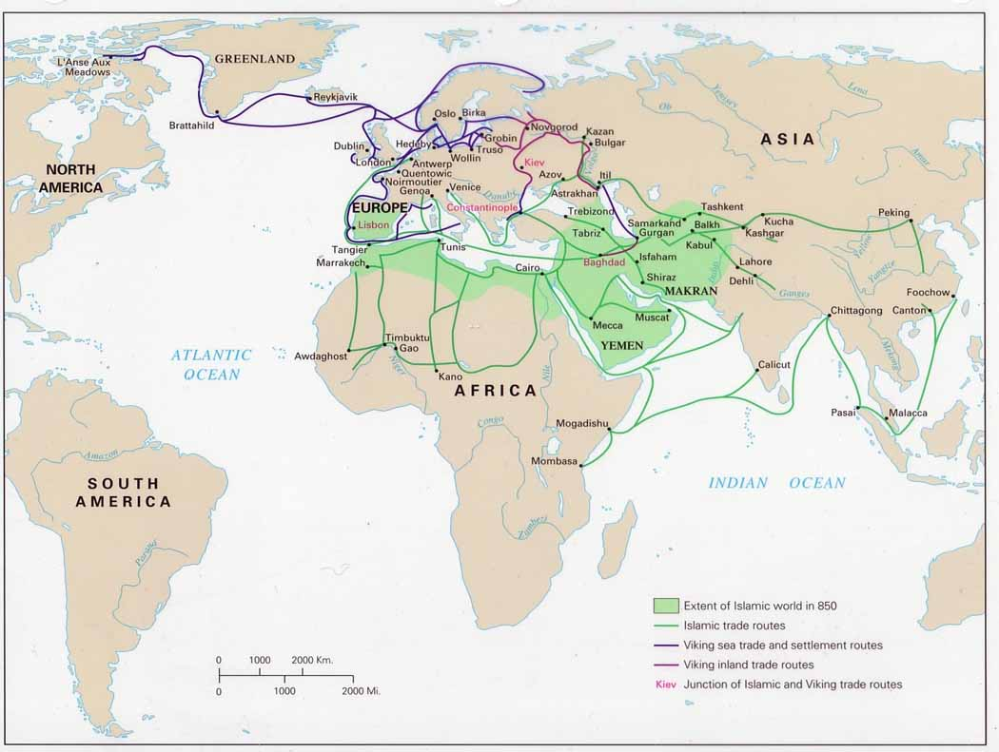
The Rise of Islam

Slide 5
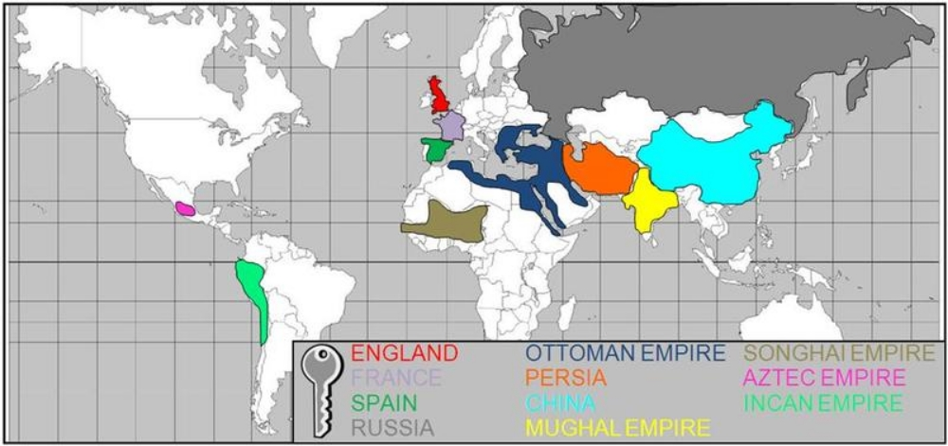
World in 1500

Slide 6
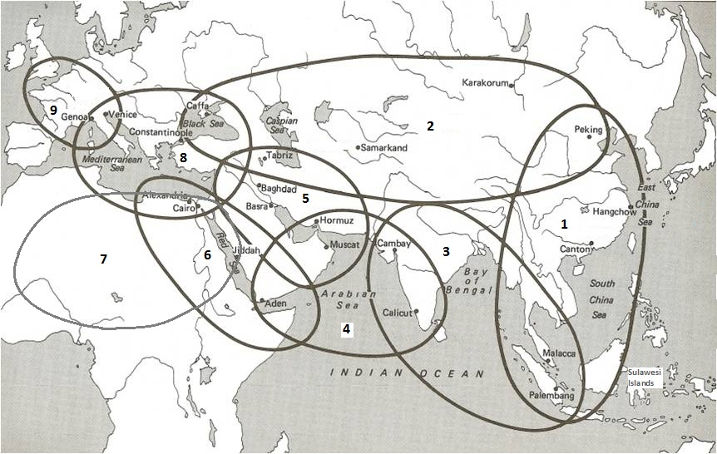

Slide 7
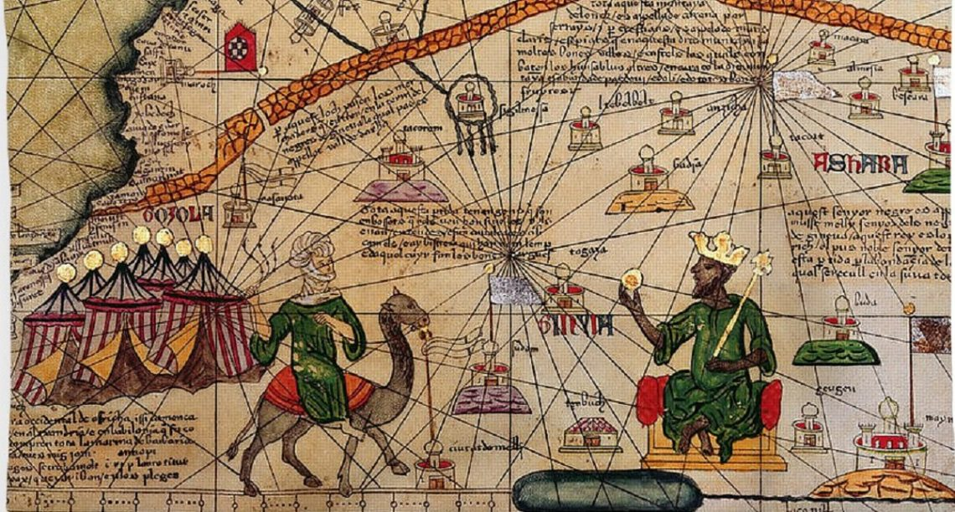
Mansa Musa: Catalan Atlas of Abraham Cresques (1375)

Slide 8
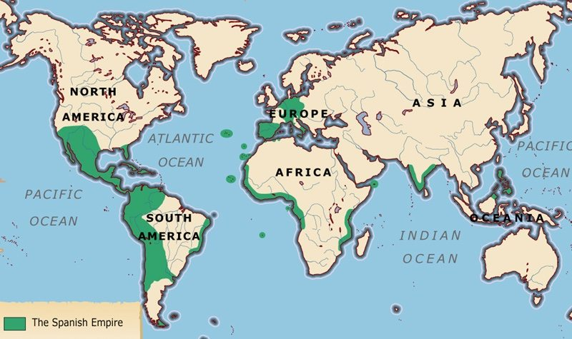
Spanish empire, est. 1492

Slide 9
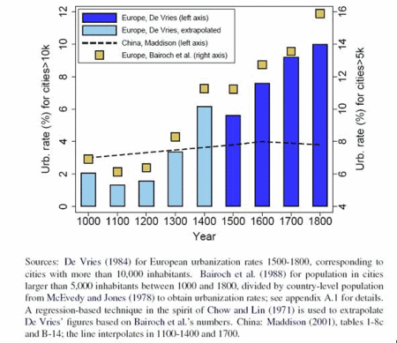
Population and Urbanisation
Dramatic population rise in some areas … increased European population as a whole… 75 million in 1500 and 110 – 120 million in 1700
(De Vries, 1984, p. 36)

Slide 10
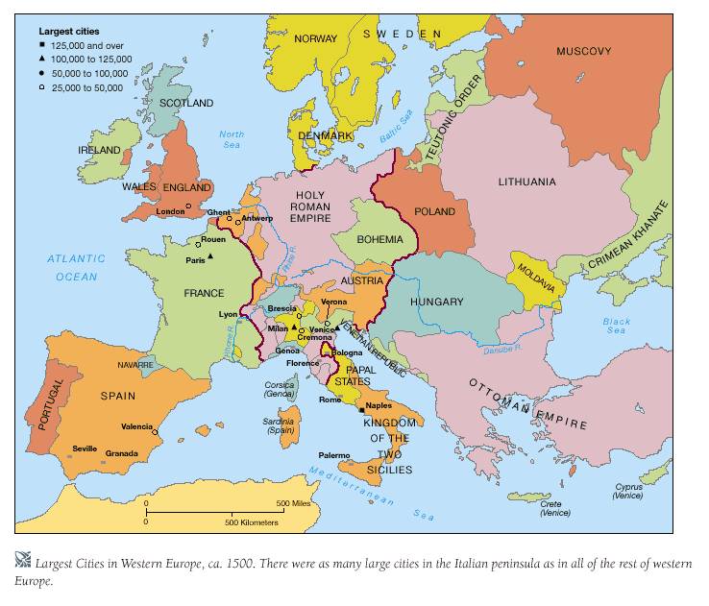

Slide 11
Population and Urbanisation
The population of some major Italian cities in 1600 and 1700
 | 1600 | 1700
Bologna | 62,000 | 15,000
Brescia | 24,000 | 11,000
Milan | 130,000 | 65,000
Verona | 54,000 | 31,000
Venice | 140,000 | 46,000
Italy | 13.2 m | 10.8 m

Slide 12
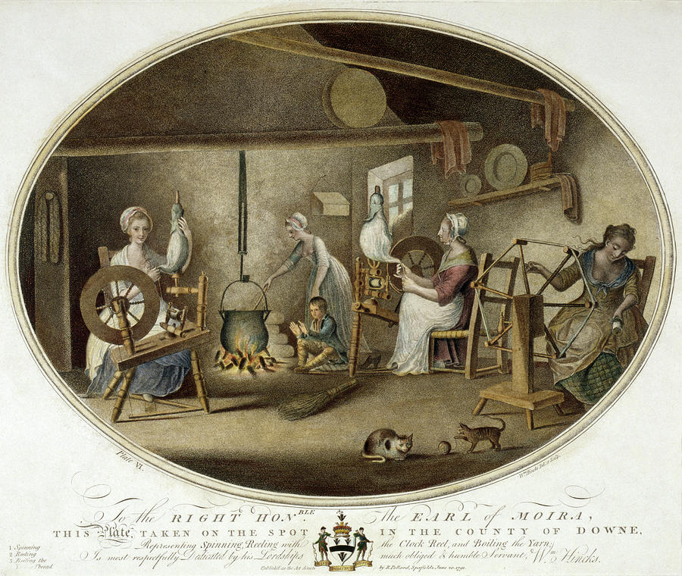
Proto-industrialisation
a strong link between agriculture and industry, coordinated by merchant entrepreneurs
goes beyond local or regional markets, involving long-distance trade
increase in population; increase in incomes; increase in consumption in the countryside
an increase of capital in the hands of merchant entrepreneurs
F. Mendels, 'Proto-industrialisation: the First Phase of the Industrialisation Process’, Journal of Economic History 32 (1972)
P. Kriedte, H. Medick and J. Schlumbohm, Industrialization before Industrialization (Cambridge, 1981)

Slide 13
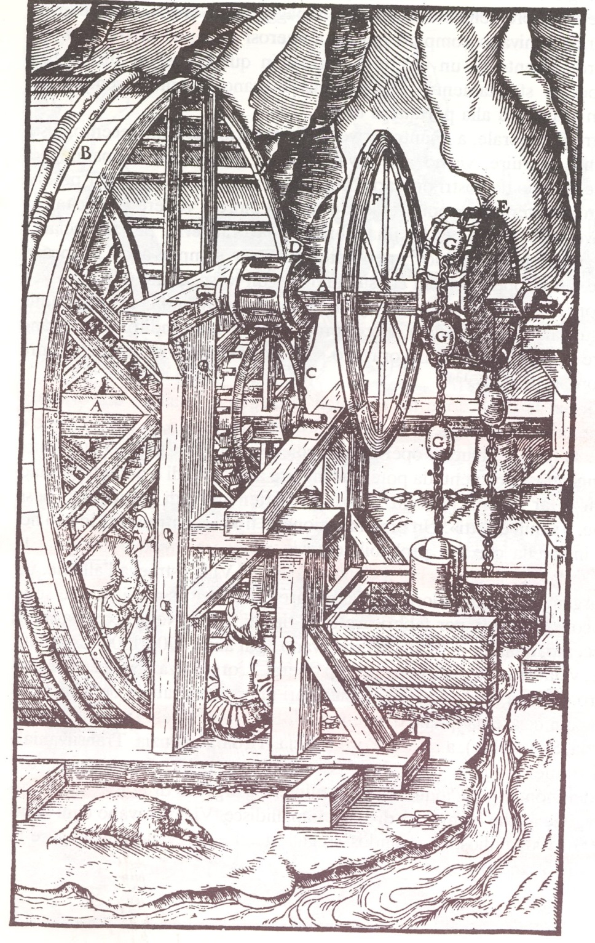
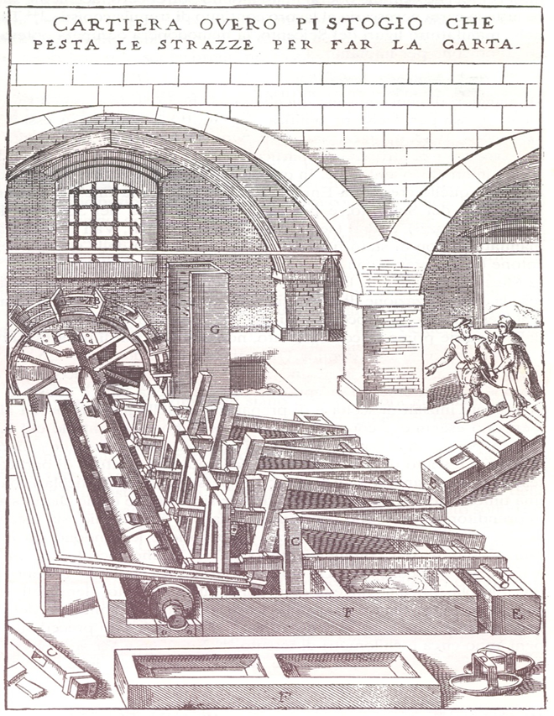
Mining and Paper Industries

Slide 14
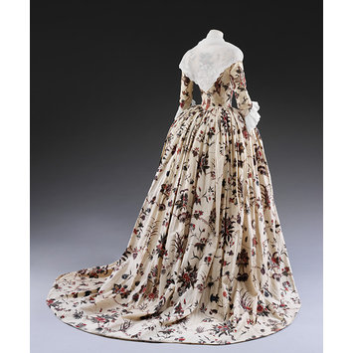
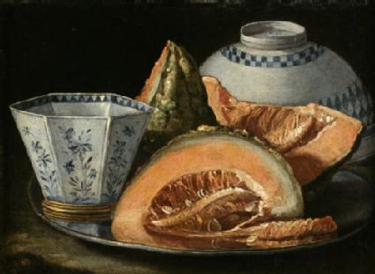
Increased demand for consumer goods
Cristoforo Munari (1667-1720). A Still-Life with Melon. (The Lodi Collection, Campioni d’Italia).
Painted and dyed cotton
partly lined with silk
Coromandel Coast
c. 1760-1770
V&A Collections

Slide 15
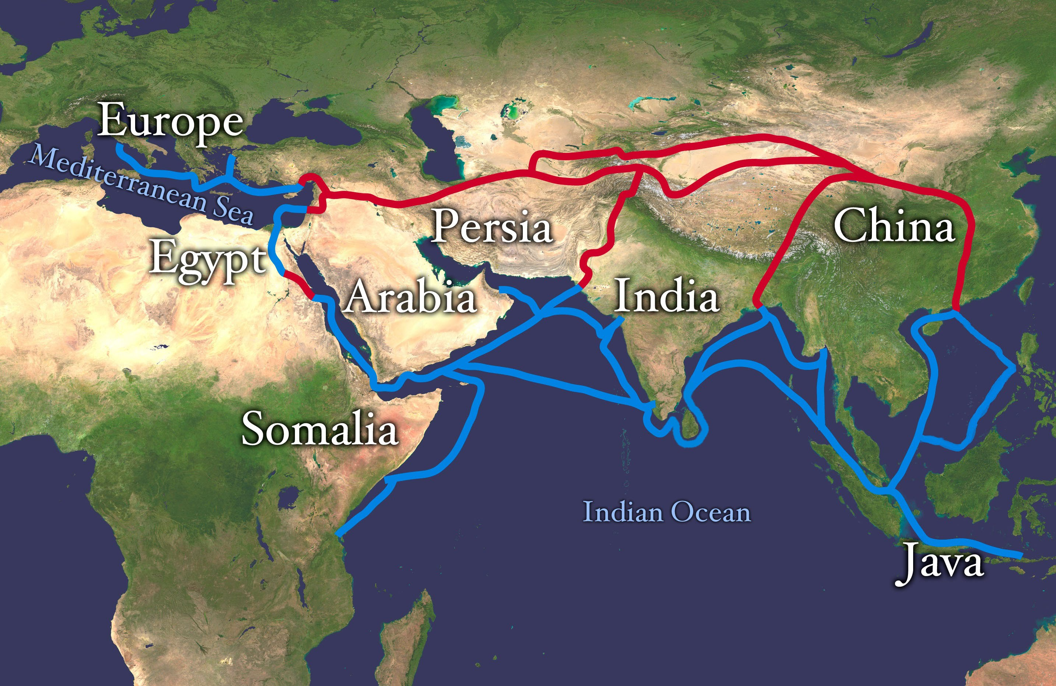

Slide 16
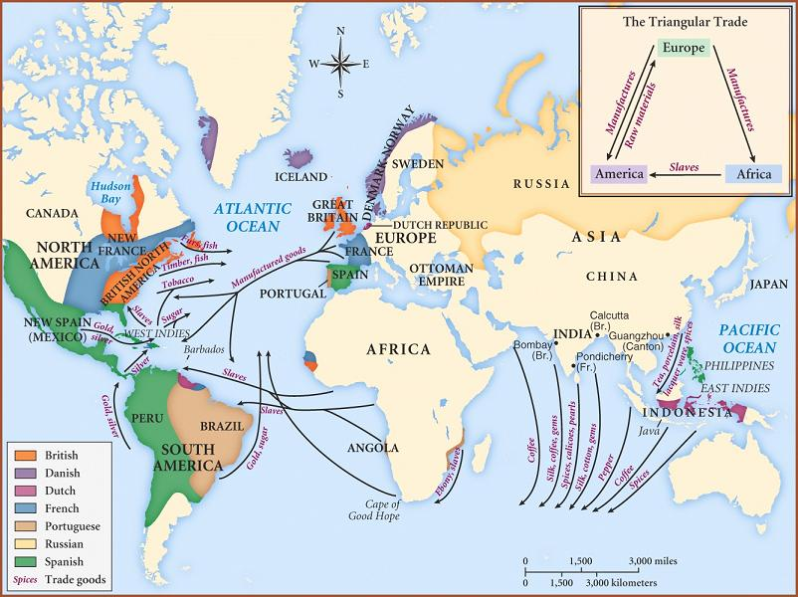
Trade

Slide 17
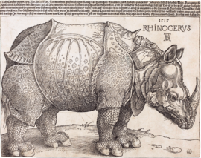
Global Commodities
goods of wonder and collection
goods that could be systematically traded: (sugar, tobacco, coffee, cocoa, or chocolate, opium, pepper, spices, silk, silver, cotton, textiles and porcelain (Augustus II the Strong (1670-1733), Elector of Saxony/King of Poland, the fascination with porcelain as ‘la maladie de porcelaine’)

Slide 18
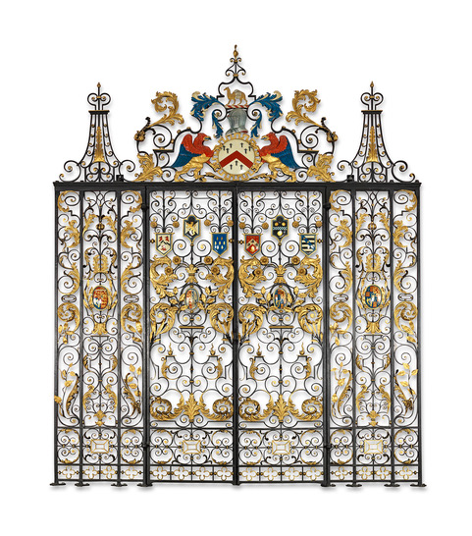
Wrought iron and gilded gates, The Grocers’ Company Hall 1680-1730
The design incorporates spice plants, including black pepper, vanilla, nutmeg, cloves and stems of sugar cane.
https://grocershall.co.uk/the-company/history/

Slide 19
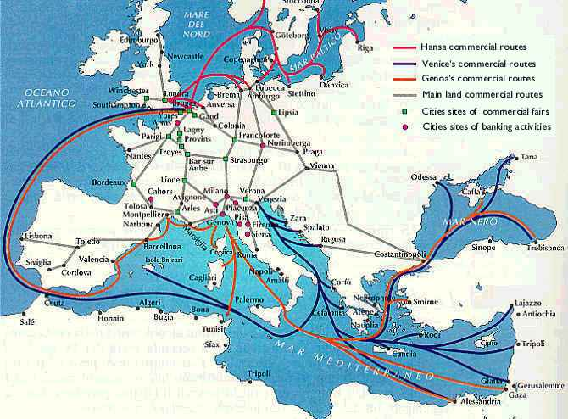

Slide 20
Trade

Slide 21
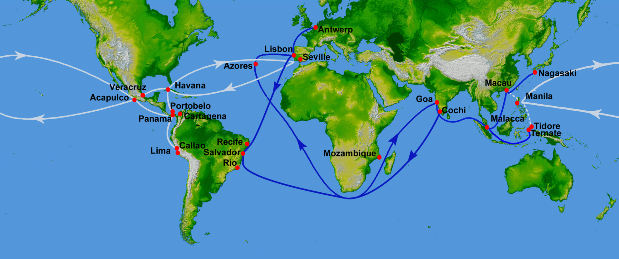
Silver trade routes

Slide 22
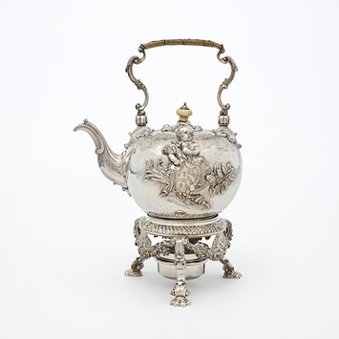
Silver tea kettle, stand and lamp, Paul de Lamerie, London 1736-7 (The Rosaline and Arthur Gilbert Collection)
The kettle was commissioned for the marriage in 1738 of John Lequesne, a wealthy Grocer merchant, the year he was appointed Director of the Bank of England.
The tea kettle is decorated with the plants of his trade, sugar cane and tobacco leaves.

Slide 23
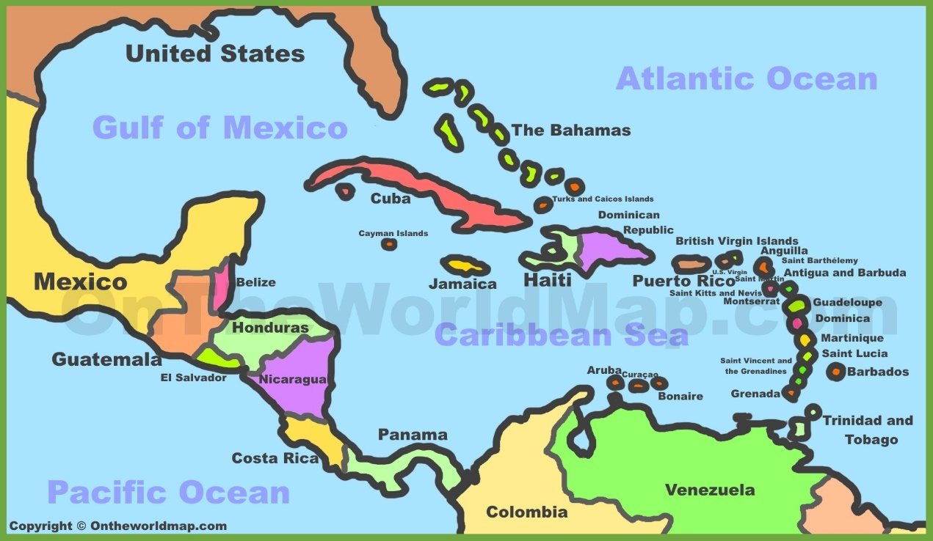
The Caribbean and Sugar Plantations

Slide 24
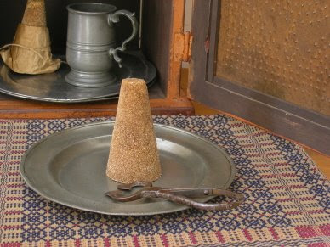
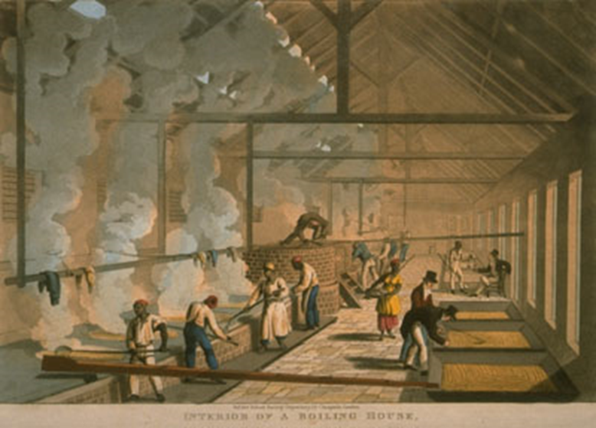
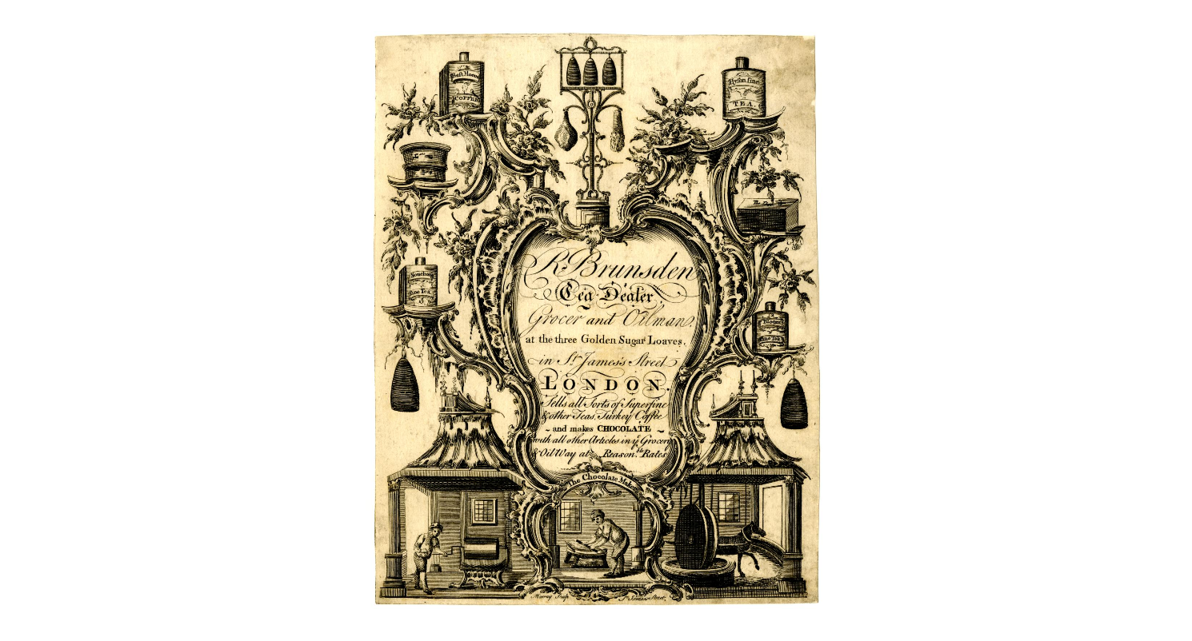
Sugar production and trade

Slide 25
The growth and impact of Atlantic trade
Growth in the trade of enslaved peoples from Africa to the New World1525 – 1790 of 2.1% a year, 10 million Africans were enslaved and traded over the whole period to the end of the 18thC.
sugar shipments rose at annual average rate of 2.2% 1663-1669 to 1751-1760 – Chesapeake tobacco exports grew at 5.1% per year 1622-1775
British sugar consumption rose from 6.5 lbs per head 1710 to 23.2 lb./head in 1770
Sugar made up 2/3 of British grocery imports in 1700 [groceries included sugar, coffee, tobacco, chocolate, tea and spices]
Atlantic trades grew by over 2% per year in volume in the 18th century
Cape route trades grew by 1.1% per annum to the 1790s. A much smaller trade, but one with a highly significant impact on manufacture and industry.

Slide 26
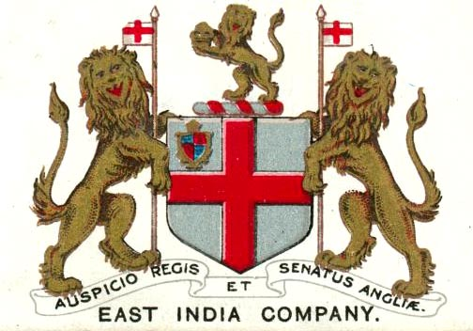
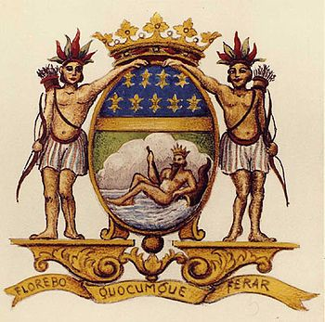

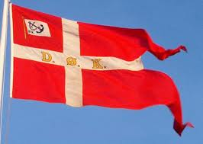

Notes:
EIC (1600) VOC (1602); Compagnie des Indes Orientales (1684)
China Trade: Ostend (1722); Swedish EIC (1731); Danish Companies 1668 and 1732

Slide 27
The European Chartered Companies in Asia
After 1500 the Portuguese Carreira da India, and after 1600 the Dutch (VOC) and the English East India Companies
joint stock companies: financed by a multitude of small shareholders
enjoyed forms of privilege or monopoly over the routes to Asia given through a charter of patent.
traded in a variety of commodities such as cottons, silks, porcelain.
conquered key trading ports across Asia (start of Empire)

Slide 28
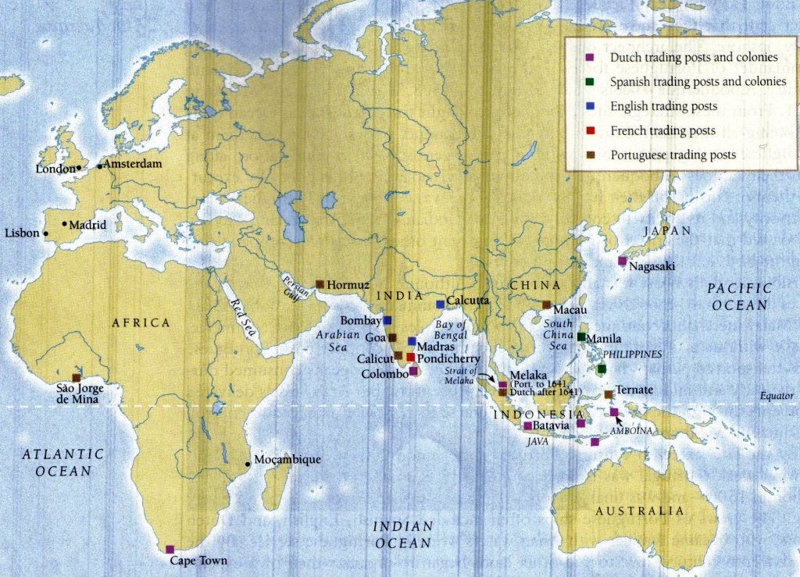

Slide 29
Impact on the Global Economy
Americas – outflow of precious metals and plantation commodities
– matched by inflow of European manufactures & re-exported Asian goods and African enslaved peoples
Asia - no significant demand for European goods – silver the most important demand
Early modern period – Asia was the first to have a global trading system

