Slide 1
Europe in the Making Lecture: The Impact of Reformation
Peter Marshall

Slide 2
Lecture themes and questions:
What was the ‘Reformed’ tradition in Protestantism?
How did it emerge and why did it diverge from Lutheranism?
What were the key features of Calvin’s thought?
Why was Calvinism able to spread internationally?
What were the medium-term political and social consequences of the Protestant Reformation?
Should it be judged a failure?

Slide 3
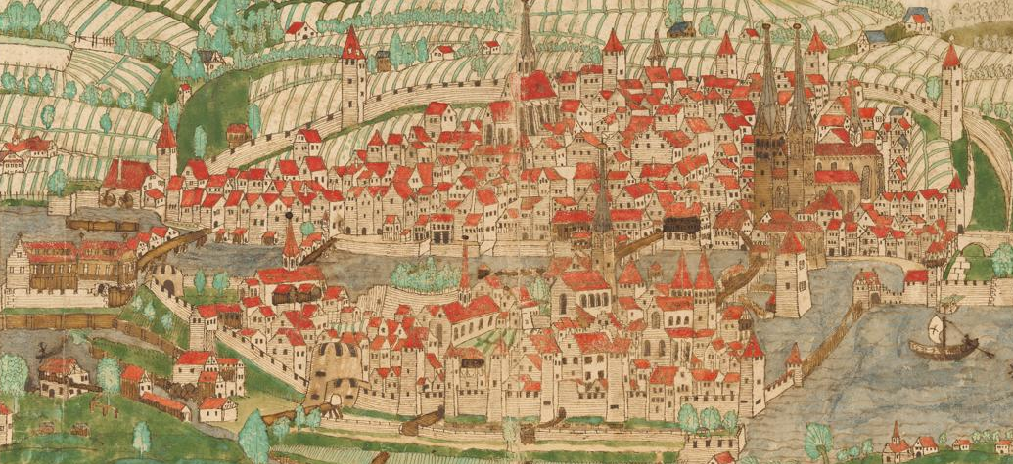
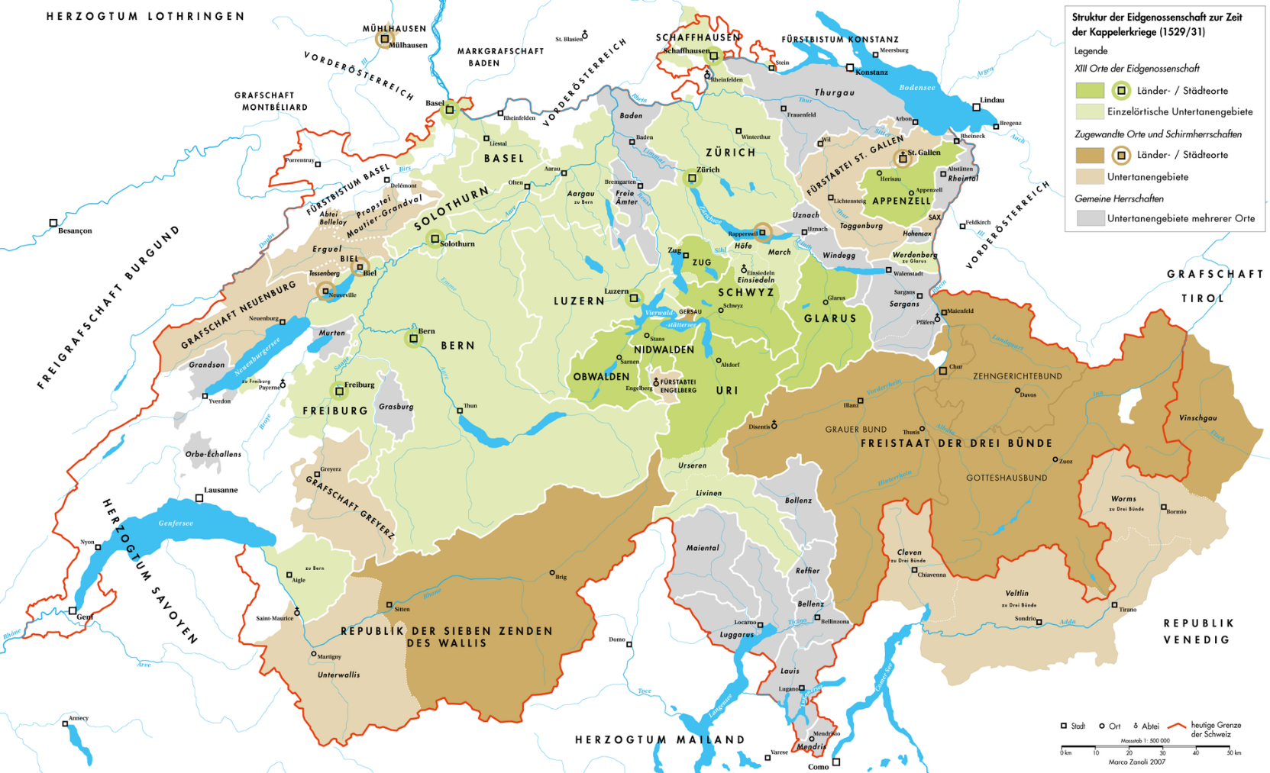
The Birthplace of ‘Reformed’
Protestantism: Zürich, in the
Swiss Confederation

Slide 4
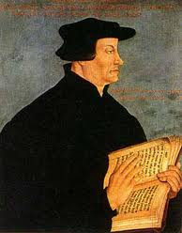

Ulrich Zwingli (1484-1531)
The Affair of the Sausages, 1522
Attack on church tradition
Declaration of ‘Christian Freedom’
‘I began to preach the gospel of Christ... Before anyone in our region had ever heard of Luther’

Slide 5
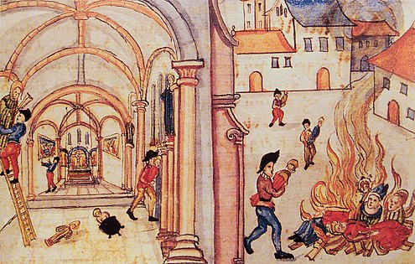
Iconoclasm in Zürich, 1524: two weeks of
smashing, burning, white-washing
Key differences from Lutheranism:
Even more biblicist (no tolerance for things that could not be proved by scripture)
Desire to purify church
Hostility to religious images; vestments (robes) for clergy; church music
Greater emphasis on reform/salvation of society, not just individual

Slide 6
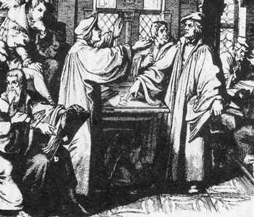
‘Hoc est corpus meum’: Luther and Zwingli clash at Marburg 1529
Inability to agree on meaning of Jesus’ words, ‘This is my body’
Protestant movement from outset divided
North/central Germany; Scandinavia = Lutheran
South-west Germany; Switzerland = ‘Reformed’

Slide 7
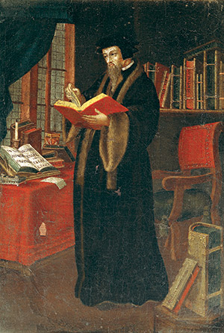
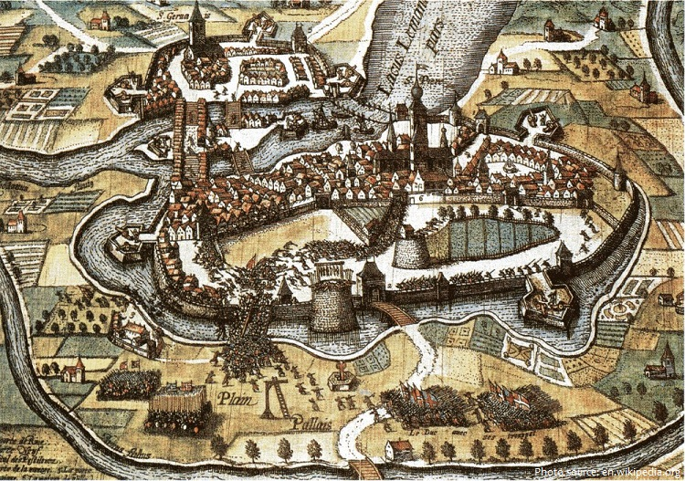
‘Second Reformation’:
Jean Calvin (1509-64) and Geneva
Refugee from Catholic France
Arrives Geneva 1536
Expelled 1538; returns 1541
Remodels Genevan Church with Ecclesiastical Ordinances
Four-part ministry:
Pastors (preach and give sacraments)
Teachers (teach doctrine/scriptures)
Elders (administer discipline)
Deacons (poor relief)

Slide 8
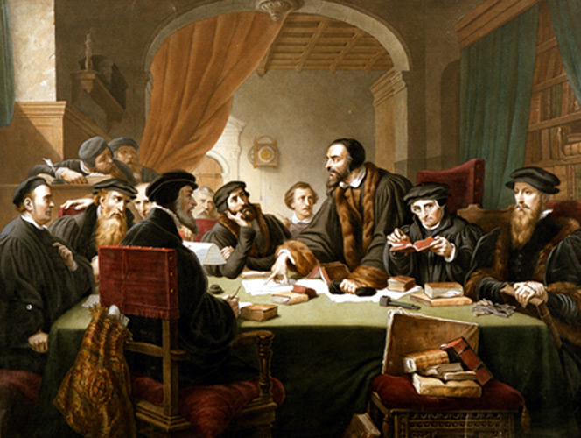
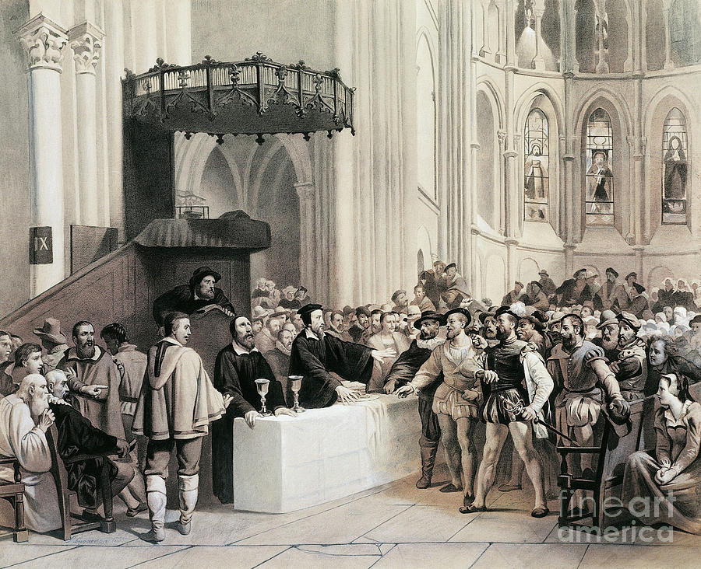
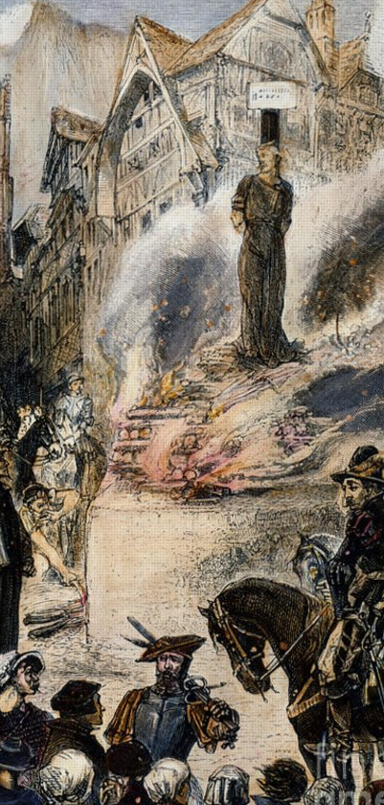
The Genevan Consistory:
A Protestant Inquisition?
1553: Execution of Michael Servetus (denied Trinity; Infant Baptism)
Increases Calvin’s prestige and authority
Internal Opposition: Calvin refuses
Communion to ‘Libertines

Slide 9
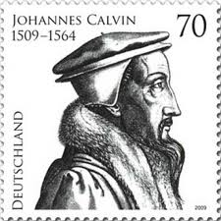
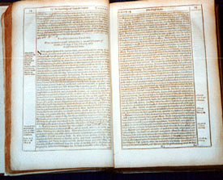
The Institutes of the Christian Religion, 1536 (revised 1539, 1543, 1550)
Comprehensive treatment of theology, sacraments, church government etc
Calvin (unlike Luther) a systematic thinker
Overarching theme: the complete majesty and freedom of God

Slide 10

Calvinism’s Defining Doctrine: Five Key Points of Predestination
Total depravity of humanity. People are sinners and cannot save themselves
Unconditional election. Only those who God chooses are saved
Limited atonement. Jesus died for the sins of the chosen only, not for all humanity
Irresistible grace. The elect have no choice but to choose God
Perseverance of the elect. Once you are saved, you are always saved.

Slide 11
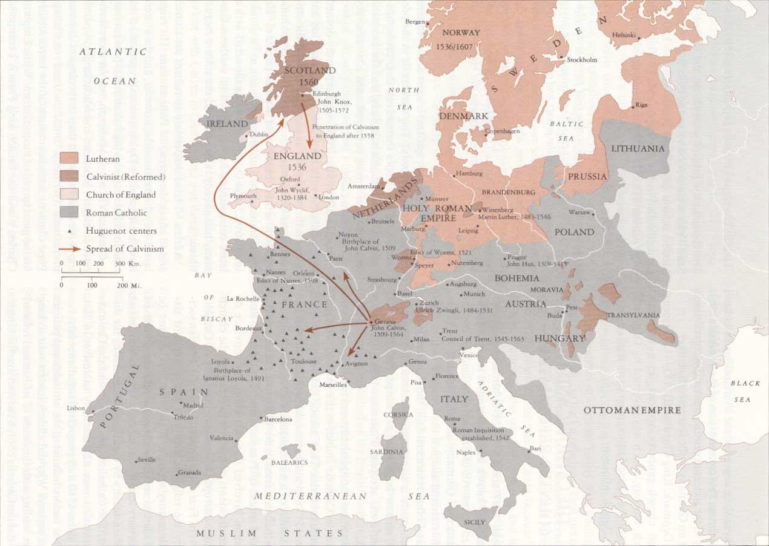
The spread of Calvinism in later 16th century

Slide 12
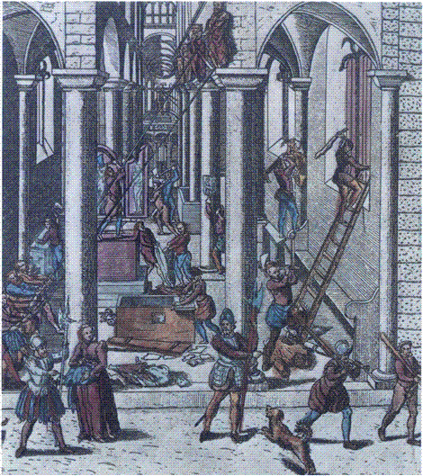
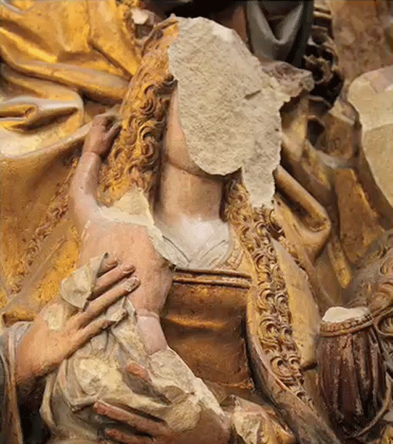
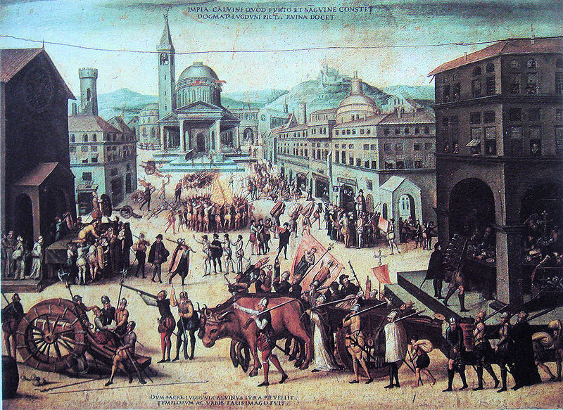
Iconoclasm (destruction of images): popular & official
Association with political revolt in France, the Netherlands & Scotland
Underground churches (in secret)/ Stranger churches (in exile)
Persecution a sign of election (Calvin condemned compromise and outward conformity ‘Nicodemism’)
Appeal in Eastern Europe (Lutheranism too ‘German’)
But also appeal to German Princes: ‘Second Reformation’ in Empire
Flexibility: Elizabethan Church of England had Calvinist theology and Catholic-style bishops
Calvinism: an international creed and a creed for rebels?

Slide 13
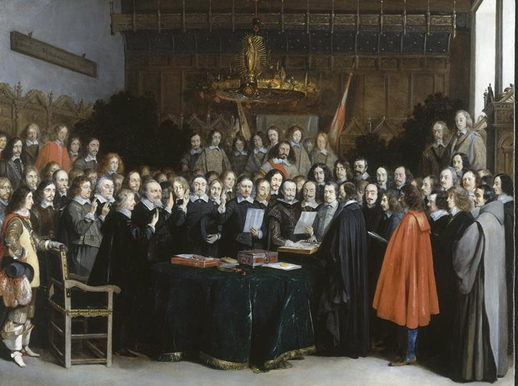
The Emergence of Religious Peace
Peace of Augsburg 1555, ending war between Charles V and Lutheran Princes: principle of cuius regio, eius religio (‘your prince, your religion’)
Edit of Nantes 1598, ending (temporarily) religious conflicts in France: rights to worship for French Huguenots
Peace of Westphalia (Treaties of Münster and Osnabrück) 1648 marking end of Thirty Years War: reinstates Peace of Augsburg and extends legal recognition to Calvinism; independence of Holland; limited rights for minorities to practice faith privately
(late 17th and 18th century warfare in Europe less obviously confessional: eg Protestant Britain allied with Catholic Austria against Louis XIV’s France)
Ratification of the Treaty of Münster, May 1648

Slide 14
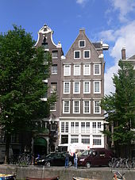
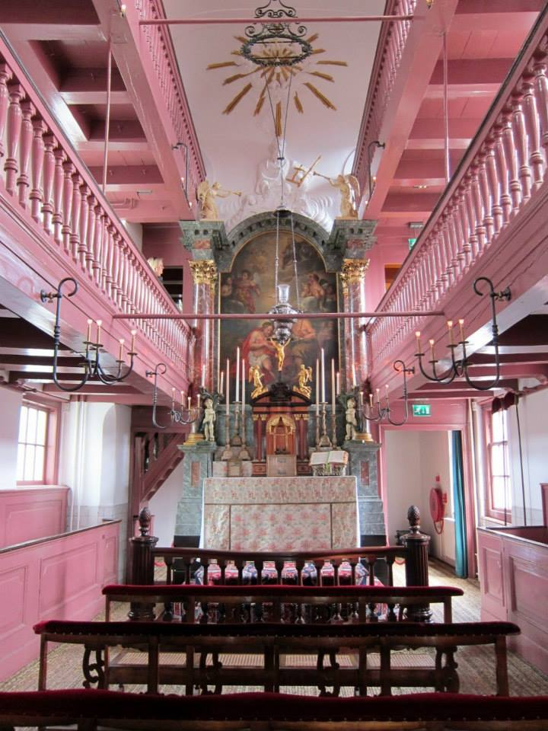
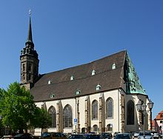
Living with Difference
Few confessionally ‘pure’ states in western Europe; virtually none in eastern Europe (Lutheran Scandinavia; Catholic Spain)
Phenomenon of religious pluralism: Lutherans, Calvinists, Catholics mixed across Holy Roman Empire; Protestant Huguenots in France; Catholic communities in Netherlands, England, Scotland; Protestant minority in Ireland
Impossible to impose complete religious uniformity: trials, executions for heresy increasingly rare after 1600
In Germany, Low Countries relatively easy to cross borders to attend alternative services (‘Auslauf’)
Formal (France, German Empire after 1648) and informal (Britain, Netherlands) toleration
‘Our Lord in the Attic’: A discrete Catholic church in 17th-century Amsterdam
St Peter’s, Bautzen:
Germany’s oldest ‘Simultankirche’ (Lutheran/Catholic shared church)

Slide 15
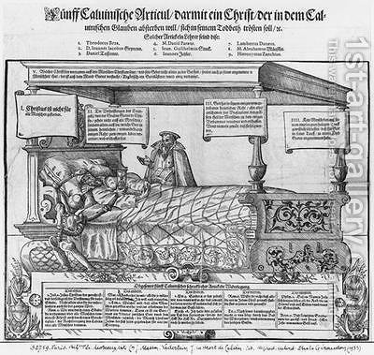
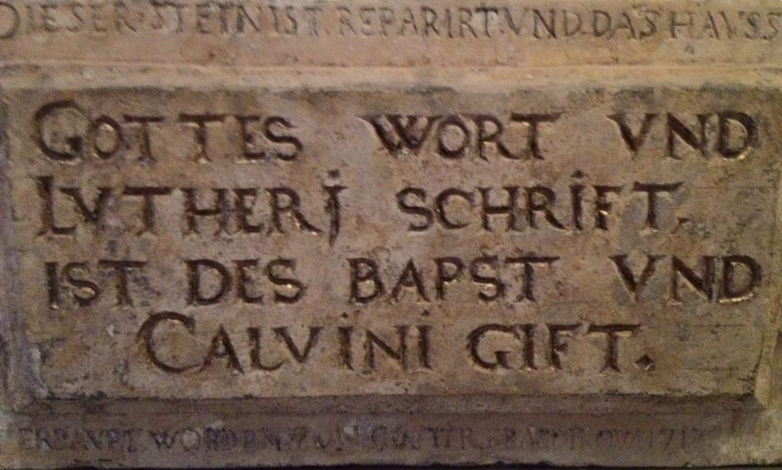
Confessional Culture in the Age of Religious Pluralism
Mutual hostility of Protestant confessions (especially Lutheranism to Calvinism)
Social peace not same as ‘good community relations’: sharing of churches involved strict policing and regulation
clearer confessional identities reduces interactions between rival groups (rates of inter-marriage falling in Netherlands, Germany in 17th century)
Identity-formation through confessional conflict: predestination more important to Calvinists because Lutherans attack it; Lutheran insistence on ‘real presence’
Gregorian Calendar 1582 not adopted by Protestant Europe – Christmas, Easter etc celebrated on different days in German cities (Britain adopts 1752; Sweden 1753)
Deathbed of Calvin: A Lutheran satirical print
‘God’s Word and Luther’s writings are poison to the pope and Calvinists’: a building stone from early modern Wittenberg

Slide 16
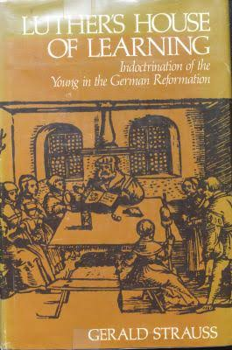
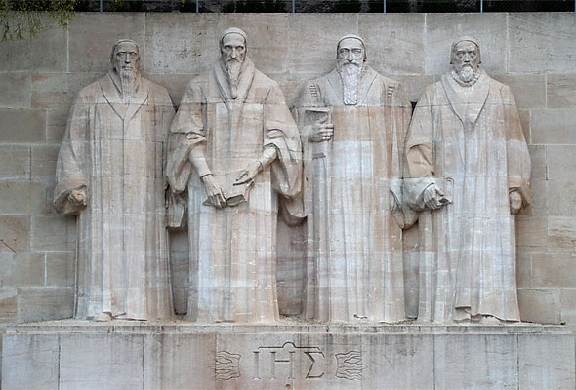
Was the Reformation a Failure?
Catholicism could be overthrown, but could ordinary people be made to accept and understand doctrines of justification, predestination, and reform behaviour?
Gerald Strauss, Luther’s House of Learning (1978) – Reformation an educational failure. Evidence of church ‘visitors’ in Saxony, Brandenburg 1570s and 80s: widespread ignorance, absence from church, work on Sundays; some villages where not single person knew Ten Commandments
Consistory records from across Calvinist Europe: continuing ‘superstition’, belief in magic, fairies, ghosts
Sense of reformers themselves that they had failed: – eg Johann Aurifaber, editor of Luther’s Table Talk (1566) – his teachings ‘are now everywhere despised, and so many men have lost interest in them that his very name is held in contempt’.
The ‘Reformation Wall’, Geneva (1909)

Slide 17
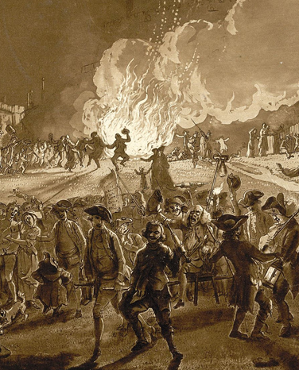
Conclusions: The Impact of the Protestant Reformations
Hopes and aspirations of Protestant reformers often not fulfilled (sin and ignorance persist!)
But, across Europe, strong sense of Protestant (or Lutheran, Calvinist) cultural identity: in era of ‘confessionalization’ ordinary people were ‘starting to own the labels’ (D. MacCulloch)
Gradual emergence of first de facto then legal religious toleration, though in some ways this increases religious tensions as much as eases them
Public, political importance of religion: crucial in 1600, even 1700, but wanes over course of 18th century
Secularization? Better seen as privatization of religious faith
Pluralization, Privatization, Toleration – last things Luther or Calvin would have wanted. Reformation a lesson in unintended consequences!
Popular Protestantism and Anti-Catholicism: Bonfire Night in early 18th century

