Slide 1
EUROPE IN THE MAKING 1450-1800
Introduction and Rationale

Slide 2
What is the module about?
Why is it a core module?
Why ‘Europe in the Making’?
Why 1450-1800?

Slide 3
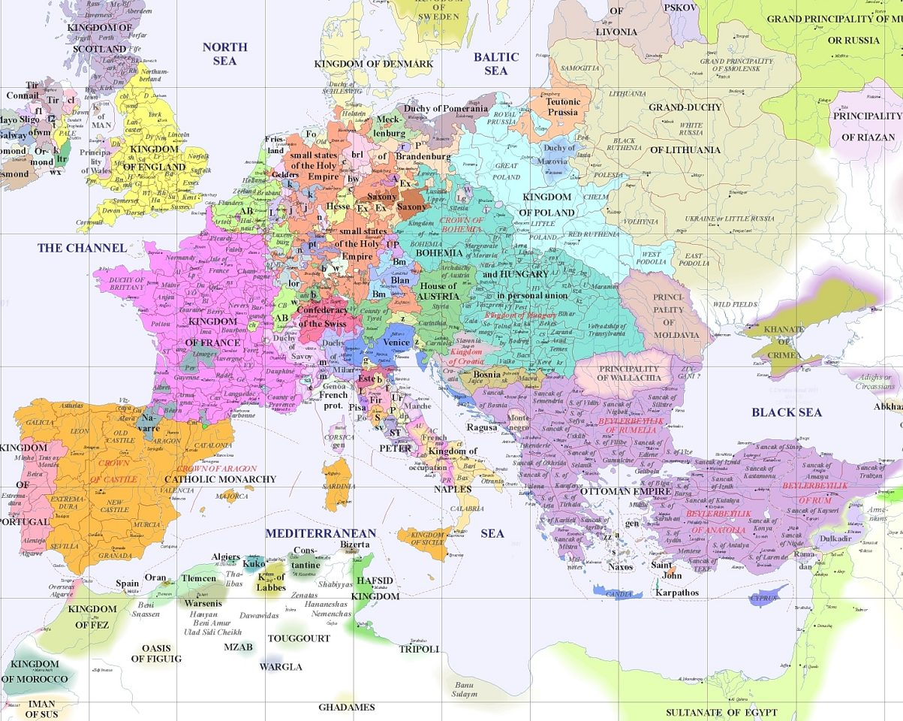
Notes:
The political topography of Europe c. 1500, including the familiar (England), less familiar (Holy Roman Empire) and unexpected (Ottoman Empire)
The village of Artigat in South-West France (setting for ‘Martin Guerre’)

Slide 4
‘Early Modern’: Some dates and developments
1450 – Johannes Gutenberg printing press with moveable type; new possibilities for diffusion of knowledge and standardization of texts (and survival of texts)
1453 – Fall of Constantinople; Christian confrontation with Islamic ‘Other’
1492 – Columbus’s ‘discovery’ of America; economic, political and cultural implications of a more globally connected world
1517 – Martin Luther’s challenge to the papacy; fragmentation of a unified ‘Christendom’ and era of new ideological conflict (leading eventually to pluralism)

Slide 5
Themes that give some coherence –
Social change: a rising population that put pressure on resources (up to mid 17th c)
Economy: The emergence of Europe-centred networks of production and exchange; growing ‘consumer’ demand
Culture: a ‘long Renaissance’ that changed the nature and exchange of knowledge; moves from received knowledge towards experimentation; frictions between social disciplining and popular customs
Politics: The emergence of a European state and imperial system; ever larger-scale warfare, state formation and a power shift away from the periphery towards the centre

Slide 6
Sense of turning points around end of 18th century: political Revolutions (1776 America; 1789 France); industrialisation and urbanisation on larger than ever scale – beginnings of ‘modernity’
But equally important to think about what does not change in ‘early modern’ period, or changes very slowly:
        Basic life expectancy and conditions of material existence?
        Social hierarchies of rank, age and gender?
Assessing balance of continuity and change the key historical challenge?
Is period 1450-1800 unique, special, or even helpful in this task?

