Slide 1
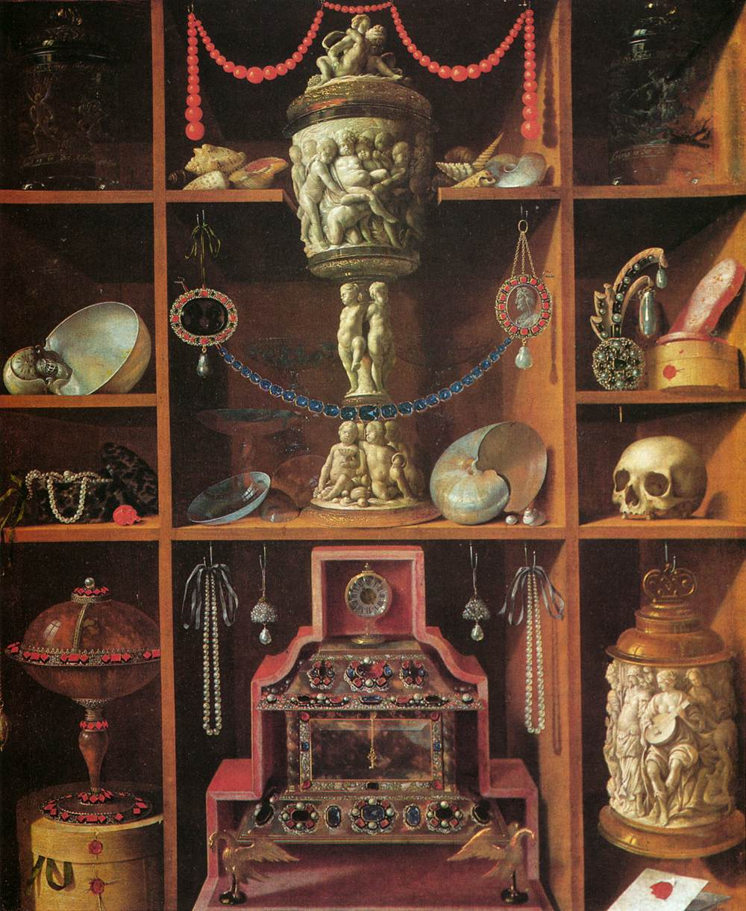

Cabinets of Curiosities 2026-27
Masculinities in History
Are you interested in communication, museums or public history?
Join the team to create your own cabinet of curiosity for display in the department!
The project is guided by Dr Imogen Knox, historian of masculinity
Gain first-hand experience in curation
Explore masculinities throughout history
Customise the department space
Add something unique to your CV
For more details email Imogen.H.Knox@warwick.ac.uk or visit the webpage via the QR code

Slide 2
Luther and the Origins of Reformation
Peter Marshall

Slide 3
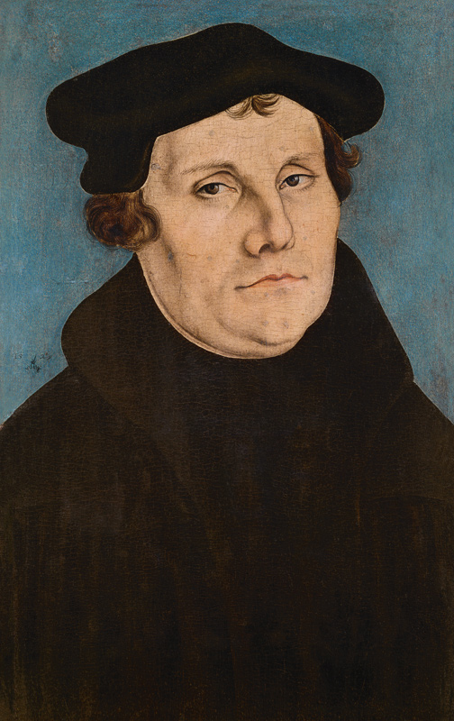
Themes of the Lecture:
Who was Martin Luther?
What were the origins of his protest against Roman authority?
How and why did Luther’s protest escalate?
Was Luther a radical or a conservative?
What were his views on rebellion, marriage and gender, Islam and Judaism?
Resolving the paradox of Luther

Slide 4
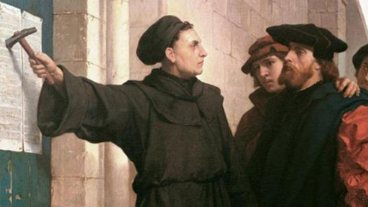
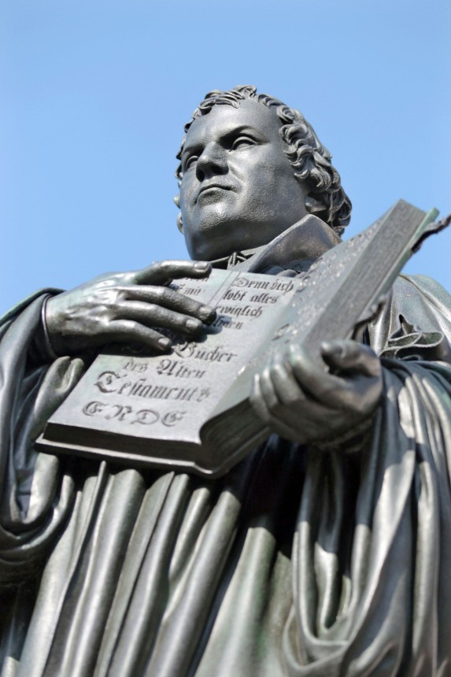
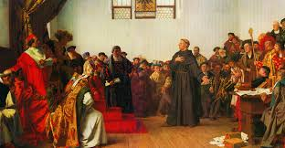
The Myth of ‘Great Man’ Luther:
archetypal rebel!
The lone figure confronting authority:
posting of 95 Theses, 1517
appearance at Diet of Worms, 1521 (‘Here I stand, I can do no other’).
The first ‘Protestant’
instigator and leader of ‘the Reformation’
icon for rights of individual conscience; a modern rather than medieval man.

Slide 5
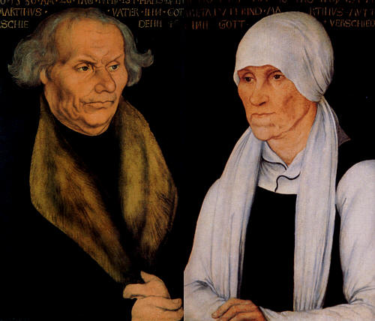
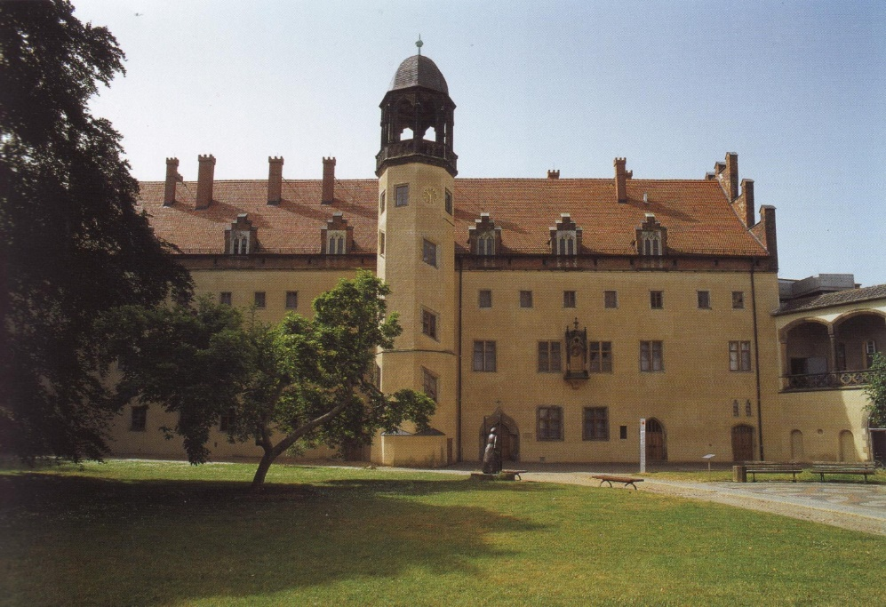
But… none of this apparent at the time
No intention in 1517 to start a ‘Reformation’, a schism in the Church:
Luther initiating academic debate, about one aspect of theology, in fairly normal way.
no advocate of individual rights (‘my conscience is captive to the Word of God’).
Conventional background: comfortable upbringing in Mansfeld, Saxony (father an affluent master-smelter, not a poor miner).
Most rebellious thing was to defy father and become a monk! 1511 transfer to monastery in Wittenberg, and teaching at university; 1512 Professor of Biblical theology; 1514 city preacher
part of the late medieval Catholic establishment.
Luther’s parents: Hans and Margarthe
Augustinian monastery, Wittenberg

Slide 6
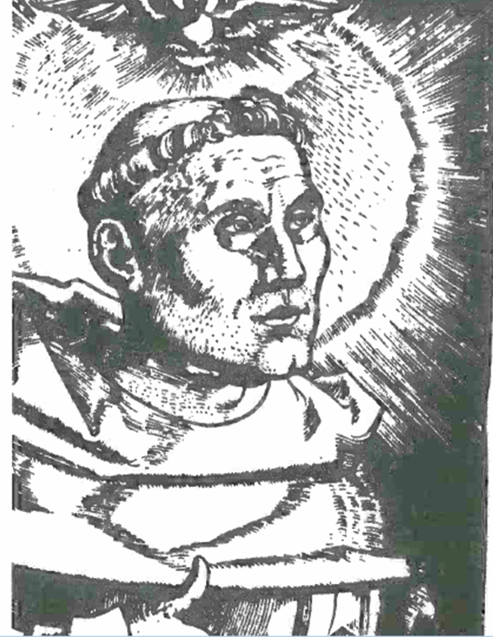
Luther the Catholic friar

Slide 7
How does Luther become ‘radicalised’?
Combination of personal spiritual crisis (and its resolution) and public debate which becomes question of authority.
Luther’s scrupulosity – how can I be good enough to satisfy God’s demands?
Problem of righteousness. Teaching of scholasticism (academic approach to theology) – facere quod in se est (‘do the best you can’) – not working for Luther: doubt and despair.

Slide 8
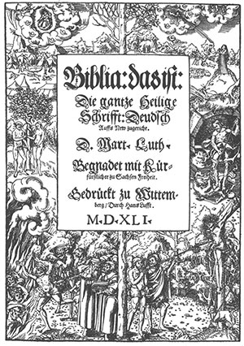
Luther’s Breakthrough: ‘Justification by Faith Alone’.
1514-15 Turmerlebnis (‘Tower experience’) sudden moment of conversion and insight.
Probably more gradual development of ideas 1513-18. Intense interest in bible (not unusual for medieval theologian!)
but new understanding of St Paul’s Letter to the Romans ‘the righteous shall live by faith’.
Righteousness not achieved, but imputed: not ‘good works’ but Christ’s sacrifice makes people reconciled to God, who accepts them as righteous, even though they remain completely sinful.

Slide 9
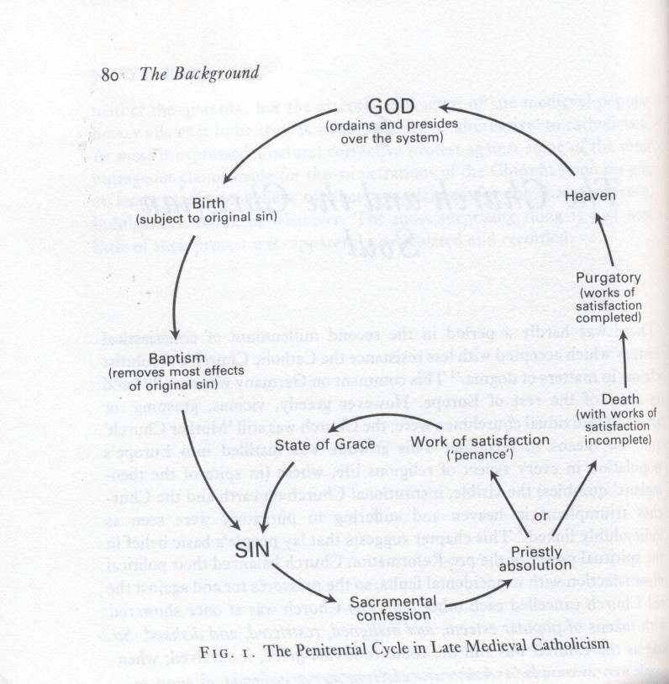
The Indulgence Controversy –
in medieval theology sins forgiven by priest in confession, but still a penalty (satisfaction) to be paid, either in this life or purgatory.
Part or all can be commuted in return for good work – saying certain prayers, pilgrimage etc – indulgence a certificate of this.
Becomes possible to buy them, with money to specific good cause (eg rebuilding of a church), and to buy on behalf of someone already dead.
Church has ‘Treasury of Merit’ to draw on, comprising the excess good deeds of Christ and the saints (popes claim to hold the keys to this)

Slide 10
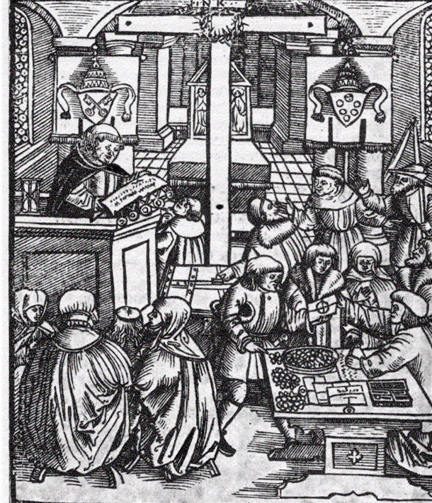
Luther’s unease –
seems to imply God’s forgiveness can be bought
widely shared in medieval Church. Some of 95 Theses (why does pope not free all souls from purgatory?) familiar themes.
Specific indulgence issued 1517 by Leo X for building of St Peter’s Basilica part of ‘dodgy deal’.
Preached in Germany by Dominican friar Johan Tetzel in particularly materialistic way.
Protest amplified by: printing; humanist support; nationalistic and anti-Italian feeling.
“As soon as the coin in the coffer rings…”Tetzel’s Indulgence campaign

Slide 11
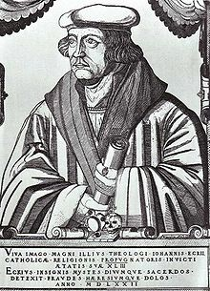
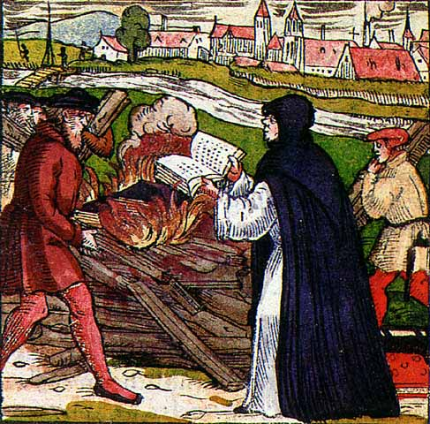
Opposition radicalises Luther
1519 Leipzig Debate with clever orthodox opponent, Johan Eck. Luther manoeuvred into condemning General Councils as well as Popes (Jan Hus unjustly condemned 1415).
Scripture now the only source of authority; papacy the Antichrist.
Pope excommunicates Luther 1520; Luther publically burns bull of excommunication!
Three key treatises: To the Christian Nobility of the German Nation (secular authority should reform church); The Babylonian Captivity of the Church (only three sacraments, not seven); The Freedom of a Christian Man (faith the only way to righteousness).
By 1521 figurehead of a revolutionary movement: best-selling author, most famous priest in Germany.
Johan Eck
Point of no return: Luther burning papal bull of excommunication, 1520

Slide 12
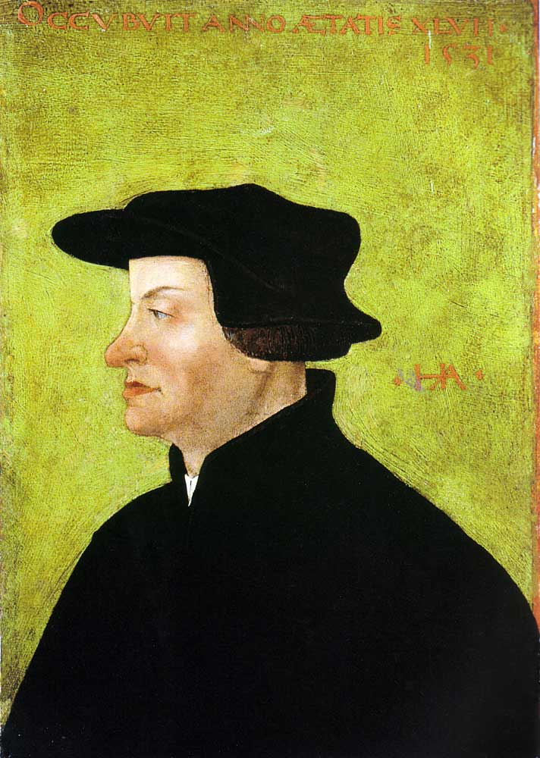
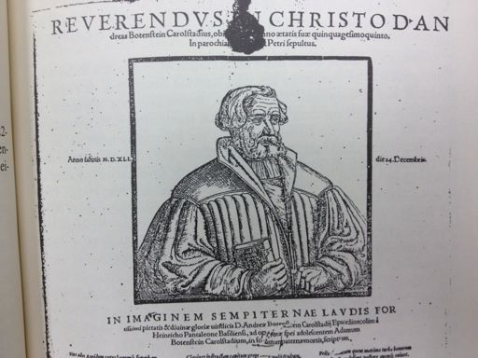
The Limits of Luther’s Radicalism:
quarrel with ally Andreas von Karlstadt, who reforms Wittenberg during Luther’s absence 1521-2, removing images from churches and abolishing Latin services.
Luther reverses the changes – reform must be orderly, and directed from top.
Luther good at quarrels – retains elevation of bread during mass because Karlstadt opposed it!
Inflexible too in growing split with followers of Zwingli: Marburg Colloquy 1529, Luther refuses to negotiate over ‘real presence’ in eucharist.
Ulrich Zwingli
Andreas von Karlstadt

Slide 13
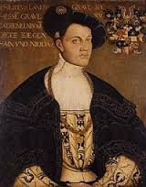
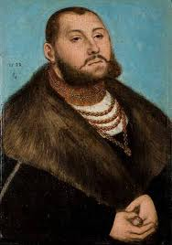
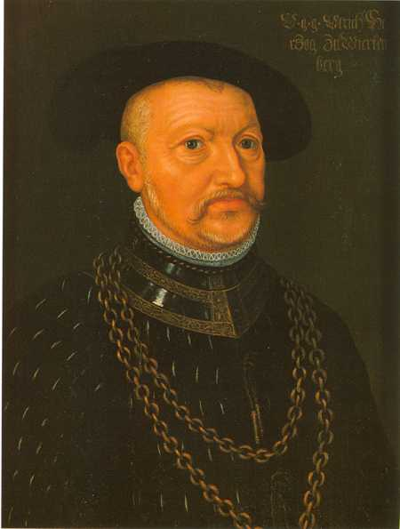
Theologically radical and politically conservative?
‘Christian liberty’ a key concept, but refers to binding of spirit and conscience, not social freedoms.
‘Two Kingdoms’ theory (in Of Secular Authority, 1523): Kingdom of God is true church, found in hearts of the justified, no need for coercion over it; Kingdom of the World that to which justified and unjustified alike belong.
Princes as God’s ministers wield ‘the sword’ to keep sinful in order, and control all property and structures of the visible church.
Even evil rulers must be obeyed (Romans 13: ‘be you subject to the powers that be’) – though Luther does help produce justification for German princes’ opposition to Charles V.
Philip of Hesse
John Frederick of Saxony
Ulrich of Wurttemberg

Slide 14
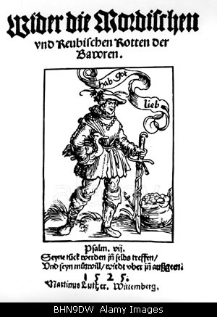
Peasants’ War 1524-5
strengthens Luther’s identification with forces of order.
Fear that peasants misunderstanding his teaching, and endangering his reformation, seeing ‘the Gospel’ as a charter of social liberation.
Luther publishes against the ‘robbing and murdering hordes’ and urges princes to crush them with brutal force.
“Therefore let everyone who can, smite, slay, and stab, secretly or openly, remembering that nothing can be more poisonous, hurtful, or devilish than a rebel…”
Luther’s tract of 1525

Slide 15
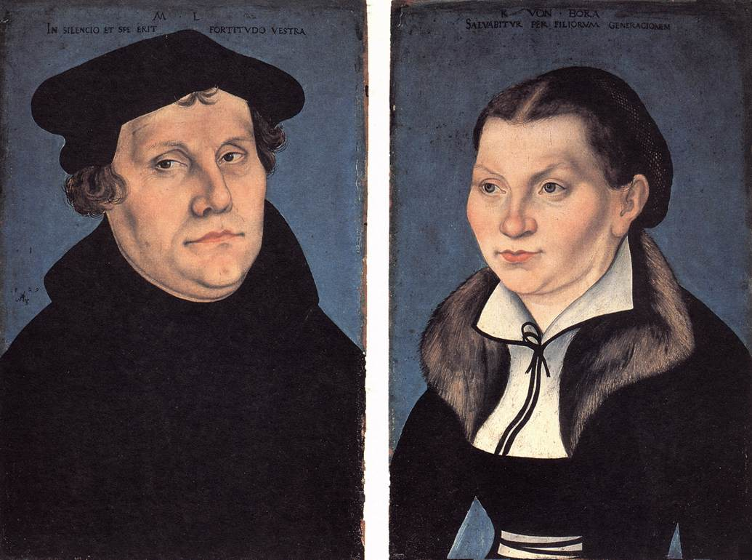
Social and cultural attitudes:
intriguing mix of revolutionary and old-fashioned/reactionary.
Marriage: revolutionary step of marrying Katharina von Bora (a former nun!) and living with her in former monastery.
Bold statement of equality of clergy and laity; virginity not superior to married life; spiritual vocation to be husband, wife, mother or father.
Divorce now possible.
But… no relaxing of patriarchy, and distinctly unmodern attitudes to women (‘Let them bear children to death, that’s what they’re there for’).

Slide 16
Other faiths:
Luther unusual in opposing anti-Islamic crusades (religion should not be imposed by force, and pope rather than ‘the Turk was true enemy). Interested in, and even praises some Turkish customs; Supports translation of Koran 1542.
But not religiously tolerant – Islam a false faith, and reading Koran would help people to see this!
Judaism: Luther rejects medieval slander of ‘ritual murder’, and 1523 pamphlet That Jesus Christ was born a Jew argues Jews should not be shunned or forced into usury.
But ‘liberal’ attitudes entirely tactical – Catholic Church blamed for making it hard for Jews to convert.
Failure of Jews to convert (and mistaken belief among Jewish communities he was their supporter) push Luther to harder position: On the Jews and their Lies (1543) advocates destruction of synagogues, burning of books, and expulsion from German territories.

Slide 17
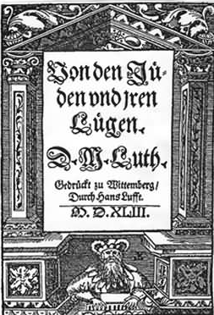
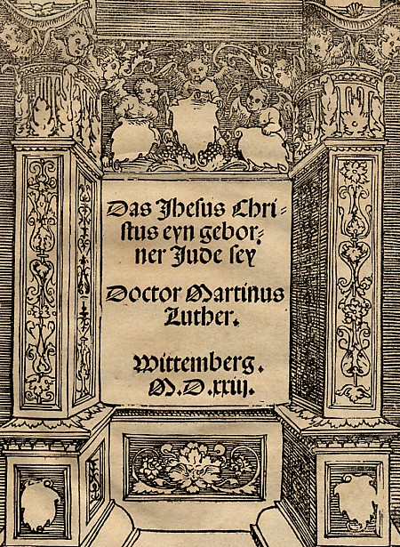
Luther’s anti-Semitic slide, from That Jesus Christ was Born a Jew (1523) to On the Jews and Their Lies (1543)

Slide 18
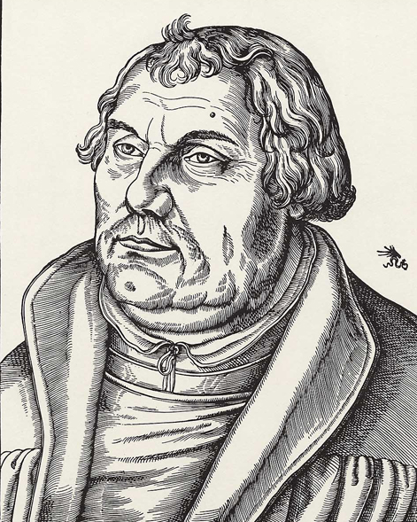
Which Luther?
Liberal or repressive?
‘Medieval’ or ‘modern’?
Veneration of political authority, but princes were ‘God’s jailers and hangmen’ and often ‘the greatest fools or the worse knaves on earth’.
Luther a puzzle to modern people, a problematic ‘hero’. But need to take him on his own terms:
paradoxes are very heart of Luther’s theology and belief.
Human beings are simul justus et peccator (at the same time justified, and a sinner)
the eucharist is both real bread and the true body of Christ
people are totally enslaved by their sinful nature and liberated by the Gospel of Christ. In some ways,
Luther looks conservative not because his theology was not as radical or innovative as that of other reformers, but because in some ways it was more so!

