Slide 1
Nature
Europe in the Making
Dr. Michael Bycroft
22 October 2019

Slide 2
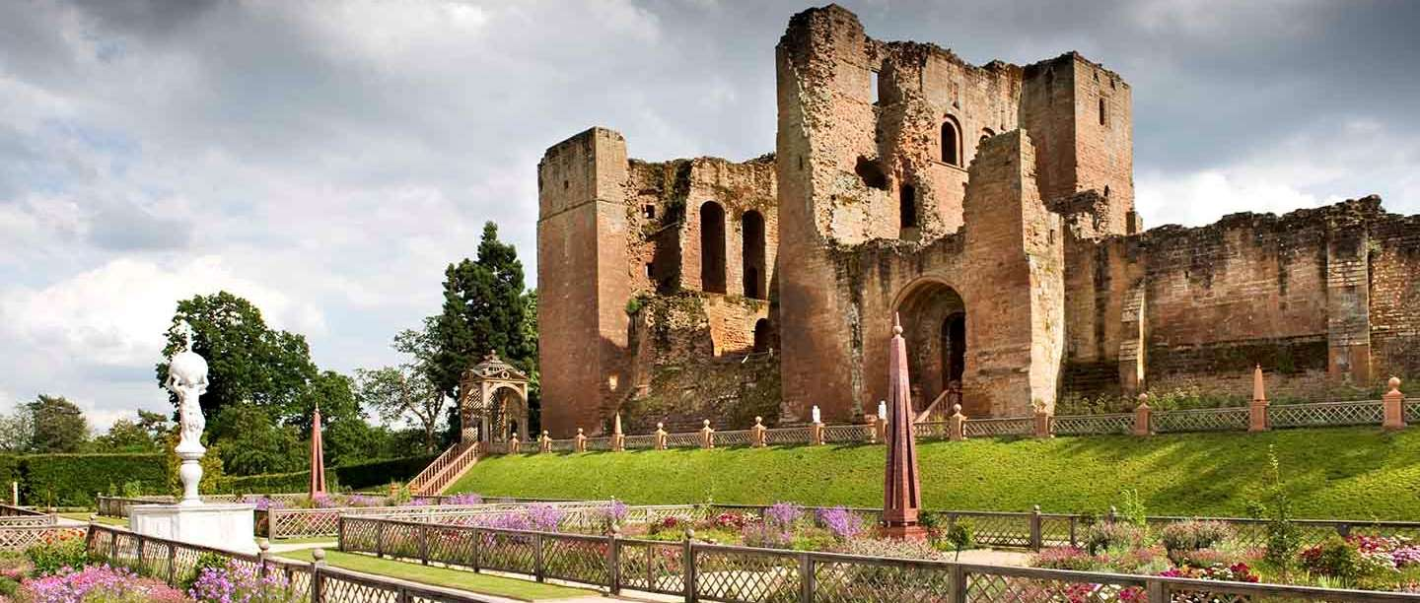

Slide 3
Why?
When?
So what?

Slide 4
The cosmos
The animal kingdom

Slide 5
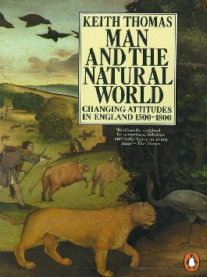
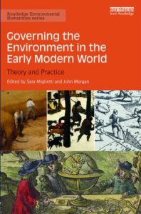
1983
2017

Slide 6
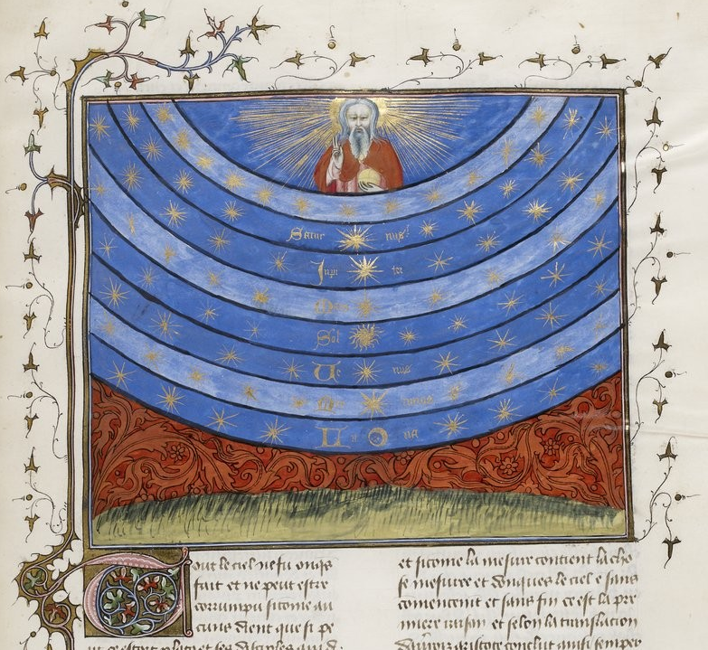
The Medieval cosmos, from French manuscript c. 1400-1420, containing works by Nicholas Oresme

Slide 7
Mercury
Moon
Fire
Earth
‘Planet’ earth

Slide 8
The Medieval cosmos, from French manuscript c. 1400-1420, containing works by Nicholas Oresme

Slide 9
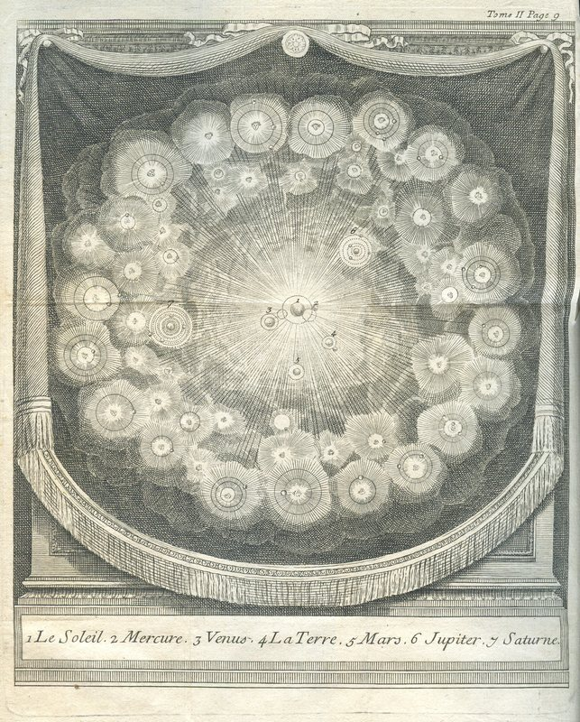
Bernard le Bovier de Fontenelle, Conversations on the Plurality of Worlds (first pub. 1686, this from 1766 edn.)

Slide 10
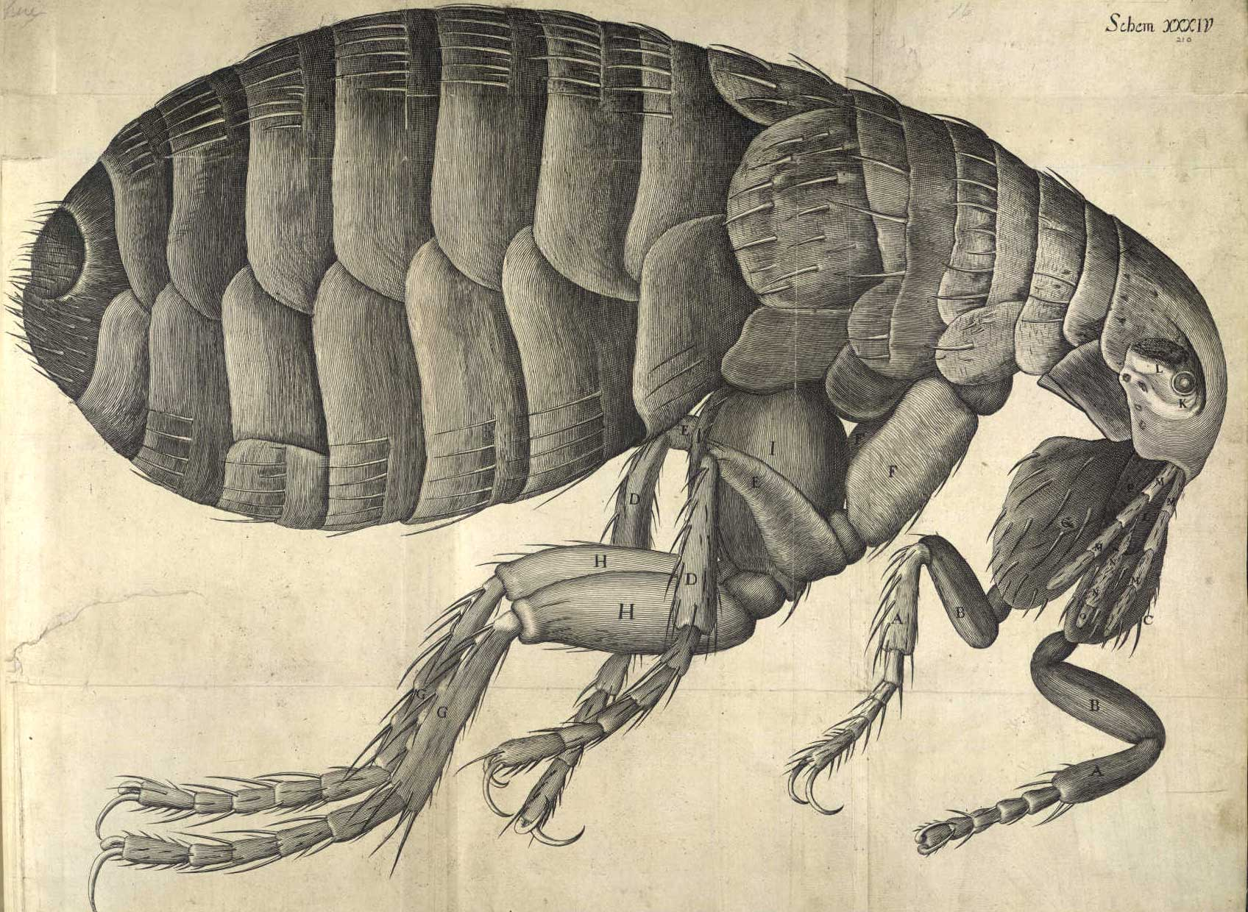
Flea, from Robert Hooke, Micrographia, 166?

Slide 11
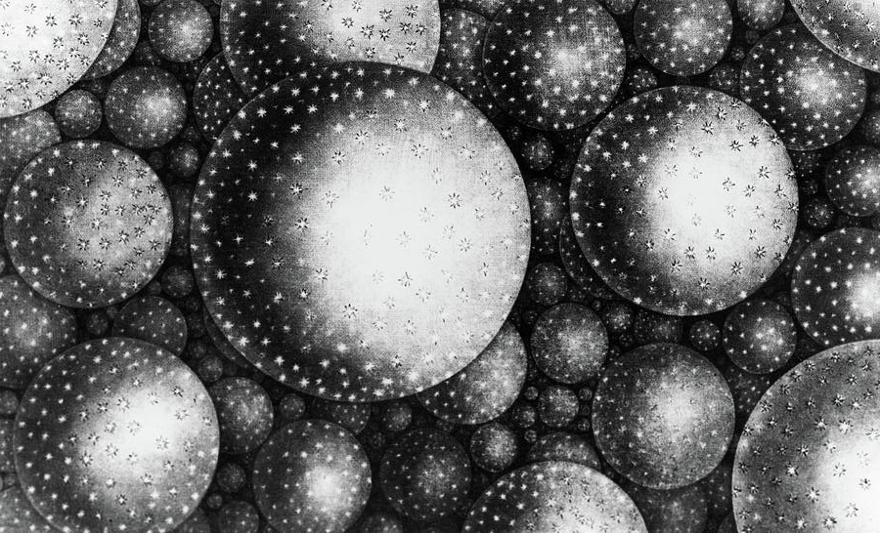
‘A Partial View of Immensity’, from Thomas Wright, Original Theory or New Hypothesis of the Universe (1750)

Slide 12
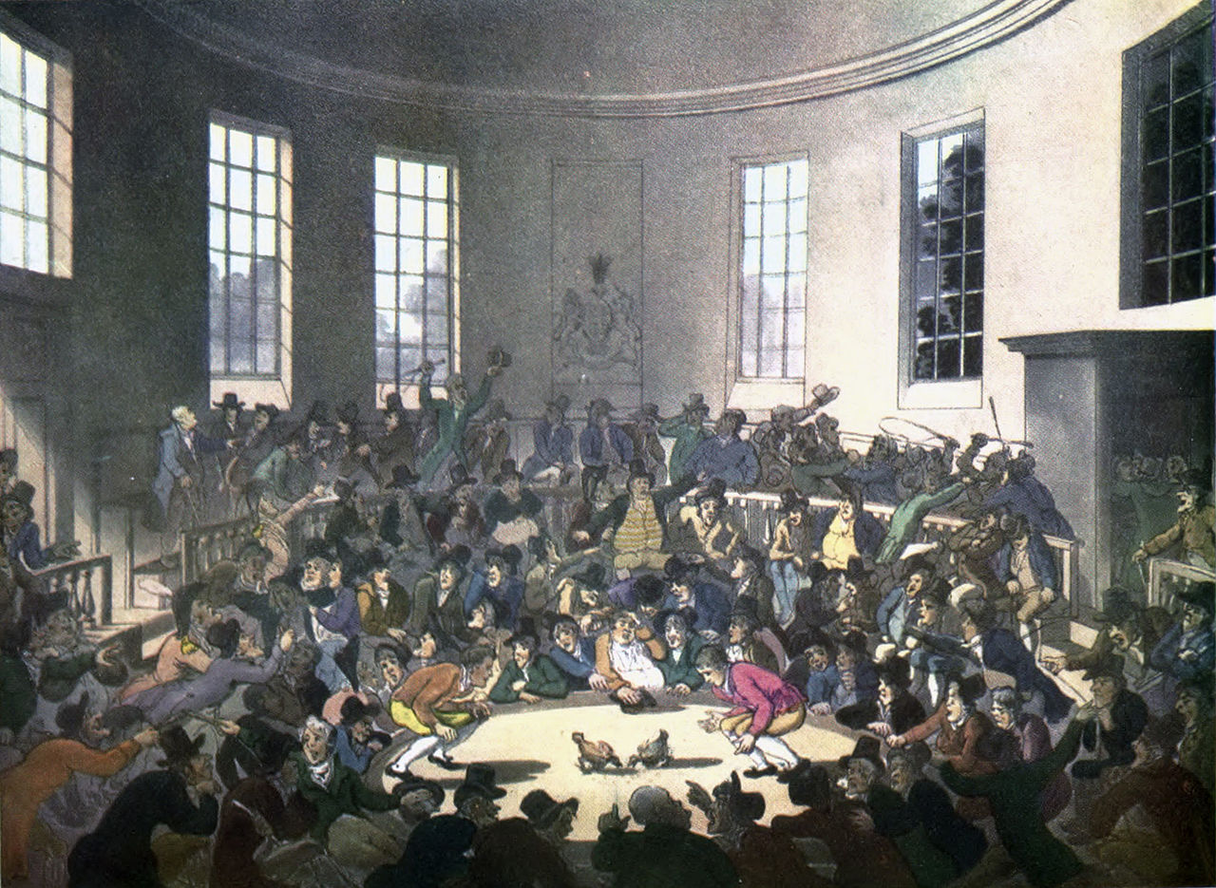
Cock-fight in London, c. 1808

Slide 13
The fear of you and the dread of you shall be upon every beast of the earth, and upon every fowl of the air, upon all that moveth upon the earth, and upon all the fishes of the sea; into your hand are they delivered. Every moving thing that liveth shall be meat for you.
-- Book of Genesis, Old Testament, chapter 9, verses 2-3

Slide 14
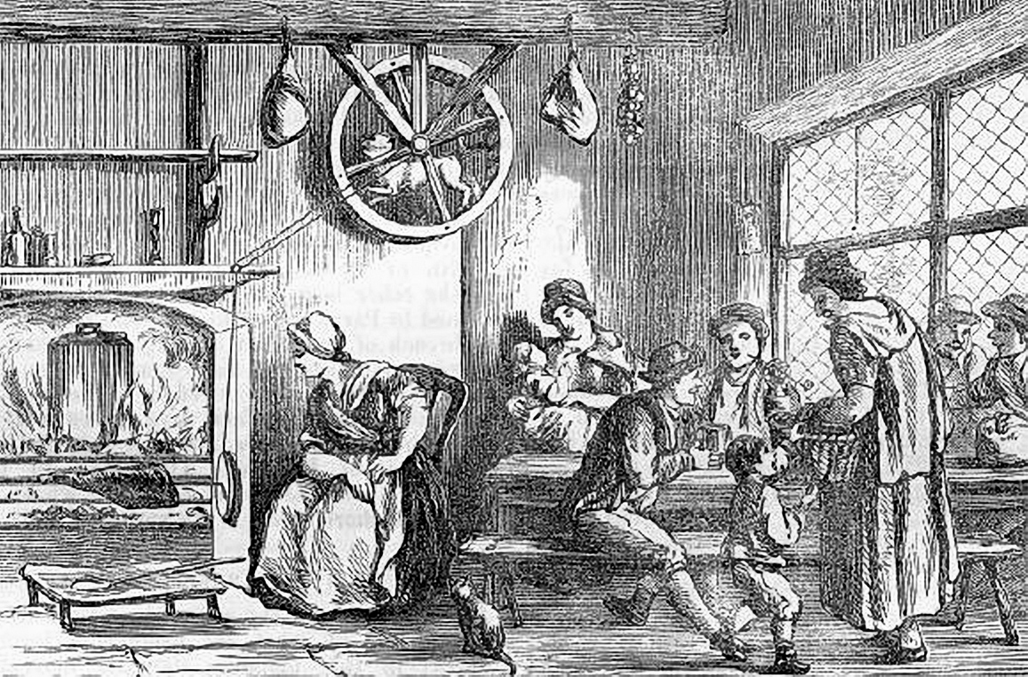
Turnspit dog at an inn (?) in Wales, c. 1800

Slide 15
The barking of curs, bawling of mastiffs, bleating of sheep, tattling of jackdaws, girning of boars, yelping of foxes, squeaking of weasels, kekling of hens, chanting of swans, chattering of jays, peeping of chickens…
-- from Thomas Urquhart, translation of works of Rabelais, 1653

Slide 16
Acts of Parliament against…
  Horses and cattle (1822)
  Dogs (1839 and 1854)
  Bear-baiting and cock-fighting (1835 and 1849)
1596 – Chester bans bear-baiting
1654 – Protectorate bans cock-fighting and cock-throwing
1773 – Birmingham bans bull-baiting

Slide 17
Why?
When?
So what?

