Slide 1
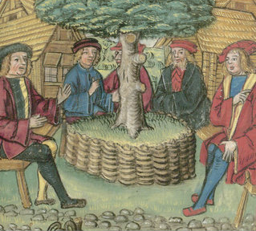
POPULAR POLITICS & PROTEST
EUROPE IN THE MAKING – SECTION ‘POWER’
Spring Week 8 Beat Kümin
1. Introduction & Historiography
2. Local government
3. Regional & territorial dimensions
4. The politics of resistance
Diplomatic assembly under a linden tree. Illustrated chronice (1513)

Slide 2
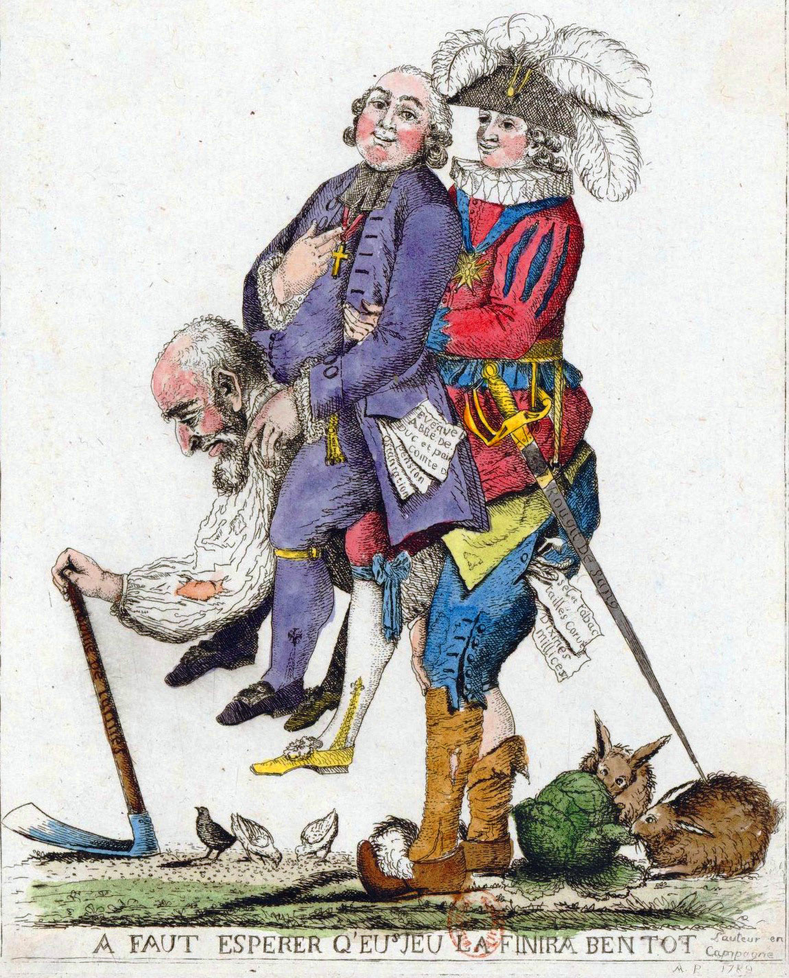
I Introduction Early Modern Theory The subjected third estate carrying nobles and clerics on its back (French print, 1790)

Slide 3
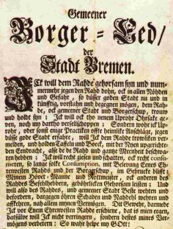
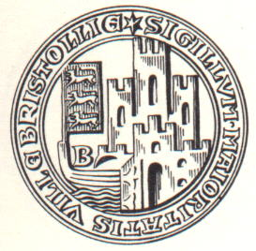
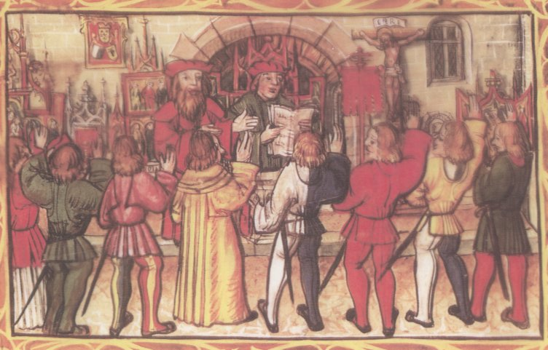
Seal of the burgesses of the City of Bristol (14thC, left) & burgher oaths sworn at Bremen (early modern text) / Lucerne (1513 image)
Early modern practice

Slide 4
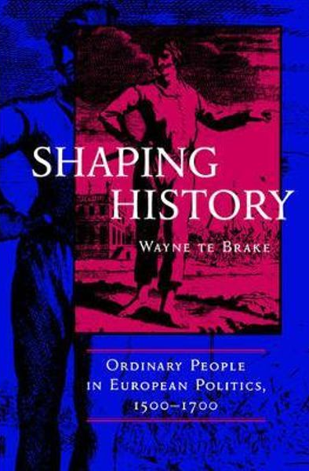
Historiography
‘[I]t is useful to regard politics as an ongoing bargaining process between those who claim governmental authority in a given territory (rulers) and those over whom that authority is said to extend (subjects)’.
Wayne te Brake, Shaping History: Ordinary People in European Politics 1500-1700 (1998), p. 6.

Slide 5
Current perspectives
From ‘political history’ to ‘political cultures’ (J.C. Scott / E.P. Thompson)
Extended source base
Poll – Who played the most significant role in early modern politics?
Princes / Rulers
Ministers / Officials
Burghers / Peasants

Slide 6
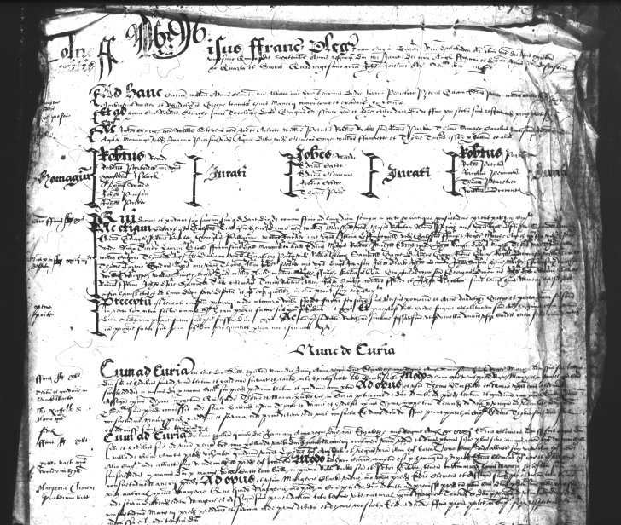
2. Local government
Rural context
Manor courts
Earls Colne, Manor Court Roll 1606 Essex Record Office

Slide 7
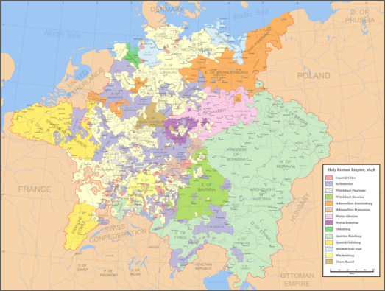
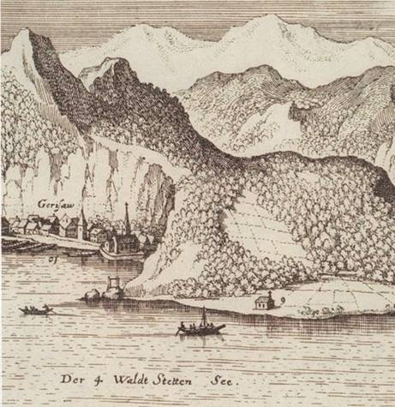
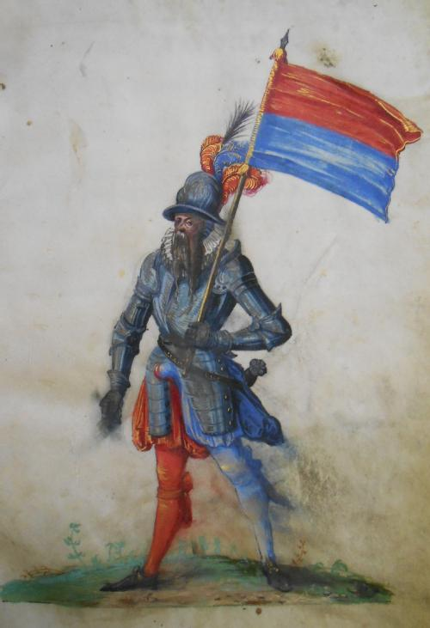
Rural communes
The parish republic of Gersau on Lake Lucerne: prospect with gallows (1640s, left) and standard bearer (1605, below)

Slide 8
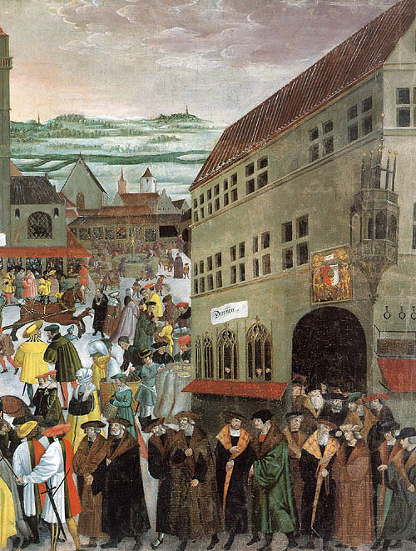
Town Hall and Councillors of the Imperial Free City of Augsburg Painting by Jörg Breu c. 1525
Urban
Communes

Slide 9
Our essential reading
The Concept of ‘Communalism’
& its critics

Slide 10
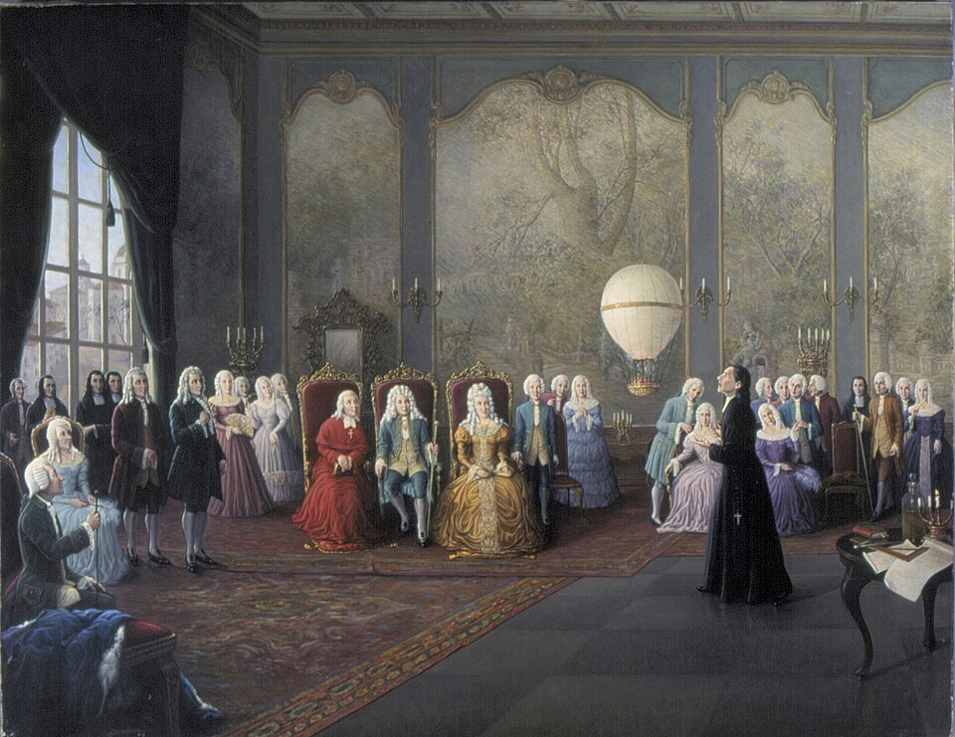
3. Regional & territorial dimensions
Informal influence
Personal approaches
Petitioning
An audience at the Portuguese Court
(c. 1740)

Slide 11
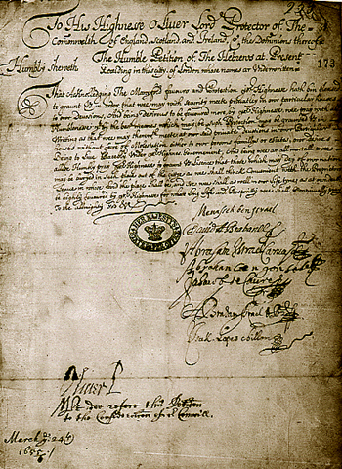
Petition by the Jews of London to Oliver Cromwell 1656 & see further examples on our seminar site

Slide 12
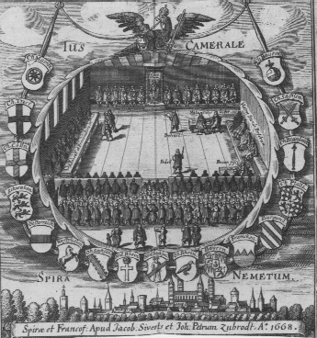
Formal influence - Recourse to the law - ‘Juridification’ of conflicts Session of the ‘Imperial Chamber Court’ in the Holy Roman Empire (17th century)

Slide 13
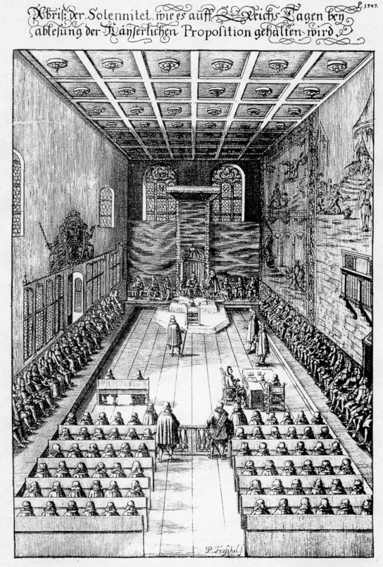
Session of the Imperial Diet at Regensburg (Engraving of 1675)
Involvement in representative
assemblies

Slide 14
RURAL REPUBLICS Example of the Three Leagues of the Grisons
‘The form of our government is democratic: and the election and deposition of the magistrates, all kinds of officers, judges and commanders, both in our free and ruling lands and in those which are subject to us, belongs to our common man; he has the power, according to his majorities, to create [and depose] them, to establish alliances with foreign princes and estates, to [decide] questions of war and peace, and to deliberate about all other matters pertaining to the high and lesser magistrates.’
Extract from an early 17thC pamphlet (Blickle 1998, 91, 114-15)

Slide 15
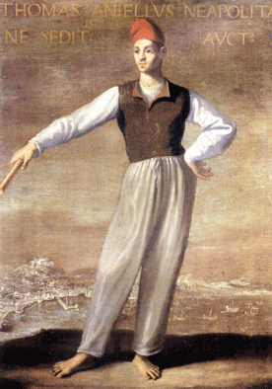
4. The politics of resistance
Gradations of discontent
Examples of early modern rebellions
Comparative analysis
Onofrio Palumbo (attrib.), ‘Portrait of Masaniello’. Napoli, Museo di San Martino.

Slide 16
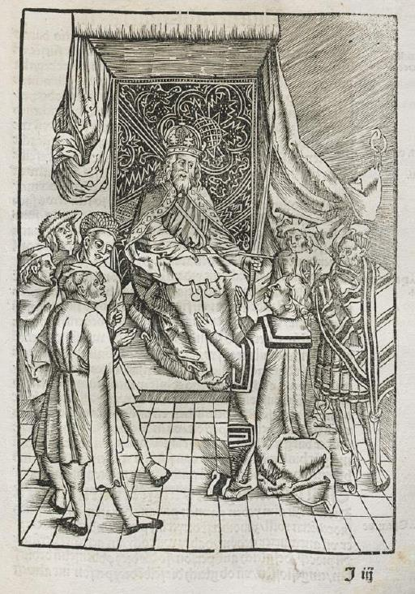
GRADATIONS of resistance
(Paradigm-changing) revolutions
(Military) pursuit of interests
(Constitutional) rebellions
(Socio-economic) riots
Written petitions
Personal pleas (e.g. at audiences)
Weapons of the weak (James C. Scott)
The Holy Roman Emperor granting a favour; woodcut in Ulrich Tengler, Layen Spiegel [The Mirror of the Laity] (Augsburg, 1509), f. 73r.

Slide 17
RIOTS - three ENGLISH contexts
General social discontent
Agrarian unrest (enclosures)
Food riots (famines)

Slide 18
‘A ‘bread riot’ might occur in England or France after a poor harvest, when local people saw grain being carried away to be sold … in some distant city. The rioters [tried] to force local magistrates to intervene, [reminding] them that they were failing in their duty. Very often the move succeeded. … Women … played a prominent part …, which made it easier for magistrates to agree to the demands without losing face. … But tolerance went only so far. [They] responded positively to the demands of Ann Carter, who led a grain riot at Maldon (Essex) in March 1629, but when she led another, larger and more threatening riot in May that year she was promptly arrested, tried and hanged.’
Bernard Capp, ‘Popular Culture(s)’, in The European World

Slide 19
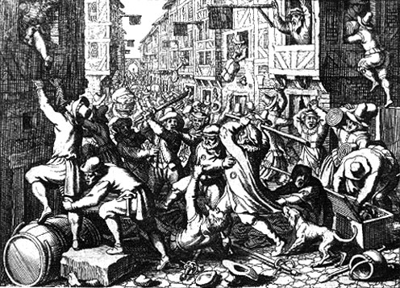
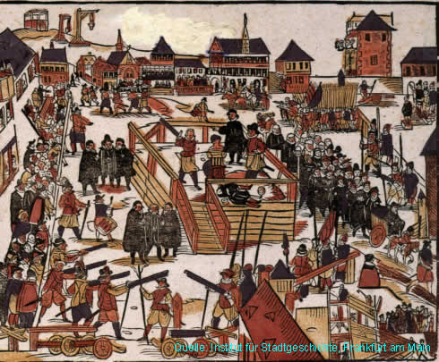
Rebellions The Fettmilch rising (1612-16)
Imperial Free City
of Frankfurt a. M.
To learn more about anti-Jewish aspects follow the link in the right-hand margin of our seminar site

Slide 20
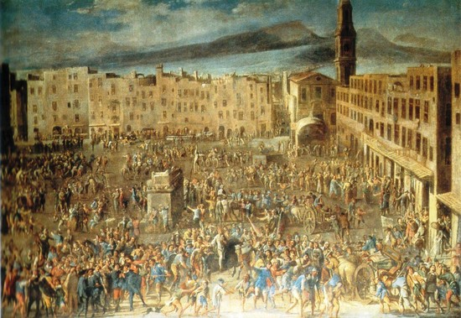
rebellions Naples 1647-48
A case of ‘down with the government’ combined with ‘long live the King’ & an attempt to restore 16thC governance.
Micco Spadaro, ‘Masaniello’s Revolt’. Napoli, Museo di San Martino
Onofrio Palumbo (attrib.), ‘Portrait of Masaniello’. Napoli, Museo di San Martino

Slide 21
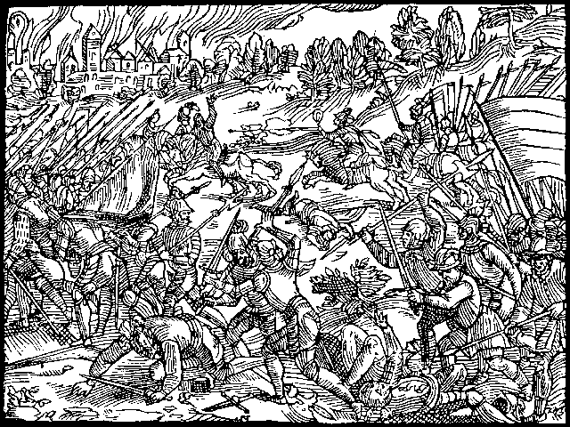
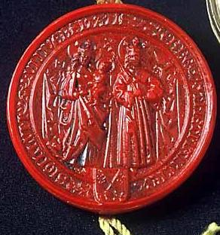
MILITARY CAMPAIGNS Peasant victory at Hemmingstedt (1500) & seal of the peasant republic of Dithmarschen
For some more facts & figures relating to the battle see the video link on our seminar site

Slide 22
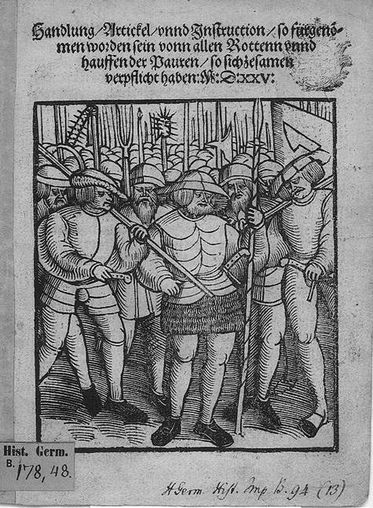
The Twelve Articles drawn up in the German Peasants’ War of 1525 targetted Church, lords & state First, it is our humble desire and request, and the intention and conviction of us all, that henceforth we want to have the full power for a whole congregation to select and elect its own pastor; and also the power to remove him, if he acts improperly ……. Third, until now it has been the custom for us to be regarded as a lord's personal property, which is deplorable since Christ redeemed us all with the shedding of his precious blood. ……. Ninth, we are burdened with a great evil in the constant making of new laws. We are not judged according to the offense, but sometimes with great ill will, and sometimes much too leniently. In our opinion we should be judged according to the old written law .
REVOLUTION ?

Slide 23
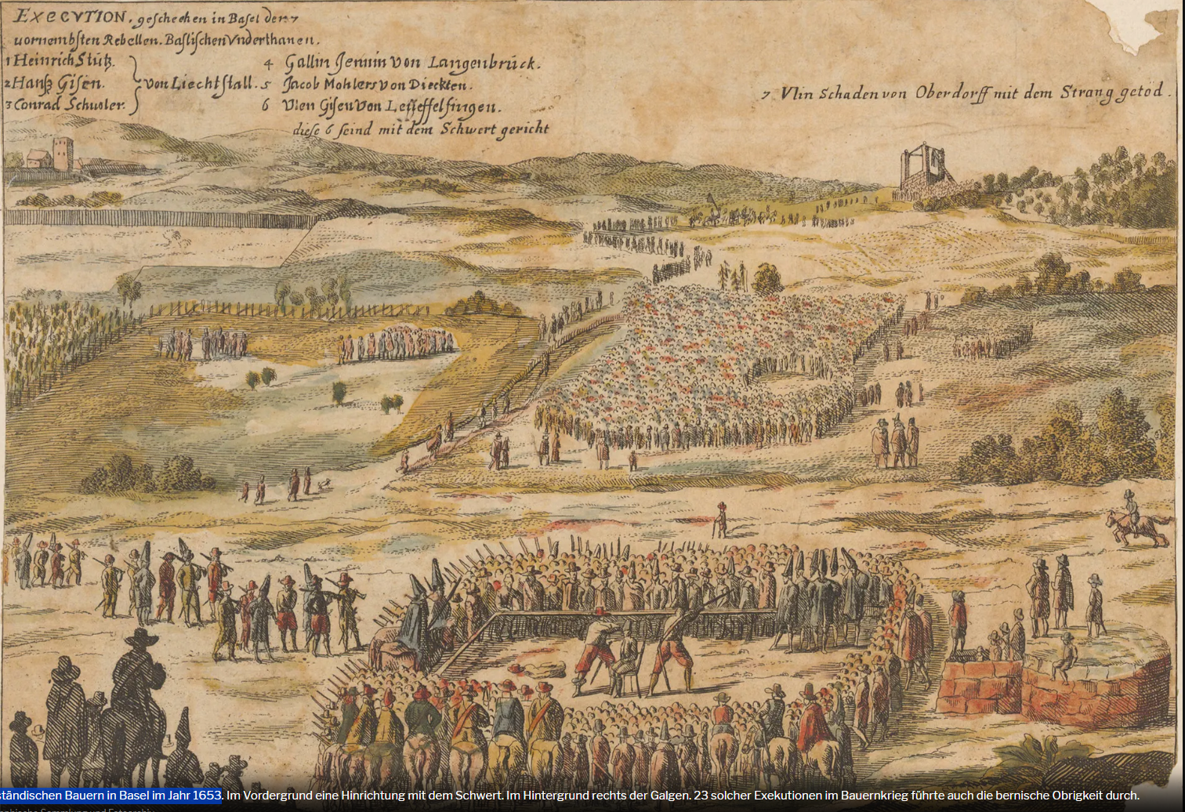
Execution of Peasant Ringleaders (Basel, 1653)
Zürich Central Library, Collection of Prints and Foto Archive

Slide 24
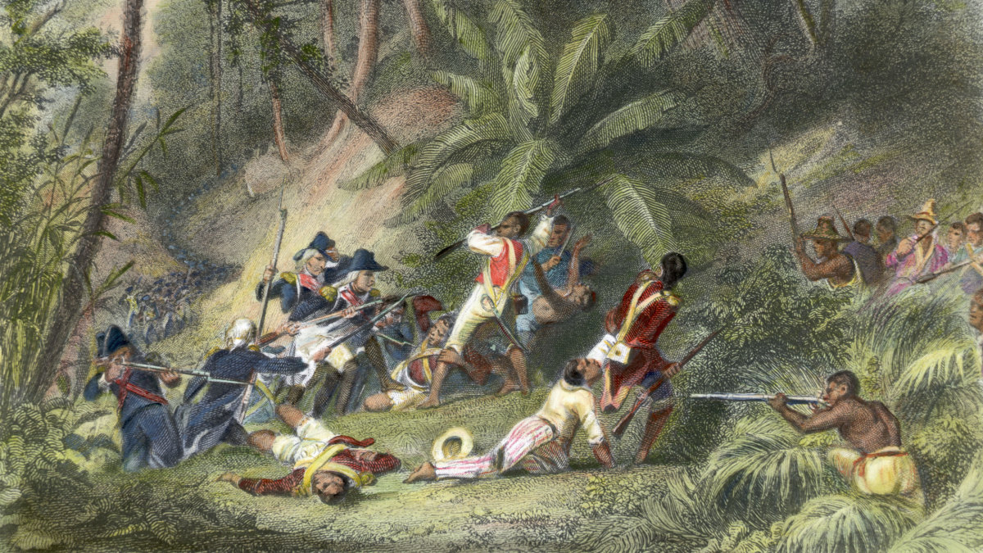
REVOLUTION !
Artistic imagination of Toussaint Louverture fighting French power in Saint-Domingue.
Bettmann Archive / Getty Images.

Slide 25
Comparative analysis
* The ‘moral economy of the crowd’ (E. P. Thompson 1971)
Popular protests were stimulated by more than purely material concerns.
While fighting for more resources, food rioters also denounced violations of accepted customs and practises. Crowds invested themselves with authority since the regular rulers appeared corrupted (// at Naples in 1647, rioters impaled loaves of bread on stakes). This was no ‘class warfare’ in the strict Marxist sense, as resistance often involved a mixture of social groups.
Causes Taxes, Succession, Bad Government, Oppression, Religion …
Carriers Middling, Charismatic, Communes ….
Aims Custom, Equity, Livelihood, Salvation, Rights …
Processes Alerting, Rallying, Threatening, Demanding, Rising …
Ideologies ‘Conservative’ (equity) / moral economy * / (rarely) freedom
Outcomes Mostly unsuccessful, yet often with indirect effects

Slide 26
Conclusions
Considerable scope for popular politics
within an unequal and hierarchical system
dominated by princes and nobles
with substantial impact on historical process
through formal and informal channels
From oral appeals via routine administration to rebellion
at different levels
local, regional, territorial, imperial
in support of distinct values
Subsistence, custom, equity, participation
with multiple tools
‘weapons of the week’, petitions, assemblies, violence …

