Slide 1
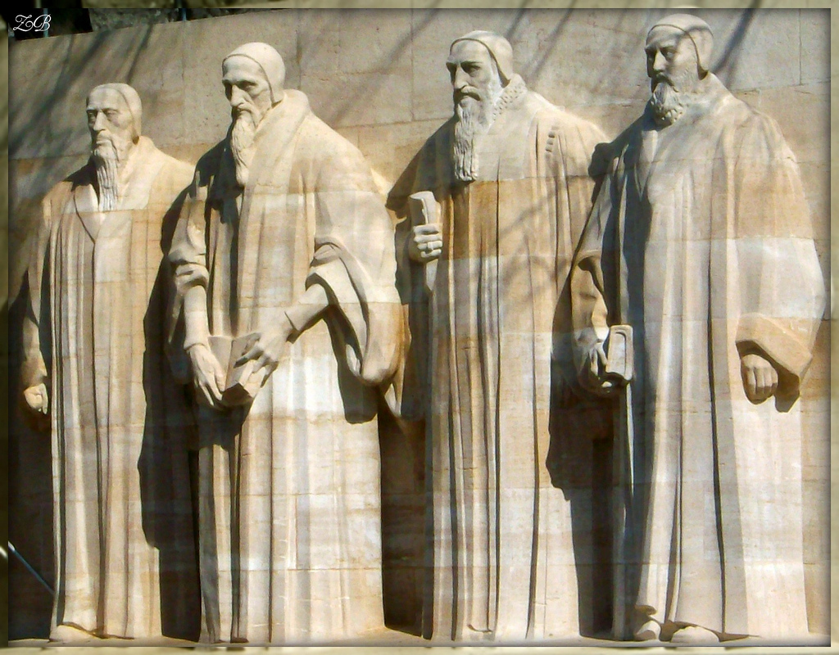
THE IMPACT OF REFORMATION
Reformation Wall (Le Mur des Réformateurs), Geneva (1917)

Slide 2
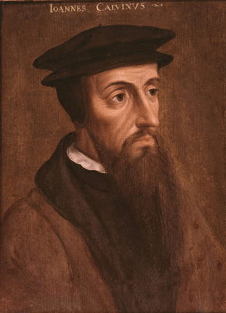
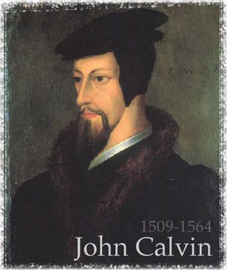
CALVIN AND CALVINISM
Important but not only influential figure/leader even during life. Reform movement developed by others after death in 1564.

Slide 3
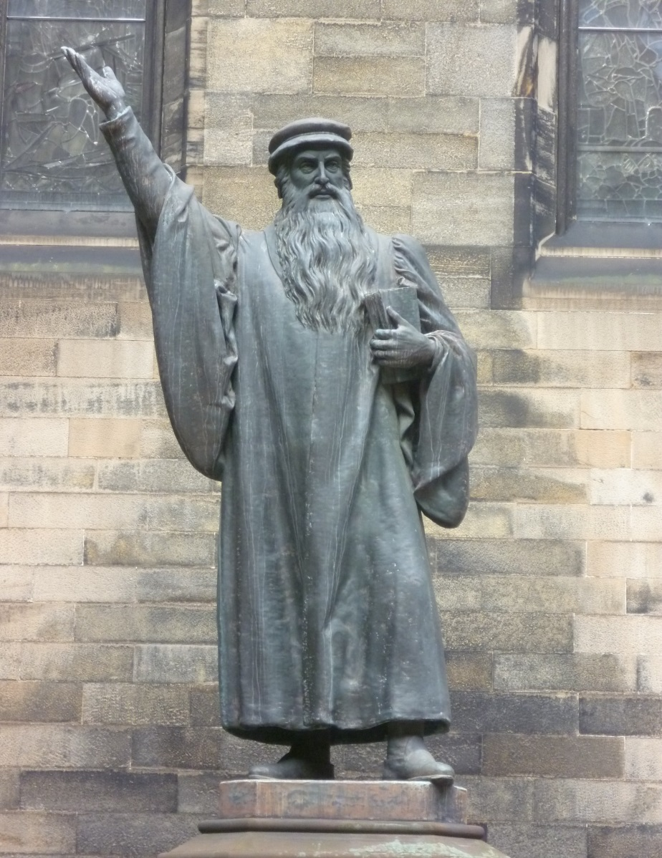
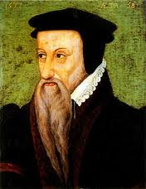
The symbolism of
PROPHETIC BEARDS
John Knox (c. 1514-1572)
Theodore Beza (1519-1605)

Slide 4
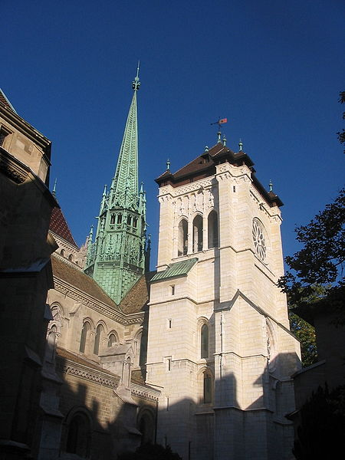
‘The most perfect school of Christ that ever was since the days of the Apostles’ (John Knox)
Struggle for Control in Geneva
Expelled after first attempt 1536-38
Worked in Strasbourg with Martin Bucer, 1538-41
Political as much as religious struggle in 1540s
Disputes over baptismal names, dancing, gambling…
Servetus challenged theology, burned 1553
Increasingly French city because influx of refugees
Life in/as exile significant
Became major printing centre in 1550s
Academy to train ministers established 1559

Slide 5
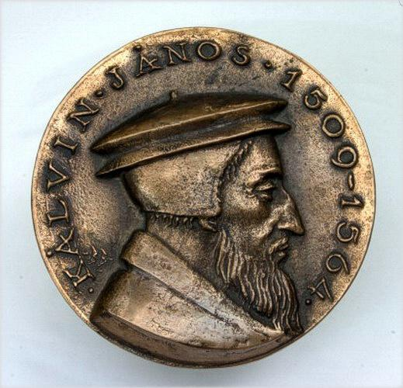
CALVIN’S LEGACY:
Halted retreat of Protestant Reformation?
Importance in churches of Scotland, France, Poland, Netherlands, Hungary, Transylvania, Puritans
More systematic doctrine than Luther (Institutes 1536)
More structured and independent church (Ecclesiastical Ordinances 1541): synods, elders, deacons, poor relief
Appeal of faith based on discipline and austerity (role of Consistory)!
Salvation & Scripture at centre of ministry
Flexibility, ‘exportability’, lay officials, ‘work ethic’

Slide 6
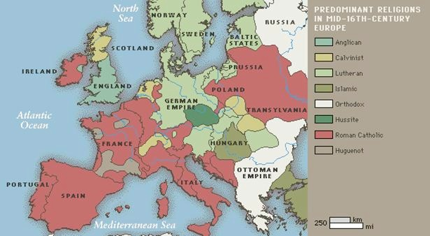
Religious Map of C16th Europe

Slide 7
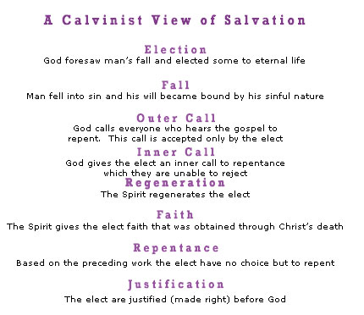
The Appeal of Calvinism

Slide 8
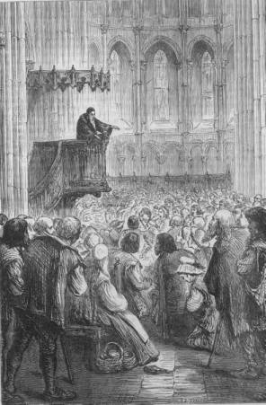
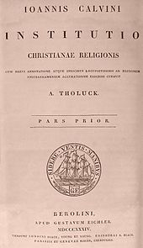
Importance of the Word
Calvin Preaching in Geneva
Calvin’s Institutes of the Christian Religion (1536)

Slide 9
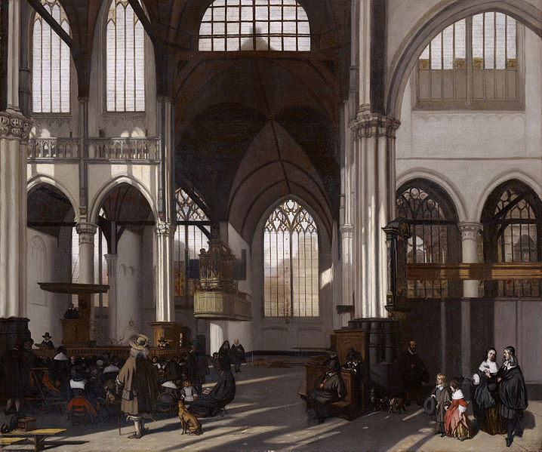
Calvinist Church in Amsterdam

Slide 10
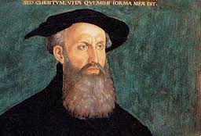
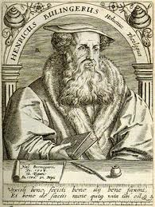
Importance and Influence of…
Heinrich Bullinger (1504-1575)
Contemporary of Calvin based in Zürich (heir to Zwinglian Reformation)
Major figure in Reformed Church
Second generation focused on unifying movement Consensus Tigurinus (1549)
Correspondence and co-operation with Calvin & Beza
Wrote influential Second Helvetic Confession (1566)
Importance in Germanic territories and re ‘godly magistracy’

Slide 11
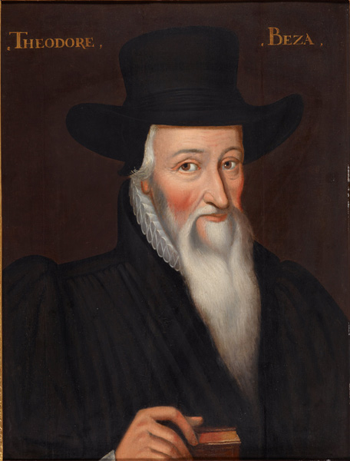
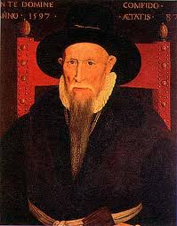
Built on foundations laid by Calvin and headed Calvinist Church for forty years
Theodore Beza (1519-1605)
Fully developed doctrine of double pre-destination
Participated at major events in France (Colloquy of Poissy, 1561) and corresponded with key leaders e.g. Henri IV (1589-1610)
Dealt with devastating aftermath of St Bartholomew’s Day Massacre (1572)
Helped develop theory of resistance which allowed for magistrates to resist an ungodly tyrant: The Right of Magistrates (1574)
‘Calvinist International’

Slide 12
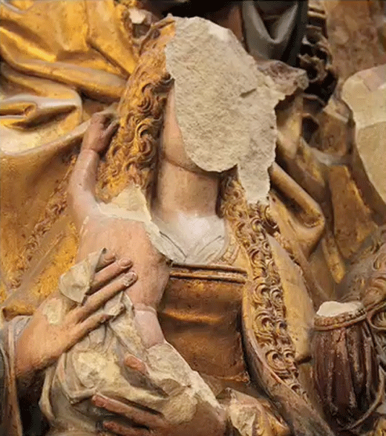
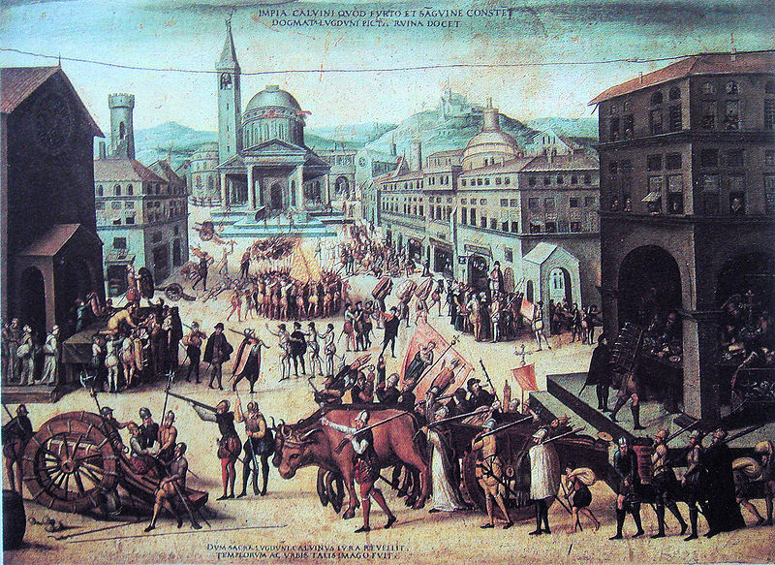
Despite Calvin’s declaration that rulers not be opposed: plenty of evidence to contrary
Calvinism: a creed for rebels?
Persecution a sign of election (Calvin condemned covert worship ‘Nicodemism’)
Association with political revolt in France, the Netherlands & Scotland
Iconoclasm (destruction of images): popular & official
Underground churches (in secret)/ Stranger churches (in exile)
Success > compromise & pragmatism

Slide 13
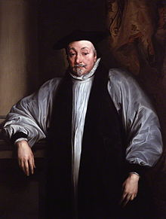
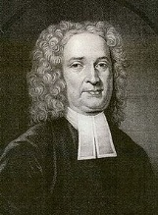
Seventeenth-century Arminianism
emergence = internal challenge to Reform akin to Jansenist controversy within Catholic Church
danger of schism over role of free will (cf Jansenists re grace)
Archbishop Laud (1573-1645) in England controversial supporter
later influence on Baptists & Methodists (John Wesley 1703-91)
But Puritans remained dominant force in New England

