Slide 1
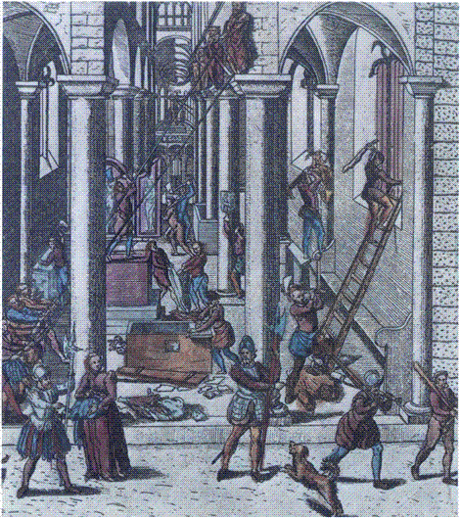
THE IMPACT OF REFORMATION
Europe in the Making
Spring Term, Week 2
Prof. Beat Kümin
Iconoclasm at Ghent (1566)

Slide 2
Themes and questions
Why and how did Protestantism become divided?
What were the key features of the Swiss ‘Reformed’?
Why was Calvinism able to spread internationally?
Should the Reformation be judged a failure?
Lecture structure
Tensions among early Lutherans
The Swiss Reformation (in Zurich & later Geneva)
Wider long-term implications

Slide 3
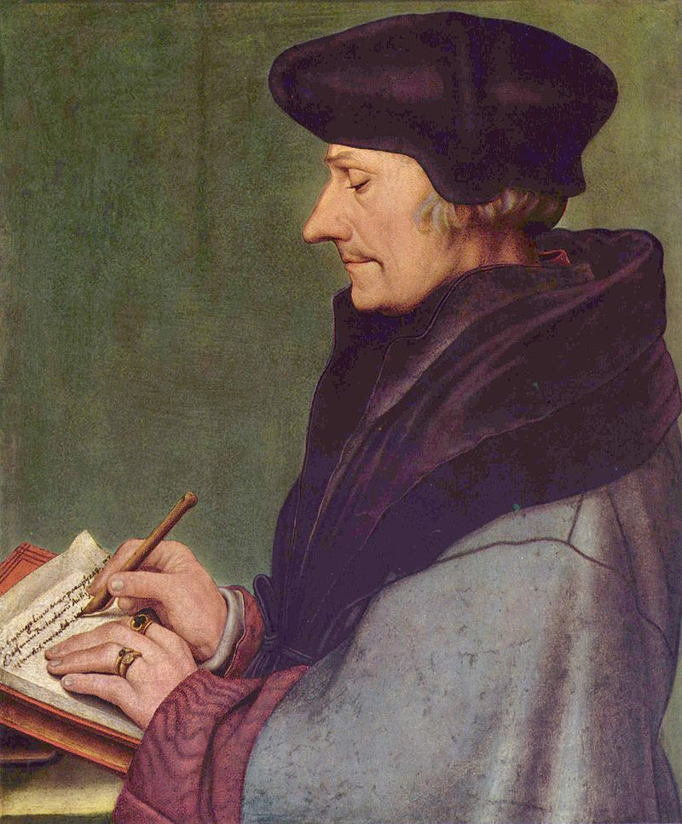
1. Tensions in the early Reformation
Break with some Humanists
Erasmus (over free will)
Wittenberg Disagreements
Emergence of more radical theologians

Slide 4
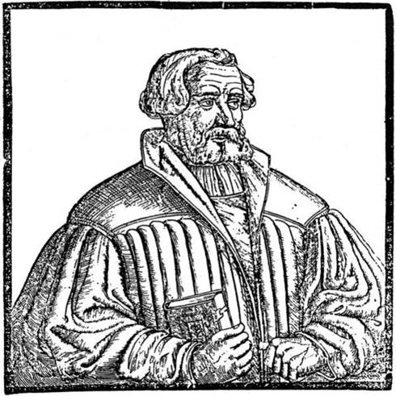
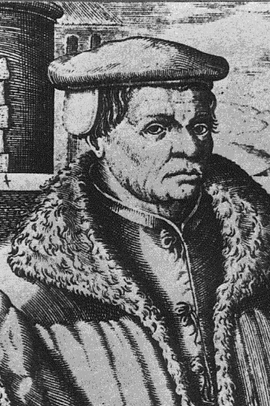
Andreas Karlstadt (left, d. 1541) Thomas Müntzer (d. 1525) Posthumous engravings

Slide 5
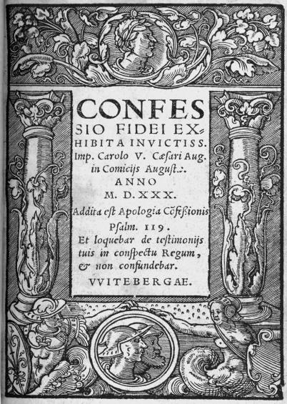
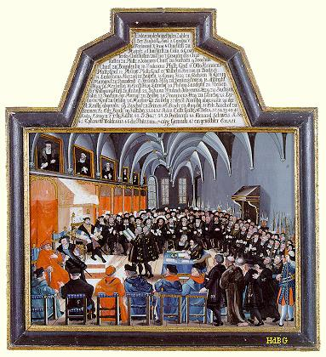
Confession of Augsburg (1530) Title Page
Presentation to Emperor at Diet of Augsburg (1530)

Slide 6
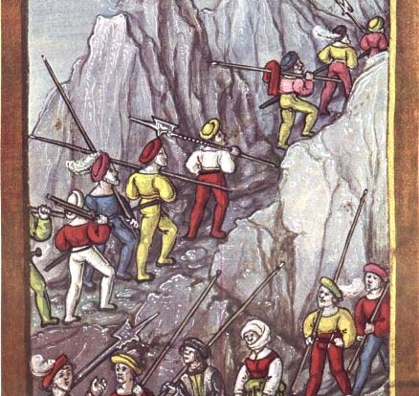
2. The Swiss Reformation
Distinct socio- political context
Alliance of urban & rural republics
Weak Church hierarchy
Inner tensions (mercenary trade)
Pikemen
crossing
the Alps. Illustrated
chronicle
(1513)

Slide 7
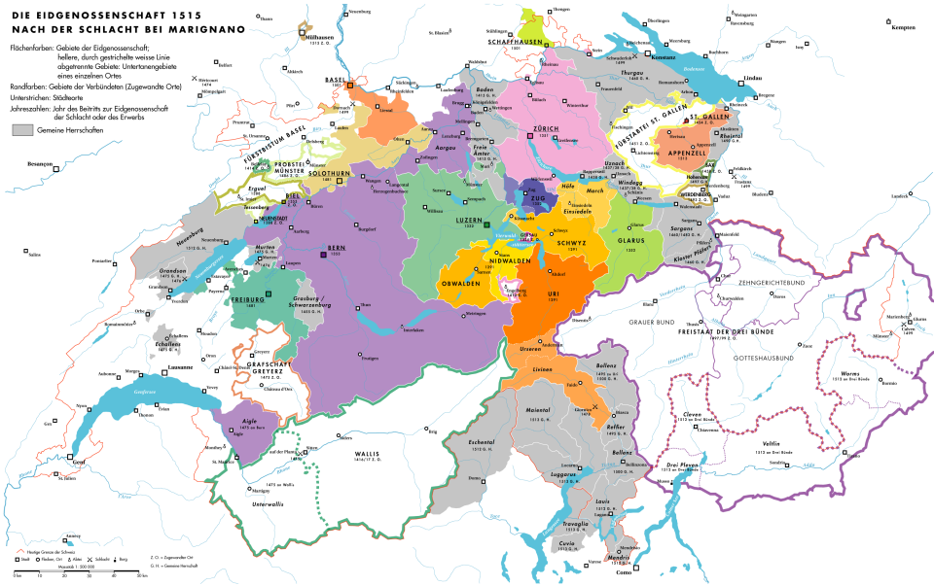
The Confederation (c. 1515) Full members (filled in) Associates (boundaries) Condominions (grey) Catholic heartlands Reformed cities

Slide 8
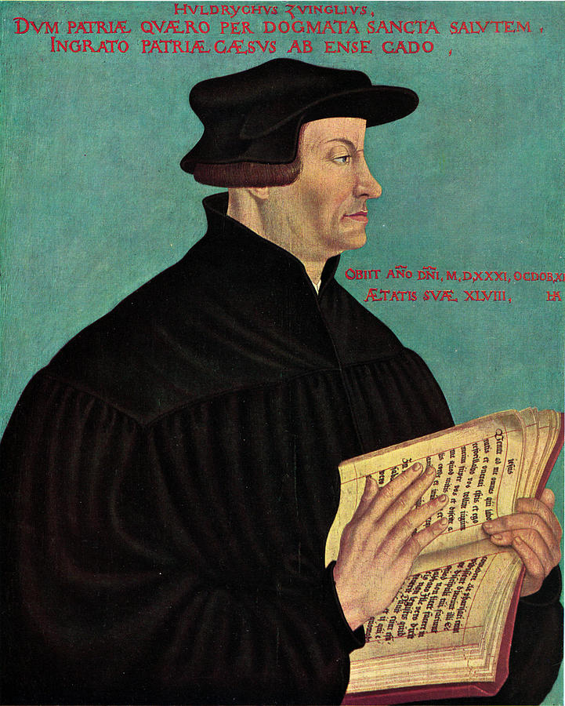
Huldrych Zwingli (d. 1531) Reformer of Zurich Portrait by Hans Asper (1549)

Slide 9
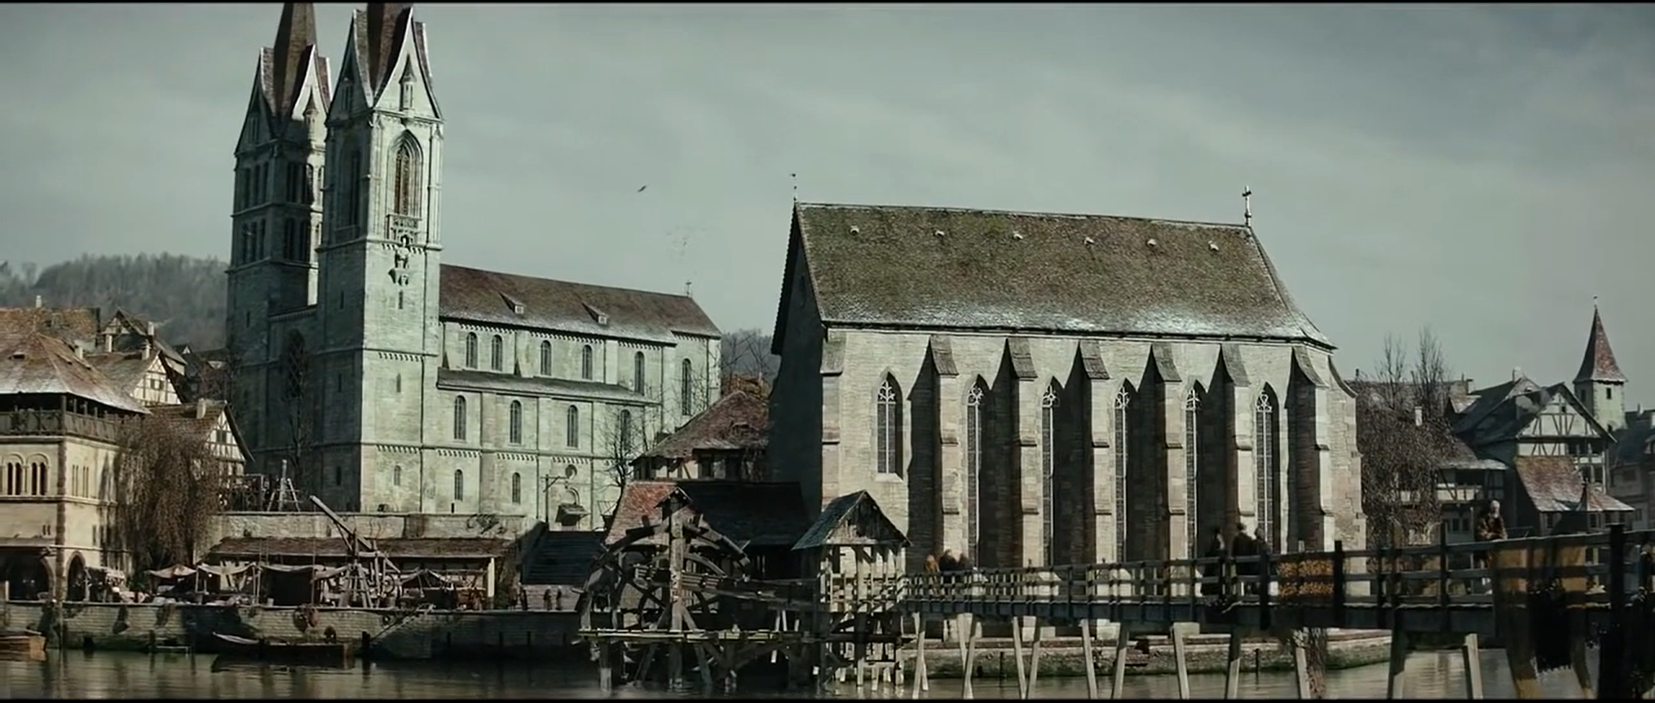
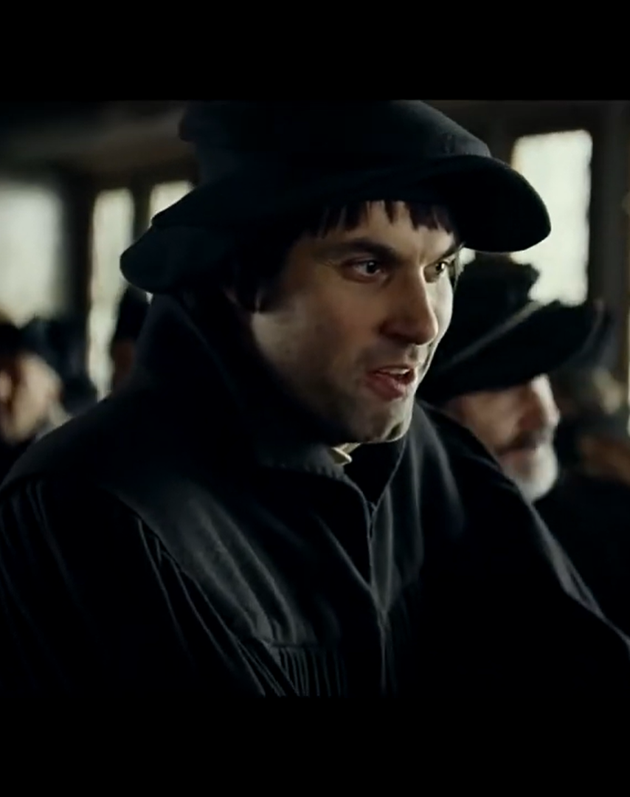
Stills from ‘Zwingli’
feature film (2019)
Regeneration of Zurich
Bible as a code of conduct
Zwingli and Erasmus

Slide 10
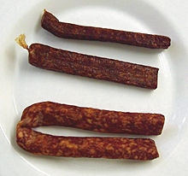
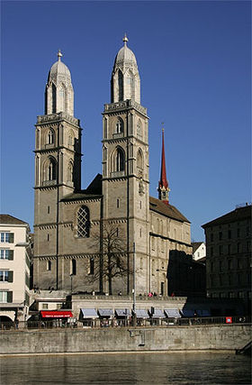
‘Affair of the Sausages’ (1522)
‘I began to preach the gospel of Christ ... Before anyone in our region had ever heard of Luther’
Lay council decides on right religion
Zurich’s Great Minster
(Preaching & 1523 disputation)

Slide 11
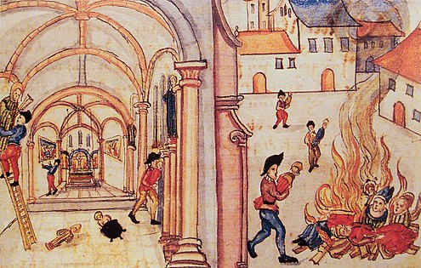
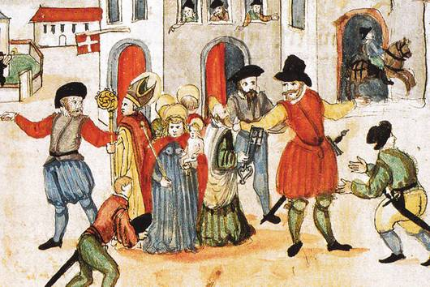
Religious Regeneration
of society as a whole
Key differences from Lutheranism:
Even more biblicist (no tolerance for things that could not be proved by Scripture)
Desire to purify church more thoroughly: hostility to images; no vestments for clergy; stop church music
Greater emphasis on moral cleansing of community than subtleties of justification
Iconoclasm (1524) - Bullinger’s Reformation Chronicle
→ a degree of international influence: MacCulloch

Slide 12

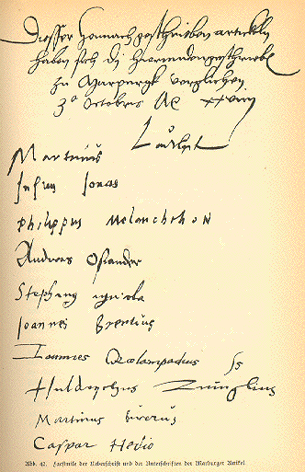
Marburg Articles 1529 Signed by the leading reformers Some common ground but key inability to agree on meaning of Jesus’ words: ‘This is my body’ (Transubstantiation vs Consubstantiation vs spiritual presence)

Slide 13
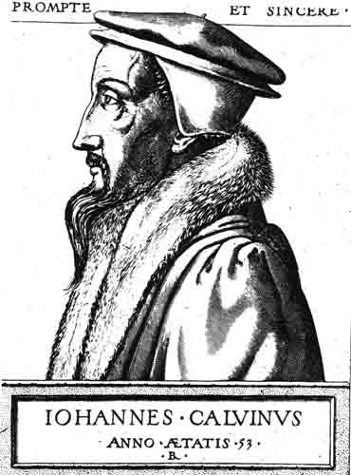
‘Second’ Reformation: Jean Calvin (d. 1564) Transforms Geneva into a kind of ‘Protestant Rome’ 17thC engraving

Slide 14
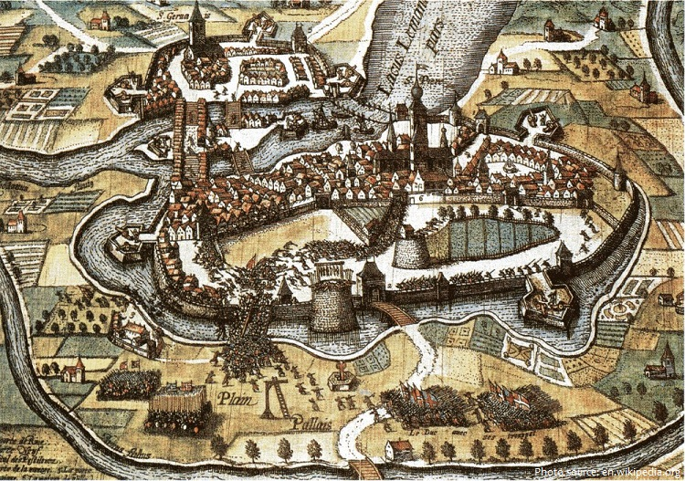
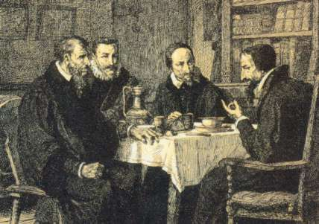
Farel, Beza, (Pierre) Viret (d. 1571) and Calvin 19thC impression
Evolution of
a systematic
Theology
Institutes of the Christian Religion (1536)
Ecclesiastical Ordinances (1541)
Porspect of Geneva
Four-part ministry
Pastors (preach and give sacraments)
Teachers (teach doctrine/scriptures)
Elders (administer discipline)
Deacons (poor relief)
Double predestination
Total depravity, unconditional election, limited atonement, irresistible grace, perseverance of the elect

Slide 15
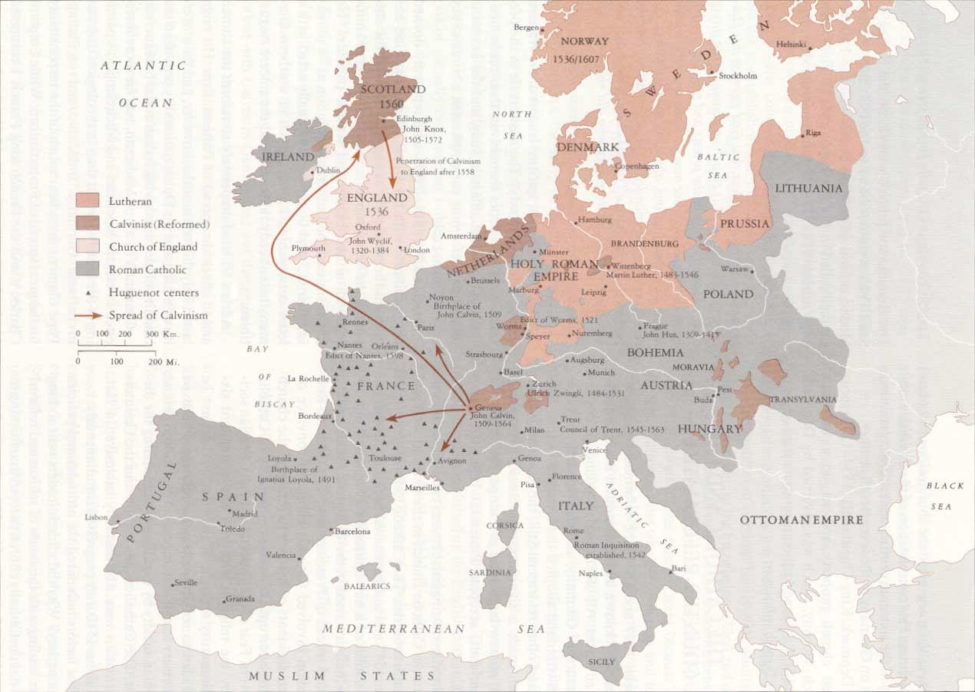
Calvinism’s spread in later 16th century
International Calvinism
Spread to France, Netherlands, British Isles, Holy Roman Empire (conversion of e.g. Brandenburg elector) & Eastern Europe (Lutheranism too ‘German’)
Flexibility: Elizabethan Church of England had Calvinist theology and Catholic-style bishops
A creed for rebels?
Association with political revolt in France, Netherlands & Scotland
Underground & stranger churches
Persecution a sign of election (Calvin rejects outward conformity ‘Nicodemism’)
On the other hand, strong emphasis on asceticism, discipline, living a godly life

Slide 16
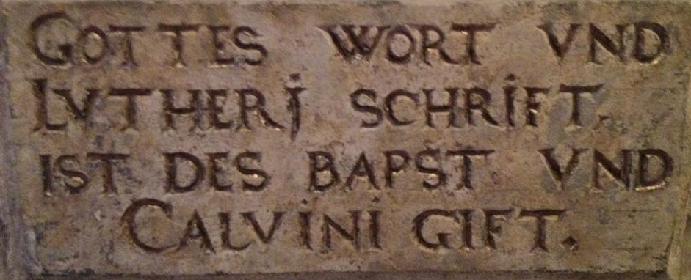
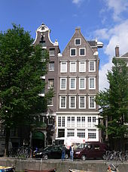
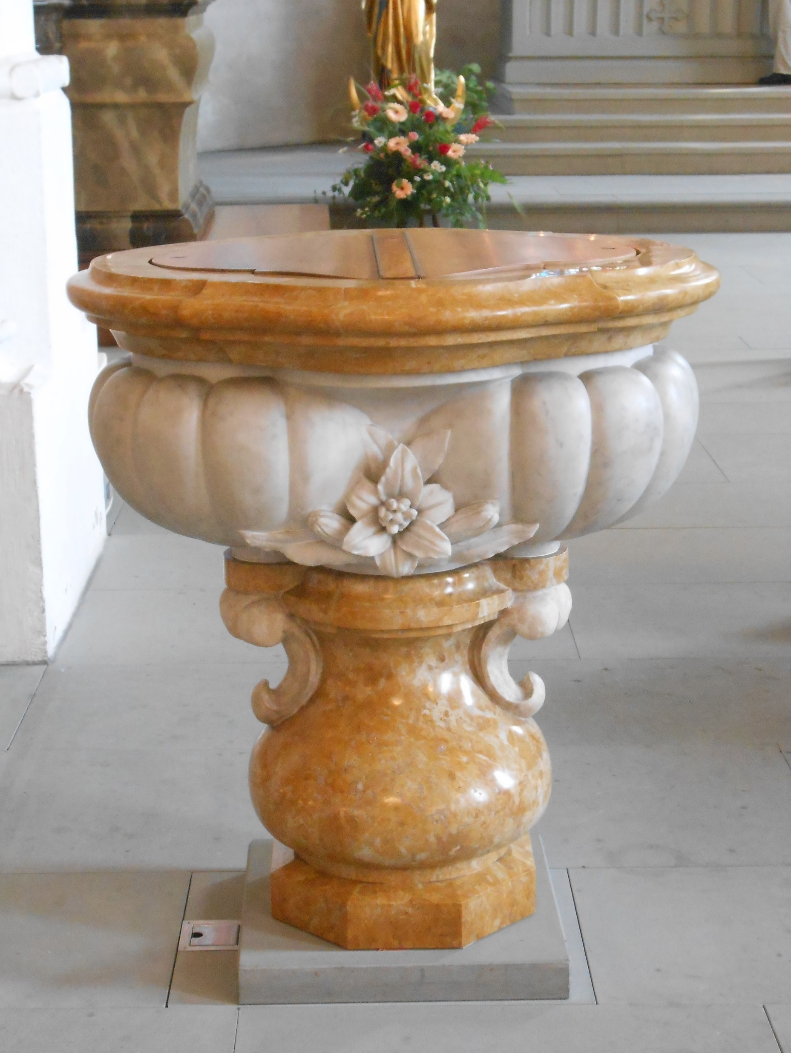
Living with Difference
Few confessionally ‘pure’ states (Lutheran Scandinavia; Catholic Spain) & much rel. pluralism (Lutherans, Calvinists, Catholics mixed across Holy Roman Empire; Protestant Huguenots in Catholic France; Catholics in Netherlands, Protestant minority in Ireland) – much hostility and identity-formation through confessional demarcation: predestination more important to Calvinists because Lutherans attack it
→ In the Holy Roman Empire easy to cross borders to attend alternative services (‘Auslauf’) and some shared churches (‘Simultankirchen’);
gradual acceptance of religious diversity: trials & executions for heresy decrease after 1600, ‘grudging’ co-existence on the ground; more active choice in highly diverse Poland-Lithuania
→ emergence of informal, if often grudging co- existence (Dutch Republic), but long road to toleration
‘God’s Word and Luther’s writings are poison to the pope & Calvin’: inscription in early modern Wittenberg
‘Our Lord in the Attic’: A discrete Catholic church in 17thC Amsterdam
At St Albin, Ermatingen (Thurgovia), church & font are still shared by Zwinglians (left) & Catholics (right)

Slide 17
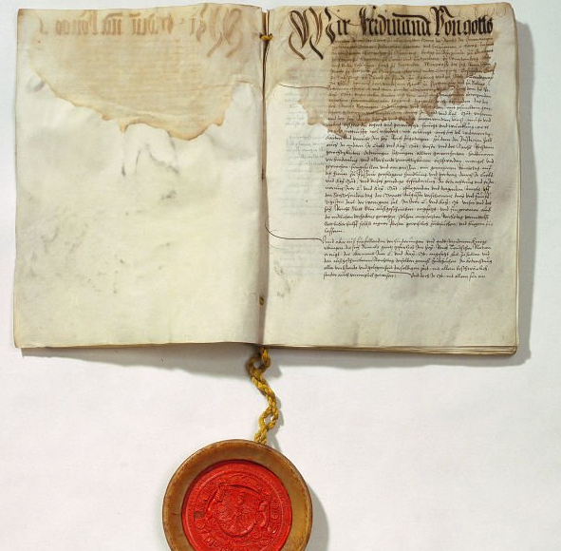
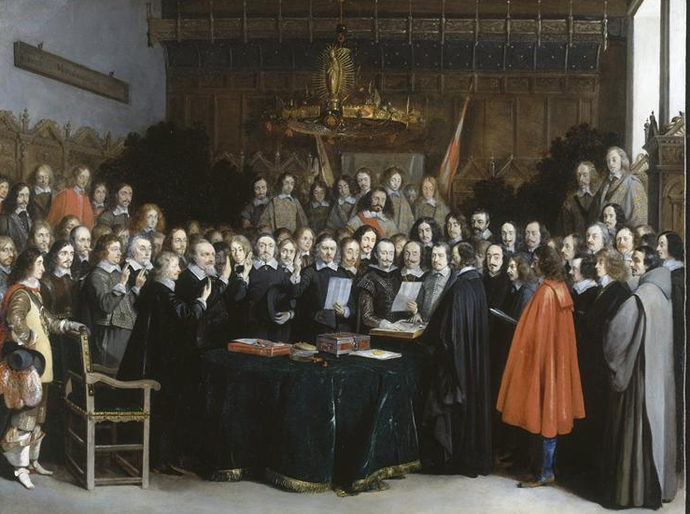
Towards Co-Existence
Peace of Kappel 1531, earliest example of settlement accepting 2 confessions among Swiss Confederates (their shared lordships got to vote on their religion!)
Peace of Augsburg 1555, ending war between Catholic Charles V + Lutheran Princes: principle of cuius regio, eius religio (‘your prince, your religion’)
Edit of Nantes 1598, ending (temporarily) religious conflicts in France: grants rights to worship for French Huguenots
Peace of Westphalia (Treaties of Münster and Osnabrück) 1648 marking end of Thirty Years War: reinstated Peace of Augsburg and extended legal recognition to Calvinism; independence of Dutch Republic / Swiss Confederation; limited rights for minorities to practice faith privately
(late 17th and 18th century warfare in Europe less obviously confessional: e.g. Protestant Britain allied with Catholic Austria vs Louis XIV’s France)
Peace of Augsburg (1555)
Ratification of Treaty of Münster (1648)

Slide 18
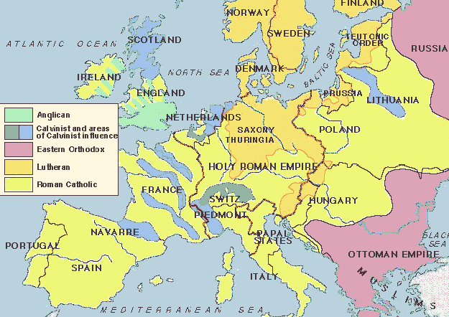
Europe c. 1600

Slide 19
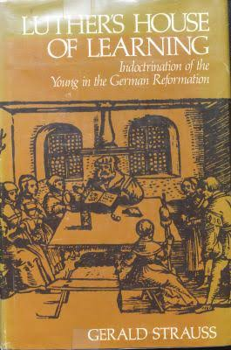
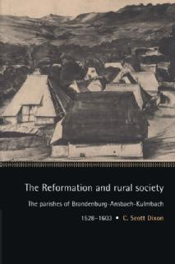
Was the Reformation a Failure?
Could ordinary people be made to understand complex doctrines? Some reformers despaired: in 1566, Johann Aurifaber stated that Luther’s teachings ‘are now everywhere despised’
Gerald Strauss, Luther’s House of Learning (1978) – Saxon church ‘visitors’ encountered ignorance, absence from church, work on Sundays; places where no single person knew the Ten Commandments
Consistory records from across Calvinist Europe: continuing ‘superstition’, belief in magic /ghosts
↔ Catholicism could be overthrown in many places; commoners accept changes selectively (e.g. better clergy education, greater access to the Word of God) but not attacks on local festive culture; a case of a negotiated (Scott Dixon) and heterogeneous Reformation.

Slide 20
ASSESSMENT
Access to the ‘pure’ Gospel breeds disunity: a case of unintended consequences
Europe faced with plurality of ‘Catholic’, ‘Lutheran’, ‘Reformed’ & radical identities
Gradual acceptance of co-existence
Reformation or Reformations?

