Slide 1
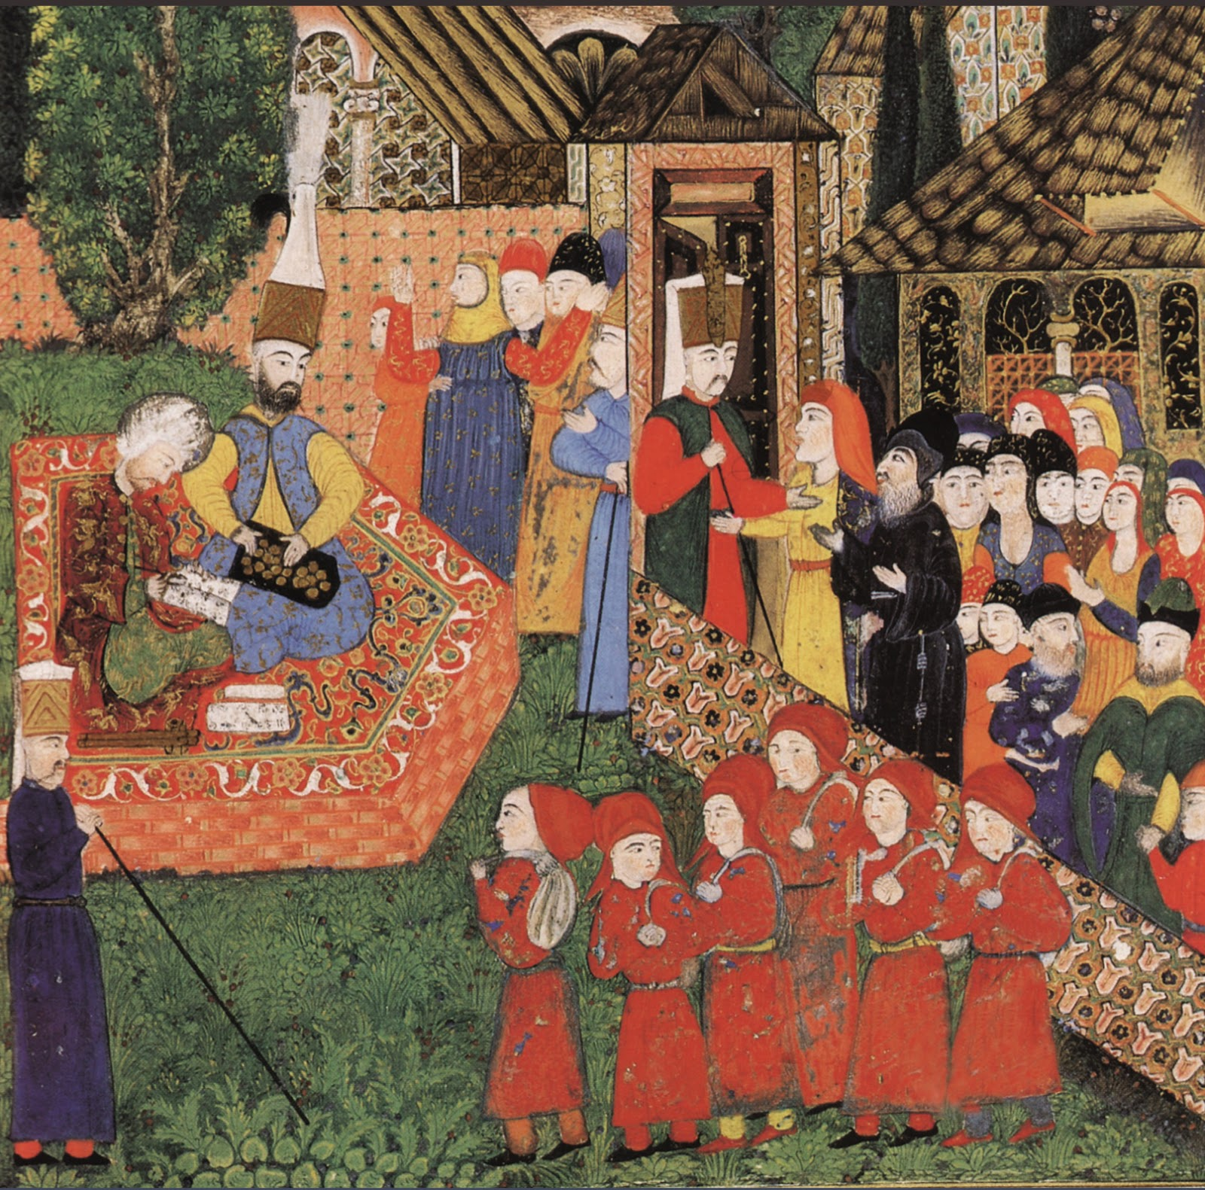
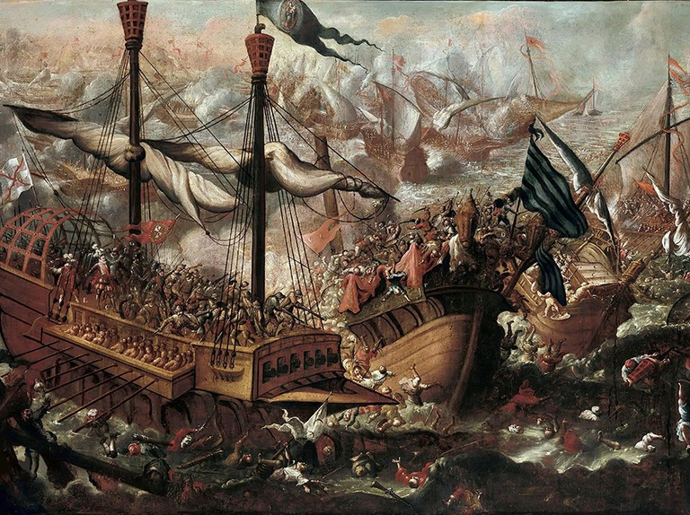
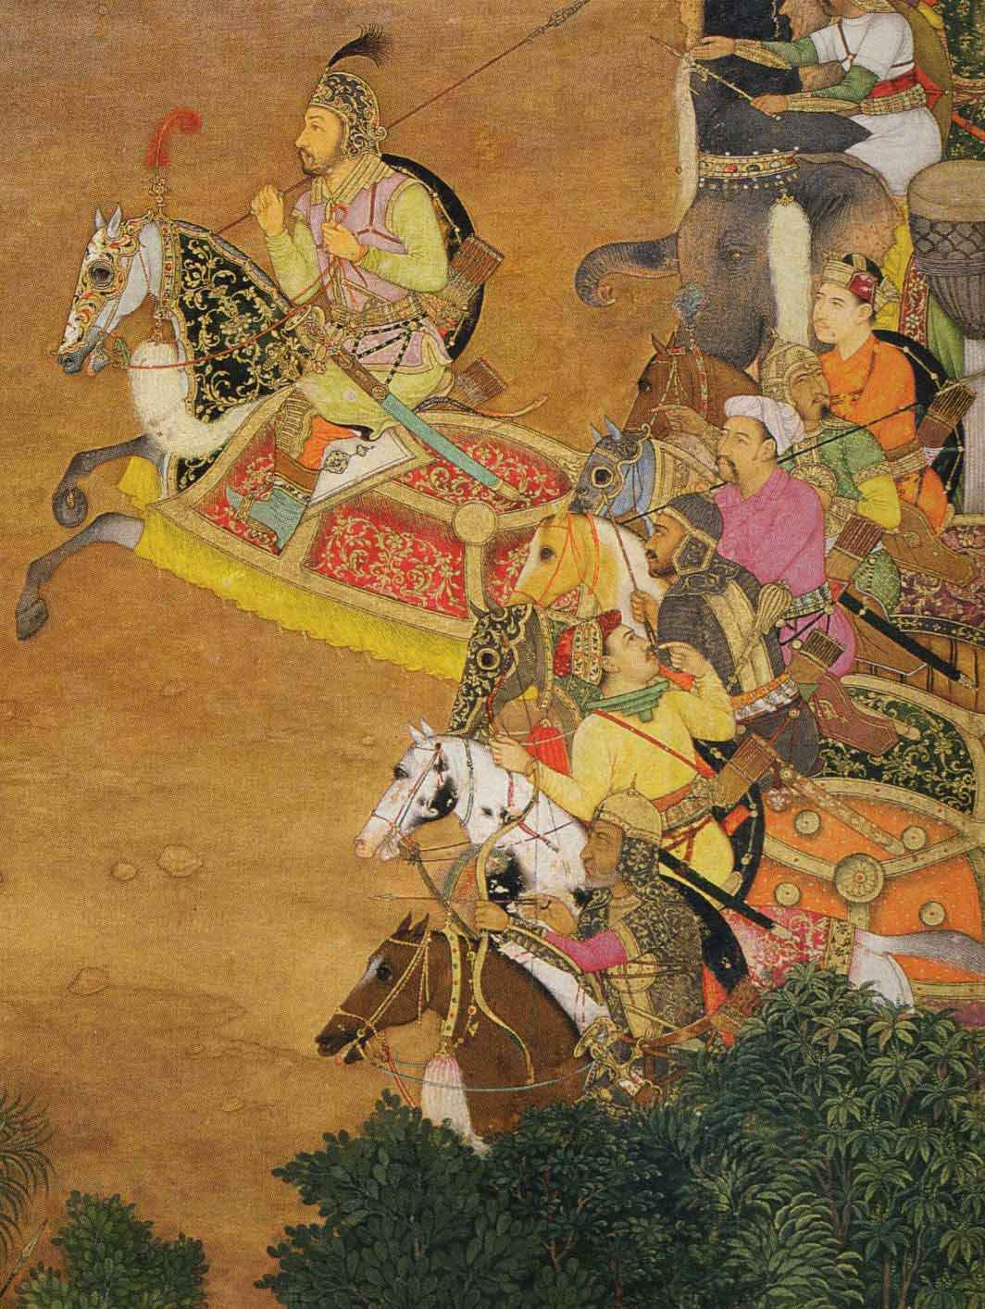
Rival Empires
HI113: Europe in the Making
Week 10
Jonathan Davies

Slide 2
Today’s lecture
Empires in the early modern world
Habsburg, Ottoman & Mughal empires

Slide 3
How did empires deal with the management of diversity within their borders and competition with rivals outside them?
How to expand and consolidate one’s rule?
How to acquire, concentrate, and distribute resources?
How to administer a highly diverse population across dissimilar regions?
How to project and maintain one’s power both domestically and abroad?

Slide 4
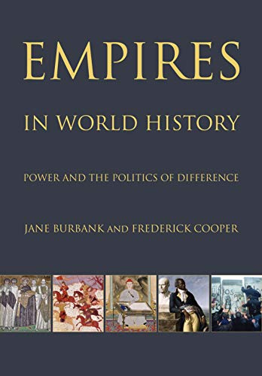
“Empires are large political units, expansionist or with a memory of power extended over space, polities that maintain distinction and hierarchy as they incorporate new people. […] The nation-state proclaims the commonality of its people – even if the reality is more complicated – while the empire-state declares the non-equivalence of multiple populations.”
“The concept of empire presumes that different peoples within the polity will be governed differently.”
“What successful empires produced, usually, was neither consistent loyalty nor constant resistance: they produced contingent accommodation.”

Slide 5
Land empires: contiguous, based on conquest and tributary relations with vassal states (suzerainty)
Tsarist Russia, Ming/Qing China, Mughal India, Ottoman Empire, Safavid Iran, Austrian Habsburg Empire, Spanish America, British India
Maritime empires: non-contiguous, based on conquest and trade relations, network with plural nodes
Venetian Empire, Spanish Empire, Portuguese Empire, Dutch Empire, English/British Empire, French Empire
Nomadic vs. sedentary/agrarian: Conquest from the steppe (1) vs. conquest of the steppe (2)
(1) Mongols, Timurids, Mongol/Turkic ancestors of Ottomans and Mughals
(2) Russia, Qing China, United States

Slide 6
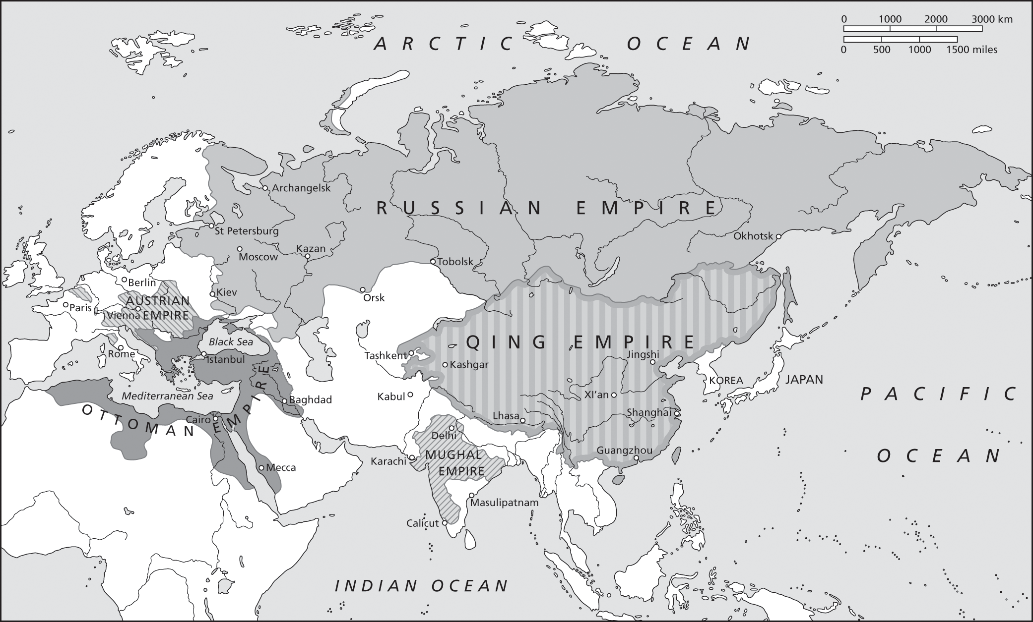

Slide 7
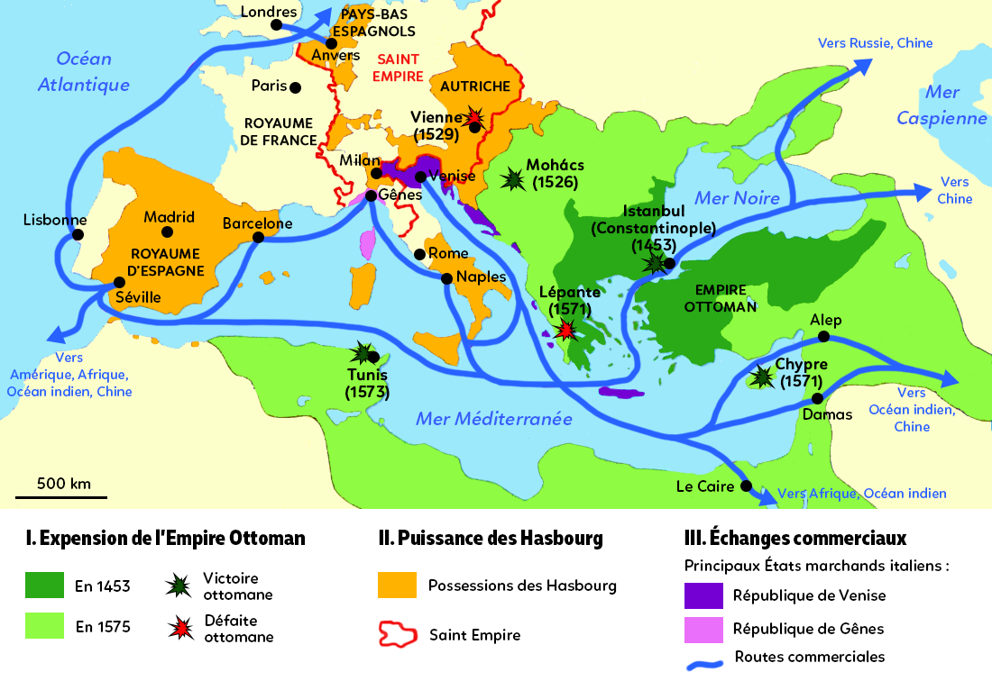

Slide 8
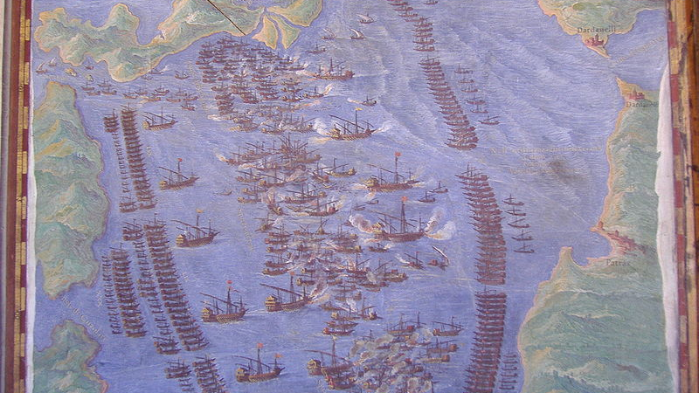

Slide 9
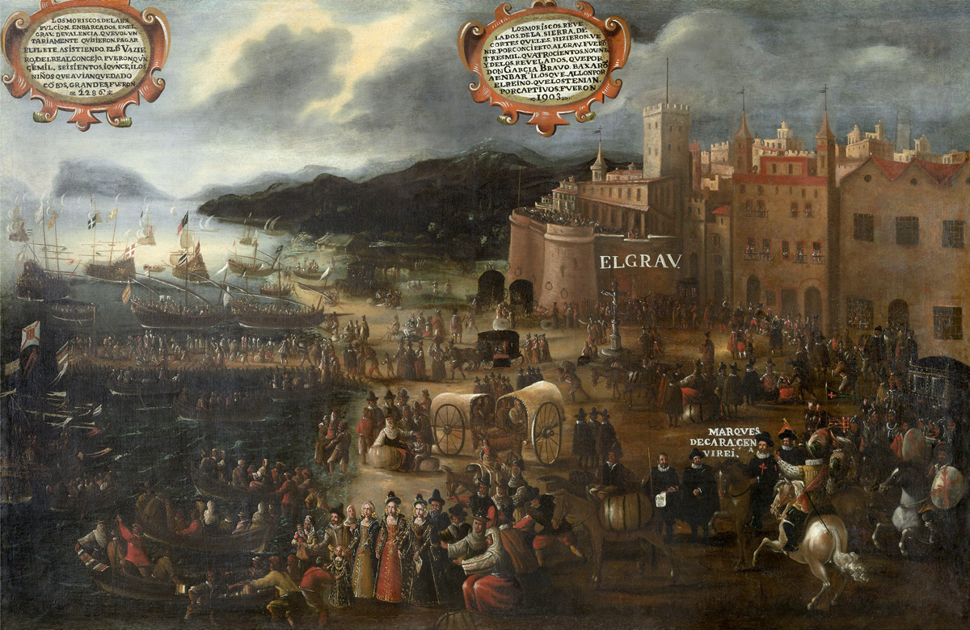

Slide 10
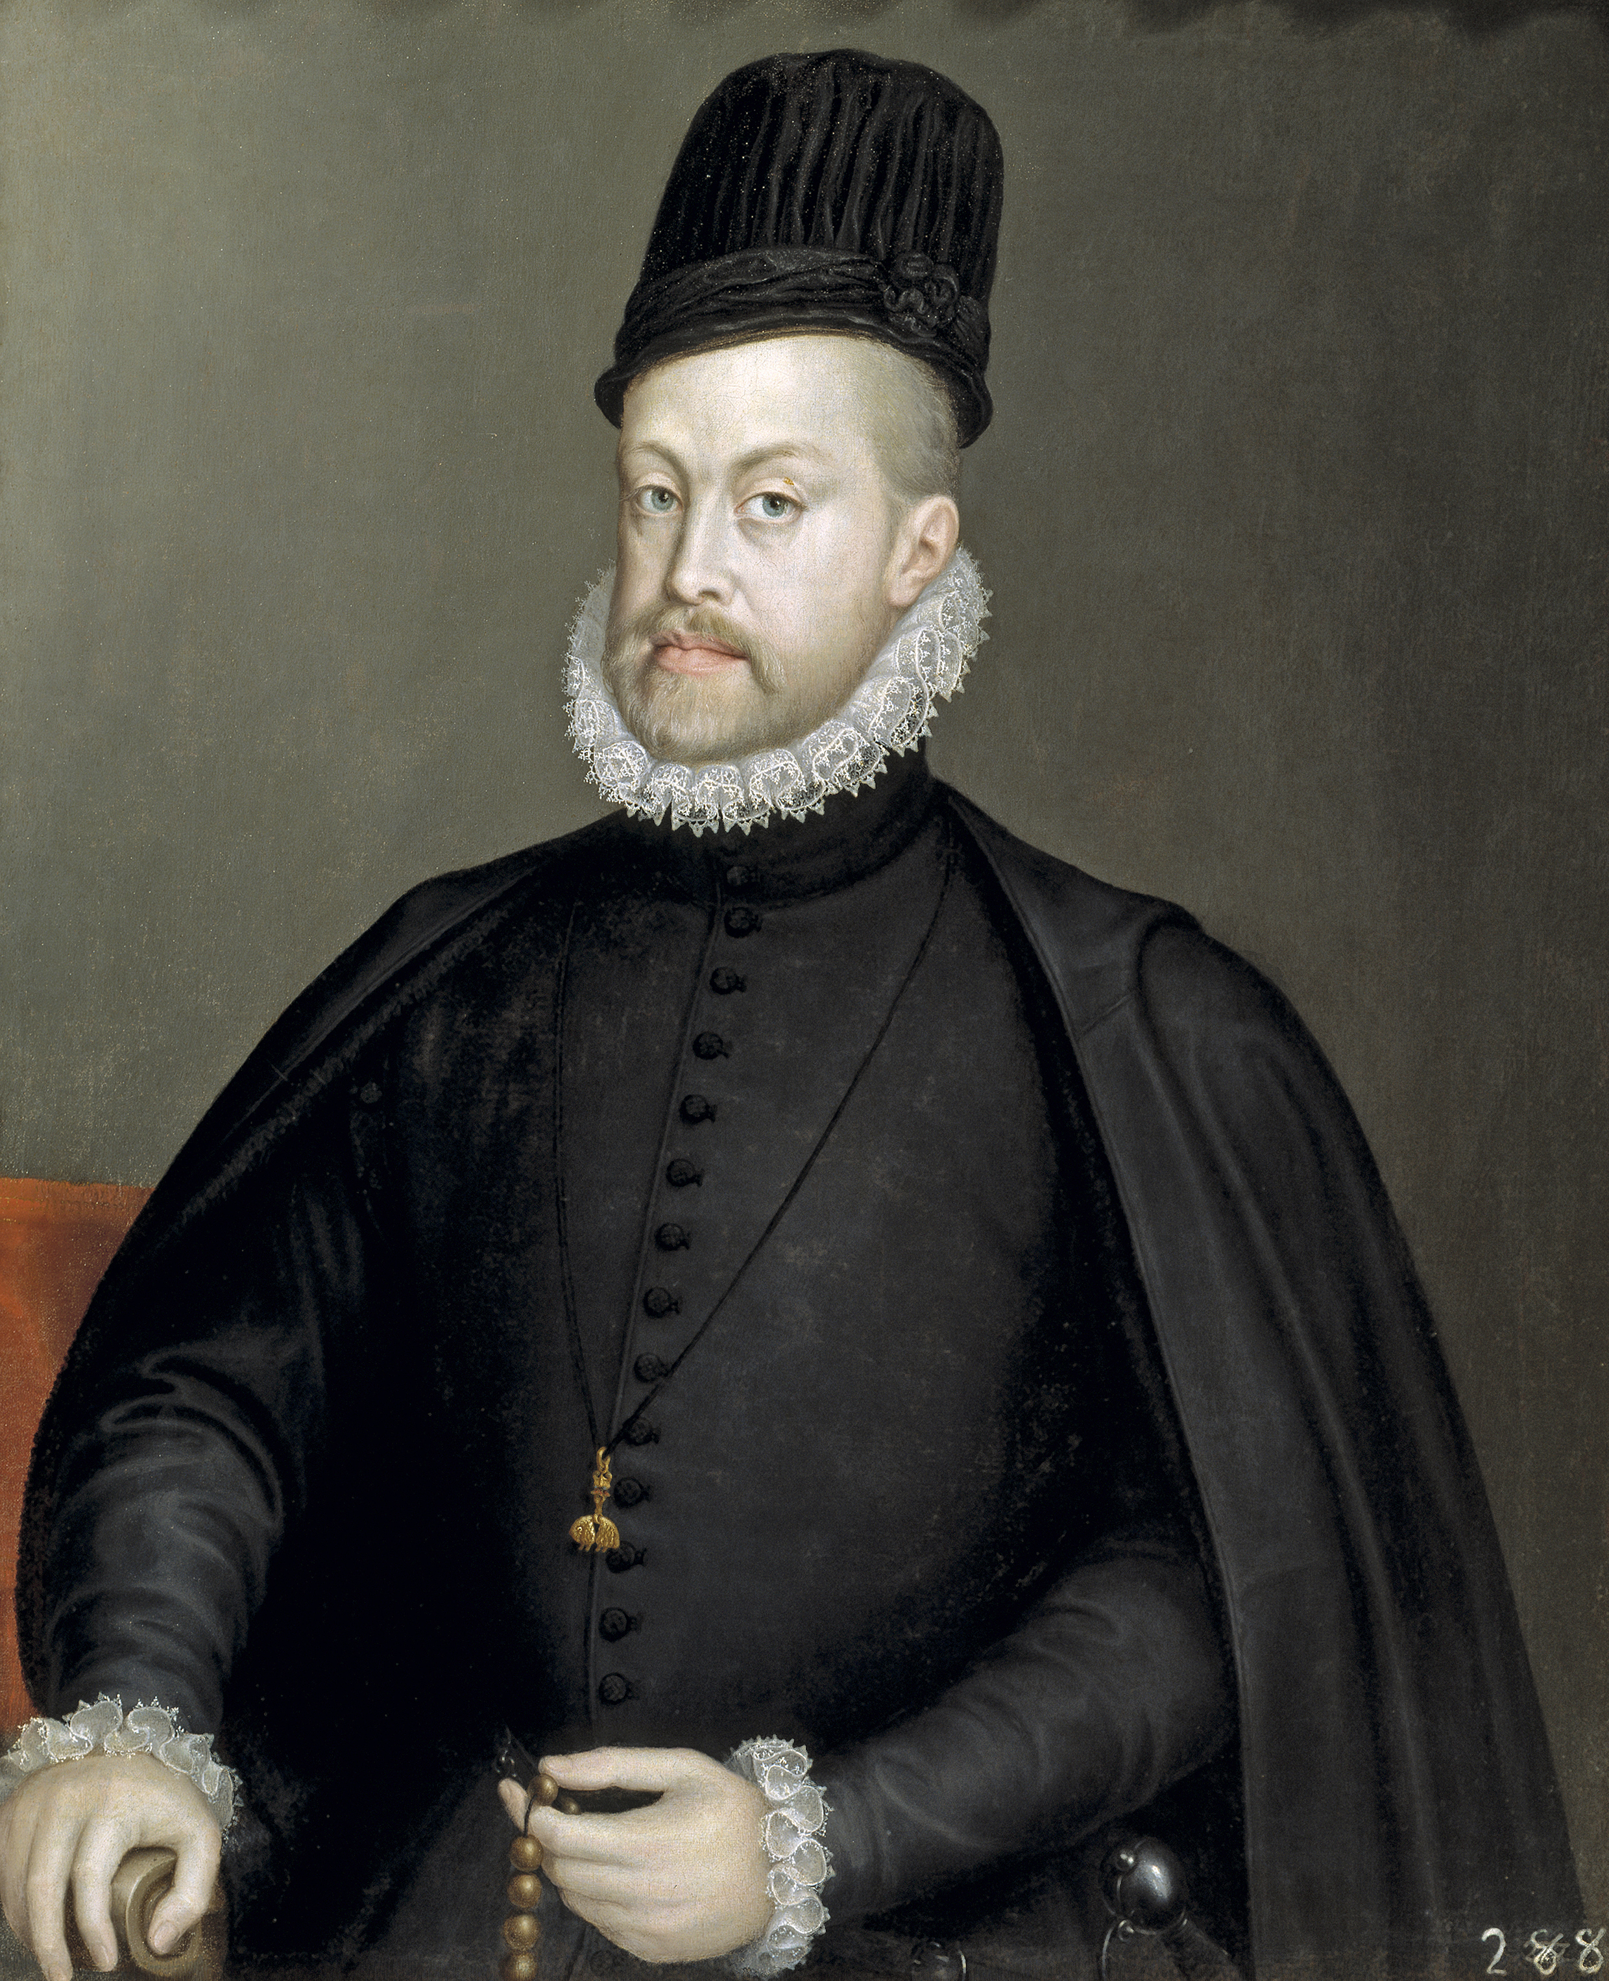
Habsburg Empire
Composite monarchy
Spanish and Austrian branches
united under Charles V (1519-1556)
Union of Crowns of Spain and Portugal 1580-1640
Global empire under Philip II
Uniformity of institutions imposed on diverse colonial possessions
Staunchly Catholic and religiously intolerant – persecution of minorities

Slide 11
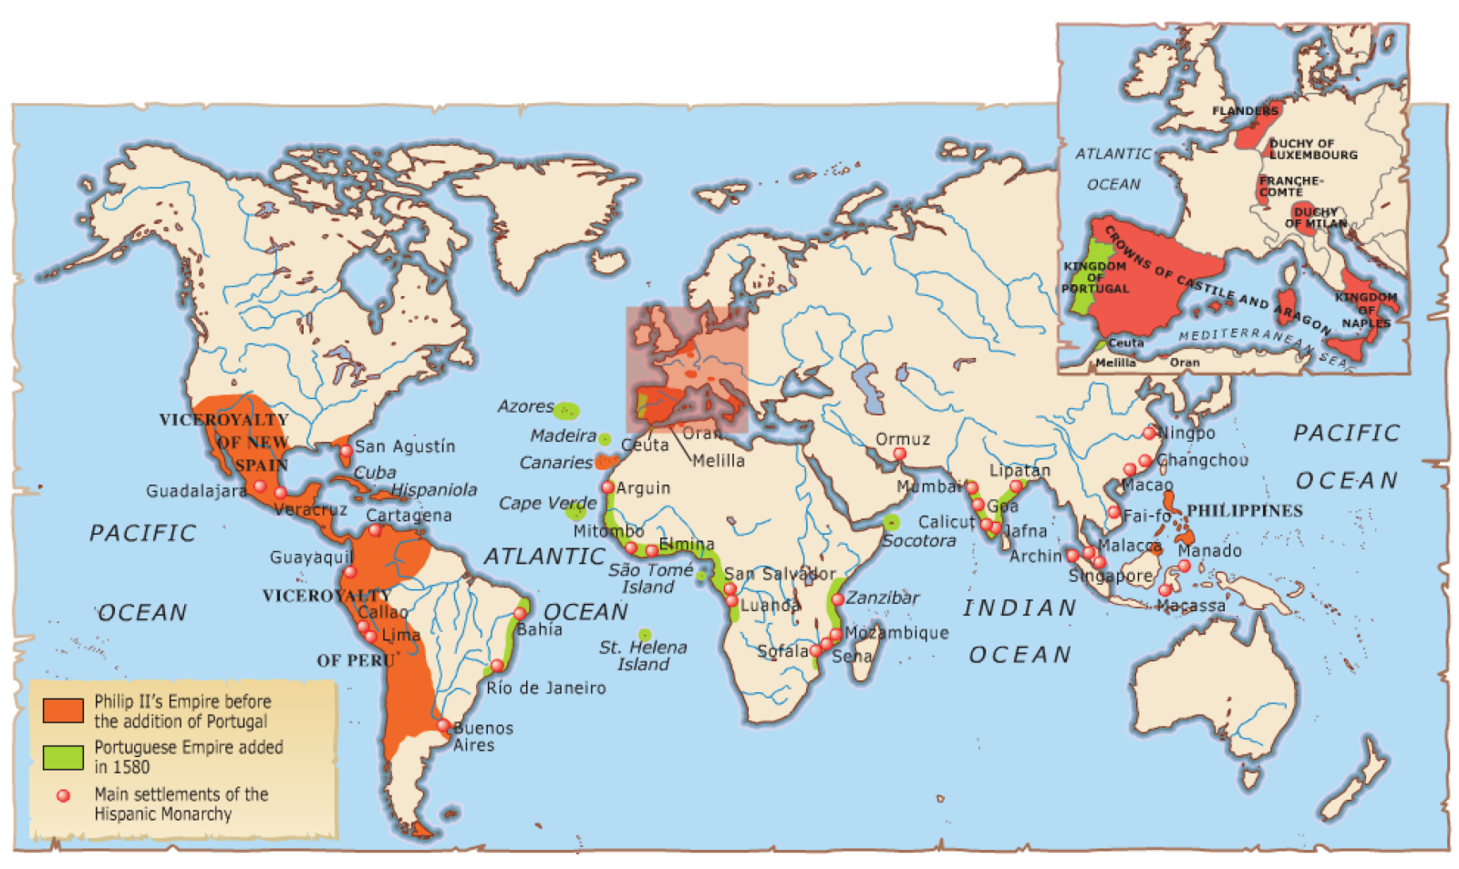
Philip II’s global empire after 1580

Slide 12
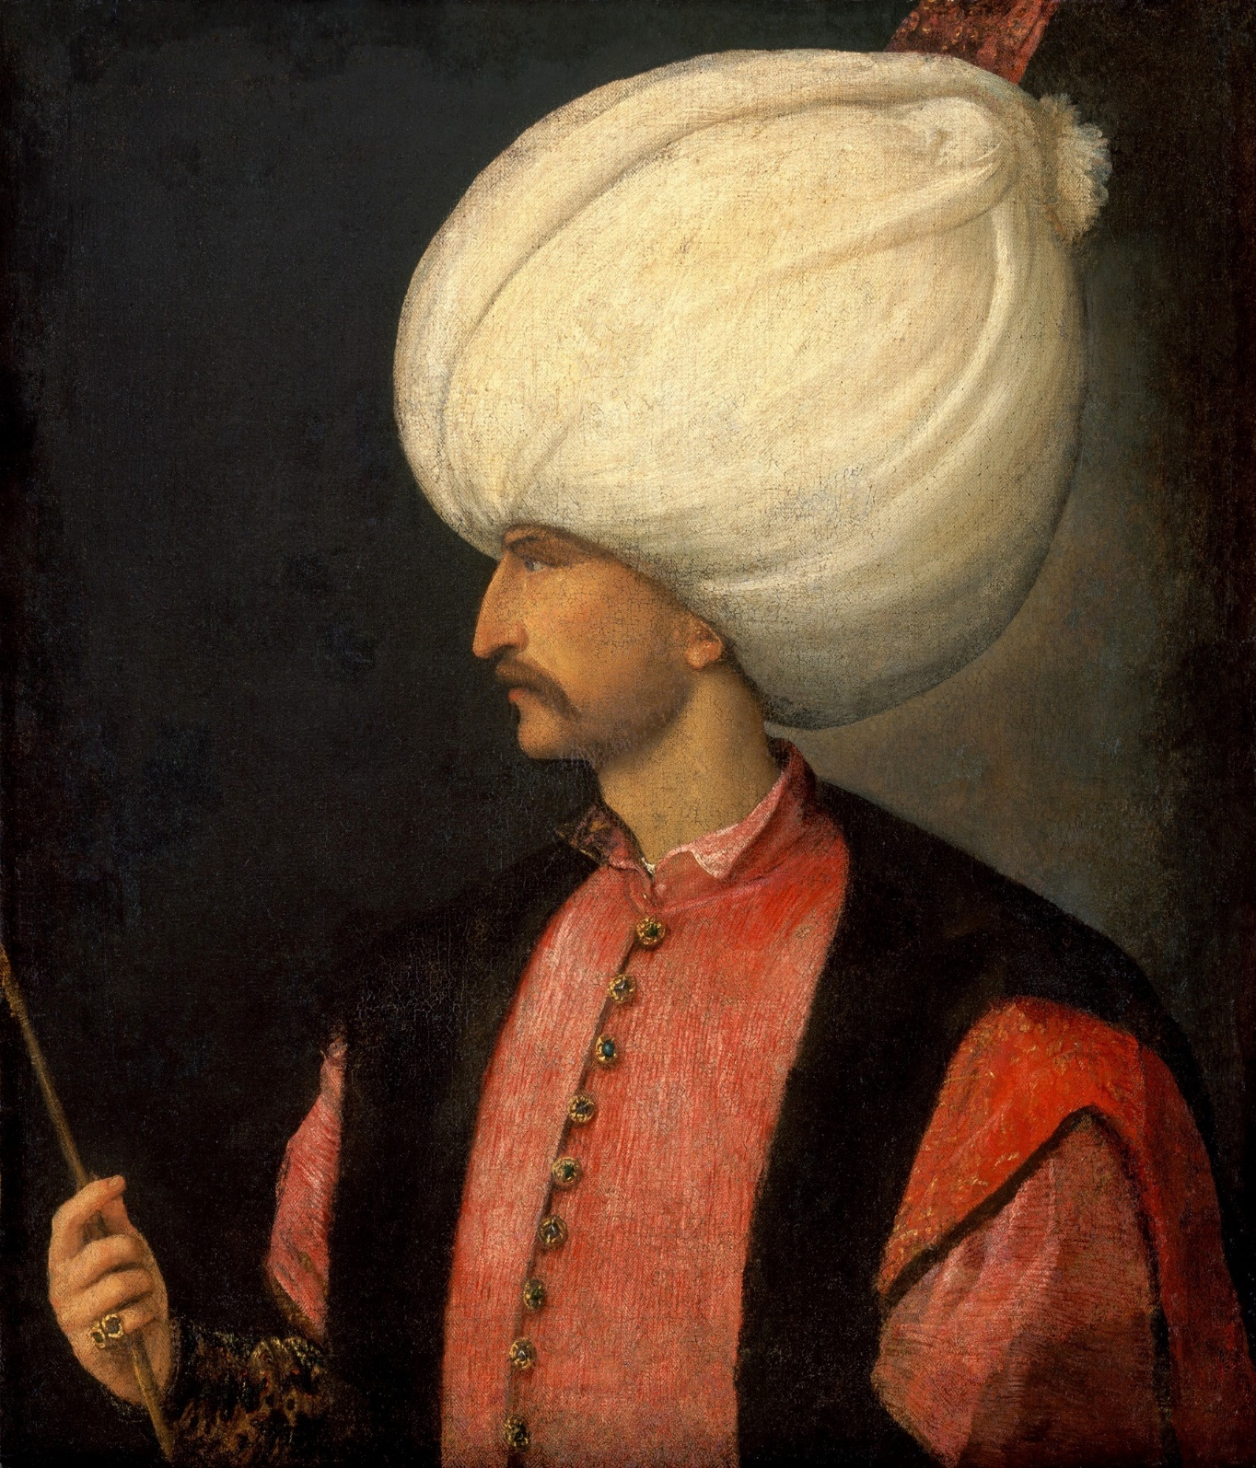
Ottoman Empire
Ethnic and religious diversity
- Dhimmis (protected minorities)
Jizya (poll tax on non-Muslims)
Imperial and military institutions
- Devşirme (levy of Christian boys)
Janissaries (elite infantry troops)
Harem (women’s quarters of imperial household)
Trade, diplomacy, conflict, and cultural exchange
- Ahdname

Slide 13
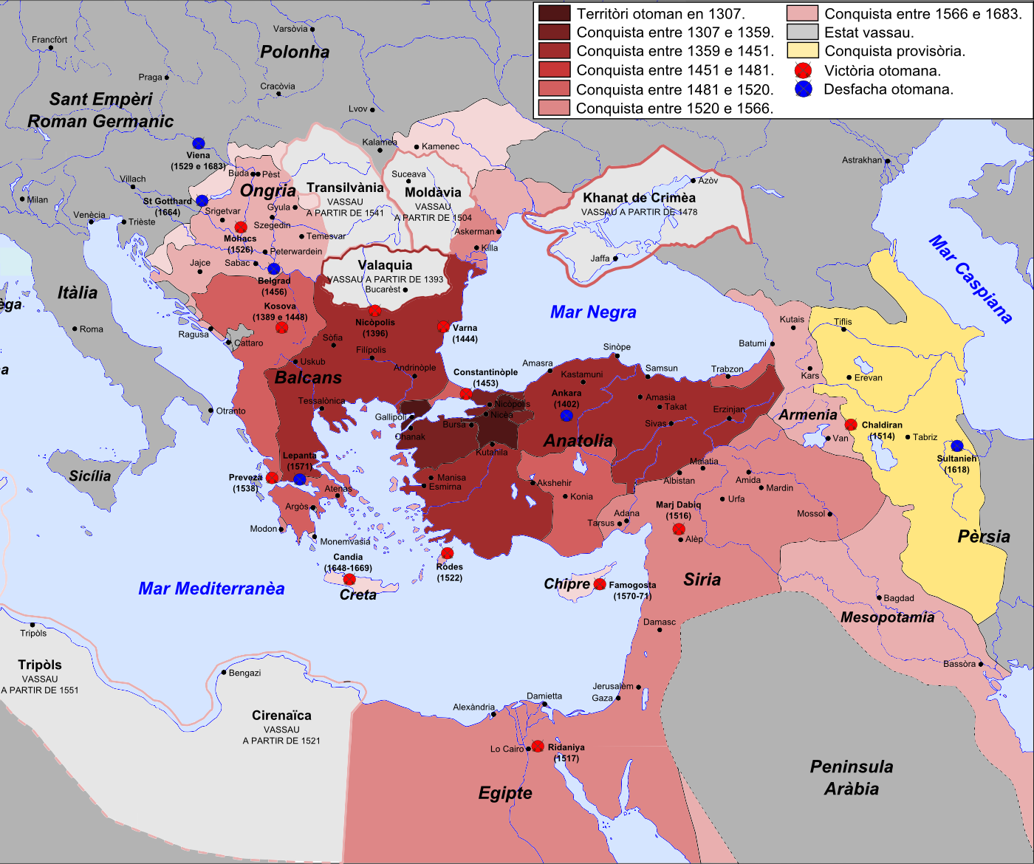
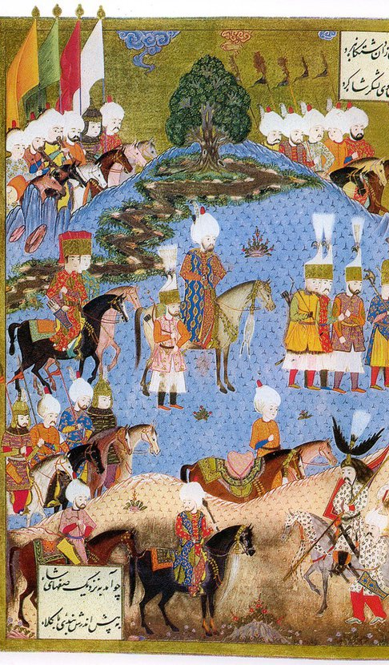

Slide 14
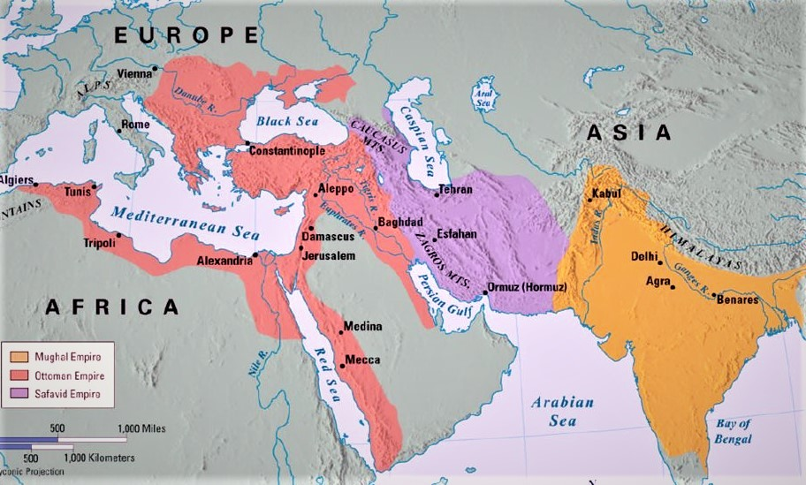

Slide 15
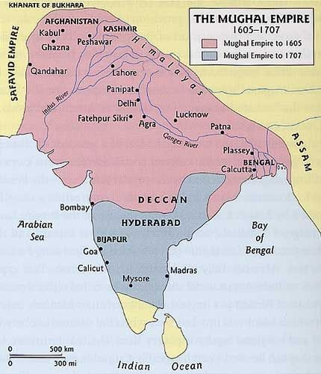
The Mughal Empire (1526-1857)
‘[The Mughals ruled] over a complex and plural empire with a fair degree of ideological flexibility.’
Sanjay Subrahmanyam, ‘A Tale of Three Empires: The Mughals, Ottomans, and Habsburgs in a Comparative Context’ (2006), p. 82.

Slide 16
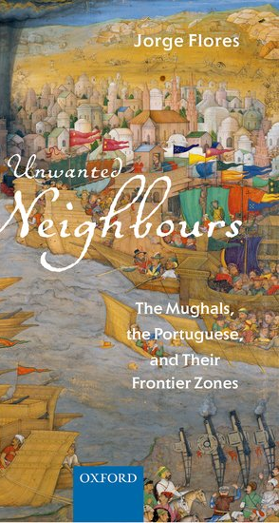
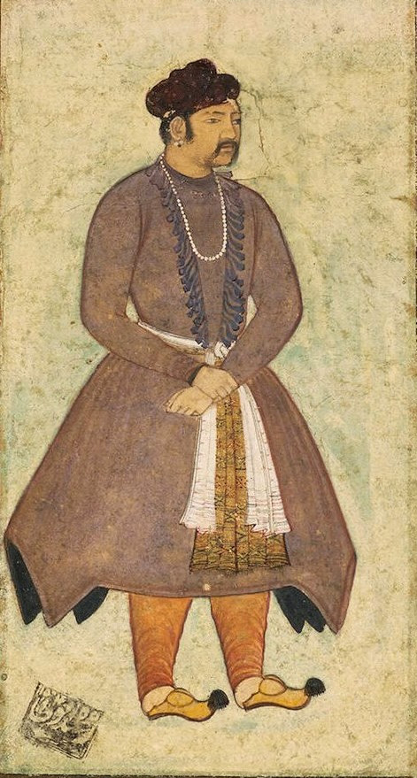
‘…to the Mogor [Mughal emperor Akbar, r. 1556-1605], the whole world seems small, and he thinks that everything within it belongs to him’.
Philip II of Spain to Viceroy Dom Francisco da Gama, 15 January 1598

Slide 17
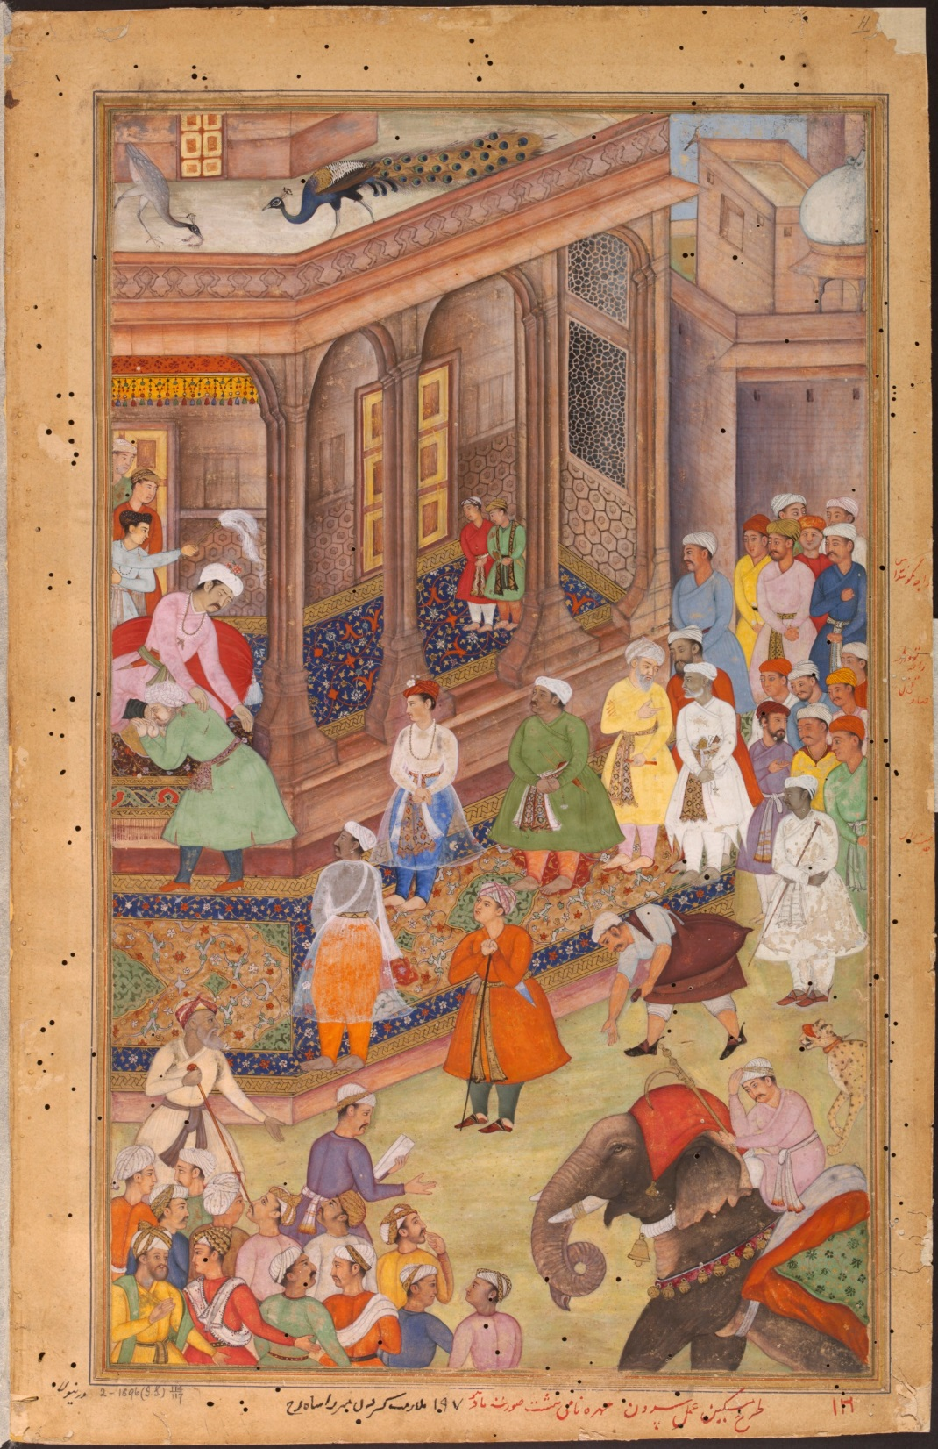
Ruling the empire
Expansion: military and dynastic
Administration and economy: managing plural populations
Religion: syncretism and diversity
Projecting power: internal and external challenges
18th c: Disintegration and decline

Slide 18
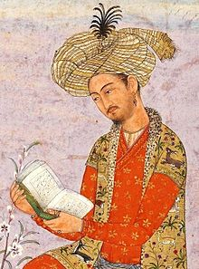
Mughal dynasty (1526-1857)
Babur (r. 1526-1530)
Humayun (r. 1530-1540; 1555-1556)
Akbar (r. 1556-1605)
Jahangir (r. 1605-1627)
Shahjahan (r. 1628-1657)
Aurangzeb (r. 1658-1707)
-
Bahadur Shah II (r. 1837-1857)

Slide 19
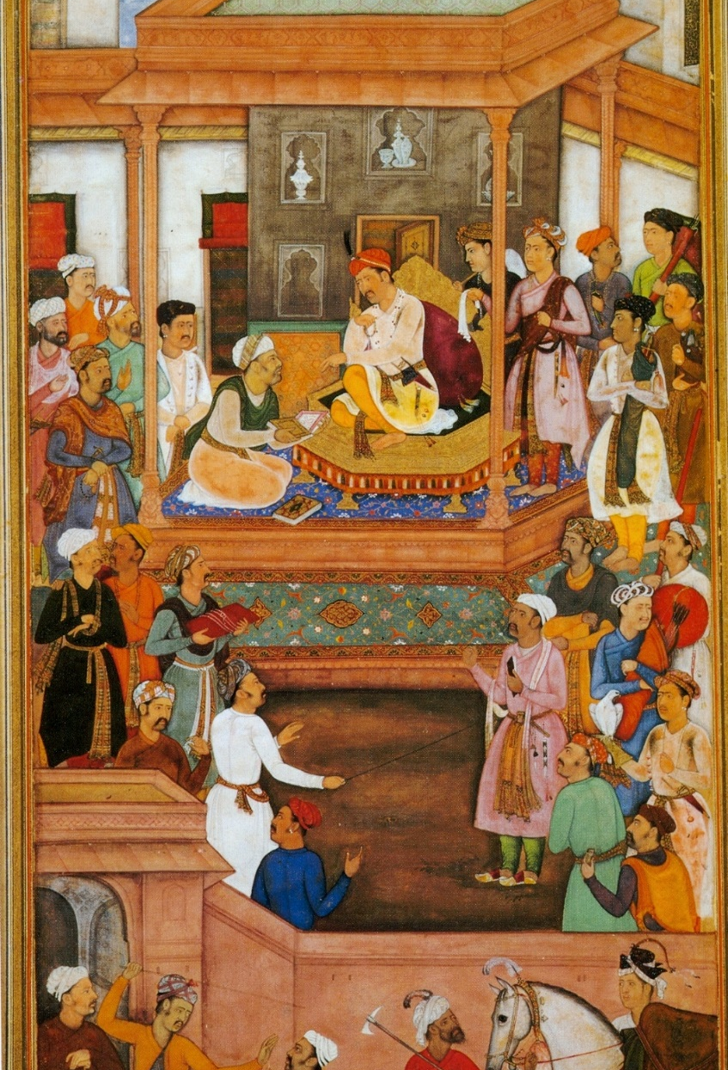
Administration and Economy
Diverse cadre of officers (Chaghatai, Uzbek, Turani, Irani, Rajput, Maratha, Afghan, Indian Muslims)
Mansabdari system determining the rank, pay-scale, and military duties of office-holders
Centralised revenue system, with (rotating and non-hereditary) land grants (jagirs) made to mansabdars as reward for service
Agriculture + manufacturing: silk and cotton textiles
Oceanic trade: private merchants and members of governing elite

Slide 20
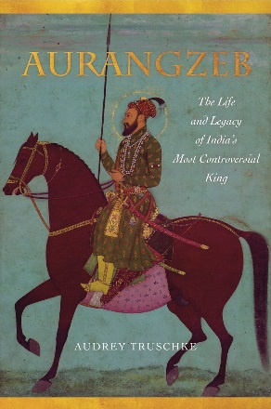
Religion
Mughal emperors followed Sunni Islam, interest in Sufism and fairly tolerant of other religions
Syncretism and personality cult Akbar
jizya tax on non-Muslims abolished in 1579; reinstated in 1679
Religion no bar to entering Mughal elite
Greater turn towards Sunni orthodoxy under Aurangzeb, yet forced conversions remained few

Slide 21
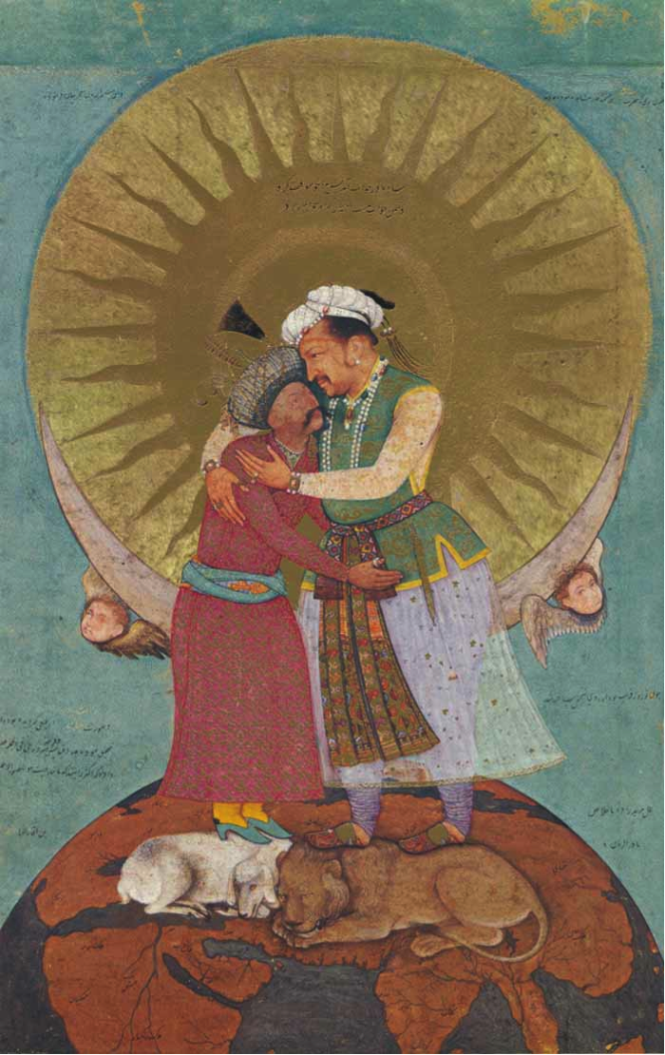
Internal and external challenges
Internal: vassals and tributaries (i.e. rajas, zamindars), nobles, rival members of imperial family (succession disputes)
External: Safavids, Uzbeks, Deccan sultanates, Marathas, Sikhs, Europeans
Responses:
Diplomacy and force
Imperial ideology expressed through elaborate court ceremonial, art and architecture

Slide 22
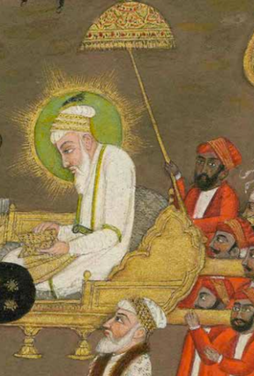
Disintegration and Decline
Weakening of central authority after death Aurangzeb (1707)
Emergence of successor states in 18th c., e.g. Bengal, Ahwad, Hyderabad
Rise to power of the Marathas
Sack of Delhi by Nader Shah (1739)
British East India Company assumes the diwani over Bengal (1765)
Bahadur Shah II deposed by British after 1857 uprising (“Mutiny”)

Slide 23
Conclusions
Comparing empires: seeing the diversity and commonalities of political and cultural arrangements across early modern world
Mughal & Ottoman empires based on contiguous territorial expansion; Habsburg empire both land-based & maritime
Ottoman and Mughal rule not chiefly extractive, unlike Habsburg rule in Spanish America
Imperial rule based on compromise with local and regional elites: permitting plurality within empire, yet to different degrees

