Slide 1
Science and religion
HI113 week 15, 2024-5
Dr. Michael Bycroft

Slide 2
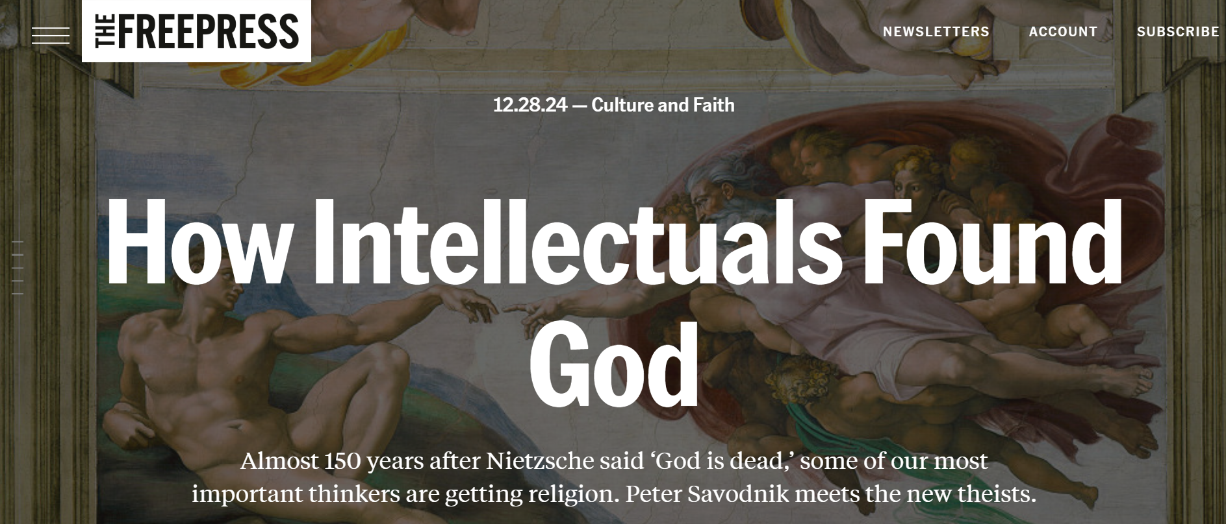

Slide 3
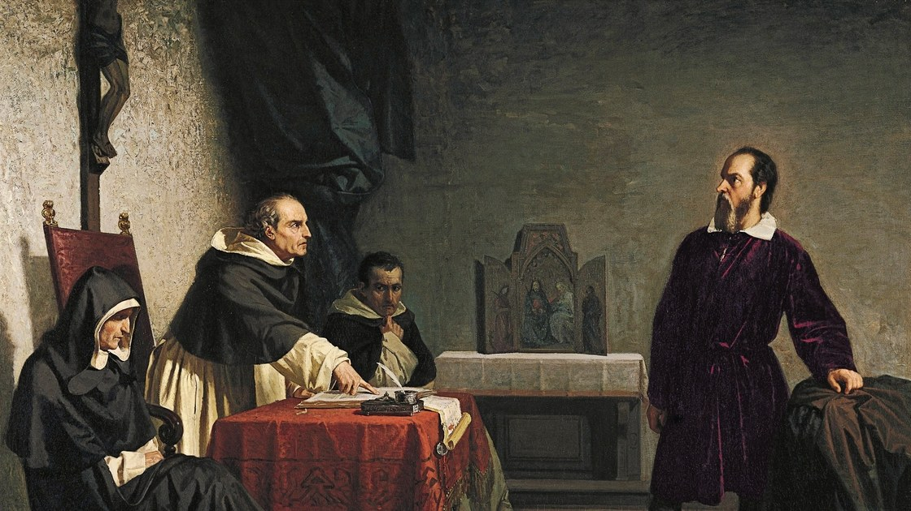
19th-century painting showing the Italian professor and courtier Galileo Galilei on trial for heresy before the Roman Inquisition, in 1633
Christiano Banti, Galileo before the Inquisition, 1857
‘

Slide 4
In all modern history, interference with science in the supposed interest of religion, no matter how conscientious such interference may have been, has resulted in the direst evils both to religion and to science…
Andrew Dickson White, History of the Warfare of Science with Theology in Christendom (1885)

Slide 5
The formal organization of values constituted by Puritanism led to the largely unwitting furtherance of modern science.
Robert Merton, “Science, Technology and Society in Seventeenth Century England,” in Osiris vol. 4 (1938): 360-632

Slide 6
…where science prospered in early modern times, it derived important support and reinforcement from organized religion.
John Heilbron, “Science in the Church,” in Science in Context vol. 3, no. 1 (1989): 9-28

Slide 7
In the Islamic world, science and faith had always [ie. at least up to the early modern period] gone hand in hand.
James Poskett, Horizons: A Global History of Science (2022)

Slide 8
The nature of early modern science
The Copernican Revolution
Conclusions

Slide 9
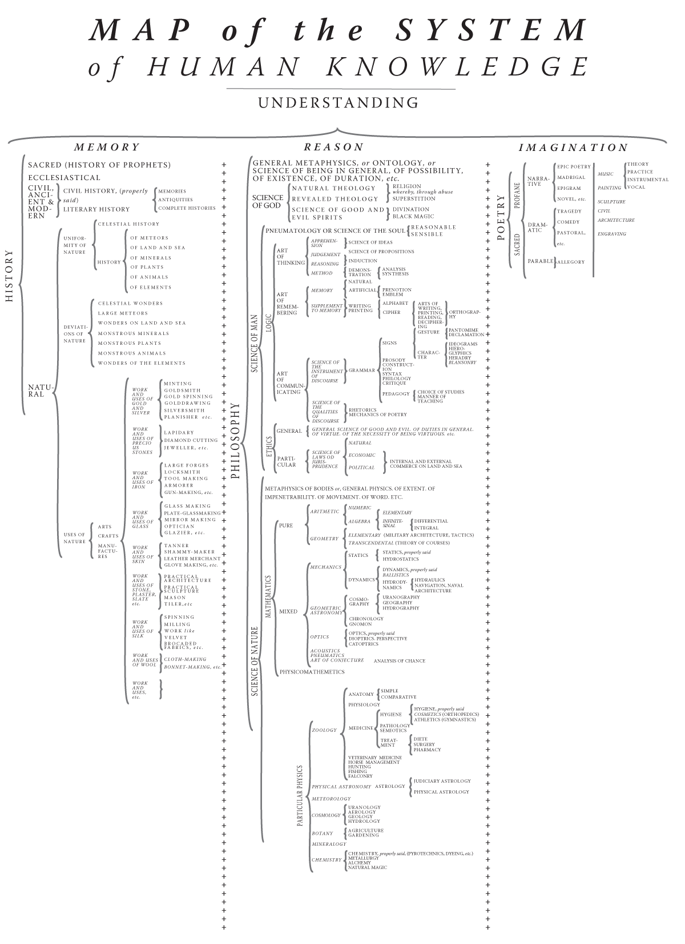
“Map of the System of Human Knowledge,” modern translation of a diagram in the Encyclopédie (1751-1772) of Denis Diderot and Jean-le-Rond d’Alembert, 1749

Slide 10
Science before ‘science’
the word ‘scientist’ was coined in 1833
the words ‘science’ and ‘scientia’ were used in the early modern period
but those terms included much of what we now call ‘philosophy’
and they excluded much of what we now call ‘engineering’, ‘mathematics,’ ‘botany’ and ‘mineralogy’
the closest early modern ancestors to today’s science were called ‘natural history,’ ‘natural philosophy,’ ‘mixed mathematics’, and ‘the mechanical arts’
this is not just a terminological point

Slide 11
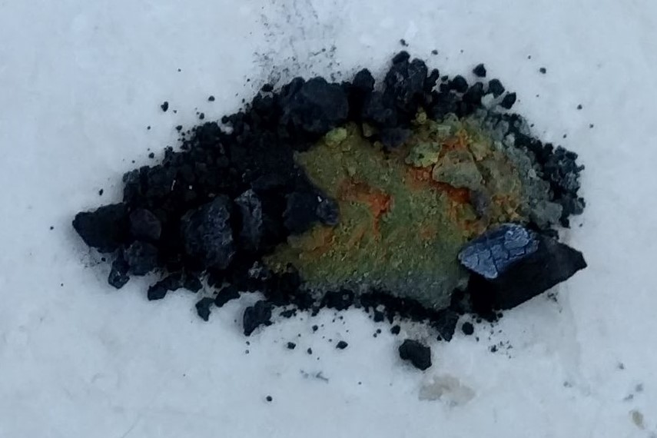
One step in the creation of the Philosopher’s Stone, from a fifteenth-century text.
A ‘burning coal’ is placed next to a sample of ‘black faeces’ which is then overspread with a ‘Citrine colour, very glorious to behold.’
Performed by Prof. Larry Principe, University of Warwick, May 2018.

Slide 12
Science or pseudo-science?
alchemy, astrology, and magic were widely practiced in early modern Europe, under those names
they were often based on beliefs that have no place in present-day science
but these beliefs are very hard to separate from ones that do have a place in present-day science
Galileo cast horoscopes, Robert Boyle believed in May Day fatality, Isaac Newton hunted for the philosopher’s stone…
Separating ‘early modern science’ from ‘early modern pseudo-science’ is a fool’s game!

Slide 13
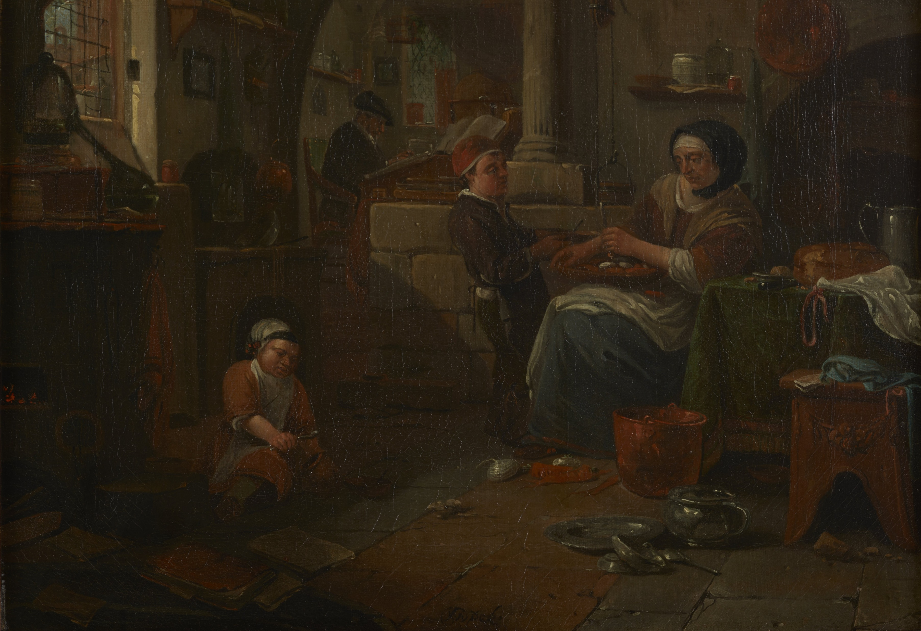
‘Alchemist and family’
Thomas Wijck, England/Dutch Republic, c. 1640s-70s
Courtesy of the Chemical Heritage Foundation
Discussed in Simon Werrett, Thrifty Science (Chicago UP, 2019)

Slide 14
The place of science
much (most?) early modern science was done outside the university
private households, sometimes with servants or spouses
the courts of kings, queens, dukes, duchesses, emperors
commercial and industrial sites, e.g. mines, apothecary shops
places of leisure, e.g. pubs and coffee houses
while travelling by foot, ship, carriage, hot-air balloon…
in rural areas (e.g. plant-collecting) as well as in towns and cities
‘thrifty science’ (Simon Werrett) was the norm, ie. making use of material culture designed for non-scientific purposes

Slide 15
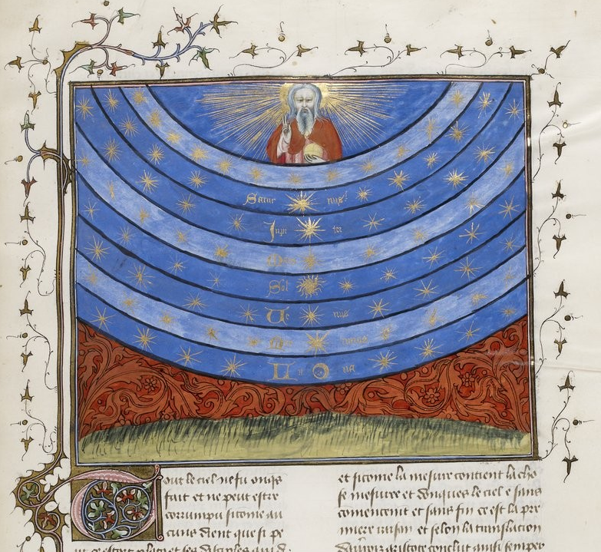
The Christian cosmos in the late Middle Ages, showing the geocentric universe
From French manuscript c. 1400-1420, containing works by the theology professor Nicholas Oresme (c. 1325-1382)

Slide 16
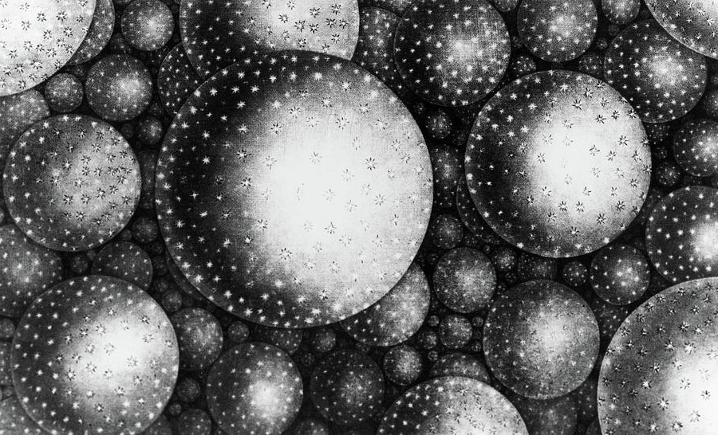
The universe as a collection of star systems or galaxies
‘A Partial View of Immensity’, from Thomas Wright, Original Theory or New Hypothesis of the Universe (1750)

Slide 17
A Scientific Revolution?
earth-centred cosmos to vast, sun-centred cosmos
microscope, telescope, binomial nomenclature (e.g. ‘homo sapiens’), differential calculus, colour indicators…
unprecedented engagement with the natural world outside Europe
merging of natural philosophy, natural history, and mixed mathematics,
university-trained scholars interact with merchants and artisans
establishment of Royal Society of London, 1660s
“scientific revolution” is a fiercely contested term, but…
“It is undisputed that during this period [1500 to 1750] every aspect of natural knowledge in Europe was radically reconfigured”
Lorraine Daston, in Histoire des sciences et des savoirs, ed. Stéphane van Damme (2016)

Slide 18
2. The Copernican Revolution

Slide 19
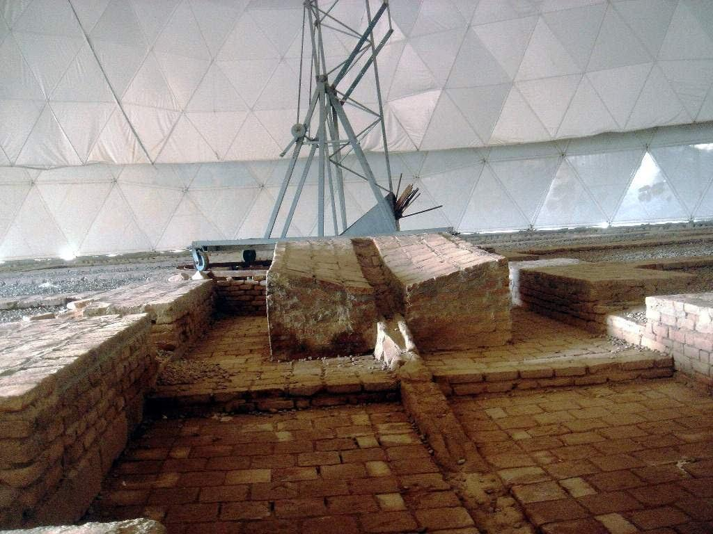
Stone sextant, a giant “protractor” for measuring celestial angles
Maragheh observatory, est. 1259 in Maragheh in Northern Iran
Hulagu Kahn, grandson of Genghis Kahn, lay siege to Baghdad in 1258

Slide 20
Science in the Islamic golden age
Abbasid caliphate, 750-1258; capital in Baghdad; North Africa to Iran
Major contributions to medicine, optics, logic, maths, astronomy…
Textual basis, e.g. translation of Ptolemy’s Mathēmatikē Syntaxis (Greek) into al-majisṭī (Arabic), now known as the Almagest
Institutional basis, e.g. world’s first observatory set up in Baghdad in 858
Theoretical advances, e.g. secular change in obliquity of ecliptic
Defence of Sunni branch of Islamic faith
Mathematical problems from the Quran, e.g. direction of Mecca
Imitating ancient Persian Abbasid empire
Abbasids a model for later Islamic empires

Slide 21
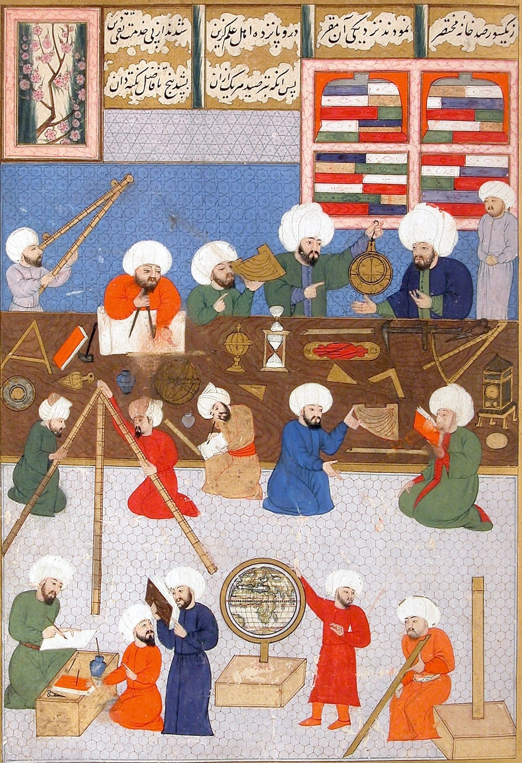
Astronomers at work in the sixteenth-century Istanbul observatory
Note the sextant, astrolabe, terrestrial globe, and mechanical clock
From an Ottoman manuscript of the Shahnameh (‘The Book of Kings’), a Persian epic poem

Slide 22
The Islamic Renaissance
Istanbul Observatory, built in 1577 for Ottoman sultan Murad III
A very large sextant, early use of mechanical clocks
After conquest of Constantinople by the Ottoman empire in 1453
Ulugh Beg Observatory in Samarkand (now in Uzbekistan), part of Timurid Empire, built 1420
Very large sextant, astronomers include Ali Qushji, early defender of heliocentrism
Beg himself was a skilled astronomer
Astronomy in Timbuktu (now in Mali), under patronage of Askia Muhammad (1443-1538), ruler of the Islamic Songhay empire
Askia Muhammad’s pilgrimage to Mecca in 1496 brings Arabic astronomy to Timbuktu

Slide 23
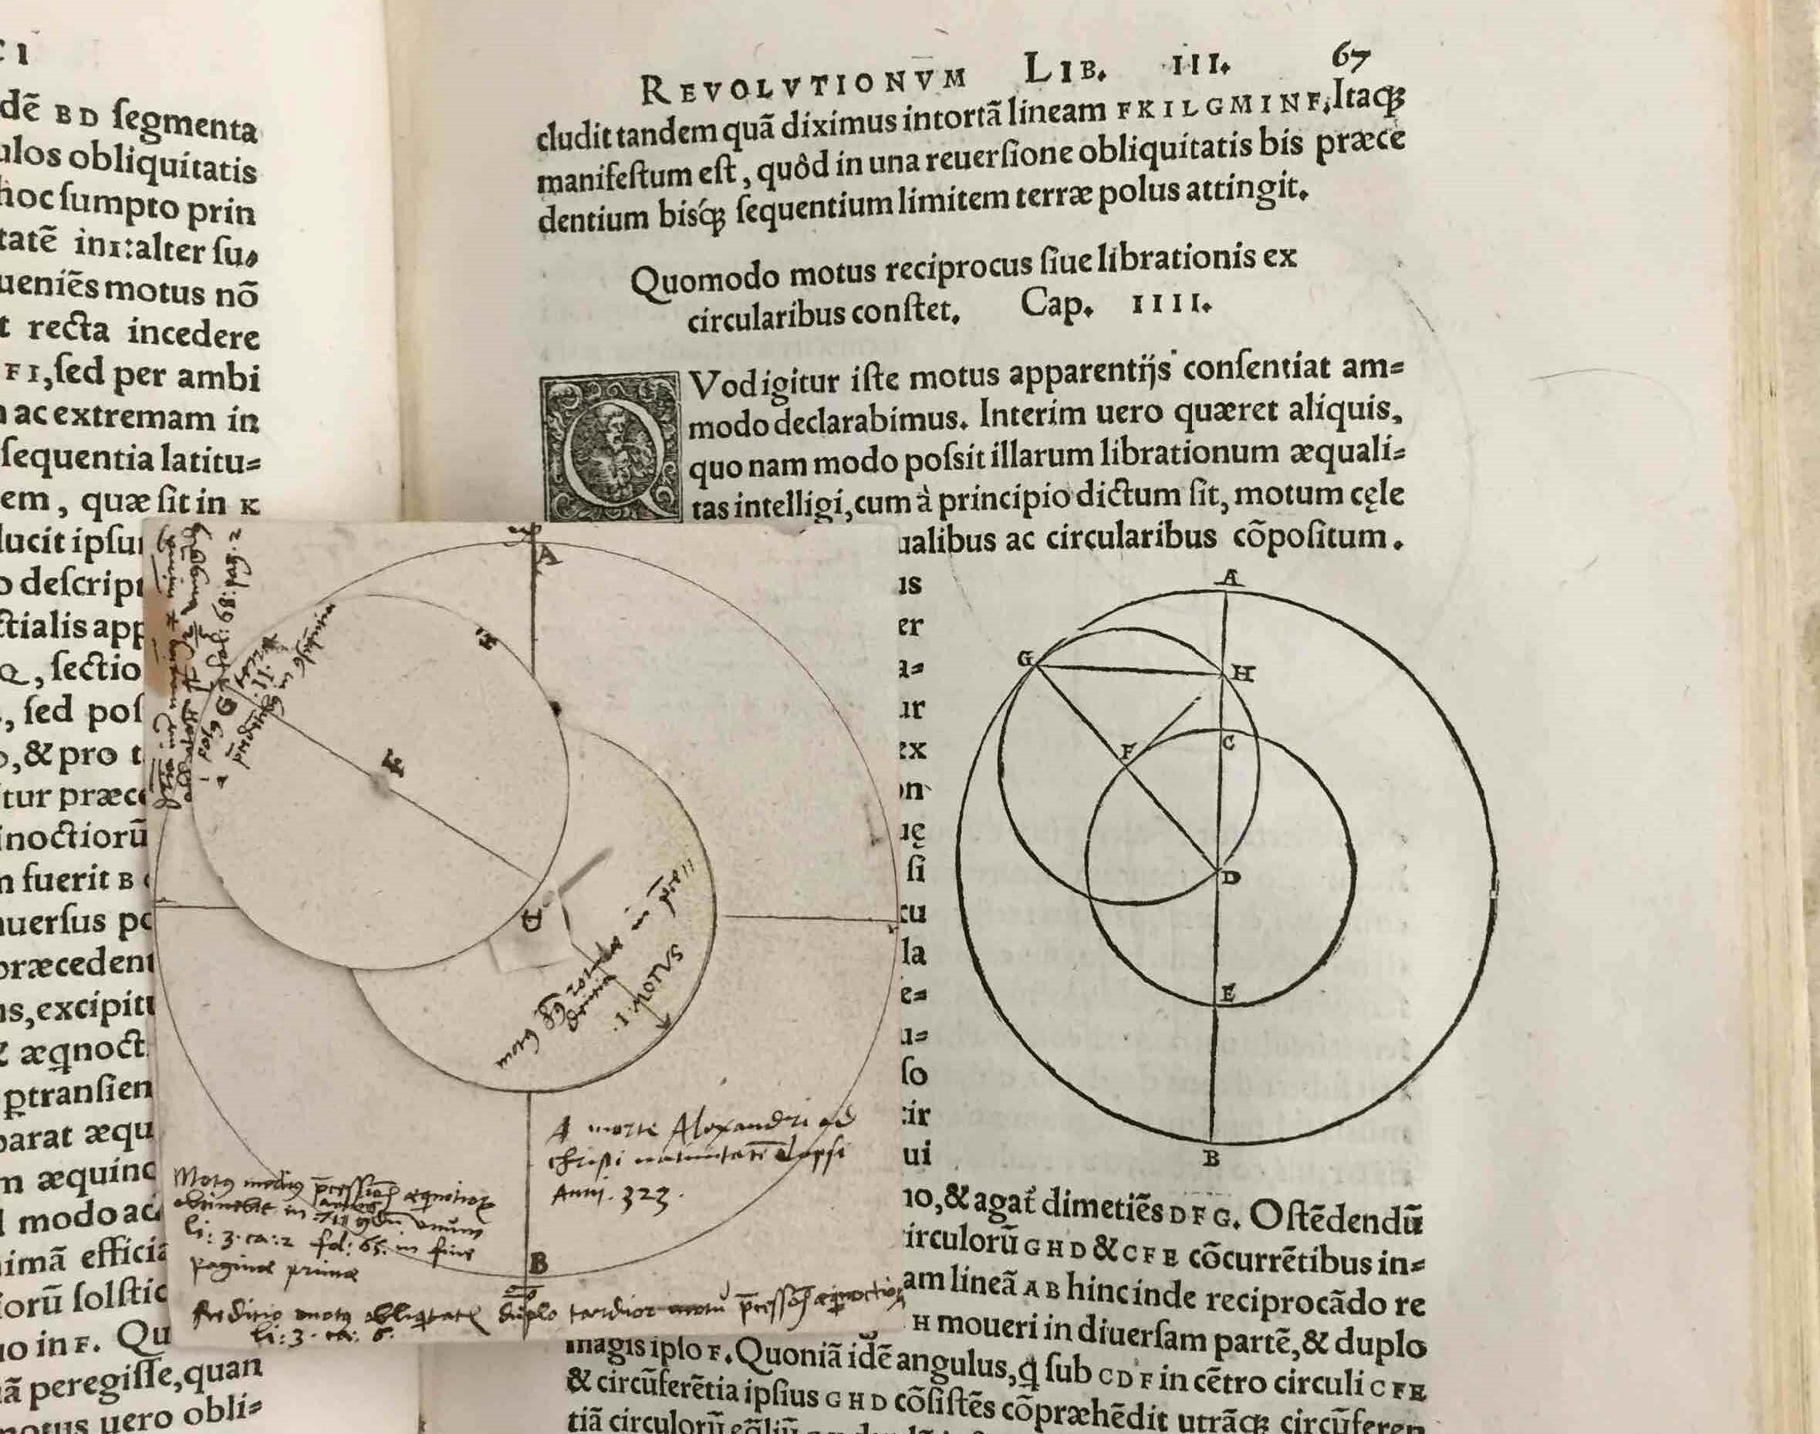
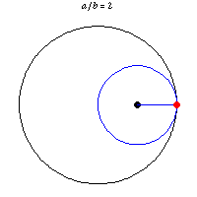
Modern animation of the Tusi couple
First described in 1247 by Nasir al-Din al-Tusi,
Persian astronomer who later worked at the Maragheh Observatory
Diagram of Tusi couple in copy of Nicolaus Copernicus (1473-1543), Revolutions of the Heavenly Spheres (1543)
Paper mechanism added by a later user

Slide 24
The conservative Copernicus
First sustained written defence of sun-centred cosmos
Earth just another planet, with the same motions as Mars, etc.
Mathematical realism – ‘the simplest model is literally true’
Benefits from cultural exchange following fall of Constantinople in 1453
Copernicus saw himself as reviving an ancient thesis
More insistent on circular motion that Ptolemy had been
Copernicus supported by his maternal uncle, bishop of Varmia
Studied canon law (religious law) in Italy
Became a canon (lay expert on religion) attached to a cathedral in Varmia
Revolutions dedicated to Pope Clement VII with letter of encouragement from Nicholas Schoenberg, a German cardinal

Slide 25
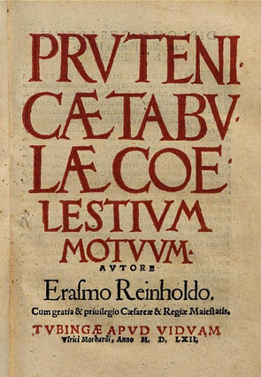
Erasmus Reinhold, Prutenic Tables of Celestial Motions, first published 1551
Tables of astronomical data, based on Copernicus’ mathematics, dedicated to the Lutheran Albert, Duke of Prussia

Slide 26
University of Wittenberg
Martin Luther a professor of theology at Wittenberg from 1512
Luther helped to appoint Philip Melanchthon as a professor in 1518
Melanchthon the architect of the Augsburg Confession of 1530
Georg Joachim Rheticus appointed as professor of mathematics and astronomy at Wittenberg by Melanchthon
Rheticus works with Copernicus in Poland during a two-year period of leave; publishes a summary of Copernicus’ book in 1540
Erasmus Reinhold, another Wittenberg professor, publishes the Prutenic Tables 1551
Copernicus’ mathematics spreads through Protestant lands thanks largely to these tables

Slide 27
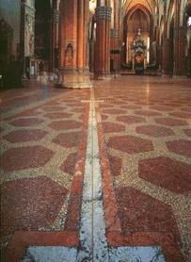
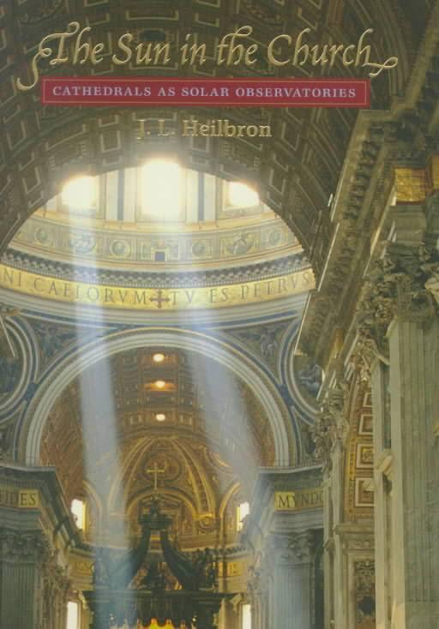
Meridian (North-South) line in a Bologna cathedral
Installed in the 17th century to observe motions of the sun
John Heilbron, The Sun in the Church: Cathedrals as Solar Observatories (Harvard University Press, 1999)

Slide 28
Jesuit science
follow the natural philosophy of the ancient Greek philosopher Aristotle
also the teachings of Thomas Aquinas, the 13th-century theologian
adopt new theories instrumentally, eg. the sun-centred cosmos
emphasise mathematics, eg. Mathematics Academy at Jesuit College in Rome, late 16th-century
textbooks, natural history collections, correspondence networks
bring European science to China and Japan, e.g. Matteo Ricci studied maths and astronomy at Jesuit College in Rome before beginning his Chinese mission
mathematics useful for navigation, calendrics, conversion, and avoiding controversial theories

Slide 29
Christiano Banti, Galileo before the Inquisition, 1857

Slide 30
Heretic or saint?
in 1616 Galileo ‘ordered…to abandon completely the opinion that the sun stands still at the centre of the world and the earth moves...’ - Roman Inquisition
Galileo defends this opinion in Dialogues on the Two Chief World Systems (1632)
Galileo convicted of ‘vehement suspicion of heresy’ in 1633
but Pope Urban V had approved Galileo’s project in 1630…
on the condition that Galileo disavow literal heliocentrism at end of book…
…but Galileo puts this in the mouth of the simple-minded Simplicio!
Galileo was a committed Catholic who wanted to use science to interpret Scripture not debunk it

Slide 31
Who can doubt that within another 400 years the church will recognize Galileo’s divine gifts, atone for his sufferings, ignore his arrogance, and make him a saint?
John Heilbron, Galileo (2010)

Slide 32
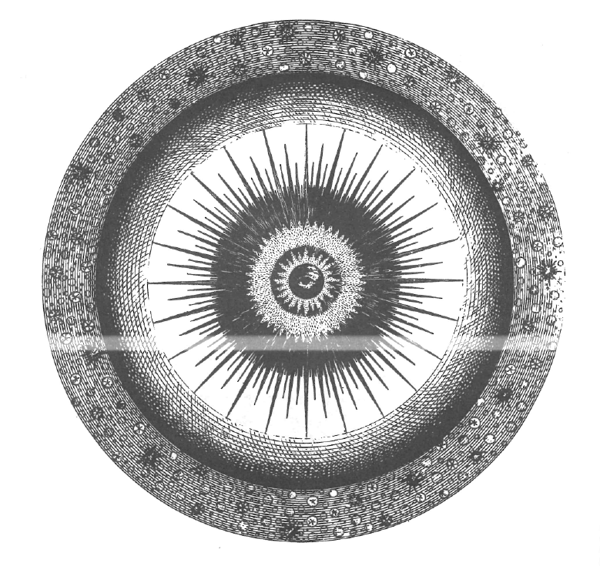
“a central section” of the universe, “with the eye of Providence seated in the centre”
Thomas Wright, Original Theory or New Hypothesis of the Universe (1750), plate XVI

Slide 33
Astro-theology in the Enlightenment
“Natural theology” used natural science to argue for the existence and goodness of the Christian God
The “radical Enlightenment” questions the accuracy of the Christian Bible, e.g. Baruch Spinoza (1632-1677)
The “experimental philosophy” (natural philosophy with lots of experiments and observations) has much public success from the 1660s
Isaac Newton argues in his Mathematical Principles of Natural Philosophy (1687) that all bodies in the solar system attract eachother
How does God avoid the gravitational collapse of the stars?
How are the stars distributed in the universe?
The beginning of stellar astronomy and the end of the “fixed stars”

Slide 34
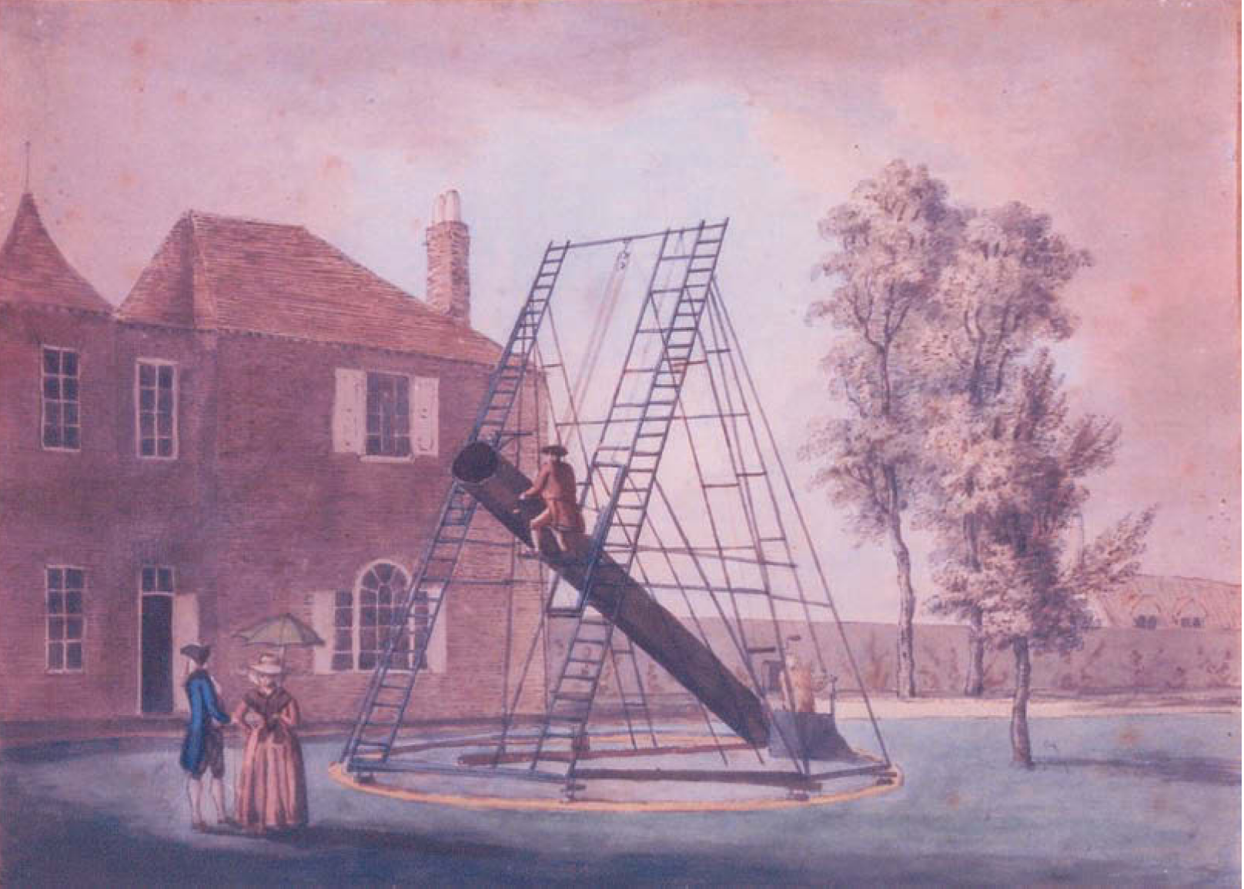
William Herschel (1738-1822) operating a 20-foot telescope in his garden near Windsor Castle, in 1784 or 1785

Slide 35
Conclusions
early modern science was neither ‘science’ nor ‘pseudo-science’
it was multi-sited and changing rapidly
the Copernican Revolution was not just about Copernicus
early modern science could not flourish without the support of organised religion…
…in Europe and beyond Europe
…well into the eighteenth century

Slide 36
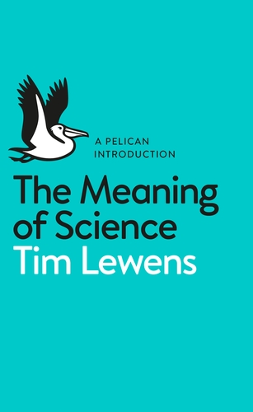
If science can’t interpret itself, can the humanities do so?
Are the humanities the new religion?

