Slide 1
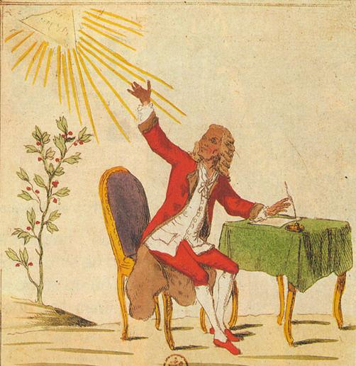
The Enlightenment and Revolution: Europe and the World
Prof Mark
Knights

Slide 2

Lecture aims
To explain the Enlightenment and its key messages
To examine how the Enlightenment helped to shape European identity and Revolution (two C17th GB revolutions, American Revolution, French revolution)
To question how far the Enlightenment was a European phenomenon and how far it was a global one
The British (and hence also European?) contribution to the Enlightenment was celebrated at the opening festival of the London Olympics in 2012

Slide 3
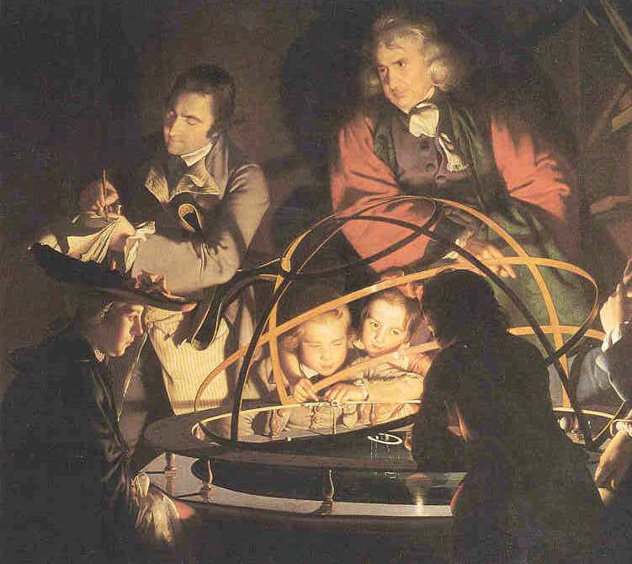
The terms of Enlightenment
Enlightenment: it was contemporary; 1784 Prussian essay competition ‘was ist Aufklärung?’
But it is a very contested and ambiguous term – it has been a shorthand for a set of European values that underpinned modernity but this has become increasingly problematic
The? Description of a ‘process’ rather than an ‘event’ or period
an intellectual and cultural movement in the ‘long eighteenth century’ (c.1650 or 1680 to 1815)
the term ‘Age of Reason’, which is also used, does suggest a period.
The image of light.
Joseph Wright: A Philosopher lecturing about the Orrery

Slide 4
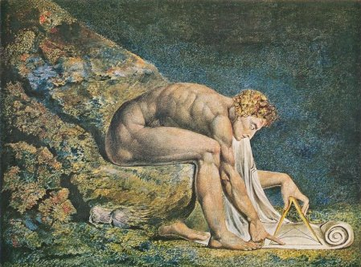
What ideals did the Enlightenment seek?
Two over-arching characteristics (though some would contest the coherence of the Enlightenment):
1) Reason and experiment
Immanuel Kant, 1784 ‘dare to know’, free oneself from being slaves to others, think for yourself, use reason. Deification of reason
Experimental philosophy – don’t go on assumptions but start from direct observation, and that will clear you from the ignorance of the past
2) optimism in progress towards the good life and happiness, through what man could achieve by observing himself and nature
William Blake’s depiction of Isaac Newton as the personification of reason , 1805

Slide 5

Can we identify where Enlightenment ideals appear distinctive?
Religion.
Attacked the ignorance and superstition pedalled by the established church (both Catholic and Protestant). Hostility to superstition and to intolerance – and pleas for freedom of conscience. Rational religion.
Questioned the relationship between Church and State; and religious institutions such as the Jesuits (disbanded 1773, restored 1814).
In its more radical form also the nature of revealed religion - some adopted a more rational form of religion, deism (Voltaire, Thomas Paine) and even atheism (Baron d’Holbach).

Slide 6
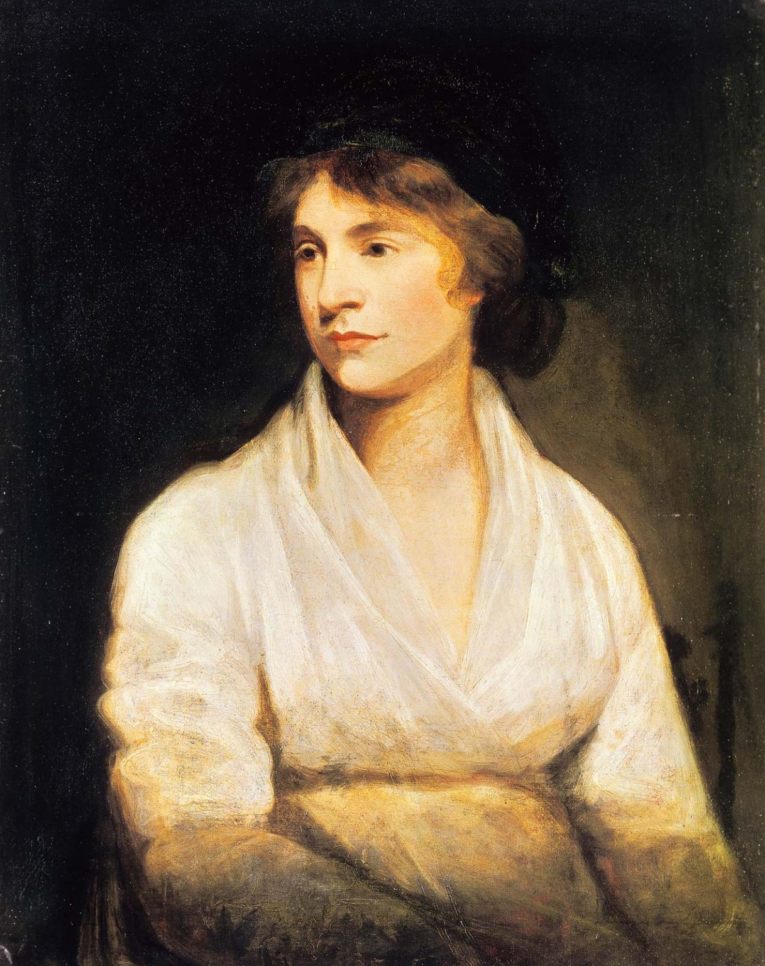
But in many ways it was also a religious Enlightenment: many clerics were part of the Enlightenment e.g. Abbé Sièyes on the ‘third estate’.
And difficult to keep rethinking of religion within one sphere e.g. Freeing of social/sexual mores from religious prescription? Mary Wollstonecraft, Vindication of the Rights of Women (1792); Marquis de Sade, Juliette (1797) – what were the limits of sexual freedom?

Slide 7
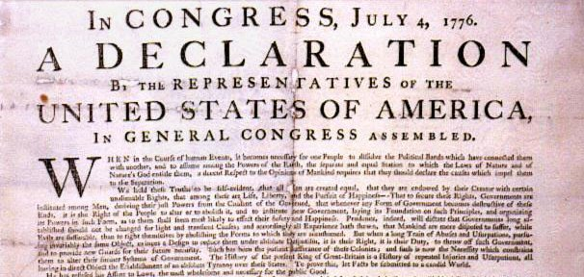
2) Political Authority
New ways of thinking about the powers of the people and their rulers.
Ideas of contract and natural rights (John Locke; Rousseau).
Ideas of natural equality and liberty
Of citizens rather than subjects
Desacralisation of monarchy; admiration of republics (strong influence of antiquity)
Justification of revolution: Britain 1689, America 1776
Ideals of peace and end to war (William Penn, Essay towards the Present and Future Peace of Europe (1693); Saint-Pierre, Project for Settling an Everlasting Peace (1713); Rousseau, peace through federated Europe); idea of international law; Kant perpetual peace
We hold these truths to be self-evident, that all men are created equal, that they are endowed by their Creator with certain unalienable Rights, that among these are Life, Liberty and the pursuit of Happiness.--That to secure these rights, Governments are instituted among Men, deriving their just powers from the consent of the governed, --That whenever any Form of Government becomes destructive of these ends, it is the Right of the People to alter or to abolish it, and to institute new Government, laying its foundation on such principles and organizing its powers in such form, as to them shall seem most likely to effect their Safety and Happiness.

Slide 8
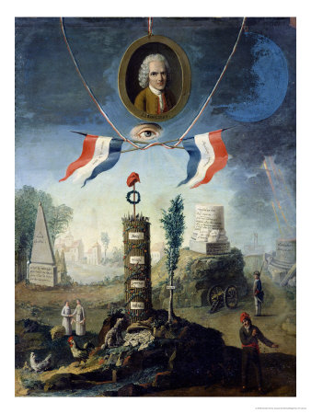
France 1789
Attack on the ‘ancien régime’: a term invented at the French Revolution of 1789 to describe the ‘old rule’, ‘old order’, or ‘former regime’ that the revolutionaries were trying to sweep away
The Revolutionaries of 1789 saw themselves as carrying out many of the ideas formulated by the philosophes and idolised some of them
Had stronger social element than British or American revolutions
1794 Allegory of the Revolution by Nicolas Henry Jeaurat de Bertry

Slide 9
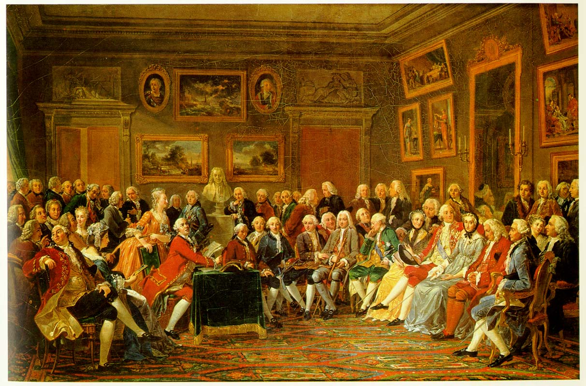
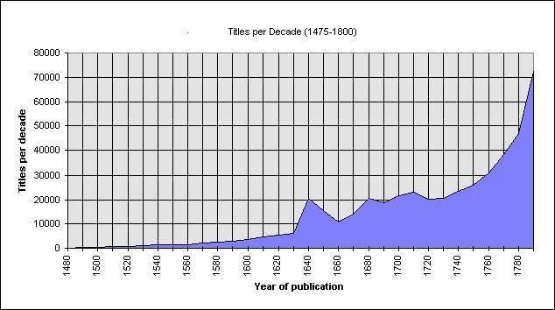
3) The rise of the public
The public as a force
Proliferation of print and case for press freedom
New institutions where the public met and debated: coffee houses, cafés, salons.

Slide 10

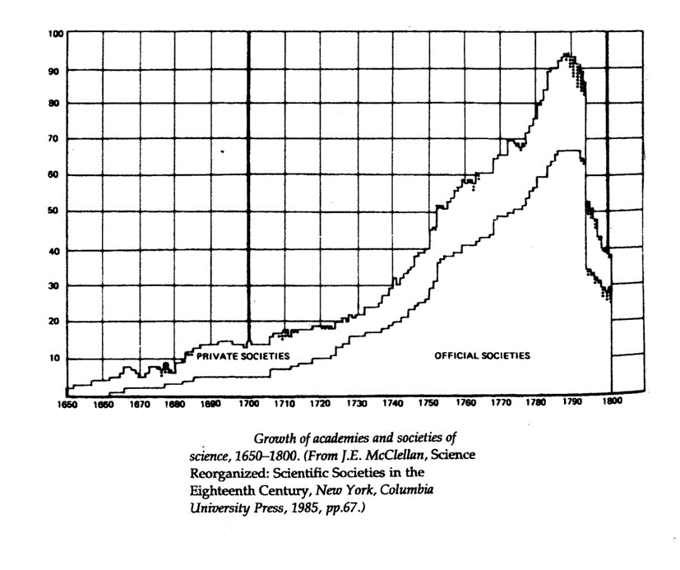
4) Reason and Knowledge
The organisation and collection of knowledge and artefacts (Carl Linnaeus 1707-1778; the Encyclopédie 1751-1772) – D’Alembert and Diderot
New energy to understand the natural world, the body, and scientific processes (inoculation, analysis of air, the microscope, dissection and medicine)
Confidence in scientific approach (Societies; museums and collections; public health eg hospitals)
Exploration of the world (Vitus Jonassen Bering, James Cook, Comte de Bougainville

Slide 11
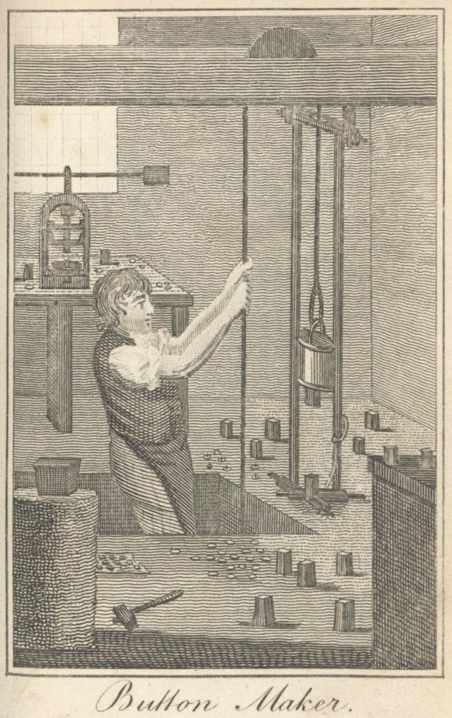
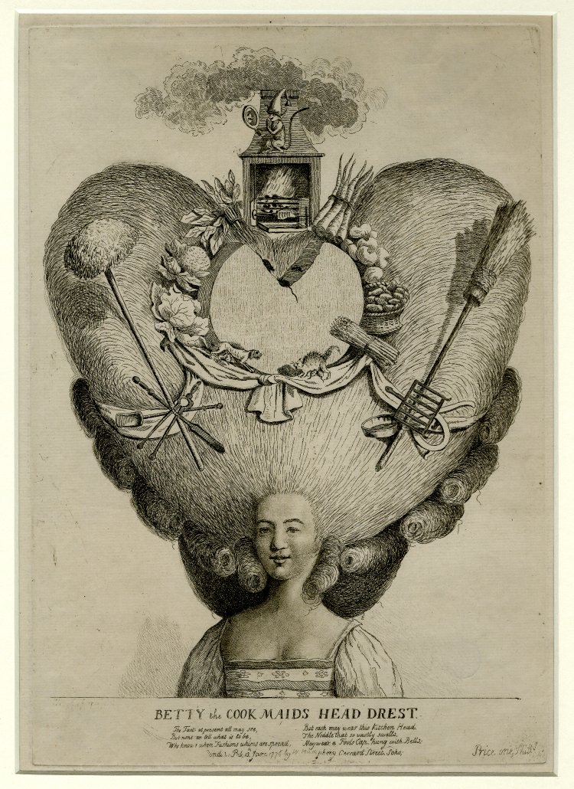
5) Wealth and luxury
Changing notions about the creation of wealth – a move away from consumption as sinful
Debate about luxury
A questioning of protectionist economics – Adam Smith’s Wealth of Nations (1776) – interest as the key motivator of trade and a freeing of the market from the state and mercantile monopolies
‘Industrial Enlightenment’ –Joel Mokyr: industrialisation was driven, in large part, by the accumulation of scientific and technical knowledge eg Matthew Boulton and the Lunar Society

Slide 12
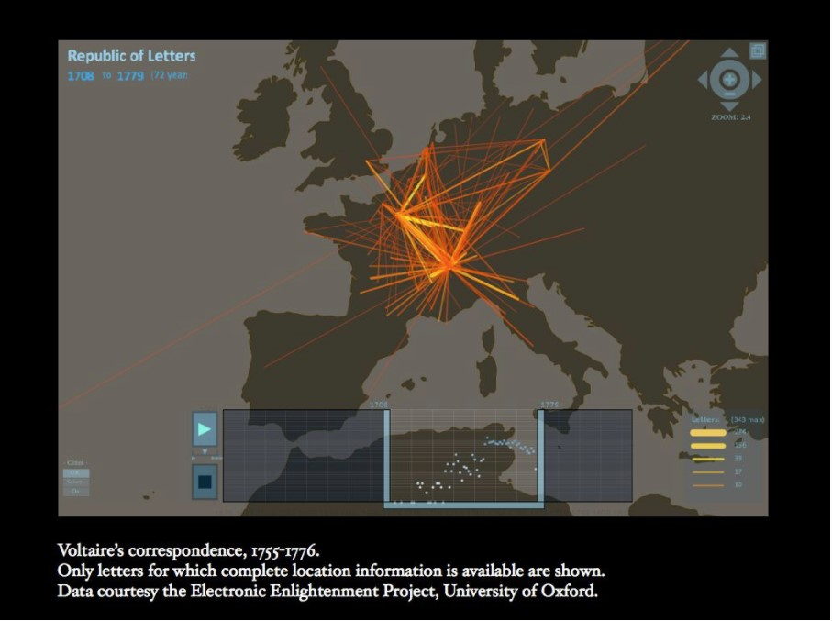
How universal and how European?
These values seemed to be universal ones and hence unifying; there was a ‘republic of letters’ across Europe and the enlightened corresponded across borders – ‘citizens of the world’
Rousseau saw Europe bound together by Christianity, law, commerce and culture
Enlightenment as an original and autonomous product of Europe – that gave birth to the ‘modern world’
But was the Enlightenment concentrated in NW Europe? Catholic as well as Protestant Enlightenment? Disbanding of Jesuits was result of pressure from Catholic regimes and from reform movement (Jansenism) within catholicism - 1755-64 in France and its empire; 1759 Portugal; Austria 1767; Spanish Empire 1767-8
But historians have stressed different national enlightenments and different paces of change

Slide 13
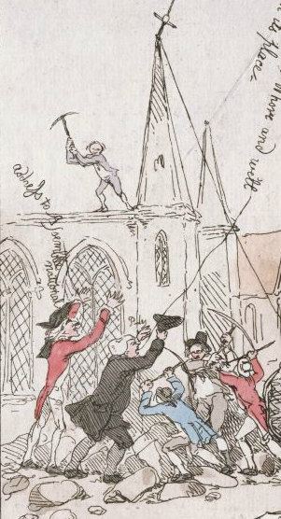
Enlightenment could also lead to disunity within Europe and to its fracturing
Competing ideological ‘isms’: liberalism; socialism; conservatism as a reaction to Enlightenment (Edmund Burke, Reflections on the French Revolution (1790), rejected natural rights in favour of what was tried and tested eg monarchy and church).
Culture wars – divided even within itself (Rousseau’s stress on emotion and feeling emotion and feeling, including rapture of nature. The Confessions (completed 1770, pub. 1781) – self-conscious autobiography. ‘I must have mountain torrents, steep rocks, firs, dark forests, mountains, roads to climb or descend, precipices at my side to frighten me’.)
A church and king mob destroyed the Birmingham house of scientist and preacher Joseph Priestley, because he was seen as a supporter of the French revolution

Slide 14
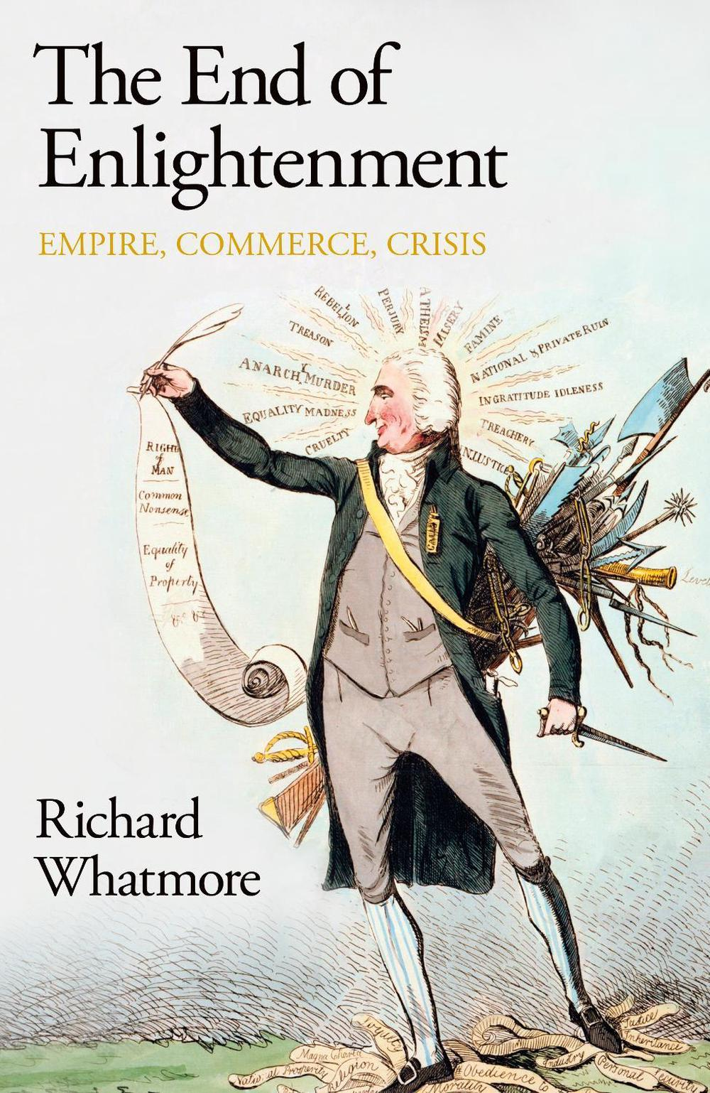
A loss of optimism?
Whatmore argues that the Enlightenment was, in the final decades of the C18th, for many of its philosophers, a failure
In Britain David Hume, Catherine Macaulay, Adam Smith, Edward Gibbon, Edmund Burke thought they had failed to curb ideological zealotry and popular demagoguery.
Worries that luxury and the pursuit of wealth had corroded national values – Europeans had become corrupted
If Enlightenment sought to end war, especially religious war, the commercial and imperial forces, including the mercantile system, threatened international peace [Hume, ‘Of the Jealousy of Trade’ (1758)]
Burke and Paine themselves turned to war as a solution (with very different objectives).
May Wollstonecraft turned against revolution as a tool of change

Slide 15
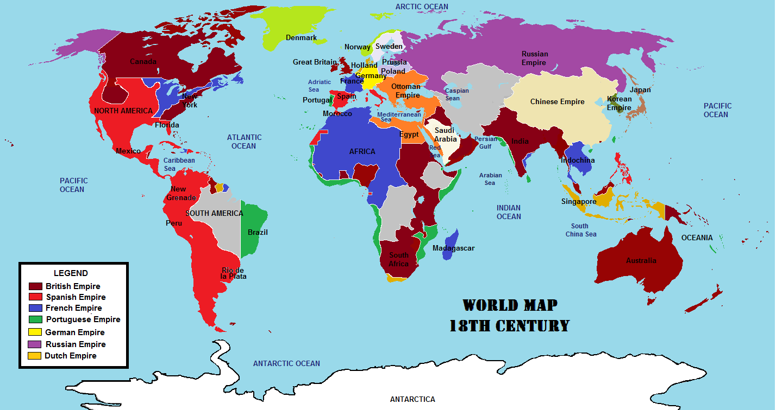
An era of war between European rivals
nationalism/colonialism and the era of large-scale warfare on a frequent basis between Britain, France, Spain, Austria, Prussia, Russia.
Hardly a year passed between 1650 and 1800 without fighting involving one or more European powers
Imperial war. 7 Years War 1756-1763: war on a global scale. 1m deaths.
Wars against France 1792-1815 (2.5m deaths)
Primary text for seminar discussion: Rousseau on peace through the federation of Europe

Slide 16
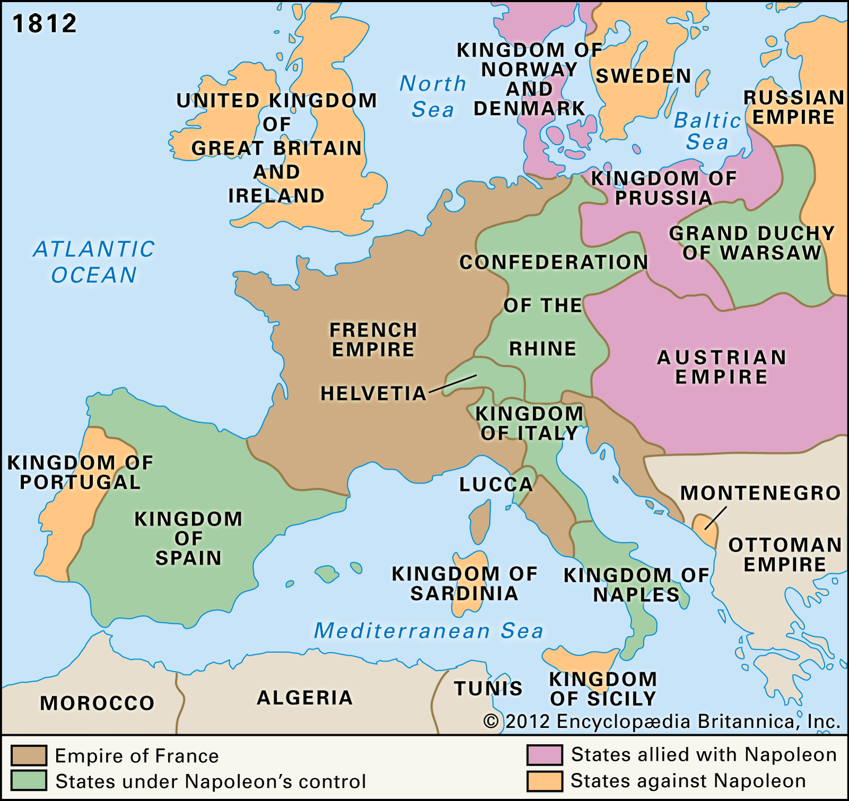
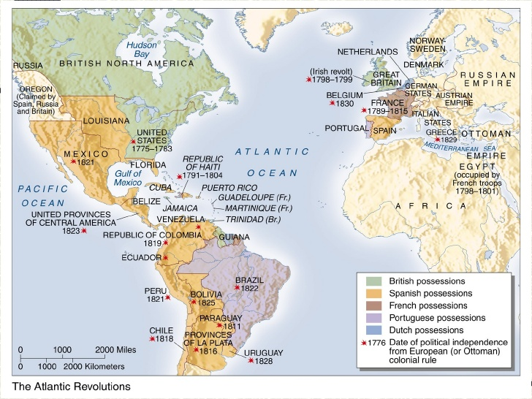
The French Revolution as reshaping Europe but also as a Global War
Nb the republics of Venice, Geneva, Swizerland the Netherlands were all swept away

Slide 17

Critiquing the Enlightenment
How rational, how enlightening?
Enlightened absolutism: harnessed Enlightenment ideals to enhance the power of the state, particularly in Eastern Europe (Prussia, Russia and Austria). Bureaucratic domination in which subjects become instrumental to the state
Adorno and Horkheimer, The Dialectic of Enlightenment (1944):
‘the Enlightenment has always aimed at liberating men from fear and establishing their sovereignty. Yet the fully enlightened earth radiates disaster triumphant’
‘Mankind, instead of entering into a truly human condition, is sinking into a new kind of barbarism’
‘The flood of detailed information and candy-floss entertainment simultaneously instructs and stultifies mankind; progress becomes regression’
‘Pure reason becomes unreason’
‘the enlightened want to replace God by the superman’
‘Enlightenment is as totalitarian as any system’.
Dachau

Slide 18
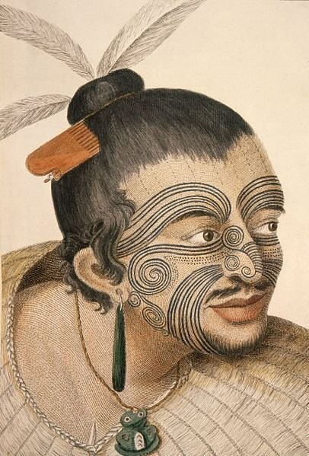
Was there a ‘Global Enlightenment’
Did it originate only in Europe or was it Global?
Increasingly seen as a phenomenon affecting the Atlantic world and governing Europe’s interaction with global expansion; but also a challenge to the Euro-centric view of the Enlightenment
Paradox: on the one hand a drive against intellectual slavery; on the other, the C18th witnessed the enslavement of many (6 million Africans transported by Britain, France, Spain, Holland)
Rousseau and Denis Diderot attempted to praise the ‘noble savage’; fascination with the exotic (Tahiti); Montesquieu’s Lettres Persanes (Persian Letters) as a way of critiquing European values; and Voltaire attacked the fact that the price of sugar consumption was slavery; but more done against the slave trade by evangelicals?
Semi-scientific categorisation of exotic peoples (Karl Linnaeus) – notions of primitive, savage.
Enlightenment could lead to a sense of alienation/racism over the people or things that were dominated (Richard Popkin). Growing sense of European civilisation as superior (Johan Wincklemann)
Fed into European militaristic and cultural imperialism and paternalistic civilising missions
A Maori chief as drawn by Sydney Parkinson, Thomas Cook’s artist (1769)

Slide 19
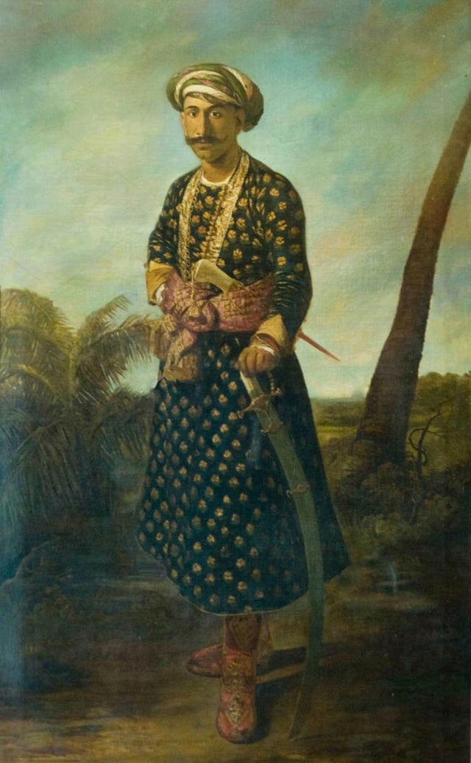
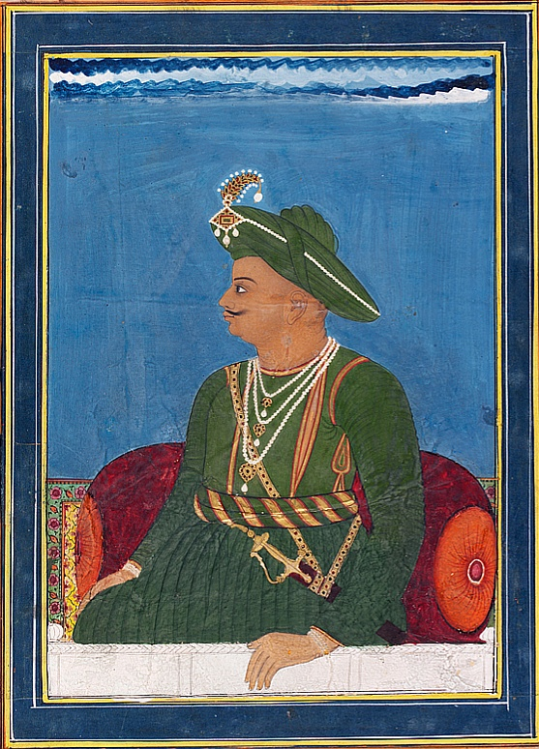
Enlightenment beyond Europe
1) European Enlightenment was in part a response to global entanglements e.g. free trade as a response to mercantile companies trading in the Indies; polite sociability enabled by porcelain and tea from the East; knowledge gained from exploration and from non-European co-produces of knowledge
2) Outside Europe there were hybrid versions of European and indigenous or local cultures– again, in part a response to global interactions
Eg Tipu Sultan, the ruler of Mysore and arch-enemy of the British, began in the 1790s to fashion himself as an enlightened monarch but also drew on Hindu and Islamic traditions
Revolution in Haiti (Saint-Domingue) in 1791 – hybrid of French ideals (rights) and tradition of slave revolts and African practices – in turn forced French National Convention to abolish slavery in 1794
Above: by an anonymous Indian artist
Right: Portrait by John Zoffany, 1782

Slide 20
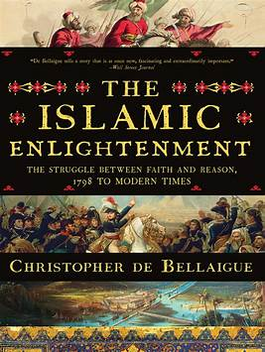
Europe did not have a monopoly on cultural transformations and intellectual conflicts
Latin America had its own reformist impulses and ideas
Reinhard Schulze has seen an independent “Islamic Enlightenment”: the “idea of autonomy of thought, that through experience and reason arrives at truth, was formulated by a large number of Islamic thinkers” in the eighteenth century. Bellaigue’s story is more C19th-focsed.
reason, improvement, emancipation become an available ‘language’ – ‘Increasingly, Enlightenment was employed as a concept that allowed historical actors to think globally and to position their communities on a world stage’ (Sebastian Conrad)

Slide 21
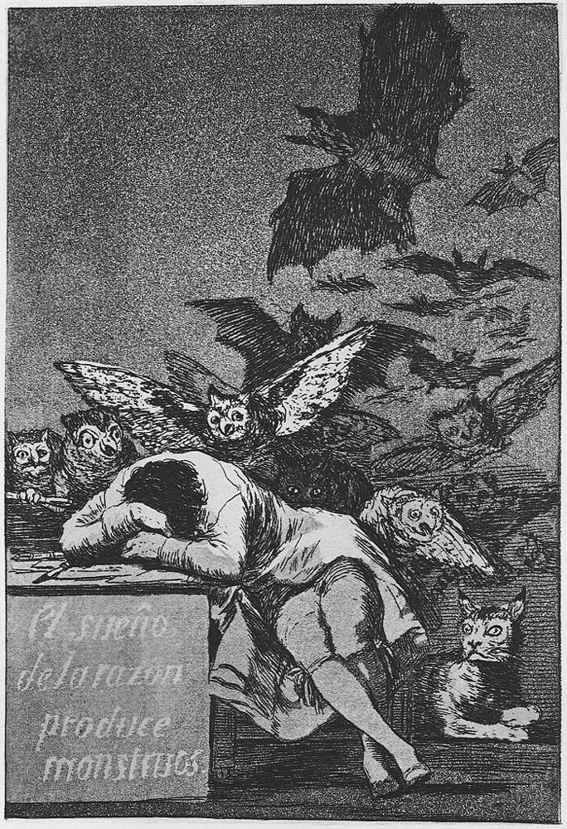
Enlightenment paradoxes:
Creating a universal set of European values whilst also undermining the cohesion of Europe through a series of culture wars and contests over political, economic and social power; and Enlightenment was not just limited to Europe - the term can define and centre Europe but also challenge that centring!
Creating a critique of European values but also helping their imperial export/imposition
Creating a set of ideals about European peace in an age of global war
Creating a scientific attitude based on reason but could also have been said to usher in unreason
Promoting ideals of equality that nevertheless created a sense of European cultural superiority
Creating new attitudes to wealth creation that both underlined/advanced European economic supremacy and maximised competition of interests
The Enlightenment is a problematic, shifting and ambiguous term that is essentially one about contested ideas and practices, both in the past and among historians – so a useful one for historians to think with!

