Slide 1
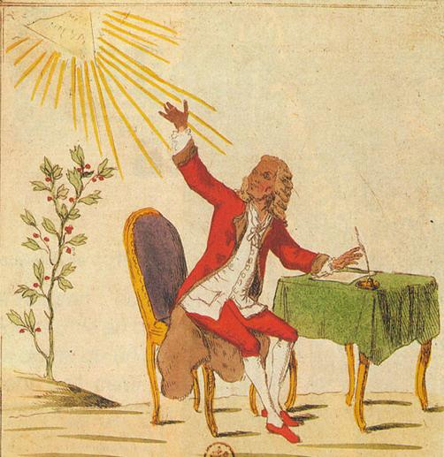
The Enlightenment and Revolution: Europe and the World
Dr. Michael Bycroft

Slide 2
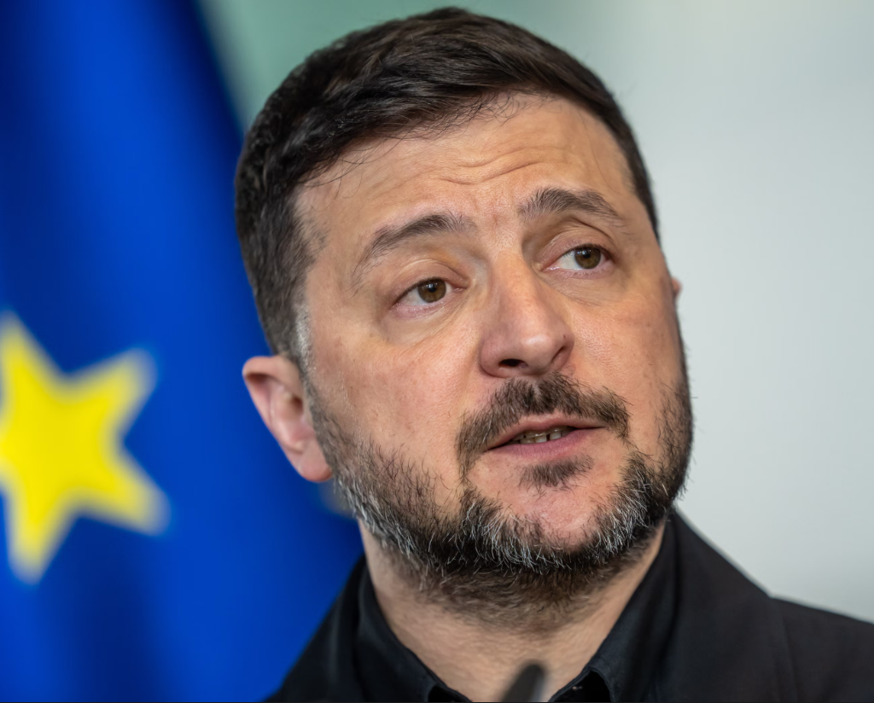
Lecture aims
To explain the Enlightenment and its key messages
To link the Enlightenment to the English, American and French revolutions
To consider how far the Enlightenment was a purely European phenomenon that created a coherent European sense of identity
Ukrainian President Volodymyr Zelenskyy pictured in April 2026, with European Union flag in background
Photograph: The Guardian Online; Michael Kappeler/DPA/Cover Images

Slide 3
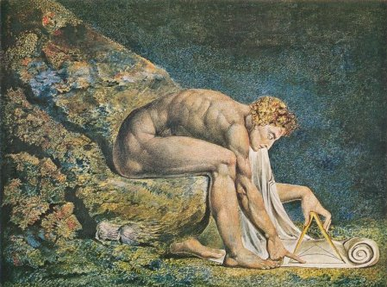
What ideals did the Enlightenment seek?
Two over-arching characteristics
1) Reason
‘dare to know’ (Immanuel Kant, 1784), free oneself from being slaves to others, think for yourself, use reason. Deification of reason.
2) Progress
Optimism and progress towards the common good of life and happiness
William Blake’s depiction of Isaac Newton as the personification of reason , 1805

Slide 4
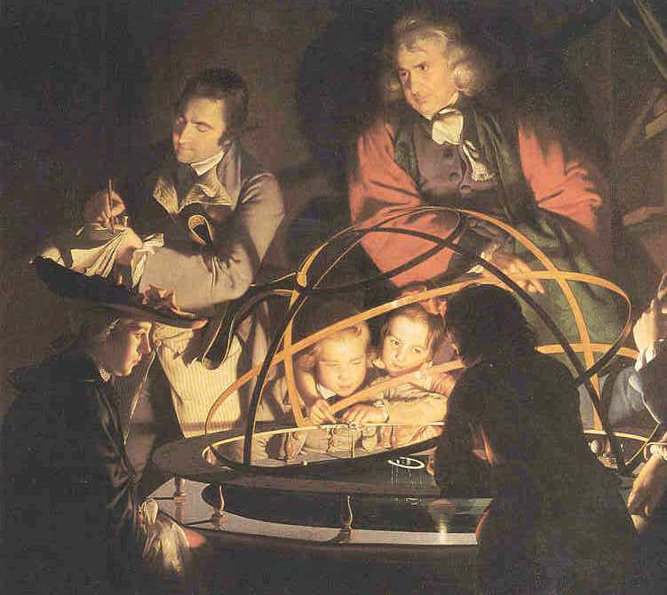
The terms of Enlightenment
Enlightenment: it was contemporary; 1784 Prussian essay competition ‘was ist Aufklärung?’
But it is a very contested and ambiguous term – it has been a shorthand for a set of European values that underpinned modernity but this has become increasingly problematic
The? Description of a ‘process’ rather than an ‘event’ or period
an intellectual and cultural movement in the ‘long eighteenth century’ (1648 to 1815)
the term ‘Age of Reason’, which is also used, does suggest a period
The image of light
Joseph Wright of Derby,
‘A Philosopher Lecturing about the Orrery’ (1766)

Slide 5
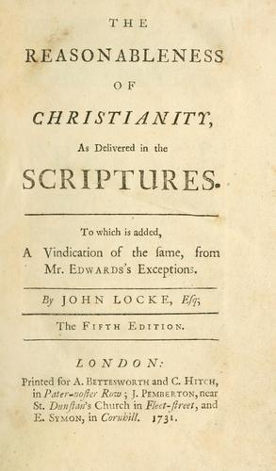
Can we identify areas where Enlightenment ideals appear distinctive?
Religion
Attacked the ignorance, superstition and intolerance peddled by the established church (both Catholic and Protestant).
Questioned the relationship between Church and State; and religious institutions such as the Jesuits.
In its more radical form also the soundness of revealed religion - some adopted a more rational form of religion, deism (Voltaire, Thomas Paine) and even atheism (Baron d’Holbach, probably David Hume).
Caveats: many clerics were part of the Enlightenment e.g. Abbé Saint-Pierre on perpetual peace; ‘natural theology’ used science to defend Christianity; Rousseau thought atheists should be shot!

Slide 6
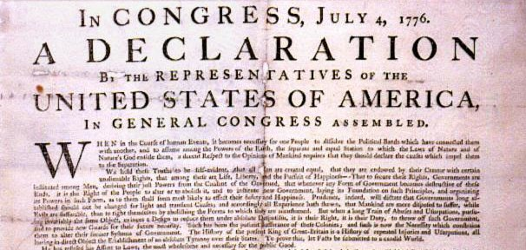
2) Political Authority
New ways of thinking about the powers of the people and their rulers.
Ideas of contract and natural rights (John Locke; Rousseau).
Ideas of natural equality and liberty
Desacralisation of monarchy; admiration of republics (strong influence of antiquity)
Justification of revolution: Britain 1689, America 1776
“We hold these truths to be self-evident, that all men are created equal, that they are endowed by their Creator with certain unalienable Rights, that among these are Life, Liberty and the pursuit of Happiness.--That to secure these rights, Governments are instituted among Men, deriving their just powers from the consent of the governed, --That whenever any Form of Government becomes destructive of these ends, it is the Right of the People to alter or to abolish it…”

Slide 7
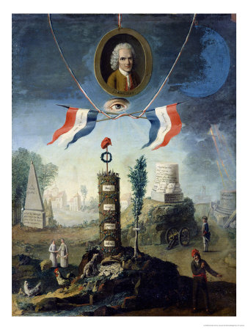
France 1789
Attack on the ‘ancien régime’: a term invented at the French Revolution of 1789 to describe the ‘old rule’, ‘old order’, or ‘former regime’ that the revolutionaries were trying to sweep away
The Revolutionaries of 1789 saw themselves as carrying out many of the ideas formulated by the philosophes and idolised some of them
The precise role, identity and vehicle of these ideas is debated, but their relevance is not
1794 Allegory of the Revolution by Nicolas Henry Jeaurat de Bertry

Slide 8
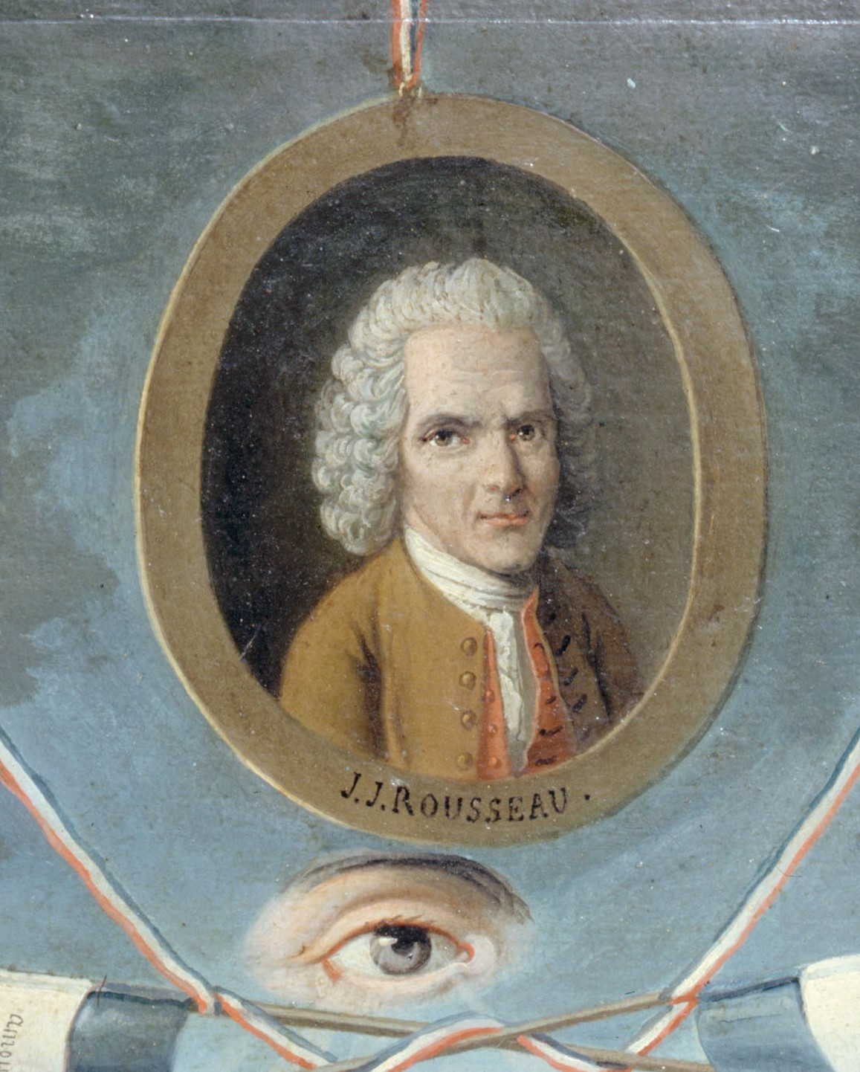
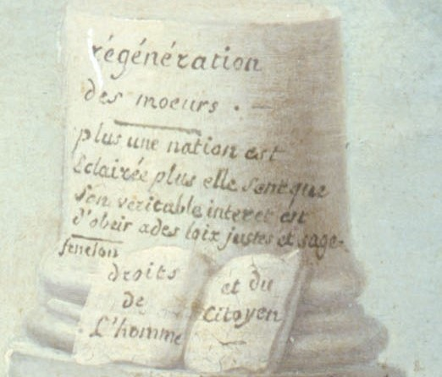
“Regeneration of morals
The more enlightened [éclairée] the nation, the more it feels [sent] that its real interest is to obey just and wise laws
The rights of man and the citizen.”

Slide 9
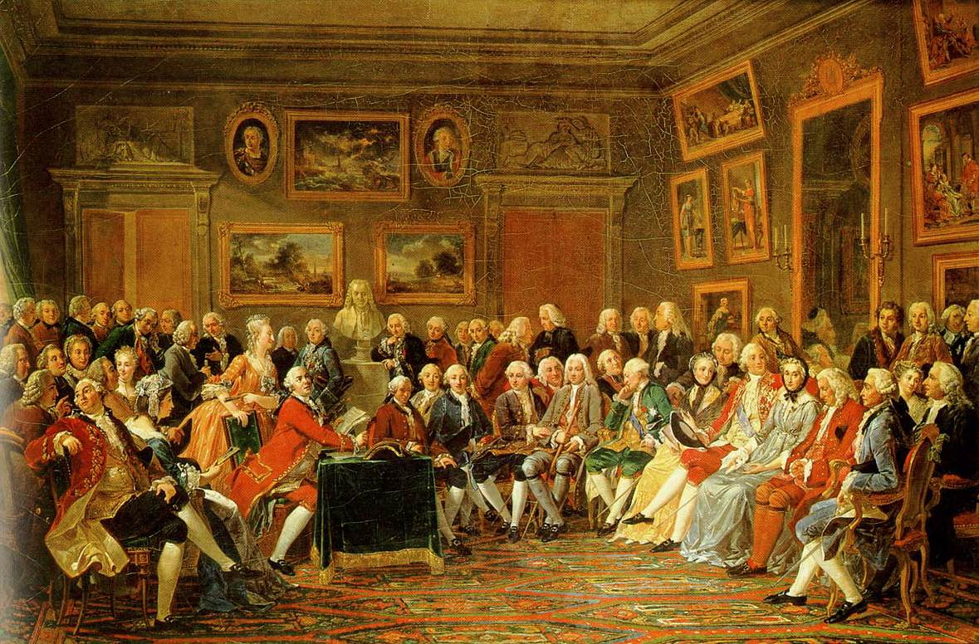
3) The rise of the public
Jurgen Habermas, The Structural Transformation of the Bourgeois Public Sphere (1962, trans. 1989)
Not just ideas but debates – but where did debates happen?
New or more open institutions: coffee houses, salons, museums, theatres, newspapers
Public opinion becomes a political force
“I must always consult public opinion; it is never wrong.” - Louis XVI (French king 1754-1793)
Driven by commerce and state-formation
Most people left out!
“In the Salon of Madame [Marie Thérèse] Geoffrin in 1755,” by Anicet Charles Gabriel Lemonnier

Slide 10
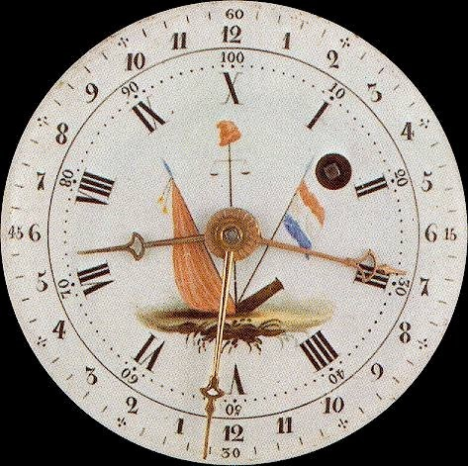
4) Natural science
“all errors in politics and morals are based on philosophical errors, which are themselves the result of errors in natural science [physique].” – Condorcet, Progress of the Human Mind (1795)
Natural science starts to challenge theology as a basis for moral and political life
Mathematical approaches to social questions (Condorcet)
Scientific progress a model for moral progress (Joseph Priestley)
Anatomy a basis for judging ‘races’ (Johann Friedrich Blumenbach)
Contrast to Galileo, who had separated natural from moral questions
Clock from the French Revolution, showing decimal time – 10 hours in a day, 100 minutes in an hour. Image courtesy of Horological Foundation.

Slide 11
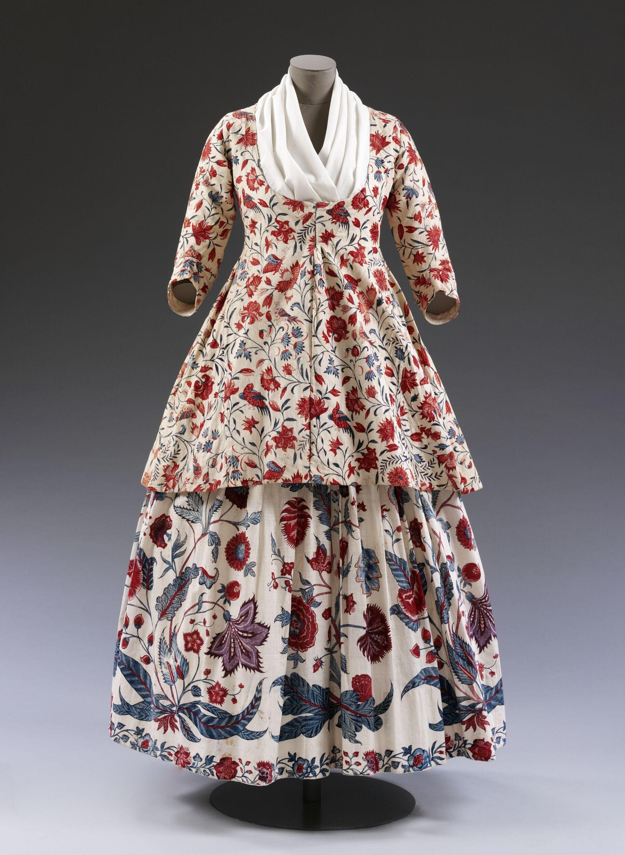
5) Wealth and luxury
“the ages of refinement are both the happiest and most virtuous” – David Hume, “Of Refinement in the Arts” (1752)
“It is not from the benevolence of the butcher, the brewer, or the baker, that we expect our dinner, but from their regard to their own interest.” – Adam Smith, Wealth of Nations (1776)
“It is but equity, that they who feed the whole body of the people, should have such a share of the produce of their own labour as to be themselves tolerably well fed.” – Adam Smith, Wealth of Nations (1776)
“It is under the rustic clothing of a labourer, and not under the gilded frame of a courtesan that one finds physical strength and energy” – Rousseau, Discourse on the Arts and Sciences, 1750
Chintz jacket, made Coromandel Coast, c. 1750. Courtesy of V&A Museum.

Slide 12
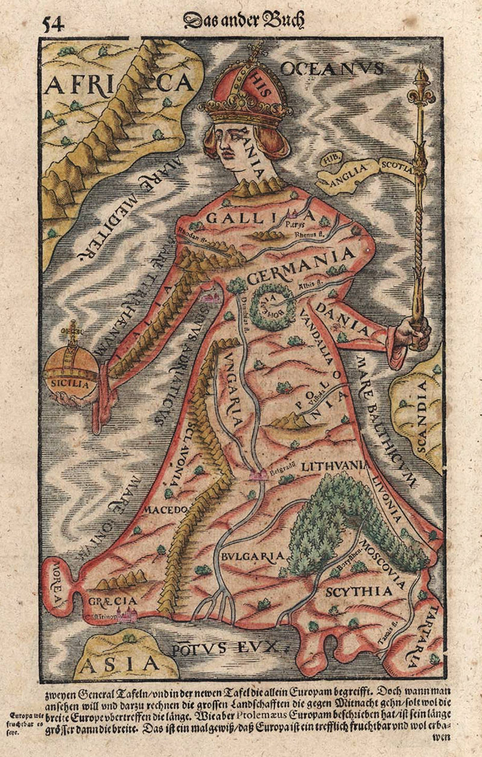
The idea of Europe (recap)
Sporadic reference to ‘Europe/Europa’ before 15th century
Growing use in 16th and 17th centuries
Usually equated with Christendom
Major histories of ‘Europe’ published in 17th century
18th century changes: sense of European confidence and unity grows, with the help of Enlightenment ideals, though room for ambiguity and self-critique
First map of Europe in form of queen. This edition by Sebastian Münster, 1544, presented to Holy Roman Emperor Charles V

Slide 13
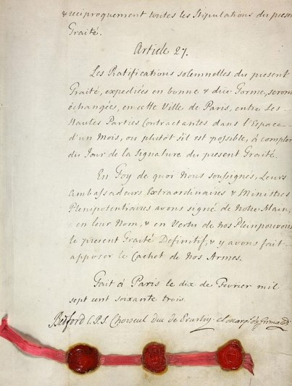
A European Union?
“…if the eighteen main powers of Europe, in order to conserve the present governance, avoid internecine wars...wanted to make a unifying treaty and hold a perennial congress...and form a European Union [Union européene]...the weakest would have enough security that the most powerful of the great powers would be unable to harm them.”
Castel de Saint-Pierre, Project for Perpetual Peace in Europe (1713)
Influenced later works by Jean-Jacques Rousseau (1761), Condorcet (1795), Immanuel Kant (1795), and others
Signature page of the 1763 Treaty of Paris, ending the 7 Years’ War between (among others) Britain and France. Courtesy of UK National Archives.

Slide 14
A European Union? continued
A legal or diplomatic union of European nations in the interest of peace
Europe similar in scope to Renaissance maps, not just Charlemagne’s empire of c. 800 AD
Older models: the Roman Empire, Holy Roman Empire, the Hanseatic League, Swiss Federation, and of course Christianity
Muslim powers mostly still seen as ‘other’
New emphasis on intellectual progress, peace through trade, Enlightened self-interest of nations, and optimism about future peace
‘wars, like assassinations, will be ranked in the number of those daring atrocities, humiliating and loathsome to nature’ – Condorcet, Progress of the Human Mind (1795)

Slide 15
Intellectual disunity
“Thus the whole education of women ought to be relative to men. To please them, to be useful to them, to make themselves loved and honored by them, to educate them when young...” – Rousseau, Emile
“If, after having publicly recognised these dogmas [of the civil religion, e.g. that God exists], someone acts as if they do not believe them, the penalty with be death.” – Rousseau, Social Contract, book 4, chap. 8
“Custom, then, is the great guide of human life.” – Hume, Human Understanding, section 5.6
“In less than a hundred years there will not be three geometers [i.e. mathematicians] in Europe” – Denis Diderot, c. 1750, quoted in Heilbron, Elements of Early Modern Physics, p. 54

Slide 16
Ideological disunity
Liberals look to John Locke on individual liberties (especially private property) and Adam Smith on free trade
Socialists look to Jean-Jacques Rousseau on the communal approach to politics, which informed later ‘utopian socialists’ such as Henri Comte de Saint-Simon (1760-1825) and Charles Fourier (1772-1837)
Conservatives look to Edmund Burke’s (1790) defence of custom and tradition as against rational planning and revolution
The Whig and Tory factions in British politics emerged in the context of the Glorious Revolution of 1688-9
The Left/Right distinction first used for seating arrangements of the National Assembly at the start of the French Revolution in 1789

Slide 17
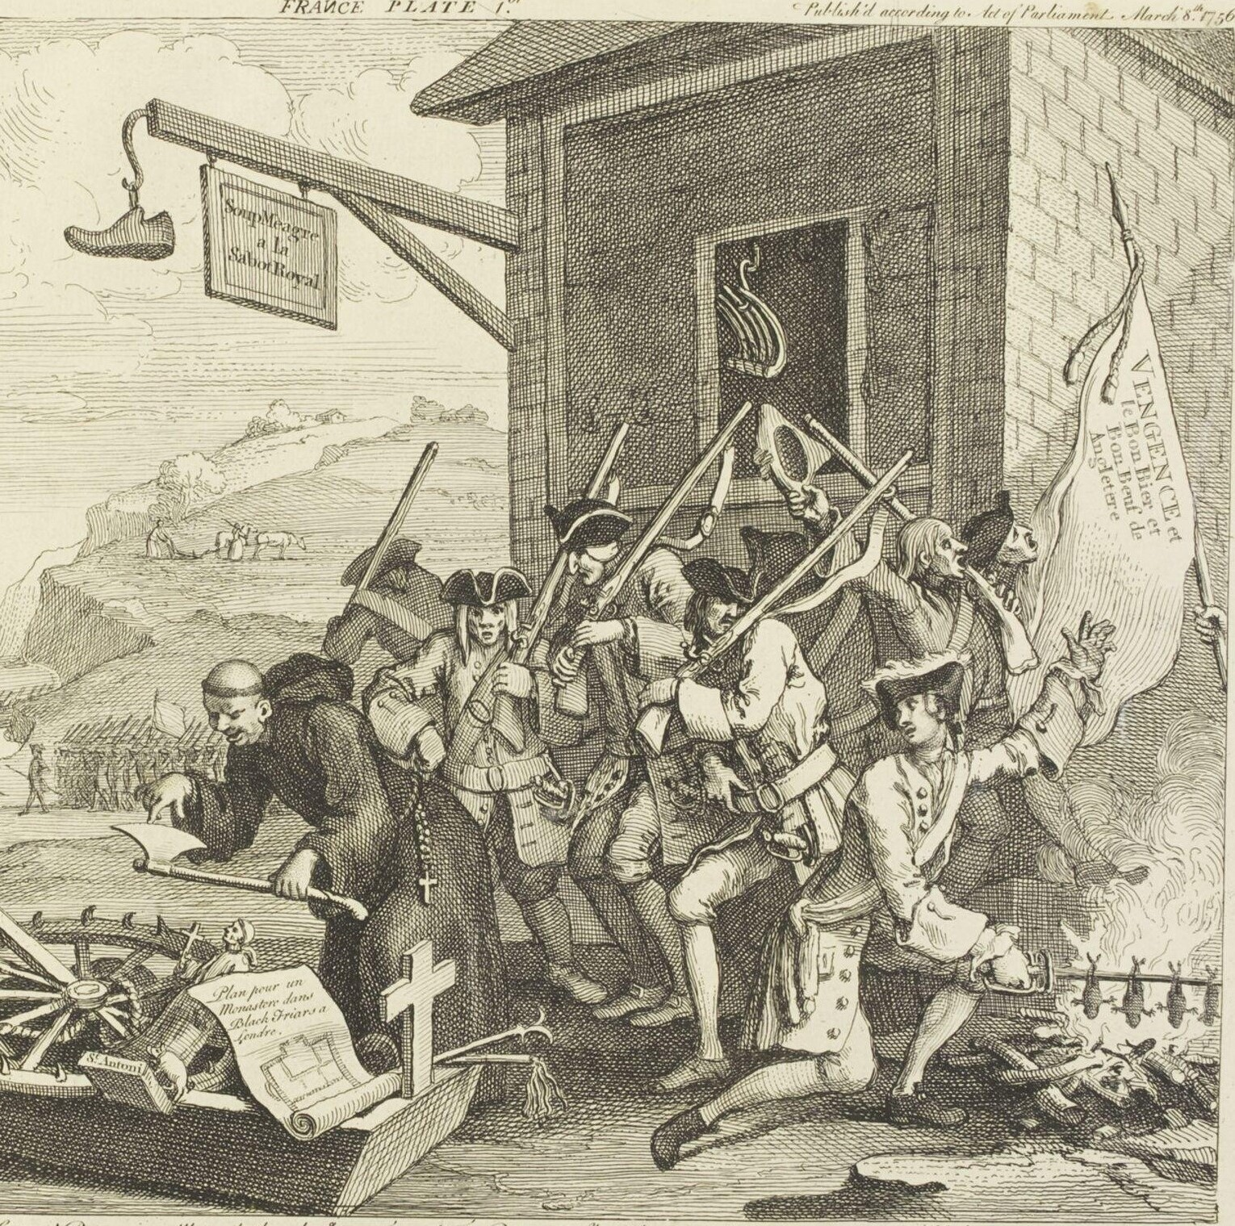
Nationalism
William Hogarth, The Invasion, plate 1: France (1756)
National feeling ran high in eighteenth-century Europe
Driven by state-formation, religion (still!), and French triumphalism
Theories of ‘national characters’ shaped by climate and geography
François-Ignace d’Espiard de La Borde, Essay on the Genius and Character of Nations (1743)
Montesquieu, The Spirit of the Laws (1748)
Porter and Teich, eds, The Enlightenment in National Context (1981)

Slide 18
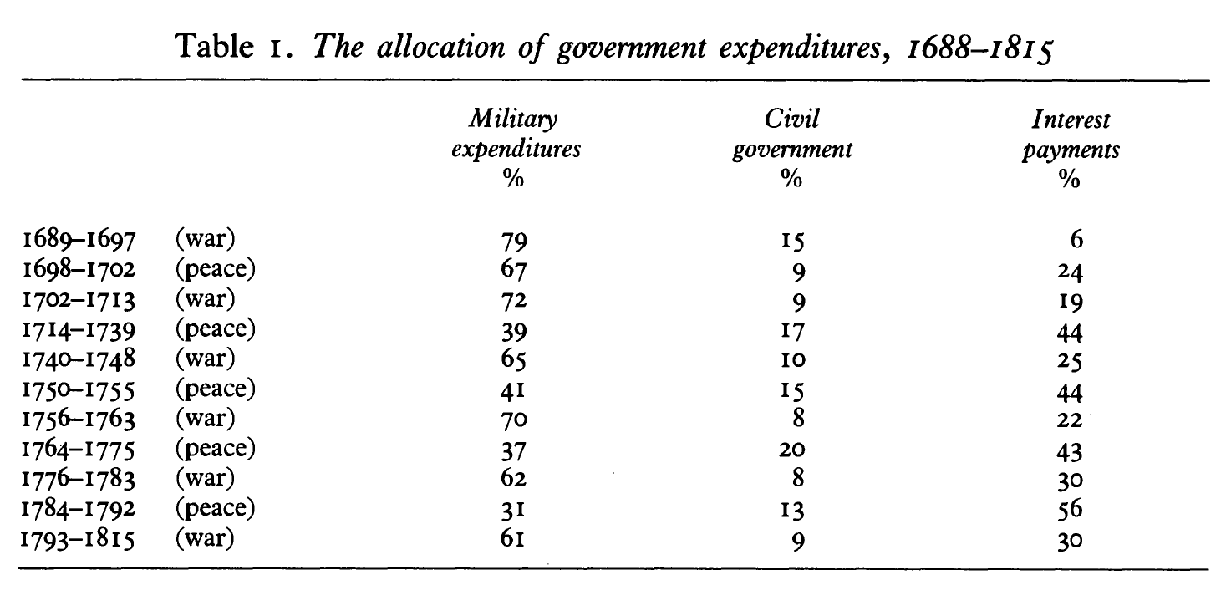
9 Years’ War
Spanish Succession
Austrian Succession
7 Years’ War
American Revolutionary
Great French Wars
From Patrick O’Brien, “The Political Economy of British Taxation, 1660-1815,” The Economic History Review (1988)
For comparison: military spending (‘defence’) was 4.8% of total UK government expenditure 2022-3

Slide 19
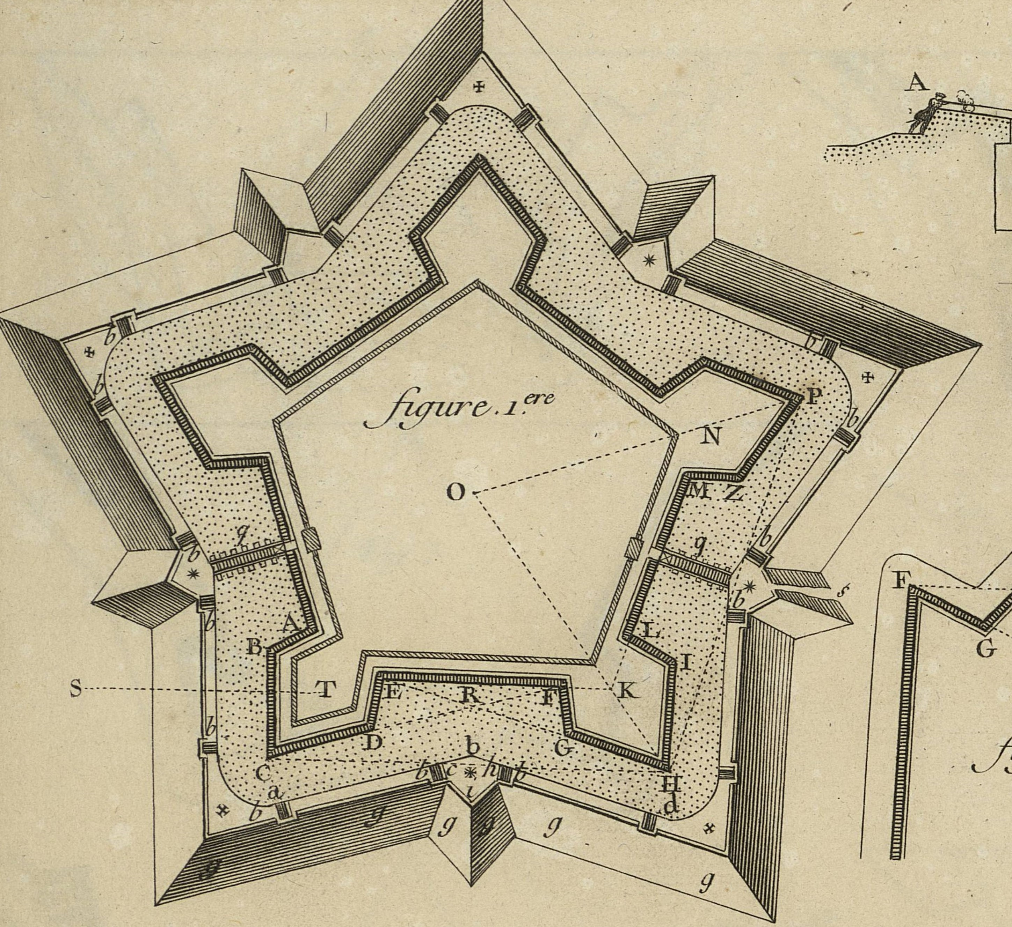
Enlightened war
The idea of perpetual peace was a response to near-constant warfare
Saint-Pierre’s 1713 book appeared during negotiations at end of War of Spanish Succession
Voltaire’s Candide (1759) was a satire on the 7 Years’ War
But ‘reason’ and ‘progress’ often meant rationalising war
Frederick II (‘the Great’) of Prussia a ‘philosopher-king’ (Voltaire) who made Prussia ‘not a country that has an army but an army that has a country’ (Prussian official)
Birds-eye view of fortification, in Diderot and d’Alembert Encyclopédie, vol. 1 of plates, 1762

Slide 20
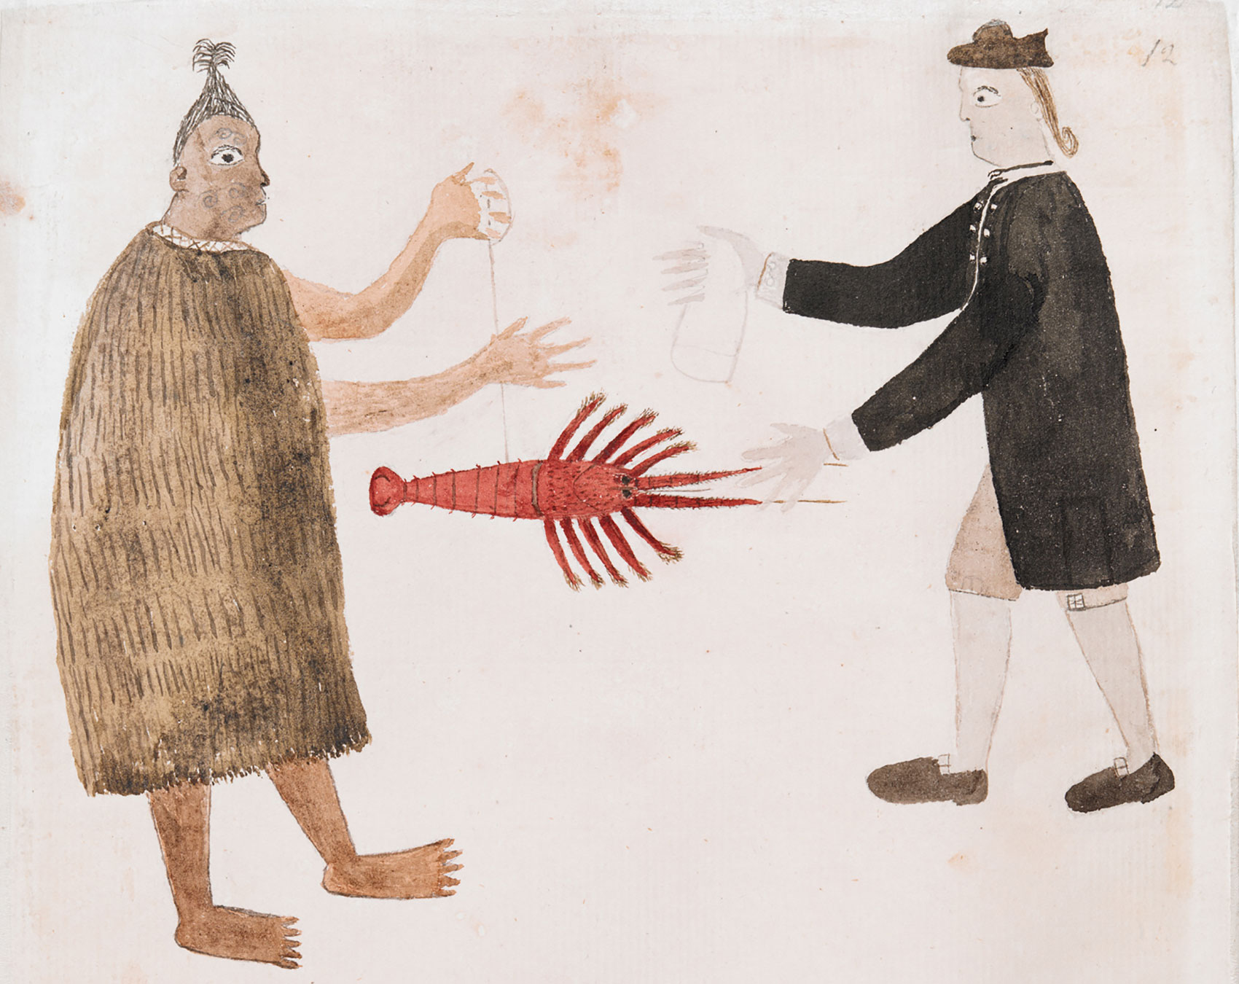
Māori person trading a crayfish for cloth with the naturalist Joseph Banks
Aotearoa New Zealand, 1769, during Pacific voyage of Captain James Cook
Drawing by Tupaia, Tahitian priest and navigator
British Library, Additional Manuscript 15508, f. 12

Slide 21
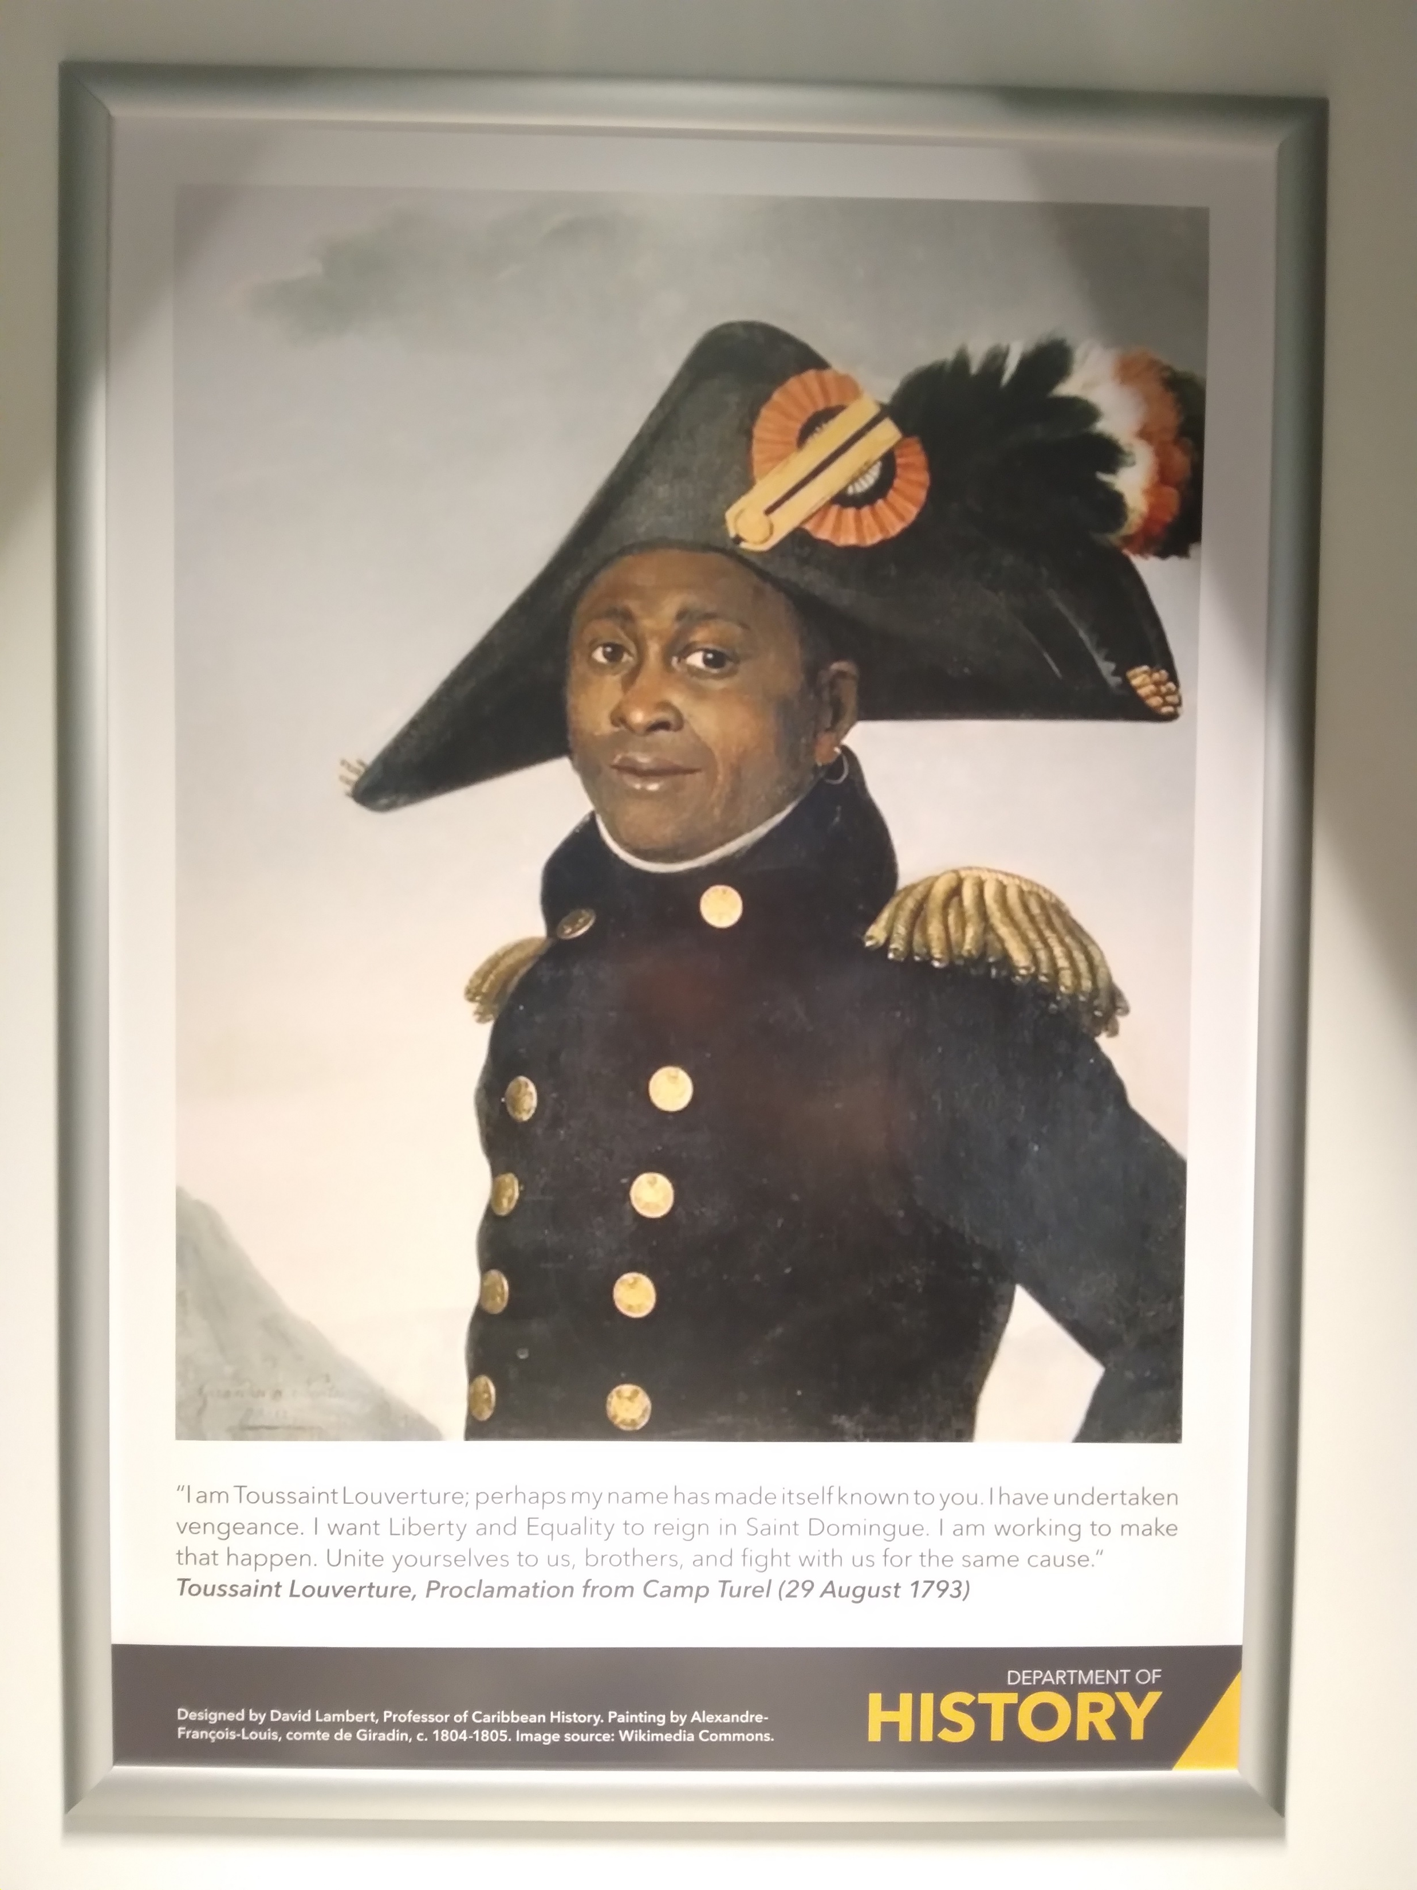
“I am Toussaint Louverture…I have undertaken vengeance. I want Liberty and Equality to reign in Saint Domingue. I am working to make that happen. Unite yourselves to us, brothers, and fight with us for the same cause.”
Toussaint Louverture (1743-1803), Proclamation from Camp Turel (29 August 1793)

Slide 22
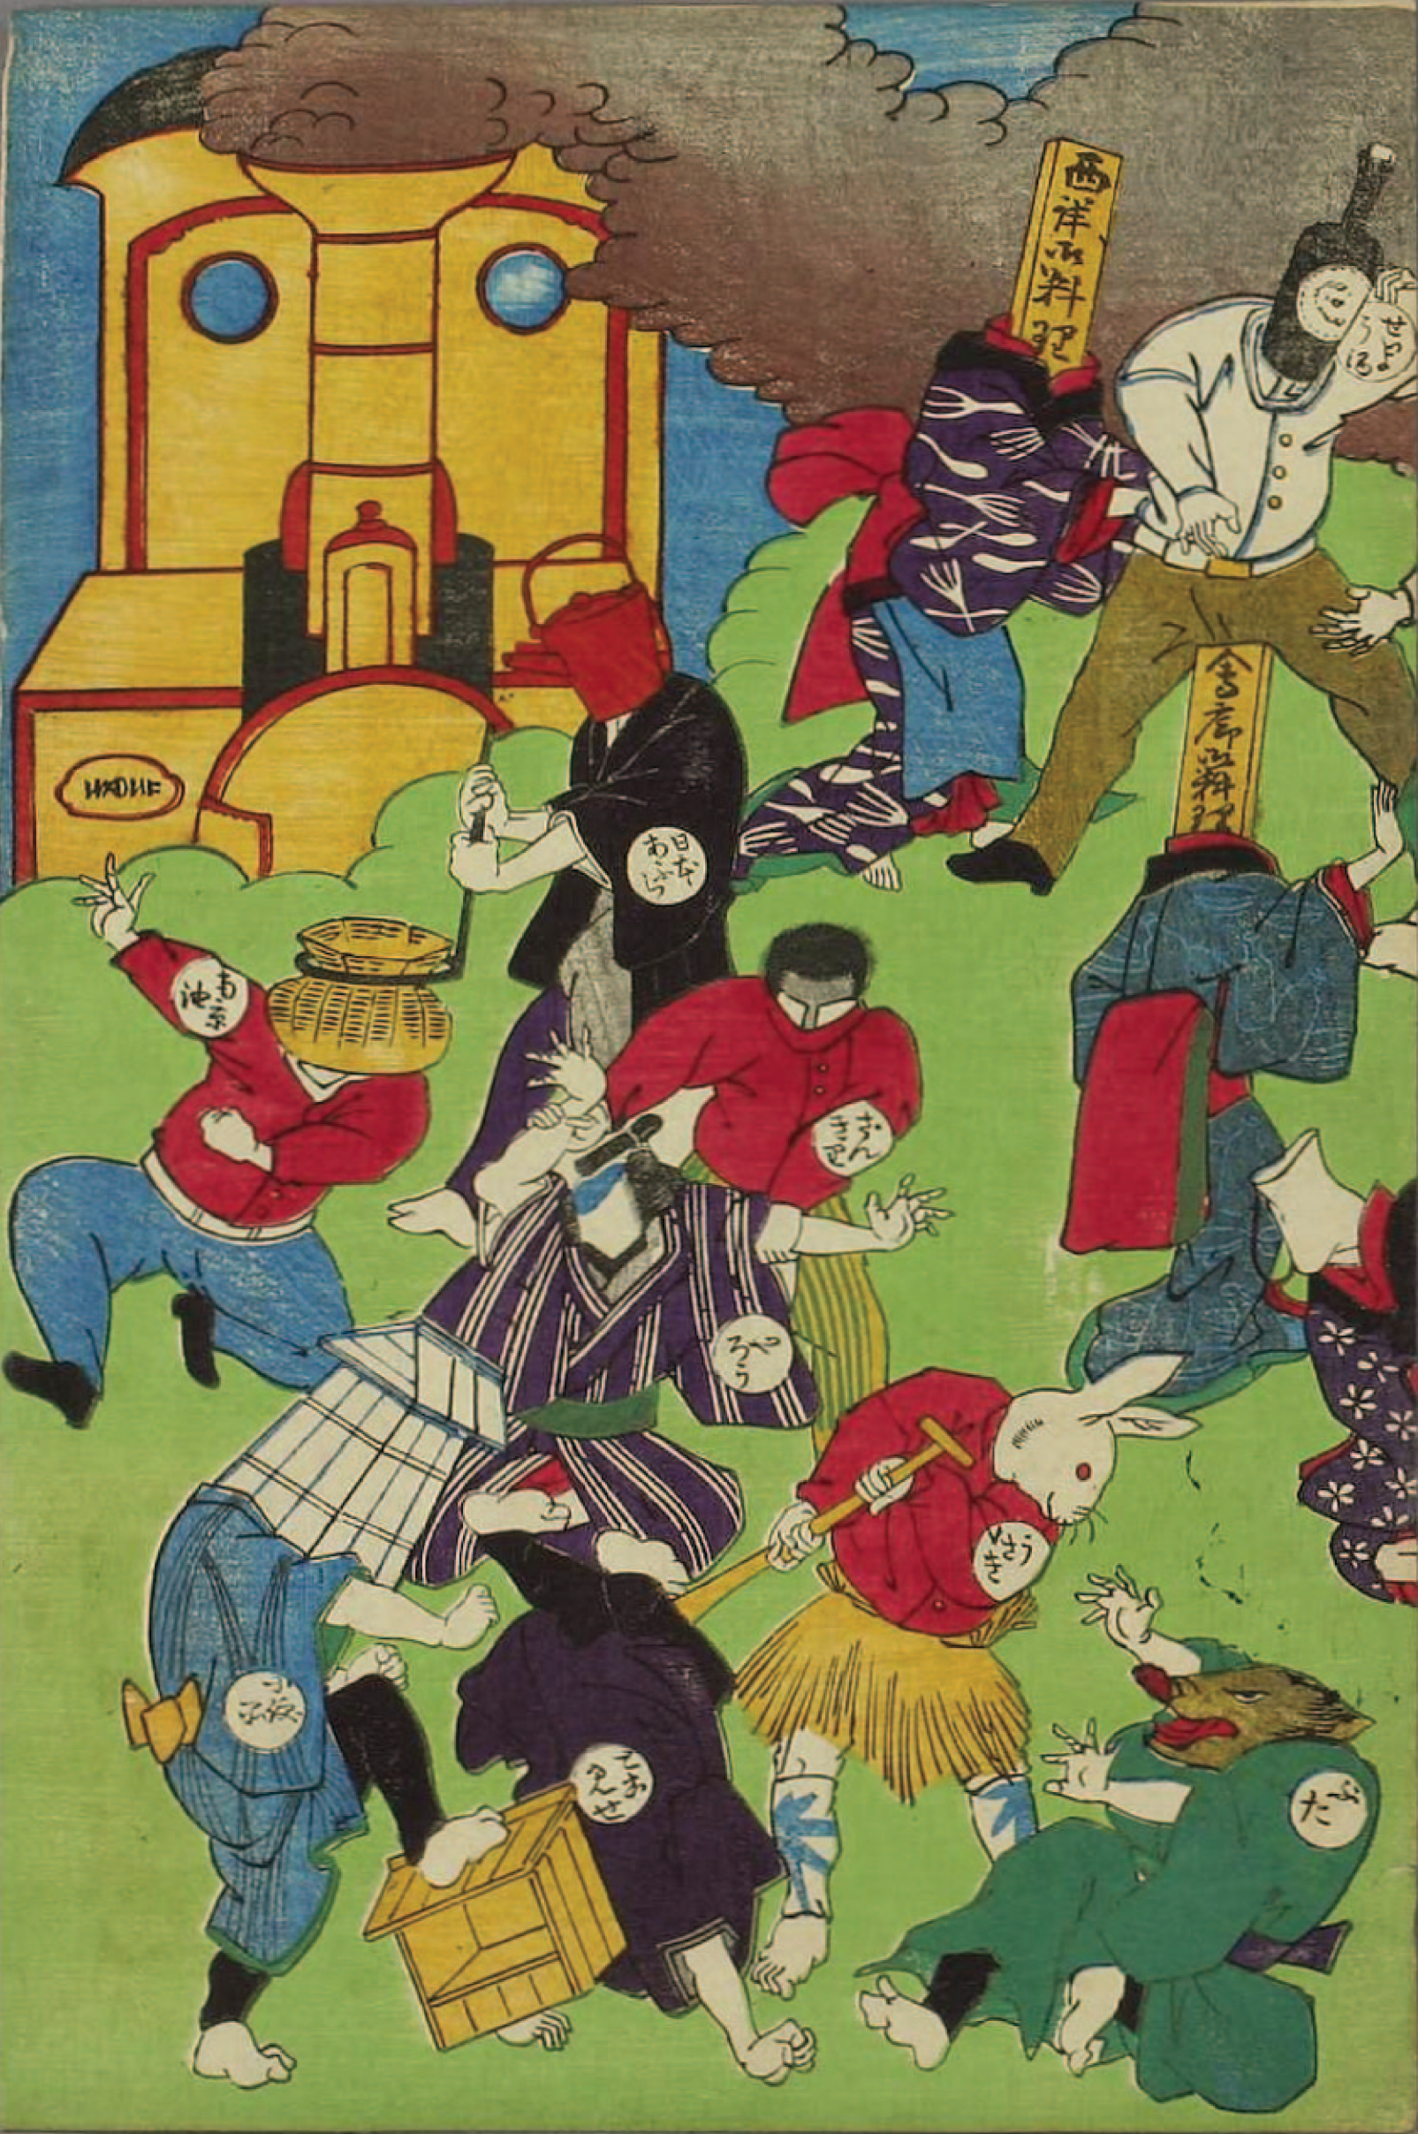
A global Enlightenment?
European expansion in North America, South Asia, and the Pacific
Two-way exchanges of ideas and techniques
Hybrid and eclectic us of Enlightenment ideas
Non-European contributions often hidden by racism and power imbalance
Some genuine curiosity and admiration towards cultures outside Europe
the Enlightenment as a global symbol of modernity
→ was the Enlightenment about European distinctiveness or rather dependence?
Shōsai Ikkei, ‘Mirror of the Rise and Fall of Enlightenment and Tradition,’ Woodblock print, 1872

Slide 23
Enlightenment paradoxes
a universal set of European values and undermining the cohesion of Europe through a series of culture wars and contests over political, economic and social power
creating a set of ideals about European pacifism in an age of global war
a critique of European values but also their imperial export/imposition
creating a scientific attitude based on reason that nevertheless created a perhaps irrational sense of European cultural superiority
creating new attitudes to wealth creation that both underlined/advanced European economic supremacy and maximised competition of interests
The term can define and centre Europe but also challenge that centring!
The Enlightenment is a problematic, shifting and ambiguous term that is essentially one about contested ideas and practices, both in the past and among historians – so a useful one for historians to think with!

