Slide 1
The Mediterranean
Europe in the Making
Aysu dincer

Slide 2
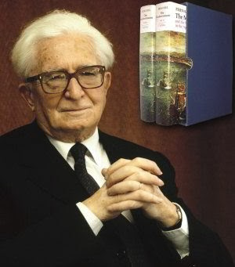
Fernand Braudel, The Mediterranean and the Mediterranean World in the Age of Philip II (2 vols) (1949)
Fernand Braudel (1902-1985)
Annales School: Lucien Febvre, Emmanuel Le Roy Ladurie, Marc Bloch, George Duby, and others
Braudel wrote: 'I have therefore sought out, within the framework of a geographical study, those local, permanent, unchanging and much-repeated features which are the 'constants' of Mediterranean history' (Braudel, vol. II, p.1239)

Slide 3
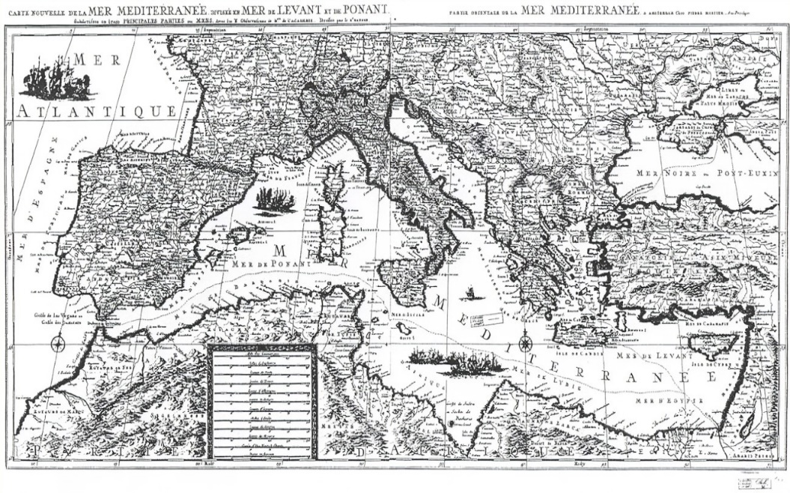
Braudel’s Main Arguments
‘a timeless landscape’
the longue durée (the long period)
'The Greater Mediterranean’
Braudel wrote: : 'I have therefore sought out, within the framework of a geographical study, those local, permanent, unchanging and much-repeated features which are the 'constants' of Mediterranean history' (vol. II, p.1239)

Slide 4
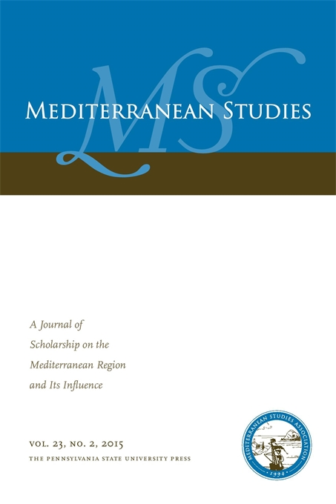
Criticisms of Braudel’s work
The Mediterranean as a construct
‘Master narrative’
Eurocentric approach
Limits of archival work
Time period
Too little on culture
Nonetheless contributed to:
The field of ‘Mediterranean Studies’
Human geography; environmental history

Slide 5
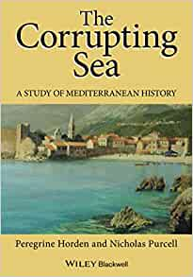
Mediterranean Studies after Braudel
Continuing emphasis on human geography (environmental studies)
Sources written in other languages (Ottoman, Arabic)
Also looking at the 18th century, and beyond
Some important works:
Peregrine Horden and Nicholas Purcell, The Corrupting Sea: A Study of Mediterranean History (2000)
David Abulafia, The Mediterranean in History (2003); D. Abulafia, The Great Sea: A Human History of the Mediterranean (2011)
Francesca Trivellato, The Familiarity of Strangers: The Sephardic Diaspora, Livorno, and Cross-Cultural Trade in the Early Modern Period (2009)
Brian Catlos and Sharon Kinoshita (eds) Can We Talk Mediterranean? Mediterranean Perspectives (2017)

Slide 6
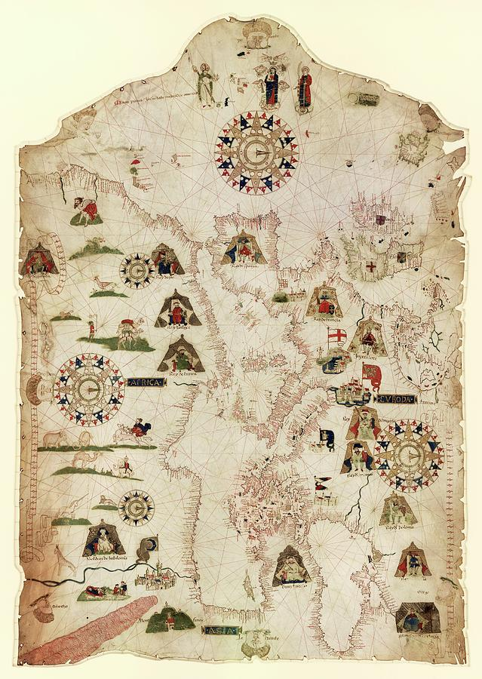
Why Study the Mediterranean?
economic encounters (trading networks, material exchange, and urbanisation processes)
political encounters and the rise of empires
Cultural encounters and exchange
a multicultural, multilingual and multifaith zone

Slide 7
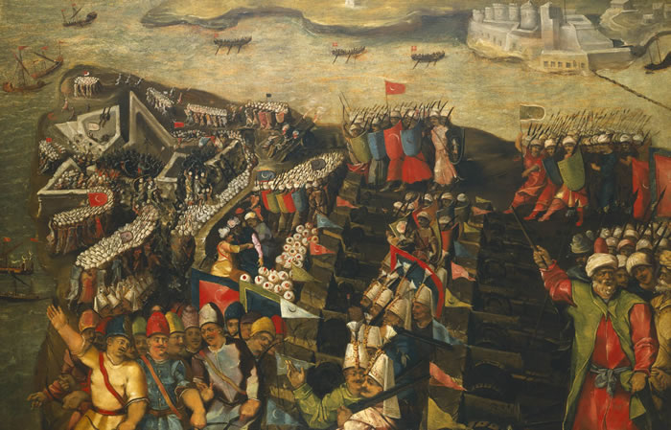
Contact and Conflict

Slide 8
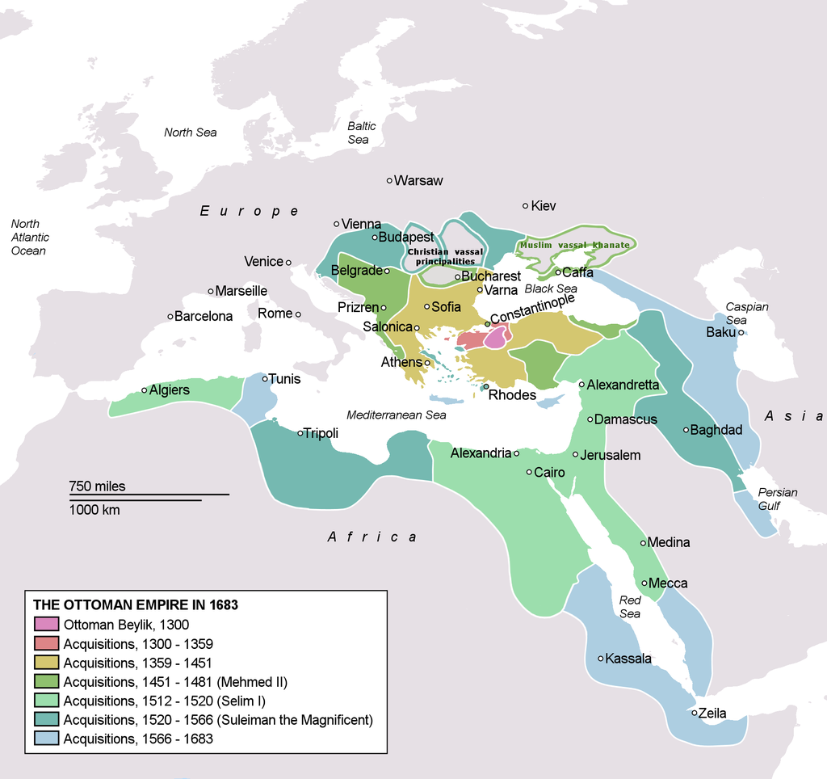
Rise of the Ottoman Empire

Slide 9
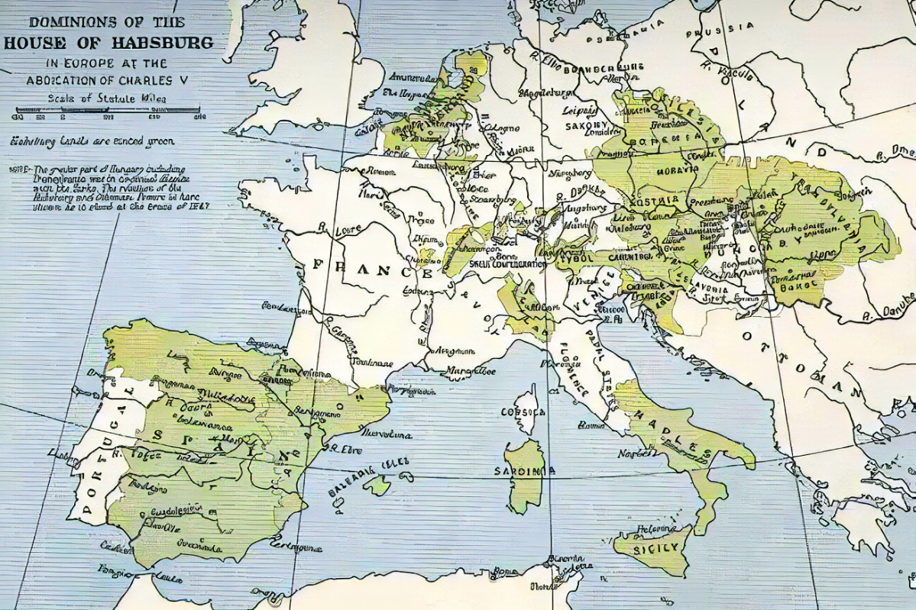
Expansion of the Spanish Empire

Slide 10
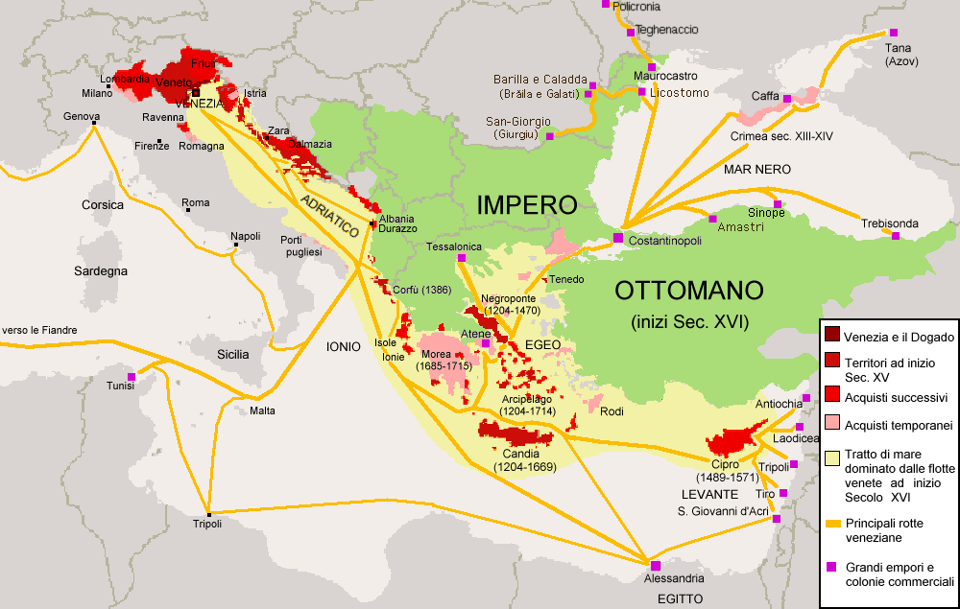
Venetian Empire

Slide 11
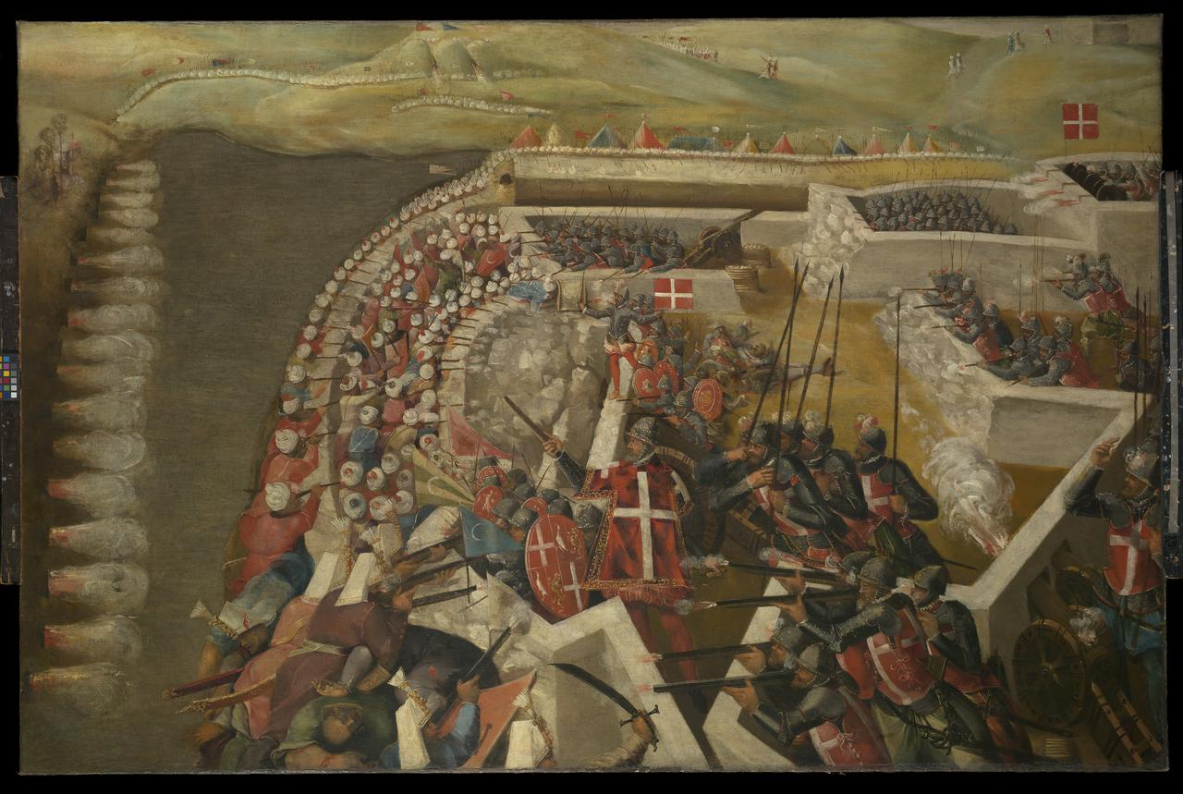
The siege of Malta by Ottomans 1551&1565

Slide 12
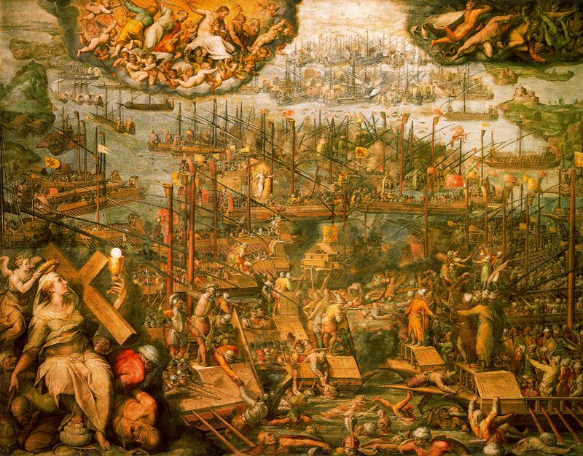
The Battle of Lepanto: Ottomans defeated

Slide 13
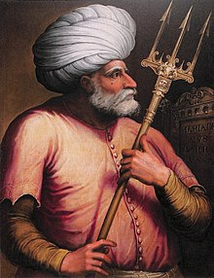
Corsairs to Admirals
The Barbarossa brothers (Hayreddin Barbarossa, also known as Hizir Reis, and his elder brother Oruc Reis)
Sailors turned privateers/corsairs
Sultan Suleiman granted Hayreddin the title of Grand Admiral (Kapudan-i Derya) in 1532

Slide 14
Trade and Contact in the Mediterranean
Increasing Dutch and English presence, from the end of the 16th century onwards
Maria Fusaro: ‘A new era’
French presence in the 17th century
Molly Greene: Post-1453- Pax Ottomanica

Slide 15
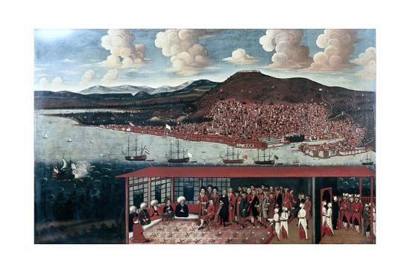
The Dutch consul in Smyrna, 1665

Slide 16
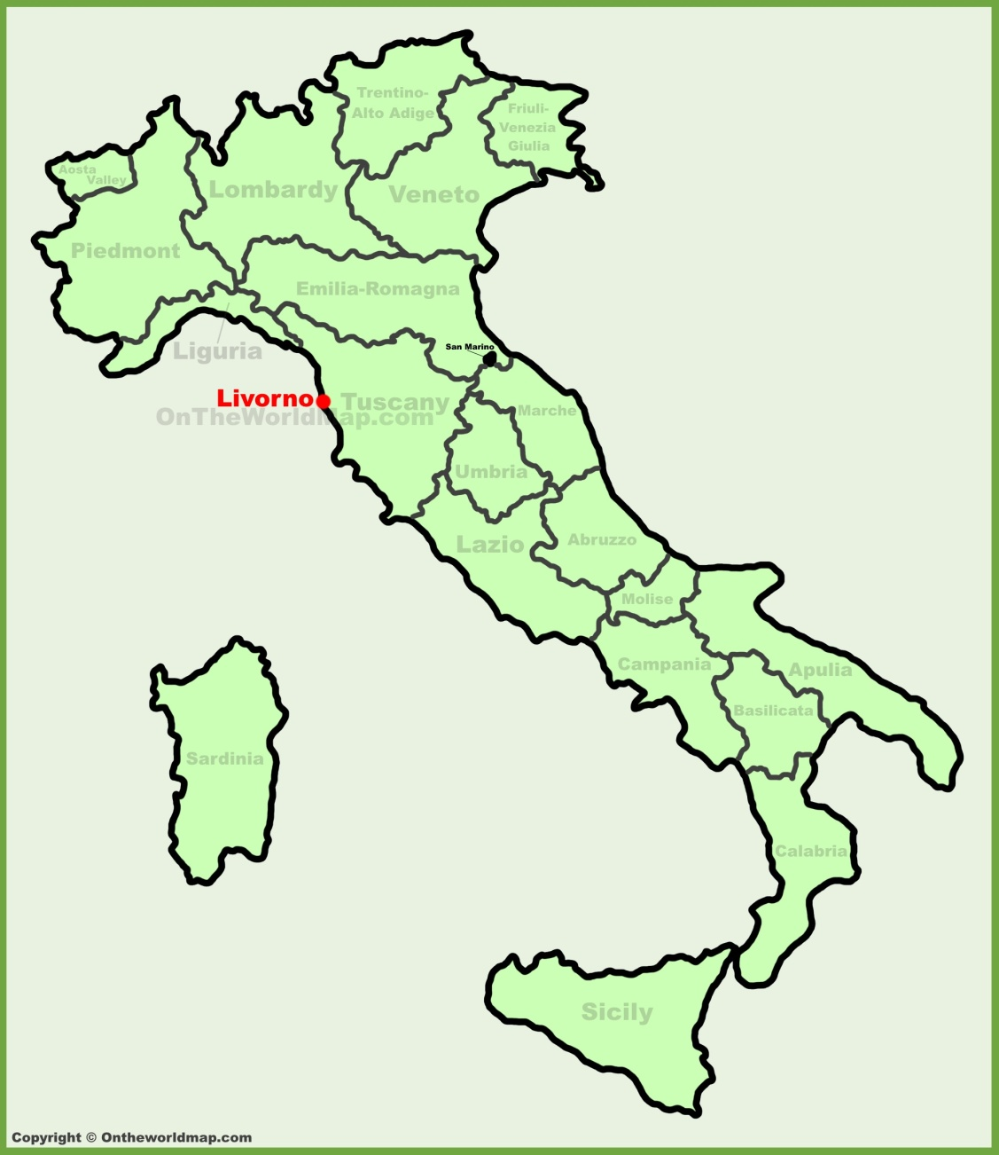
Livorno (Leghorn)
The Medici advertised their city as being 'the ideal city and the fatherland of everyone' (la città ideale e la patria di tutti)
A Venetian report from 1624 explains: 'Livornese, Corsican, Genoese, French, Flemish, English, Jewish, Venetian and other merchants are settled in Algeria and Tunisia. They buy up all the stolen merchandise and send it to the free port of Livorno and from there it is distributed all over Italy'

Slide 17
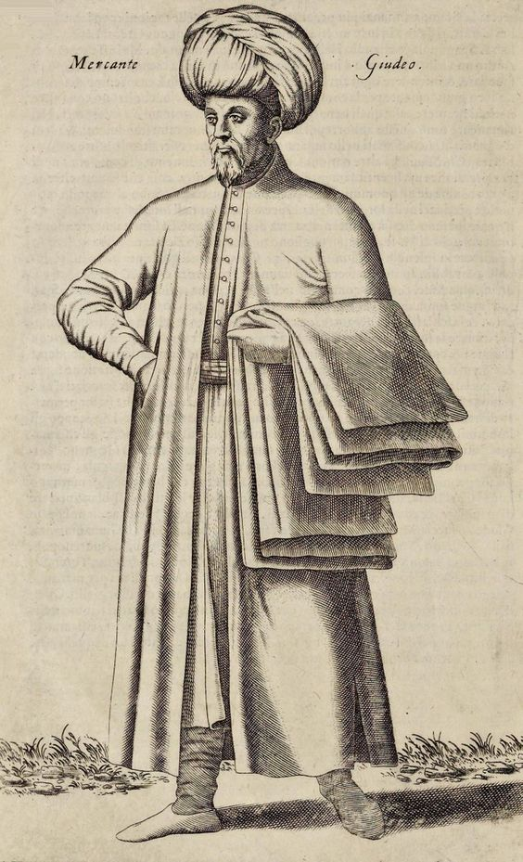
Braudel: 'The Mediterranean speaks with many voices; it is a sum of individual histories’
Hasan Aga, was the former Samson Rowlie from Great Yarmouth
Beatrice Michiel fled from Venice, to Istanbul, adopting the name of Fatima Hatun
An English merchant reports: 'I was sent immediately to the Kitchin, and had order to dress a Couple of Wild Ducks for my Master; that I did without much difficulty: but when I had other Meats less usual in our Country, I made such mad Sauces, and such strange Ragoux, that everyone took me for a Cook of the Antipodes, whose People have Palates that relish things that ours abhor: I was full of Mistakes; sometimes I put Oyl instead of Vinegar, and Salt instead of Pepper. But that I might keep up my Credit amongst the Beholders, I did handle my Meat so nimbly, that they all believed I had been used to Cookery.’
(http://penelope.uchicago.edu/TS_Africa/)

