Slide 1
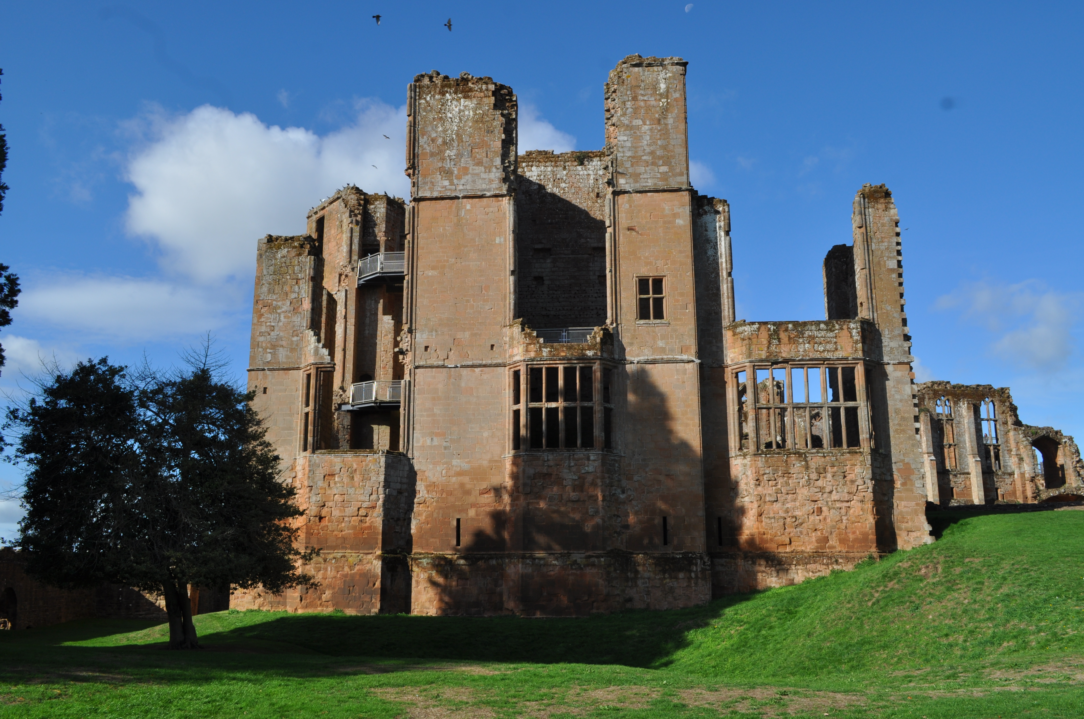
INTRODUCTION
Europe in the Making, 1450-1800 (HI113)
Week 1, 5 Oct. 2026
Dr. Michael Bycroft

Slide 2
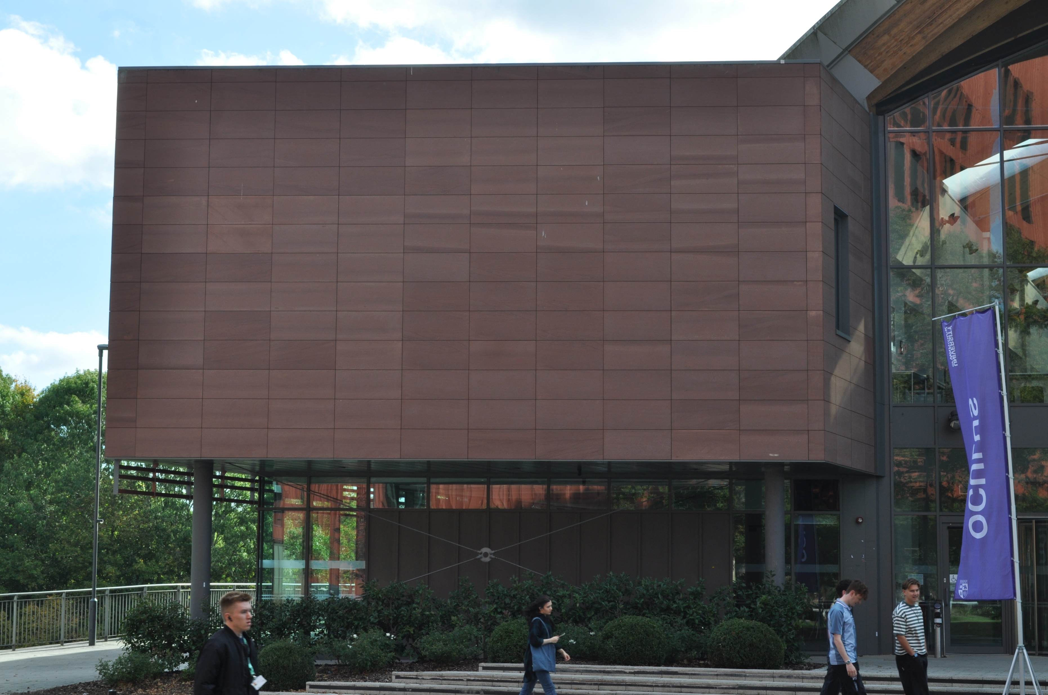
Oculus building, October 2026
Photo: MB

Slide 3

Cross-bedding of red sandstone
Oculus building, October 2026
Photo: MB

Slide 4
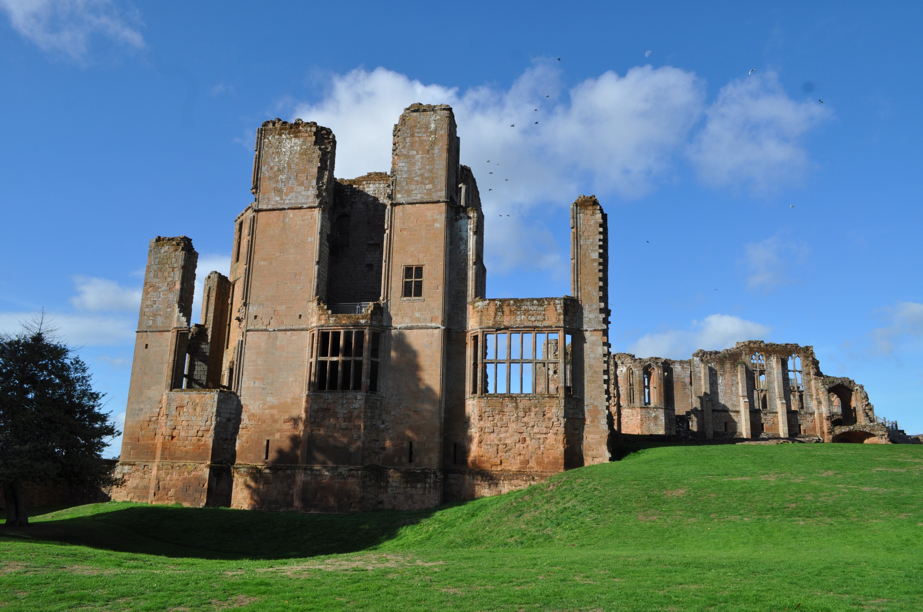
‘Elizabeth’s tower’,
Kenilworth Castle.
Built by Sir Robert Dudley, favourite of Elizabeth I, as part of (unsuccessful) courtship
Image: MB

Slide 5
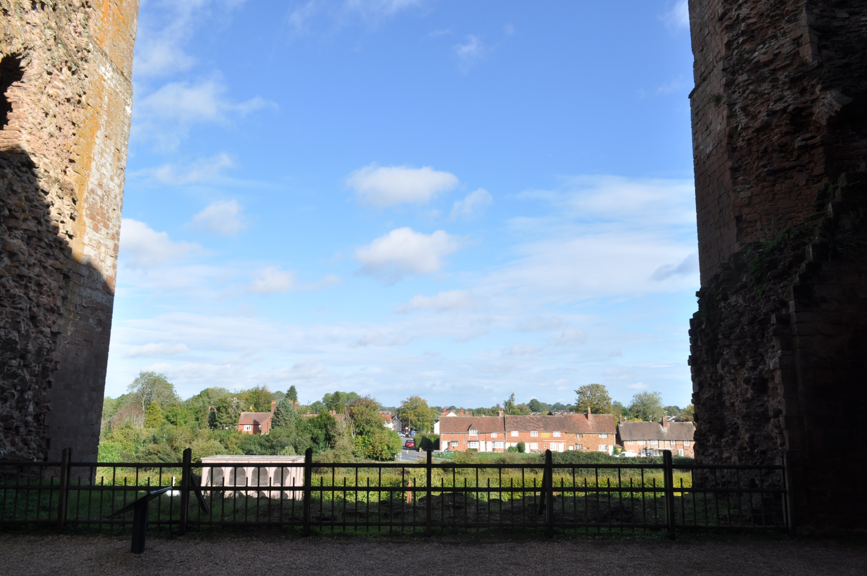
Missing wall in the twelfth-century Norman keep at Kenilworth Castle.
The wall was destroyed or ‘slighted’ in 1649, by the victorious Parliamentary forces in the English Civil War.
Image: MB

Slide 6
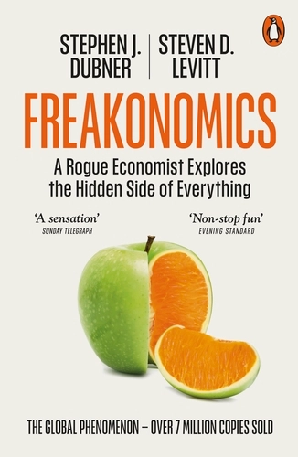
First published by Penguin, 2005
Image: Penguin

Slide 7
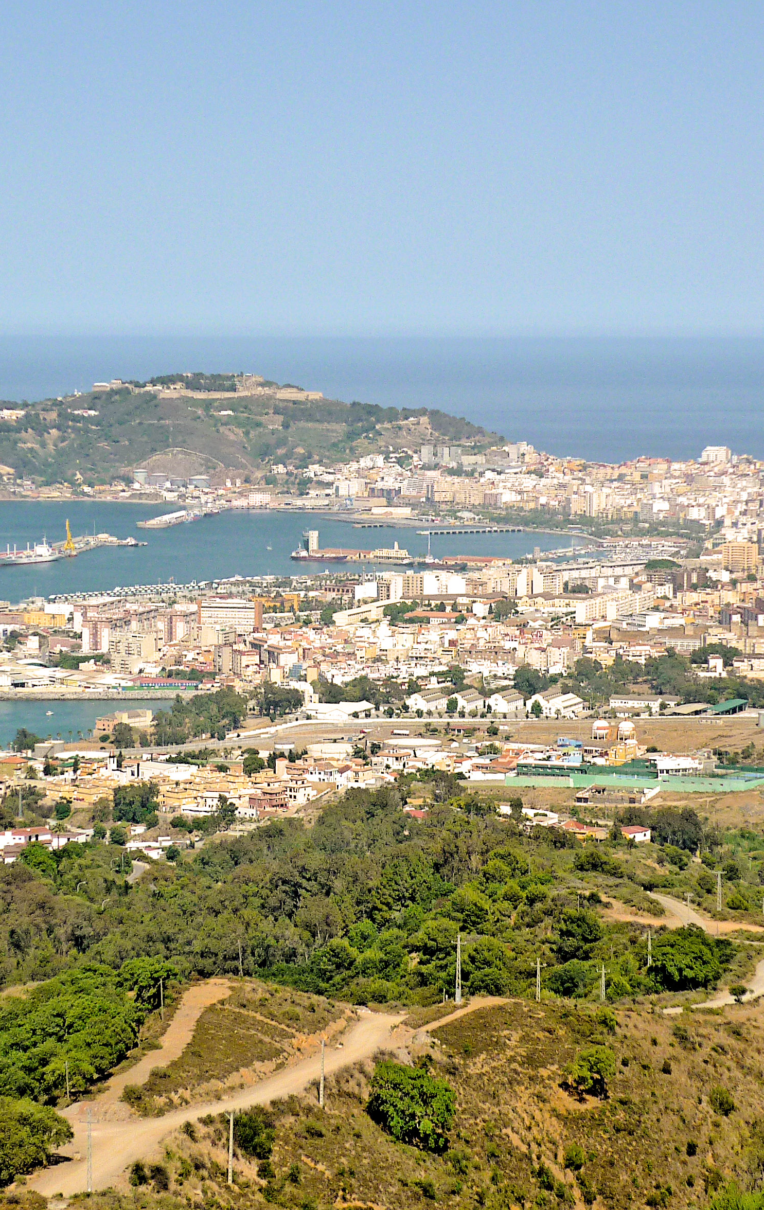
Cueta, Spanish enclave on the coast of North Africa, opposite Gibraltar, bordering Morocco
Migrant crisis, August 2026
Morocco/Algeria/Spain clash over control of Western Sahara
Cueta seized by Portugal 1416
Union of Spanish-Portuguese crowns 1580-1640
Retained by Spain 1640
Spain use Western Sahara coast as slave port from late 15th century
Spanish claim Western Sahara as a colony 1884
Image: Dr. Pierre Purseigle

Slide 8
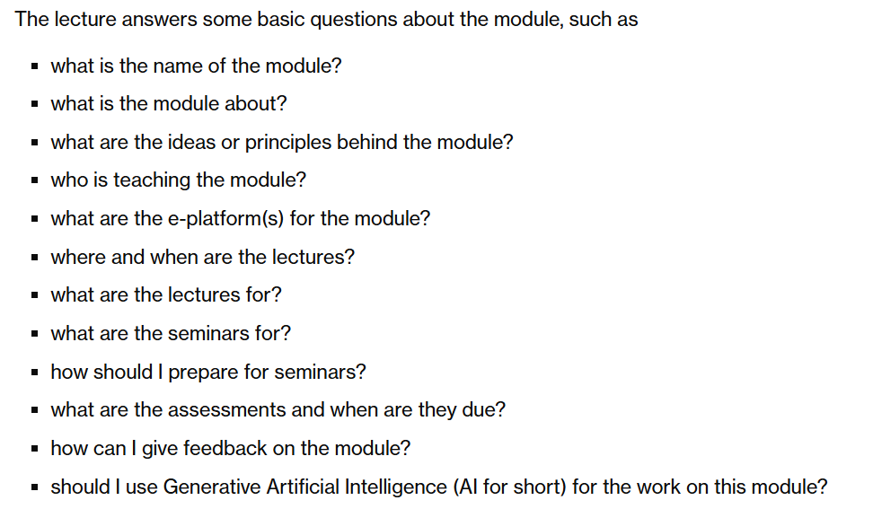
Europe in the Making, module webpage, week 1 overview

Slide 9
What is the name of the module?
“Europe in the Making, 1450-1800 (HI113)”
“HI113”
“the Europe module”
“the early modern module”
“EITM”
“ETM”

Slide 10
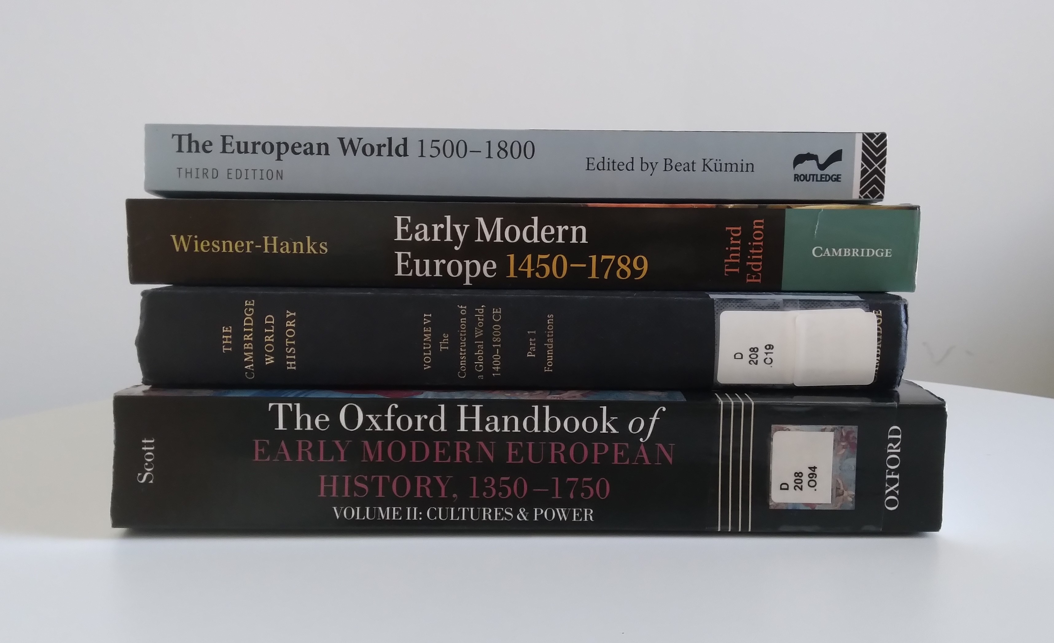
What is the module about?
‘The Cambridge World History:
The construction of a global world, 1400-1800 CE’
Publication dates, top to bottom: 2018, 2023, 2015, 2018

Slide 11
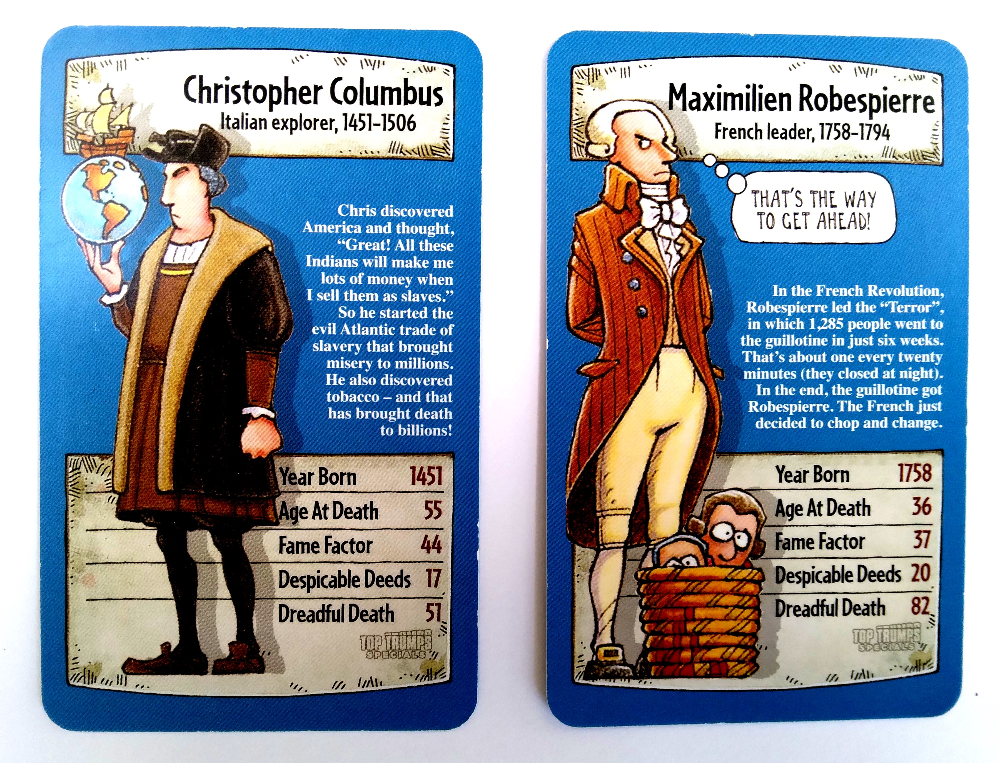
‘Top Trumps specials’
Horrible Histories card game
Date unknown (2010s?)

Slide 12
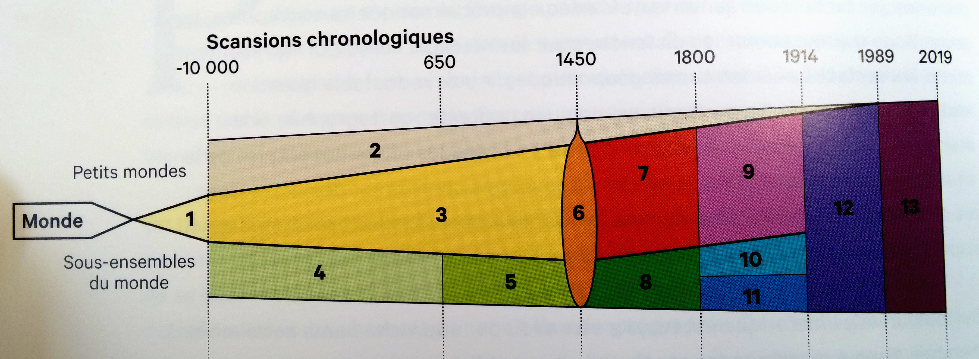
Periods
Little worlds
World
Subsets of
The World
2 = largely autonomous worlds e.g. Pacific, Americas
3 = networks of the Old World, e.g. Silk Roads
4 = Old World societies to the 7th century, e.g. Roman empire
5 = Old World societies, 7th to the 15th centuries, e.g. Mali empire
6 = the world in the 15th century, e.g. Renaissance, Aztecs
7 = European weaving-together of the world, e.g. transatlantic slave trade
8 = Europe, 15th to 18th centuries
9 = the world dominated by Europe (1789-1914), e.g. scramble for Africa
10 = non-European powers, e.g. U.S.A, Ethiopia
11 = Europe, 1789-1914
12 = the world dominated by the West
13 = the world since 1989
Christian Grataloup, with Patrick Boucheron, Historical World Atlas [in French] (2019), p. 14

Slide 13
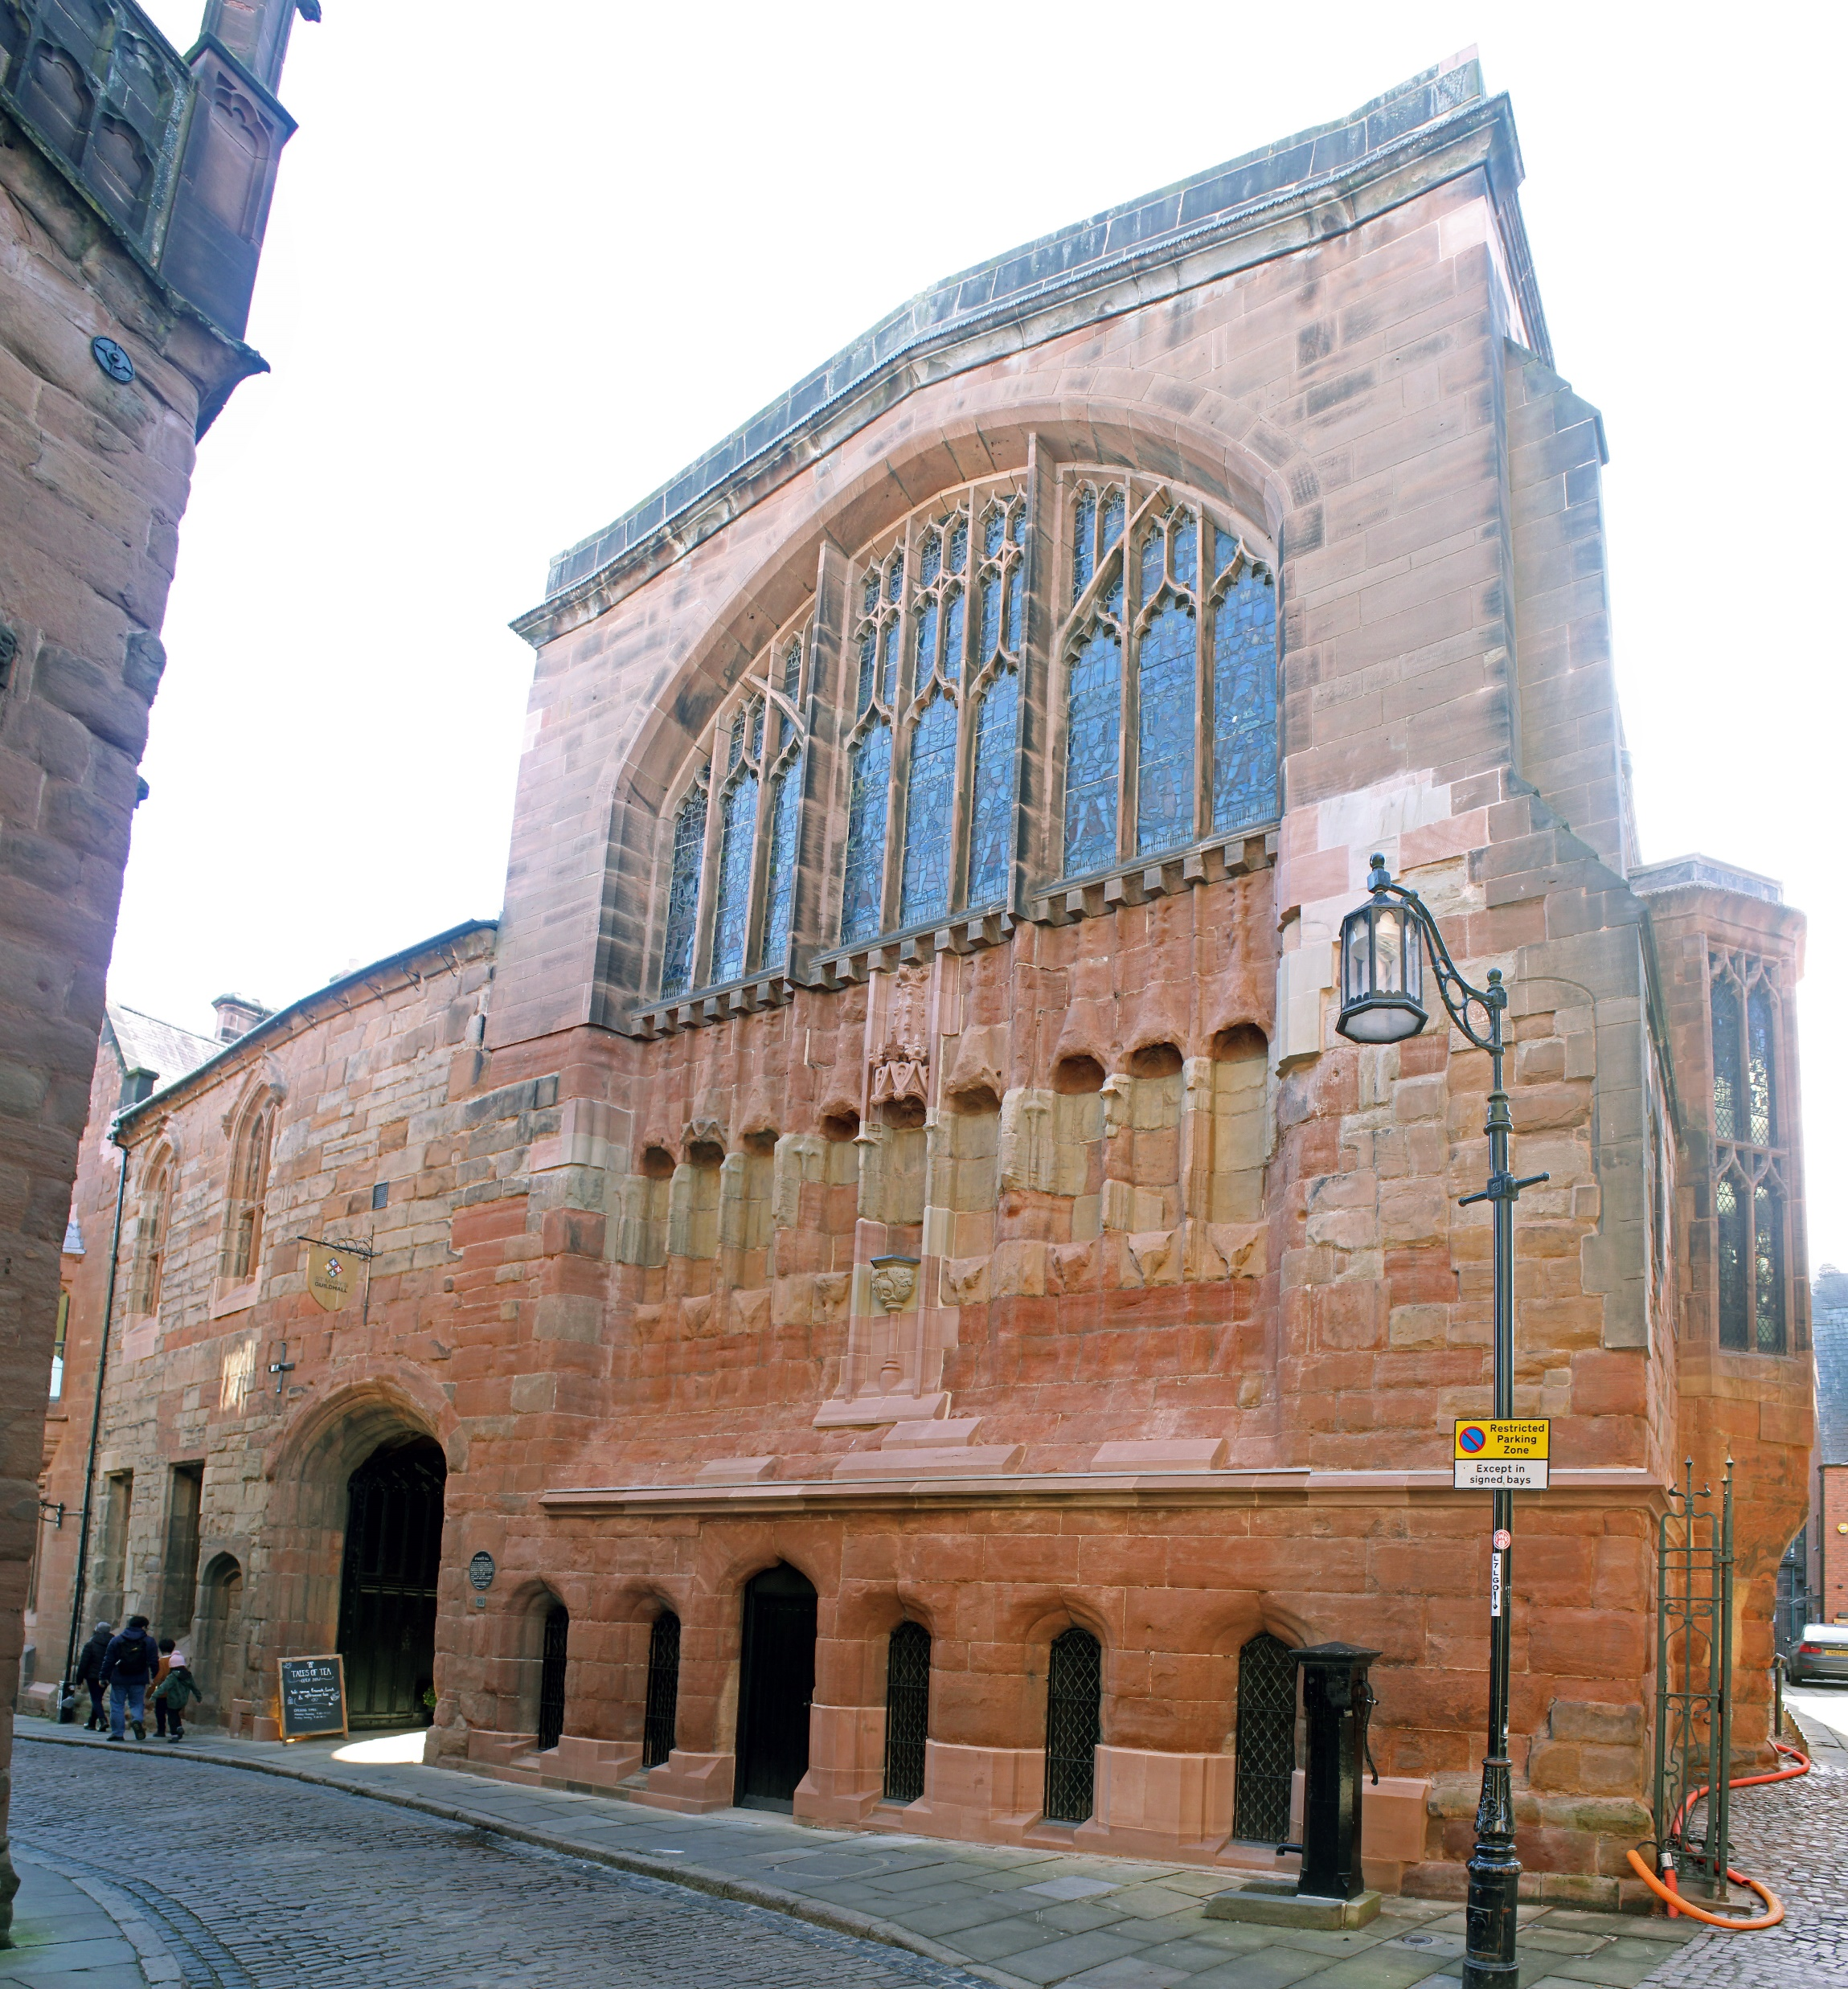
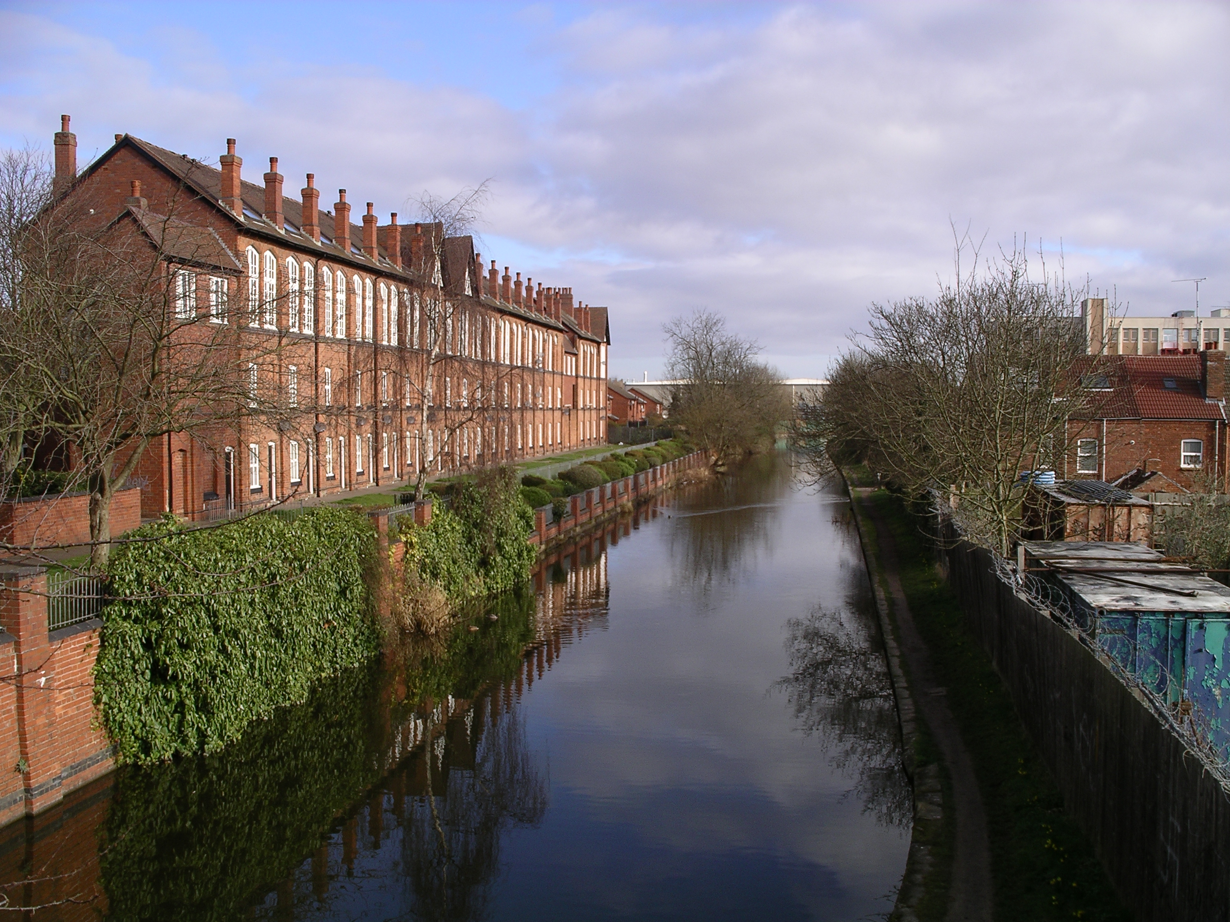
Coventry Canal, completed 1769.
View to the north from Cash's Lane Bridge, Coventry
Image: Wikipedia / Snowmanradio, CC BY-SA 4.0
St Mary’s Guildhall, Coventry, completed 1460
Image: Wikipedia / Jo and Steve Turner, CC BY-SA 2.0

Slide 14
Some early modern landmarks
Renaissance to Enlightenment
End of feudalism to start of industrial capitalism
Martin Luther (b. 1483) to John Wesley (b. 1703)
End of 100 Years’ War (1453) to end of Seven Years’ War (1763)
Ottomans gain Constantinople (1453) and lose Crimea (1783)
‘First Atlantic World’ – Columbus to Toussaint L’Ouverture
Coffee invented in Yemen (15th century) and institutionalised in France (18th century)
Heinrich Kramer's Malleus Maleficarum (1486) to the British Witchcraft Act (1735)

Slide 15
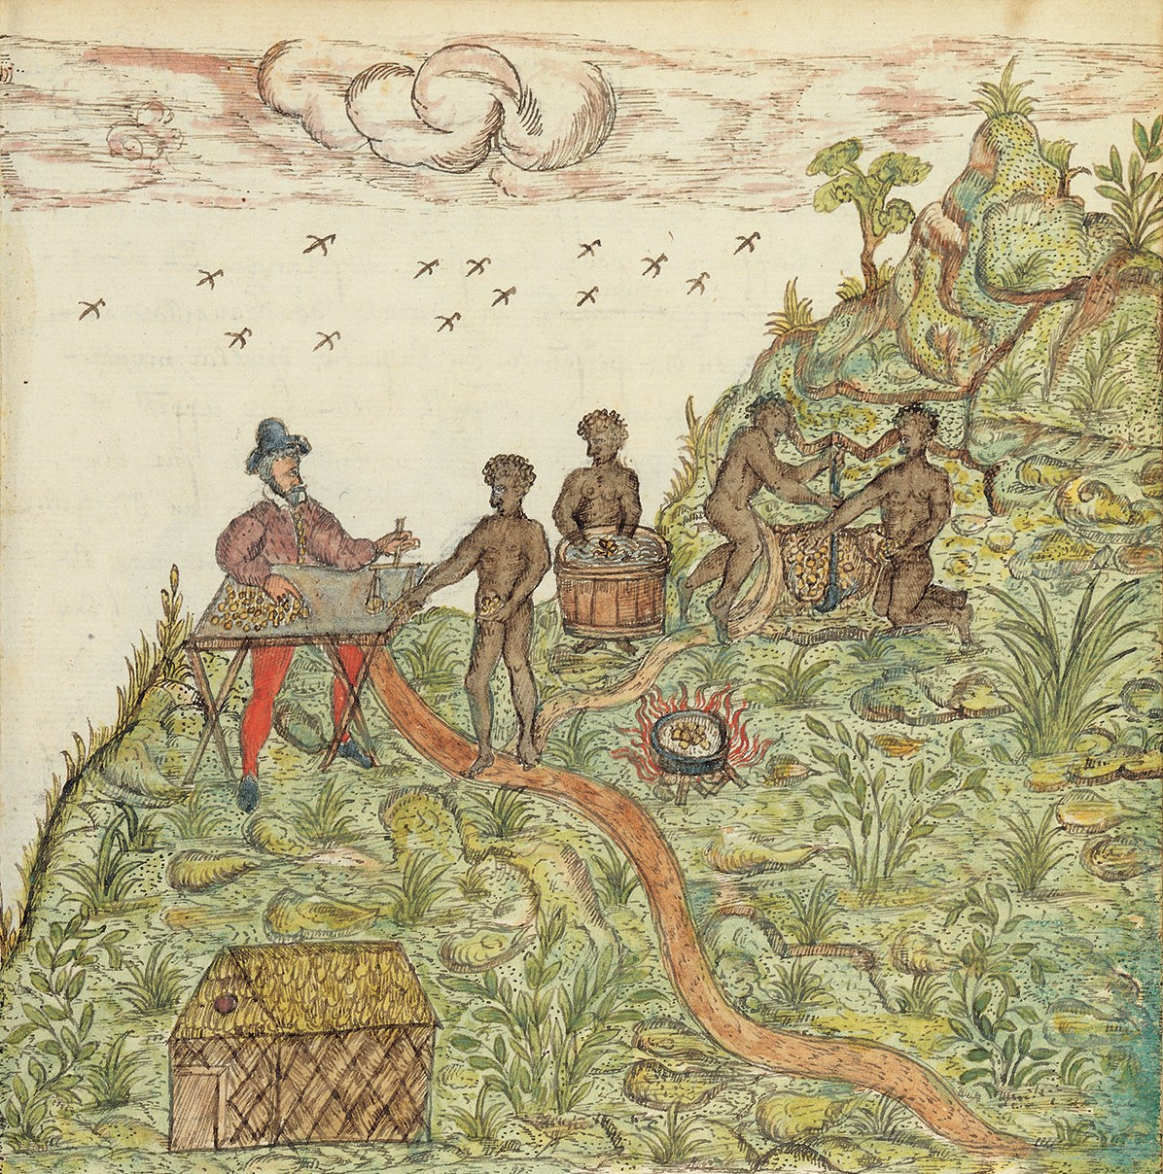
Artist’s impression of gold mining in Central America c. 1600
From ‘Drake Manuscript,’ associated with Sir Francis Drake
Accompanying text in French
Overseer in image is Spanish
Working miners (probably) of African heritage
Location is present-day Panama, home of Cueva people
Source: Histoire Naturelle des Indes (c. 1586), Morgan Library and Museum (New York), MA 3900, f. 100r.

Slide 16
“Western Christendom was a great project about European unity, over a millennium in the making. Its destruction, by contrast [in the 16th century] was rapid and total.”
Mark Greengrass, Christendom Destroyed: Europe, 1517-1648 (2014), p. xxix
“If it had not been for the discovery of America, ‘Europe’ would not have existed.”
ibid., p. 27-28
“The deliberate substitution of ‘the West’ for ‘Europe’ was then made for the first time explicitly and thoroughly in the voluminous writings of the French philosopher Auguste Comte (1798-1857).”
Georgios Varouxakis, The West: The History of an Idea (2025), p. 8

Slide 17
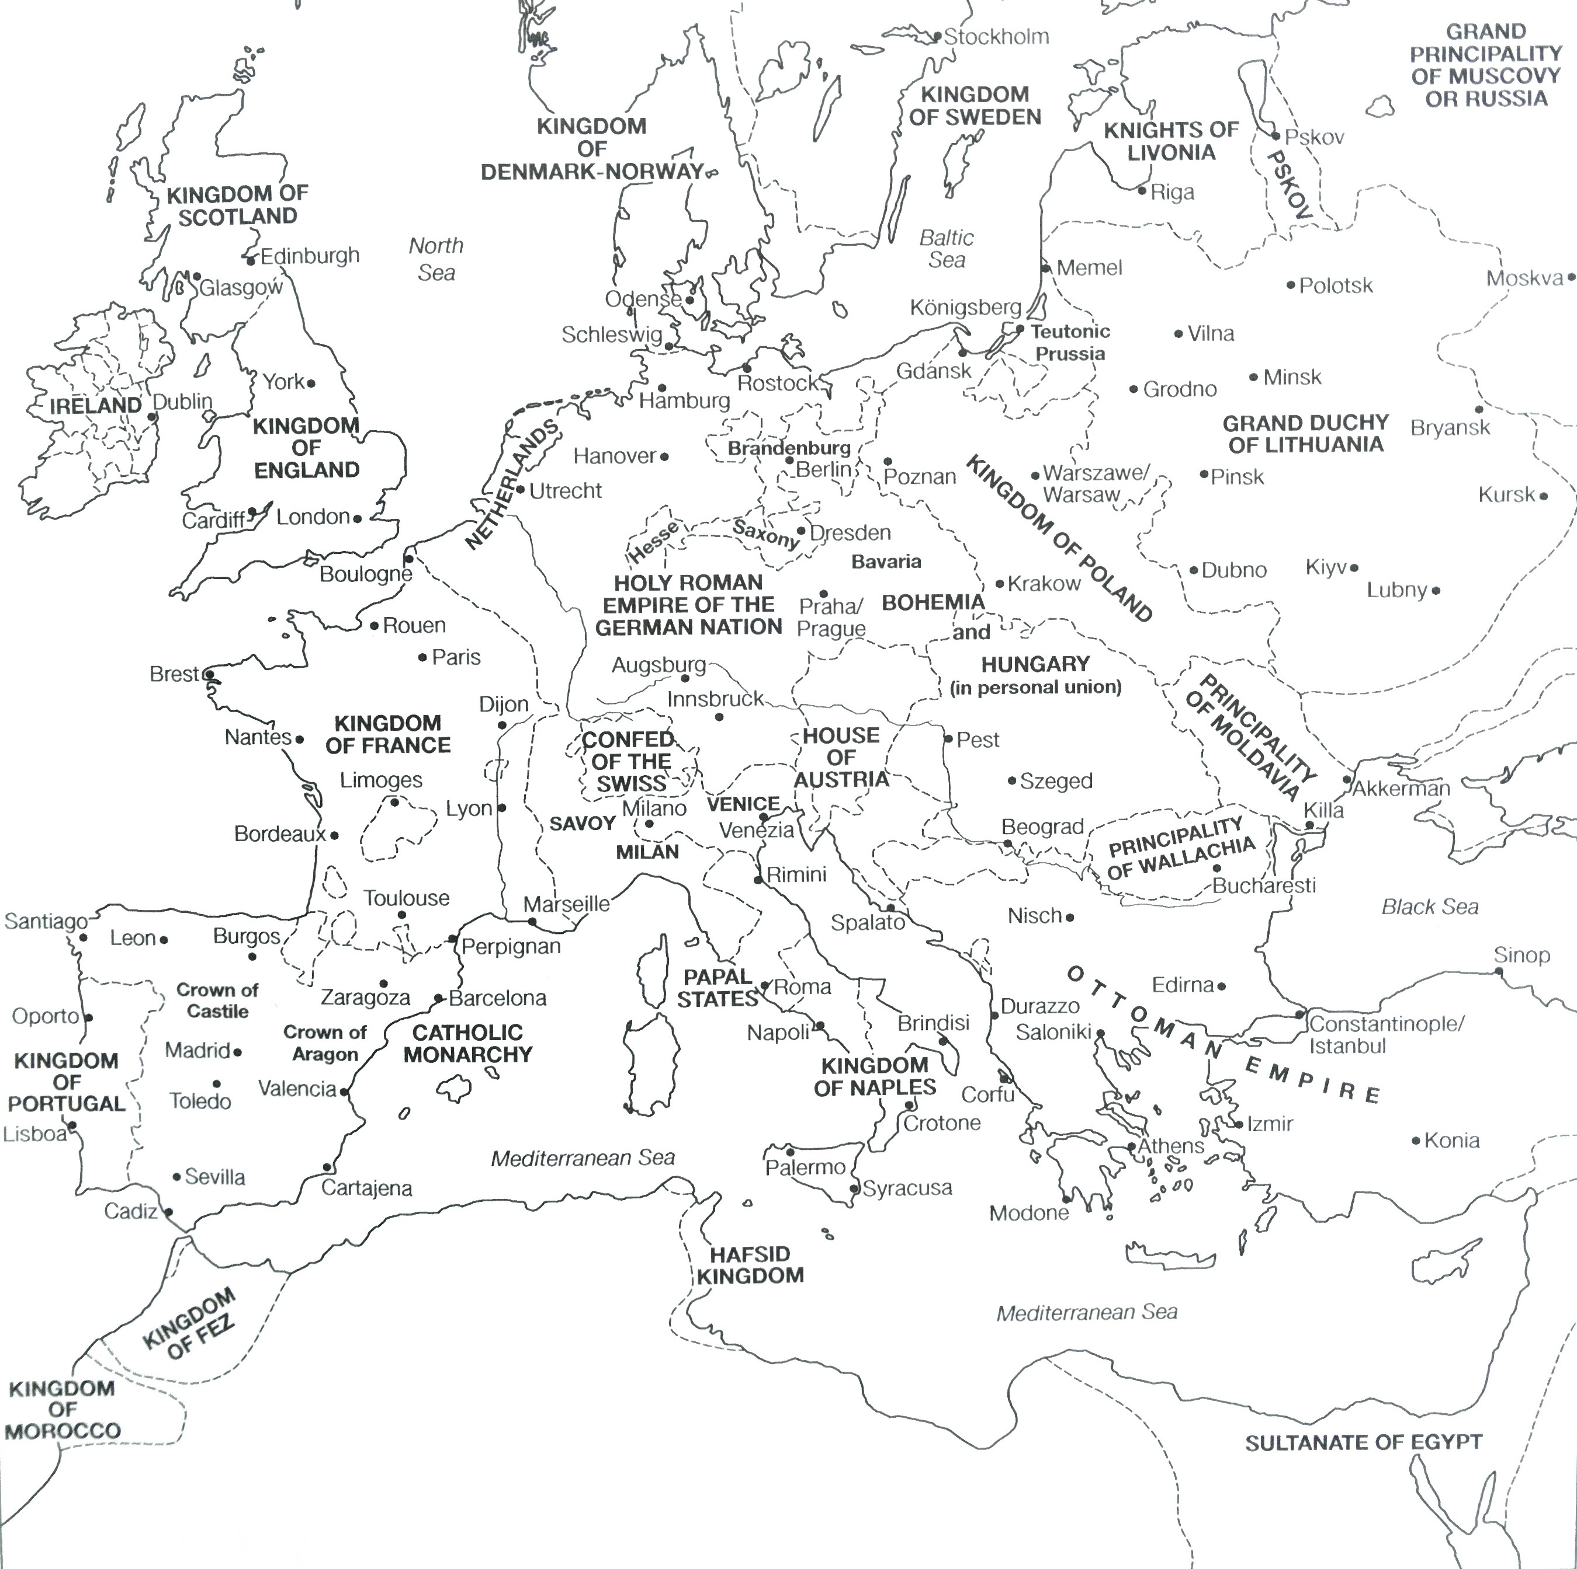
Europe, c. 1500
Familiar, e.g. Portugal, England, Swiss Confederation
Unfamiliar, e.g. Holy Roman Empire, Ottoman Empire, Italian peninsula, no Great Britain
From Kümin, The European World, 3rd edn. (2018)

Slide 18
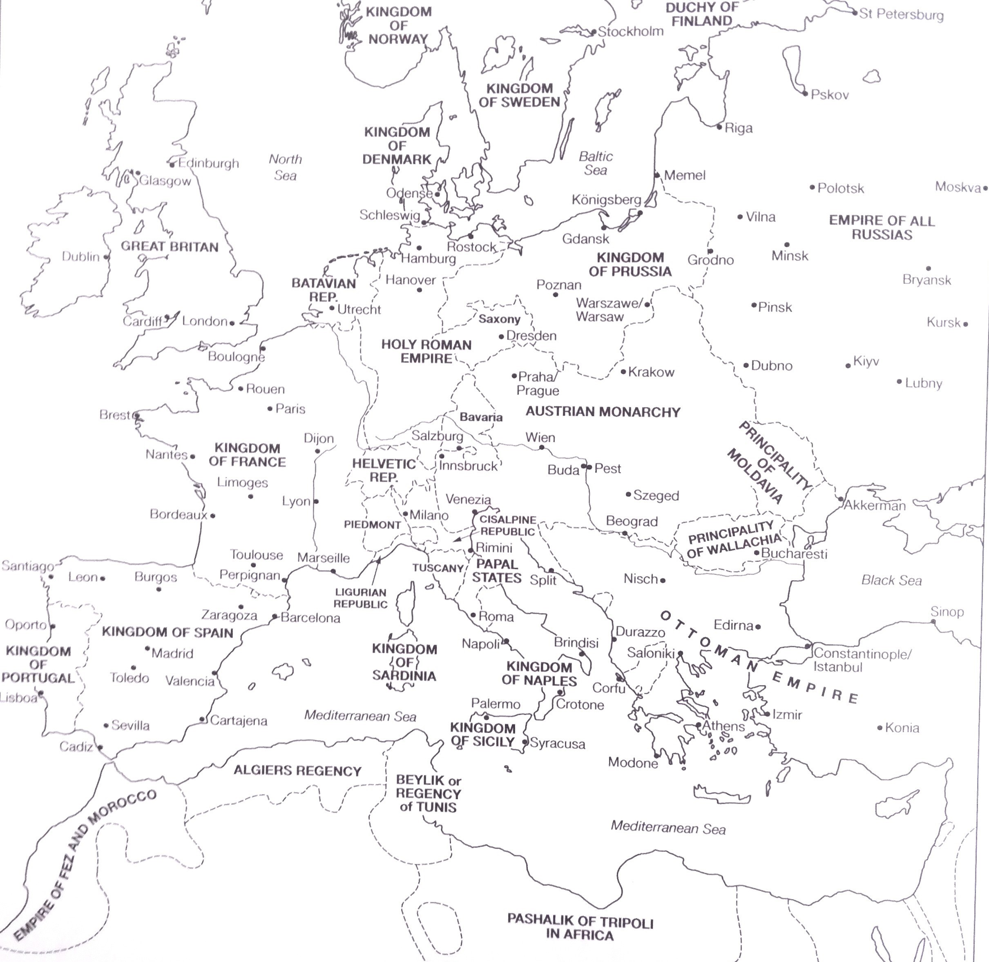
Europe, c. 1800
Familiar, e.g. Great Britain, Russian Empire
Unfamiliar, e.g. Holy Roman Empire, Italian peninsula, Ottoman Empire
From Kümin, The European World, 3rd edn. (2018)

Slide 19
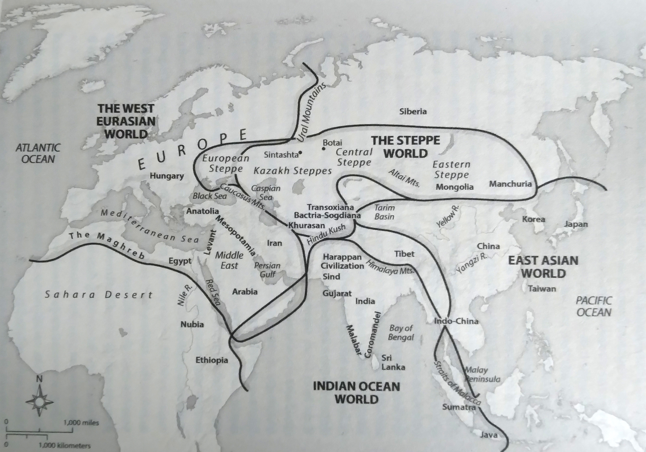
“Europe is the wrong space in which to understand a lot of its own history”
- James Belich, The World the Plague Made (2022), p. 19, and map. 1: The Four ‘Old Worlds’

Slide 20
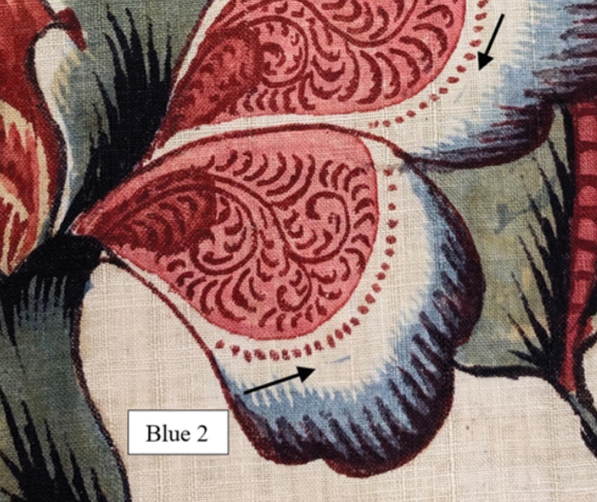
What are the ideas or principles behind the module?
Primary sources call for careful reading and awareness of the bigger picture
Alka Raman, “Before Arsenic: Recovering a Forgotten Indian Technique of Painting with Indigo and its Implications for Knowledge Transfer”, Technology and Culture 66, no. 2 (2025): 509-534, fig. 3.

Slide 21
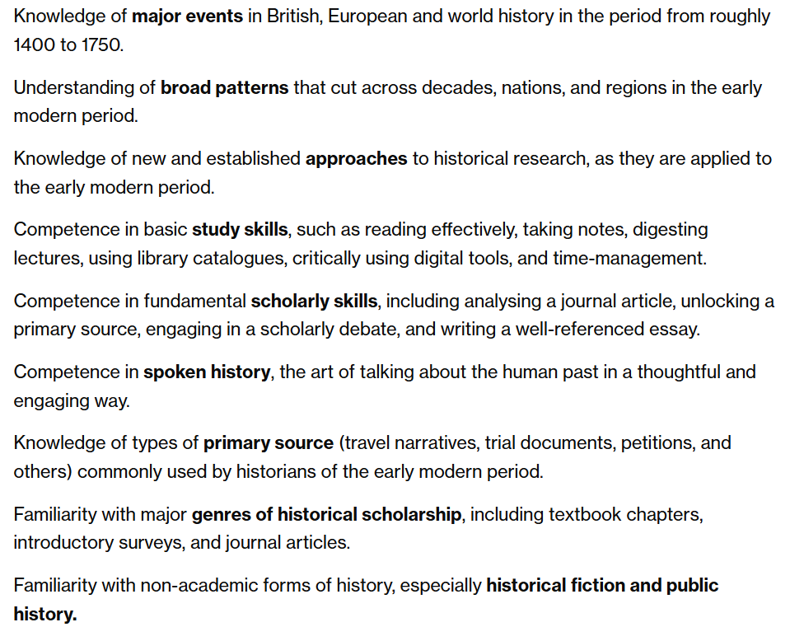
Aims of the module, from module webpage

Slide 22
Europe in the Making, module webpage, week 1 seminar

Slide 23
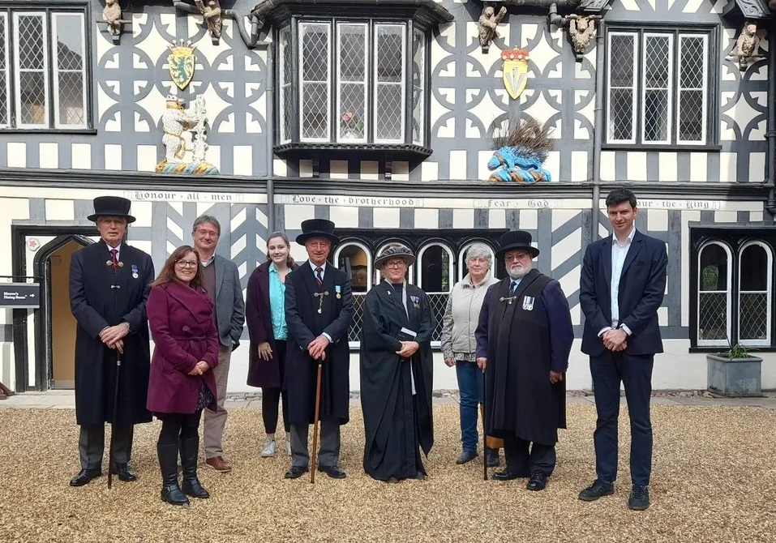
Project team for…
Brotherhood and Belonging at the Lord Leycester Hospital
1571-1700
Display in Warwick, June-July 2026
Image: https://warwick.ac.uk/fac/arts/history/ecc/brethren/
Angus Crawford
Professor Beat Kümin
Dr. Naomi Pullin

Slide 24
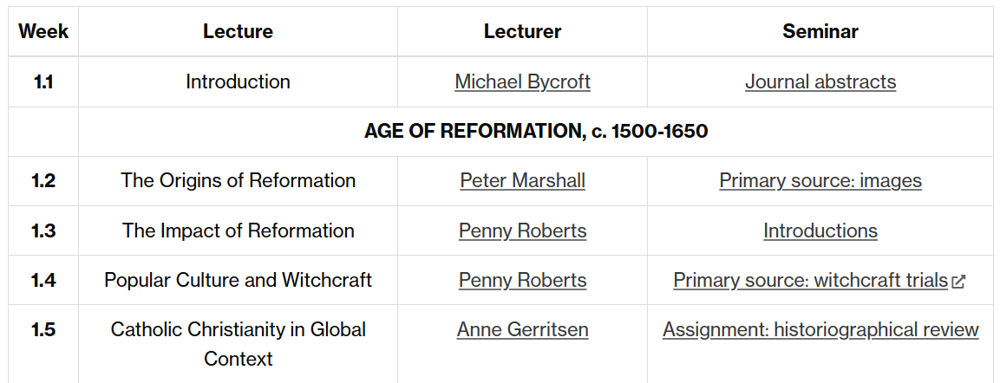
From the module webpage, under ‘Programme’

Slide 25
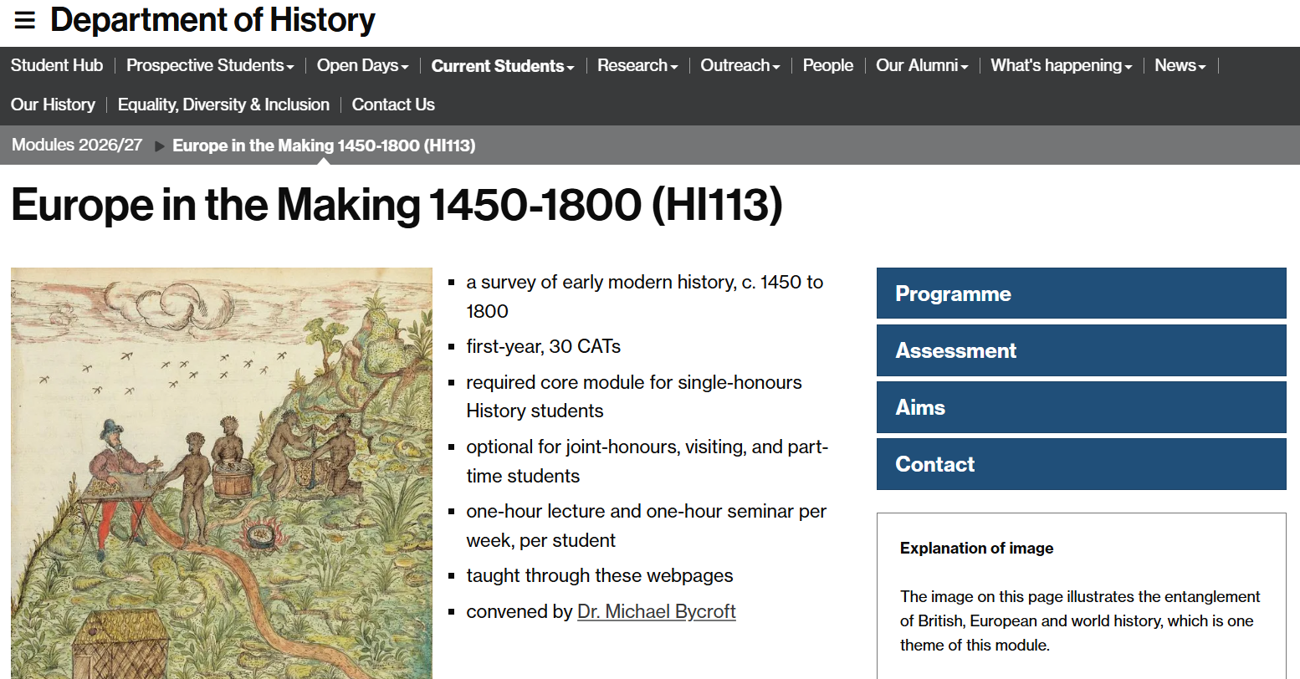

Slide 26
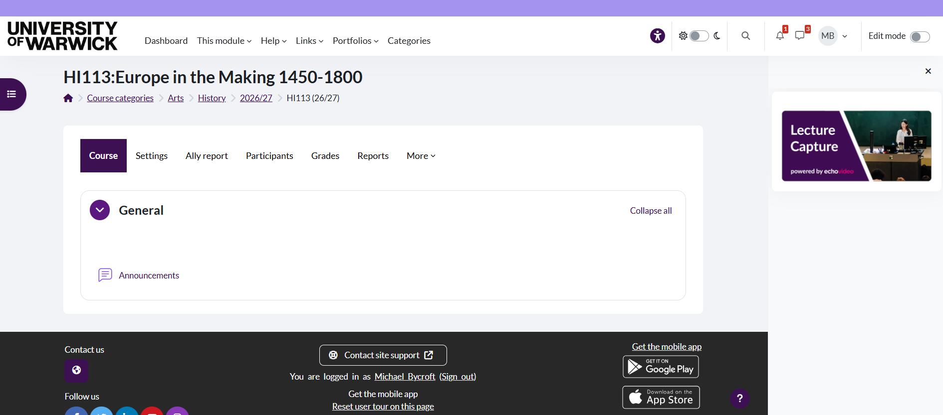

Slide 27
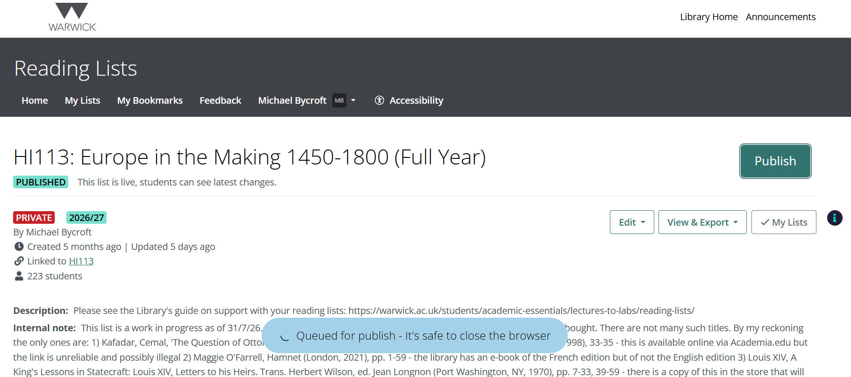

Slide 28
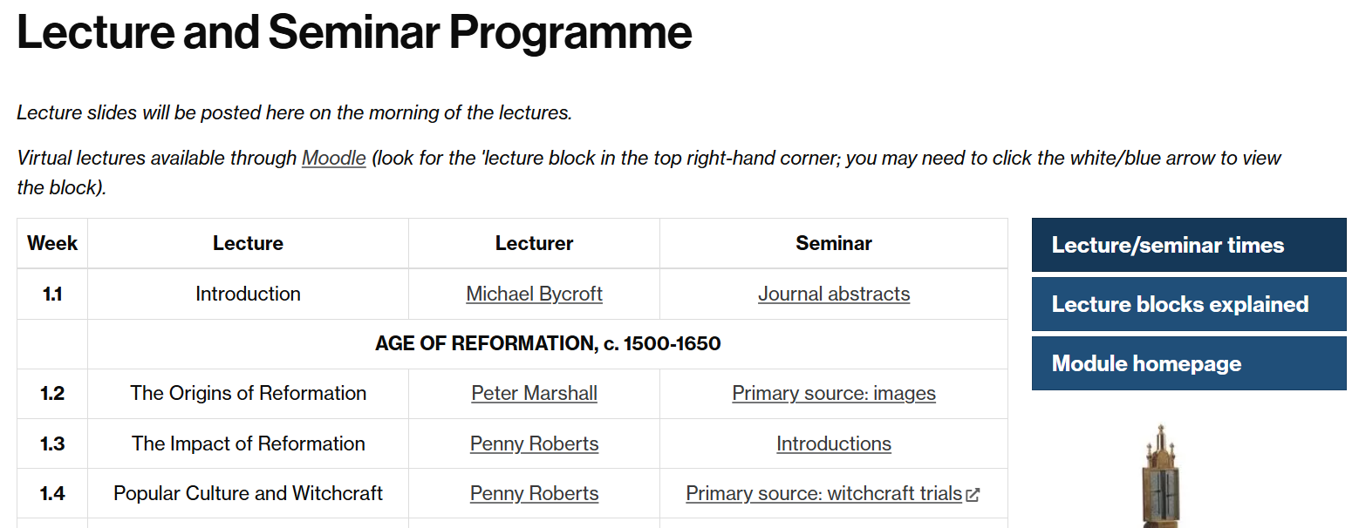
Lecture space issue in term 1
Extra lecture (week 1), extra office hour, virtual lectures (Moodle)
Bigger room in term 2 and term 3

Slide 29
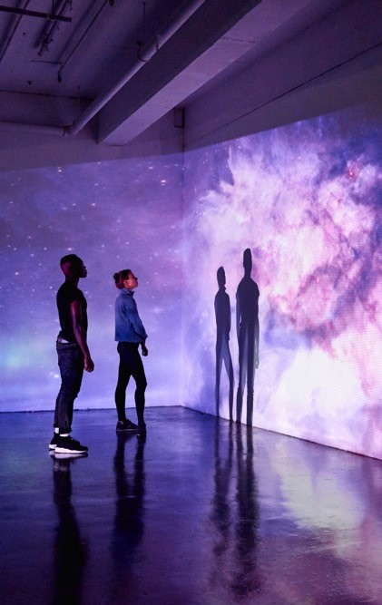
LECTURES GIVE BREADTH
SEMINARS GIVE DEPTH

Slide 30
https://warwick.ac.uk/fac/arts/history/students/modules/hi113/syllabus/t1wk1/

Slide 31
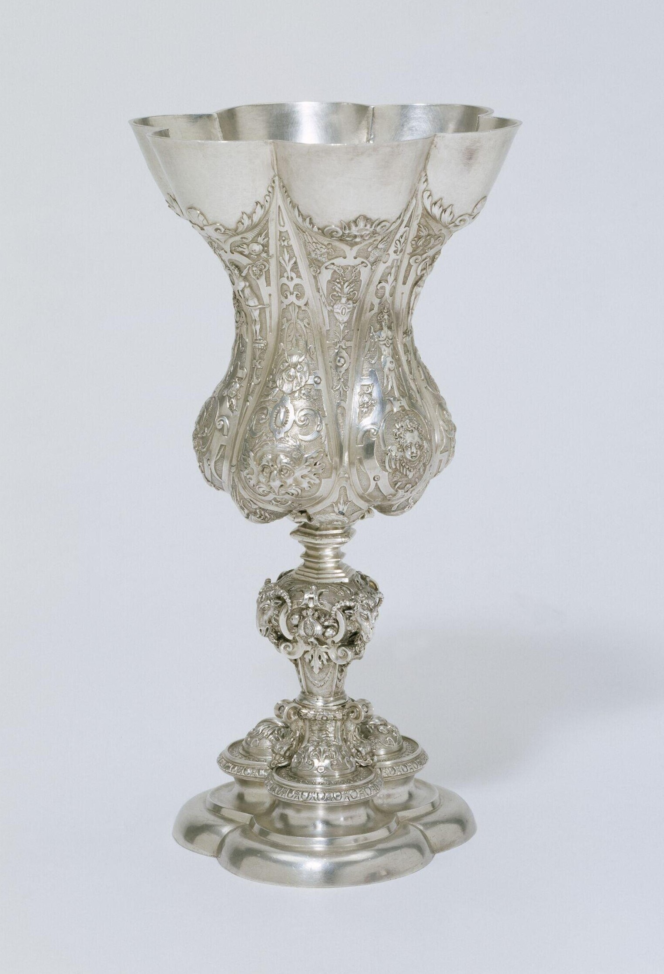
1. APPRENTICESHIP
2. JOURNEYMAN YEAR
3. CREATE MASTERPIECE
Cup made 1580-1600, formerly belonging to the Nuremburg Goldsmiths Corporation. Known as 'Columbine Cup', commonly used as test of skill in this guild in the 16th century.
Image: Victoria and Albert Museum, Accession Number 150-1872

Slide 32
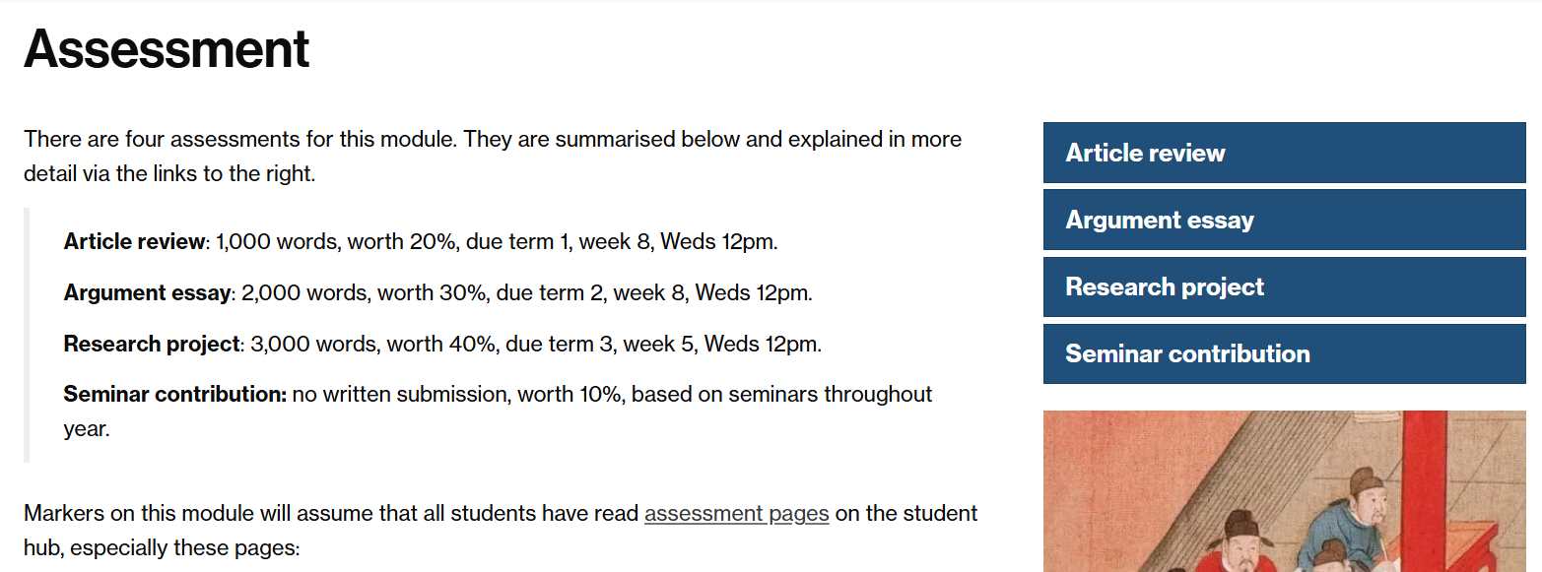

Slide 33
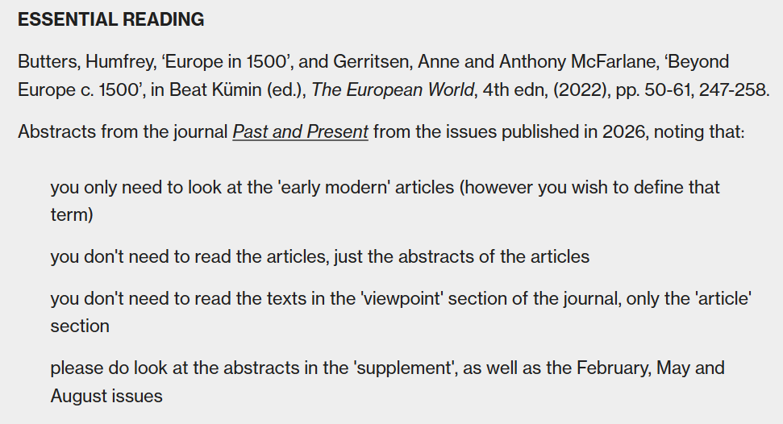
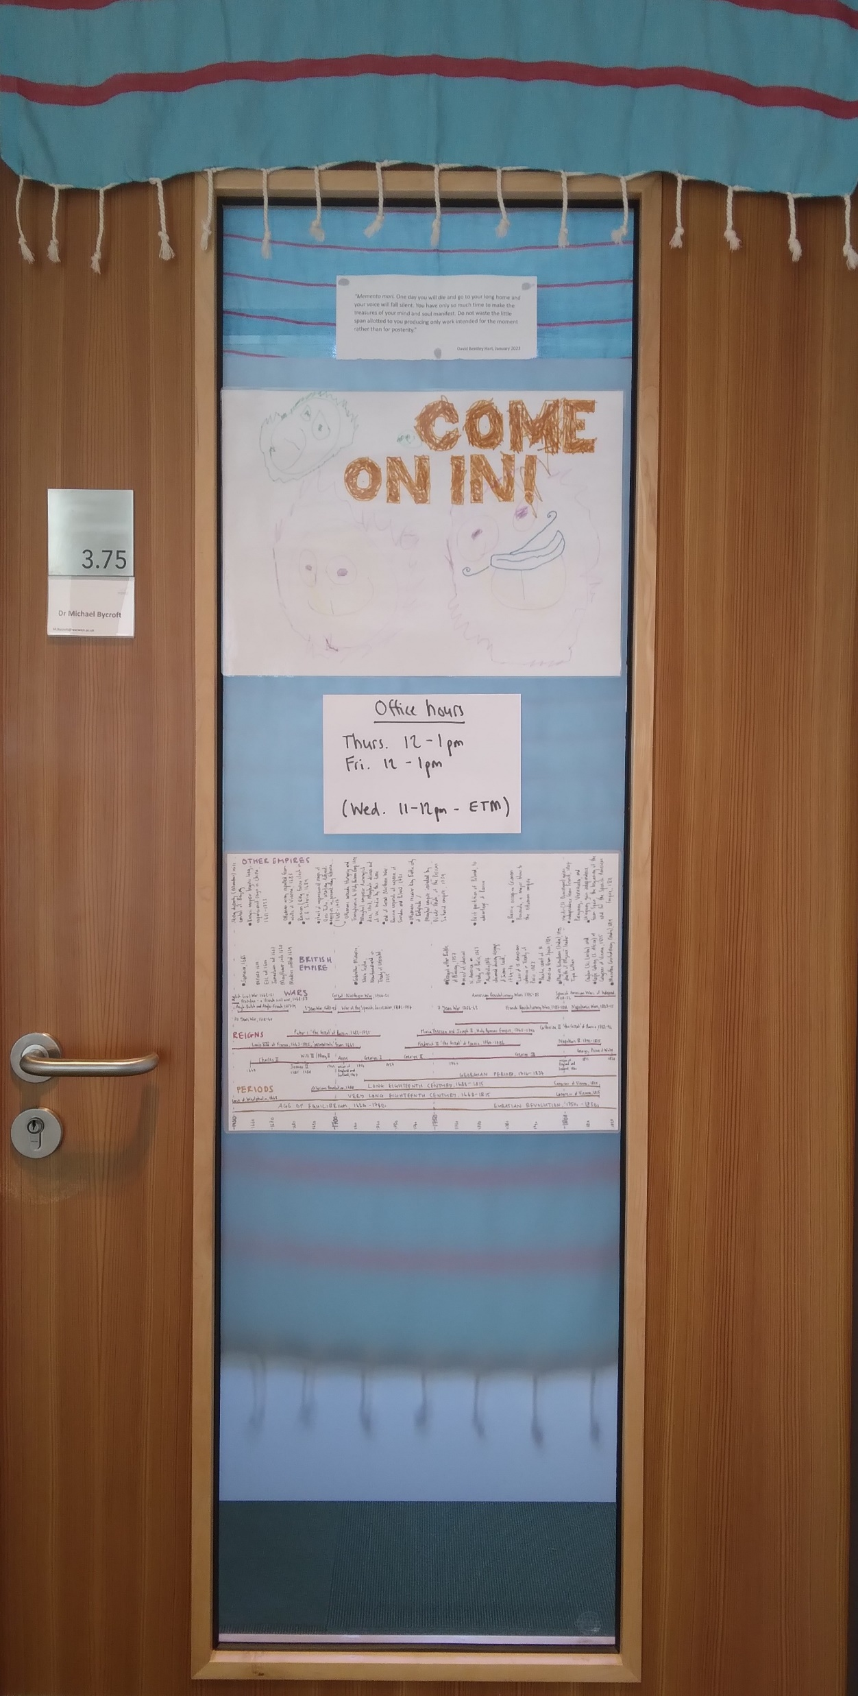
Module convenor’s office door, Faculty of Arts Building (FAB), floor 3, cluster B, room 3.75

Slide 34
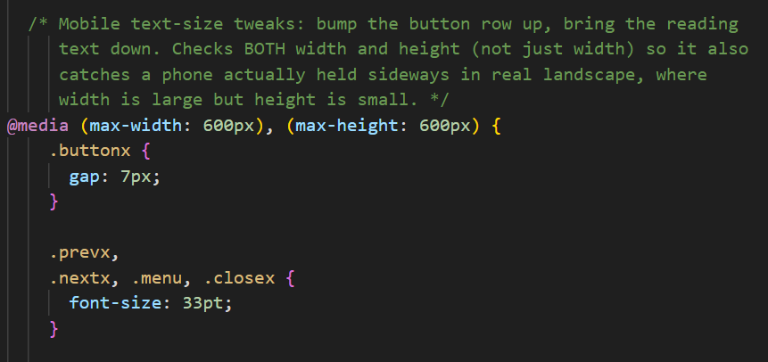
Should I use Generative Artificial Intelligence (AI for short) for the work on this module?
NO, BUT…

Slide 35
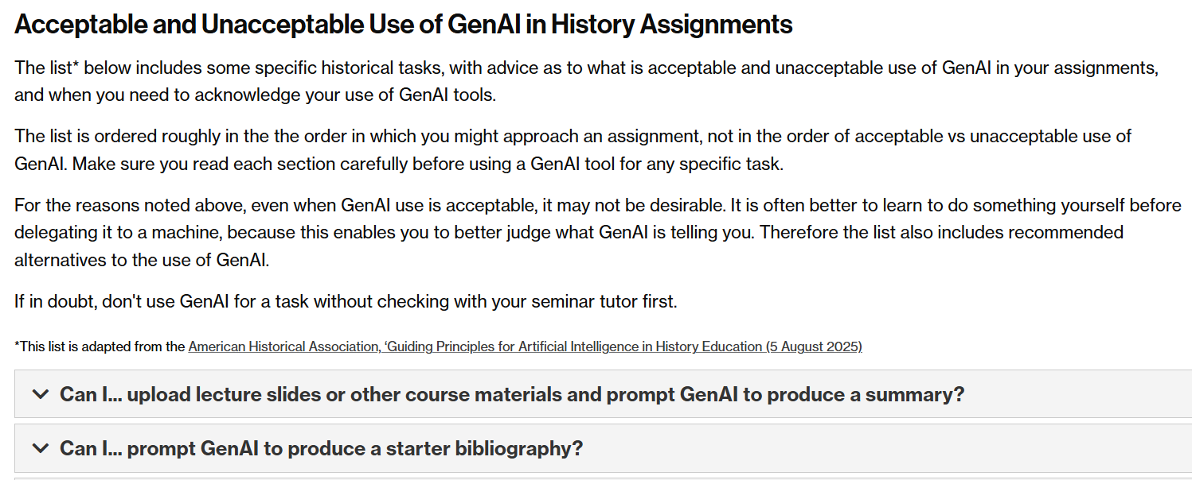
From History Student Hub, https://warwick.ac.uk/fac/arts/history/studenthub/assessment/ai/#acceptable

Slide 36
what is the name of the module? Ee-tee-em
what is the module about? C. 1400-1800 from vantage point of Europe
what are the ideas or principles behind the module? Historical thinking as well as events
who is teaching the module? Early modern specialists
what are the e-platform(s) for the module? Module webpage (plus Moodle for virtuals)
where and when are the lectures? Term 1 this room/time, with one virtual lecture p/p
what are the lectures for? Breadth
what are the seminars for? Depth
how should I prepare for seminars? Gray box, 3-4 hours, strategic reading if needed
what are the assessments and when are they due? Working towards your masterpiece
how can I give feedback on the module? In person, email, anonymous forms
should I use Generative Artificial Intelligence (AI for short) for the work on this module? No (but)

Slide 37
QUESTIONS?
Cup made 1580-1600, formerly belonging to the Nuremburg Goldsmiths Corporation. Known as a 'Columbine Cup', commonly made as ‘masterpiece’ object in this guild in the 16th century.
Image: Victoria and Albert Museum, Accession Number 150-1872

Slide 38
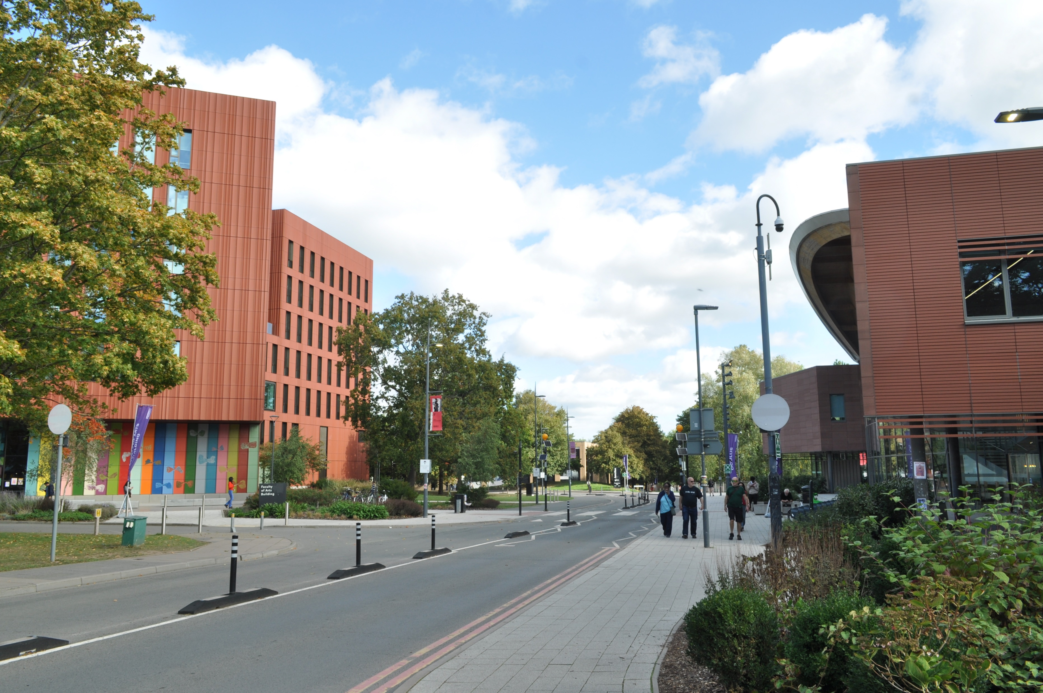
Oculus and FAB, October 2026
Photo: MB

