Slide 1
European Colonialism and Its Impact

Slide 2
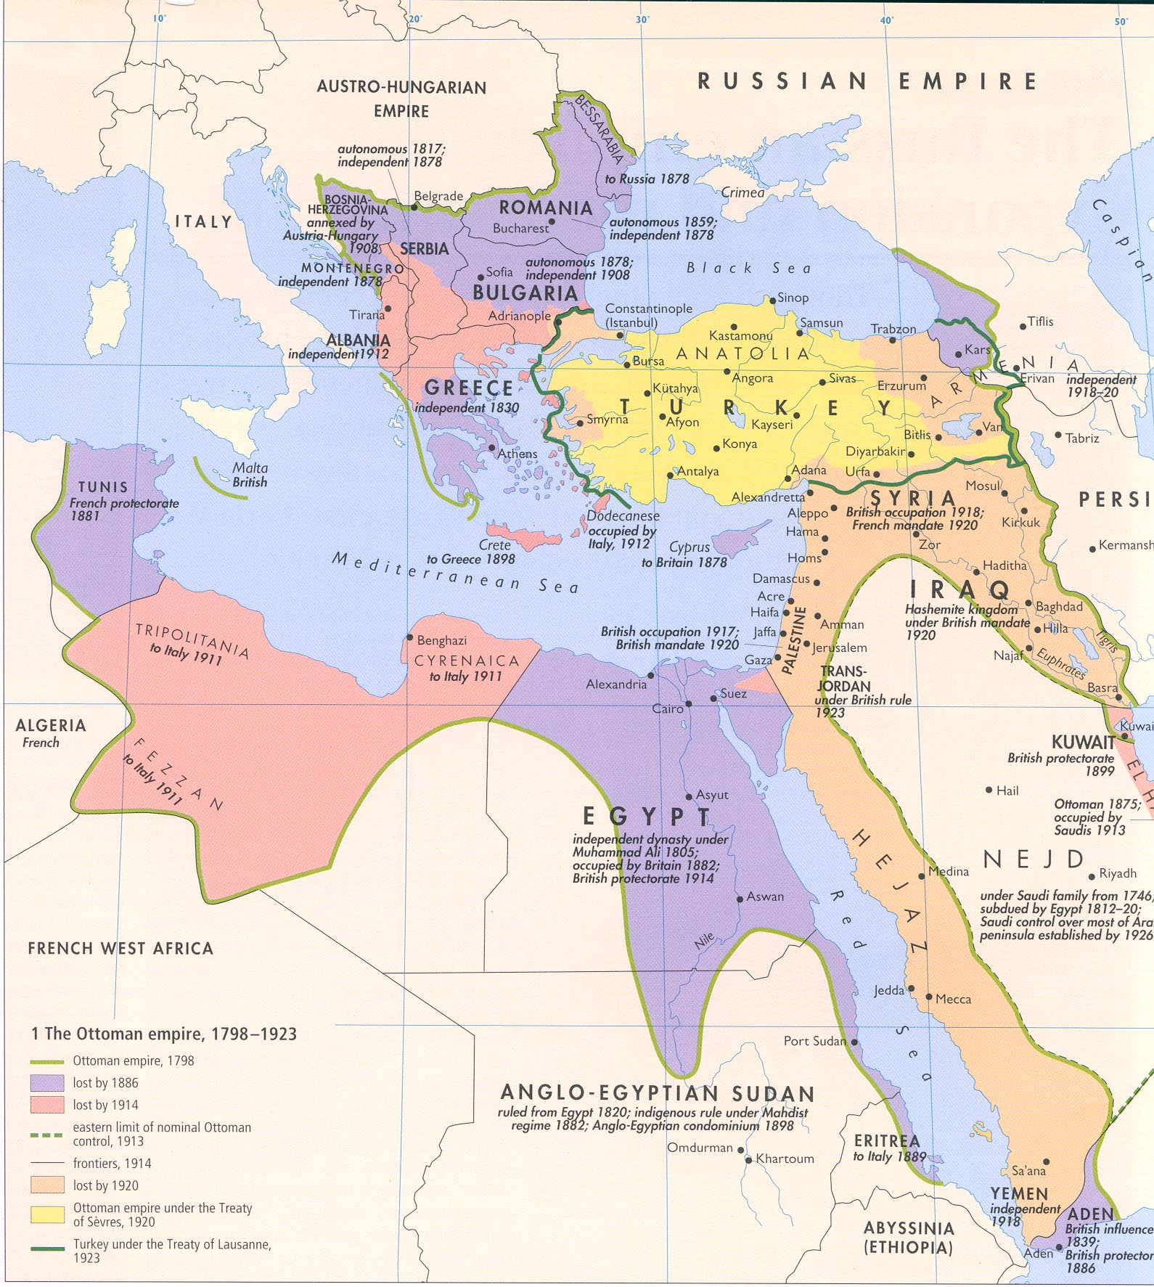

Slide 3
Ottoman Empire as the ‘Sick Man of Europe’
How has this dramatic sickness or shrinking of the Ottoman Empire been explained?
A ‘Clash of Civilisations’?
Imperialist Expansion?

Slide 4
(1) The ‘Impact of the West’
Starts with a big bang by invasion of Europe led by Napoleon Bonaparte in 1798 to spread ‘civilization’ to Middle East/Orient, imagining self as a Prophet with the Quran (law book).
‘Liberating’ from Ottomans and local warriors such as the military cast of the Mamluks.
In response to invasion, Egyptians were soundly defeated in Cairo revolt.

Slide 5
Al-Jabarti, famous chronicler
Interested in mathematics and astronomy. Describes his visit to ‘Institut Egyptien’ in 1800
Taken to be example of how Muslim mind gets baffled by knowledge and light brought and collected by French (e.g. scientific instruments and knowledge of his own religion)
Significance of encounter with West did not lie in technological prowess and armies, but power of ideas: fraternity, equality, and liberty, leading to rise of new nations from ruins of the Ottoman Empire.

Slide 6
Alternative to 19th century ‘clash of civilizations’? Imperialist Expansion
Yes, Napoleon did come with new ideas but why? Simply to liberate Egypt from the Ottomans?
Main reason for French invasion of Egypt was to fight British because British Navy too powerful. Ultimately, French power resides in challenging overseas colonies in India, Egypt (to Iraq and Iran) to force collapse of the British Empire.
Logic of this argument: trade is the basis of British power (and the Industrial Revolution) in overseas markets. 1820-1840: areas outside of Europe are primary consumers of cotton.

Slide 7
Ghandi produced cotton domestically to fight import of British cotton

Slide 8
Economic Explanation
1798: French invasion of Egypt
1830: French occupation of Algiers
1838: Balta Limani: treaty removes tariffs, forcing open Ottoman markets for British goods.
1839: Aden annexed by Britain (to Suez…coal…oil)
1881: France occupies Tunisia
1882: British occupation of Egypt; Lord Cromer (1883-1907)
WWI: Dissolution of Ottoman Empire

Slide 9
New Imperialism: ‘White Man’s Burden’
‘Enlightenment’ argument can explain events of the 19th century as outcome of imperialism and remember, not first Europe-Ottoman/East encounter.
The ‘newness’ here is an imperial West with eyes on the entire globe: Africa, Middle East, East Asia, Canada, Australia, Latin America, India.
‘Scramble for Africa’ 1887-1914 (racialist logic)
Imperialism is good and is ‘the white man’s burden’
Lord Salisbury; Cecil Rhodes; Lord Cromer

Slide 10
The two explanations may not be opposed: Deconstruct ‘the West’
‘Clash of Civilisation’: basis for how encounter between East and West is described. But what of economics? Reasons for British, French and others expanding in the 19th c.? Two arguments not necessarily opposed.
Al-Jabarti: Observed the link between the bafflement of modern science and battling army brought by French = Knowledge intertwined with power and violence, not separate.
Al-Jabarti’s description of the Institute reveals awareness of order, science, knowledge.
Sees method of knowledge/power as something hard to take because so complicated and peculiar.
The paradox is that ‘encounter’ or ‘impact of West’ is constituted by both: forms of knowledge and violence simultaneously.

Slide 11
Part II: The question of ‘the East’
Thinking about more than one East: not one East, but many players.
Mohammed ‘Ali, governor of Egypt, 1805-1848
How can we read same history from different perspectives and politics (from London, Cairo, Constantinople/Istanbul)?
We study this topic because it is currently significant.

Slide 12
Narrative of Mohammed Ali’s Life
Where to locate his identity:
Mehmed Ali (Turkish) v. Mohammed ‘Ali (Arabic)
British view: interest in OE, Lord Palmerston (East Med, Arabia, Yemen, Syria, 1840s), to protect India. Who will fill vacuum if OE collapses? Feared the Russians.
Ottoman view: M. Ali threatens integrity of empire.
Egyptian/Arab historiography: Not Ottoman governor except in name because by practice he is a nationalist leader despite language and ethnicity
Egyptian nationalist view: Egypt was part of the OE but always maintained true identity deep down waiting to be ‘reawakened’ by M. Ali. He was interested in improving Egypt with blueprint for national rejuvenation of development.

Slide 13
How can we look at series of events in history differently and their political consequences today?
The past has much to do with political concerns today.
Arguments about political developments in Egypt, Turkey, and Iran:
‘Reform’ has not been forthcoming, blocked indigenously, so outside help is needed in various forms. Advice or invasion/occupation.
There has been ‘reform’ in the region for a while since 19th century in all three countries of Egypt, Turkey, and Iran. Role of the West is ambiguous but complex in this reform process.
Colonialism and revolution in the Middle East especially prevalent from 1906 to 1908, prior to WWI.

Slide 14
Ottoman Empire and the Politics of Reform
19th c. Reforms: Army, schools, hospitals, fiscal and tax reform (countryside), new bureaucracy (degree of professional class, autonomy, servants serving administration not the Sultan).
Beginning of legal and constitutional reforms in the Ottoman Empire
Starts with European pressure to institute reforms

Slide 15
‘Tanzimat’ (Reforms) 1830s
Gulhane Edict, 1839
Hatti Humayun, 1856
State guarantee of security of life, property of subjects;
Regular, fair tax structure;
Military conscription systematized (info for masses);
Greater equality in religion
Reiterates principles of equal protection under law
Constitutional movement creates constitutional monarchy
Bureaucrats, reforms, intellectuals call for reform from Sultan, galvanized around constitution to limit monarch’s power.

Slide 16
Committee of Union and Progress (CUP): Turkey
‘Young Turks’: 3 military generals and important bureaucrats (Enver Talaat, Jemal). Force to depose Sultan Abdel-Hamid (1876-1909).
Return to original question of ‘Sick man of Europe’?
Not really, yes shrinking, but heartland still functioning and ideals of constitutionalism have struck and military reforms are good. 19th century reform was not completely wasted.

Slide 17
Egypt
Khedive Ismail (1863-1879): Opera house, highways, increasing local resentment about development, mismanagement, hard labour. Europeans install advisers and ministers. Huge European encroachment on sovereignty.
Colonel Ahmad Urabi leads 1881 revolt.
British occupy Egypt in 1882
Increasing calls for constitutionalism in late 1870s and early 1880s.
Raise revolt, call for constitution, elections, parliament. British interfere and occupy. Bomb Alexandria in 1882 and battle Urabi at the Nile Delta; control Egypt until 1952.

Slide 18
Racism and Imperialism
Positive connotations: Lord Cromer felt this is ‘best interest’ of subject races by reforming finances of country. Very shrewd administrator (reformed India’s) and ‘balances Egyptian budget’ and productivity; not interested in health and education.
‘Veiled protectorate’: Egypt is within Ottoman empire but occupied and retains degree of autonomy; odd status.
1906 Dinshaway marks boiling point. Hunting British soldiers kill villager and British officer killed. Jailed the villagers and sent to tribunal with public sentences for the peasants.
British occupier takes drastic measures to control population and underlines moral violations to secure interests. Cromer retires after this.
Anticolonial politics triggers organized revolutionary movements in 1919.

Slide 19
Iran
Call for reform explicitly about Constitution 1906-1911, making a ‘revolution’.
Domestic and outside elements. People agitating against rule of the Qajar Shah and intervention of Great Britain and Russia. Concessions to European prospectors and financiers to use resources of country, especially minerals and railroads: de Reuter; D’Arcy for oil.
Reuter Concession (late 19th) for RR, mining, banking for profits to Qajar shah (strategy to centralized telegraphs, armies, railways).
This is much more decentralized versus Egypt/Turkey; nomadic semiautonomous rulers. NO significant army.
1901: Shah gives concession to D’Arcy for oil; Pattern of how oil struck and exported through complicity between local rulers and exporters; 1908 discovered oil in commercial quantities
1911: British (Churchill and Admiralty) take plunge to transform all British battleships from relying on coal; oil is more energy efficient adds speed to battleships but also ‘scramble for concessions.’
Significance: consequences of British having to depend on resource outside of country. Independence affected fate of constitutional movement in Iran.

