Slide 1
Islam: Dogma, Faith, and Practice

Slide 2
Historical background of Islam
Islam is a complex faith. Second largest of the world’s religions.
How do we explain the appearance of this religion though it appears to emerge from the apparent backwaters of the Middle East rather than a ‘civilization,’ such as Persia or Mesopotamia?
Emerges in the 7th century Arabian peninsula.
Why did people believe in the Prophet Mohammed?
What was the appeal of his reformist message?

Slide 3
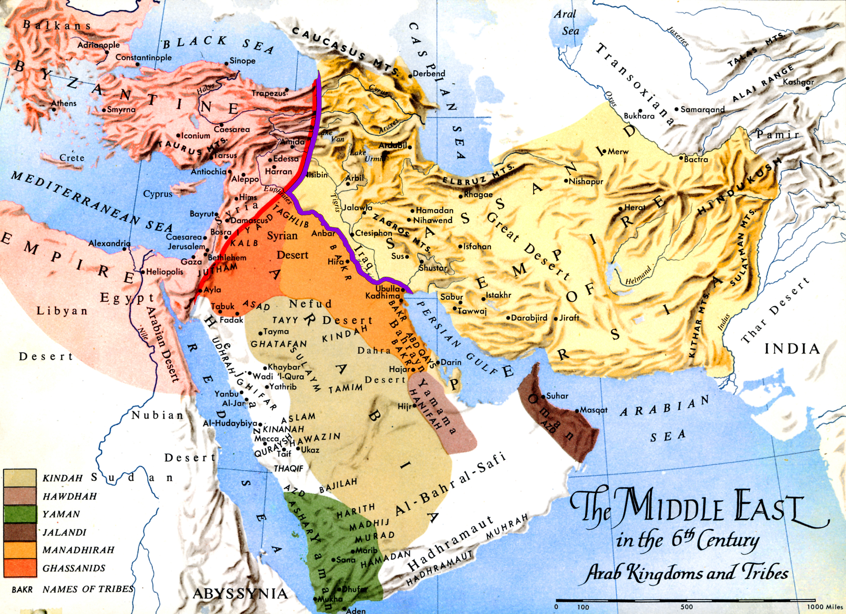
Map of pre-Islamic Middle East, 6th century CE

Slide 4
Pre-Islamic Middle East
Byzantine (Eastern Roman) Empire:
Polytheist, 2nd century, agrarian, army, taxes, bureaucracy, political unification centered on Rome.
320 A.D., Roman emperor Constantine converts to Christianity; legitimate religion with a new capital in Constantinople (Byzantium – eastern part of the Empire, speak Greek instead of Latin).
Sassanid (Persian) Empire:
Agrarian, mono/ditheistic Zoroastrianism, taxes, bureaucracy.
Christianity, Manicheanism, Buddhism, Judaism with Ctesiphon as the royal capital of the Persian Empire until the Islamic conquest in 651 AD.

Slide 5
Arabia, 7th century CE
Desert, no unified political system; nomadic confederations of people with common ancestry. Females dependent, no obligation to defend ‘tribe.’
Main building, Ka’aba (cube) in Mecca with pre-Islamic, polytheist roots as a monument for ritual.
Value system: Language/poetry is flourishing mark of each nomadic group in asserting hegemony, expressed identity through memorized poem; loyalty; family.
No major agriculture, some herding, domestication of camel. Exceptions to ‘barren-ness’: Trade was a major economic activity and linked peninsula to neighbors globally: China, India, Mediterranean, Africa.
Conclude: No major political unity among warring tribes. Agriculture and settled agriculture alongside polytheism but not isolated by virtue of trade and knowledge of surrounding areas.

Slide 6
Ancient Trade Routes

Slide 7
Prophet Mohammed’s accomplishments
570 AD, born in Mecca from Quraysh nomadic group (marginal)
610 AD, prophet, claim of direct link to one God; attracted animosity of tribal public
622 AD, Hijra (flight) to Yathrib (Medina)
628 AD, captured hometown of Mecca
630 AD, Arabia prays allegiance to him
632 AD, death
In his lifetime, he engaged in caravan trade (Yemen-Syria)
Married Khadija, a business woman

Slide 8
Political Message
Conversion—decisively—to very strong monotheism with no human attributes; no intercession via saints and intermediaries, just a direct link between people and God.
shahhadah – no god but God and Mohammed is his Prophet
political revolution – tribes subsumed under umma (Muslim people or community of Islam)
from oral culture to textual written practices: Koran/Quran is the first book written in Arabic.

Slide 9
Quran (the Recitation): first book in Arabic

Slide 10
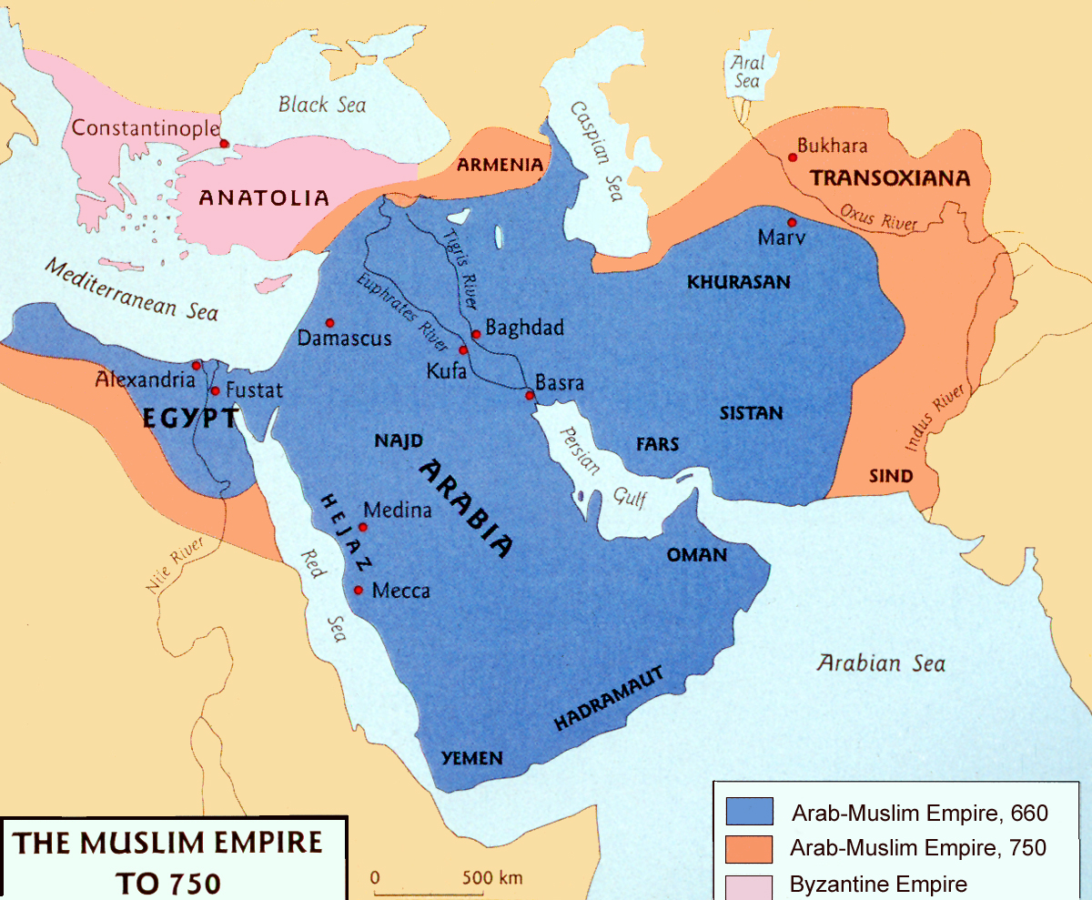
750 CE, Muslim world expands

Slide 11
Basic Islamic Beliefs
Monotheistic, Abrahamic (earliest prophet), seeking single God in polytheist environment
Does not believe in an original sin. Humans are endowed with rational mind, accountability, but can be distracted from true path of God, but can be drawn back (e.g. through Prophet guidance: Solomon, Abraham, Moses, Jesus)
Mohammed is last of the prophets – the seal
God will not interfere so directly in human affairs after this, making message complete and final.
The message is the Koran transmitted through a messenger; literally the word of God, not words of Mohammed, by divine inspiration.
God is just and expects people to discern good from bad because of the Day of Judgement, a resurrection in body and spirit. Notion that people are not essentially sinful but legalistic conception, based on performance.

Slide 12
Many more similarities that connect Islam to Christianity and Judaism than differences
Messages/Messangers (higher than Prophets):
Torah (Old Testament)
Gospel (New Testament)
Koran (but not simply inspired text, literally the Word)
Sacred scripture, prophets, angels, devils, moral universe, God is one

Slide 13
Major teachings of the Koran and the Muslim Community
Profession of the faith: shahadah
Textuality of the faith: answers to social, religions, political, legal issues. Muslim means to submit and surrender to God as made clear in Koran.
If text is so central, then the question of what the text means is of enormous importance. Who has authority to interpret the text?
This has enormous political resonance now.

Slide 14
Authority to Interpret the Text
US Constitution, judges of Supreme Court interpret allowing those selected as judges to retain significant power.
Koran equivalent is the ulama (ilm, root means knowledge)
Are they Muslim ‘church’? Do they intercede between man and God as the Catholic Church does in Christianity?
No official intercession in Islam.
Mohammed delivered message and lived it to provide example (infallible) = the sunna or path that people followed of Mohammed’s practices.

Slide 15
Disputes, given the nature of the text
Compare with Christianity: Jesus was sent as son of God…many questions left…concerning his nature: Human? Partly divine, of God? Indivisible?
Corporal question: what is the link/order of son/father/God? Resurrection in body, soul, spirit?
In Islam, it is the text, not Mohammed’s body, that is in question.
200 years after his death: mihna (trial; period of persecution of religious scholars) poses serious mental, legal, and spiritual challenge.
Koran says it is word of God, but what does it mean? Generates philosophical questions of logic.
Because God is indivisible, but hears, has a voice = is this literal or metaphoric?
Is Koran created or eternal? Most said created, others said eternal.
This is only example of political establishment posing questions (of theologians) to take sides and impose judgement on meaning. Then decided it was created but rejected by ulema.
Whereas, Christianity would see ruler backing bishop to impose interpretation he wanted.

Slide 16
Politics of the Faith: After Prophet Mohammad’s death
Hadith are the utterances of Mohammed.
Do we need successor to follow Mohammed? Yes, but in what form? Another messenger? NO.
What of political role/unit he made? Back to tribal order? No.
Taha Hussein 1889-1972
Salman Rushdie controversy, Satanic Verses publication 1988.

Slide 17
Taha Hussein, 1889-1972
Professor of Arabic Literature in Cairo
‘On Pre-Islamic Poetry’, 1927
Hussein applied criticism to Koran arguing that Arabic predated Islam, so could not be divine language but was ‘alive.’
If pre-Islamic poetry used as guide to understand language of Koran then subversive statement.
Hussein put on trial for ‘apostasy.’

Slide 18
Problem of Succession
Elect successor (Caliph, khalifa) in his capacity as political leader = problem of Khalifah (i.e. successor): Sunni/Shi’a schism
Prophet Mohammed
Caliphs (Sunni): Abu Bakr, Umar, Uthman, Ali
Imams (Shi’a): believed Ali should have been first successor because he was a cousin of the Prophet, closest in mind, brought up in his household, endowed to be true successor or interpreter of the text.
Behind schism is question of political leadership and nature of institution because ‘Ali closer to ‘true nature’ than others. Caliph is a political leader. Imam has the capacity to interfere and do religious interpretation.

Slide 19
Schism: Sunni v. Shi’a
Sunni focus on consensus, no religious component to successor.
Shi’is say Ali should have succeeded as political leader and interpreter of text by virtue of religious kind of connection to Mohammed.
All figures related by being from the Quraysh Meccan tribe.
Umayyads, Abbasids: palaces, minting coins without human figures but inscribed with the shahada
Dome of the Rock (691 AD): rock structure from where Mohammed began night journey to heaven; capital moves to Damascus.
Persecution: Karbala where descendants of Ali besieged by Umayyads and massacred.
Disciples succession – religious or political

Slide 20
Coinage minted without figural images

Slide 21
Dome of the Rock, 691 CE

Slide 22
20-21st century: What is the significance today?
1926, Abdel Raziq, Egyptian judge:
‘On the Principles of Rule in Islam’: dispute between Sunni/Shi’a out of proportion because Islam does not call for political unit among Muslims. Nothing in sunna or Koran that necessitates political unification of followers; purely religious. <-- Considered blasphemy.
Political fundamentalist Islam:
13 centuries of legal reasoning is not binding and we will interpret text as we see fit. Imagine the subversion of Bin Laden and others.
As if to say that the judges in US Supreme Court not entitled to interpret the constitution
All preceding judgements are redundant. We will go to Founding Fathers and decide what they meant in, not the current appointed judges or the court.
Founding Fathers did not lead lives we thought. Ignore history thereafter and reinterpret what they did, their acts.

