Slide 1
Petroleum Politics (I)

Slide 2
Long-Berenger Oil Agreement, 1919
Post-war conference between Britain and France on the division of 95% of the Ottoman Empire, rights to oil are allocated with a ¼ share each to Shell, APOC (now BP), the French oil company (Total), and the Near East Development Corporation.
The Agreement is the basis for the San Remo Oil Agreement of 1920, which gave France a 25% share of Iraqi oil. 5% is also allocated to the Ottoman Armenian entrepreneur, Calouste Gulbenkian.

Slide 3
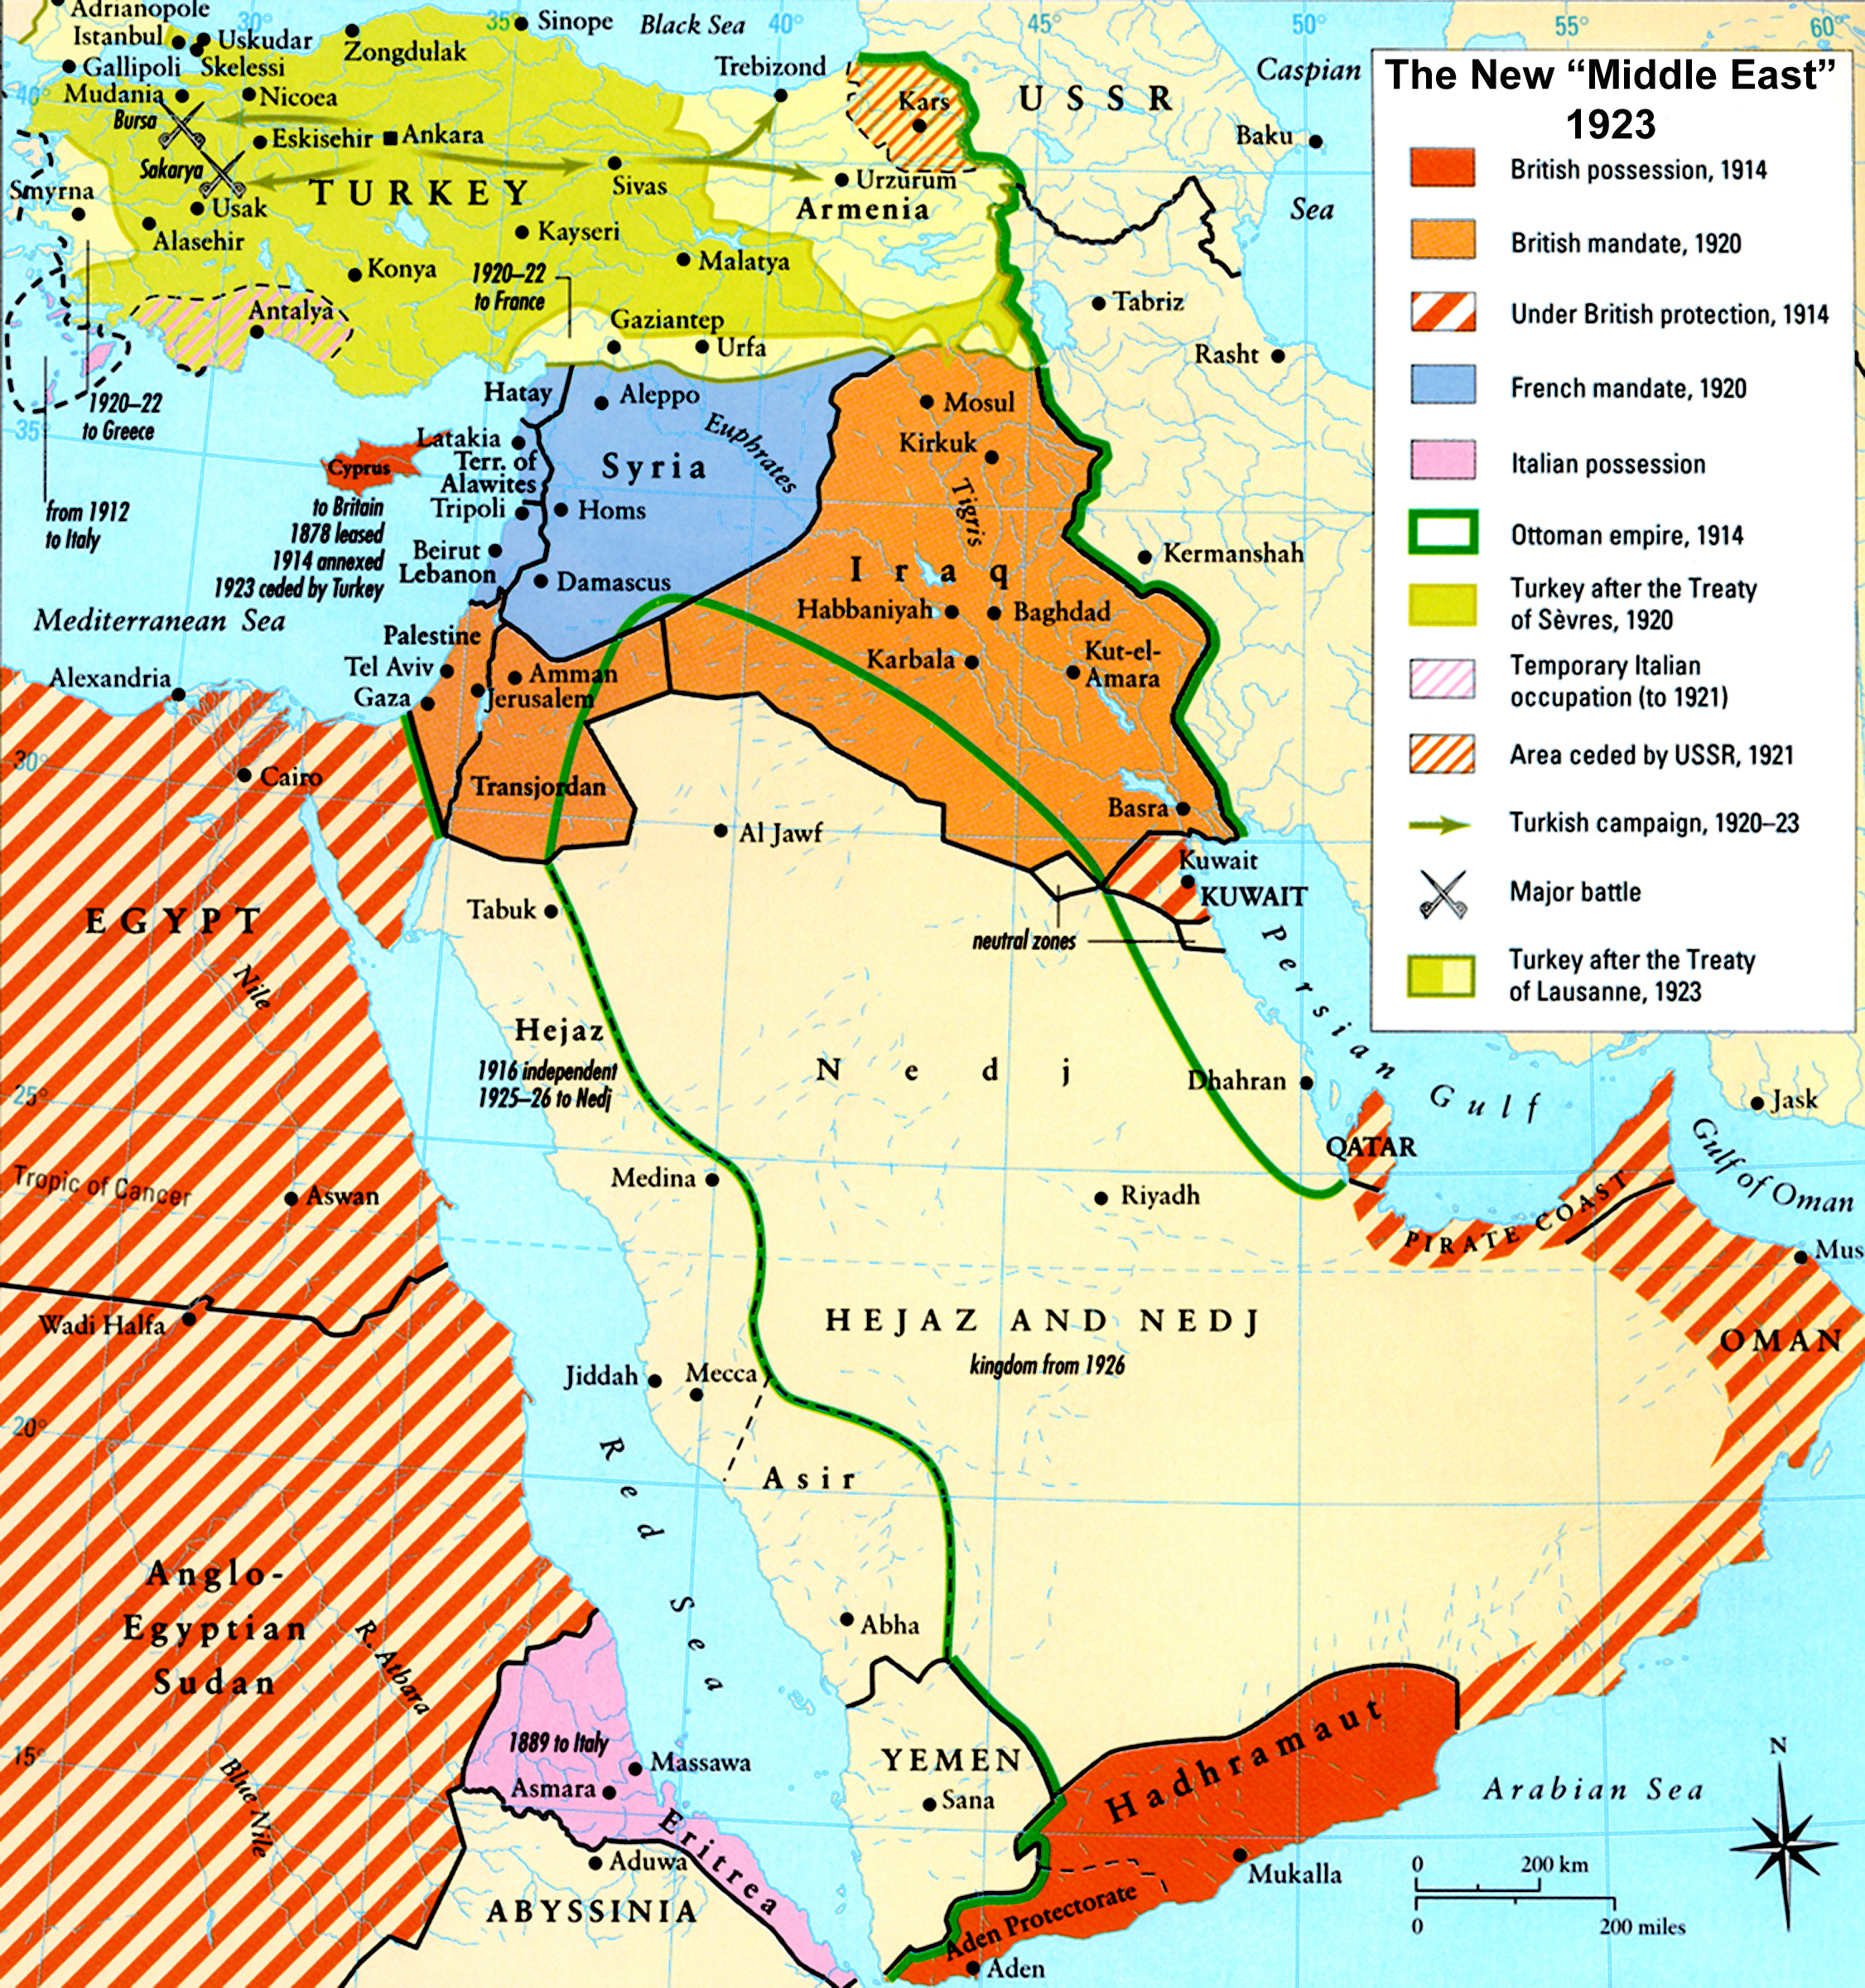
Iraq and the Arabian Peninsula (Saudi Arabia)

Slide 4
Managing Oil Abundance
Oil abundance up to WWI when demand for oil increases rapidly with the invention of the internal combustion engine.
Cheapest source of production is in the Middle East.
The Texas Railroad Commission (TRC) is setting the price up to 1929-30s which then shifts to control by the largest major oil corporations after WWII followed by OPEC.

Slide 5
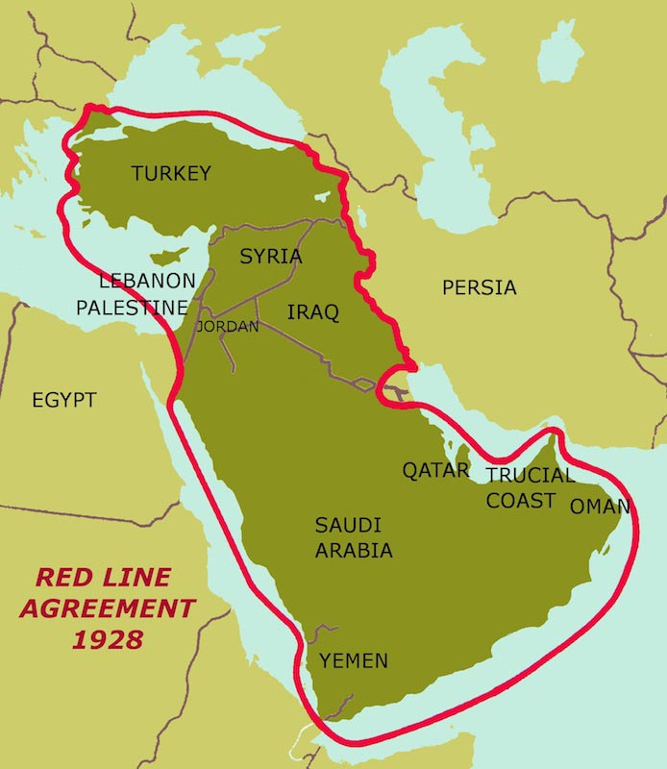
Red Line Agreement, 1928

Slide 6
Anti-market Mechanisms:
Cartels and Monopolisation
If each company was left to produce as it wanted their market would be established and sold at competitive prices and be remarkably cheap.
The energy system needs to be built in a way that demand and overabundance are managed.
Oil already discovered in the US in 1859. Rockefeller did not actually own his own wells but monopolized infrastructure for the distribution and refining of oil.
Post-WWI, monopoly of production is recreated on a global scale.
This pricing system continues from 1920s to end of 1959.

Slide 7
Kingdom of Saudi Arabia
1920s prospecting for oil led by Standard Oil of NY, NJ, and California which become Aramco and Chevron
Western coast of Arabian peninsula is Ottoman controlled while eastern coast is controlled by independent Amirs (Ibn Saud in Najd; Emirates).
Abd-al Aziz bin Saud in 1932 unites the region into a single kingdom of Saudi Arabia.
Ibn Saud is installed with the backing of the British. Make a deal with SoCal (Aramco) and Texaco in a 1930 agreement.

Slide 8
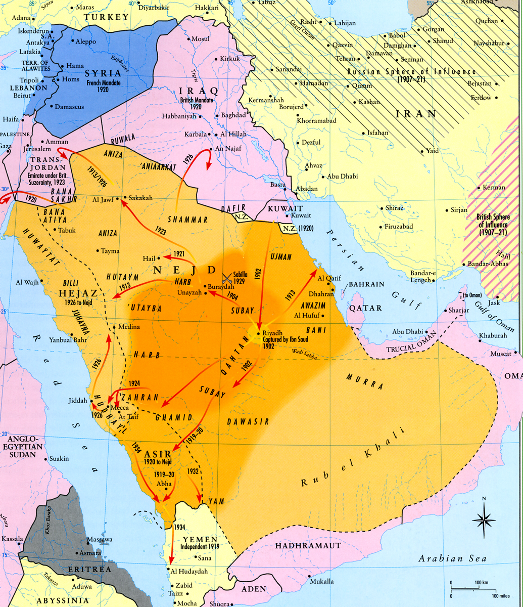

Slide 9
How to make a modern state?
Aramco allies with Ibn Saud. Keep in mind that the largest oil producers are US and Russia.
New form of politics results:
- brings financial support
- build roads, hospitals, schools, air fields
- WWII, air base, by persuasion of US and its control, is the largest between Germany and Japan.
- contractors: employ Bechtel to build the state
- US financial advisers, ministry of finance

Slide 10
Aramco and American Exceptionalism
Operations of Aramco (Dharan), ‘helping to build a state’ not mentioned in history books
American ‘exceptionalism’ especially with regard to rise of Saudi State:
Saudi Arabian history not story of colonisation like neighboring regions.
America’s role here exceptional in terms of creating empires
Aramco (American oil company) exceptional in creating a ‘modern state’ while ‘preserving traditional’; a munificent company
‘Anti-imperial’ connotation
Running of economy by local elite allied with foreign powers and economic interests means that it is not exactly a sovereign state.
1940s-50s political struggles: Racism toward work force around the world as new transnational corporations established overseas operations

Slide 11
Mexico 1936-38; Iran 1929, 1944-51; Venezuela
Something about 20th century politics need to create alliances with states, cannot just occupy and settle.
Different responses to labor unrest in Iran versus Saudi Arabia:
Iran: Nationalist movement, protest working conditions, discrimination
Saudi Arabia: labor movement in 1940s-50s asking for better conditions. Eg. 1956, demanding right to form labor unions, release of imprisoned workers, political parties and constitution, end to US interference, closing of US base which was used to protect Aramco.

Slide 12
Role of transnational corporation (TNC)
While not colonizing, still involved in political repression:
First, if oil had been a commodity in the 19th century, may have been easier to occupy but no longer possible in the 20th century so that a company must build up power of local state and need to give it political cohesion and legitimacy.
Second, particular solution to establish political control is that Aramco forms alliance with Ibn Saud and a new dynamic force: Islamic politics, namely Wahhabism
Alliance with Ibn Saud means a drawing on forces of ‘Ikhwan’ (Brotherhood) fighters to cleanse moral/financial.
Ibn Saud forces settlement of nomadic population but still needs to make cohesive modern state.
Ibn Saud realizes political usefulness of reliance on Wahhabism as source of discipline and authority
Thus, we observe dependence on new force with own logic and a curious arrangement of TNC with revivalist Islam as best way to build this new political order.
Curious alliance of religious revivalism and oil company to help train armies, police, control strikes, and discipline state in exchange for company to remain.

Slide 13
Critique of Culturalist Explanation
Contrast this arrangement with argument of Bernard Lewis
A kind of ‘Jihad v. McWorld’ (Barber): assumed pockets of religious fundamentalism as opposed to McWorld or Globalization and rational behavior of business.
McJihad (Mitchell) captures meaning of these forces actually working together so that the oil company needs religious fundamentalism to politically discipline the state and religious fundamentalists need oil company to survive and grow financially and infrastructurally.

Slide 14
Iran
1906 Constitutional Revolution: leads to establishment of constitutional form of government known as the Majlis.
Does not survive due to conditions of WWI and division of country into spheres of influence and other movements emerging in northwest of the country such as Baku oil workers demanding redistribution of wealth. War of poverty, suffering, disease.
New political order emerges because Britain and Russia have created organized military force: Cossacks in which Reza Khan emerges and becomes prime minister of Iran in 1923 and Shah in 1925.

Slide 15
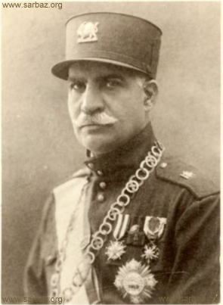
Reza Pahlevi
Cossack Brigade commander, replaces Qajar monarchy in British supported coup, 1921-25
Industrial and military projects; suppresses autonomy movements in the provinces; ulema power weakened
Abdicates to son, Mohammad Reza Pahlevi, in 1941

Slide 16
Iran versus Saudi Arabia
1. Policies described as modernizing from above and imposed do nothing to address inegalitarian social structure, maintaining rural population at 90% who own no land versus small percentage that controls all land
2. Oil completely under the control of the British. 80% of profits to British, small royalty, and after WWII, attempts to negotiate terms. British refuse to negotiate leading to embargo in 1950s and nationalization movement to claim the oil.
3. In Saudi, the government wants more and the oil company says OK but we will make American tax payer pay you directly through a tax loophole that allows company to register increased profit payments as additional foreign income tax that is deductible and payed for by the US tax payers = ‘50-50’

Slide 17
Key points
The building of the Middle East oil economy and the modern state. The issue of oil abundance and demand for oil and controlling abundance to keep prices high (price mechanism). A situation similar to the colonizing corporation controlling trade routes, slaves, etc. but in the 20thc., the commodity was oil.
Particular kinds of policies were pursued in the Middle East:
In Saudi Arabia, we have seen that creating the modern state involved the accumulation of royalties by the Saudi royal family. Legitimacy was achieved through alliances with religious and disciplinary forces and the ruling family.
In Iran, modernization was imposed from above so to speak. By 1941, the oil industry was the largest employer than any other industry or factory in the country.

Slide 18
The other aspect is the dominant role of large landowners in Iran which is different from Saudi.
In Saudi and Iran the main turning points occurred in 1970s and 1950s respectively.
Similar movements around the world in Americas, Mexico in the 1930s, Venezuela in the 1930s supported by nationalist government against oil company that leads in 1949 to renegotiation of terms to 50/50 profit sharing with oil companies and national government.

Slide 19
50-50 Profit Sharing
Symbolic notion of 50/50 share that fuels debate in Iran and Saudi but 2 different response by Americans in Saudi and British in Iran.
Saudi demand this in 1949, 50/50 at first rejected but then get the US government to pay increased royalty to Saudi and to pretend its tax on our economic activities (Saudi government taxation of company). This is a form of subsidization by the US Treasury department agreeing to forgo taxes on revenue so that 50/50 to Saudi works with no cost to the company.
British in Iran are far more dependent on income from Iranian oil than America’s dependence on Saudi oil because America still had large income from domestic production. This led to political crisis with rejection of demand for 50/50.

Slide 20
Iran: 1950-53 Coup
At end of the 1950, Iranians learn of Saudi 50/50 agreement with America so that Iran calls from British for some or else nationalization (a new idea) with pressure of oil workers from the southwest. In Britain, railroads and coal all taken over by the state,
April 1951, Mossadegh: big landowner, head of national front, elected to parliament on mandate of nationalization of oil.
Issue taken to Hague World Court: solution is Britain/AIOC accept 50/50 but British continue to control marketing of oil.
1950s (1953): Critical moment; channeling of funds to conservative forces
Before: Shah was previously forced to rule according to representational parliament and demands.
After: Popular movement arrested, eliminated Tudeh from politics, nationalists get short sentences and re-emerge
Thus, nationalization of oil left in place but given control of marketing to consortium: 40% to BP; 14% to Shell; 7% to US oil majors; 5% to smaller companies.

Slide 21
Iran: 1953-1960s
Following the 1953 coup, US replaces Britain completely to back this new and more authoritarian regime: military assistance, 1953-61 from US.
Nationalism repressed via security service and SAVAK, 1957, political repression but more cautious with bazaar (merchant class) and religious establishment.
1959-63:
Opposition emerges and Shah introduces reforms: land reform legislation and in face of student protests, there is series of attempts at modernization and education.
Large holdings out of 375 acres; Owners decide which land to keep
First time religious opposition emerges: Khomeini in 1963 in Qum exiled to Iraq, criticizes land reforms of the White Revolution
1964: more US aid, strikes, protests, deportations

Slide 22
Saudi Arabia, 1950s
Threat of nationalization put off because American corporation willingness to accede to 50/50 profit sharing.
With transformation of new state, strikes in oil industry emerge in 1950s, 1953, 1956.
Change in Saudi politics later in 1958: sons of ibn Saud, ‘reformist princes’ backing political change known as the ‘free princes’
America looking for something different and cements closer alliance to Saudi (1957-58) to counter Egypt and Iraq.
Saudi seen as center of gravity; promises of constitution, judicial reform. Americans interested questioned and linked to control of oil. In this period, we see emergence of OPEC 1960.

